Slide 1
Checkerboard Hubbard
Pairing and emergent altermagnetism
Weekly progress · constrained-path QMC, L = 12
49 of 49 half-filling cells complete
Notes:
The L=12 half-filling grid finished this week, giving the first complete (U, delta) map of the altermagnetic splitting. The dxy crossover was confirmed independently in equal-time and tau-integrated data.

Slide 2
Where the week landed
Three things that were not available seven days ago
49
2
0.833
half-filling cells complete
U = 0 to 5, δ = 0.1 to 0.7
independent measures agree
on the dxy crossover
filling down to which dxy
now dominates at δ ≥ 0.5
The grid ran across five nodes at roughly 11 hours per cell. Everything here is measured, with no interpolation across missing cells.
Doped set at n = 0.847 is 37 of 49 done and still running.
Notes:
Grid completeness is what makes an uninterpolated map legitimate. On the partial grid a heatmap would have filled empty cells with invented colour.

Slide 3
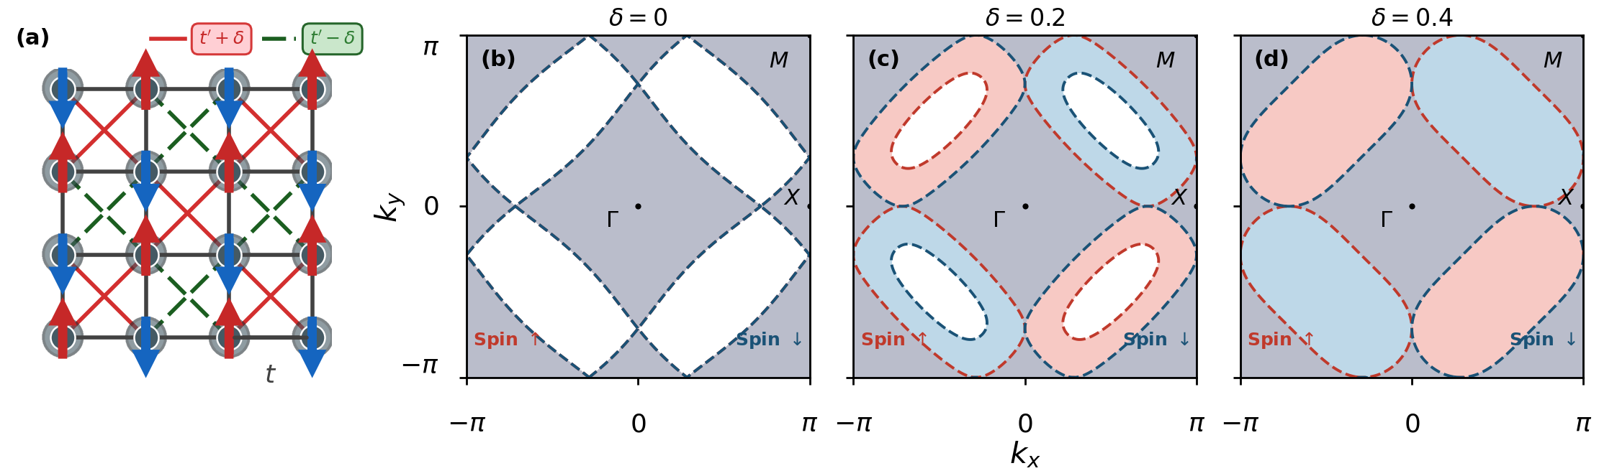
The model
Alternating strong and weak diagonals on the checkerboard
(a) lattice, red t′+δ and green t′−δ diagonals with Néel order. (b–d) spin-split Fermi surfaces at δ = 0, 0.2, 0.4.
The weak diagonal t− = t′ − δ passes through zero at δ = 0.3 and changes sign beyond it. That sign change is where the pairing channel switches.
Notes:
Emergent altermagnetism: the hopping is spin independent, so the splitting appears only once antiferromagnetic order forms. Not the PRL route, where spin-dependent hopping splits the bands already at U = 0.

Slide 4
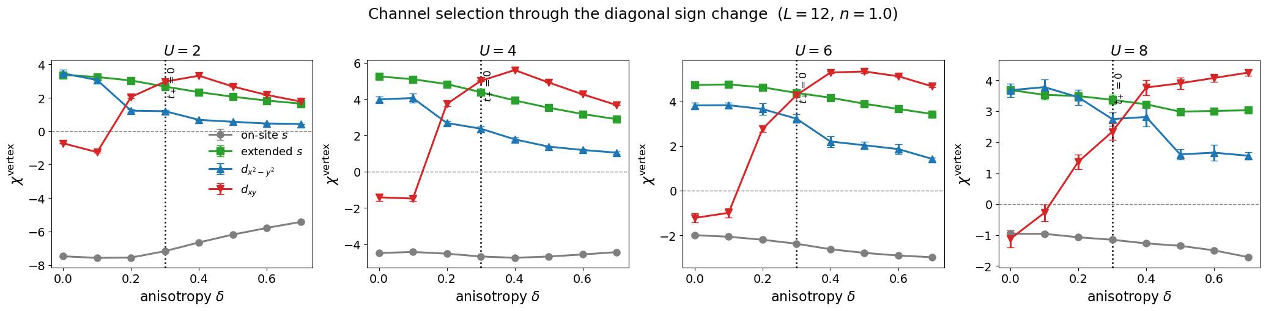
dxy replaces dx2−y2
Pairing vertex against anisotropy, L = 12, half filling
1
Confirmed in two independent measures
• Equal-time Fortran vertex and τ-integrated χ give the same crossing, and it moves up with U.
• δ where dxy overtakes dx2−y2: 0.18 (U = 2, 4), 0.25 (U = 6), 0.33 (U = 8).
• Periodic and antiperiodic boundaries agree, so it is not a shell effect.
Notes:
The dotted line marks t- = 0 at delta = 0.3. The channel switch tracks the diagonal sign change, which makes it a mechanism rather than a correlation.

Slide 5
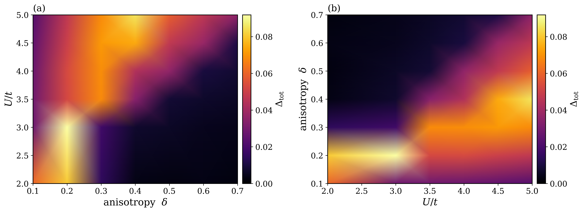
The altermagnetic splitting has a ridge
Complete 6 × 7 grid, smooth shading between measured points only
2
Optimal anisotropy rises with U: δ* = 0.2, 0.2, 0.3, 0.3, 0.4, 0.4 for U = 2, 3, 3.5, 4, 4.5, 5
Peak Δtot = 0.0919 at U = 3, δ = 0.2. δ frustrates Néel order, so a larger U is needed to sustain the moment that produces the splitting.
Notes:
U = 0 was dropped. It is identically zero and the U grid is uneven below 2, so shading was smoothing across a wide unsampled gap.

Slide 6
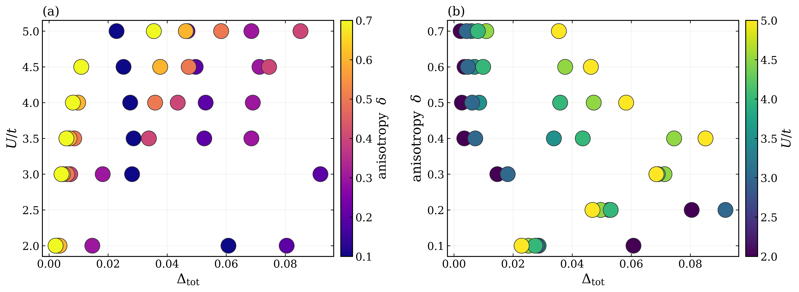
A regular onset ladder in U
Each extra 0.1 of anisotropy costs about 0.5 more U
Onset U
δ = 0.4
U = 3.5
δ = 0.5
U = 4.0
δ = 0.6
U = 4.5
δ = 0.7
U = 5.0
3
Δtot on x, colour carries the swept parameter
• For δ ≥ 0.4 the splitting switches on sharply, and the threshold climbs one step per 0.1 of δ.
• δ = 0.1 and 0.2 run the other way: U = 2 gives the largest Δtot and raising U suppresses it.
• The sign flip between δ = 0.1 and 0.4 is the same ridge seen along a different cut.
Notes:
A filled colormap is impossible on these axes: Delta_tot is not monotonic in either parameter, so one value maps to two different delta. Measured points only.

Slide 7
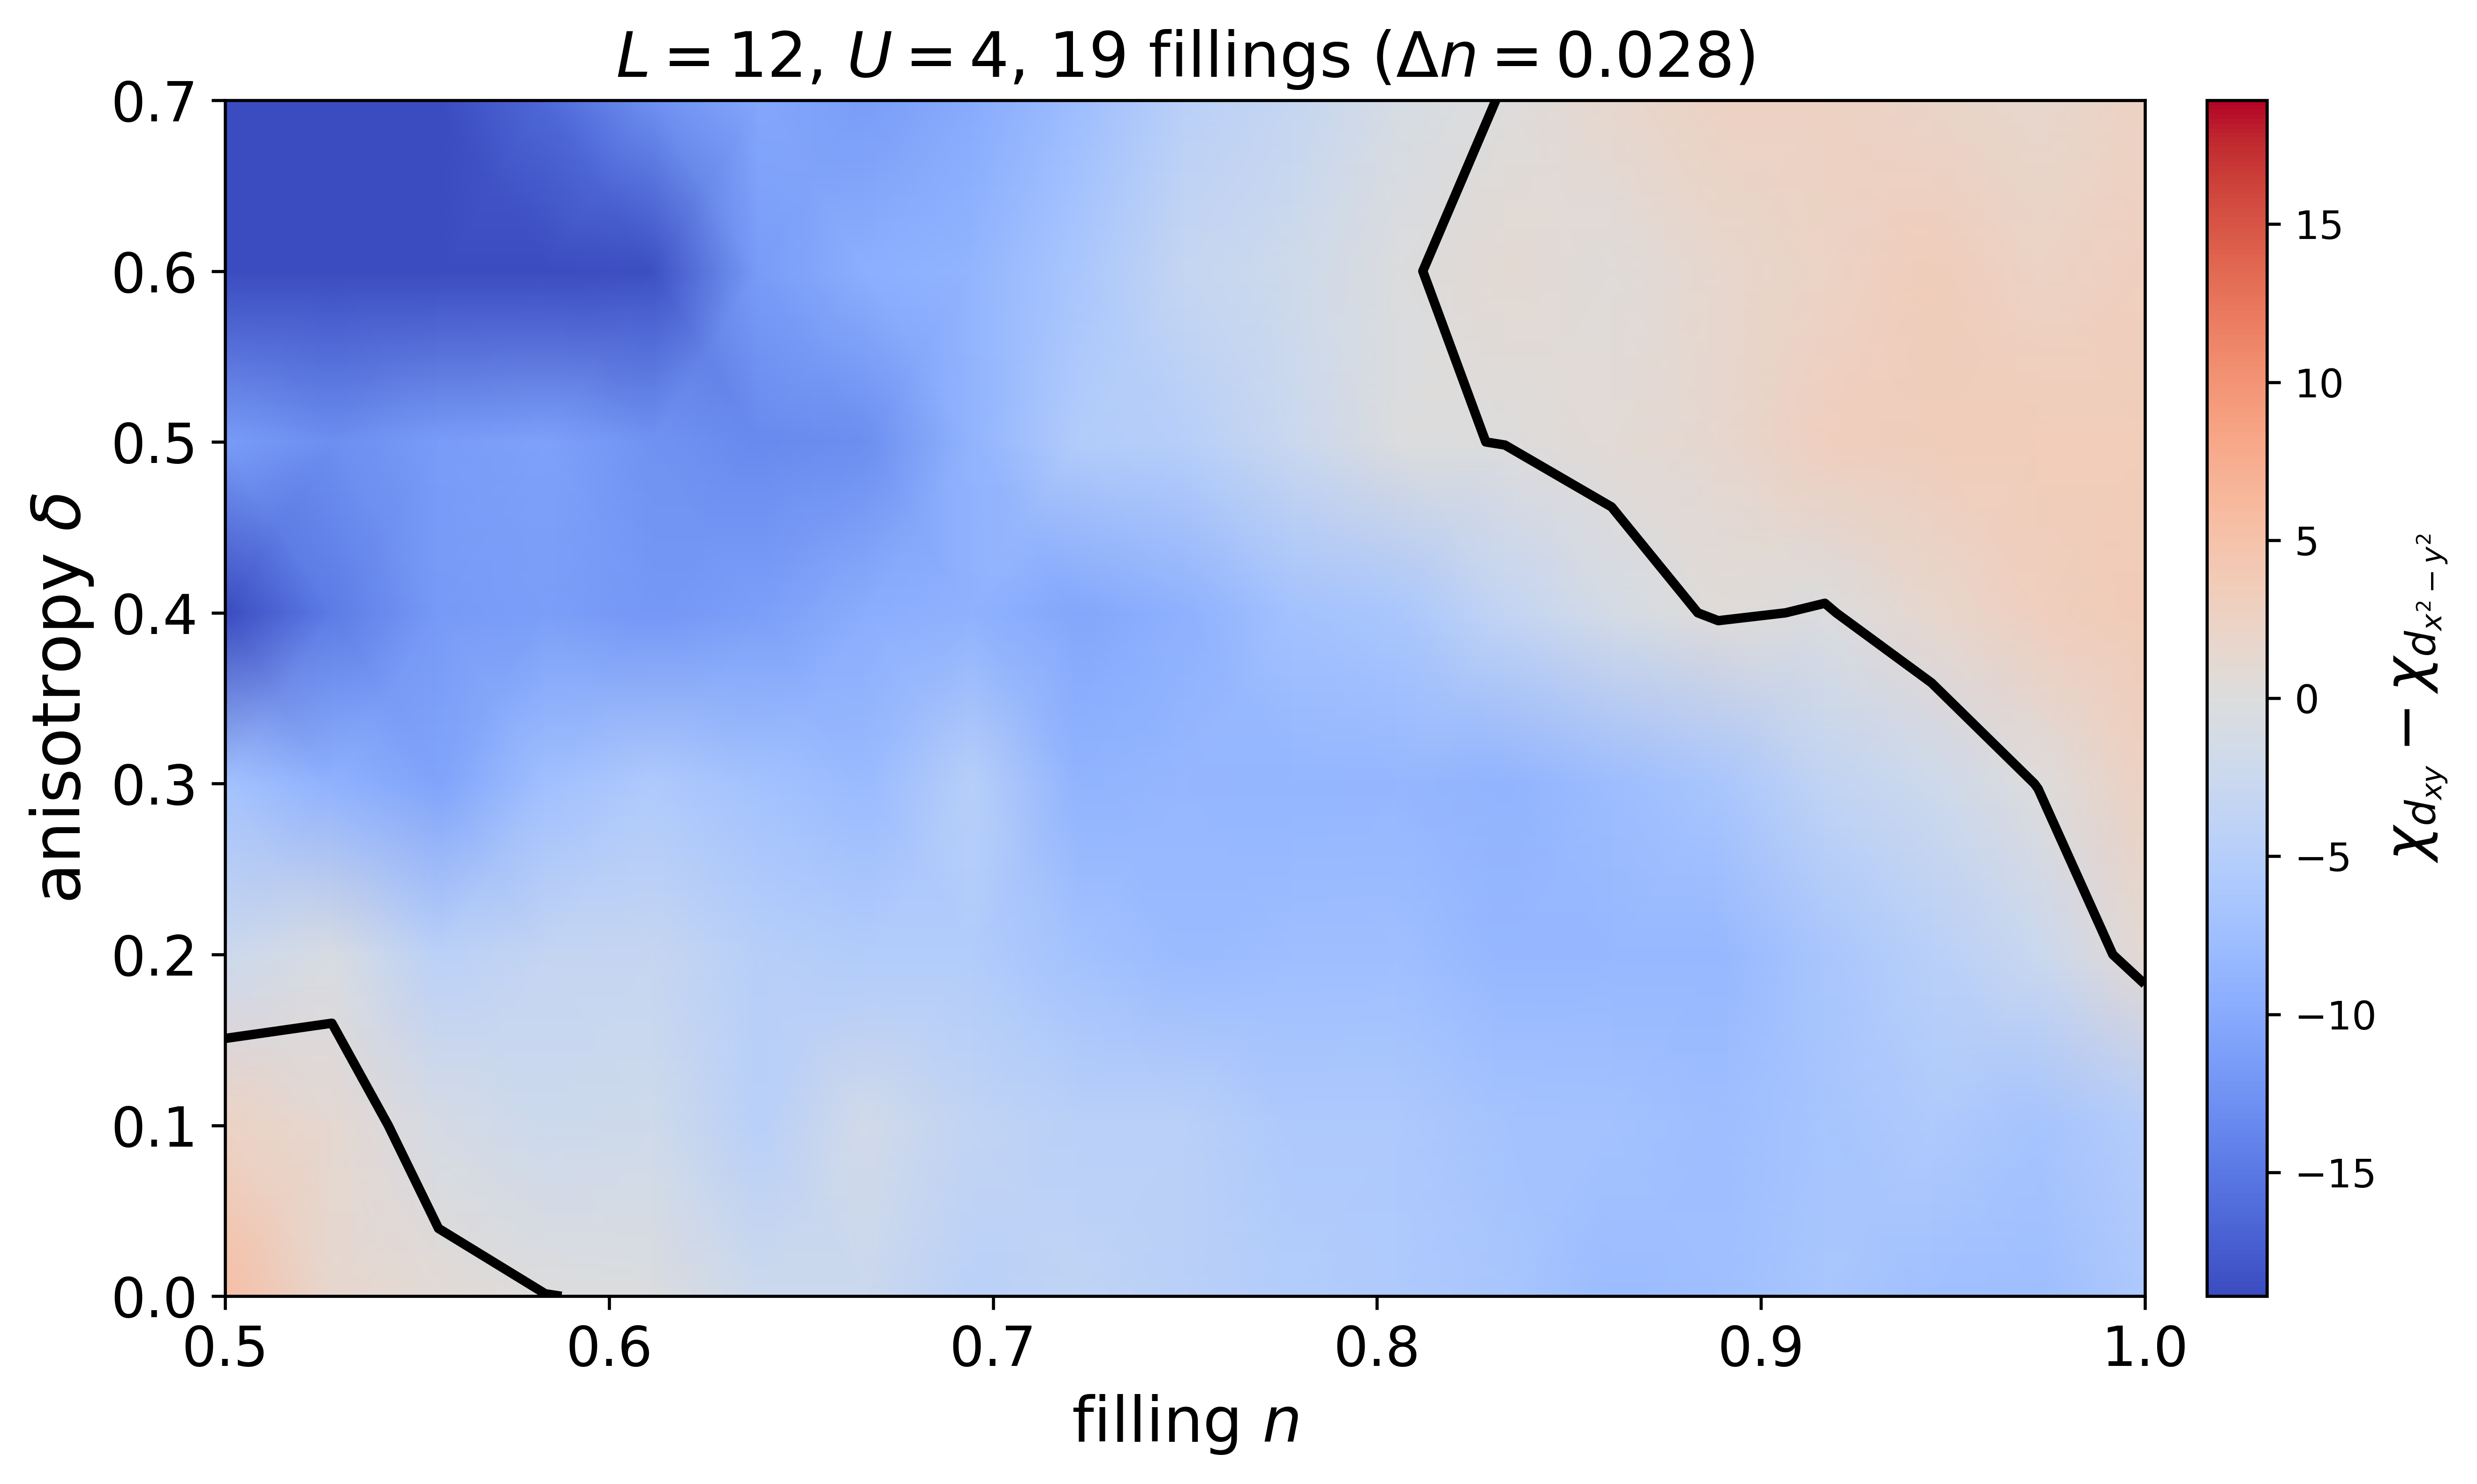
Phase diagram now reaches δ = 0.7
The old cutoff at 0.4 was hiding most of the dxy region
dxy wins for n ≥
δ = 0.2
1.000
δ = 0.3
0.972
δ = 0.4
0.889
δ = 0.5
0.833
δ = 0.6
0.833
δ = 0.7
0.833
Anisotropy widens the dxy region away from half filling, then saturates near n ≈ 0.83. dxy leads on 22% of the plane, so the claim stays scoped to large δ near half filling.
19 fillings × 8 anisotropies, 6 seeds per cell. Replot only, no new compute.
Notes:
The published version stopped at 0.4 because the saved notebook output predated the delta 0.5 to 0.7 runs. The data was already on the node.

Slide 8
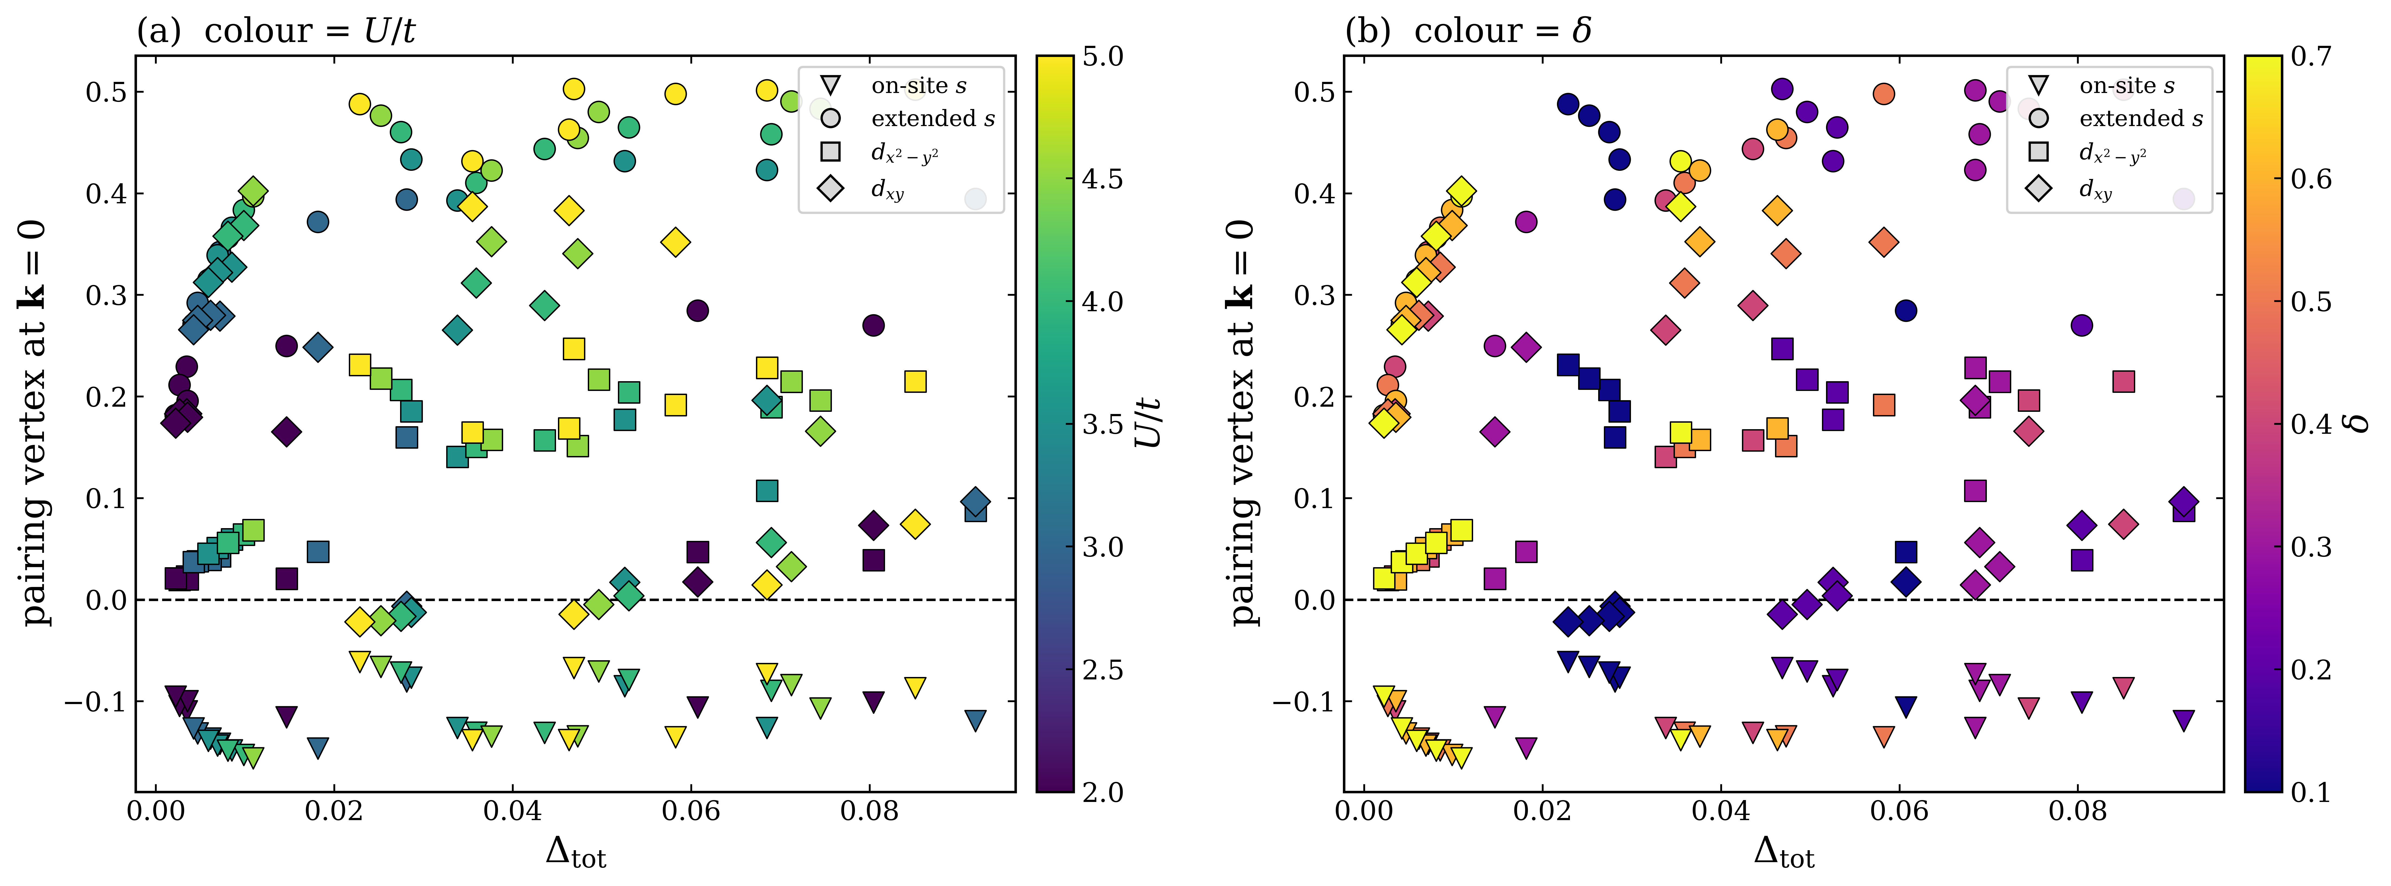
One result to be careful with
Pairing and magnetism do not track together the same way in U and in δ
dxy is the only channel that changes sign: r = −0.54 sweeping δ at fixed U, but r = +0.37 sweeping U at fixed δ.
Δtot peaks at δ ≈ 0.2 to 0.4 while dxy keeps growing out to δ ≈ 0.6 to 0.7. The interaction builds both, the anisotropy trades one for the other.
Notes:
This matters for framing. "Magnetism supports pairing" holds in U but not in delta, and a referee comparing the two panels will see it.

Slide 9
Manuscript figures
Six main figures, five already drawn
1
Model and spin-split Fermi surfaces
2
dxy / dx2−y2 crossover, four U panels
ready
ready
3
(n, δ) dominant channel, dense grid
4
Vertex, P(R), finite-size scaling
replotted
needs runs
5
Magnetic order and Q* correction
6
Δtot and Δn(k) maps
ready
refresh
The one real gap: full versus uncorrelated pair-field susceptibility exists only at δ = 0, which is exactly where the effect is absent.
Surveyed 93 figures across 13 notebooks on the cluster, which is how five of the six turned out to already exist.
Notes:
Closing the Fig 4 gap is the highest-value small job: it is the defence against the pairing being a bubble artifact.

Slide 10
Next week
1
Finish the doped set
37 of 49 cells done at n = 0.847, the rest land this evening. Gives the filling axis for Δtot.
2
Close the Fig 4 gap
Run P and P̄ for both d channels at δ = 0.4 and 0.6, half filling, U = 4. Small and targeted.
3
Decide the framing
Lead with the diagonal sign change as mechanism, or with dxy dominance as observation.
4
Caption the trial caveat
Δtot onset tracks the UHF trial Stoner threshold at low U and high δ. State it, rather than let a referee find it.
Notes:
Priority order as listed. The doped set needs no action beyond gathering.

