Slide 1
Emergent altermagnetism and pairing in the checkerboard Hubbard model
Single-band, spin-independent hopping
Constrained-path quantum Monte Carlo, benchmarked by exact diagonalization
Group meeting progress report

Slide 2
Altermagnetism
• A compensated magnet: zero net magnetization, but the up and down bands are split in momentum space.
• The spin splitting is momentum-dependent with a definite d-wave symmetry, and needs no spin-orbit coupling.
• Here the splitting has d_xy symmetry, set by the lattice geometry (map below).
Ref: Smejkal, Sinova, Jungwirth, PRX 12, 031042 (2022) and PRX 12, 040501 (2022).

Slide 3
Prior work and the gap
Existing microscopic altermagnetism studies:
• Imposed AM via spin-dependent hopping, treated by QMC: group Paper 1 (Li, Liu, Yang, Tang, 2026) and Paper 2 (this group, combined square-lattice model).
• Interaction-driven AM, treated by mean-field / variational methods: Giuli, Mejuto-Zaera, Capone, PRB 111, L020401 (2025); extended-Hubbard preprint arXiv:2507.00837 (2025).
The gap:
• No emergent altermagnet treated with an unbiased many-body method.
• This work: emergent, spin-independent AM, solved with unbiased CPQMC and benchmarked by exact diagonalization.
Refs: Li, Liu, Yang, Tang (2026); Giuli et al., PRB 111, L020401 (2025); arXiv:2507.00837.

Slide 4
Model and method
Model:
• Single-band Hubbard on the checkerboard (planar-pyrochlore) lattice.
• H = -t (nearest-neighbor) - t_diag (anisotropic diagonal) + U n_up n_dn, with diagonal hopping t_pm = t' +/- delta.
• The hopping is spin-INDEPENDENT, so the altermagnetism is not imposed: it must emerge from U and geometry.
Method:
• Constrained-path quantum Monte Carlo (Zhang, Carlson, Gubernatis, PRB 55, 7464 (1997)).
• Every observable benchmarked against exact diagonalization.
Ref: Zhang, Carlson, Gubernatis, PRB 55, 7464 (1997).

Slide 5
Parameters, and why these values
t = 1 : nearest-neighbor hopping; sets the energy unit.
t' = -0.3 : diagonal (next-nearest) hopping; fixes the band structure and van Hove filling, in the physical t-t' range of cuprate-like models (PRB 35, 3359).
delta = 0 to 0.4 : geometric anisotropy of the diagonal bonds (t_pm = t' +/- delta); the knob that generates the emergent altermagnet. The range spans isotropic to strongly anisotropic, passing delta = 0.3 where one diagonal bond weakens toward zero.
U = 4 : on-site repulsion; intermediate coupling (U ~ bandwidth) where correlations are strong but constrained-path QMC is controlled. Standard for Hubbard altermagnet studies (Giuli et al. 2025; Scalapino, RMP 84, 1383 (2012)).
n (filling) : half filling for the altermagnetic order; doped n ~ 0.6 to 0.8 is where pairing is expected to live.
Refs: PRB 35, 3359; Giuli et al., PRB 111, L020401 (2025); Scalapino, RMP 84, 1383 (2012).

Slide 6
Observables, and why we measure them
Delta n(k) = n_up(k) - n_dn(k) : momentum-resolved spin imbalance; the altermagnetic order parameter, revealing the d_xy spin-splitting form factor (Smejkal 2022).
S^z(q) : static spin structure factor; its peak position Q identifies the magnetic ordering vector (Neel (pi,pi), spiral, diagonal).
chi_zz(q) : the tau-integrated (dynamic) magnetic susceptibility; the thermodynamic magnetic response, sound where the equal-time S^z(q) is not (Scalapino, RMP 84, 1383 (2012)).
Pairing susceptibility chi_zeta : connected pairing tendency in channel zeta (s, d_x2-y2, d_xy). The tau-integrated susceptibility is the ED-validated observable, unlike the constrained-path-biased equal-time vertex.
R_p : sharpness of the S^z(q) peak; distinguishes long-range from short-range order.
Refs: Smejkal et al., PRX 12 (2022); Scalapino, RMP 84, 1383 (2012); Zhang et al., PRB 55, 7464 (1997).

Slide 7
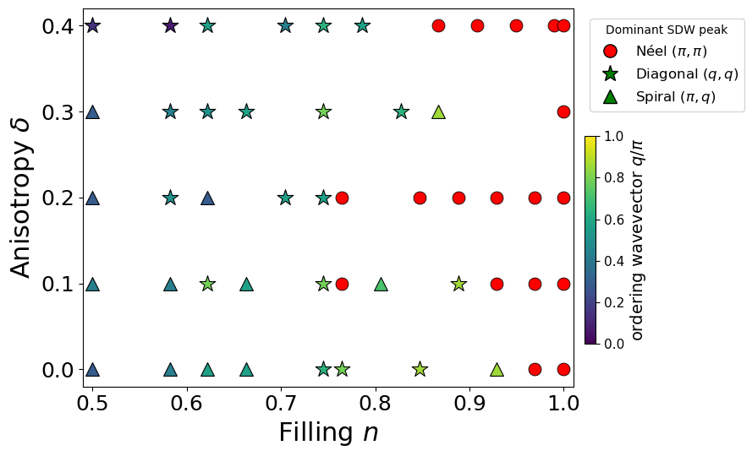
Emergent altermagnetism
• Interactions drive Neel order near half filling.
• Once a moment M forms, the geometry gives its spin splitting a d_xy symmetry, m ~ M x delta x sin(kx) sin(ky) -- the altermagnetism is emergent.
• Doping drives the order incommensurate: Neel -> spiral / diagonal.
Refs: group magnetic-correlations paper; Smejkal et al., PRX 12 (2022) (symmetry).

Slide 8
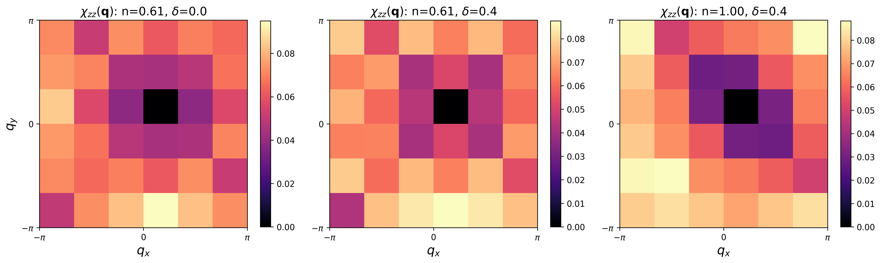
Magnetic susceptibility chi_zz(q)
• The momentum-resolved magnetic susceptibility peaks at (pi,pi) near half filling -- the Neel / altermagnetic signal -- and weakens and shifts away under doping.
Ref: Scalapino, RMP 84, 1383 (2012).

Slide 9
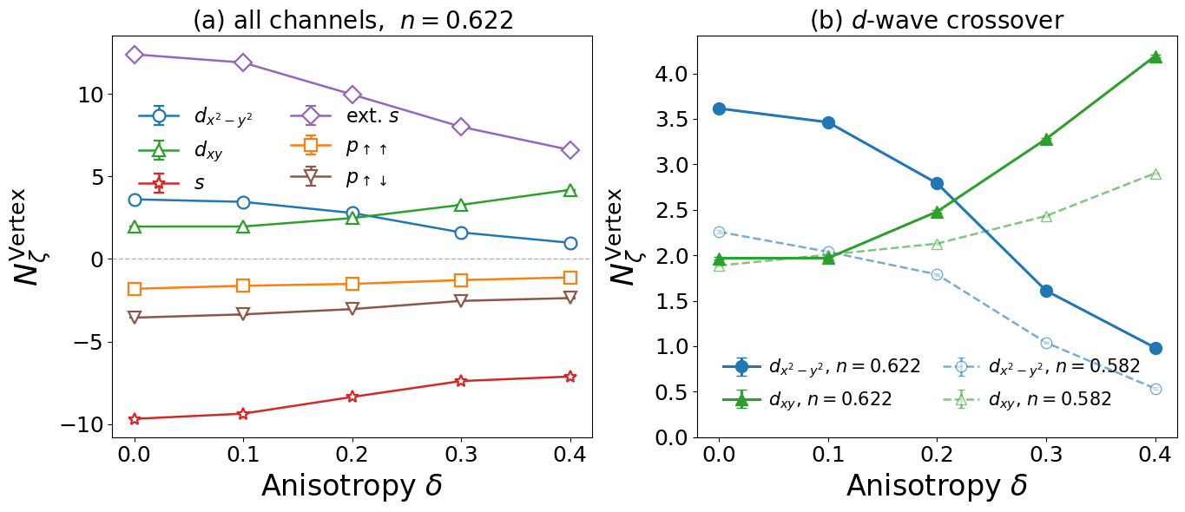
Pairing: choosing the correct observable
• The equal-time pairing vertex (as in the PRL) suggests a d_x2-y2 -> d_xy crossover with delta.
• But exact diagonalization shows the equal-time d-wave vertex has the WRONG SIGN (ED -3.9 vs QMC +0.1): the known constrained-path bias.
• The tau-integrated susceptibility is ED sign-faithful -> it is the observable we trust.
Refs: Zhang et al., PRB 55, 7464 (1997); Scalapino, RMP 84, 1383 (2012).

Slide 10
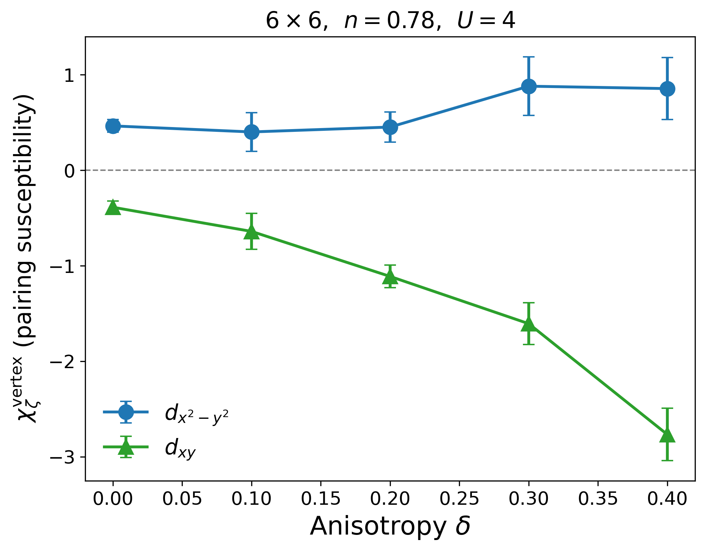
Channel swap: delta suppresses d_xy, keeps d_x2-y2
• In the sound susceptibility the picture reverses:
• d_xy is SUPPRESSED by the anisotropy (repulsive, worse with delta).
• d_x2-y2 stays ATTRACTIVE and is mildly enhanced.
• The surviving/enhanced pairing is ORTHOGONAL to the d_xy symmetry of the altermagnet -- unlike imposed-AM models, where the pairing shares the AM symmetry (Papers 1, 2).
Contrast: group Paper 1 (2026); Paper 2 (this group).

Slide 11
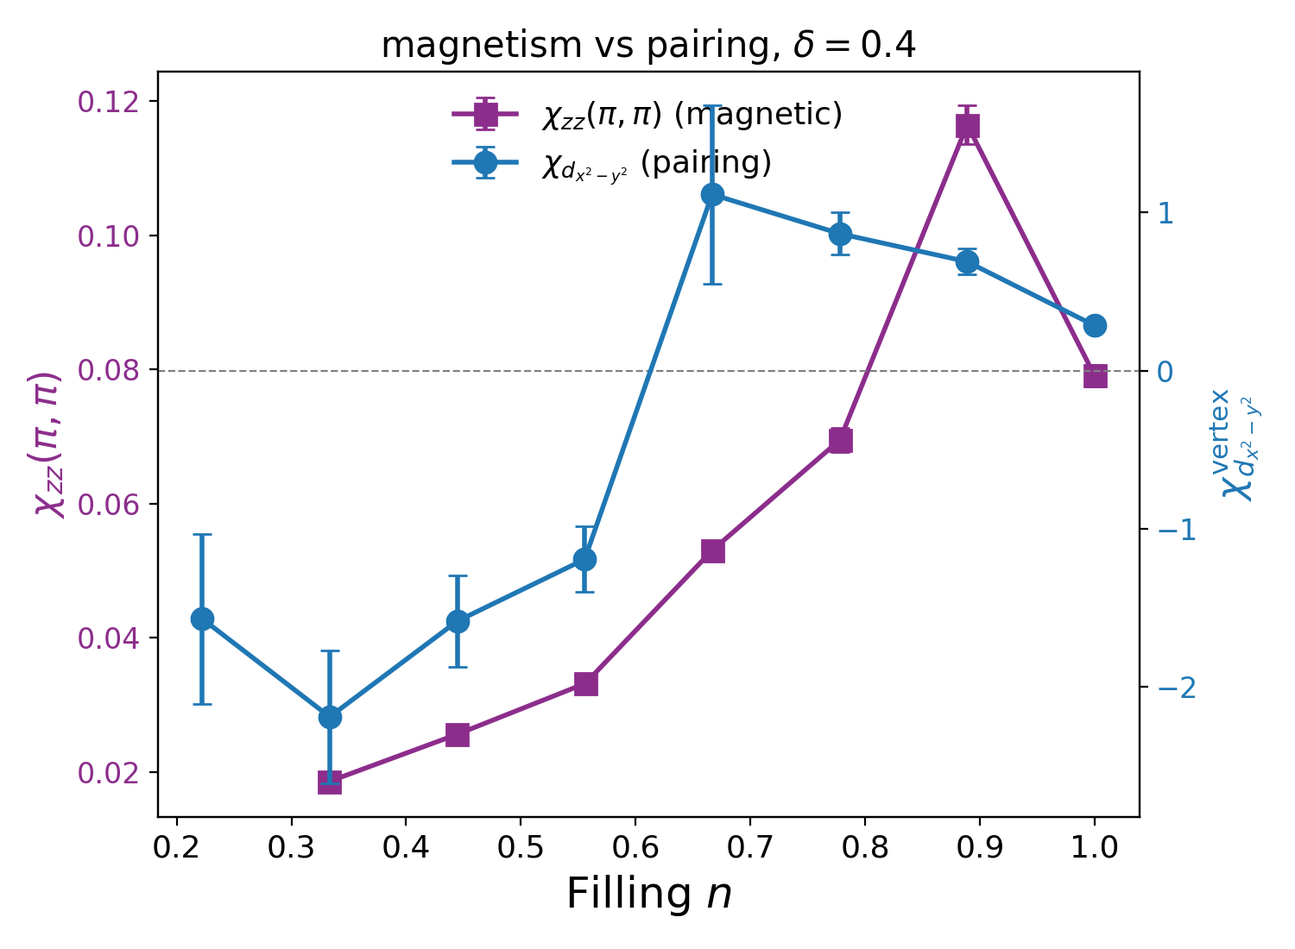
Mechanism: d_x2-y2 pairing is AFM-mediated
• d_x2-y2 turns attractive in exactly the doping window where chi_zz(pi,pi) is large.
• So d_x2-y2 pairing is antiferromagnetic-fluctuation-mediated -- the cuprate mechanism.
• d_xy does not couple to the (pi,pi) fluctuations and is suppressed.
• The magnetic and pairing symmetries therefore decouple.
Ref: Scalapino, RMP 84, 1383 (2012).

Slide 12
Conclusions and outlook
Three results:
• 1. First unbiased demonstration of emergent, spin-independent altermagnetism (checkerboard, on-site U plus geometry).
• 2. Caught and corrected a constrained-path artifact in the pairing vertex using exact diagonalization; the susceptibility is the sound observable.
• 3. The anisotropy enhances AFM-mediated d_x2-y2 pairing and suppresses d_xy, so the magnetic and pairing symmetries decouple -- distinguishing emergent from imposed altermagnetism.
Outlook:
• 8x8 finite-size confirmation; more seeds; a pairing-aware (BCS/AGP) trial to sharpen the vertex.
Key refs: Smejkal PRX 12 (2022); Giuli PRB 111 (2025); Zhang PRB 55 (1997); Scalapino RMP 84 (2012).

