Slide 1
Real-space pairing and the delta polarisation
P(R) decomposition at every filling, and pairing against the magnetic polarisation
Checkerboard Hubbard · CPQMC at T = 0 · L = 12, six fillings, five U, eight anisotropies
14 August 2026
Headline: the d_xy channel wins at long range only at half filling. Doping kills it, and it turns repulsive.
Notes:
Full P(R) cube is now complete: 40 chunks, 155520 rows, U in 0,2,4,6,8 times eight anisotropies times six fillings times six seeds.

Slide 2
What P(R) measures, and why it was needed
the q = 0 susceptibility adds local and long-range pairing together, and they disagree
• The pairing susceptibility sums over ALL site pairs (i, j). Keeping the separation R instead of summing gives P(R), and the vertex v(R) = P(R) - bubble(R).
• Huang, Lin and Gubernatis (PRB 64, 205101) showed that extended s wins LOCALLY while d wins at LONG RANGE. A q = 0 sum mixes the two, which is why our earlier numbers put extended s ahead of d and looked like they contradicted White.
• The driver stores a SUM over the pairs at each separation, and the multiplicity runs from 144 to 1728, so everything here is divided by the pair count. Without that division the distant shells look artificially large.
• Long range means R > 2, following Huang.
Validation: the sum rule
Scope
Summing v(R) over all 27 separations must return the original vertex from the q = 0 driver. It does, to 0.00% on all four channels.
L = 12, six fillings, U = 0, 2, 4, 6, 8, eight anisotropies, six seeds. 40 of 40 chunks complete, 155,520 rows.
Notes:
The sum rule is the thing to quote if anyone asks whether the R-resolved code is doing the same calculation as the original driver. It is exact.

Slide 3
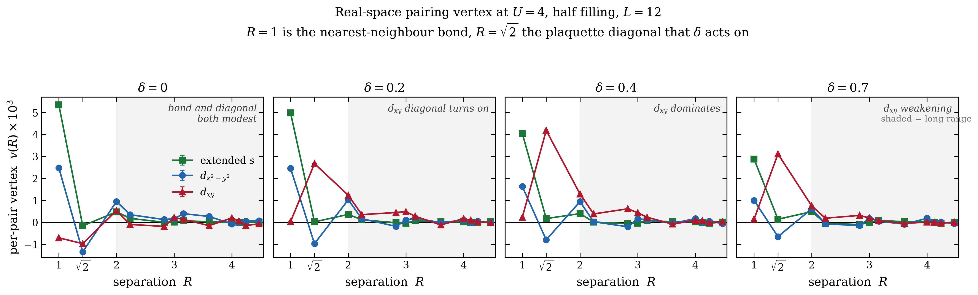
The vertex resolved by separation
U = 4, half filling: R = 1 is the bond, R = sqrt(2) the plaquette diagonal that the anisotropy acts on
Reading the panels
At delta = 0 extended s owns the bond and d_x2-y2 carries the tail, exactly the Huang result. Turning on delta lights up a large positive d_xy spike at R = sqrt(2), the diagonal bond the anisotropy strengthens, and d_x2-y2 goes negative there. By delta = 0.4 d_xy leads across the whole shaded long-range region. At delta = 0.7 it is weakening again.
Notes:
R = 0 is left off this figure because it is roughly twenty times larger than everything else; it has its own panel in the next slide.

Slide 4
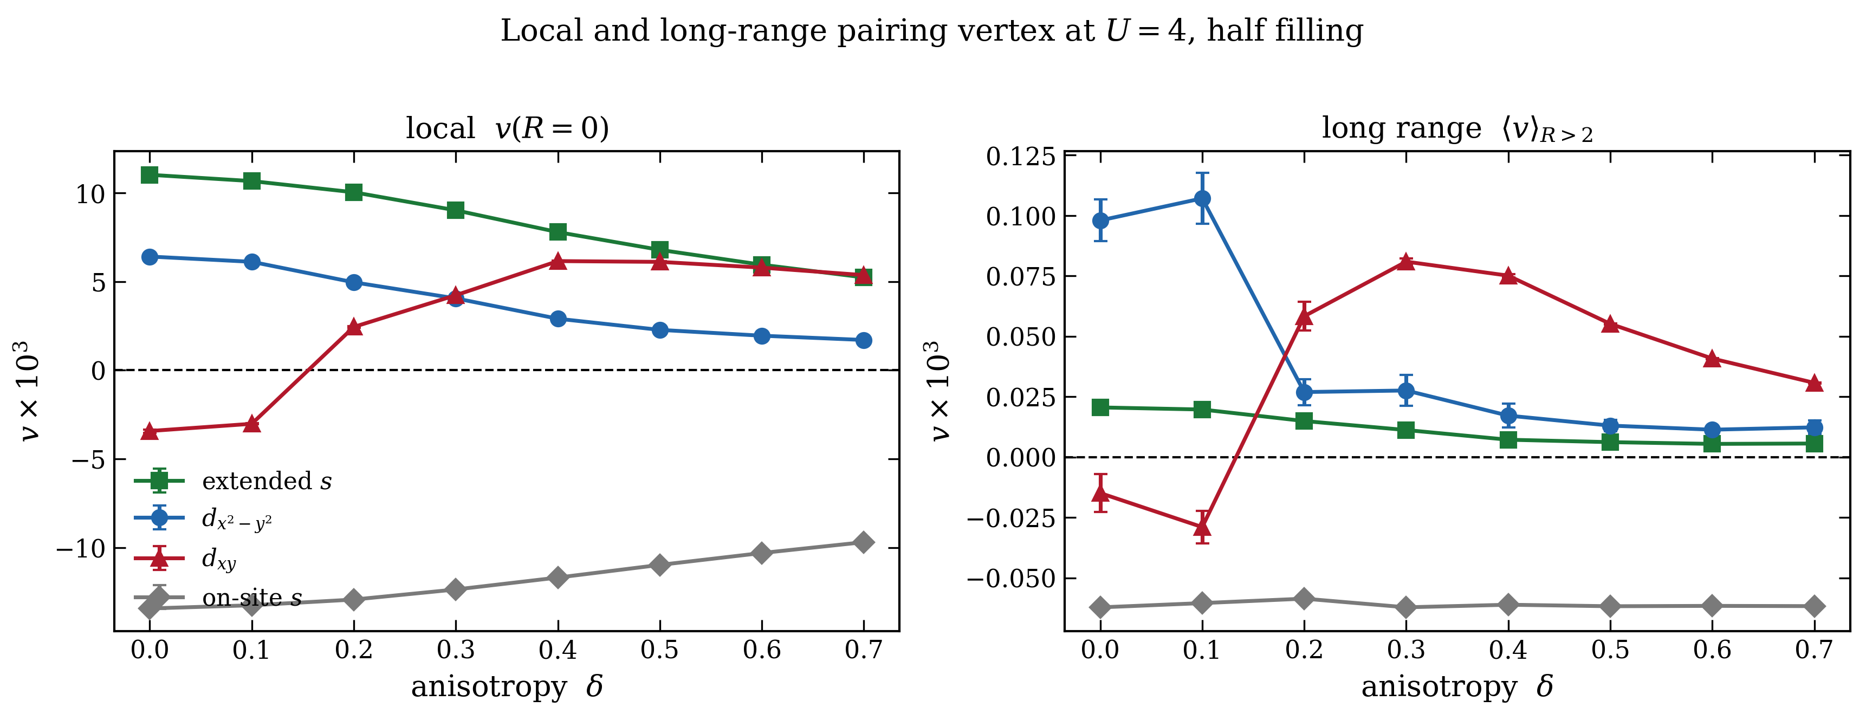
Local and long-range pairing separate cleanly
U = 4, half filling: the two panels answer different questions
Local v(R = 0)
Long range R > 2
Extended s leads at every delta. d_xy starts repulsive, crosses zero near delta = 0.15 and overtakes d_x2-y2 by delta = 0.3. On-site s is strongly repulsive throughout, as it must be.
d_x2-y2 leads at delta = 0 and 0.1, then collapses. d_xy takes over from delta = 0.2, peaks near delta = 0.3 and decays. Extended s is never the long-range winner.
Notes:
This is the slide that answers the supervisor's question about where each channel actually dominates: extended s locally, d or d_xy at long range.

Slide 5
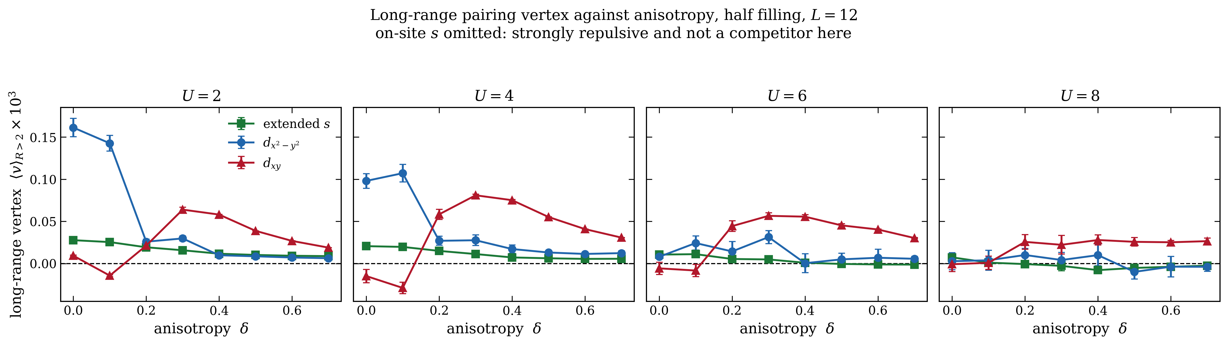
The long-range takeover happens at every interaction strength
half filling; on-site s omitted because it is strongly repulsive and not a competitor
U | long-range winner at delta = 0 | winner by delta = 0.4 | d_xy crossing
2 | d_x2-y2 | d_xy | 0.3
4 | d_x2-y2 | d_xy | 0.2
6 | extended s | d_xy | 0.2
8 | extended s | d_xy | 0.2
What stays the same
d_xy ends up the long-range leader at every U. The signal shrinks steadily with U, so by U = 8 all three channels are pressed close to zero and the margin is small.
Notes:
Note the vertical scale is shared. The U = 8 panel is not empty, it is genuinely small.

Slide 6
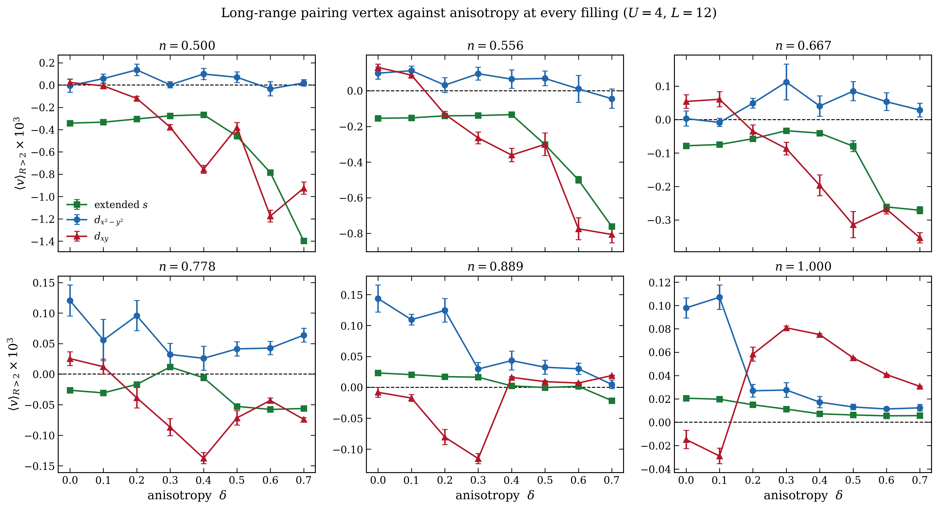
Away from half filling the d_xy channel dies
long-range vertex against anisotropy at all six fillings, U = 4
This is the most important slide in the deck
Only at n = 1.000 does d_xy rise above zero and take the long-range lead. At every doped filling it is negative and falls further as delta grows, reaching -0.9 at n = 0.500. d_x2-y2 is the long-range winner everywhere except half filling. The channel swap is a half-filling phenomenon, not a generic one.
Notes:
If asked why: the d_xy form factor lives on the plaquette diagonals, and the diagonal correlations that support it are tied to the commensurate structure at half filling. Doping destroys that and the channel goes repulsive.

Slide 7
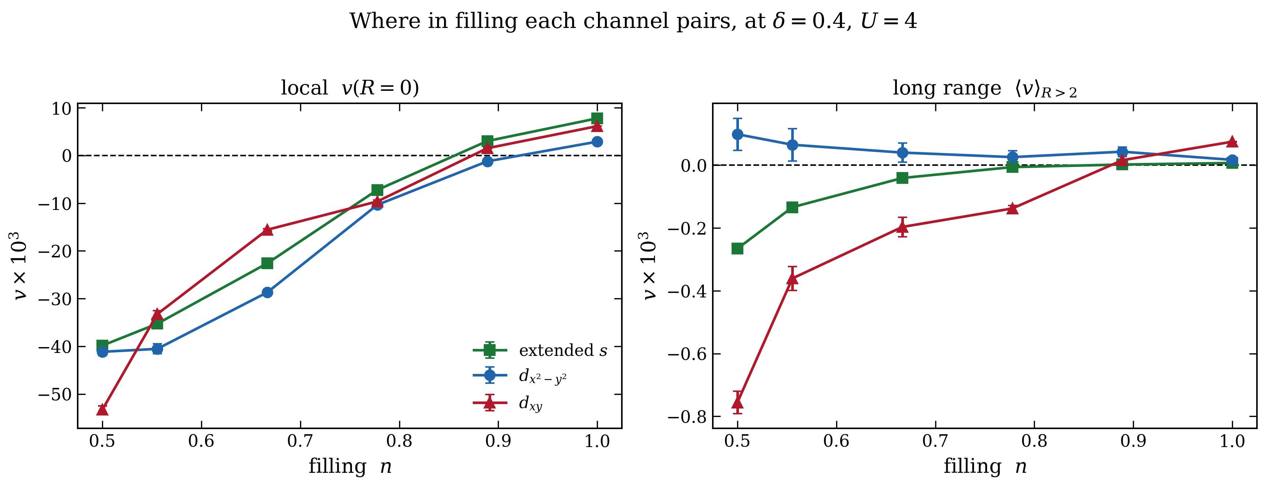
The same result read along the filling axis
delta = 0.4, U = 4: local on the left, long range on the right
Reading it
Locally the picture is smooth: extended s and d_xy both strengthen towards half filling. At long range the three channels are all negative or near zero across the doped region and only separate in the last step to n = 1. The honest statement is that our long-range pairing signal exists near half filling and nowhere else.

Slide 8
The delta polarisation, and what plotting against it tests
replacing the m_AM = delta m times delta construction
• S_zz(pi, pi) is the spin structure factor at the Neel wavevector. m = sqrt( S_zz(pi,pi) / N ) is the staggered polarisation; the 1/N inside the root is what makes m comparable across system sizes.
• Delta m = m - m(U = 0) removes the free-fermion background. That background is not small: at L = 12 it is 60 to 93 per cent of m, so delta m is a difference between two comparable numbers and should be quoted with that caveat.
• Putting delta m on the x-axis collapses the two knobs U and delta into one question: is the pairing controlled by the magnetic polarisation? If every (U, delta) point fell on one curve the answer would be yes.
Why drop the times delta factor
The answer, in one line
delta already enters through the suppression of m, so multiplying by it again double counts. arXiv 2607.06106 defines the order parameter on this lattice as the plain staggered magnetisation.
Within each U the pairing tracks delta m tightly. Across U the curves are offset and do not collapse, so delta m alone does not control the pairing.
Notes:
m(U=0) is finite because free fermions already have spin correlations from Pauli statistics. It is a background, not order.

Slide 9
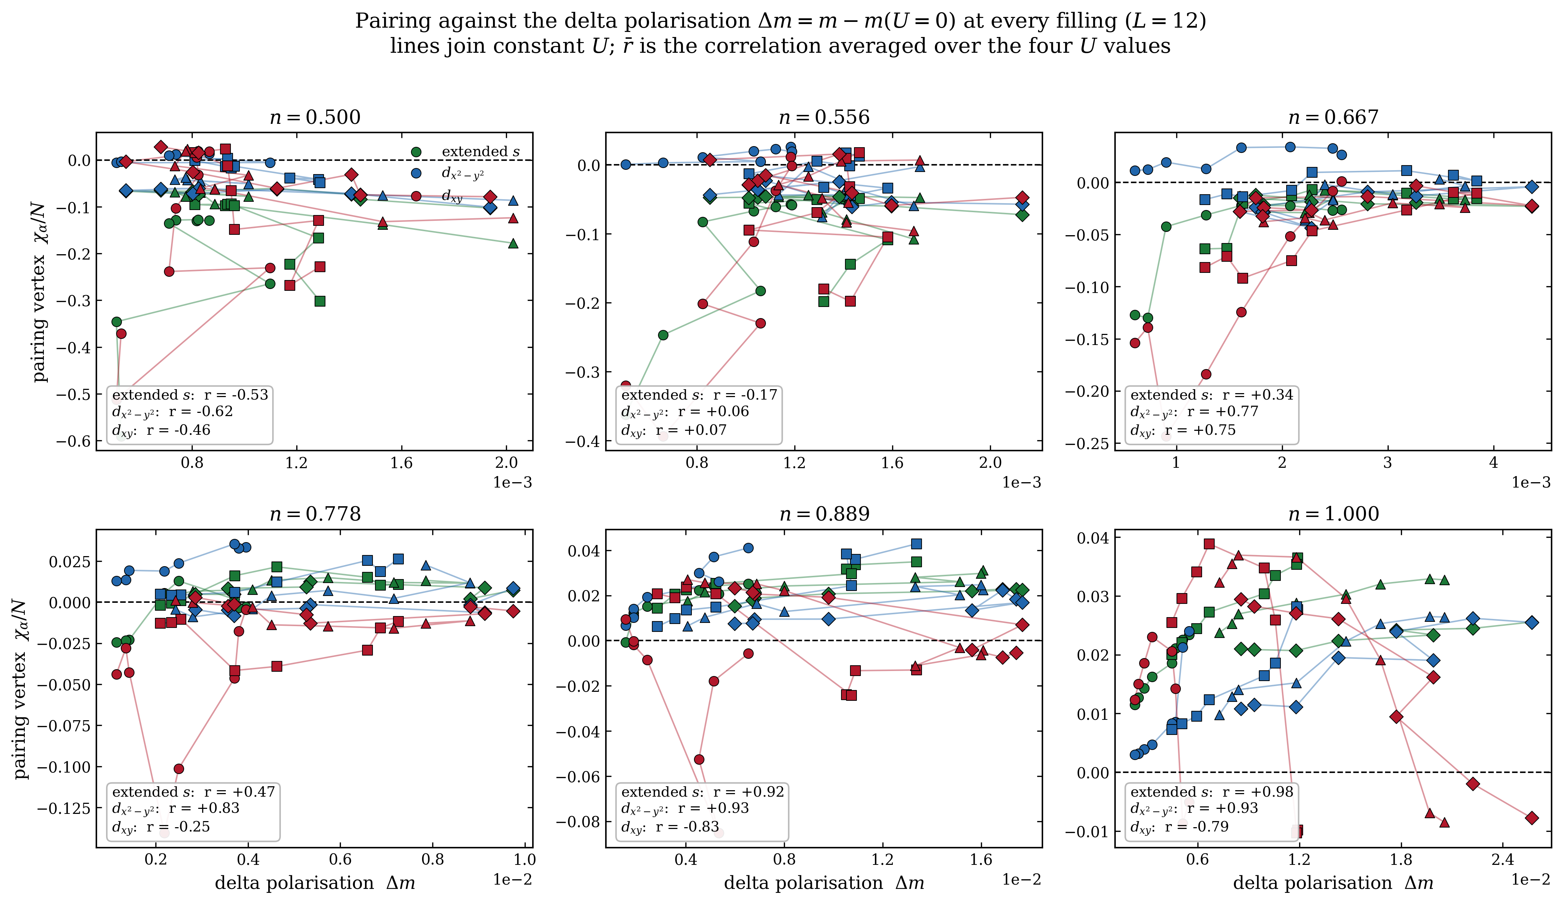
Pairing against the delta polarisation, every filling
each point is one (U, delta); lines join constant U; r is the within-U correlation
n | extended s | d_x2-y2 | d_xy
1.000 | +0.98 | +0.93 | -0.79
0.889 | +0.92 | +0.93 | -0.83
0.778 | +0.47 | +0.83 | -0.25
0.667 | +0.34 | +0.77 | +0.75
0.556 | -0.17 | +0.06 | +0.07
0.500 | -0.53 | -0.62 | -0.46
The anti-correlation is a near-half-filling effect
At n = 1.000 and 0.889 extended s and d_x2-y2 track the polarisation at r above +0.9 while d_xy runs against it at about -0.8. By n = 0.667 d_xy has flipped to +0.75, and below that the correlations are weak and unstable. Same boundary as the P(R) result.

Slide 10
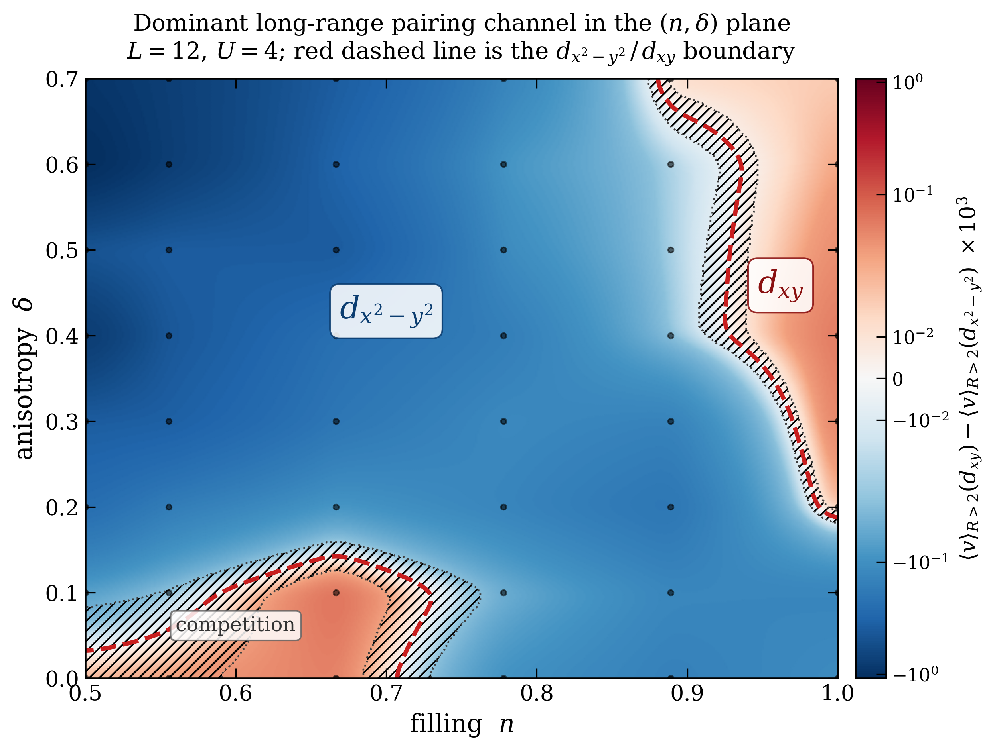
Single-panel pairing phase diagram in the (n, delta) plane
built to mirror Fig. 4 of PRB 113, 134443, with pairing channels in place of ordering vectors
How to read it
Colour is the difference between the two long-range vertices, so blue means d_x2-y2 leads and red means d_xy leads. The scale is symmetric log because the repulsive corner at low filling is ten times larger than the d_xy signal. Hatching marks where the two channels sit within one combined error bar. Extended s never leads anywhere on this grid, which is why the panel needs only two colours.
Notes:
The analogue of their red line is the d_x2-y2 to d_xy boundary. Their Q coordinate said which magnetic ordering vector wins; this difference says which pairing channel wins, and it is a single continuous number for the same reason: only two channels are ever in contention.

Slide 11
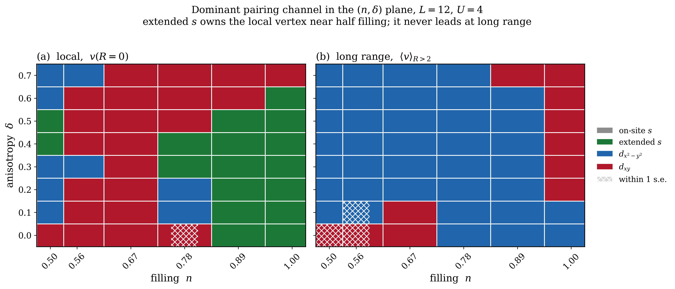
Where extended s dominates, and why the previous panel had only two colours
same plane, dominant channel by category, both pieces of the vertex
Panel (a), local
Panel (b), long range
Extended s wins 17 of 48 cells, in a solid block at n = 0.889 and 1.000 for delta up to 0.5. d_xy takes 22 cells in the middle. On-site s wins nowhere, as expected for a repulsive channel.
Extended s wins 0 of 48. d_x2-y2 takes 37 cells and d_xy 11, all of them at high filling. That zero is why the continuous panel needed only two colours.
Notes:
This is the Huang result stated as a map rather than a pair of curves: extended s is a local channel and d is a long-range one. Hatched cells are where the top two are within one combined standard error.

Slide 12
Where this leaves us
two independent measurements, one consistent boundary
• P(R) reproduces Huang at delta = 0: extended s wins locally, d_x2-y2 wins at long range. Our earlier q = 0 result was not in conflict with White, it was summing two competing pieces.
• Anisotropy hands long-range leadership to d_xy at every U, entering through a large positive spike on the plaquette diagonal at R = sqrt(2).
• That takeover exists only near half filling. At n <= 0.778 the long-range d_xy vertex is negative and falls further with delta.
• The delta-polarisation plots draw the same boundary independently: d_xy is anti-correlated with the polarisation at n = 1.000 and 0.889, and stops being so below that.
• Two different observables agreeing on the same filling boundary is the strongest evidence in the deck.
• The phase diagram puts the d_xy region at n above roughly 0.88 and delta above roughly 0.2, with a competition pocket at low delta and intermediate filling.
• Extended s dominates the LOCAL vertex over 17 of 48 cells but never leads at long range, which is the Huang local-versus-long-range split stated as a map.
• Still open: pinning the delta at which d_xy changes sign. Twist-averaged runs on a finer grid at U = 2 and 4 are in flight.
What we cannot claim
v(R) decays into noise past R = 3.5 and chi/N is flat in system size, so there is no long-range order here. The defensible claim is a change in WHICH channel is attractive, not superconductivity.

