Slide 1
Two validation results
twist-averaged boundary conditions · real-space pairing P(R)
Checkerboard Hubbard, CPQMC at T = 0, L = 12
13 August 2026
Both were open questions last week. Both are now answered.
Notes:
Two things the supervisor asked for: check the open-shell trial state is not producing the result, and do the Huang local-versus-long-range decomposition. Both done.

Slide 2
Why twist averaging was needed
under periodic boundaries every filling at L = 12 is open shell
• A twist is a boundary phase ψ(r + L x̂) = e^{iθx} ψ(r), shifting the k grid from 2πm/L to (2πm + θ)/L. Shell effects come from that discrete grid landing awkwardly on the Fermi surface; averaging over θ fills the zone and washes them out.
• Only θ = 0 and π keep the hopping matrix real, which the engine requires — so no rewrite was needed.
• The two mixed twists are exactly degenerate by the lattice's x ↔ y symmetry (eigenvalues agree to 1e-14), so three runs with weights 1 : 2 : 1 give the four-point average.
• Shell effects are real, not hypothetical: at L = 8, n = 0.781 the extended-s vertex jumps sixteen times its typical step exactly where the shell character flips.
The three runs
Free validation
(+1,+1) periodic, weight 1 — already had it
(−1,+1) half twist, weight 2 — stands for (+1,−1) too
(−1,−1) both antiperiodic, weight 1
The U = 0 null test still passes under both twists — max |vertex| = 8.6e-13 and 8.1e-13. Twisted boundaries do not break the full-minus-bubble decomposition.
Scope: L = 12, half filling, U = 2, 4, 6, 8, all eight anisotropies, six seeds. Both twist legs complete.
Notes:
If asked why not full twist averaging: a continuous theta grid needs complex hoppings, and cpqmc.py is real-only. That is a one-to-two week rewrite. This four-point version removes the worst artefacts without touching the engine.

Slide 3
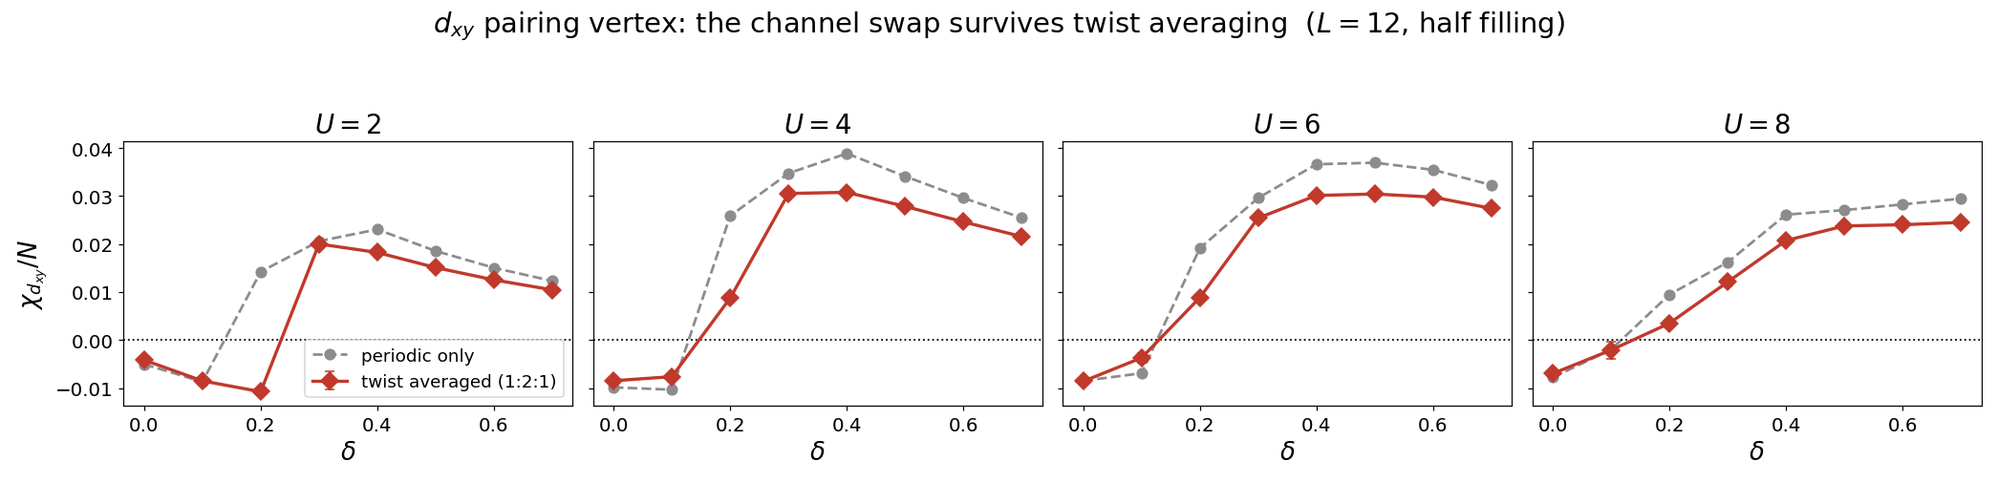
The channel swap survives at every interaction strength
d_xy pairing vertex, periodic against twist-averaged
U | crossing δ | peak χ/N | vs periodic
2 | 0.3 | +0.0200 | −21%
4 | 0.2 | +0.0308 | −21%
6 | 0.2 | +0.0304 | −17%
8 | 0.2 | +0.0245 | −17%
What it confirms, and what it costs
d_xy is repulsive at δ = 0 and 0.1 and attractive from δ = 0.2 at every U. The open-shell trial state is NOT producing the swap.
But magnitudes fall 17–21% under averaging, so the periodic numbers were inflated. Quote the twist-averaged values.
Notes:
The honest detail: at U = 2, delta = 0.2 the sign actually flips under averaging, from +0.014 to -0.011, moving the crossing from 0.15 to 0.25 at weak coupling. Everywhere else the crossing location is unchanged.

Slide 4
Real-space pairing P(R)
the decomposition Huang, Lin and Gubernatis use (PRB 64, 205101)
V_α(R) = P_α(R) − P̄_α(R) local = V(R = 0) long range = mean V(R > 2)
• The existing routine sums the pair matrix over ALL site pairs and discards the structure. Keeping that matrix and binning each entry by the separation between the two sites gives P(R) instead.
• Summing P(R) back over R must return the original susceptibility. That sum rule is the validation — it reproduces both the full susceptibility and the vertex to 0.00% in every channel and every seed.
• The sum rule caught two bugs before any production run: a call to a method that does not exist (guarded by hasattr, so equilibration was silently skipped — 400% error), and a missing per-block reorthogonalisation.
• Distances use the minimum-image convention; 27 distinct separations at L = 12.
Why this matters for the White comparison
Our q = 0 susceptibility adds the local and long-range pieces together. If they favour different channels — which is exactly what Huang finds — then the sum can name the wrong winner. That is the suspected reason our δ = 0 ordering put extended s ahead of d_x²−y², where White has d_x²−y² first.
Notes:
Emphasise the sum rule. It is an exact internal check: the R-resolved code must reproduce the old routine when the bins are added back, and it does to every digit.

Slide 5
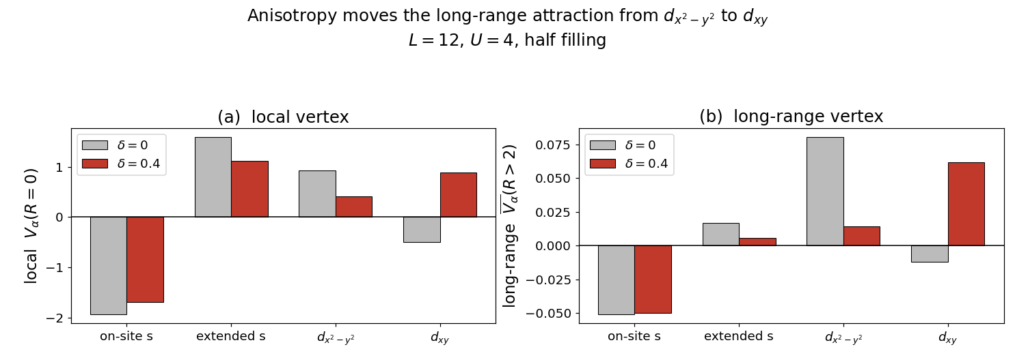
Huang's result reproduced — then reversed by anisotropy
L = 12, U = 4, half filling
At δ = 0: exactly Huang's finding
At δ = 0.4: d_xy takes over
LOCAL: extended s (+1.59) beats d_x²−y² (+0.92).
LONG RANGE: d_x²−y² (+0.080) beats extended s (+0.017) by 4.8×.
The local piece is ~20× larger, so the q = 0 sum names extended s.
d_x²−y²'s long-range vertex collapses 0.080 → 0.014, while d_xy goes −0.012 → +0.062 and leads by more than 4×. The handover happens in the long-range channel.
Notes:
This resolves the apparent disagreement with White completely, and it is a stronger statement than the q=0 result: the handover is in the piece that actually matters for ordering.

Slide 6
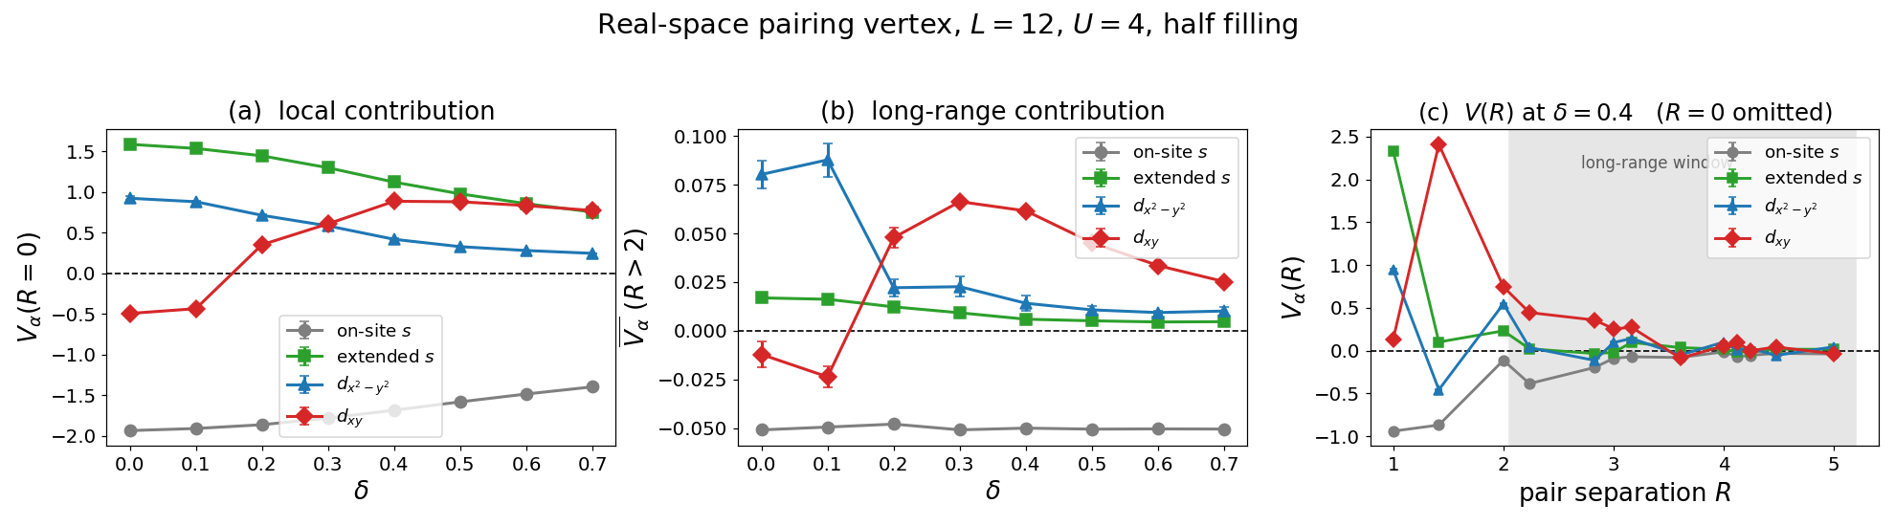
Where each channel dominates, anisotropy by anisotropy
long-range vertex V(R > 2), L = 12, U = 4, half filling
δ | on-site s | extended s | d_x²−y² | d_xy | leader
0.0 | −0.051 | +0.017 | +0.080 | −0.012 | d_x²−y²
0.1 | −0.049 | +0.016 | +0.088 | −0.024 | d_x²−y²
0.2 | −0.048 | +0.012 | +0.022 | +0.048 | d_xy
0.3 | −0.051 | +0.009 | +0.023 | +0.066 | d_xy
0.4 | −0.050 | +0.006 | +0.014 | +0.062 | d_xy
0.7 | −0.051 | +0.005 | +0.010 | +0.025 | d_xy
The handover
Between δ = 0.1 and 0.2 the long-range attraction moves from d_x²−y² to d_xy — a factor of four collapse in one channel and a sign change in the other.
Notes:
Panel (c) shows V(R) decaying into the noise past R about 3.5 in every channel. That is the honest limit on any ordering claim - short-range correlations, no long-range order.

Slide 7
What these two results do and do not establish
Established
The d_xy channel swap is not an open-shell artefact — it survives twist averaging at U = 2, 4, 6 and 8.
Established
At δ = 0 our channel ordering agrees with Huang once local and long-range are separated, which explains the apparent conflict with White.
Established
Anisotropy moves the long-range attraction from d_x²−y² to d_xy between δ = 0.1 and 0.2.
Revised
Periodic-boundary magnitudes are 17–21% too high. All quoted numbers should come from the twist average.
NOT established
Long-range order. V(R) decays into the noise past R ≈ 3.5 in every channel, and χ/N is flat in system size. What we can defend is a change in which channel is attractive — not superconductivity.
Notes:
End on the limitation. Huang reach the same conclusion for t-t'-U: no tendency for the correlations to grow with system size. Saying it first makes the positive claims credible.

Slide 8
Next
1
Running now
P(R) queue: 13 of 40 chunks done. U = 4 complete at all fillings and anisotropies; U = 8 in progress.
2
Timing
264–521 min per chunk against my 225 estimate — the full set lands Friday evening, not tonight.
3
Then
Same local/long-range decomposition at U = 2, 6, 8, and across fillings — does the handover track the filling boundary at n ≈ 0.85?
4
Open
Twist averaging is only at half filling. The doped case is untested.
Both figures are reproducible: twist_average.py and checkerboard_pr.py, with the sum-rule test as the correctness check.
Notes:
The doped twist check is the obvious next validation - the channel swap is claimed to be a half-filling effect, and the twist test so far only covers half filling.

