Slide 1
Emergent altermagnetism and pairing
in the checkerboard Hubbard model
Constrained-path quantum Monte Carlo · weekly progress
12 August 2026
Headline: anisotropy selects the d_xy pairing channel at half filling
Notes:
Two cubes finished this week. Lead with the pairing channel swap: size independent, holds at every U, 27 sigma. Magnetism is the supporting explanation, not the lead.

Slide 2
This week
what ran, what it answered, and what is still in flight
9,840
~300
1e-13
0 / 48
measurements across
the two complete cubes
node-hours of CPQMC,
six nodes in parallel
U = 0 null-test residual
in all four channels
L = 12 fillings that
are closed shell
This week we ran roughly 300 node-hours of CPQMC across six cluster nodes in parallel.
Both cubes are now closed. L = 8, 10, 12 at U = 0, 2, 4, 6, 8, fillings from n = 0.5 to 1, eight anisotropies δ = 0 to 0.7, six independent seeds per point. That is 9,840 measurements with no gaps and no NaN, and the U = 0 rows pass the null test to 1e-13. We also measured the full pair-field susceptibility at δ = 0, so the vertex can now be compared against the uncorrelated susceptibility the way White et al. do.
Last week we derived that interactions drive Néel order near half filling, and that with δ ≠ 0 that order becomes an altermagnet of d_xy symmetry. We also found the equal-time vertex is CP-biased, so we moved to the integrated vertex. This week we tried to answer: does the pairing follow the magnetic order, or just the anisotropy?
The answer is that it follows both, and the two are not separable. The d_xy channel turns attractive only where the anisotropy is large AND the filling is above n ≈ 0.85 — the same region where the moment is strong. Away from half filling the same anisotropy drives d_xy further into repulsion.
Currently twist-averaged boundary conditions are running at L = 12, to test whether the open-shell trial state is distorting the result. Those land tomorrow.
Notes:
Narrative version. The key sentence is the fourth paragraph - pairing follows both the magnetic order and the anisotropy, and they cannot be separated. Everything after this slide is evidence for that claim.

Slide 3
Method and observables
CPQMC, back-propagated, six independent seeds per point
χ = P_full − P_bub
P_bub is the uncorrelated susceptibility — the same diagram with the interaction vertex removed. Written P̄ in the figures.
• Constrained-path QMC at T = 0, back-propagated, six independent seeds per point.
• The vertex is full minus bubble, integrated over imaginary time. Positive means the interaction is attractive in that channel; negative means it opposes pairing.
• The equal-time vertex is CP-biased against exact diagonalisation, so we report the integrated form throughout.
• Four channels measured in a single back-propagation pass at q = 0 — on-site s, extended s, d_x²−y² and d_xy — differing only in the bond pattern the form factor weights.
• χ is an unnormalised double site sum and therefore extensive, so every comparison across lattice sizes uses χ/N.
• Magnetic moment m = √( S(q*) / N ), with Δm = m − m(U=0) isolating the interaction part, since S(q) is finite even for free fermions.
• q* is the measured peak of S(q), not assumed to be (π,π) — see the correction later.
Validation that the machinery is sound
At U = 0 the vertex must vanish identically and the full susceptibility must equal the bubble. Measured residual: 1.7e-13 to 7.6e-13 across all four channels and all three lattices. On-site s is repulsive in all 576 measured points, as a positive U requires.
Notes:
The U=0 null test is the strongest single argument that the full-minus-bubble decomposition is implemented correctly.

Slide 4
Both cubes are now complete
no gaps, no NaN, six seeds everywhere
 | U = 0 | U = 2 | U = 4 | U = 6 | U = 8
L = 8 | ✓ | ✓ | ✓ | ✓ | ✓
L = 10 | ✓ | ✓ | ✓ | ✓ | ✓
L = 12 | ✓ | ✓ | ✓ | ✓ | ✓
dataset | rows | status
magnetic_master | 4,320 | complete
pairing_master | 5,520 | complete
pairfull (δ = 0) | 540 | complete
S(q) grids | 15 files | collected
twist average | in flight | tomorrow
✓ = all eight anisotropies δ = 0 … 0.7, six fillings, six seeds
Two data problems found and fixed
• χ is an unnormalised double site sum, so it is extensive — every cross-size comparison must use χ/N. Raw ratios matched N ratios to under 1%.
• The L = 12 S(q) grids had never been collected; 33 files were scattered over six nodes in four directories, now merged into one file per (L, U).
Notes:
9840 QMC rows total, every point six seeds. Roughly 300 node-hours this week across five nodes.

Slide 5
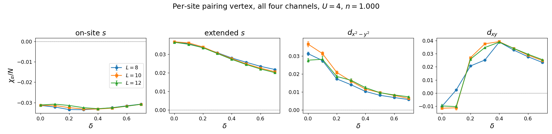
Headline: anisotropy selects the d_xy channel
per-site vertex, half filling, U = 4 — identical at all three lattice sizes
on-site s
extended s
d_x²−y²
d_xy
flat
decays
decays
CHANGES SIGN
−0.031 → −0.031
+0.036 → +0.020
+0.028 → +0.007
−0.010 → +0.026
δ = 0 → 0.7 at U = 4. Three channels are dull; only d_xy crosses zero, at δ ≈ 0.15, peaking near δ = 0.4.
Notes:
The paper's lead result. Three lattices lie on top of each other once chi is divided by N - 1% spread at U=4. dxy is the channel the checkerboard symmetry predicts.

Slide 6
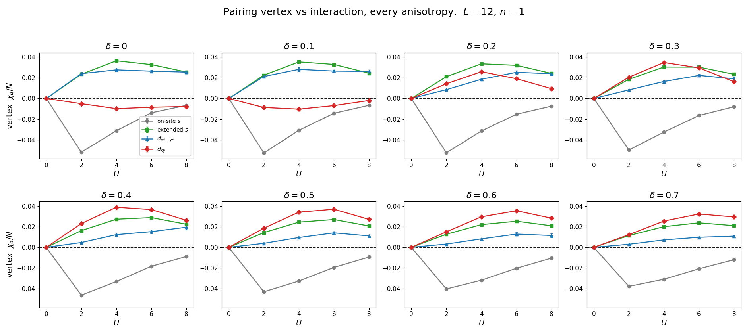
The reordering happens between δ = 0.1 and 0.4
pairing vertex vs U, one panel per anisotropy, half filling
Reading the panels
• δ = 0, 0.1 — d_xy (red) sits below zero: the worst of the four
• δ = 0.2 — it crosses zero
• δ = 0.3 — it passes d_x²−y²
• δ ≥ 0.4 — d_xy is the top curve, the strongest attractive channel
• every curve starts at exactly zero at U = 0
• all peak near U = 4–6, not at the strongest coupling
The whole reordering happens over a narrow window in anisotropy.
Notes:
Point at the red curve rising through the panels. The peak at U=4-6 rather than U=8 is worth a sentence: attraction is strongest at intermediate coupling.

Slide 7
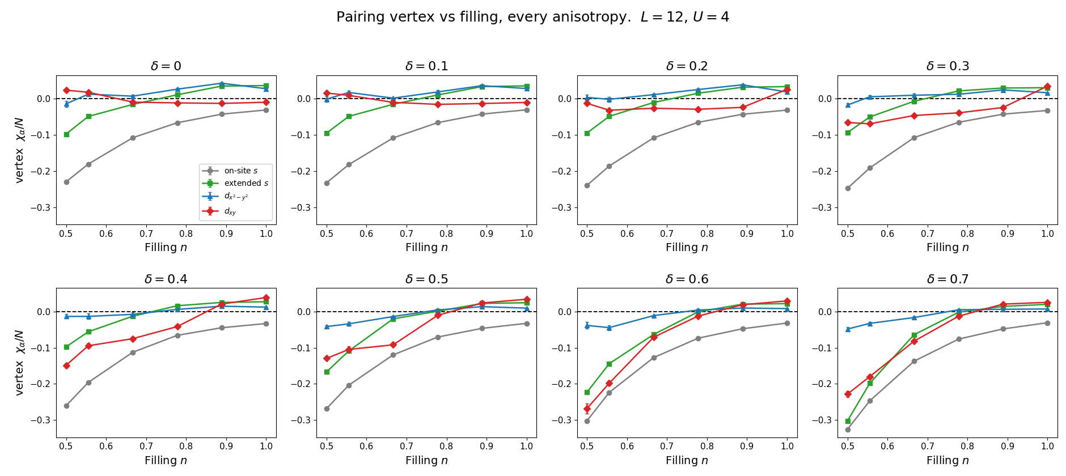
Anisotropy does opposite things at the two fillings
pairing vertex vs filling, one panel per anisotropy, U = 4
At half filling — δ helps
d_xy vertex/N goes −0.010 → +0.039 as δ goes 0 → 0.4. Repulsive becomes strongly attractive.
When doped — δ hurts
At n = 0.778 the same anisotropy drives d_xy from −0.012 to −0.042, and the trough reaches −0.23 at n = 0.5, δ = 0.7.
Same knob, opposite sign at the two ends of the filling axis.
Notes:
Direct answer to whether dxy is suppressed away from half filling. Yes - and it gets worse with delta, not better.

Slide 8
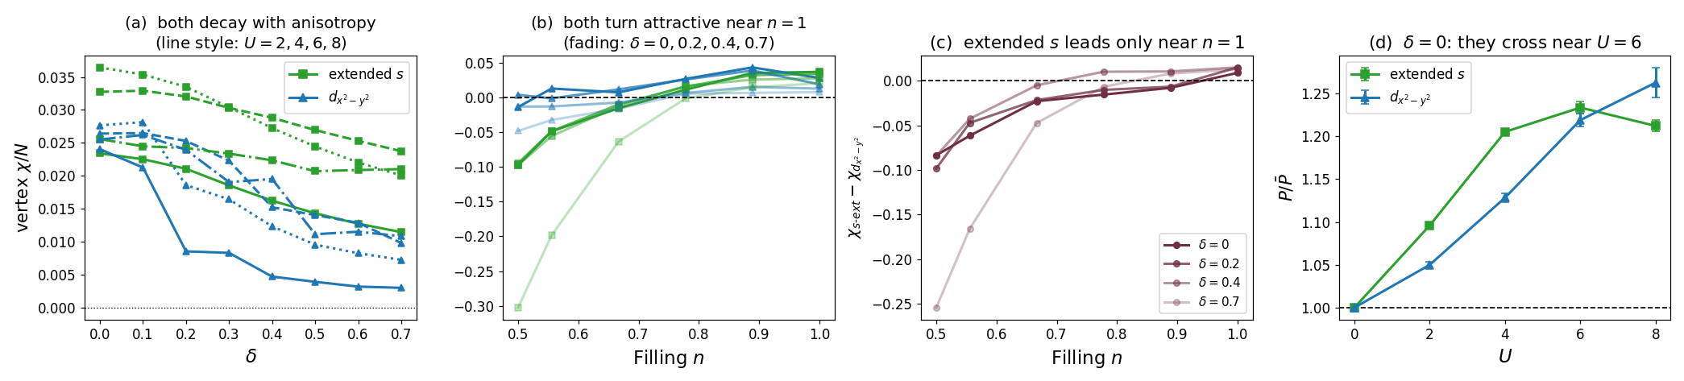
The other two channels: extended s and d_x²−y²
both attractive near half filling, both weakened by anisotropy — but not equally
Both decay with δ
Both need half filling
Extended s leads — but only at n = 1
extended s falls ×1.8 from δ = 0 to 0.7 (0.0364 → 0.0201). d_x²−y² falls ×3.8 (0.0277 → 0.0072) — twice as fast.
extended s turns attractive above n = 0.733, d_x²−y² above n = 0.530. Anisotropy pushes both windows toward n = 1.
the gap χ_s-ext − χ_d is +0.009 at δ = 0 and grows to +0.015. Away from half filling d_x²−y² leads.
By P/P_bub at δ = 0 the two cross near U = 6: extended s leads at weak coupling, d_x²−y² at strong (1.21 vs 1.26 at U = 8).
Notes:
These are the two conventional channels. Both behave the way White's square-lattice work predicts. The point of the slide is that anisotropy hurts dx2-y2 twice as fast as extended s, which is what clears the way for dxy to take over.

Slide 9
Why extended s leads, and where to be careful
the one place our δ = 0 result departs from White — and it has an explanation
The apparent disagreement
The explanation, from Huang et al.
White finds d_x²−y² the most attractive channel on the square lattice. We reproduce all four of his channel SIGNS, but our ordering differs: extended s is larger (0.0364 against 0.0277 at U = 4, δ = 0).
They show extended s dominates the LOCAL pairing while d_x²−y² dominates the LONG-RANGE part. Our χ integrates over all separations, so the local piece wins on magnitude. Separating them needs the real-space P(R) decomposition we have not built yet.
Reliability of these two channels — both need care
channel | seed noise | size collapse | shell sensitivity | verdict
on-site s | 0.3% | 3% | 0.2× (none) | solid
extended s | 1.3% | 3% | 16× at boundary | check twist
d_x²−y² | 20.3% | 13–58% | 3.5× | needs seeds
d_xy | 5.2% | 22% | 1.0× (none) | solid
d_x²−y² is the weakest channel in the dataset on every measure. Its sign and its decay with δ are safe; precise values are not.
Notes:
Be upfront that dx2-y2 is our noisiest channel. The headline dxy result is the cleanest one, which is fortunate. If asked what would fix it: more seeds, and the real-space decomposition to separate local from long-range.

Slide 10
The effect switches off below n ≈ 0.85
d_xy vertex at L = 12, U = 4, as δ goes 0 → 0.7
filling n | d_xy with δ | verdict
0.500 | +0.024 → −0.228 | reversed
0.556 | +0.018 → −0.180 | reversed
0.667 | −0.010 → −0.082 | no swap
0.778 | −0.012 → −0.013 | no swap
0.889 | −0.013 → +0.021 | SWAP
1.000 | −0.010 → +0.026 | SWAP
Filling at which each channel turns attractive
δ | extended s | d_x²−y² | d_xy
0.0 | 0.733 | 0.530 | 0.628
0.2 | 0.712 | 0.570 | 0.942
0.4 | 0.716 | 0.729 | 0.852
0.7 | 0.790 | 0.752 | 0.820
Anisotropy pushes every channel's attractive window toward half filling. d_x²−y² turns attractive from n = 0.53 at δ = 0, but only from n = 0.75 at δ = 0.7.
The pairing boundary sits between n = 0.778 and n = 0.889 — the same place the magnetic moment becomes strong. The two hang together: the altermagnetic correlations that drive the d_xy attraction only exist near half filling. The claim should be scoped to n ≥ 0.85 explicitly, with the doped panels shown as the control.
Notes:
Scoping to near half filling is a strength - a falsifiable prediction with a control region where the effect vanishes.

Slide 11
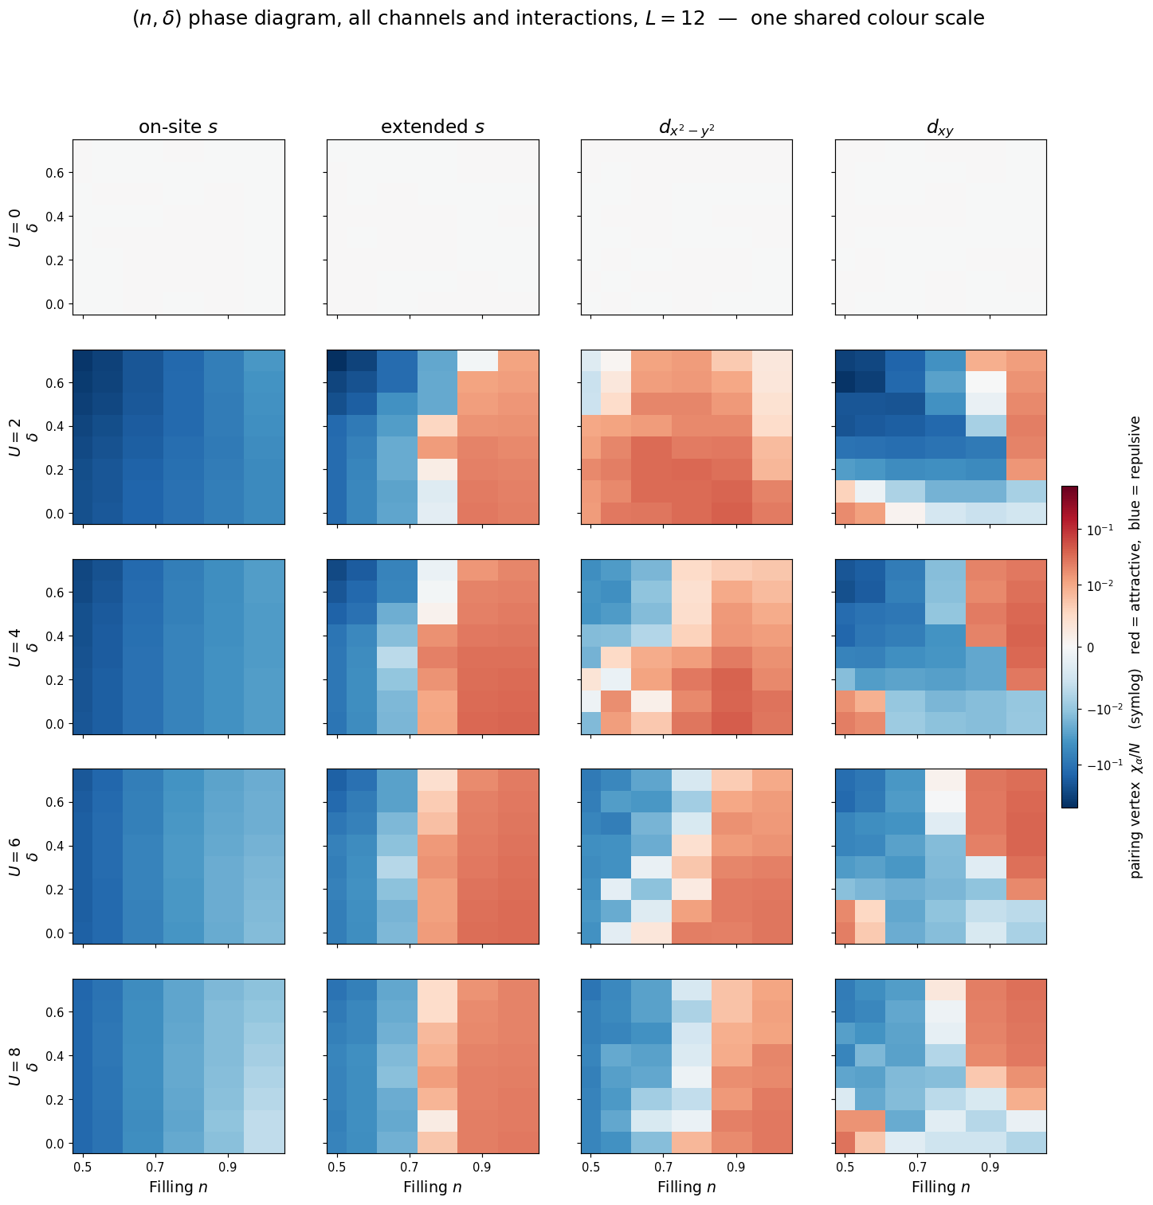
(n, δ) phase diagram — every channel, every interaction
L = 12, one shared colour scale across all twenty panels
Read the columns
Each column is one channel. Red is attractive, blue repulsive, white is no effect. The whole U = 0 row is white — the null test, seen directly.
Read the rows
The attractive region grows and pushes leftward as U increases, then recedes slightly at U = 8. All four channels are repulsive on the dilute side.
The d_xy corner
Top-right of the fourth column: attractive only where δ is large AND n ≥ 0.89. That corner is the paper's result, and nothing else in the figure looks like it.
Colour scale is symmetric-log: on-site s reaches −0.59 while the d channels live at ±0.04, so a linear shared scale would flatten them to white.
Notes:
This replaces the old scatter version and answers meeting point 5. One shared scale was requested; it needs to be symlog because the channels differ by more than a decade in magnitude. If asked, the linear version is available but the d channels vanish in it.

Slide 12
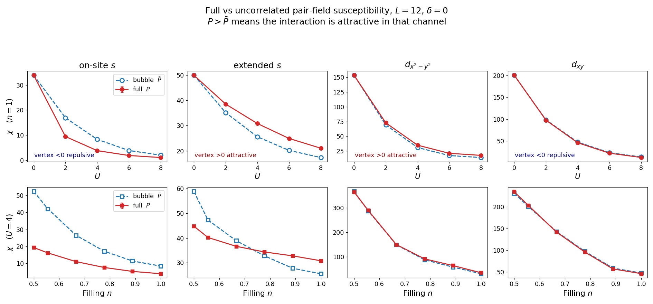
Your question: does d_x²−y² dominate over extended s?
full P against the uncorrelated P_bub — the White et al. comparison, at δ = 0
The answer has a twist
d_xy has the LARGEST full susceptibility of the four — yet its vertex is negative.
Its bubble alone is 47.67, so it looks dominant for purely kinematic reasons while the interaction pushes against it.
Ranking channels by P alone inverts the physical answer. That is exactly why White introduced the uncorrelated susceptibility.
channel | full P | bubble P_bub | vertex | interaction
on-site s | 3.85 | 8.34 | −4.49 | repulsive
extended s | 30.83 | 25.58 | +5.25 | ATTRACTIVE
d_x²−y² | 35.00 | 31.02 | +3.98 | ATTRACTIVE
d_xy | 46.25 | 47.67 | −1.42 | repulsive
By vertex the ordering is stable at every U: extended s and d_x²−y² attractive, on-site s and d_xy repulsive — reproducing White's channel signs on a lattice he never studied.
Notes:
By vertex the ordering is stable at every U: extended s and dx2-y2 attractive, on-site s and dxy repulsive - reproducing White's signs on a lattice he never studied.

Slide 13
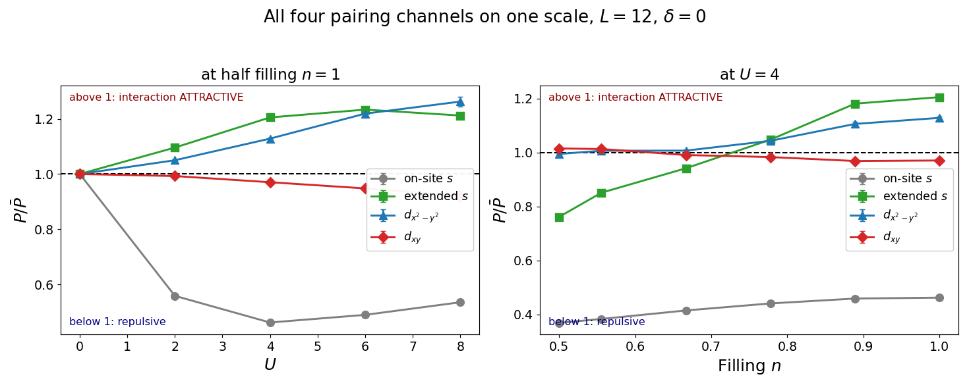
All four channels on one scale
P / P_bub divides out the kinematic bubble; above 1 the interaction is attractive
All four curves start at exactly 1.000 at U = 0 — the null test, made visible. At U = 8 the interaction enhances d_x²−y² by 26% and extended s by 21%, while suppressing d_xy by 8% and on-site s by 46%. Extended s crosses the line at n = 0.733.
Notes:
The U=0 flat line at exactly 1 is worth pausing on - the null test as a visual anchor.

Slide 14
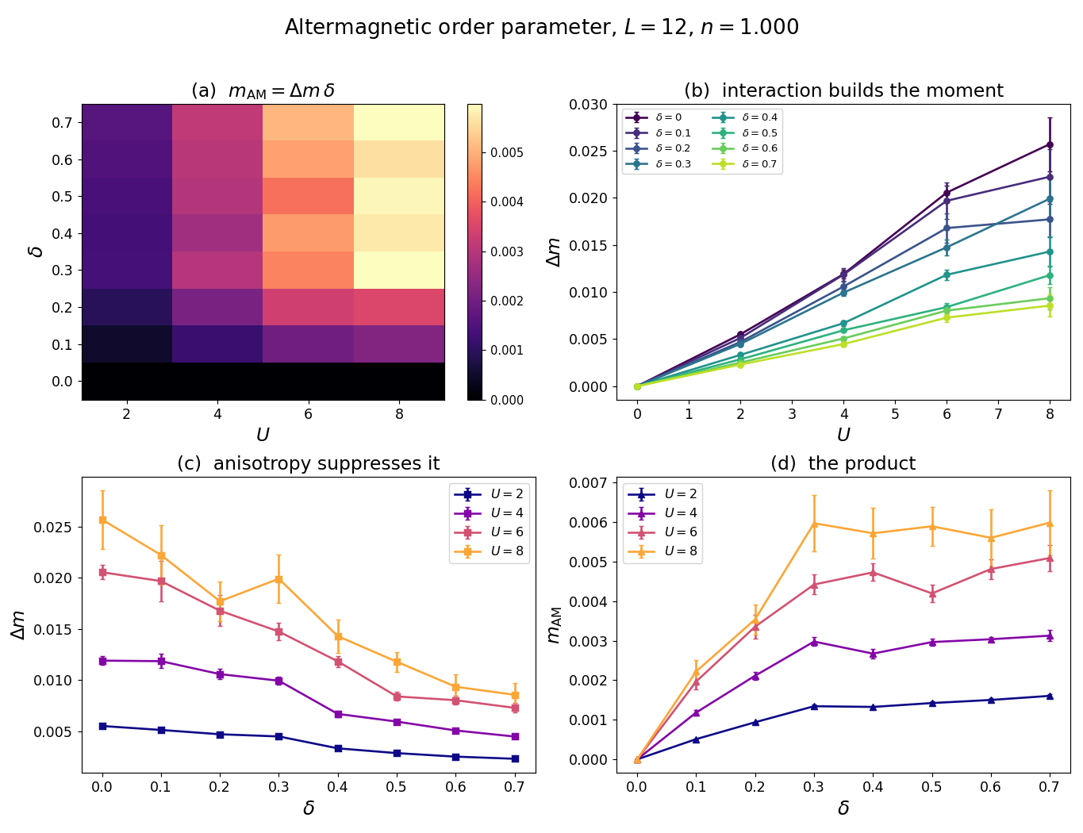
Meeting point 7: m_AM against U and δ
the two contributions separated — they pull in opposite directions
U builds the moment
Δm rises roughly linearly with U at every anisotropy: 0.0055 at U = 2 to 0.0257 at U = 8.
δ destroys it
At U = 8 the same Δm falls by a factor of three, 0.0257 → 0.0086, as δ goes 0 → 0.7.
The product plateaus
m_AM = Δm·δ climbs to δ ≈ 0.3 then flattens — two effects cancelling, not saturation.
Caveat: U = 6 and U = 8 are within 1σ of each other at δ ≥ 0.6.
Notes:
Be honest: the U dependence is established up to delta about 0.4 and unresolved beyond, where the top two curves touch. Delta m is also still shrinking with lattice size.

Slide 15
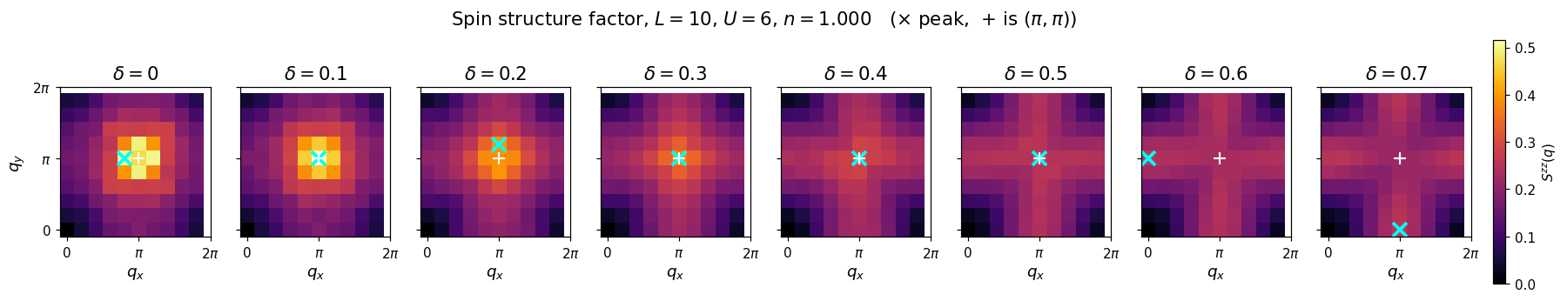
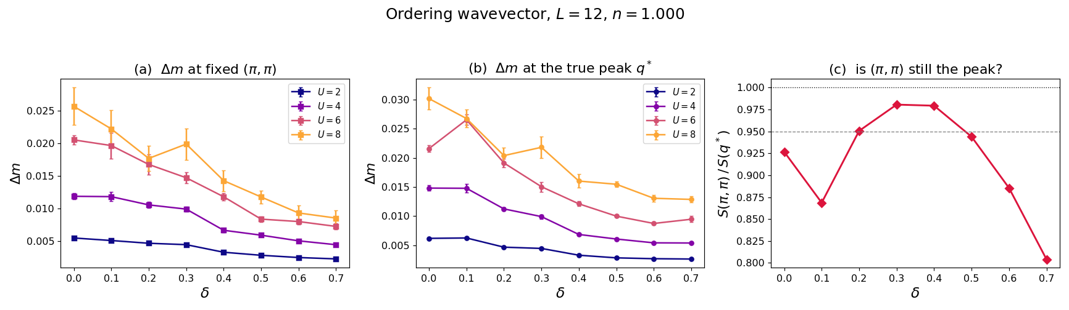
A correction we found ourselves
the magnetic peak leaves (π,π) — the moment was being read at the wrong wavevector
δ | peak q* | S(π,π)/S(q*)
0.0 | (π, 0.83π) | 0.927
0.3 | (π, π) | 0.981
0.5 | (π, π) | 0.944
0.7 | (0, π) | 0.804
Incommensurate at small δ, commensurate Néel near δ ≈ 0.35, stripe-like at large δ. Recomputing Δm at the true peak leaves the suppression intact — factor 2.3 instead of 3.0 — so the headline survives. Both limits match published work.
Notes:
Stress that we found this by checking our own order parameter, not because a referee asked - and the conclusion survived.

Slide 16
Meeting point 11: closed-shell filling
answered — and it turned out to matter
lattice | fillings closed-shell at every δ
L = 8 | only n = 1.72, 1.84, 1.97
L = 10 | n = 0.500, 0.740, 1.020
L = 12 | none below n = 1.65
Does it actually matter? Yes, in two channels
Testing at fixed L and fixed n, with the shell character flipping as δ varies:
• extended s jumps 16× its typical step at the boundary
• d_x²−y² jumps 3.5×
• on-site s (0.2×) and d_xy (1.0×) show nothing
At L = 12 the open-shell problem cannot be fixed by choosing a different filling — zero of its 48 (filling, δ) combinations is closed shell.
The fix: twist-averaged boundary conditions — running now, results tomorrow
• A twist is a boundary phase ψ(r + L x̂) = e^{iθx} ψ(r), shifting the k grid off the awkward points.
• Only θ = 0 and π keep the hopping real, which the engine requires — so no rewrite is needed.
• The two mixed twists are degenerate by the lattice's x ↔ y symmetry (eigenvalues agree to 1e-14), so three runs with weights 1 : 2 : 1 give the four-point average.
• Our headline channel d_xy shows no shell sensitivity, so the main claim is already protected.
Notes:
The empirical test matters: we did not assume open shells were harmless, we measured a case where the shell character flips at fixed L and n, and found real jumps in two of four channels.

Slide 17
Literature check: the field has moved
two 2025–26 papers already claim altermagnetism on this lattice family
paper | model / method | overlap with us
arXiv 2607.06106 (Jul 2026) | checkerboard Hubbard, mean field + RPA | same lattice, weak coupling
arXiv 2503.08362 | t–t′–δ Hubbard, mean field + DMRG | same anisotropy; no pairing
arXiv 2505.12342 (our group) | spin-anisotropic Hubbard, CPQMC | anisotropy suppresses AFM
arXiv 2603.29377 (our group) | anisotropic t–J, CPQMC | d + p mixed pairing
White et al., PRB 39 839 | square Hubbard, DQMC | our δ = 0 benchmark
Huang, Lin, Gubernatis, PRB 64 205101 | t–t′–U, CPQMC at T = 0 | local vs long-range vertex
What this costs us
What it gives us
“Checkerboard hosts altermagnetism” is no longer available as a headline — 2607.06106 is five weeks old and says exactly that. Interaction-driven altermagnetism is an established category now.
The t–t′–δ paper explicitly declines to compute pairing. Our d_xy channel swap is unclaimed, it is CPQMC at intermediate coupling where the competitors are mean field, and we have the doping axis nobody else has.
Notes:
Recommend reframing: lead with pairing, use magnetism as the explanation. Stronger position than the original plan, but it means rewriting the introduction.

Slide 18
Status against the eleven meeting points
four done, one newly answered, three substantially done, three outstanding
1
δ to 0.7
DONE
9
equal-time vertex
resolved, unwritten
4
s-channels: trivial or not
DONE
10
strengthen the novelty
answer changed
6
spectral function in CPQMC
DONE
2
twist-averaged BC
running now
7
m_AM vs U and δ
DONE
3
periodic BC, TRIM
partial
11
closed-shell filling
ANSWERED
8
write the manuscript
fragments only
5
heatmaps not scatter
mostly
—
real-space P(R)
not started
Point 6 closed with a decision rather than a measurement: G(k,τ) is measurable, but the usable window is τ ≈ 0.4–0.8, too short for analytic continuation. DQMC would cost 1–2 months and inherits the sign problem CPQMC was chosen to avoid.
Notes:
Point 6: propose Hartree-Fock band structure as the cheap way to display the altermagnetic spin splitting, since neither CPQMC nor DQMC shows it in a spin-symmetric simulation.

Slide 19
Next
1
Tomorrow
Twist average completes — confirm the d_xy swap is twist-robust
2
This week
Real-space pair correlations P(R): the code does not exist, and without it we cannot speak to long-range order at all
3
This week
More seeds for d_x²−y² — 20% seed noise against 0.3–5% elsewhere
4
Decision
Reframe the paper around pairing rather than magnetism?
Honest limitation to carry into the manuscript
χ/N is flat in system size, so there is no tendency toward long-range pairing order. What we can defend is an interaction-driven change in which channel is attractive — not superconductivity. Huang, Lin and Gubernatis reach the same conclusion for t–t′–U.
Notes:
End on the limitation deliberately. Saying plainly what the data cannot support makes the positive claims more credible.

