Slide 1
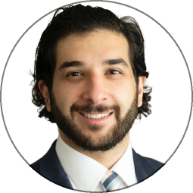
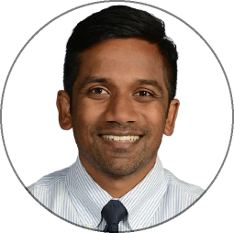
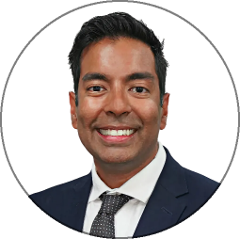
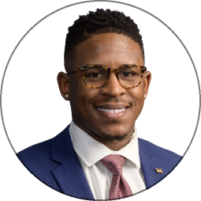

SLIDE 12: REVISED DRAFT 3/23/26
Our Team
Built by people who understand the visit
Founder - CEO
Founder
Founder
Founder
Yashar Niknafs, MD, PhD
Balaji Pandian, MD, MBA
Rana Kabeer, MD, MPH
Kristian Black, MD, MS

