Slide 1

Uncertain World
Probabilistic Decision Making: Navigating Uncertainty in the Real World
A Practical Guide for Future Innovators

Slide 2


Improved Decision Making
Life is full of decisions, big and small.
Many of these decisions involve uncertainty.
Example: Should a company invest in a new product? Will a new drug be effective? What's the best route to take given traffic?
Traditional decision-making often relies on intuition or rules of thumb, which can be suboptimal when uncertainty is high.
Probabilistic decision making provides a framework to make better, more informed choices by explicitly quantifying and managing uncertainty.

Slide 3
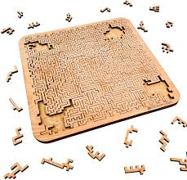
Problem Description - The Challenge of Imperfect Information
How do we make the "best" decision when we don't know exactly what will happen? How do we quantify the likelihood of different outcomes?
Ignoring uncertainty can lead to:
Suboptimal outcomes
Unexpected losses
Missed opportunities

Slide 4

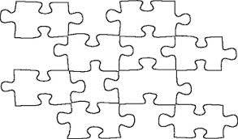
Solution

Slide 5

Solution Strategy - Steps
Probabilistic decision making offers a systematic approach to tackle uncertainty.
It involves:
Identifying variables and outcomes: What are the factors at play? What are the possible results?
Quantifying uncertainty: Assigning probabilities to different events or outcomes.
Modeling relationships: Understanding how different variables influence each other.
Evaluating choices: Comparing different decision paths based on their expected outcomes and risks.
Updating beliefs: Incorporating new information as it becomes available.

Slide 6
Examples – Service Sector
Need to automate customer services.
What do you think the steps are?
The expectation matrix of customers and companies provides you with an important orientation framework to set the right priorities for automation through Artificial Intelligence—and to keep customer expectations in mind!
Stakeholder readiness (determine through survey)
Identify Technology (pros and cons of technology)

Slide 7

Why Uncertainty ?
Customers may respond vaguely
One may carry out sentiment anlysis to evaluate product
How many of the customers are promoters etc?
Many such quiestions may need probabilistic processing …

Slide 8



Examples - AI in Media
Fill in expectation matrix
APPLICATION IN CORPORATE COMMUNICATION
WHAT TYPE OF AUTOMATION CAN BE DONE ?
Robotic Journalism

Slide 9
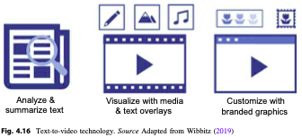
Fill in expectation matrix

Slide 10
Video Analytics
Fill in expectation matrix

Slide 11
Industrial Maintenance

Slide 12

Modelling Uncertainty
Lets design probability models
What type of data is required ?
Data can be categorized
Segregate data into categories
Calculate new data, if required (derived data)
Models can be developed
Can be used for predictions

Slide 13
Data Characterization
Priors
Likelihoods
Posteriors
Inferencing Rules

Slide 14
Data Characterization
Priors
historical ocurrence of an event
Likelihoods
which event would have led to the desired output (given that output is achieved)
Posteriors
Possible outcomes given events have occured
Inferencing Rules
Relationship between priors, likelihoods, and posteriors

Slide 15

Key Concept: Priors (Prior Probability) - Our Initial Beliefs
The prior probability of an event is our initial belief about its likelihood before considering any new evidence or information.
It's based on:
Historical data
Expert opinion
General knowledge
Even subjective assessment (though this should be minimized in objective analysis)
Example (Industry): A pharmaceutical company's prior belief about the effectiveness of a new drug based on preclinical trials.

Slide 16

Key Concept: Likelihood - How Well Evidence Supports a Hypothesis
Definition: The likelihood of a hypothesis (or a specific state of the world) given observed evidence.
For example, if we have a hypothesis H and observe evidence E, the likelihood is P(E∣H).
It tells us how probable the evidence is if our hypothesis is true. It is NOT the probability of the hypothesis being true.
Example (Industry): In medical diagnosis, the likelihood of a positive test result given a patient actually has the disease.
P(Positive Test∣Disease Present)

Slide 17
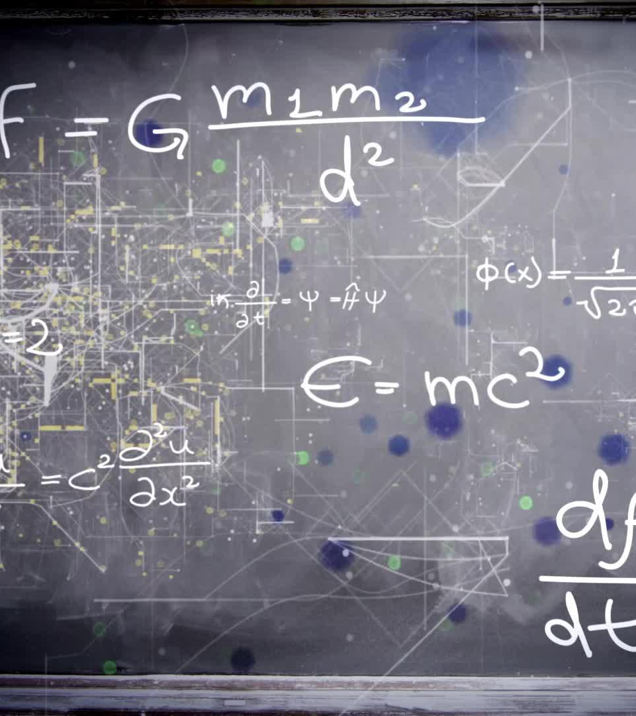
Key Concept: Conditional Probability - When Events Depend on Each Other
Definition: The probability of an event occurring given that another event has already occurred.
Denoted as P(H∣E), read as "the probability of H given E."
Formula: P(H∣E)=P(H∩E)/P(E)
Example (Industry): The probability of a loan default given a low credit score. P(Default∣Low Credit Score)

Slide 18

Key Concept: Joint Probability - When Multiple Events Occur Together
The probability of two or more events occurring simultaneously.
Denoted as P(A∩B) or P(A,B).
Formula (for independent events): P(A∩B)=P(A)∗P(B)
Formula (for dependent events): P(A∩B)=P(A∣B)∗P(B)
Example (Industry): The probability that a customer buys Product A and Product B. P(Buy A∩Buy B)

Slide 19
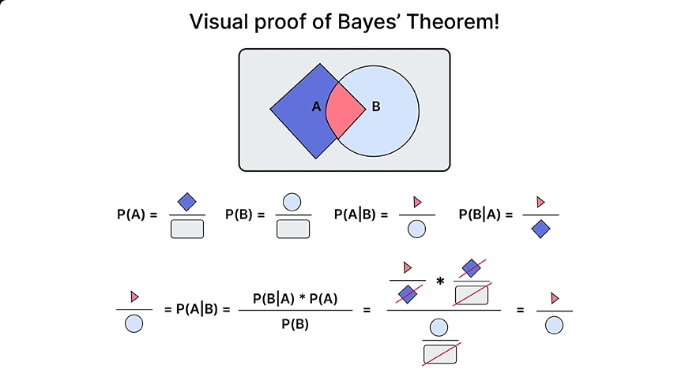
The Power of Bayes' Theorem: Updating Our Beliefs with New Evidence
Bayes' Theorem is the cornerstone of probabilistic decision making, especially in dynamic environments.
It allows us to update our prior beliefs (priors) about an event after observing new evidence.
Formula:
P(H∣E)= P(E∣H) ∗ P(H) ​ / P(E)
Where:
P(H∣E): Posterior Probability (the updated probability of our hypothesis given the evidence)
P(E∣H): Likelihood (the probability of the evidence given our hypothesis)
P(H): Prior Probability (our initial belief about the hypothesis)
P(E): Marginal Likelihood (the probability of observing the evidence, which acts as a normalizing constant)

Slide 20

Real-World Example: Medical Diagnosis - Diagnosing Disease with Data
Problem: A patient presents with symptoms. Does the patient have a rare disease?
Priors:
P(Disease):
The general prevalence of the disease in the population (e.g., 0.01% for a rare disease).
Evidence: A medical test result (Positive or Negative).
Likelihoods:
P(Positive Test∣Disease): Sensitivity of the test (e.g., 99%).
P(Negative Test∣No Disease): Specificity of the test (e.g., 95%).
Goal: Calculate P(Disease∣Positive Test) (the probability the patient actually has the disease given a positive test).
Why it's important: Prevents misdiagnosis, unnecessary treatment, and provides accurate patient information.

Slide 21

Real-World Example: Predictive Maintenance in Manufacturing
Problem: When will a machine part fail? How can we prevent unexpected downtime?
Variables:
Machine Age
Operating Hours
Vibration Readings
Temperature Readings
Maintenance History
Part Failure (Yes/No)
Probabilistic Approach:
Collect data on all these variables for many machines.
Build a model (e.g., a Bayesian Network) that learns the probabilistic relationships between these factors and part failure.
Decision: Based on current sensor readings and historical data, predict the probability of imminent failure for a specific machine. Schedule maintenance proactively.

Slide 22

Real-World Example: Financial Risk Assessment - Lending Decisions
Problem: Should a bank approve a loan application? What is the probability of default?
Variables:
Applicant's Credit Score
Income Level
Employment History
Debt-to-Income Ratio
Past Payment History
Economic Indicators (GDP growth, policy rates)
Loan Default (Yes/No)
Probabilistic Approach:
Use historical loan data to build models that predict default probability.
Bayesian Networks or other probabilistic models can be used to assess the complex interplay of these factors.
Decision: Approve or deny the loan, or adjust loan rates based on the calculated probability of default.

Slide 23

Brain Storming
Design NLP application that generate text based on simple queries ?

