Slide 1
Fraud Detection
Name
01

Slide 2
Abstract
“Money laundering is the process of taking money obtained from illegal income like drugs, crimes, terrorist activities and make money appears to be earned from legal business. For decades, governments from around the world are trying to defeat the money laundry because of its harmful effect on the economics and because it helps criminals use their dirty money. This study aims to detect the money suspicions transactions, by identifying unusual and repeated patterns
”
03

Slide 3
Dataset
To achieve the goal of this study the dataset Synthetic Financial Datasets For Fraud Detection will be used. This dataset can be found at Kaggle.
This dataset contains transactions with the following fields:
step - maps a unit of time in the real world. In this case 1 step is 1 hour of time. Total steps 744 (30 days simulation).
type - CASH-IN, CASH-OUT, DEBIT, PAYMENT and TRANSFER.
amount -amount of the transaction in local currency.
nameOrig - customer who started the transaction
oldbalanceOrg - initial balance before the transaction
newbalanceOrig - new balance after the transaction
nameDest - customer who is the recipient of the transaction
oldbalanceDest - initial balance recipient before the transaction. Note that there is not information for customers that start with M (Merchants).
newbalanceDest - new balance recipient after the transaction. Note that there is not information for customers that start with M (Merchants).
isFraud - This is the transactions made by the fraudulent agents inside the simulation. In this specific dataset the fraudulent behavior of the agents aims to ”
03

Slide 4
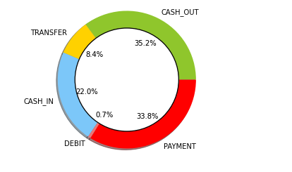
Dataset Breakdown
break down the dataset based on the transaction type
03

Slide 5
Clean dataset
Check for null values
Check for duplicates
Dataset is too large, so I took 100000 sample
Change the Payment type with numbers instead of text
Drop unneeded columns
03

Slide 6
Trained Models Accuracy
Accuracy | Algorithms
89.80% | Logistic Regression
95% | Random Forest Classifier
90% | Kneighbors Classifier
03

Slide 7
Conclusion
Check for null values
Check for duplicates
Dataset is too large, so I took 10000 sample
Change the Payment type with numbers instead of text
Drop unneeded columns
03

Slide 8
Tools & Libraries
TensorFlow
Scikit-learn
matplotlib
Pandas
Numpy
03

Slide 9
THANK
YOU!
Any Questions?
Name
35

