Slide 1

CodeSleuth
AI Security Audit & Sandboxed Test Execution Engine
Grounded AI Reviews • Semgrep Static Rules • Live Pytest Sandbox • GitHub PR Analysis
🏆 International Hackathon Submission • Presentation Deck

Slide 2
CODESLEUTH • INTERNATIONAL HACKATHON PITCH
The Problem: AI Code Reviewers Lack Verification
1. AI Hallucinations
• Standard LLMs invent non-existent security flaws.
• Generates ungrounded suggestions.
• Wastes developer time reviewing false positives.
2. Broken Unit Tests
• Generated unit tests often fail to run.
• Syntax errors & import failures.
• No execution proof provided by LLMs.
3. Unverified PRs
• PR reviews rely purely on text generation.
• No sandbox testing of diff hunks.
• Zero runtime validation of suggested fixes.

Slide 3
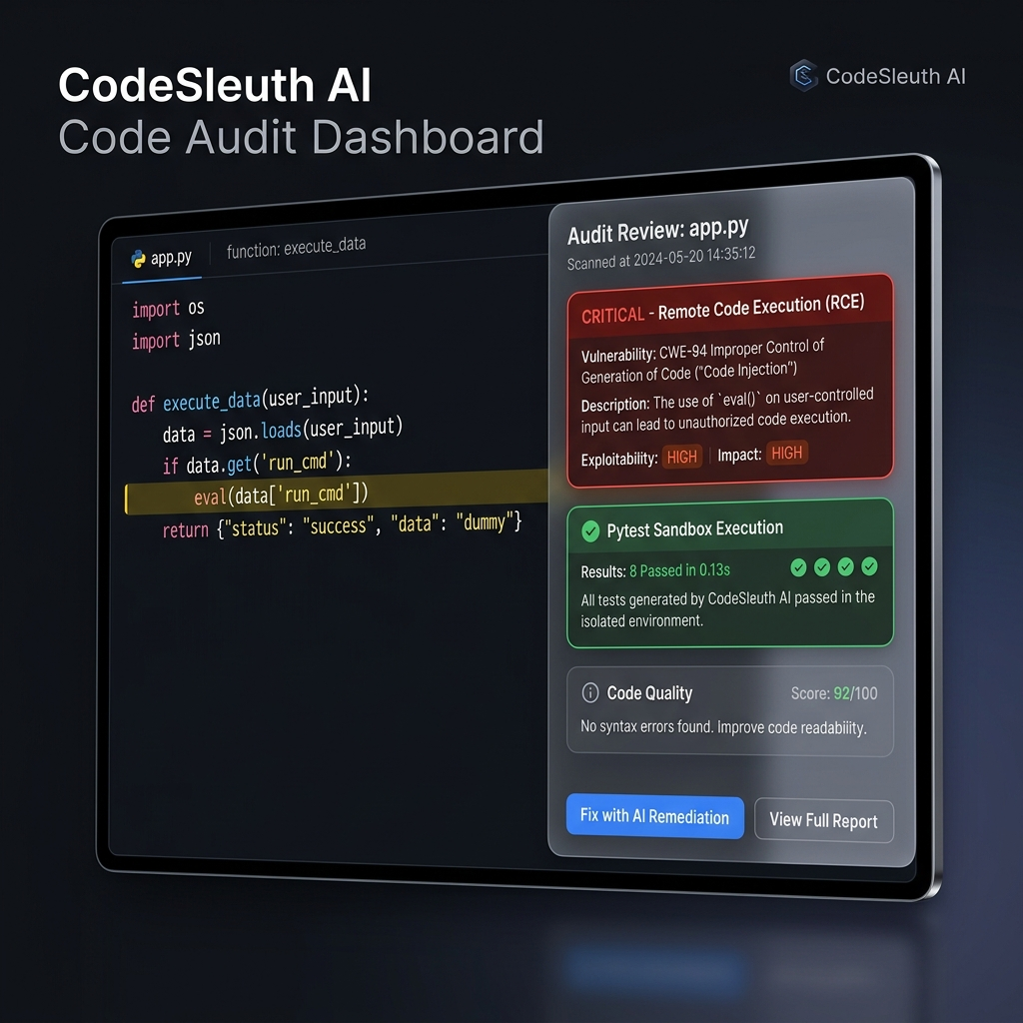
CODESLEUTH • INTERNATIONAL HACKATHON PITCH
The Solution: Grounded AI + Sandboxed Execution
Dual-Layer Intelligence
• Semgrep Static Scan: Runs p/security-audit rulesets for deterministic grounding.
• Gemini AI Inference: Explains RCE exploits & generates clean pytest code.
• Isolated Pytest Sandbox: Spawns tempdir subprocess & executes tests live.
• Empirical Output: Returns '8 passed in 0.13s' with terminal stdout logs.

Slide 4
CODESLEUTH • INTERNATIONAL HACKATHON PITCH
Why CodeSleuth Wins: Grounded vs. Unverified AI
❌ Generic AI Code Tools
• Simple prompt wrapper.
• Cannot prove generated tests pass.
• Syntax errors & broken imports.
• Fails on complex pull requests.
⚡ CodeSleuth Engine
• Dual-layer verification (Semgrep + Gemini AI).
• Executes real Pytest subprocesses in temp sandboxes.
• Empirical execution proof: '8 passed in 0.13s'.
• Hot-reloading API key management.

Slide 5
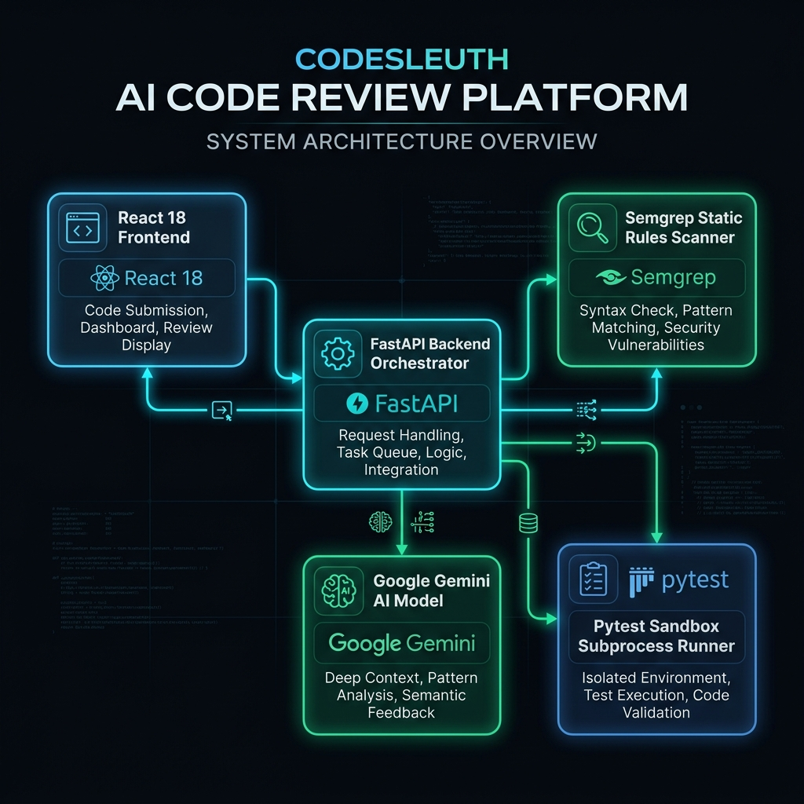
CODESLEUTH • INTERNATIONAL HACKATHON PITCH
System Architecture & Execution Pipeline
Pipeline Architecture
• React + Vite UI (Port 5173): Glassmorphism interface with status pills.
• FastAPI Backend (Port 8001): Asynchronous orchestrator with non-blocking threading.
• Semgrep Static Scanner: Eliminates hallucinations with rule-based evidence.
• Pytest Sandbox Runner: Isolated subprocess with 15s hard execution cap.

Slide 6
CODESLEUTH • INTERNATIONAL HACKATHON PITCH
Live Demo: Critical Vulnerability & Sandbox Execution
1. Vulnerable Code
• Python token validator.
• Dangerous eval(token) RCE.
• Missing zero-price check.
2. Grounded AI Audit
• Flags CRITICAL RCE flaw.
• Explains attack vector.
• Proposes json.loads() fix.
3. Sandbox Inspector
• Generates 5 pytest cases.
• Runs inside temp sandbox.
• Output: '8 passed in 0.13s'.

Slide 7
CODESLEUTH • INTERNATIONAL HACKATHON PITCH
Technical Stack & System Resilience
Technology Stack
• Frontend: React 18, Vite, Glassmorphic CSS.
• Backend: FastAPI, Uvicorn, Python 3.10+.
• AI SDK: google-genai (Gemini 3.5/3.6 Flash).
• Static Analysis: Semgrep CLI.
• Sandbox: Pytest Subprocess Runner.
Resilience Features
• Model Fallback Chain: Auto-retries gemini-3.5 ➔ gemini-3.6 ➔ gemini-latest.
• Non-Blocking Async: asyncio.to_thread keeps /health 100% active.
• Dynamic Key Reloading: Instantly picks up new API keys from .env.
• Error Matrix: Clean HTTP status codes (400, 403, 406, 413, 429).

Slide 8
CODESLEUTH • INTERNATIONAL HACKATHON PITCH
Security, Isolation & Privacy Guarantees
Tempdir Isolation
• Executes inside temporary directories.
• Automatically purged from disk after run.
• Zero persistent code storage.
Process Timeouts
• 15-second hard process cap.
• Prevents infinite loops & hang attacks.
• Resource-bounded execution.
Secrets Safety
• .env excluded from git commits.
• No PAT/OAuth tokens logged.
• Sanitized error responses.

Slide 9
CODESLEUTH • INTERNATIONAL HACKATHON PITCH
Future Roadmap: Scaling CodeSleuth
Phase 1: CI/CD Bot
• GitHub Action bot integration.
• Automated PR review comments.
• Inline test execution badges.
Phase 2: Multi-Language
• Node.js (Jest) sandbox runner.
• Go (go test) sandbox runner.
• Rust (cargo test) sandbox runner.
Phase 3: Enterprise
• Self-hosted Docker runner cluster.
• Custom internal Semgrep rules.
• SOC-2 compliant code privacy.

Slide 10
CodeSleuth — Grounded & Verified Code Intelligence
A submission-ready, fully functional prototype for international hackathons.
• Live Application: http://localhost:5173 • Backend API: http://localhost:8001 • Interactive Docs: http://localhost:8001/docs
Thank you! Open for Judges Q&A.

