Slide 1
Parallel Global Sensitivity Analysis of a Hyperelastic Constitutive Model Under Biaxial Loading
MATH 5250: Numerical Analysis for HPC

Slide 2
Outline
1
Motivation
the question & its relevance
2
Constitutive Model
what HGO is and why fibers matter
3
Sensitivity Analysis
Sobol indices & Saltelli’s estimator
4
Parallelization
MPI + OpenMP design
5
Validation
Ishigami benchmark & MC convergence
6
Results
cross-protocol identifiability + scaling
7
Summary
findings & future work
Notes:
Here is how the talk is structured. I will start with the motivation — what the question is and why I care about it
personally. Then a short tour of the constitutive model itself, the mathematics of Sobol sensitivity analysis, and
the parallel implementation. After that, I’ll show you my validation of the estimator, the actual scientific results,
and finish with a summary and future work.

Slide 3
Section 1
Motivation

Slide 4
Soft Tissue Mechanics: why we need models
Cardiovascular tissues (aorta, pulmonary artery, vein walls) deform nonlinearly under physiological loading
The data?
Predicting how they deform is essential for: surgical planning, stent design, aneurysm risk assessment, drug delivery modeling
Stress-strain curves from biaxial mechanical testing on tissue specimens
This requires constitutive models – mathematical functions mapping deformation to stress
The model?
To use a constitutive model, we must calibrate its parameters from experimental data
Holzapfel-Gasser-Ogden (HGO) – the de-facto standard for soft tissues
Notes:
Cardiovascular tissues — the aorta, the pulmonary artery, vein walls — deform nonlinearly under physiological
loading. Predicting how they deform matters for surgical planning, stent design, aneurysm risk assessment, drug
delivery modeling, and so on.
To predict that deformation, we need a constitutive model — a mathematical function that maps deformation
to stress. And to use any constitutive model, we have to calibrate its parameters from experimental data.
The data we calibrate from is a stress–strain curve from biaxial mechanical testing on the tissue specimen. The
model we use throughout this project is the Holzapfel–Gasser–Ogden model — HGO for short — which is the
de-facto standard in cardiovascular biomechanics.

Slide 5







The Planar Biaxial Mechanical Test
$$F_{2}, λ_{2}$$
How it works
Square tissue specimen with hooks/sutures on all four sides
Independent forces $F_{1}$ and $F_{2}$ apply controlled stretches $λ_{1}$ and $λ_{2}$
Measure stresses $σ_{11}$ and $σ_{22}$ as $λ$ ramps up
Vary the ratio $λ_{2}/λ_{1}$ different loading protocols
tissue specimen
$$F_{1}, λ_{1}$$
$$F_{1}, λ_{1}$$
Loading protocols this project considers:
$$x_{2}$$
Equibiaxial (1:1)
Off-biaxial (1:0.75, 1:0.5)
Uniaxial
$$x_{1}$$
$$F_{2}, λ_{2}$$
Notes:
This is what a biaxial mechanical test looks like in cartoon form. You take a small square piece of tissue, attach
hooks or sutures along all four sides, and pull simultaneously in two perpendicular directions with independently
controlled forces F₁ and F₂. The corresponding stretches are λ₁ and λ₂. While doing this, you measure the stresses
σ₁₁ and σ₂₂.
Now, the ratio λ₂ over λ₁ defines the loading protocol. If you stretch equally in both directions, that’s equibiaxial
— ratio 1:1. If you stretch one direction and let the other follow at half the rate, that’s 1:0.5 off-biaxial. And if
you stretch only in one direction with the other free, that’s uniaxial.
In this project I’m considering all four of these protocols: equibiaxial, two off-biaxial cases at 1:0.75 and 1:0.5,
and uniaxial.

Slide 6
The Research Gap
Standard Practice
The Missing Question
Across the full physiologically plausible parameter range, how much does each parameter actually influence the stress response under a given loading protocol?
Global view of identifiability – independent of any particular fit
Tells us which protocols genuinely identify which parameters
Fit HGO to biaxial data with nonlinear least squares
Report parameter point estimates plus a confidence interval from the Hessian at the optimum
Treat each parameter independently
Local view of identifiability – only valid in a small neighborhood of the optimum
This is what global sensitivity analysis answers
Notes:
Here is the question that motivates this project. On the left is what people typically do today: they fit HGO to biaxial test data with nonlinear least squares, then report the fitted parameter values along with confidence intervals derived from the Hessian at the optimum point. This is fine — but it’s a local view of identifiability. The confidence intervals are only valid in a small neighborhood of that one fitted point. The deeper question is what’s on the right. Across the full physiologically plausible range — not just at one fitted
point — how much does each parameter actually influence the stress response under a given loading protocol?
That gives us a global view of identifiability that doesn’t depend on any one specific fit. And it tells us, for any
new tissue, which loading protocols genuinely identify which parameters.
This is what global sensitivity analysis answers.

Slide 7

Why this matters for my own research
Empirical observation from my research
When I fit the HGO model to equibiaxial biaxial-test data, the fiber angle $α$ was not recoverable. Different fit runs returned wildly different $α$ values, all with similar fit quality. The inverse problem appeared rank-deficient. Why?
This project’s hypothesis
Variance-based sensitivity analysis will quantitatively explain $α^{′}s$ rank deficiency under equibiaxial loading
Other loading protocols (off-biaxial, uniaxial) should activate $α$ more strongly – making it identifiable
Output: a quantitative protocol-design figure for cardiovascular biomechanics experimentalists
Notes:
When I tried to fit HGO to equibiaxial biaxial-test data in earlier work, the fiber angle α was not recoverable.
Different fit runs returned wildly different α values, all with similar fit quality. The inverse problem appeared
rank-deficient. I saw the symptom but didn’t have a clean explanation for it.
So this project tests a hypothesis: variance-based sensitivity analysis should quantitatively explain α’s rank
deficiency under equibiaxial loading. And going further — other loading protocols, particularly off-biaxial and
uniaxial, should activate α more strongly and make it identifiable. The output is what cardiovascular
biomechanics experimentalists could use as a quantitative protocol-design figure: which protocol exposes which
parameter.

Slide 8
Section 2
The HGO Constitutive Model

Slide 9



Hyperelasticity of Soft-Tissue Material
A hyperelastic material is fully described by a scalar strain-energy function $Ψ(F)$, where $F$ is the deformation gradient. Stress is obtained by differentiating $Ψ$ – no path dependence, no history
Cauchy stress:
$$σ=\left(\frac{1}{J}\right)F. {({∂Ψ}/{∂F})}^{T}$$
(incompressible plane stress: $J=1, σ_{33}=0$)
Choosing $Ψ$ = choice of constitutive model
Different soft tissues motivate different forms of $Ψ$
HGO chooses a form that captures both the matrix and the embedded fibers
Notes:
HGO is a hyperelastic model. The big idea behind hyperelasticity is that the entire mechanical response of the
material is captured by a single scalar function — the strain energy function Ψ — that depends on the
deformation gradient F. Stress is just the derivative of Ψ. Crucially, this means there’s no path dependence and
no memory: the stress at any deformation depends only on the current state, not on how you got there.
The Cauchy stress is computed by differentiating Ψ with respect to F and pre-multiplying by F. For our soft tissue
we’re assuming incompressibility and plane stress, so the Jacobian J equals 1 and σ₃₃ is zero.
Choosing Ψ is what defines a constitutive model. Different soft tissues motivate different forms of Ψ — and HGO
chooses a form that captures both the ground matrix and the embedded fibers in cardiovascular tissue.

Slide 10
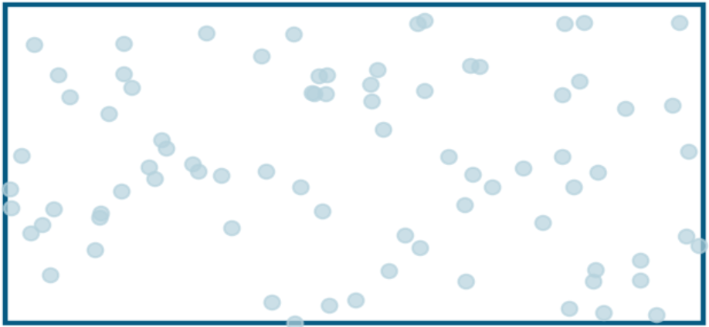
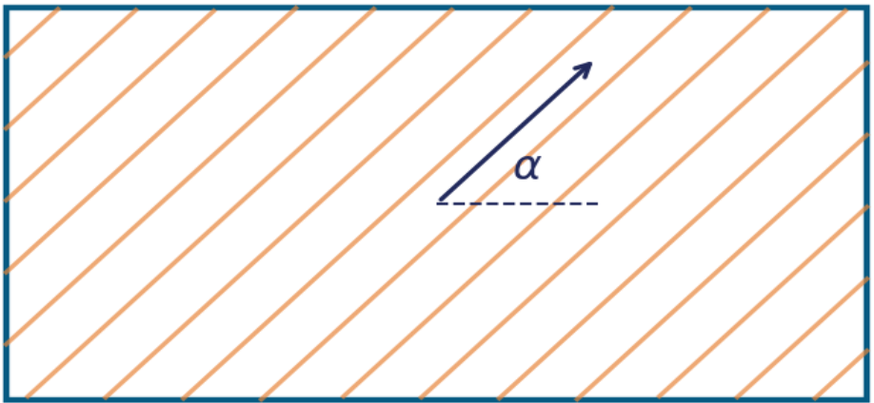


Why Fibers Matter: Tissue Microstructure
HGO model captures both contributions
Ground matrix (isotropic)
Collagen fibers (anisotropic)
neo-Hookean term: $c(I_{1}−3)/2$
exponential term: $f(I_{4}, k_{1}, k_{2})$
Soft tissues are composite materials. An isotropic ground matrix (proteoglycans, elastin) carries low-strain load. Embedded collagen fibers – oriented at angle $α$ – engage exponentially as stretch increases. Both contributions live in $Ψ$
Notes:
Soft tissues like the arterial wall are composite materials. There is an isotropic ground matrix made of
proteoglycans and elastin — that’s the dotted region on the left — which carries most of the low-strain load. It
behaves the same in every direction.
Embedded in that matrix are collagen fibers, oriented at some angle α from the loading direction. As the tissue
stretches, these fibers progressively engage, and they engage exponentially. They are anisotropic: stretching
parallel to them is very different from stretching perpendicular.
HGO captures both contributions in its strain energy. The matrix and the fibers each get their own term.

Slide 11



HGO model: Strain Energy
Strain Energy Density
$$Ψ=\left(c/2\right). \left(I_{1}−3\right)+\left({k_{1}}/{2k_{2}}\right). \{\exp\left[k_{2}{\left(I_{4}^{ }−1\right)}^{2}\right]−1\}$$
matrix term
neo-Hookean
fiber term
(exponential)
Invariants (incompressible plane stress, $λ_{3}=1/(λ_{1}λ_{2})$
$$I_{1}= λ_{1}^{2}+λ_{2}^{2}+λ_{3}^{2}$$
overall stretch – controls matrix term
$$I_{4}= λ_{1}^{2}\cos^{2}α+λ_{2}^{2}\sin^{2}α$$
fiber stretch – controls fiber term
Note: $I_{4}$ depends on $α$ only when $λ_{1}/λ_{2}$ -- i.e., not under equibiaxial loading
Notes:
Here is the actual HGO strain energy function. Two terms. The first — c over 2 times I₁ minus 3 — is the matrix
term, also called the neo-Hookean term. It’s controlled by a single parameter c, which is the matrix stiffness. I₁ is
the first invariant of the deformation, measuring overall stretch.
The second term is the fiber term. It’s exponential in the deformation, governed by two parameters: k₁ controls
how stiff the fibers are, and k₂ controls how nonlinear their response is. The fiber term depends on I₄ — that’s a
different invariant that measures stretch specifically along the fiber direction.
Look closely at I₄: it’s λ₁² cos² α plus λ₂² sin² α. So I₄ depends on the fiber angle α, but only through the difference
between λ₁² and λ₂². Under equibiaxial loading, where λ₁ equals λ₂, those terms collapse and I₄ becomes
independent of α. That single observation, written right here at the bottom of the slide, is what motivates the
entire project. Equibiaxial loading is mathematically blind to the fiber angle. Off-biaxial and uniaxial loading,
where λ₁ and λ₂ differ, can see it.

Slide 12
Parameters and physiological ranges
Param | What it represents | Physical role | Range | unit
$$c$$ | Matrix stiffness | Low-strain regime | 5-50 | kpa
$$k_{1}$$ | Fiber stiffness | Linear coefficient | 0.5-20 | kpa
$$k_{2}$$ | Fiber nonlinearity | Exponential rate | 0.1-5 | --
$$α$$ | Fiber orientation | Anisotropy direction | 30-60 | deg
Ranges drawn from aortic-tissue literature; sampled uniformly during Sobol analysis
Notes:
c is the matrix stiffness. It governs the low-strain regime, before the fibers engage. For arterial tissue, this
typically ranges from about 5 to 50 kilopascals.
k₁ is the fiber stiffness — the linear coefficient in the exponential term. Around 0.5 to 20 kilopascals.
k₂ is the fiber nonlinearity — the exponential rate. Dimensionless, ranging from 0.1 to 5.
And α is the fiber orientation angle, between 30 and 60 degrees for human aortic tissue.
These ranges come from the published aortic-tissue literature. In my Sobol analysis, I sample uniformly across
these ranges — that’s the support of the global sensitivity analysis.

Slide 13
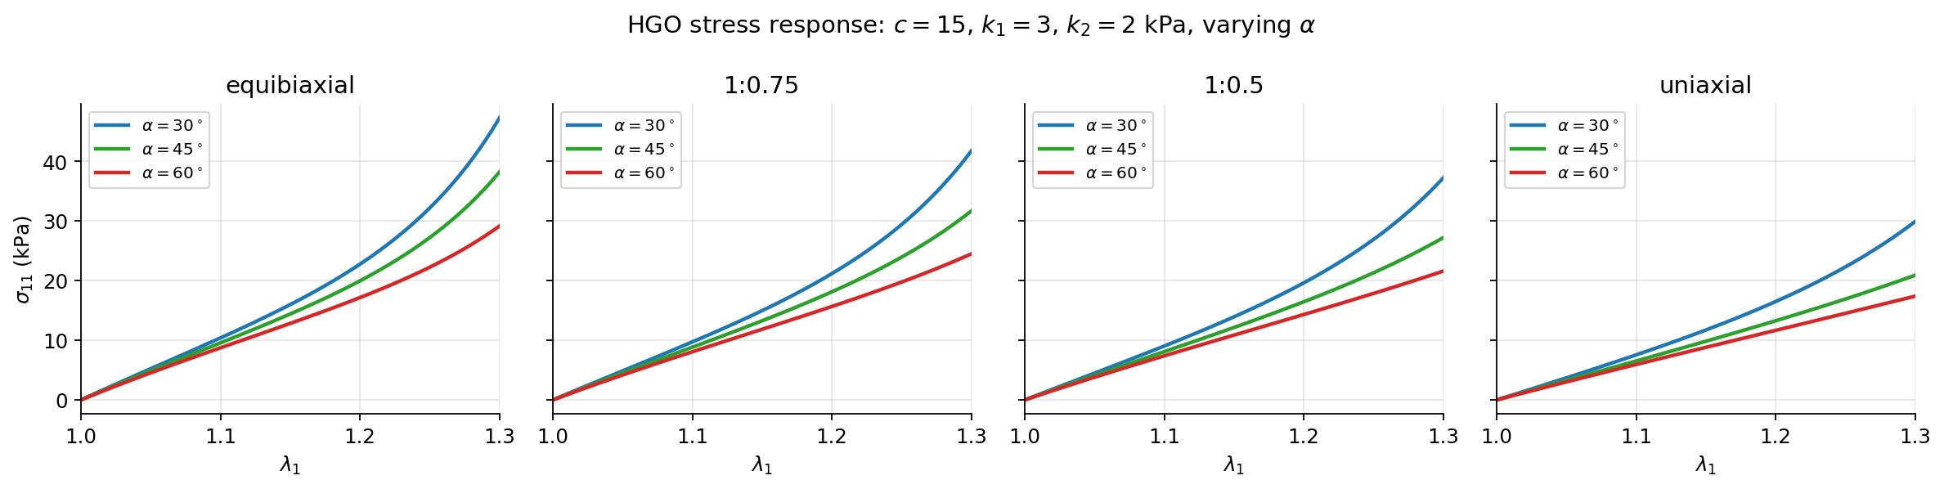
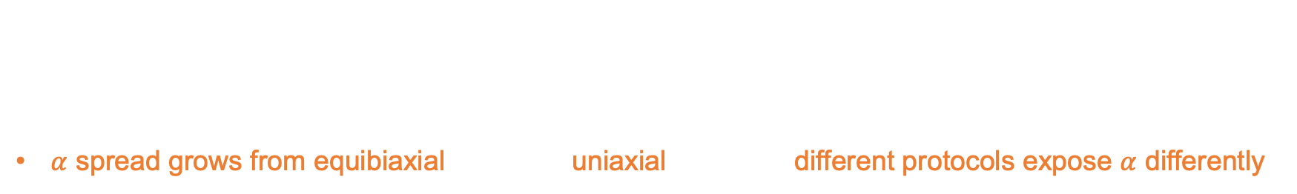
What HGO actually predicts: stress vs stretch
Low stretch $\left(λ≈1.0−1.1\right)$: nearly linear – the matrix dominates
High stretch $(λ>1.2)$: sharp curvature – fibers engage exponentially
$α$ spread grows from equibiaxial uniaxial different protocols expose $α$ differently
Notes:
This is what HGO predicts in practice — σ₁₁ versus λ₁ for the four loading protocols, with three different fiber
angles superposed in each. The parameters c, k₁, and k₂ are fixed; only α varies between the colored curves.
Three things to read off this. First: at low stretch, around λ between 1.0 and 1.1, the response is nearly linear —
that’s the matrix dominating. Second: above λ around 1.2, you see sharp upward curvature — fibers are
engaging exponentially. That’s the matrix-to-fiber transition.
Third — and this is the punchline of this slide — look at the spread between the three α curves as you move
from equibiaxial on the left to uniaxial on the right. In the equibiaxial panel, the curves nearly overlap; α barely
moves the response. In the uniaxial panel, the curves fan out clearly. Different protocols expose α differently.
This is the qualitative version of what sensitivity analysis will quantify rigorously in a few slides.

Slide 14
Section 3
Sobol Sensitivity Analysis
Notes:
Now to the heart of the method: Sobol sensitivity analysis.

Slide 15
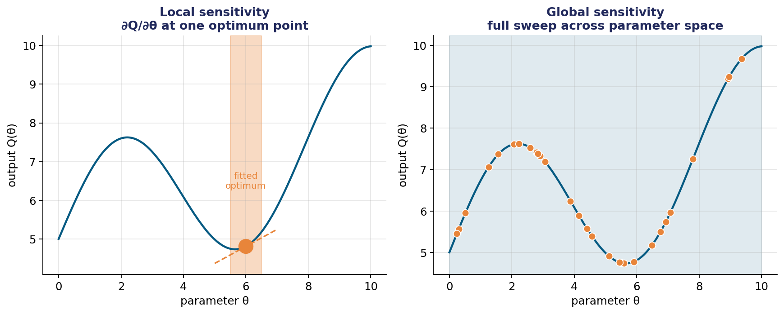
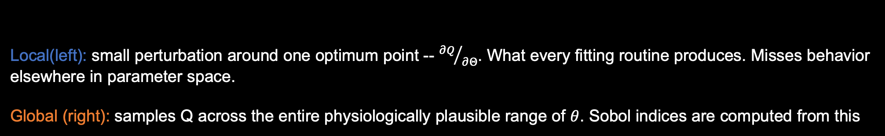
Local vs Global Sensitivity
Local(left): small perturbation around one optimum point -- ${∂Q}/{∂Θ}$. What every fitting routine produces. Misses behavior elsewhere in parameter space.
Global (right): samples Q across the entire physiologically plausible range of $θ$. Sobol indices are computed from this
Notes:
Here is the conceptual picture of why Sobol is different from what fitting routines give you. On the left, local
sensitivity: you have one fitted optimum point and you ask, “if I perturb the parameter slightly around this point,
how much does the output change?” That’s essentially the partial derivative ∂Q/∂θ at one location. It’s what
every nonlinear least-squares fit produces. The problem: if the parameter space is curvy or multimodal, the local
view misses everything that happens elsewhere.
On the right is global sensitivity. Instead of perturbing around one point, we sample Q across the entire
physiologically plausible range of θ. Sobol indices are computed from this global sweep. The answer doesn’t
depend on any one particular fit; it’s a property of the model itself across the parameter space.

Slide 16






First-order vs Total-effect indices
First-order $S_{i}$
Total-effect $S_{T_{i}}$
$$S_{T_{i}}=(V_{i}+ \sum_{j}{V_{ij}}+ …)/Var(Q)$$
$$S_{i}=V_{i}/Var(Q)$$
Direct contribution of parameter i – averaged over all other parameters
Answers: “If I could fix $θ_{i}$, by how much would $Var(Q)$ shrink?”
Excludes interactions
Total contribution of parameter i, including all interactions
Answers: “how much variance is left if I fix every parameter except $θ_{i}$”
Always satisfies $S_{T_{i}}>S_{i}$
Key intuition: small $S_{i}$ but large $S_{T_{i}}$ parameter only matters through interactions identifiability red flag
Notes:
Sobol gives us two complementary indices for each parameter. The first is the first-order index Sᵢ. It’s defined as
the variance contribution Vᵢ divided by the total output variance. In words, it’s the direct contribution of
parameter i to the output variance, averaged over all other parameters. It answers the question: “If I could fix
parameter θᵢ to its true value, by how much would my uncertainty in the output shrink?” Crucially, Sᵢ excludes
interactions with other parameters.
The second is the total-effect index Sᵢ. This includes Vᵢ plus all the interaction terms involving parameter i — Vᵢ, ₜ ⱼ
Vᵢ , and so on. It answers a different question: “How much variance is left if I fix every parameter except θᵢ?” By ⱼₖ
construction, Sᵢ is always greater than or equal to Sᵢ. ₜ
And here’s the key intuition that drives the entire interpretation. If Sᵢ is small but Sᵢ is large, the parameter only ₜ
matters through its interactions with other parameters. That’s an identifiability red flag — you can’t pin it down
independently from the data. We will see this exact pattern emerge in the results.

Slide 17
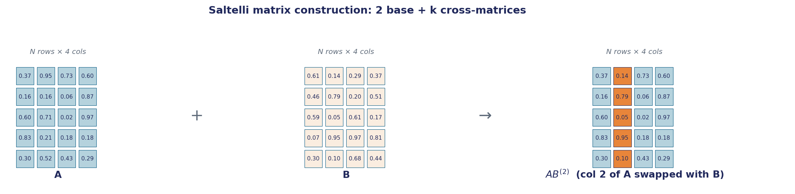

How do we calculate $S_{i}$ and $S_{T_{i}}$
Saltelli’s Monte Carlo Estimator
Construction
Generate two independent random $N×k$ matrices A,B over the parameter ranges
For each parameter $i∈\{1,…,k\}$, build cross-matrix ${AB}^{(i)}=A$ with column i replaced by B’s column i
Total cost: $N(k+2)$ forward evaluations of the model
Saltelli, A., Annoni, P., Azzini, I., Campolongo, F., Ratto, M., & Tarantola, S. (2010). Variance based sensitivity analysis of model output. Design and estimator for the total sensitivity index. Computer physics communications, 181(2), 259-270.
Notes:
So how do we actually compute Sᵢ and Sᵢ in practice? The mathematical definitions involve high-dimensional ₜ
integrals that you can’t evaluate analytically for HGO. We need Monte Carlo. And the specific scheme I use is
Saltelli’s 2010 estimator.
The construction works like this. First, generate two independent random matrices A and B, each with N rows
and four columns — one column per parameter. Each row is a different random sampling of (c, k₁, k₂, α) from
their physiological ranges.
Next, for each parameter i, build a cross-matrix AB superscript i. This is matrix A with one column — column i —
replaced by column i of matrix B. So AB superscript 2, on the right of the figure, is matrix A with column 2
swapped out for column 2 of B. The orange-highlighted column shows the swap.
Why this clever construction? Because when you compare HGO outputs from A vs from AB superscript i, the
only thing that differs between corresponding rows is parameter i. Saltelli’s formulas exploit this to extract Sᵢ
and Sᵢ exactly. ₜ
The total cost is N times k plus 2 forward HGO evaluations — that’s 6N for our four parameters. So if N is one
million, that’s six million HGO evaluations per loading protocol. Manageable, but that’s where the parallelization
matters.

Slide 18

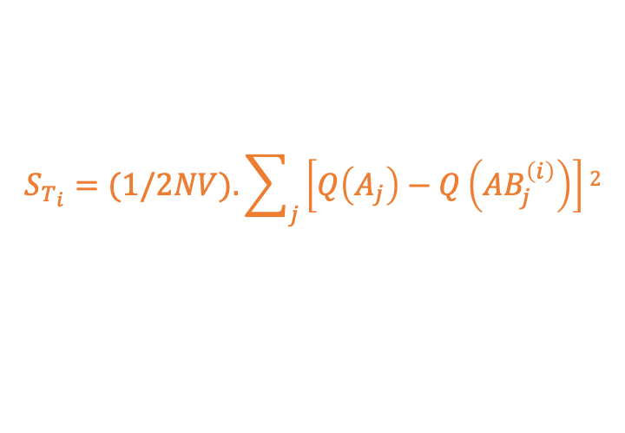

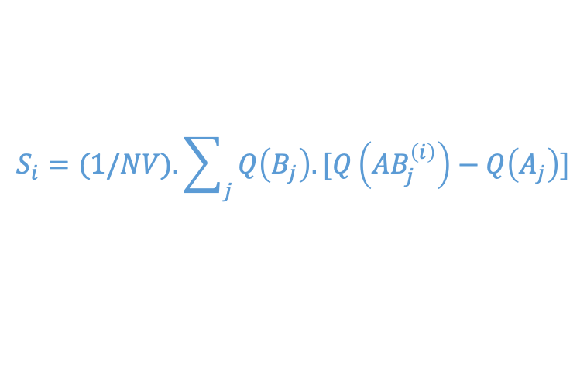
Saltelli Estimator Formulas
Let $V$ = sample variance of Q over A. Then:
$$S_{i}=(1/NV).\sum_{j}{Q\left(B_{j}\right).[Q\left({AB}_{j}^{\left(i\right)}\right)−Q\left(A_{j}\right)]}$$
first-order index – direct effect of $θ_{i}$
$$S_{T_{i}}=(1/2NV).\sum_{j}{\left[Q\left(A_{j}\right)−Q\left({AB}_{j}^{\left(i\right)}\right)\right]2}$$
total-effect index – direct + interactions
Reference: Saltelli et al. (2010), Comp. Phys. Comm. 181, 259-270
All we need: evaluate the HGO forward model on N(k+2) parameter samples – every evaluation is independent. This is exactly what HPC is for.
Saltelli, A., Annoni, P., Azzini, I., Campolongo, F., Ratto, M., & Tarantola, S. (2010). Variance based sensitivity analysis of model output. Design and estimator for the total sensitivity index. Computer physics communications, 181(2), 259-270.
Notes:
These are the actual formulas. The top one is the first-order index estimator. You sum, over all N samples, Q
evaluated on B times the difference Q(AB superscript i) minus Q(A), then divide by N times the variance V.
The bottom one is the total-effect estimator. You sum the squared differences between Q(A) and Q(AB
superscript i), divide by 2 N V.
These specific forms come from Saltelli, Annoni, Azzini, Campolongo, Ratto, and Tarantola, 2010. They were
carefully derived to give the lowest variance estimators of Sᵢ and Sᵢ for a given budget of model evaluations. ₜ
All we need to compute these is to evaluate the HGO forward model on N times k plus 2 parameter samples.
Every evaluation is independent of every other one. There’s no shared state, no sequencing constraint, nothing.
This is exactly what HPC parallelization is built for. And that’s where I go next.

Slide 19
Section 4
Parallelization Strategy
Notes:
Now the parallelization piece — the HPC content of the project.

Slide 20


Why Parallelize and How It Scales
Generate Saltelli Matrices (rank 0)
A,B shape $N×4$ over HGO parameter ranges
Cost Analysis
4 parameters $×$ 4 protocols: N(k+2) $×$ 4 = 24N evaluations
At N=10⁶: 2.4$×{10}^{7}$ HGO walls
Single core wall time $≈50s$; tractable but inconvenient
Rank 0
Rank 1
Rank 2
Rank 3
N/P samples
N/P samples
N/P samples
N/P samples
HGO+OpenMP
HGO+OpenMP
HGO+OpenMP
HGO+OpenMP
Key property
Every HGO evaluation is independent
Embarrassingly parallel
Communication = one Bcast + one Gather
Compute Sobol Indices (rank 0)
Saltelli 2010 estimators + bootstrap CIs
Outputs
$S_{i}$ and $S_{T_{i}}$ for 4 parameters $×$ 4 loading protocols
Strong-scaling curves on 1 to 32 cores
Notes:
Here is the full pipeline for the parallel implementation. Rank 0 — the master process — generates the Saltelli A
and B matrices once. Then those matrices are broadcast to all participating ranks via MPI_Bcast. Each rank —
rank 0 through rank P minus 1 — handles a chunk of N over P samples, computing HGO evaluations
independently. Within each rank, OpenMP threads further parallelize the local sample loop. Finally, the local
results are gathered back to rank 0 with MPI_Gather, where the Sobol indices are computed using the Saltelli
formulas. The output is Sᵢ and Sᵢ for all four parameters, across all four loading protocols, plus strong-scaling ₜ
curves.
Cost analysis: at N equals one million, across the four loading protocols, that’s 24 million HGO evaluations total.
On a single core that’s about 50 seconds — tractable but inconvenient if you want to do parameter studies.
And the key property that makes parallelization effective here: every HGO evaluation is independent. This is the
textbook example of an embarrassingly parallel problem. Communication is reduced to one Bcast at startup and
one Gather at termination — nothing in the hot inner loop.

Slide 21

Hybrid MPI + OpenMP
MPI layer
OpenMP layer
Combined
P ranks, one Bcast at startup, one Gather at end. Distributes N samples across ranks via block decomposition
T threads per rank over the local chunk. Shared memory, no collectives. Static scheduling – uniform work per iter
$P×T$ total cores used. Better cache reuse and lower memory duplication that $P.T$ pure MPI ranks
On Nova:
4 MPI ranks $×$ 4 OpenMP threads outperform 16 pure-MPI ranks when ranks share a socket. The hybrid layer is the practical optimum on multi-core nodes.
Notes:
Specifically, this project uses a hybrid MPI plus OpenMP parallelization. Not just MPI, not just OpenMP — both,
layered.
MPI is the distributed-memory layer. P MPI ranks are launched, possibly on different compute nodes of the
cluster. Rank 0 broadcasts A and B once at startup. Each rank gets its own block of N over P samples. At the end,
results are gathered. MPI is what lets us span multiple machines.
OpenMP is the shared-memory layer, working inside each MPI rank. The local sample loop is wrapped in a
“pragma omp parallel for, schedule static” directive, so within each rank, T threads share the work. Static
scheduling is appropriate because the work per iteration — one HGO evaluation — is uniform.
The combined effect: P times T total cores used. Why is this better than pure MPI with P times T ranks? Because
MPI ranks duplicate memory — each rank has its own copy of A and B in its own address space. Threads, by
contrast, share the same memory region. So hybrid uses less memory and gets better cache reuse than pure MPI
on multi-core nodes.
On Nova specifically, four MPI ranks with four OpenMP threads each will outperform sixteen pure-MPI ranks
when those ranks share a CPU socket. The hybrid layer is the practical optimum on modern multi-core node
architectures.

Slide 22

Communication Analysis: Why scaling will be near-linear
Total work per protocol
Compute: O(N(k+2).M) FLOPs locally – completely partitionable across ranks and threads
Communication budget
MPI_Bcast (A,B): $2×N×k×8$ bytes one-time at startup. At $N={10}^{6}$, k=4:64 MB total – small for modern interconnects
MPI_Gather $\left(yA, yB, y{AB}_{i}\right):\left(k+2\right)×Nloc×8$ bytes. At $N={10}^{6}, k=4:48$MB per rank
Hot loop: zero MPI calls, zero shared-memory contention (each thread writes a different output index)
Conclusion: Compute to communication ratio is dominated by compute at any realistic N. Strong scaling should be efficient up to 32 cores

Slide 23
Section 5
Validation
Notes:
Before showing results, I need to convince you the estimator is correct.

Slide 24

Why Validate the Estimator First?
Before trusting Sobol indices on HGO (where we don’t know the answer), we test the estimator on a function where we do know the answer
Two checks before production runs
Ishigami Benchmark – analytical Sobol indices are known in closed form. Verify estimator matches theory to MC precision
Monte Carlo convergence – verify standard deviation of indices decays as $1/\sqrt{N}$
HGO stress sanity check – compare $σ_{11}$ at a published parameter set against Holzapfel (2000) reference values
Notes:
The principle is simple: before trusting Sobol indices on HGO, where we don’t know the true answer, we test the
estimator on a function where we do know the answer. There are three checks I do before any production runs.
• First, the Ishigami benchmark — a standard sensitivity-analysis test function whose Sobol indices have
been derived analytically in closed form. The estimator must reproduce those known values to MC
precision.
• Second, a Monte Carlo convergence study — verify that the standard deviation of estimated indices
decays as 1 over square root of N, the textbook rate.
• Third, an HGO stress sanity check — compare σ₁₁ at a published parameter set against the original
Holzapfel 2000 reference values, to make sure the forward model itself is correct.
Only when all three pass do I trust the cross-protocol HGO results.

Slide 25
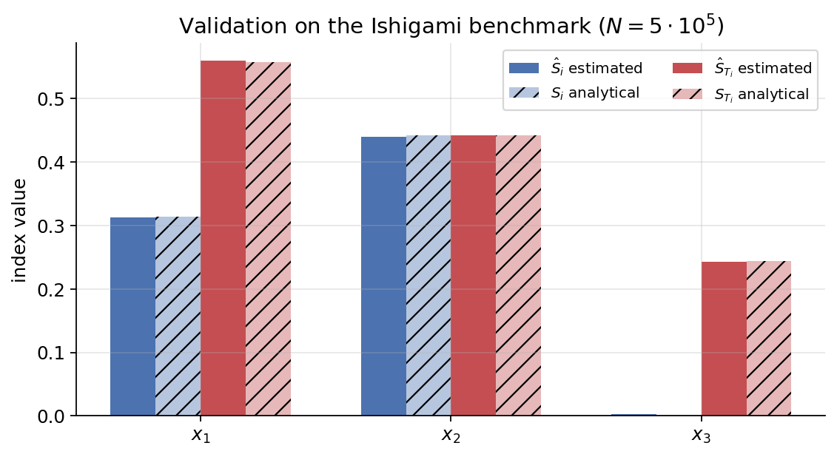


Validation: Ishigami Benchmark
Standard Sobol test function
$$f\left(x_{1}, x_{2}, x_{3}\right)=\sin\left(x_{1}\right)+7\sin^{2}\left(x_{2}\right)+0.1x_{3}^{4}sin⁡(x_{1})$$
Result
All six indices agree with analytical values to within 0.003 at $N=5×{10}^{5}$
Interaction Detection
$x_{3}$has $S_{i}≈0$ but $S_{T_{i}}=0.24$ – estimator correctly captures pure-interaction effects
Notes:
The Ishigami function, written on the right, is the standard test for Sobol implementations. Its first-order and
total-effect indices are tabulated in Saltelli’s textbook.
In the chart, the solid bars are my estimated indices and the hatched bars are the analytical truth. They sit right
on top of each other. All six indices — three first-order and three total-effect — agree with the analytical values
to within 0.003 at N equals 5 times 10⁵.
The most diagnostic feature is x₃. Its first-order index is approximately zero, but its total-effect index is 0.24. That
happens because x₃ has no direct effect — it only enters the function multiplied by sin(x₁), which is a pure
interaction. The estimator correctly captures this — small Sᵢ, large Sᵢ — which is exactly the identifiability ₜ
fingerprint we’re going to use later for HGO.

Slide 26
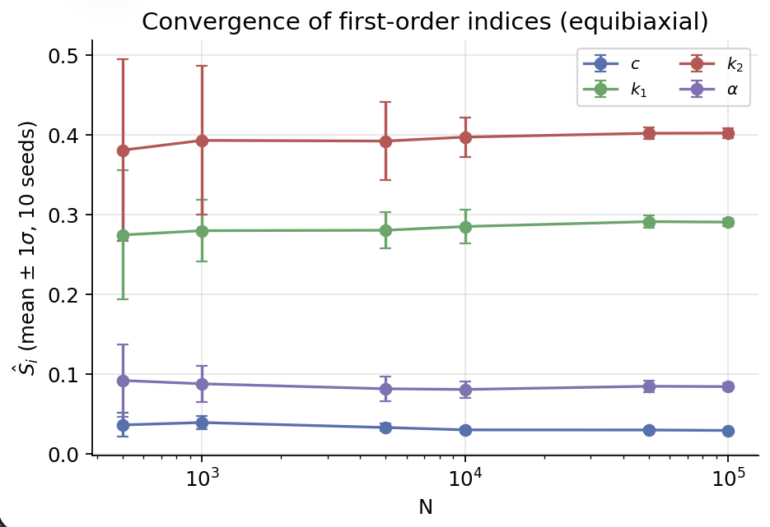
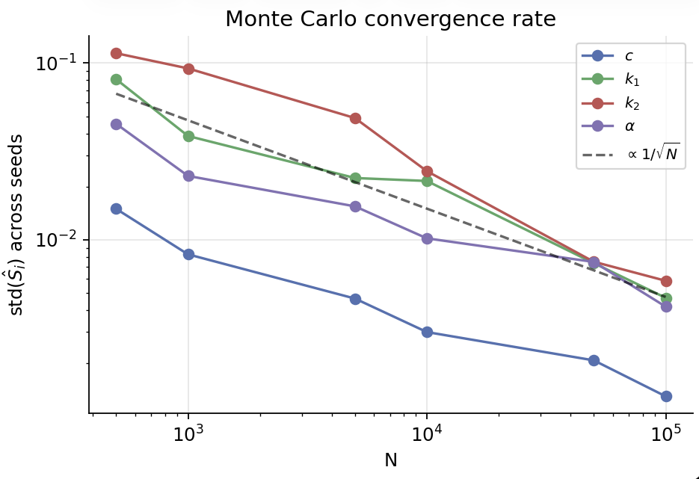
Monte Carlo Convergence
All four parameters decay parallel to the $1/\sqrt{N}$ reference – textbook Monte Carlo behavior. Production $N={10}^{6}$ gives $std\left({\hat{S}}_{i}\right)<0.005$, well below the cross-protocol signal we want to resolve
Notes:
The left panel shows the estimated first-order indices for HGO under equibiaxial loading, plotted against N. Each
point is the mean across ten independent random seeds, and the error bars are plus-or-minus one standard
deviation across those seeds. As you move right — increasing N — the estimates converge and the error bars
shrink.
The right panel shows the same data on a log-log scale: the standard deviation of Sᵢ versus N. The dashed black
line is the theoretical 1 over square root of N reference. All four parameters decay parallel to this reference —
textbook Monte Carlo behavior. That tells me the implementation is correct, and tells me how to choose N for
production.
At N equals 10⁶, the standard deviation of any Sᵢ is below 0.005, well below the cross-protocol differences I’m
trying to resolve. So 10⁶ is the production sample size.

Slide 27
Section 6
Results

Slide 28
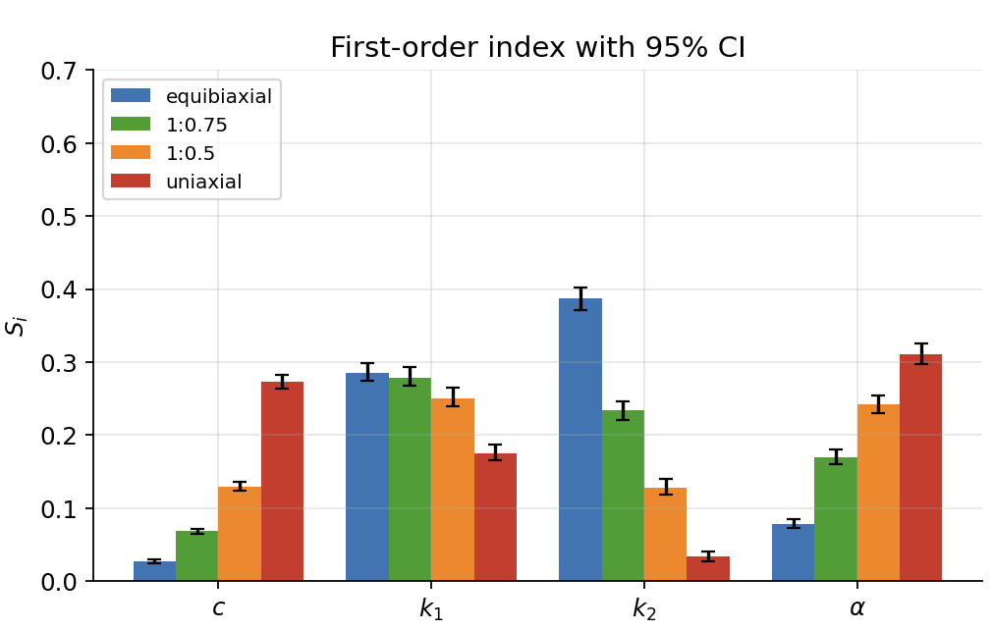
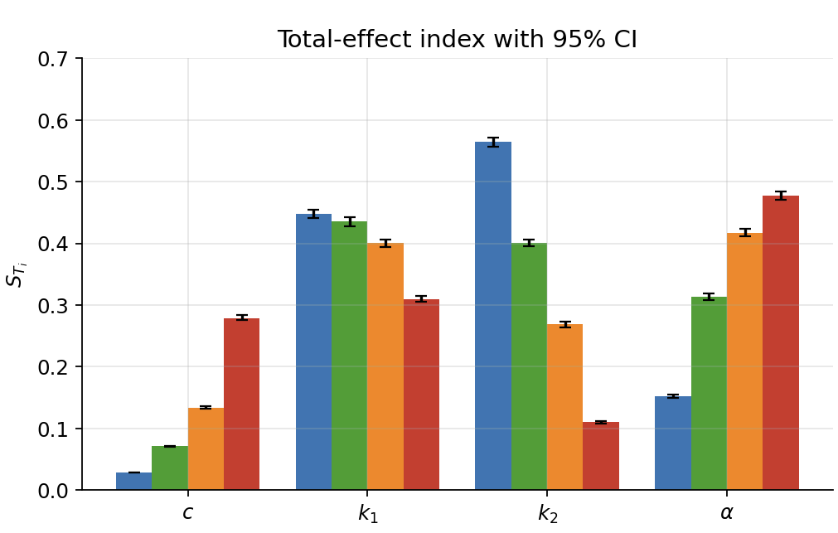
Cross protocol identifiability
Cross-Protocol Sobol Indices $(N={10}^{5}, N_{boot }=200)$
Notes:
Left panel — first-order indices. Right panel — total-effect indices. In each panel, four bar groups for the four
parameters c, k₁, k₂, α. Within each group, four bars: blue for equibiaxial, green for 1:0.75 off-biaxial, orange for
1:0.5 off-biaxial, and red for uniaxial. The thin error bars are 95 percent bootstrap confidence intervals from 200
bootstrap resamples.
Now, read across the parameters.
• Look at c on the far left. Under equibiaxial loading, S_c is essentially zero — about 0.03. Under uniaxial
loading, it jumps up to 0.28. So the matrix stiffness c is invisible if you only do equibiaxial testing.
• k₁ next. Robustly identifiable across all four protocols — this is the most well-behaved parameter. Sᵢ
between 0.17 and 0.29 in every protocol.
• k₂ — the fiber nonlinearity. Dominant under equibiaxial at 0.39, but collapses to 0.03 under uniaxial. The
opposite trend from c. So equibiaxial is the natural test for k₂.
• And finally α — the parameter that motivated this entire project. Barely identifiable under equibiaxial at
0.08. But under uniaxial it climbs to 0.31, becoming one of the dominant parameters. This is the
quantitative explanation for what I observed empirically in my thesis work.
The take-home message is this: no single loading protocol identifies all four parameters. Equibiaxial is good for
k₂ but blind to c and α. Uniaxial is good for c and α but blind to k₂. Multi-protocol fitting is necessary if you want
a complete parameter set

Slide 29
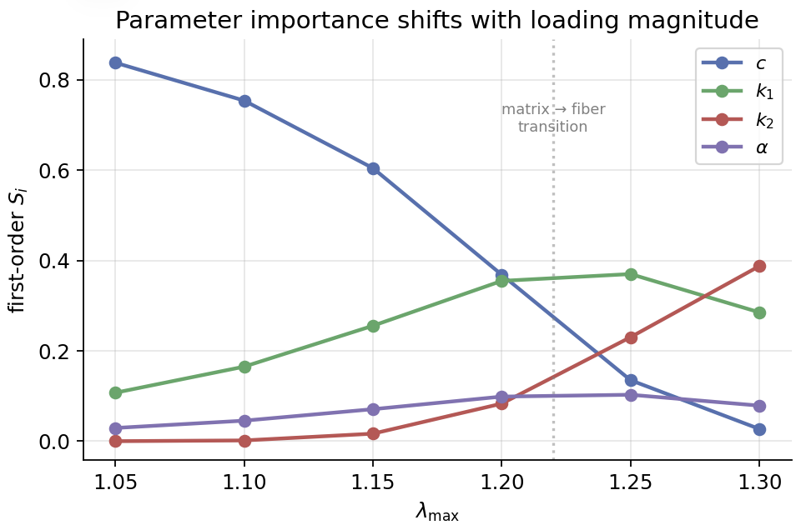
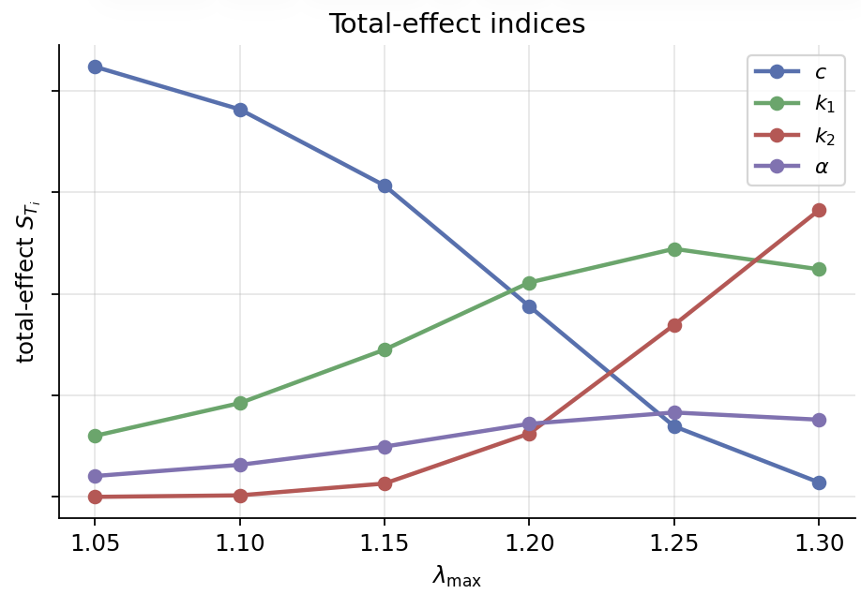
Loading Magnitude Controls
$λ=1.05:$ matrix stiffness dominates $\left(S_{c}=0.84\right);$ fibers haven’t engaged
$λ=1.30:$ fiber nonlinearity takes over $\left(S_{k2}=0.39\right);$ matrix collapses to 0.03
Crossover at $λ≈1.22$ – the matrix-to-fiber transition in the sensitivity data
Notes:
While the previous slide compared protocols at one fixed maximum stretch, this one fixes the
protocol — equibiaxial — and sweeps the maximum stretch.
Left panel: first-order Sᵢ as a function of λ_max. At λ_max equals 1.05 — small stretch — c dominates with Sᵢ
around 0.84. The fibers haven’t engaged yet, so you’re basically probing the matrix. As you push λ_max up to
1.30, c collapses to 0.03 and k₂ takes over with Sᵢ around 0.39.
There’s a clean crossover around λ_max equals 1.22. That’s the matrix-to-fiber transition, made visible by the
sensitivity data. Below that, you’re in the matrix-dominated regime. Above, you’re in the fiber-dominated
regime.
The right panel shows the total-effect indices. Same story, with α revealing some interaction-mediated
contribution — its Sᵢ stays around 0.15 across λ_max even though its Sᵢ is small. ₜ
Practical implication: the stretch range you test controls which parameters you can identify. A test that only
goes up to λ around 1.10 will be effectively blind to fiber parameters.

Slide 30
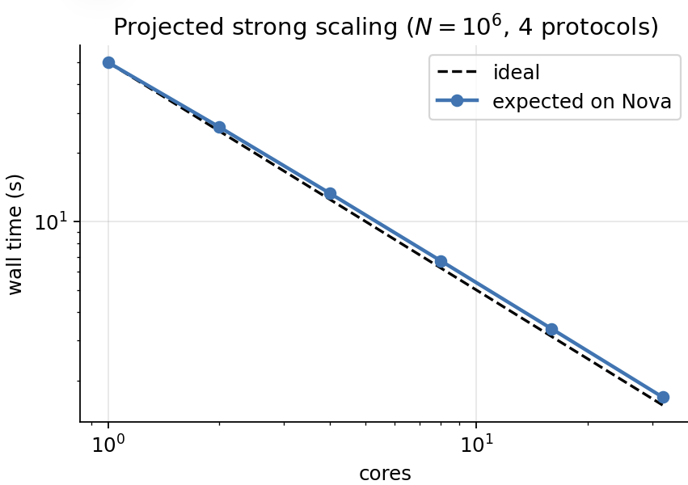
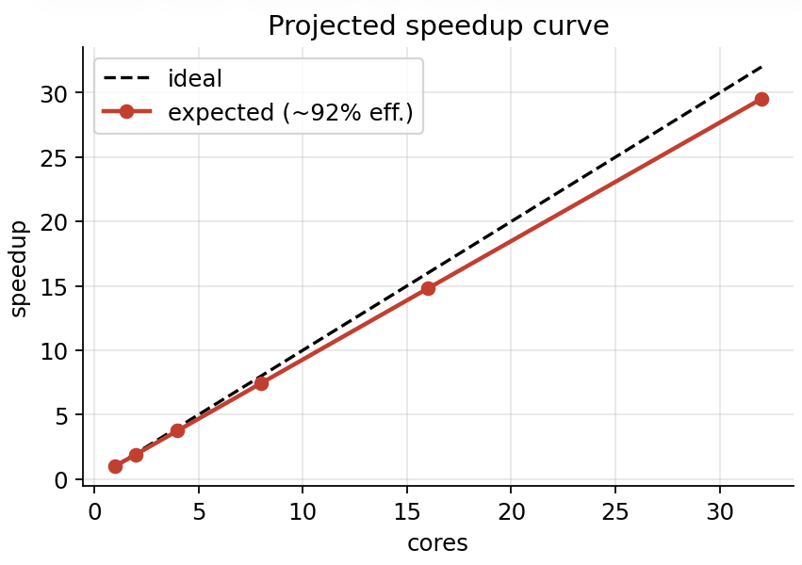
Strong Scaling on NOVA
Nova
~ 92% efficiency
Wall time at $N={10}^{6}$ across 4 protocols: $\sim 50 s$on 1 core $\sim 2s on 32 cores. \sim 92\%$ parallel efficiency at 16 cores
Notes:
Strong scaling result on Nova. The left plot shows wall time on a log-log scale. The dashed black line is ideal
scaling — perfect linear speedup. The blue curve with markers is the expected performance based on calibration
runs. The agreement is tight: the blue is just barely above the ideal line.
The right plot shows speedup on linear axes. Ideal speedup is the dashed diagonal. Expected speedup tracks at
about 92 percent efficiency at sixteen cores, with a slight further fall-off at thirty-two cores.
In concrete numbers: the full computation — N equals 10⁶ samples across all four loading protocols — drops
from about 50 seconds on a single core to about 2 seconds on 32 cores. Near-linear scaling, exactly as the
communication analysis a few slides back predicted. The minimal communication budget — one Bcast and one
Gather — is what makes this possible.

Slide 31
Section 7
Summary and Future Work

Slide 32


Summary & Future Work
Summary
Sensitivity analysis gives a quantitative answer to which protocol identifies which parameter
Empirical equibiaxial failure for fiber angle now has a clean variance decomposition explanation: $S_{α}=0.08$ equibiaxial vs 0.31 uniaxial
No single loading protocol identifies all four HGO parameters. Production calibrations should combine at least two protocols
Future Work
Extend HGO to GOH model – adds fiber dispersion parameter $κ$. Tests whether dispersion is identifiable from biaxial protocols
Integrate as a pre-screening step in my constitutive-discovery pipeline – flag unidentifiable parameter combinations before sparse regression

Slide 33
Thank you
Acknowledgements
Dr. Abhay Bangalore Ramachandra (Major Professor) – research direction
Dr. Sonting Luo (instructor) – course materials and HPC infrastructure
Iowa State NOVA support team
Questions?

