Slide 2
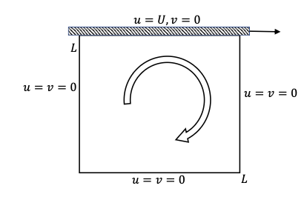
Overview of the problem
A classical benchmark problem in CFD, involving incompressible Navier-Stokes equations in a square domain with a moving top lid
Develop a robust numerical solver using the SIMPLE algorithm
Visualize the flow patterns through pressure contours, velocity vectors, and streamlines
Document challenges and solutions encountered during implementation

Slide 3
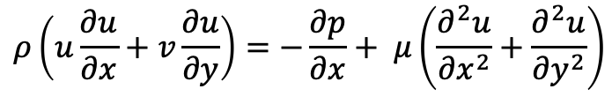
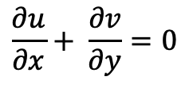
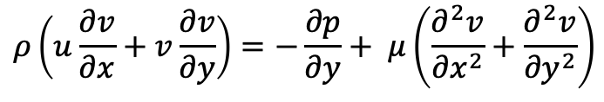
Numerical Methods
Governing Equations
Incompressible Navier-Stokes equations for 2D steady flow are:
$$\frac{∂u}{∂x}+ \frac{∂v}{∂y}=0$$
$$ρ\left(u\frac{∂u}{∂x}+v\frac{∂u}{∂y}\right)=−\frac{∂p}{∂x}+ μ\left(\frac{∂^{2}u}{{∂x}^{2}}+\frac{∂^{2}u}{{∂y}^{2}}\right)$$
$$ρ\left(u\frac{∂v}{∂x}+v\frac{∂v}{∂y}\right)=−\frac{∂p}{∂y}+ μ\left(\frac{∂^{2}v}{{∂x}^{2}}+\frac{∂^{2}v}{{∂y}^{2}}\right)$$
Where ‘u’ and ‘v’ are the velocity components, ‘p’ is pressure, $ρ=1.0 kg/m3$ is density, and $μ$ is dynamic viscosity, determined by Re = $ρ$U_{lid}L/ $μ$, with U_{lid}=1.0m/s and L = 1.0 m

Slide 4
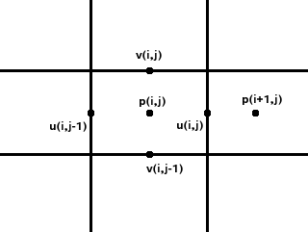
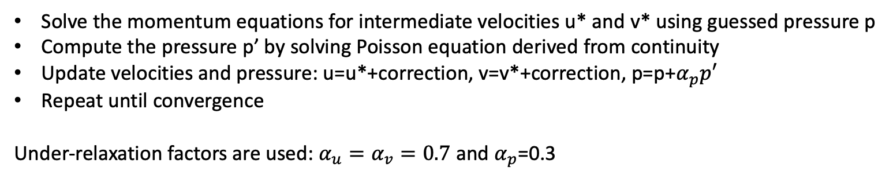
Numerical Methods
Discretization
The domain is discretized on a staggered grid with 100x100 cells.
Pressure(p) at the cell centers
U-velocity at vertical cell faces (NX+1, NY)
V-velocity at horizontal cell faces (NX, NY+1)
SIMPLE Algorithm
Solve the momentum equations for intermediate velocities u* and v* using guessed pressure p
Compute the pressure p’ by solving Poisson equation derived from continuity
Update velocities and pressure: u=u*+correction, v=v*+correction, p=p+$α_{p}p′$
Repeat until convergence
Under-relaxation factors are used: $α_{u}=α_{v}=0.7$ and $α_{p}$=0.3

Slide 5
Numerical Methods
Power-Law Scheme
Convective terms are discretized using the power-law scheme, which blends upwind and central differencing based on the Peclet Number (Pe = F/D, where F is convective flux and D is diffusive flux). The co-efficient is:
$$a=D\max\left(\left(1−0.1\left|Pe\right|\right)5, 0\right)+max⁡(−F, 0)$$
Where a is the neighbor coefficient. This scheme enhances stability for high Pe.
Boundary conditions
Top wall (y=1): u = U_{lid} = 1.0, v=0
Other walls (x=0, 1; y=0): u=v=0

Slide 6
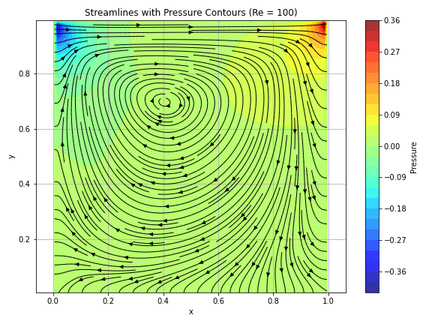
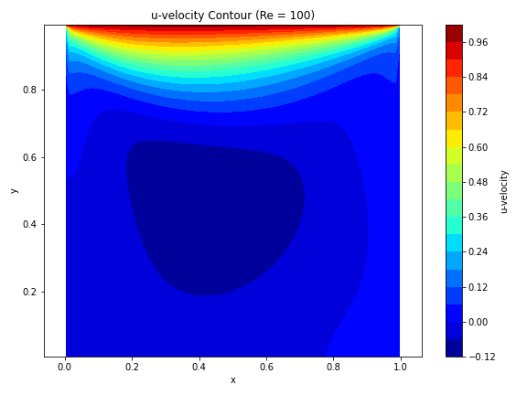
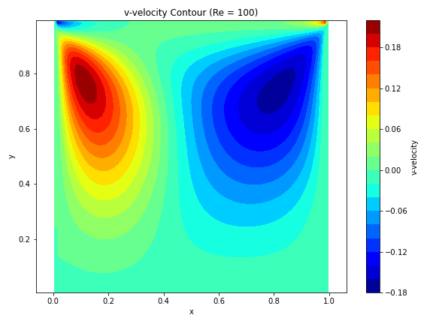
Results
Re = 100.0

Slide 7
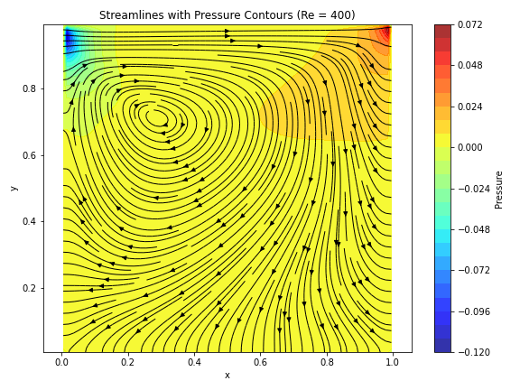
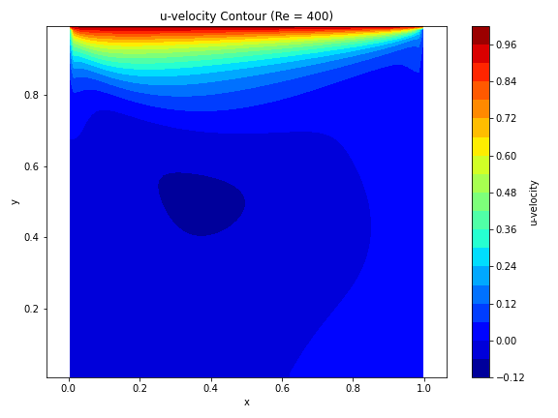
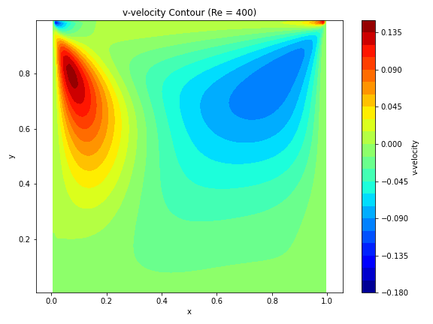
Results
Re = 400.0

Slide 8
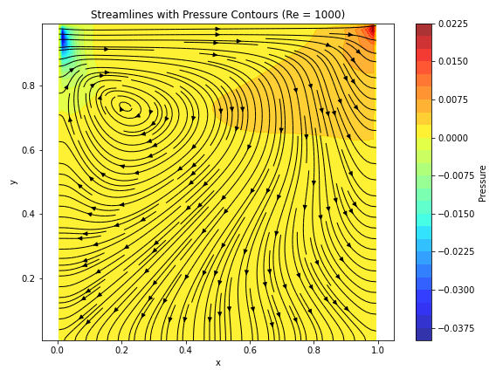
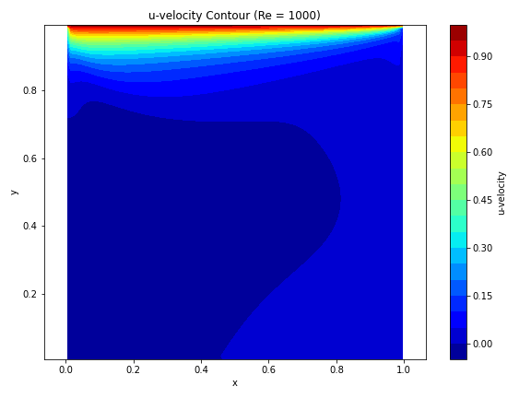
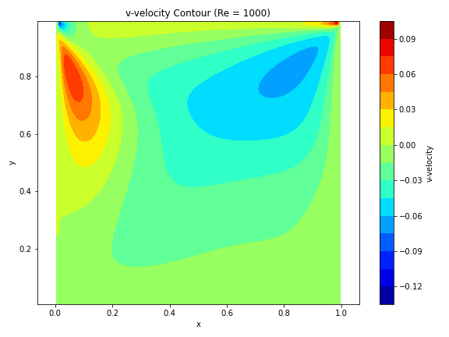
Results
Re = 1000.0

Slide 9
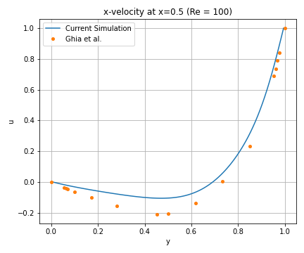
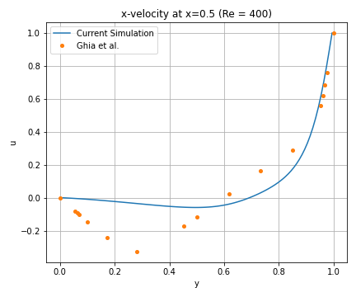
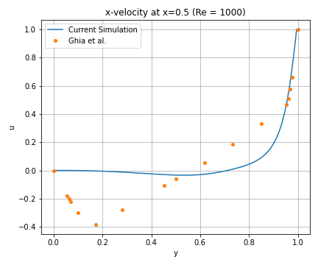
Centerline U-velocity Comparison with Ghia et, al.
Re = 100.0
Re = 400.0
Re = 1000.0
Ghia, U., Ghia, K. N., & Shin, C. T. (1982). High-Re solutions for incompressible flow using the Navier-Stokes equations and a multigrid method. Journal of Computational Physics, 48(3), 387–411.

Slide 10
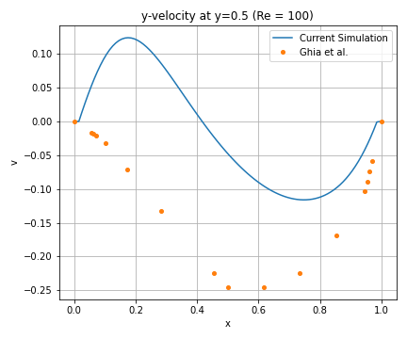
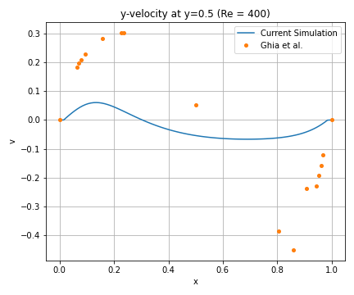
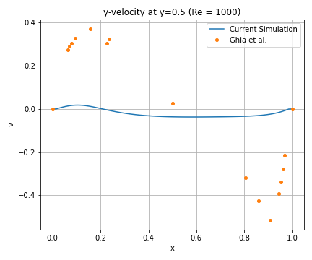
Centerline V-velocity Comparison with Ghia et, al.
Re = 100.0
Re = 400.0
Re = 1000.0
Ghia, U., Ghia, K. N., & Shin, C. T. (1982). High-Re solutions for incompressible flow using the Navier-Stokes equations and a multigrid method. Journal of Computational Physics, 48(3), 387–411.

