Slide 1
TECHNOLOGY OF ELASTOMERS Module I Compounding Ingredients
Course Outcome :
To Comprehend the preparation , properties and applications of compounding ingredients.

Slide 2
To Comprehend the preparation , properties and applications of compounding ingredients
1.1.1 Classify the compounding ingredients.
1.1.2 State the functions and characteristics of compounding ingredients with examples.
1.1.3 Explain different vulcanising agents and their roles in a recipe.
1.1.4 Describe the functions of activators and retarders.
1.1.5 State the function of accelerators and their classifications.
1.1.6 Explain the classification and role of antidegradents, processing aid, (plasticiser, softener, and extender).
1.1.7 Classify fillers with respect to colour, reinforcement, origin
1.1.8 Describe the preparation, characteristics and application of nonblack fillers like inorganic, fibrous, organic. resinous fillers.
1.1.9 Explain the classification and method of manufacturing carbon blacks.
1.1.10 State the properties of carbon black, and classification according to ASTM D 1765.
1.1.11 Describe the procedure for the determination of particle size and structure.
1.1.12 List the special purpose additives and their functions.

Slide 3
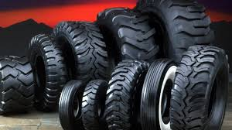
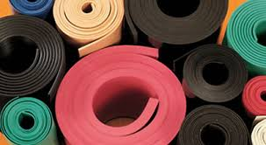
Rubber products are divided into
Tyres
Industrial goods (motor vehicle, rail road transportation, construction etc.)
Consumer goods ( footwear, mats, inner tubes, O –rings etc.)

Slide 4
Rubber Compounding
Compound – refers to a specific blend of ingredients used in the manufacturing of products in order to achieve a definite set of mechanical properties.
Rubber Compounding – science of selecting and combining elastomers and additives to obtain the desired properties (physical as well as chemical) for a finished product.
It is through compounding that the specific rubber is designed to satisfy a given application in terms of properties, cost, and processability.

Slide 5
Classification of Compounding Ingredients
Elastomers
Vulcanizing Agents (curatives)
Accelerators
Activators and Retarders
Antidegradants (Anti-oxidants, Antiozonants, Protective waxes )
Processing aids (Peptizers, Lubricants, Release Agents)
Fillers (carbon black, non-black materials)
Plasticizers, Softeners and Tackifiers
Colour pigments
Special Purpose Materials (Blowing Agents, Deodorants, etc.)

Slide 6
Elastomers/ Rubber
Single elastomer / blend of two or more different rubbers.
Elastomers can be general purpose or special purpose synthetic rubbers.
General purpose rubbers Used in the production of articles in which the basic property of vulcanized rubbers, i. e high elasticity at ordinary temperatures— is desirable
Example, tires, conveyer belts, and footwear.
Special purpose rubbers
Used in producing articles that should be resistant to the action of solvents, oils, oxygen etc. i. e , able to retain high elastic properties over a broad range of temperatures.

Slide 7
General Purpose Rubbers | Special Purpose Rubbers
Natural Rubber (NR) | Acrylonitrile butadiene rubber (NBR)
Styrene butadiene rubber (SBR) | Chloroprene Rubber (CR)
Isoprene-isobutylene rubber (IIR) | Chlorosulphonated Polyethylene ( CSM)
Ethylene propylene diene monomer (EPDM) | Silicone Rubber
Synthetic Polyisoprene | Polysulphide Rubbers
Polybutadiene rubber (BR)
Polymer Selection : Cost , Ease of mixing , Strength requirements , Modulus or stiffness requirement, Abrasion resistance requirement , Elongation requirement, Oil resistance requirement , Service temperature, Flammability , Chemical resistance

Slide 8
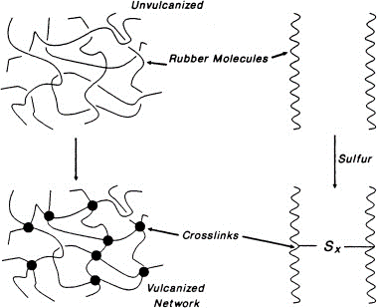
Vulcanizing Agents/Curatives
Vulcanization –
Cross linking process in which individual molecules of rubber (polymer) are converted into a three dimensional network of interconnected (polymer) chains through chemical cross links
Vulcanizing agents are necessary for the formation of crosslinks and rubber changes from the thermoplastic to the elastic state

Slide 9
History of Vulcanization
Discovered in 1839 by the U.S inventor Charles Goodyear .
Thomas Hancock , a scientist and engineer, was the first to patent vulcanization of rubber.
Hancock awarded British patent in 1844.
Goodyear received United nations patent also in 1844.

Slide 10
As long as the molecules are not tied to each other, they can move more or less freely, especially at higher temperatures.
Plastic behaviour , exhibits flow characteristics
By cross linking, rubber changes from thermoplastic to elastic state.
As more crosslinks , vulcanizates becomes tighter and force necessary to produce a given deformation increases.
Effect of vulcanization
Improved elasticity, tensile strength, hardness and weather resistance etc..

Slide 11
VULCANIZING AGENTS
TYPE | COMMON USE
Sulphur or Sulphur bearing materials | Natural Rubber, Isoprene, SBR, IIR, Poly Butadiene, EPDM, Nitrile
Organic Peroxides | Urethane, Silicone, Chlorinated Polyethylene, PVC/Nitrile
Metal Oxide | Polychloroprene, Chlorosulphonated Polyethylene, Polysulphide
Organic Amines | Acrylic, Fluorocarbon, Epichlorohydrin
Phenolic Resins | IIR

Slide 12
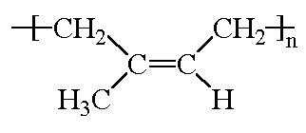
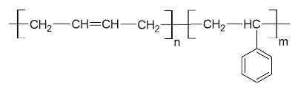
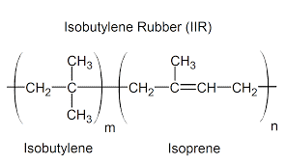
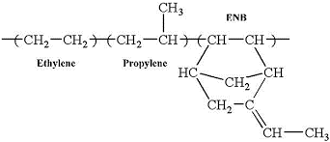
Sulphur Curing
Used for curing of unsaturated elastomers

Slide 13
Rubber + Sulphur : Vulcanization time 8 hrs @ 141 °C
Organic Chemicals
Vulcanization time 4 hrs @ 141 °C
metallic oxides
Reduced to 30 minutes or lesser

Slide 14
Accelerators
Sulphur exists as S8 ring and stable.
Splitting sulphur ring needs considerable amount of activating energy.
Process of activation occurs at higher temperature, promoted by organic substances called Accelerators
An accelerator is usually a complex organic chemical which takes part in the vulcanization, thereby reducing the vulcanization time considerably
Used to increase the speed of vulcanization.

Slide 15
Characteristics of an accelerator
Should give flat cure
Should provide scorch safety
Should give good storage properties for the uncured compound
Should give good physical properties to vulcanizates
Vulcanization rate
Delayed action
Slow
Medium
Fast / Ultrafast

Slide 16
Activators
Used to increase the efficiency of accelerators.
Additives that activate sulphur cure and improve the efficiency of sulphur based cure systems.
Commonly used - Zinc fatty acid ester which is often formed in-situ by reaction of fatty acid with zinc oxide.
Fatty acids include stearic, lauric, palmitic, oleic and naphthenic acid.
Fatty acid solubilizes the zinc and forms the actual catalyst.
Zinc oxide can also act as a filler or white colorant in rubber products whereas the fatty acid improves filler incorporation and dispersion.

Slide 17
Classification of accelerators
An accelerator is a complex organic chemical which takes part in the vulcanization, thereby reducing the vulcanization time considerably.
Vulcanization accelerators classified as (based on their role in a given compound)
Primary Accelerators
Secondary Accelerators
Based on the vulcanization rate, classified into
Slow Accelerators
Medium Accelerators
Ultrafast Accelerators
Delayed Action Accelerators
Cross-link density and the cure speed depend on the type and dosage of accelerator used.

Slide 18
Primary accelerators provides
long scorch time
medium to fast cure
good modulus (crosslink density) development.
Dosage : 0.5 to 1.5 phr
Examples : Sulphenamides and thiazoles.
Secondary accelerators (used at much lower concentration)
activates primary accelerators
increases speed of vulcanization (increases cross links density)
reduces scorch safety
Dosage : 10-40% of primary accelerator (0.05 to 0.5 phr)
Examples : dithiocarbamate, thiurams, guanidines

Slide 19
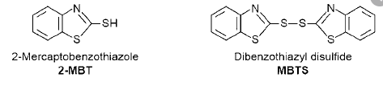
Thiazole Accelerators
Medium fast accelerator
Improved scorch safety
Need higher temperature for vulcanization
Examples :
2-mercaptobenzothiazole (MBT)
Zinc salt of mercaptobenzothiazole (ZMBT)
Dibenzene thiazyl disulphide (MBTS)
MBT & ZMBT – fast onset of vulcanization and lower processing safety
Zinc salt (ZMBT) is used mainly with latex compounds
MBTS provides safe processing

Slide 20
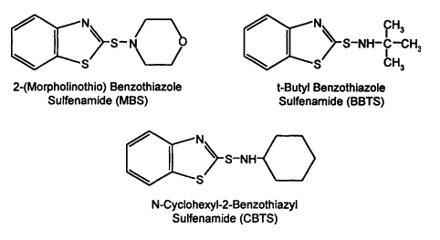
Sulphenamide accelerators
Primary accelerator
Delayed action accelerator as well as provides faster cure rate
Can be boosted with small amounts of secondary accelerators like DPG, TMTD, TMTM etc.
Provide good resistance to reversion.
Examples
Cyclohexyl benzothiazole/ thiazyl sulphenamide (CBS)
Tertiary butyl benzothiazyl sulphenamide (TBBS)
Dicyclo hexyl benzothiazyl sulphenamide (DCBS)

Slide 21
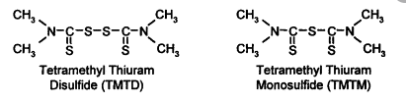
Thiuram accelerators
Fast accelerator
Faster curing rate, higher crosslink density
Lower processing safety
As secondary accelerator with dithiocarbamates, sulfenamides, or thiazole.
As primary accelerator for sulphur cured low unsaturated rubbers
Examples
Tetramethyl thiuram disulfide (TMTD)
Tetraethyl thiuram disulfide (TETD)
Tetramethyl thiuram monosulfide (TMTM)

Slide 22
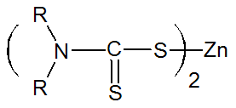
Dithiocarbamate Accelerators
Ultra fast accelerator
Mostly used in latex based compounds
Functions both as primary as well as secondary accelerators
low scorch safety
faster cure rate
higher crosslink density
Vulcanized in a short time at low temperature (115 - 120°C)
Examples
Zinc diethyl dithiocarbamate (ZDEC)
N-dimethyl dithiocarbamate (ZDMC)
Zinc N-dibutyl dithiocarbamate (ZDBC)

Slide 23
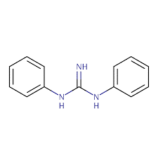
Guanidines
Examples :
diphenyl guanidine (DPG) and N, N’-diorthotolyl guanidine (DOTG).
Slow cure rate and require the use of zinc oxide for activation
Used for thick walled rubber products
As secondary accelerators in combination with thiazoles
Results in relative high crosslink density and good physical-mechanical properties such as high modulus and good compression set.
Cause a brown discoloration, not suitable for light coloured products

Slide 24
Xanthates
Ultra fast primary vulcanization accelerators
Used for vulcanization of rubber latex and rubber in solution.
Employed for low vulcanization temperature applications.
Examples :
Zinc (ZIX) and sodium isopropyl xanthate (NaIX). The later is water soluble, and ideal for latex vulcanization.

Slide 25
Thioureas
Ultrafast primary or secondary accelerators.
Examples
Ethylene thiourea (ETU)
dipentamethylene thiourea (DPTU)
dibutyl thiourea (DBTU)
Mainly used for the vulcanization of chloroprene rubbers.

Slide 26
Sulphur donors
Capable of providing active sulphur during the vulcanization process thereby generating sulphidic cross links.
Classified as those that are applied as a direct substitute for free sulphur and those that act simultaneously as vulcanization accelerators.
Examples
Caprolactam disulphide( CLD)
Tetramethylthiuram disulphide (TMTD).

Slide 27
Retarders/ Prevulcanization inhibitors (PVI)
Reduce accelerator activity during processing and storage.
Prevent scorch during processing and prevulcanization during storage.
They should either decompose or not interfere with the accelerator during normal curing at elevated temperatures.
Acts as organic acids that function by lowering the pH of the mixture, thus retarding vulcanization.
Examples
Benzoic acid
phthalic anhydride (up to 2 phr)
maleic acid
Cyclohexylthiophthalimide (CTP)

Slide 28
Non- Sulphur Vulcanization
Peroxide Curing
Metal oxide curing
Resin curing
Radiation curing

Slide 29
Peroxide Curing
Curing saturated as well as unsaturated rubbers
Used for curing EPDM, Chlorinated PE, Hypalon, Silicone rubbers.
Examples - diacyl peroxides, dialkyl or diaralkyl peroxides, peresters and peroxyketals
Curing takes place by thermal decomposition into oxy and peroxy free radicals and abstracting hydrogen atoms from the saturated elastomer to generate elastomer chain radicals.
Cannot be used with butyl rubber because they cause chain scission and depolymerisation.

Slide 30
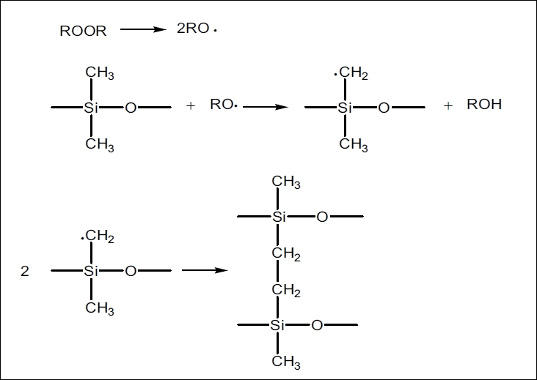

Slide 31
Metal Oxide Curing
Used for curing as polychloroprene rubber (CR), halogenated butyl rubber, and chlorosulfonated polyethylene rubber.
Curing agents - ZnO, MgO and Pb₂O₃
Mixtures of (ZnO and MgO) are used because ZnO alone is too scorchy , MgO alone is inefficient.
Zinc oxide and lead oxide combination for improved water resistance.

Slide 32
Resin Curing
Used for curing unsaturated rubbers, used with butyl rubber for high temperature applications.
Certain di-functional compounds form crosslinks with elastomers by reacting with two polymer molecules to form a bridge.
Resin cures are slower than accelerated sulphur cures and high temperatures are required, activated only by zinc oxide and halogen atoms (SnCl₂ ).
Resin has got adhering capacity, low molecular weight resin molecules diffuse into rubber thereby stiffen the rubber.
Examples :
Epoxy resins - NBR
Quinone di-oximes and phenolic resins -butyl rubbers
dithiols and diamines - fluorocarbon rubbers.

Slide 33
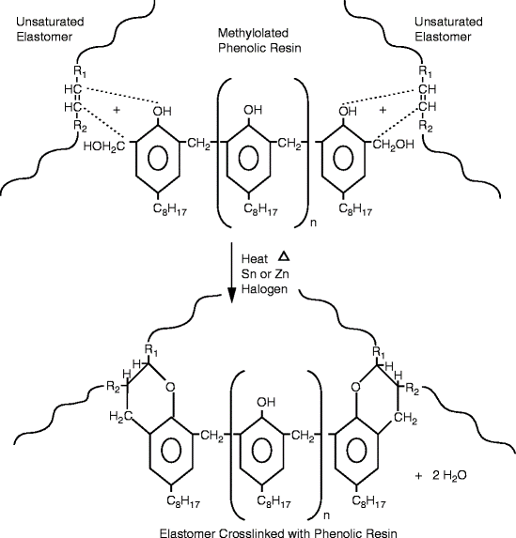

Slide 34
Radiation Induced Crosslinking
Physically induced chemical reaction, which is easier and preferable for continuous curing.
Includes electron beam crosslinking, photo-crosslinking, microwave crosslinking, ultrasonic crosslinking etc.
Upon irradiation free radicals are formed in rubber molecules.
Free radicals can combine to form crosslinks as in the case with peroxide crosslinking.
In radiation crosslinking of rubbers, kneaded rubber is placed in an aluminium die and is pressed at 100-200° C for 5-10 minutes, allowed to cool under pressure and then exposed to radiation.
Use of sensitizers can reduce the required dose and radiation time.
Examples : Halogen compounds, nitrous oxide, sulphur monochloride and bases like amine, ammonia etc.

Slide 35
Antidegradants
Degradation of Rubber
Chain scission resulting in shorter chains and lower molecular weight ( NR & IIR – softened stock showing tackiness ).
Cross-linking resulting in three dimensional structures and higher molecular weight (SBR & NBR – brittle stocks with poor flexibility and elongation)
Chemical alteration
Factors affecting degradation
External factors – oxygen, ozone, pro-oxidants, heat, light and fatigue
Internal factors – type of rubber, degree and type of vulcanization accelerators used, compounding ingredients and protective agents

Slide 36
Factors contributing to degradation
Oxygen | Mode of attack oxygen on unvulcanised rubber is different from vulcanized rubber. Unvulcanised stock – initial induction period followed by rapid up-take of oxygen Vulcanised stock- no induction period
Pro-oxidants | Cu , Mn, Co, Ni and Iron ( increase the rate of oxygen attack) in NR ; Iron – SBR Cu salts – increases rate of chain scission ; Co salts – increases rate of crosslinking
Ozone | Ozone concentration in atmosphere 0-6 ppm Ozone reacts with unsaturated rubber forming ozonides which decompose into products of lower molecular weight Ozone degradation occurs in two ways In rubber under stress cracks appear perpendicular to stress In unstressed rubber , silvery film appears on the surface of the article in hot humid weather
Heat | Combination of crosslinking and increase in rate of oxidation
Fatigue | Weakening of rubber due to continuously repeated distortions Cause of failure due to : Stress breaking of chain or cross links Oxidation accelerated by heat build p in flexing
Light and weathering ( UV radiation) | Light promotes action of oxygen at the surface producing a film of oxidised rubber Oxidised film reacts with water vapour and heat to produce crazing (fine cracks), exposing filler by washing of the oxidised layer Exposed filler can be rubbed off , a condition known a s Chalking.

Slide 37
Antidegradants are used to protect the rubber from degradation so that a longer service life is obtained.
Includes antioxidants and antiozonants.
Selection of antidegradants is based on
Type of protection desired
Environment in which the product is exposed.
Chemical activity
Persistence (volatility and extractability)
Nature of end use
Discoloration and staining
Toxicology
Cost
Antidegradants classified into
Amines - strong antidegradants , discolour and staining in nature
Phenolic compounds – less effective, non –discolouring and non-staining

Slide 38
Chemical Name | Oxygen | Heat | Flexing | Pro-oxidant | Ozone
N- phenyl-N-isopropyl P- phenylene diamine | Good | Vey good | Excellent | Excellent | Excellent
N- (1,3-dimethylbutyl) N-phenylenediamine | Good | Vey good | Excellent | Excellent | Excellent
Phenyl-β-naphthylamine | Good | Good | Good | Moderate | --
Substituted phenol | Poor | Poor | Moderate | No | No
Blend of arylamines and diphenyl-p-phenylenediamine | Good | Good | Excellent | Poor | Fair

Slide 39
FILLERS
Fillers are materials used to
Extent the range of physical properties
Reduce compound cost
Modify the processing properties
Influence the chemical resistance of the compound
The effect of a filler on rubber depends on-
Structure
Particle size
Surface area
Geometrical characteristics

Slide 40
Diluents or extenders
Non-reinforcing filler/ inactive fillers
Functional or reinforcing fillers
Functional or reinforcing fillers/active fillers
Semi- reinforcing fillers
Moderately improve the tensile strength and tear strength, but does not improve the abrasion resistance
Particle size range : 100 to 1000 nm (0.1 to 1μm)
Primarily to occupy space and used to lower the formulation cost.
Particle size : 1,000 and 10,000 nm (1 to 10 μm)
Particle size range : 10 to 100 nm (0.01 to 01 μm)
Improve the modulus and failure properties (tensile strength, tear resistance and abrasion resistance) of the final vulcanizates.

Slide 41
Reinforcing Type` | Carbon Black (listed in order of increasing particle size) | N220 (ISAF) N330(HAF) N550 (FEF) N762 (SRF-LM) N990 (MT)
 | Non-black | Silica Zinc Oxide Magnesium Carbonate Aluminium Silicate Sodium Aluminosilicate Magnesium Silicate
Extending Type |  | Calcium Carbonate Barium Sulfate Aluminium Trihydrate

Slide 42
Reinforcement by fillers
Condition for filler reinforcement is the interaction between the filler particles and the polymer.
Interactions can be strong, for example in the case of covalent bonds between functional groups on the filler surface and the polymer, or weak as in the case of physical attractive forces.
When carbon black is blended with a polymer, the level of physical interaction is high.
But interaction between silica particles and the polymer is very weak, and only by the use of a coupling agent a bond is formed between the filler and the polymer.

Slide 43
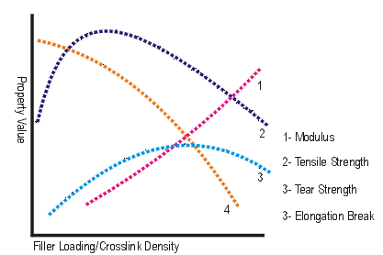
Factors influencing elastomer reinforcement
There is an optimum loading of filler indicating that there are two opposing factors in action when a reinforcing fillers such as carbon black is added.
First, there is an increase of modulus and TS, which is dependent on the particle size of filler. ( smaller PS, greater SA, interaction between polymer and filler surface)
Secondly, the reduction in properties at higher loading is a simple dilution effect, generally to all fillers, due to a diminishing volume fraction of polymer in composite. If there is not enough rubber matrix to hold the filler particles together, strength rapidly approaches to zero.

Slide 44
Carbon black
Carbon blacks are produced by converting either liquid or gaseous hydrocarbons to elemental carbon and hydrogen by partial combustion or thermal decomposition.
Chemical process | Manufacturing method | Raw materials
Thermal –oxidative decomposition | Furnace black process | Aromatic oils on coal tar basis or mineral oil, natural gas
 | Lamp black process | Aromatic oils on coal tar basis or mineral oil
 | Channel Black process | Coal tar distillates
Thermal decomposition | Thermal black process | Natural gas or mineral oils
 | Acetylene black process | Acetylene

Slide 45
Depending on the process adopted for the preparation, carbon blacks are classified as
Furnace blacks- produced by incomplete combustion of natural gas or heavy aromatic residue oils from the petroleum industries (particle size 20 nm – 80 nm).
Thermal blacks – decomposition of natural gas or oil at 1300 ºC in the absence of free air (particle size 20 nm – 80nm).
Acetylene black is a thermal type. Decomposition of acetylene gas is exothermic, so heat is supplied only to start the reaction.
Channel blacks - produced by feeding the natural gas or oil into thousands of small burner trips where the small flames impinge on to a large rotating drum
Lamp black - made by burning oil and allowing the black formed to settle out by gravity in series of chambers.

Slide 46
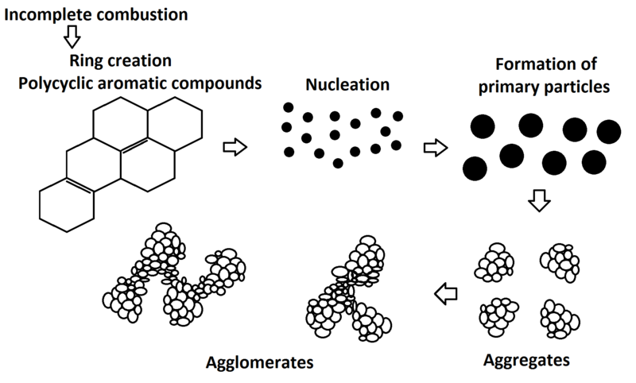
Properties of Carbon black
Composed from three colloidal particles morphological forms existing in rubber compounding includes (primary particle, aggregate, and agglomerate).
Sizes of these morphological forms have the following order:
particle < aggregate < agglomerate.
85 – 500 nm
15 – 300 nm
1 – 100 µm

Slide 47
Important properties of carbon black
Particle size
Structure
Physical nature of the surface
Chemical nature of the surface
Particle porosity

Slide 48
Particle size
The particles of carbon blacks are not discrete but are fused clusters of individual particles.
It is the fundamental property that has a significant effect on rubber properties. Finer particles lead to increased reinforcement, increased abrasion resistance, and improved tensile strength.
Transmission electron microscope and surface area by adsorption methods are used to determine particle size .

Slide 49
Determination of particle size
Surface area measurements give an indirect characterization of carbon black particle size.
Surface area determination using
Iodine adsorption (expressed in mg/g of carbon) measures the amount of iodine which can be adsorbed on the surface of a given mass of carbon black.
BET (Brunauer, Emmett and Teller ) method / Nitrogen adsorption surface area is a measurement of the amount of nitrogen which can be adsorbed on a given mass of carbon black.
Iodine and nitrogen molecules are sufficiently small to be adsorbed in the narrow slits or pores which can be formed in CB by oxidation at higher temperatures.
Rubber molecules are much bigger than these imperfections, so the extra surface area is not available for rubber- CB interactions.
Overcomed using cetyl trimethyl ammonium bromide molecule (CTAB) .CTAB (m²/g) gives best correlation with primary particle size.

Slide 50
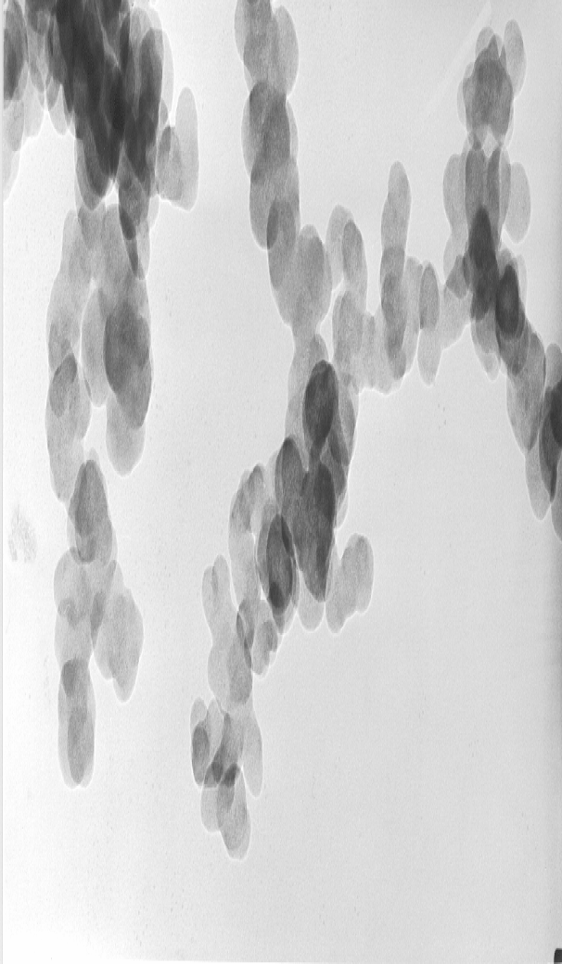
Structure
Carbon blacks do not exist as primary particles.
Primary particles fuse to form aggregates, which may contain a large number of particles.
The shape and degree of branching of the aggregates is referred to as structure.

Slide 51
Structure
Increasing carbon black structure increases modulus, hardness, electrical conductivity, and improves dispersibility of carbon black, but increases compound viscosity.
Thermal process produces blacks with little or no structure
Some particle agglomeration in channel process
Oil furnace process gives blacks with high structure.
The structure is measured by determining the total volume of the air spaces between the aggregates per unit weight of black (DBP absorption method).

Slide 52
Determination of structure
Dibutyl-Phthalate (DBP) oil absorption test measures the amount of DBP absorbed on 100g of carbon black.
Involve measuring the absorption of oil by the carbon black and they indicate the internal void volume present in both the primary and secondary aggregate structure.
DBP is added by means of a constant-rate burette to a sample of the Carbon Black in the mixer chamber of an absorptometer.
As the sample absorbs the oil the mixture changes from a free-flowing powder to a semi-plastic continuous mass, leading to a sharp increase in viscosity, which is transmitted to the torque-sensing system of the absorptometer.
The endpoint of the test is given by a pre-defined torque level.
The result is expressed as the oil absorption number (OAN), in ml/100 g.
A high OAN number corresponds to a high structure, i.e. a high degree of branching and clustering of the aggregates.

Slide 53
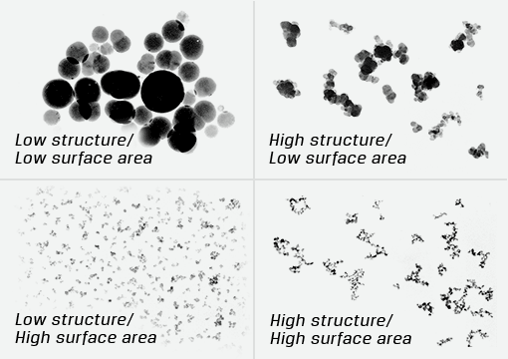

Slide 54
Physical nature of the particle surface
The physical form (beads or powder) can affect the handling and mixing characteristics.
Highly oriented layers – regular spacing- large layers -less reinforcement
Less crystalline orientation – irregular spacing – small layers - high reinforcement

Slide 55
Chemical nature of particle surface
This is a function of the manufacturing process and the heat history of a carbon black and generally refers to the oxygen-containing groups present on a carbon black’s surface.
90-99% elemental carbon
Other major constituents are (combined) hydrogen(from original hydrocarbon) and oxygen (from reduced atmosphere during manufacture).
The principal groups present are phenolic, ketonic and carboxylic together with lactones. These surface groups are not physically adsorbed but are chemically combined.
In addition to oxygen and hydrogen it contains very small amount of sulphur which do not cause cross linking of rubber.

Slide 56
Particle porosity
Fundamental property of carbon black that can be controlled during the production process.
Surface of the carbon black is not smooth
Oxidation at the non graphitic atoms make them pores.
Porosity affect the measurement of surface area providing a total surface area (NSA) larger than the external value (STSA).
Increase in porosity also allows a rubber compounder to increase carbon black loading while maintaining compound specific gravity.

Slide 57
Classification of carbon black
ASTM system consists of one letter followed by three numerals.
The first letter indicates rate of cure, N and S being used for normal and slow respectively.
The first numeral – surface area of the carbon black.
The remaining two numerals are selected arbitrarily- the second always a repeat of first numeral and the last is zero.

Slide 58
Commercially available carbon blacks
Name | Abbrev. | ASTM desig. | Particle size (nm)
Super Abrasion Furnace | SAF | N110 | 20-25
Intermediate Super Abrasion Furnace | ISAF | N220 | 24-33
High Abrasion Furnace | HAF | N330 | 28-36
Fast Extruding Furnace | FEF | N550 | 39-55
Semi reinforcing Furnace | SRF | N770 | 70-96
Fine thermal | FT | N880 | 180-200
Medium thermal | MT | N990 | 250-350

Slide 59
Application of Carbon Black
Name | Nature | Field of Application
SAF | Highly reinforcing, gives maximum tensile and abrasion resistance. High heat generation during processing | Camel back, truck treads industrial beltings and in other heavy duty items.
ISAF | Highly reinforcing, imparts high tensile strength and abrasion resistance, better processing properties than SAF | In high abrasion resistance applications like treads, camel backs, conveyer belt covers etc.
HAF | Reinforcing black with good abrasion resistance and better processing properties | In treads, camel backs, inner tubes, off-road treads and in mechanical goods
FEF | Reinforcing black with good abrasion resistance and better processing properties | In carcass. side walls, wire and cables and in calendared and extruded items requiring good dimensional stability.

Slide 60
Name | Nature | Field of Application
GPF | Moderately reinforcing, high loadings can be given, gives good processing and dynamic properties | In carcass, side walls cushion under tread, inner liner compounds, motor mounts and in high speed beltings.
SRF | Semi reinforcing, high loadings can be given gives good processing and dynamic properties. | In bead, breaker, body ply, cushion squeeze compounds, in bicycle tires, wire and cables and in other extruded items.
Thermal blacks | Low reinforcement, can be used in high loadings | In V- belts, mats, sealing compounds and in mechanical goods.
Channel blacks | Highly reinforcing, processing is easy, retards cure. | In bonding applications
Lamp blacks | Less reinforcing, gives high hardness compounds with high resilience | In truck treads and engine mounts
Acetylene black | Produce high hardness compounds, processing is easy | In compounds requiring electrical conductivity

Slide 61
Silica
Silica is not quite reactive with rubber as carbon black.
Mostly used in tyre products due to reduction in rolling resistance and increasing hardness.
Usually exists as aggregates and agglomerates, acidic in nature, leads to poor dispersion of silica.
Addition of silane coupling agents into rubber to modification of silica particles surface and increase the interaction between the silica and rubber.
Two types of silica - precipitated silica & fumed silica
Precipitated silica is manufactured by acid precipitation from silicate solution,, it has average particle size (10 to 100) nm and water contains is (10-14%).
Fumed silica is produced at a higher temperature by a reaction of silicon tetrachloride with water vapor, it has average particle size (7-15) nm.

Slide 62
Plasticisers and extenders
Functions of a plasticizer
Increase plasticity and workability of the compound
Aid in wetting and incorporation of fillers
Provide lubrication to improve extrusion, moulding or other shaping operations
Reduce batch temperature and power consumption during mixing
Modify the properties of the vulcanized products.

Slide 63
Classified into : chemical plasticisers and physical plasticisers
Softeners (Physical Plasticizers)
Do not react chemically with the rubbers involved, but function by modifying the physical characteristics of either the compounded rubber or the finished vulcanizates.
Dosage : 2 to 10 phr
Must be completely compatible with the rubber and the other compounding ingredients used in the recipe.
Incompatibility will result in poor processing characteristics or "bleeding" in the final product
Examples : Mineral petroleum oils (paraffinic , naphthenic & aromatic)
Chemical plasticizers
Synthetic type (ester based), used where mineral oils are not compatible with the rubber (polar rubbers) .
Ester plasticizers are generally used in NBR and CR compounds because they impart good vulcanization properties
dibutyl phthalate -DBP
di isobutyl phthalate-DIB
di octyl phthalate - DOP

Slide 64
Extenders
Added in large quantities so that the cost of the compound can be reduced, without seriously affecting the final properties. E.g.: Reclaimed rubber, factice .
Factices
Vulcanized vegetable oils used as plasticizers to get smooth compound in extrusion (brown) & to reduce abrasion resistance in products like erasers (white)
Stiffeners
Improve the plasticity of the compound in very small quantities. E.g. dihydrazine sulfate
Peptizers
They speed up the rate of polymer break down and also control the speed of breakdown, decreasing nerve within the compound and shrinkage during subsequent processing.
E.g. penta chloro thiophenol

Slide 65
Flame retardants
Chemicals which can improve the flame retardency of the compound
highly chlorinated paraffins and waxes, antimony oxide, aluminium oxide and selenium
Colors and pigments
They provide esthetic look and appearance for the product [organic and inorganic]
Tackifying agents
They are useful in providing tackiness to the compound.
E.g. wood rosin, coumarone resins, pine tar.
Blowing agents
They are materials which provide either open or closed cell structure by producing CO₂ or nitrous gases during vulcanization
dinitroso pentamethylene tetramene (DNPT) , azocarbonamide (ADC), baking soda (sod.bicarbonate)
Bonding agents
They facilitate adhesion between rubbers, fibers, fabrics, metals
chemlok, resorcinol – formaldehyde- latex for dipping of nylon cords in tyre manufacture

Slide 66
Silane Coupling Agents
improve properties of compounds containing silica and silicate fillers by forming chemical bonds across the filler and the rubber interface.
bis-(3-triethoxysilylpropyl)tetrasulphane and 3-thio-cyanatopropyl triethoxy silane.
The effect of coupling agents on the physical properties of the compound is to:
lower compression set
reduce heat build-up under dynamic conditions,
reduce tan delta, improve crosslink stability
improve tear related characteristics
improve resistance to swelling by water.
improve the abrasion resistance of compounds containing silica reinforcement. The effect is dependent on the surface area of the silica.

Slide 67
Tackifiers
synthetic rubbers are less tacky than natural rubber, it is often necessary to add tackifying substances. These should lead to improved uncured ply adhesion on assembling. Examples include CI resin, rosin derivatives, alkyl phenol-aldehyde resins etc.
Colours and Pigments
Pigments can be classified as inorganic or organic.
Inorganic pigments are often dull and in some cases too , insoluble and thus cannot bloom. Organic pigments - brighter shades, more sensitive to heat and other chemicals. On long term exposure to sunlight they can fade badly.
Inorganic colours : iron oxide, chromium oxide
Organic pigments contains different chromophore groups, these are mainly amines and azo-compounds such as phthalocyanines.

