Slide 1
NASA C-MAPSS XAI FINAL REVIEW
Explainable predictive maintenance for aircraft turbofan engines
Best FD001 RMSE
15.593
Transformer sequence
Ranbir Kumar and Kumar Manthan
Under the guidance of Dr. Poornima S
High-risk AP
0.873
RUL <= 30 ranking
Predict remaining useful life, explain sensor and time-window evidence, and convert model output into maintenance decisions.
Project scope
FD001-FD004
Prepared, validated, benchmarked
C-MAPSS XAI Research Foundation
01
Notes:
Sources: results/xai/FD001/model_benchmark.csv and results/xai/FD001/test_predictions.csv. High-risk ranking uses negative predicted RUL from the Transformer sequence model.

Slide 2
PROBLEM
RUL predictions need evidence a maintenance engineer can use
Final review focus: benchmark models, explain model behavior, test explanation quality, and show decision value.
Engine telemetry
RUL prediction
XAI evidence
Trust checks
Maintenance advice
>
>
>
>
Predictive performance
Explanation quality
Trust behavior
Decision support
RMSE, MAE
6 checks
7 checks
Advisor
R2 and NASA score also reported
Faithfulness, stability, robustness, consistency, sparsity, localization
Uncertainty, drift, subgroup gaps, spurious features
Risk class, top sensors, confidence, action
C-MAPSS XAI Research Foundation
02
Notes:
Teacher rubric covered directly: predictive performance, XAI generation, explanation quality, trust investigation, and decision-support value.

Slide 3
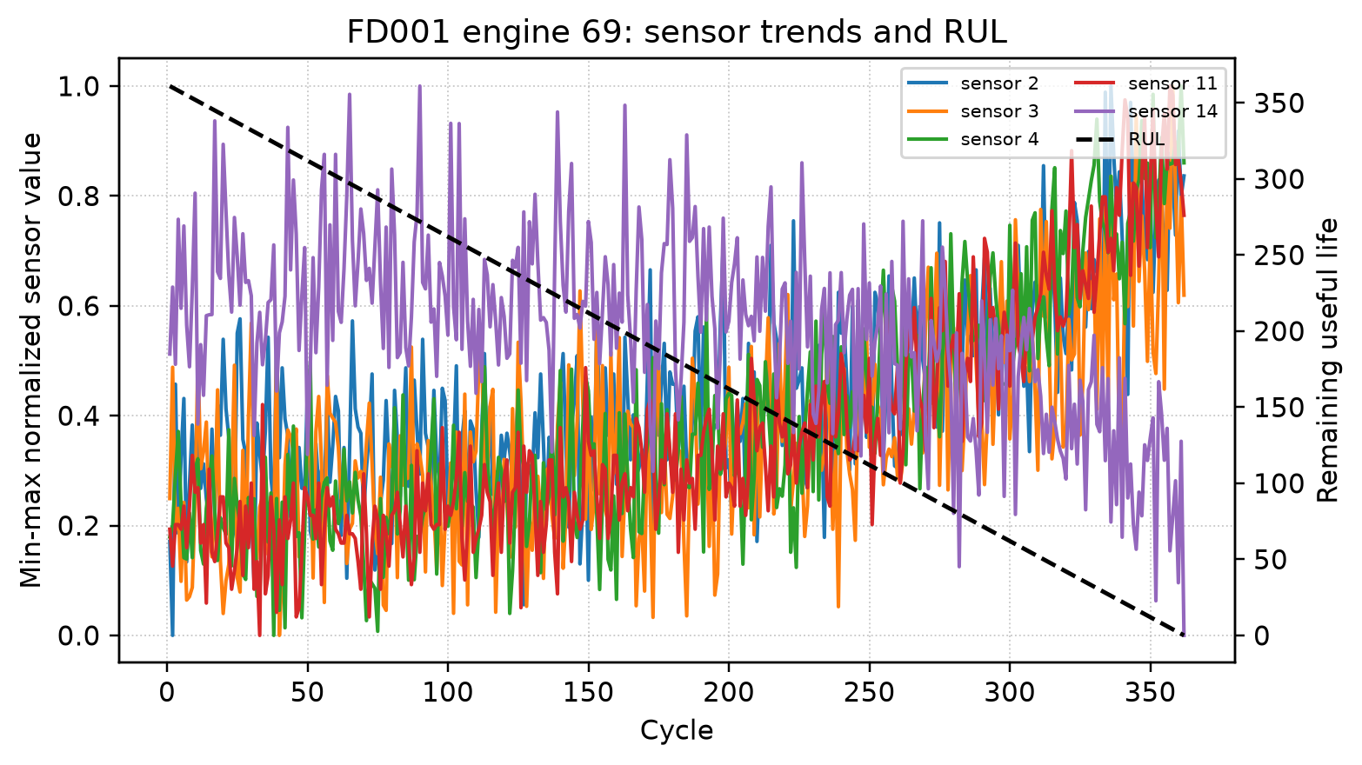
DATASET
NASA C-MAPSS gives controlled run-to-failure trajectories
Each row contains unit id, cycle, three operating settings, and 21 sensors.
Subset
Train
Test
Conditions
Faults
FD001
100
100
1
1
FD002
260
259
6
1
FD003
100
100
1
2
FD004
249
248
6
2
Pipeline outputs include Parquet tables, NPZ windows, window metadata, feature registry, scaler artifacts, metadata, and dataset hash files.
C-MAPSS XAI Research Foundation
03
Notes:
Sources: data/processed/*/metadata.json and paper/figures/fd001_engine_profile.png.

Slide 4
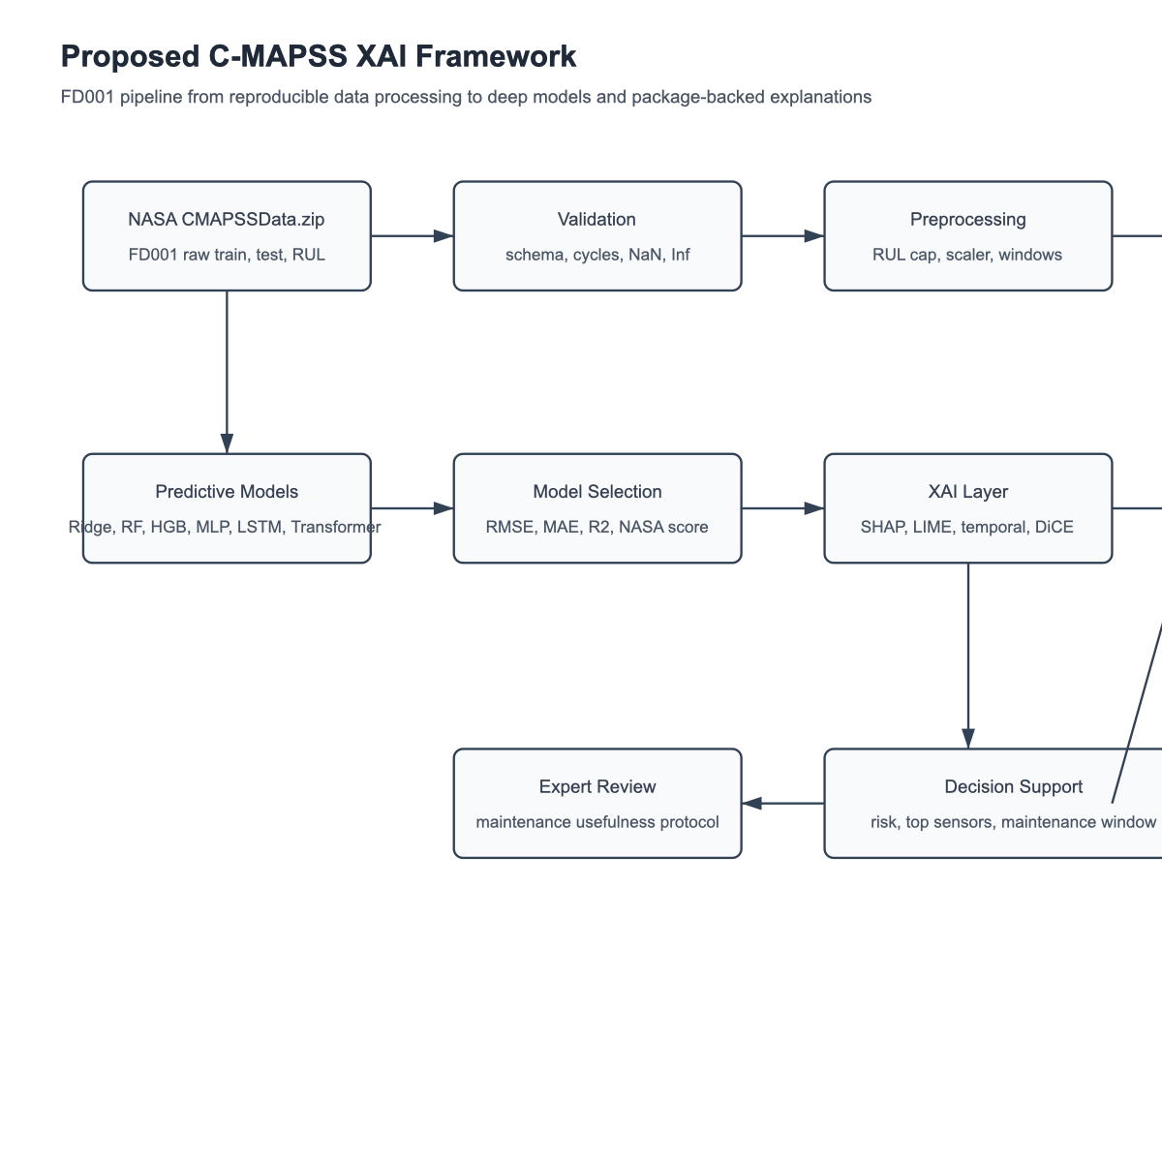
ARCHITECTURE
Reproducible pipeline from raw NASA files to dashboard evidence
The same artifacts feed the paper, PPT, Streamlit dashboard, and demo video.
Versioning
SHA-256
Config, tables, windows, registry
Validation
8 checks
Schema, cycles, NaN, Inf, windows
No training runs inside dashboard. It reads saved CSV, JSON, image, and model-output artifacts only.
C-MAPSS XAI Research Foundation
04
Notes:
Sources: paper/figures/proposed_architecture.png and implemented CLI artifact pipeline.

Slide 5
PREDICTIVE MODELS
FD001 Transformer leads, FD003 HGB gives best cross-subset RMSE
Deep models are included, but multi-condition subsets still favor classical baselines in small runs.
FD001 best
15.593
Transformer RMSE
FD001 MAE
10.879
Transformer MAE
Models benchmarked: Ridge, Random Forest, HistGradientBoosting, MLP, LSTM, GRU, Transformer.
C-MAPSS XAI Research Foundation
05
Notes:
Sources: results/xai/cross_subset_benchmark.csv and results/xai/FD001/model_benchmark.csv.

Slide 6
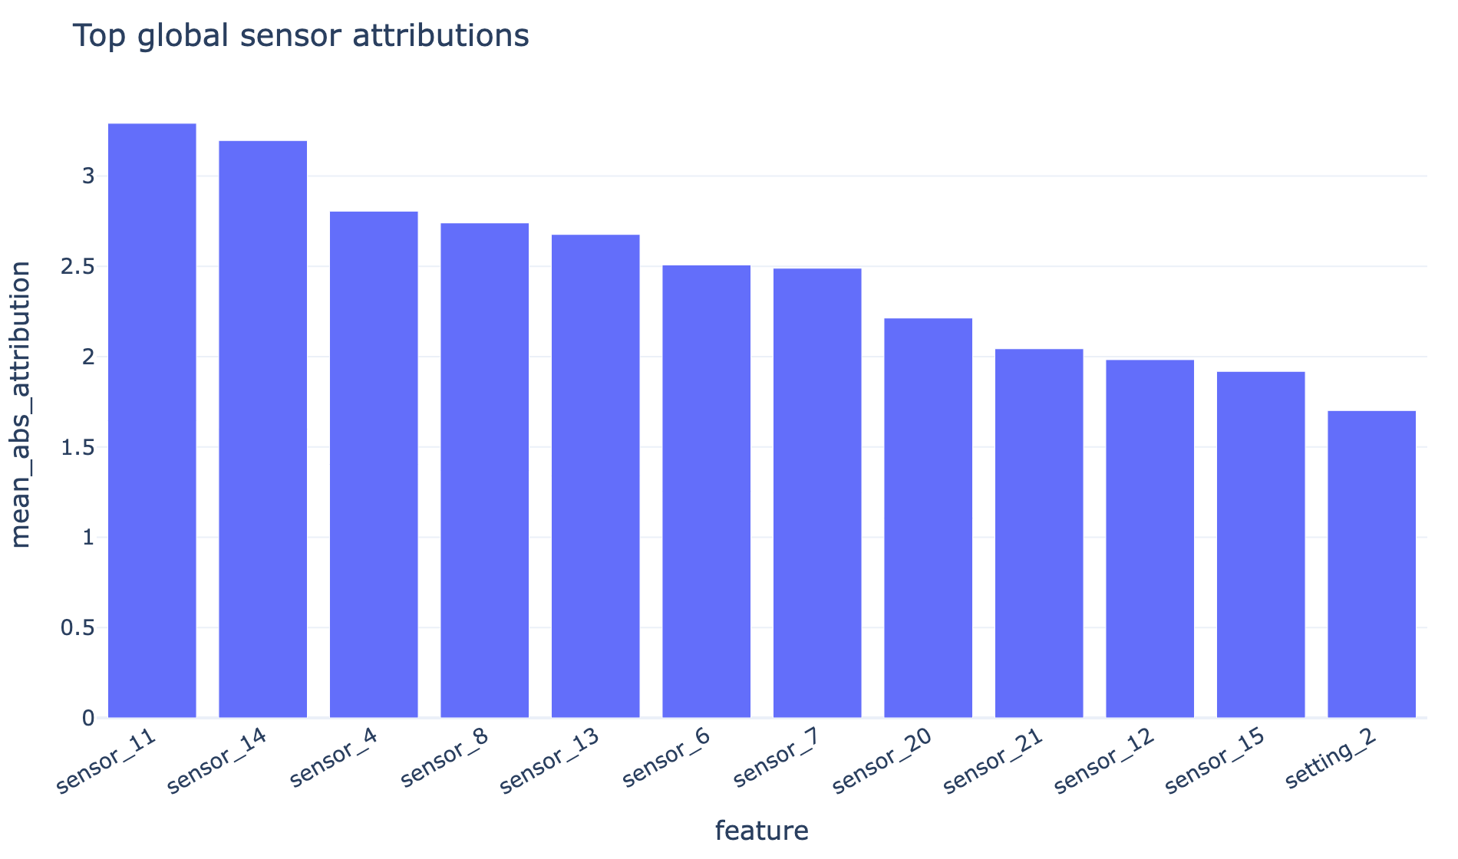
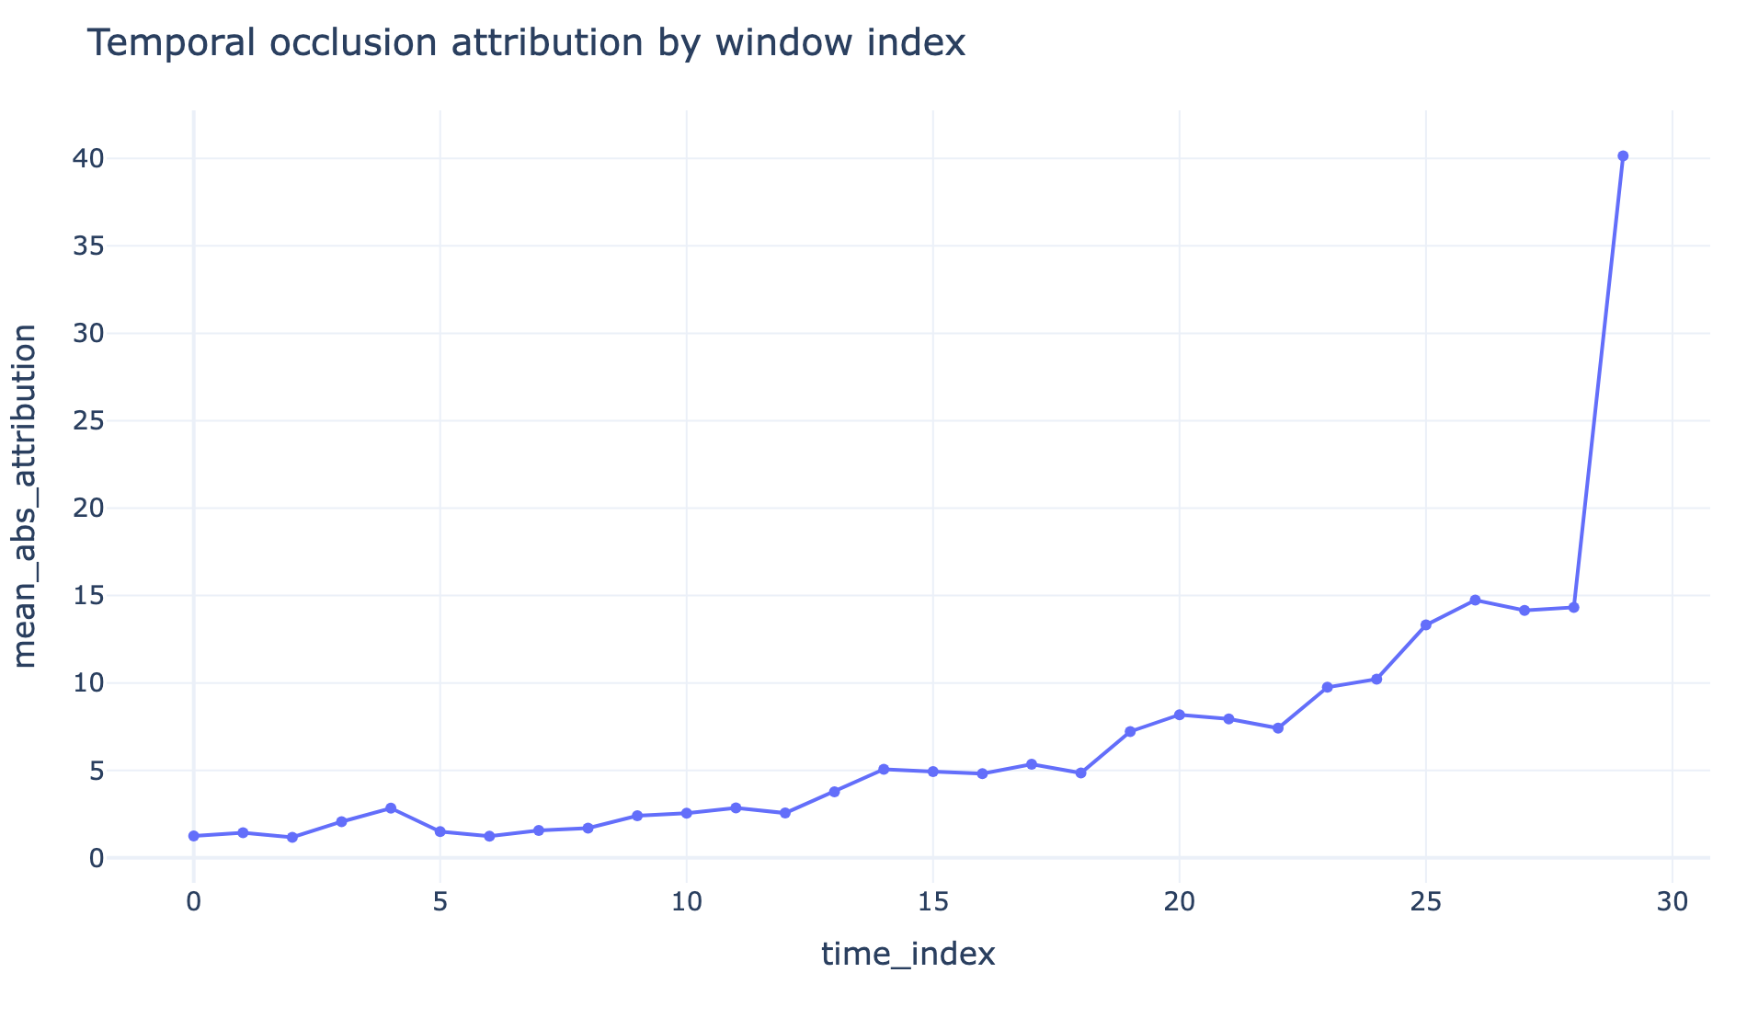
XAI METHODS
Sensor, temporal, local, and counterfactual evidence explain the prediction
The project compares package-backed explainers with fast occlusion baselines.
Methods: SHAP, LIME, DiCE, sensor occlusion, temporal occlusion, Integrated Gradients
Finding: recent cycles and dynamic sensors carry most useful evidence
Counterfactuals show higher-RUL sensor patterns for decision review
C-MAPSS XAI Research Foundation
06
Notes:
Sources: paper/figures/top_sensor_importance.png, paper/figures/temporal_importance.png, and results/xai/FD001/explanations/*.csv.

Slide 7
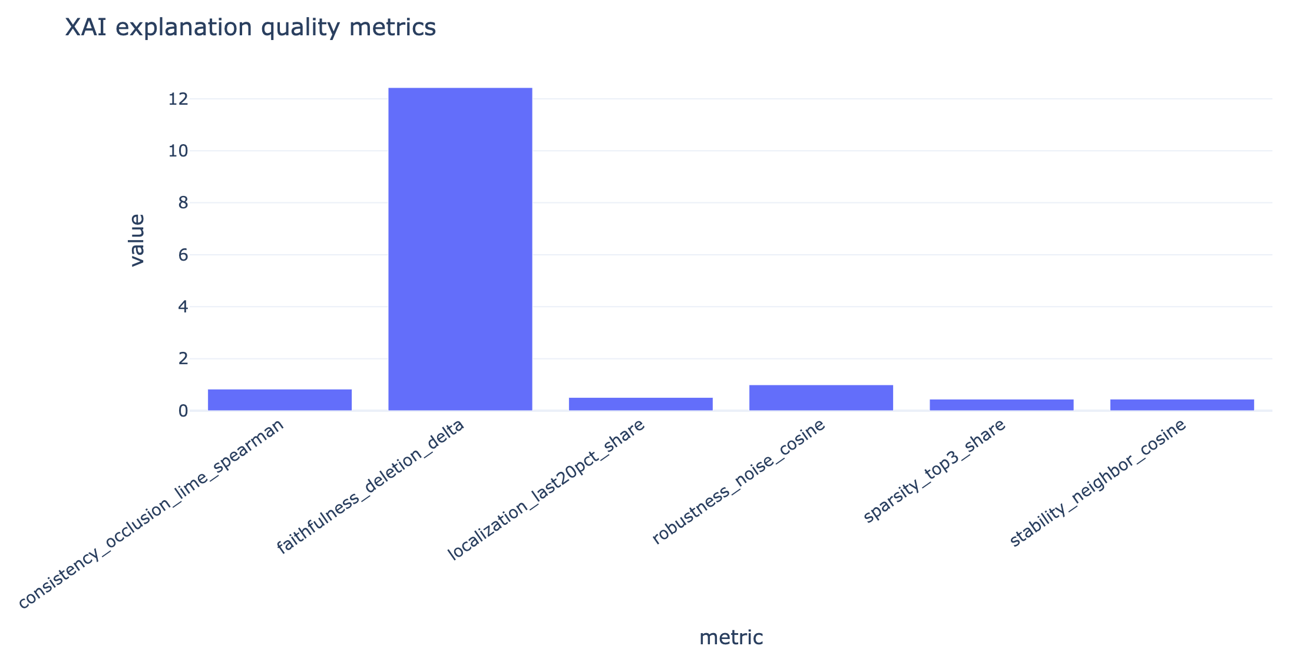
EXPLANATION QUALITY
The report measures explanation reliability instead of showing plots only
Fast occlusion gives practical coverage; package-backed explainers provide complementary validation.
Faithfulness
Robustness
Consistency
12.430
0.995
0.831
Deletion delta
Noise cosine
Occlusion vs LIME
C-MAPSS XAI Research Foundation
07
Notes:
Sources: results/xai/FD001/xai_quality.json and results/xai/FD001/explainer_runtime.csv.

Slide 8
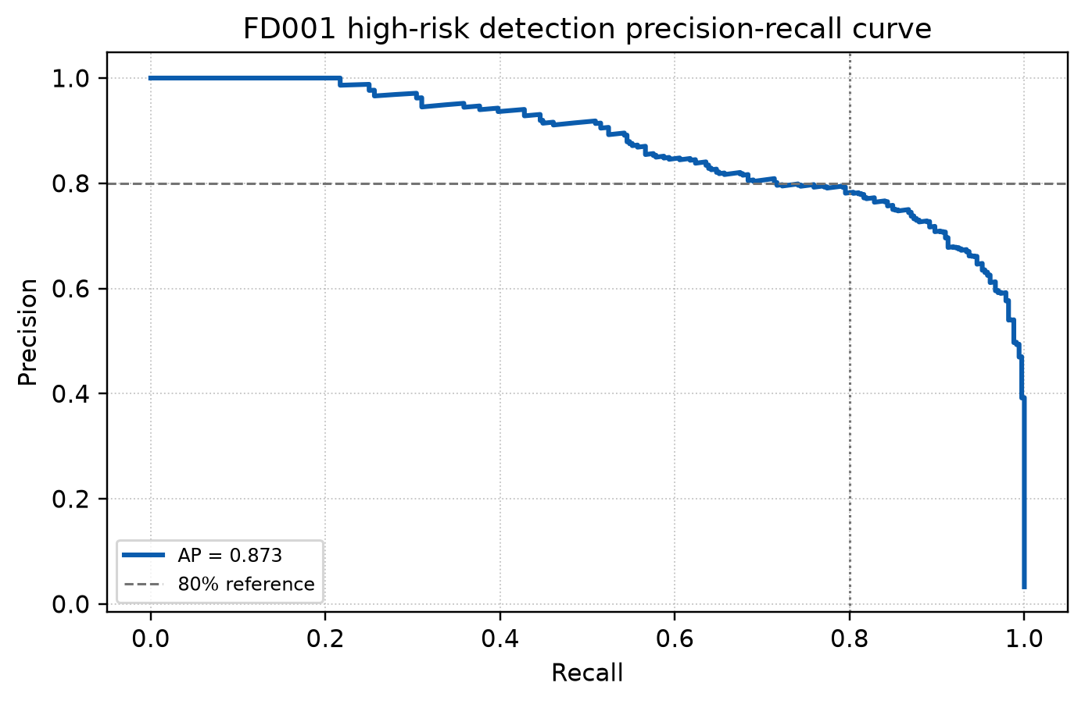
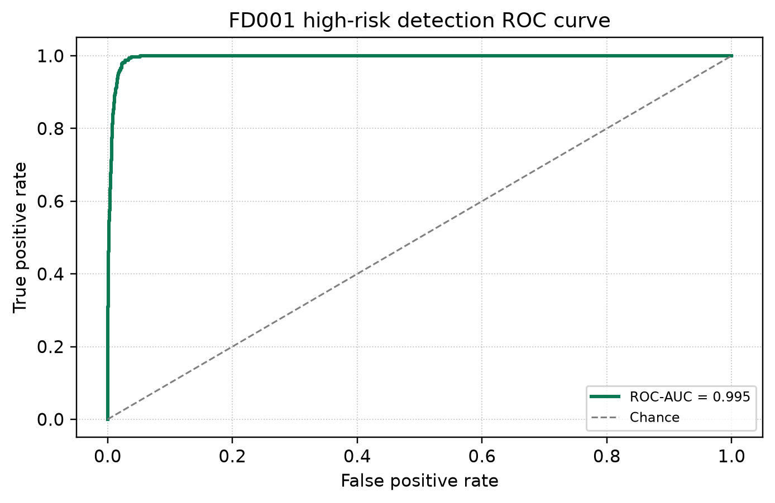
DECISION SUPPORT
High-risk ranking supports maintenance prioritization
Threshold-free PR and ROC evidence backs the advisor workflow.
Average precision
ROC AUC
Confusion matrix omitted: fixed 30-cycle threshold gives F1 0.796, below the requested 0.80 inclusion rule.
0.873
0.995
High-risk class
High-risk ranking
C-MAPSS XAI Research Foundation
08
Notes:
Sources: paper/figures/high_risk_precision_recall.png, paper/figures/high_risk_roc_curve.png, and results/xai/FD001/test_predictions.csv.

Slide 9
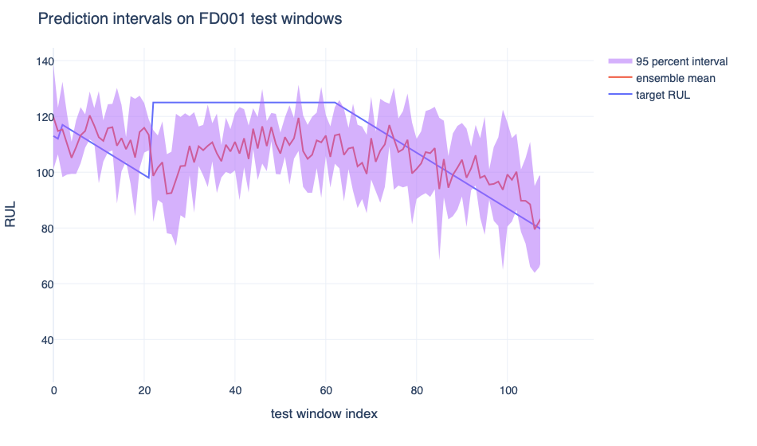
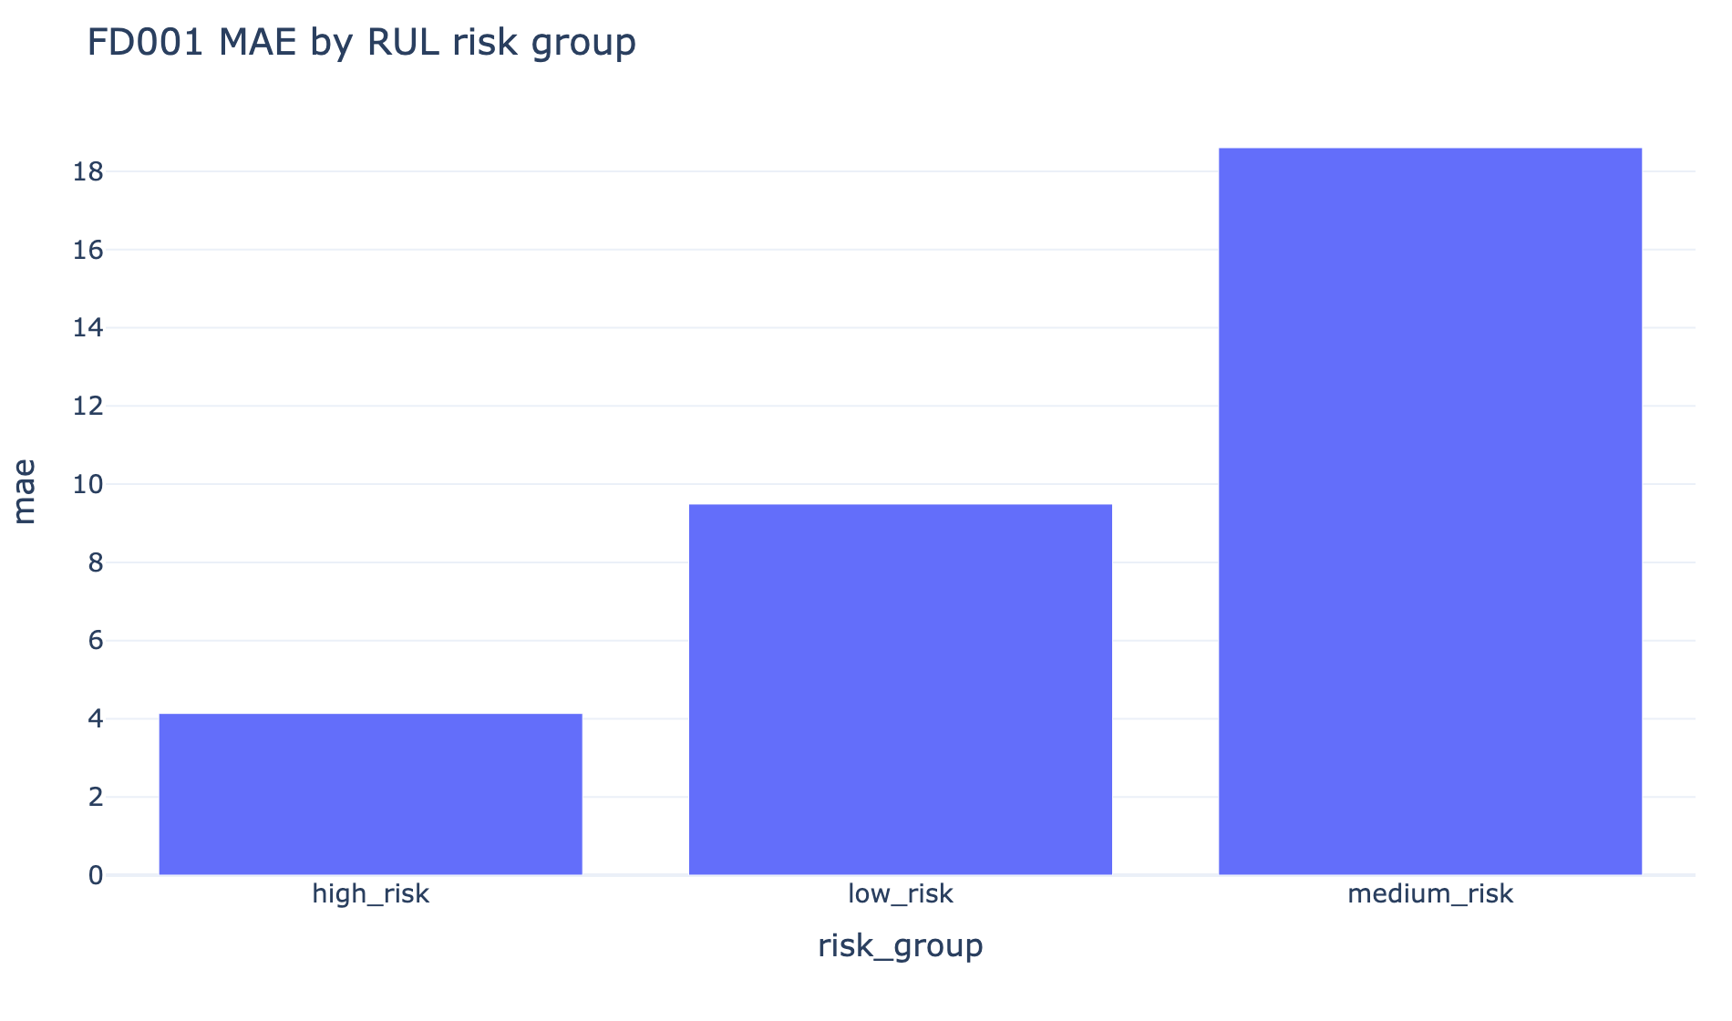
UNCERTAINTY AND SUBGROUP BEHAVIOR
The system reports confidence limits and risk-group gaps
This keeps the claims defensible when model performance varies by operating region.
Interval coverage
MAE gap
High-risk MAE
Medium MAE
0.668
14.471
4.135
18.606
Uncalibrated ensemble
FD001 subgroup gap
Best group
Hardest group
C-MAPSS XAI Research Foundation
09
Notes:
Sources: paper/figures/prediction_intervals.png, paper/figures/subgroup_mae.png, results/xai/FD001/prediction_intervals.csv, and results/xai/FD001/subgroup_metrics.csv.

Slide 10
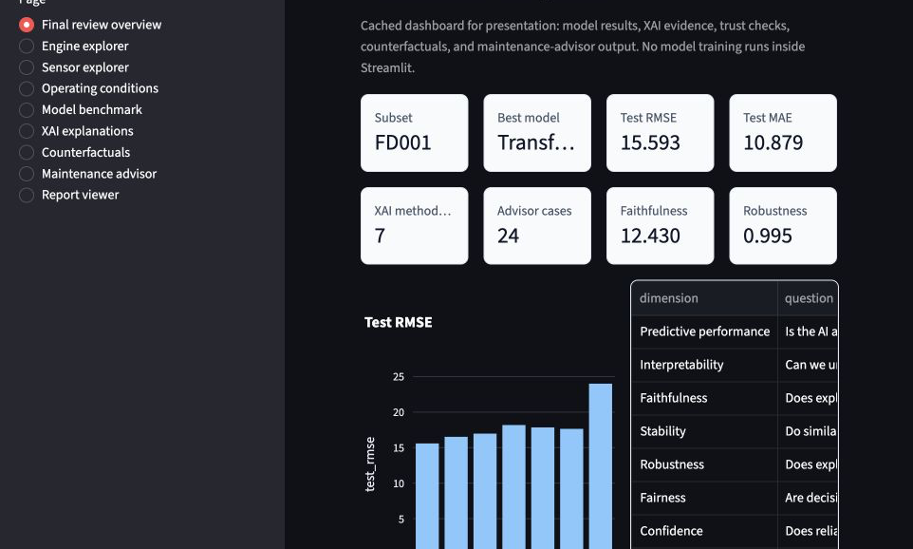
DASHBOARD DEMONSTRATION
The live demo proves the project works beyond the report
Dashboard pages read saved artifacts only, so review time is spent on evidence rather than training.
Pages
Training inside UI
8
0
Overview, explorers, benchmark, XAI, advisor
Dashboard reads cached outputs
Advisor cases
Report viewer
Top risk
Ready
RUL, sensors, confidence, action
Figures, tables, paper evidence
Demo order: overview, model benchmark, XAI explanations, counterfactuals, maintenance advisor, report viewer.
C-MAPSS XAI Research Foundation
10
Notes:
Sources: paper/figures/dashboard_overview.png and src/cmapss_xai/dashboard/app.py.

Slide 11
REPORT COVERAGE
Paper maps directly to the teacher checklist
Each requested section has a concrete artifact or reported limitation.
Requirement
Evidence in project
Predictive models
Ridge through Transformer benchmark
Paper
12 pages
XAI methods
SHAP, LIME, DiCE, occlusion, IG
IEEE-style PDF
Explanation quality
Faithfulness, stability, robustness, consistency
Trust checks
Uncertainty, drift, subgroup gaps, spurious sensors
Figures
Decision value
Maintenance advisor and high-risk ranking
16
Expert feedback
Protocol ready, responses pending
Research plots included
Human expert feedback is not fabricated. The packet and blank template are ready for real reviewer responses.
C-MAPSS XAI Research Foundation
11
Notes:
Sources: paper/ieee_report.pdf, paper/expert_review_packet.md, and paper/expert_feedback_template.csv.

Slide 12
NOVELTY AND FINAL MESSAGE
Contribution is measured XAI for maintenance decisions, not only RUL regression
The system connects model accuracy, explanation reliability, uncertainty, subgroup behavior, and maintenance action.
Research foundation
Model suite
XAI evaluation
Decision value
Versioned data, scaler artifacts, hashes, dataset card, validation reports.
Classical ML plus LSTM, GRU, Transformer across FD001 to FD004.
Quality, runtime, trustworthiness, counterfactuals, temporal attributions.
Risk triage, top sensors, explanation notes, maintenance recommendation.
Limitations to state clearly: expert feedback pending, intervals uncalibrated, larger hyperparameter search deferred.
C-MAPSS XAI Research Foundation
12
Notes:
Sources: project decision log in AGENTS.md, paper/ieee_report.pdf, and results/xai/cross_subset_benchmark.csv.

