Slide 1
RUCQA
2020201390
https://github.com/RanchiZhao/RUCQA

Slide 2
Document Crawler
A total of 4,533 documents from [RUC NEWS](https://news.ruc.edu.cn/)
No other processing of the document
May need some work on pre-processing, such as for long documents, but less is more.

Slide 3
Overall Structure

Slide 4
VRM
Vector store index based Retrieval Module
Powered by Llama Index
https://github.com/jerryjliu/llama_index

Slide 5
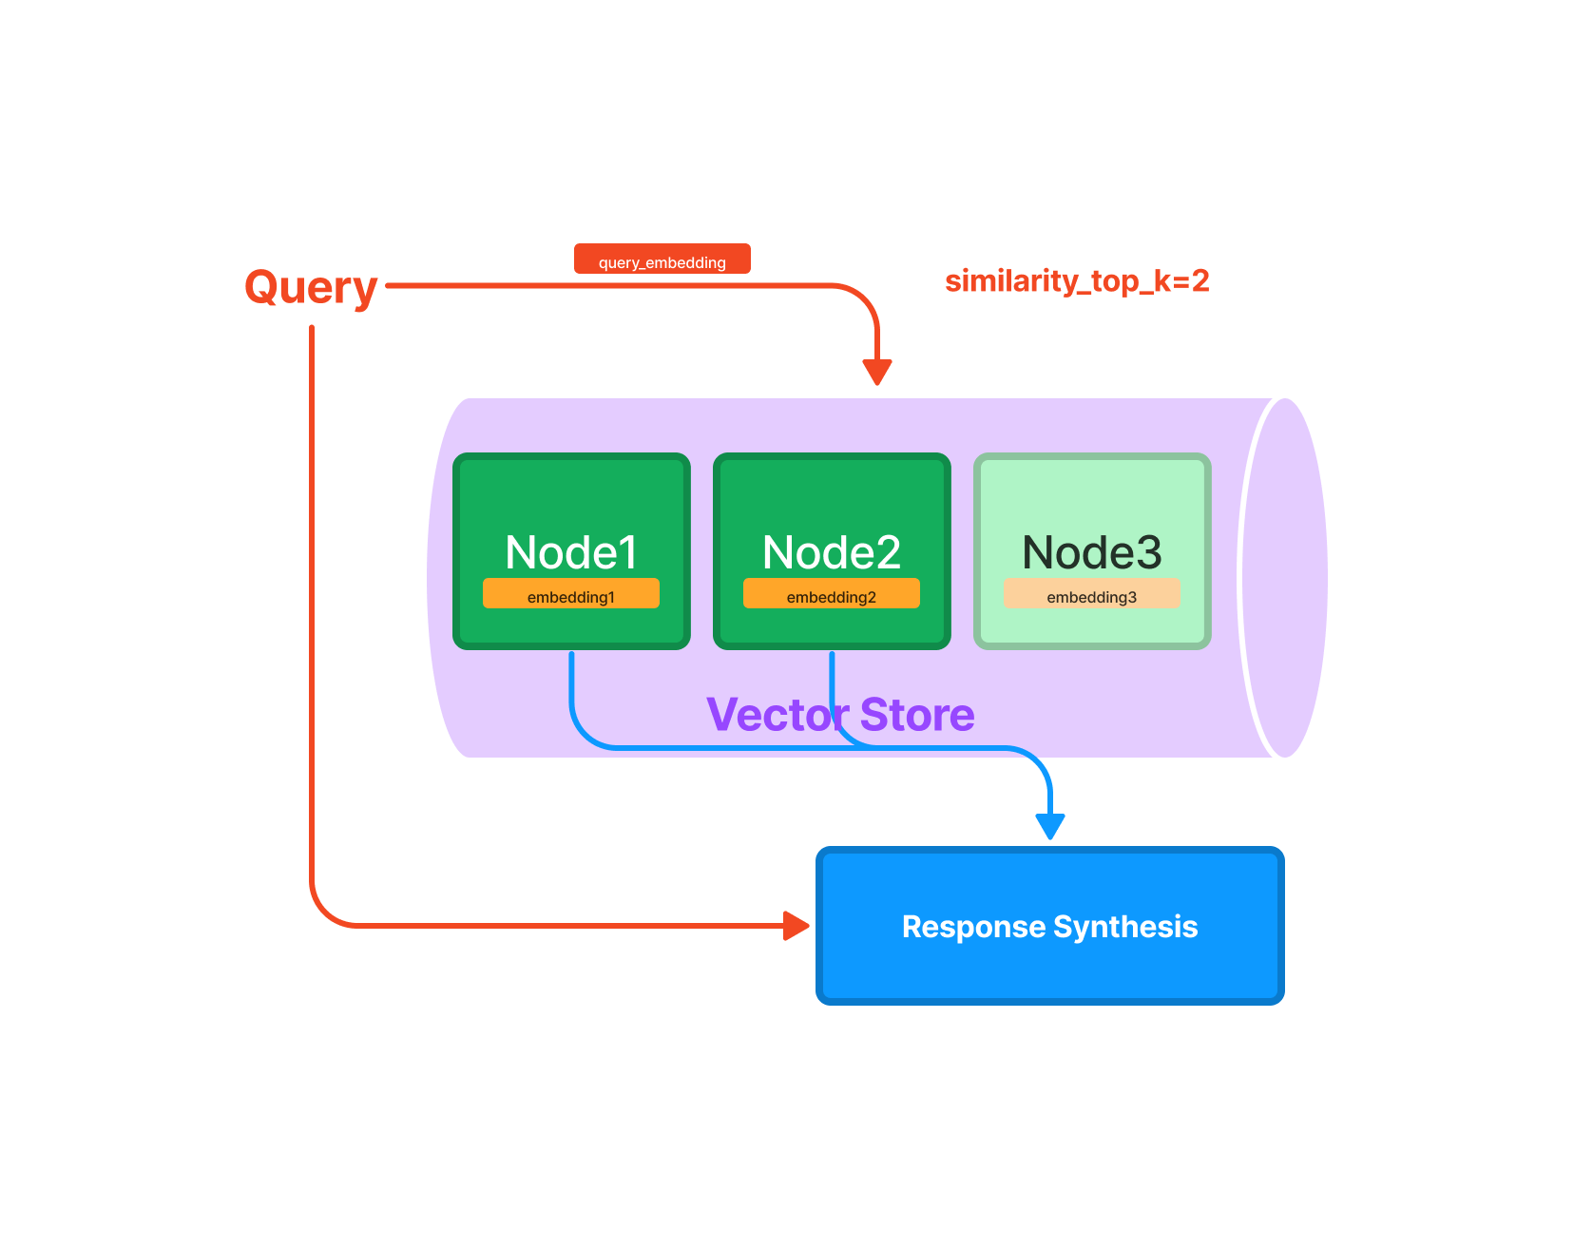


VRM

Slide 6
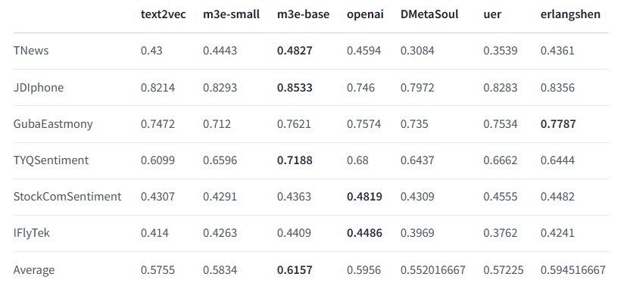
VRM
Why openai-ada-002 ?
https://huggingface.co/moka-ai/m3e-base

Slide 7
KRM
Keywords based Retrieval Module - more than precise match
Powered by LangChain https://github.com/hwchase17/langchain
Notes:
Intention Enhance - OlaGPT - https://arxiv.org/abs/2305.16334

Slide 8
Integrator & Simplifier
Tricky

Slide 9
Thanks for listening

