Slide 1
Signal Denoising Using Deep Learning Autoencoders
Arijit Ghosh ( 35000121017 )
Niloy Acharyya ( 35000121031 )
Ratan Bhowmick ( 35000121072 )
Sailesh Yadav ( 35000122041)
Mainak Dutta ( 35000122044 )
Under guidance of Dr. prasun halder
Department of computer science and engineering
Ramkrishna Mahato government engineering college

Slide 2
Problem of signal denoising
What is the problem?
Signal denoising is the process of removing unwanted noide from a signal to retrieve its original form.
Who has this problem?
Communication system, Healthcare, Data Scientists & ML Engineers, and Autonomous systems.
Why should this problem be solved?
Hide Critical information or lead to misinterpretation
How will I know this problem has been solved?
The denoised output closely resembles the original clean signal (visually and quantitatively).

Slide 3
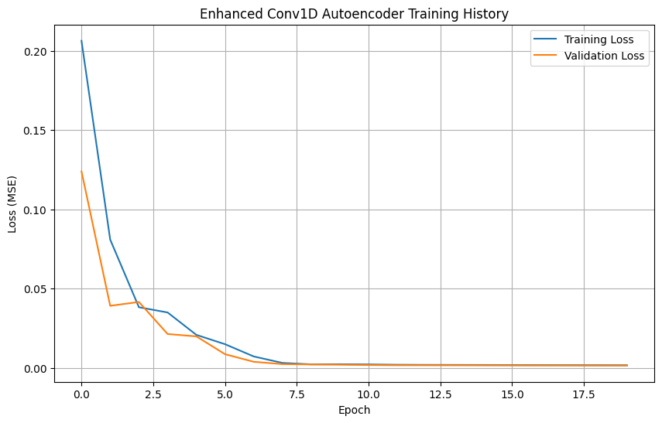
Background Information
Signals, in their essence, are representations of physical phenomena, carrying vital information across diverse fields. From the intricate electrical impulses of a human heart captured by an Electrocardiogram (ECG) to the fluctuating radio waves conveying telecommunication data, and the subtle vibrations detected by IoT sensors, signals are fundamental to understanding and interacting with our environment. The integrity and purity of these signals are paramount, as their quality directly influences the accuracy of measurements, reliability of systems, and validity of subsequent analyses.
However, in real-world scenarios, signals are rarely pristine. They are invariably corrupted by noise, which can originate from a multitude of sources. This noise, often unwanted and random fluctuations, can be inherent to the measurement system (e.g., thermal noise in electronics), external environmental interferences (e.g., electromagnetic interference, acoustic background noise), or even human-induced artifacts

Slide 4
Workable Solutions
Solution #1
Convolutional 1D Autoencoder
How it works:
Solution #2
LSTM (Long Short-Term Memory) Autoencoder
How it works:
Solution #3
low-pass filter
How it works:
Why it works:
Why it works:
Why it works:
Uses 1D convolutional layers to capture local patterns in the signal.
Efficient at handling stationary and locally repetitive patterns (like sine waves).
Uses LSTM layers in the encoder and decoder to remember long-term signal patterns.
Effective for non-stationary or dynamic signals with complex time dependencies.
Frequencies above a cutoff point are suppressed.
Common in signal processing pipelines.
Simple and fast for periodic, smooth signals.
Acts as a good baseline for comparing deep learning models.

Slide 5
The Prototype
The best workable solution selected is the Enhanced Conv1D Autoencoder model. It effectively learns and reconstructs clean signal patterns from noisy input by using convolutional filters that extract spatial features.
Plan to build the prototype:
Collect and preprocess the dataset (ex1.xlsx) containing noisy and clean signals.
Normalize and window the data for time-series modeling.Design and implement the Conv1D Autoencoder using Python (TensorFlow/Keras).
What materials will I use for your prototype?
Software Tools: Python, TensorFlow, Keras, Jupyter Notebook, Matplotlib
Platform: Google Collab

Slide 6
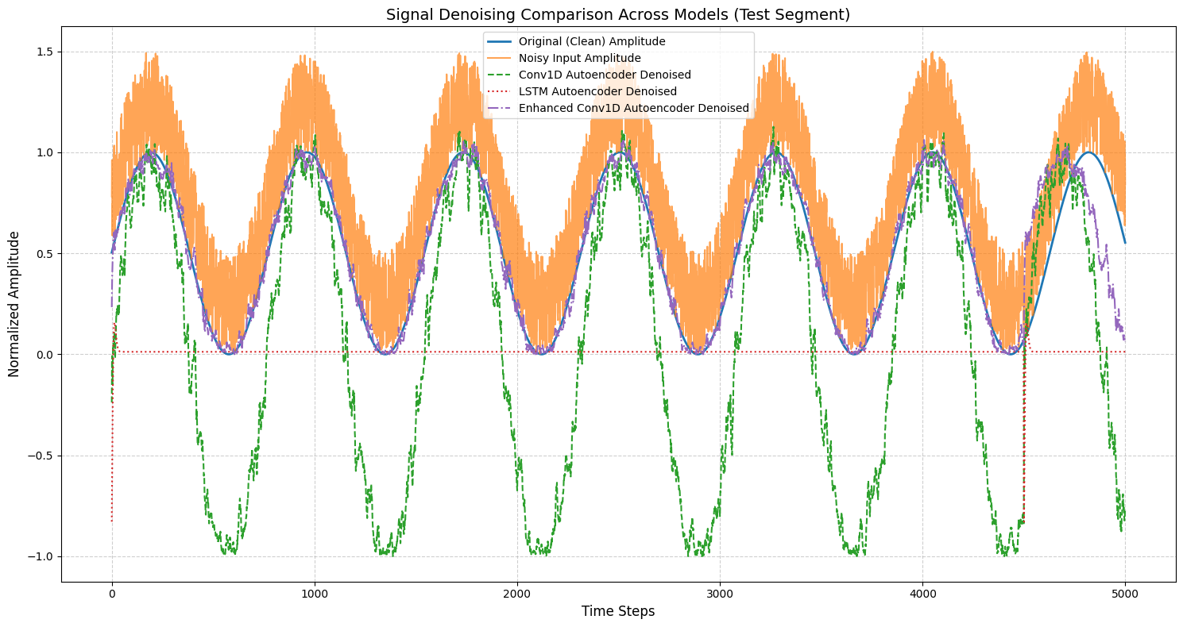
Final Result
Does the final prototype solve the problem?
Yes. The implemented Conv1D Autoencoder, along with LSTM and Enhanced Conv1D models, effectively denoised the input signals and successfully restored the original waveform. The models were trained and evaluated on time-series data containing synthetic Gaussian noise.
Visual Comparison
Clean vs Noisy vs Denoised signals were plotted.
The Enhanced Conv1D Autoencoder provided the best visual and quantitative recovery of the clean signal.
Reflection

Slide 7
conclusion
This project successfully explored the application of deep learning autoencoders for denoising time-series amplitude data. The primary objective was to develop and evaluate Conv1D and LSTM-based autoencoder architectures for effectively removing noise from a synthetic sine wave signal. The key findings from the experiments are:
• Initial implementations of both the Conv1D and LSTM autoencoders demonstrated limited denoising capabilities; in fact, their performance, as quantified by MSE, RMSE, SNR, and PSNR, was often inferior to the raw noisy signal, indicating a need for architectural refinement.
• The Enhanced Conv1D Autoencoder emerged as the most effective model. It achieved significantly lower reconstruction errors (MSE = 0.016, RMSE = 0.127) and a substantial improvement in signal quality (SNR Improvement = 7.10 dB), successfully recovering the clean signal from its noisy counterpart. This model effectively met the project's denoising objectives.
Metric | Noisy Signal (Baseline) | Conv1D Autoencoder | LSTM Autoencoder | Enhanced Conv1D Autoencoder
MSE | 0.082993 | 0.380002 | 0.388177 | 0.016197
RMSE | 0.288085 | 0.616443 | 0.623039 | 0.127269
SNR (dB) | 6.83 | 0.22 | 0.13 | 13.92
PSNR (dB) | 10.81 | 4.2 | 4.11 | 17.91
SNR Improvement (dB) | N/A | -6.61 | -6.7 | 7.1

Slide 8
reference
[1] F. Chollet et al., "Keras," 2015. [Online]. Available: https://keras.io.
[2] D. P. Kingma and J. Ba, "Adam: A Method for Stochastic Optimization," arXiv preprint arXiv:1412.6980, 2014.
[3] F. Pedregosa, G. Varoquaux, A. Gramfort, V. Michel, B. Thirion, O. Grisel, M. Blondel, P. Prettenhofer, R. Weiss, V. Dubourg, J. Vanderplas, A. Joly, B. Holt, and G. Varoquaux, "Scikit-learn: Machine Learning in Python," Journal of Machine Learning Research, vol. 12, pp. 2825–2830, 2011.
[4] C. R. Harris, K. J. Millman, S. J. van der Walt, R. Gommers, P. Virtanen, D. Cournapeau, E. Wieser, J. Taylor, S. Berg, N. J. Smith, R. Kern, M. Picus, S. Hoyer, M. H. van Kerkwijk, M. Brett, A. Haldane, J. F. del Rio, M. Wiebe, P. Peterson, P. Gérard-Marchant, K. Sheppard, T. Reddy, W. Weckesser, H. Abbasi, C. Gohlke, and T. E. Oliphant, "Array programming with NumPy," Nature, vol. 585, pp. 357–362, 2020.
[5] W. McKinney, "Data Structures for Statistical Computing in Python," in Proceedings of the 9th Python in Science Conference, 2010, pp. 56–61.
[6] J. D. Hunter, "Matplotlib: A 2D graphics environment," Computing In Science & Engineering, vol. 9, no. 3, pp. 90–95, 2007.
[7] H. Kim, S. Kim, Y. Choi, J. Jeong, and W. Hwang, "LSTM-Autoencoder Based Detection of Time-Series Noise Signals for Water Supply and Sewer Pipe Leakages," Water, vol. 16, no. 18, p. 2631, 2024. [Online]. Available: https://www.mdpi.com/2073-4441/16/18/2631.

Slide 9
Thank you!

