Slide 1
RosterBhai
Multi-Tenant Roster Management System
Version 2.0.0
November 08, 2025

Slide 2
Executive Summary
Modern SaaS application for roster and shift management
Built with Next.js 14 and TypeScript
Multi-tenant architecture with subdomain isolation
Comprehensive features for admins and employees
Google Sheets integration for easy data import
Real-time notifications and request management

Slide 3
System Architecture
3-Tier Architecture Pattern
Presentation: Next.js App Router + React Components
Business Logic: Next.js API Routes (Serverless)
Data: File-based JSON storage with tenant isolation
Middleware-based routing and security
RESTful API design

Slide 4
Multi-Tenant Architecture
Subdomain-based tenant identification
Main domain: rosterbhai.me (landing + developer portal)
Tenant subdomains: [slug].rosterbhai.me
Complete data isolation per tenant
Separate data directories for each tenant
Middleware enforces routing rules

Slide 5
System Components
Landing Page - Marketing and company registration
Developer Portal - Tenant approval and management
Admin Panel - Roster management with RBAC
Employee Portal - Self-service schedule viewing
CSV Import System - Bulk data import
Notification System - In-app and email alerts

Slide 6
User Roles & Capabilities
Developer: Approve tenants, manage subscriptions, CMS
Admin: Manage employees, modify rosters, approve requests
Employee: View schedules, submit change/swap requests
RBAC Support: Role-based permissions for admins
Session-based authentication for all roles
Secure cookie-based session management

Slide 7
Key Features
CSV & Google Sheets roster import
Shift template management
Employee profile management with photos
Shift change and swap request workflow
Real-time notification system
Audit trail for all modifications
Team-based schedule organization
Mobile-responsive design

Slide 8
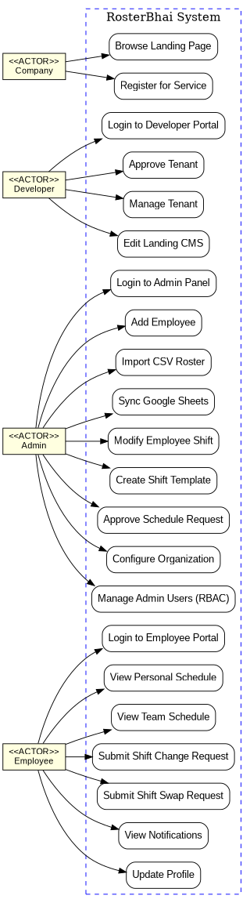
Use Case Diagram

Slide 9
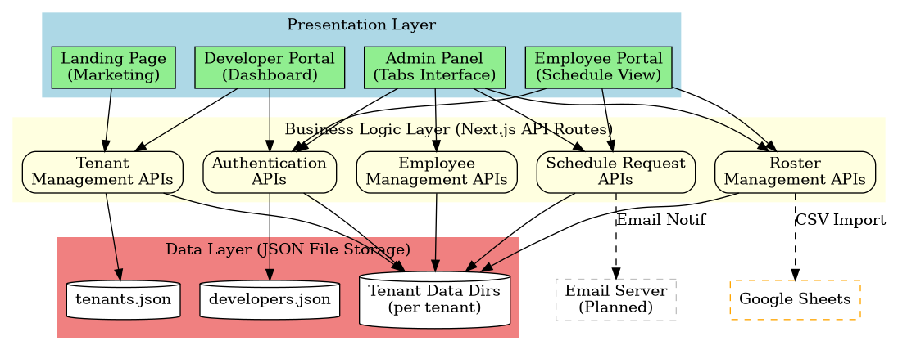
System Architecture

Slide 10
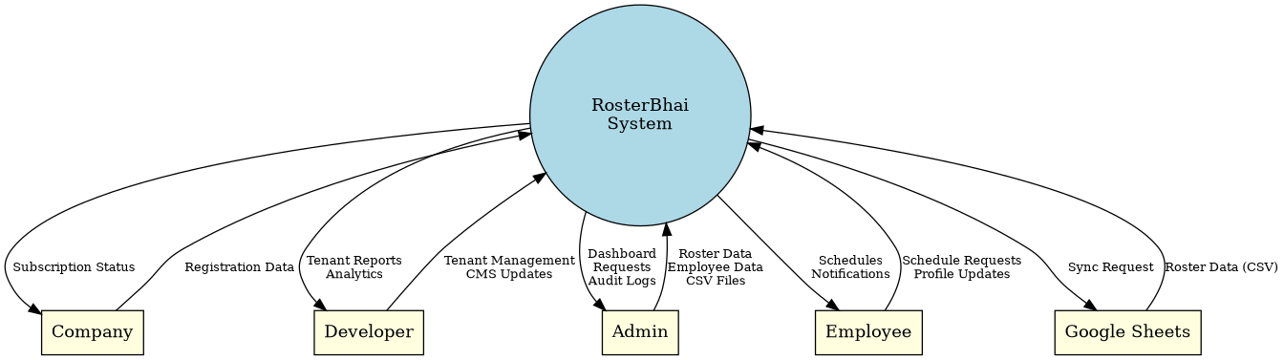
Context Data Flow Diagram

Slide 11
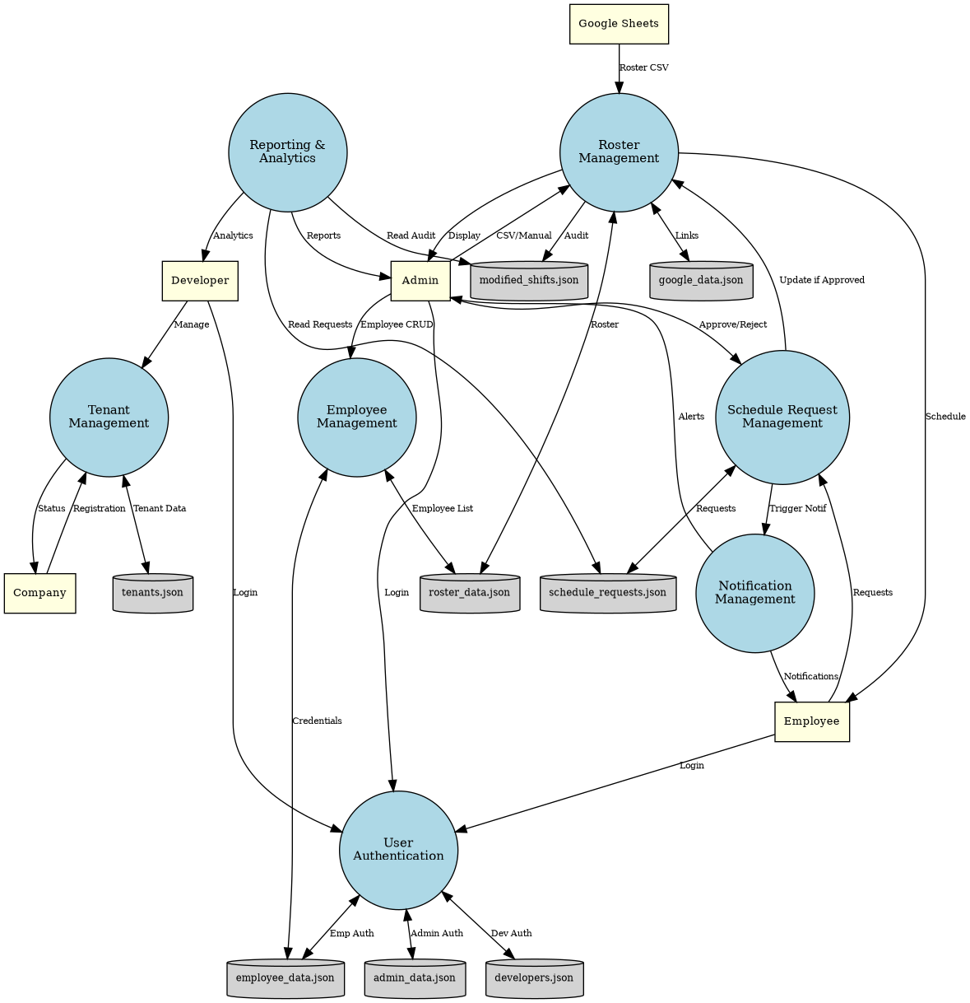
Level 1 Data Flow Diagram - NO VERSION NUMBERS

Slide 12
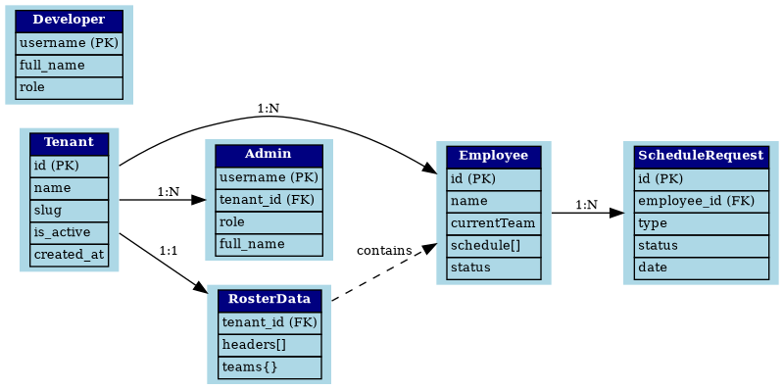
Entity Relationship Diagram

Slide 13
Security Features
HTTP-only cookies prevent XSS attacks
Subdomain-based tenant isolation
Session validation on every request
Input validation with Zod schemas
File upload restrictions and validation
Role-based access control (RBAC)
Audit logging for accountability

Slide 14
Technology Stack
Frontend: Next.js 14, React 18, TypeScript 5
Styling: CSS Modules, Modern UI
Icons: Lucide React
File Processing: Formidable, csv-parse
Deployment: Vercel (recommended)
Storage: JSON files (migrate to DB for scale)
Session: Cookie-based with HTTP-only flag

Slide 15
Future Enhancements
Native mobile apps (iOS/Android)
Home screen widget for shifts
Push notifications
Advanced analytics and reports
SSO (Single Sign-On) integration
Webhook support for third-party integration
Auto-approval rules for requests
Smart scheduling algorithms

Slide 16
Conclusion
Robust, scalable foundation for roster management
Clear separation of concerns
Multi-tenancy with complete isolation
Comprehensive features for all user roles
Ready for production deployment
Clear upgrade path for scale
Modern technology stack
Focus on security and data privacy

