Slide 1
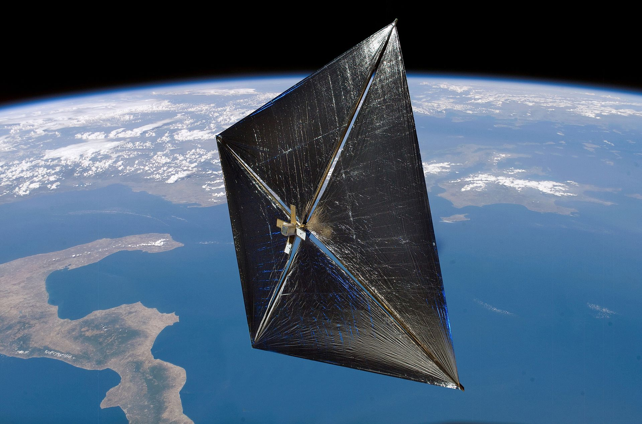


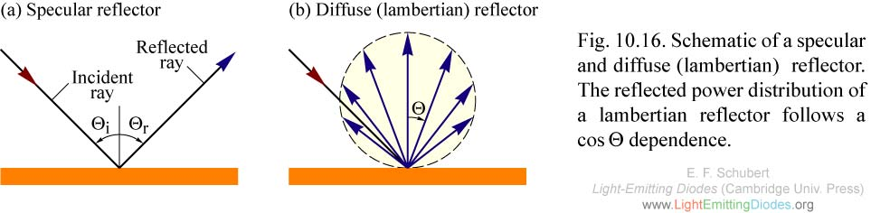
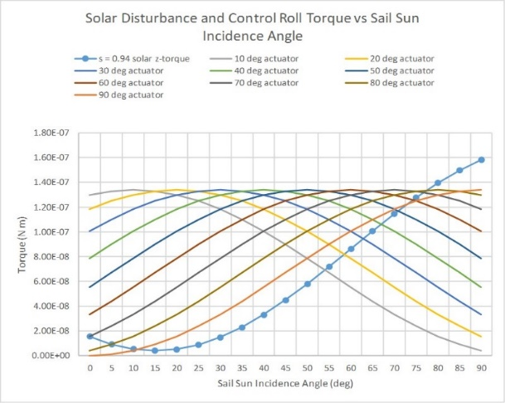
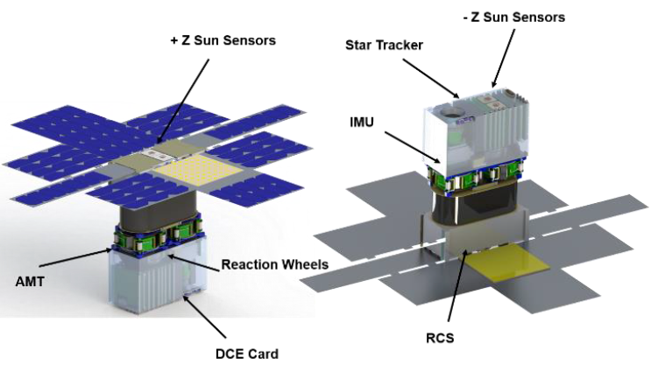
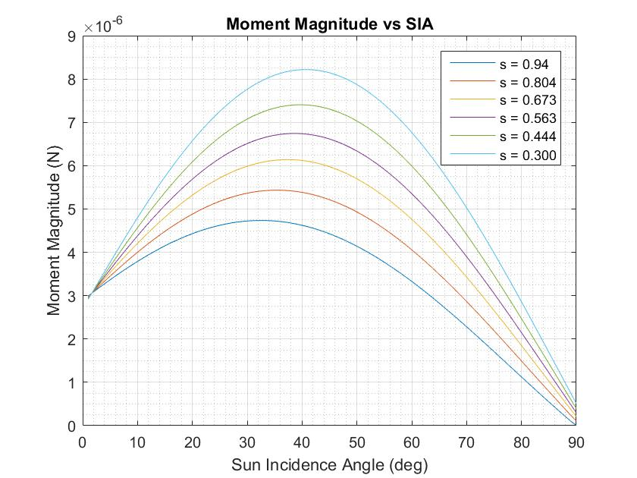
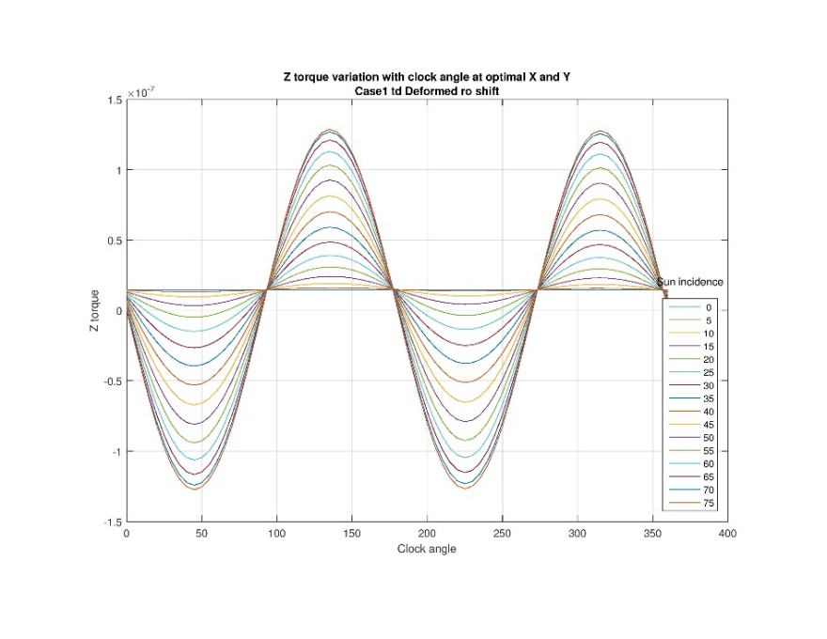
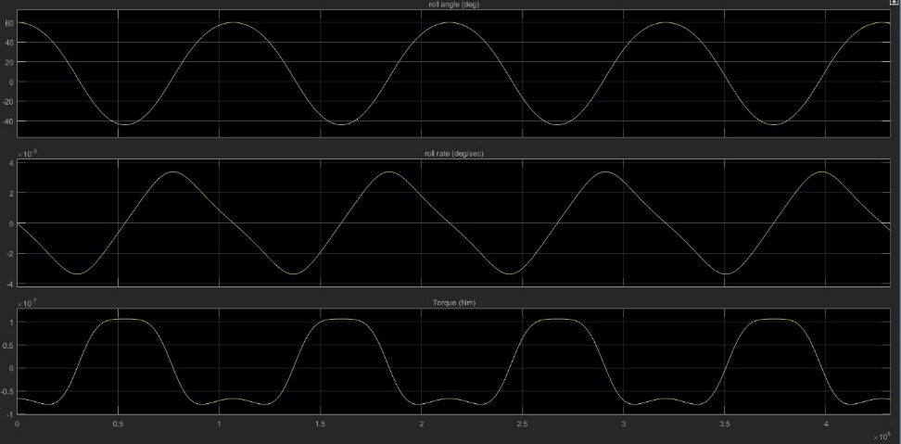
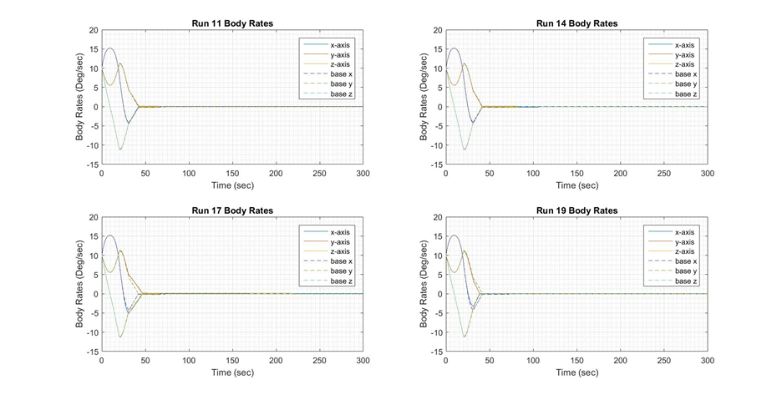
Near Earth Asteroid Scout ACS Validation and Verification William Koehrsen – Case Western Reserve University Mentor: Andrew Heaton - EV42: Guidance, Navigation, and Mission Analysis
Abstract/Background
Near Earth Asteroid (NEA) Scout is a 6-unit Cubesat that will rendezvous with and conduct optical imaging of a NEA within 1 Astronomical Unit (AU) of Earth. As a solar sail, NEA Scout is propelled by the reflection of photons from an 86 m² CP1 composite sail. NEA Scout weighs in at 11 kg and measures 30 x 20 x 10 cm. Primary mission objectives are to characterize a NEA for future crewed missions and to demonstrate the feasibility of solar sailing propulsion for interplanetary travel. The Guidance and Control (G&C) software manages the Attitude Control System (ACS), is developed in MATLAB, and is modeled using Simulink block diagrams. The ACS is composed of three primary actuators: reaction wheels (RW), a reaction control system (RCS), and an active mass translator (AMT). Sensors include a star tracker, an inertial measurement unit, and three sun sensors. Validation and Verification of the ACS model is composed of numerous small tasks rather than one large project. V&V encompasses
developing scripts
to model
segments of the
mission, collecting
data, analyzing
the data, reporting
findings to the G&C
team, and implementing software changes based on simulation results.
Modeling Specular Reflectivity Thrust Effects
The specular reflectivity coefficient, s,
measures the fraction of incident light that
is specularly
reflected by a
material. As this
value decreases
due to wrinkling of
the sail, the solar torque on the spacecraft increases, taxing the ACS.
The objective was to determine the effects of altering the specular coefficient on overall sail performance by simulating an attitude hold at a given roll angle. The solar incidence angle (SIA) was increased until the active mass translator (AMT) could no longer control the x- and y-axis momentum. The AMT works by shifting the sail CM relative to the CP to trim solar torques.
For a specular reflectivity value of 0.563, considered the lowest average value across the sail, the maximum SIA that could be tolerated was 55˚.The nominal max SIA is 50˚ for cruise phases.
Reflective Control Device Trade Study
A promising technology for propellantless attitude control is an RCD. By changing the fraction of light reflected by small areas of the sail, a control torque is generated.
Researchers at the University of Maryland have been studying
Polymer Dispersed
Liquid Crystals (PDLC)
for use in RCDs as
PDLC optical properties
can be switched from
opaque to transparent by an applied external voltage
The objective was to determine if RCDs
made using PDLC films would be a
feasible implementation for a NEA Scout- scale solar sail
As the thickness
of the PDLC films
decreases, the total
weight and power
consumption of the
device decreases,
although a larger area is required to generate the same torque. The total weight and power consumption of the RCDs was determined to be within reason.
An actuator angle of 40˚ was the best
choice for generating a z-axis control torque. Overall, the concept of RCDs for a solar sail was found to be practical and further research is ongoing for application
to a future NASA solar sailing mission.
Fig. 3. Specular vs Diffuse Reflection.
Fig. 7. RCD Application
Fig. 8. Control Torque.
Fig 1. NEA Scout Hardware Layout.
Fig 4. Magnitude of Solar Torque vs Sun Incidence Angle
Passive Roll Control Investigation
A significant fraction of fuel (240/1250 g) allocated for the NEA Scout mission is for roll (z-axis) momentum management of the RW by the RCS. Above a 5000 rpm threshold, the RCS jets fire to desaturate the RW which are responsible for precise attitude pointing.
At SIA > 20˚, there are stable roll angles around which the sail oscillates rather than continuing to build up momentum.
The goal was to characterize the initial conditions that would result in the attainment of these equilibrium angles.
Several initial configuration, including SIA = 20˚ and initial roll = 60˚, resulted in the sail achieving a stable roll angle. This demonstrates propellantless roll control is possible which could extend the mission and enable exploration of additional scientific targets.
RCS Manufacturing Variability Study
The reaction control system (RCS) is comprised of 2 on- and 4 off-axial cold gas thrusters and is responsible for spacecraft detumble, initial sun-pointing, managing z-axis momentum of the RW, performing the trajectory correction maneuver, and implementing safe mode recovery
The manufacturer of the RCS specifies tolerances of ±10% on thrust magnitude and ±0.5˚ on thrust direction. The objective
was to characterize the effects of this variation on spacecraft detumble after secondary deployment from the SLS MSA.
Cases were run starting with 10 deg/sec rotation on all body axes and were stopped when the RCS had nulled the rates to less than 0.1 deg/sec.
The baseline case
took 41.6 seconds
to detumble and
consumed 1.389
grams of fuel. Runs
were categorized by
the variation configuration and assessed in comparison to the baseline case for both the time to null rates and fuel usage.
The worst case resulted from a 0.5˚ offset in azimuthal and elevation angles of the jets and consumed 2.885 times the amount of fuel as the baseline case. However, while the fuel use was large relative to the baseline, compared to the total 1.25 kg of fuel on the spacecraft, it was considered to not be of concern to the entire mission
Conclusions
Six different investigations were completed as part of the NEA Scout Attitude Control System Validation and Verification.
RCS manufacturing variability should not significantly affect the detumble maneuver upon spacecraft deployment from SLS.
A decrease in the specular reflectivity coefficient due to sail wrinkling will result in a greater solar torque, but this torque will be manageable across the range of expected operating SIA.
Passive roll control through oscillation about a stable roll angle is possible depending on the initial conditions of the sail and would reduce overall fuel usage.
RCDs are a practical option for propellantless attitude control, and although they will not be incorporated into NEA Scout, RCDs using PDLC film are an advisable investment for future solar sails.
In the event of a loss of systems, the sail will flip and the back of the sail will face towards the sun. The booms will severely deform, and safe mode, defined as using the RCS to point the spacecraft at the sun, must be initiated for recovery.
The Blue Canyon Technologies sun sensors provided to the NEA Scout mission are properly configured and the data signals can be interpreted by the G&C software to determine a sun vector. Further testing procedures have been developed and will be implemented before the avionics testbed.
Fig. 5. Z-axis Solar Torque.
Fig. 6. Passive Roll Control Oscillation.
Fig. 2. Time to Detumble Plots.
References
McNutt, L., Johnson, L., Clardy, D., Castillo-Rogez, J., Frick, A., and Jones, L., Near-Earth Asteroid Scout, Huntsville, AL: NASA Marshall Space Flight Center, 2014.
Ma, D., Murray, J., and Munday, J., "Controllable Propulsion by Light: Steering a Solar Sail via Tunable Radiation Pressure", Advanced Optical Materials, Vol. 5, No. 4, 2016
Orphee, J., Diedrich, B., Stiltner, B., Becker, C., and Heaton, A., "Solar Sail Attitude Control System for the NASA Near Earth Asteroid Scout Mission", International Symposium on Solar Sailing, Huntsville, AL: NASA Marshall Space Flight Center, 2017.
Tsuda, Y., Mori, O., Funase, R., Sawada, H., Yamamoto, T., Saiki, T., Endo, T., Yonekura, K., Hoshino, H., and Kawaguchi, J., "Achievement of IKAROS — Japanese deep space solar sail demonstration mission", Acta Astronautica, Vol. 82, No. 2, 2013, pp. 183-188.

