Slide 1

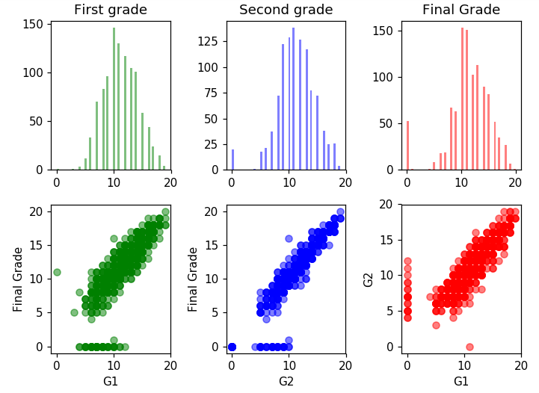
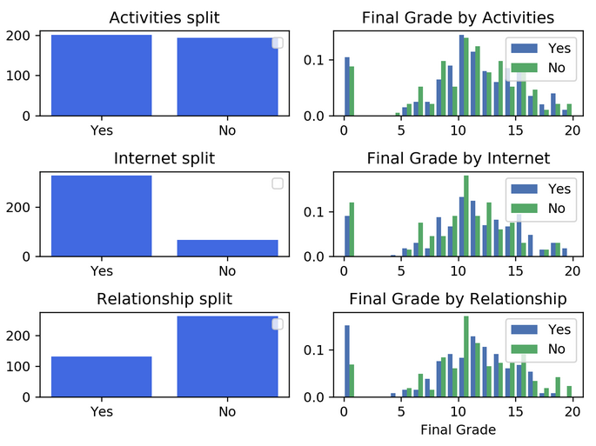
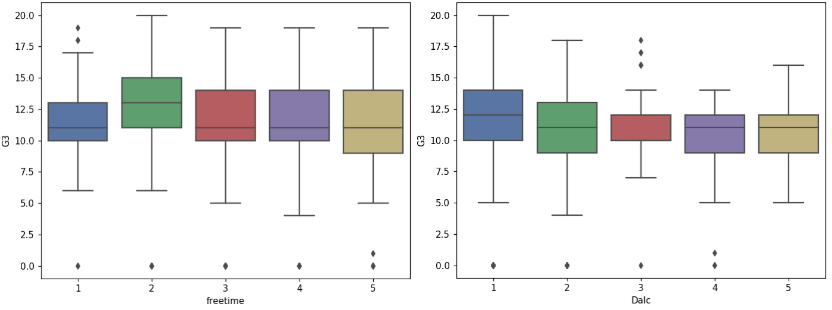
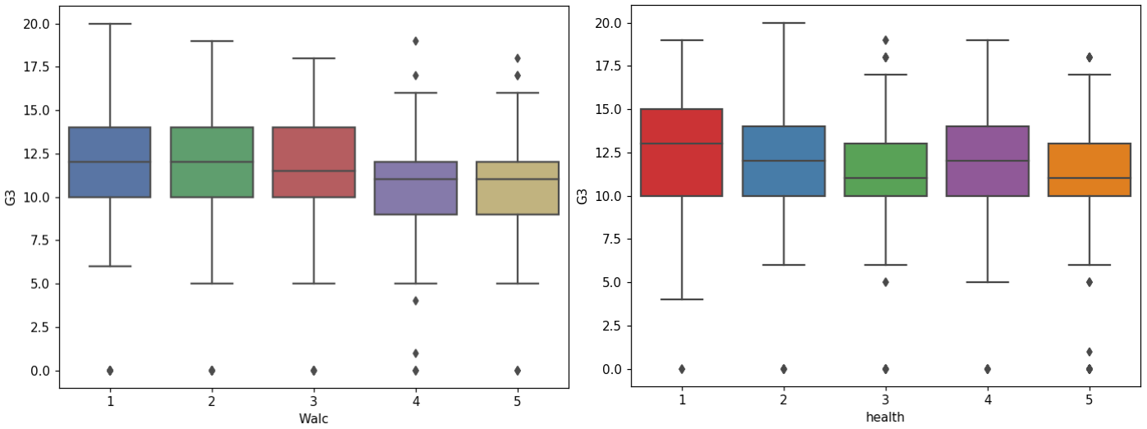
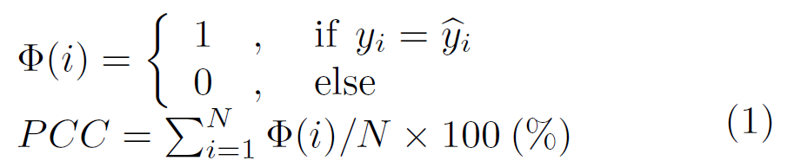
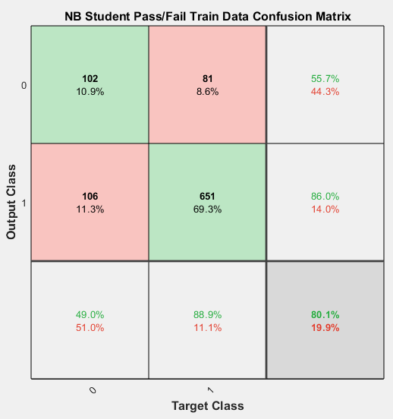
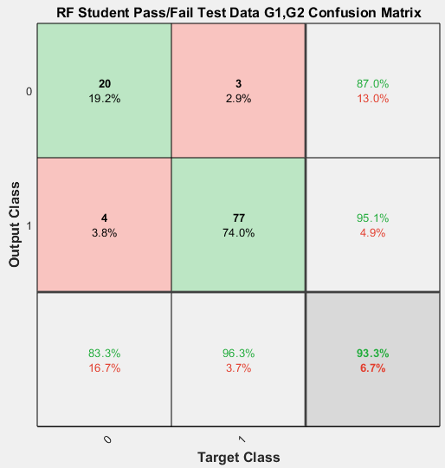
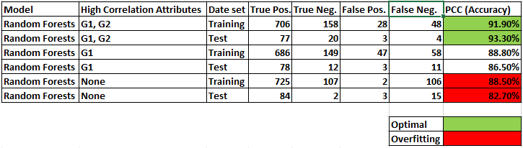
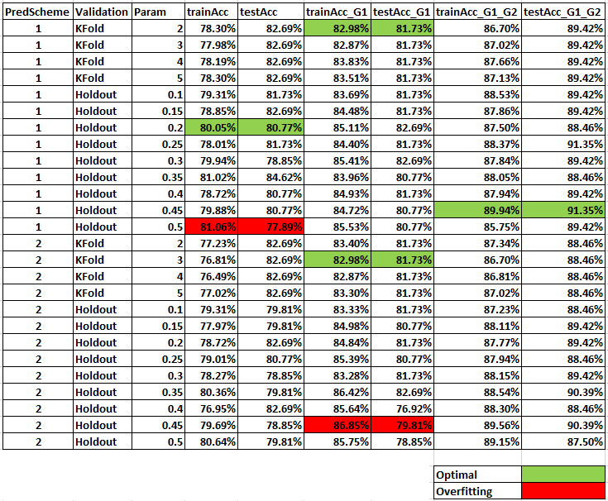
Student Performance Evaluation using Naïve Bayes and Random Forests
INM431 Machine Learning coursework – Daniel Sikar - daniel.sikar@city.ac.uk
Description and motivation
Studies in Europe and the USA have shown the fiscal and social costs of early school leaving, which typically reduces lifetime earnings and leads to higher unemployment incidence and duration, while the benefits of education include gain in net earnings and wealth, improved health status / life expectancy, lower reliance on government health and welfare programmes and reduced expenditures on criminal justice [1][2][3].
One important problem is to automatically detect students that are going to do poorly in a course early enough to be able to take remedial actions [4]. A number of Machine Learning algorithms have been used in student grade prediction. We base our study on prior work [5], using Naïve Bayes and Random Forests applied to secondary school student performance data.
Initial analysis of the data set including basic statistics
The data sets being investigated, made publicly available at the UCI Machine Learning Repository[6], were collected by using school reports and questionnaires, at two Portuguese secondary schools and refers to subjects of Mathematics (student-mat.csv) and Portuguese (student-por.csv). Both data sets contain the same column headers and were combined for the purpose of our analysis (student-labelled.csv).
The combined data set has 1044 observations and 33 attributes, consisting of 4 nominal, 13 binary and 16 numeric attributes, three numeric attributes being grades (G1, G2 and G3) following a 20-point grading scale. Attribute G3 contains the final grade. A "Result" binary attribute column was added with a value of 0 for fails (G3 less than 10) and a value of 1 for passes (G3 greater or equal to 10). Based on the "Result" attribute, the dataset was found to be unbalanced, with 78% passes and 22% fails, which shall be considered when evaluating predictive model performance.
In Fig. 1, the scatter plots show that there is strong correlation between the prior (G1, G2) and final (G3) grades and also between prior grades. The plots also show that there are outliers: data points where the final grade is zero. The data source does not explain why these grades are zero - if we assume the most likely explanation is that the student did not take the exam we could consider eliminating these from the analysis or perform analyses with and without these points.
The histograms imply that Final Grades are higher for students with internet access, no romantic relationship and extra-curricular activities. Statistical means are higher for these subsets.
The box plots suggest that students with some free time (freetime) and moderate amounts of alcohol intake during weekdays (Dalc) and weekends (Walc) have higher mean grades. According to the data source[5], attribute "Health" is described as "current health status (numeric: from 1 – very bad to 5 – very good)". Given the "health" by final grade "G3" box plot shows that students in poorest health have achieved higher mean grades, the described gradient is assumed to be inverted.
Additional data analysis box plots (not shown in Fig. 1), plotting “quality of family relationships (numeric: from 1 – very bad to 5 – excellent) versus final grade, show students with better family relationships have higher mean grades, the same being the case for students with parents with higher levels of education (numeric attributes Medu and Fedu).
Two models with their pros and cons
Fig. 1
Naïve Bayes
Pros
Computationally lightweight - when compared to Random Forests
Explainability – models are readily explainable through the assumption of independence, with attribute probabilities accounting for outcome
Cons
Assumption of independence – attributes are assumed to have no correlation, in our initial analysis, this has shown not to be the case
Random Forests - UNFINISHED
Pros
Pros – super pro
More pros
Even more pros
Cons
Explainability – models are not readily explainable. Code libraries may be extended such that attributes used in each Decision Tree are known, but were not known to exist by default
More cons
Even more cons
Hypothesis statement
Description of choice of training and evaluation methodology
Naïve Bay Kfold, holdout,
In classification, models are often evaluated using the Percentage of Correct Classifications (PCC). A high PCC (i.e. near 100\%) suggests a good classifier[5]. Where N is the number of observations and ŷ denotes the predicted value for the i-th observation.
Choice of parameters and experimental results
Naïve Bayes
Internally, the function used (fitnb DOUBLE CHECK) [7] cite mvmn / normal distributions see model DistributionNames
Categorical x numeric
Fig. 2 shows a confusion matrix for a trained model. It was not the best trained model and is shown to highlight the fact that is performing marginally better than a straight prediction of the majority class (78%).
Random Forests
Fig. 3 shows a confusion matrix for a trained RF and overall performing model (BN or RF).
When previous grades G1 and G2 (High Correlation Attributes) are not used, there is a marked drop in performance with the trained model predicting outcomes for the test data set, suggesting it is overfitting.
The best model was also found to be the optimal, with the smallest proportional difference between training and test data set accuracies.
Fig. 2
Fig. 3
Analysis and critical evaluation of results - TODO
NAÏVE BAYES
RANDOM FORESTS
* Dataset, with 1044 observations was found to be small
Table 1 – Evaluation of Random Forests
Table 2 – Naïve Bayes Grid Search
Lessons learned and future work - TODO
It would be better to use a bigger data set.
The data sets were found to be unbalanced, as a result, a hypothetical model which only predicts the majority class could have matched the performance of the majority of Naïve Bayes models trained without attributes G1 and G2. To address this issue, a potential improvement would be to artificially boost the minority classes, with methods such as ADASYN and bootstrapping (DOUBLE CHECK) .
References
[1] Belfield, C. (2008) Cost of Early School-Leaving and School Failure (p. 48). New York: Economics department, City University of New York
[2] Brunello, G. & Paola, M.D. 2014, "The costs of early school leaving in Europe", IZA Journal of Labor Policy, vol. 3, no. 1, pp. 1-31.
[3] Fernandez-Gutierrez, M. & Martinez, J. 2014, "THE NON-MONETARY COSTS OF EARLY SCHOOL LEAVING: ESTIMATION IN TERMS OF YEARS OF GOOD HEALTH", EDUCACION XX1, vol. 17, no. 2, pp. 241-263.
[4] Meier, Y., Xu, J., Atan, O. & van der Schaar, M. 2016;2015;, "Predicting Grades", IEEE Transactions on Signal Processing, vol. 64, no. 4, pp. 959-972.
[5] P. Cortez and A. Silva. Using Data Mining to Predict Secondary School Student Performance. In A. Brito and J. Teixeira Eds., Proceedings of 5th FUture BUsiness TEChnology Conference (FUBUTEC 2008) pp. 5-12, Porto, Portugal, April, 2008, EUROSIS, ISBN 978-9077381-39-7.
[6] https://archive.ics.uci.edu/ml/datasets/Student+Performances Retrieved 23.11.2019

