Slide 1
Title: Personalized recommendation for Scratch.
M.Sc. Dissertation
Roman Shaikh
M.Sc. Computer Science, Data Science 2018/19
Date 27/06/2019

Slide 2
Overview
What is Scratch?
A block based programming language
Developed by the Lifelong Kindergarten group at the Massachusetts Institute of Technology
Drag and combine code blocks to make a range of programs, including animations, stories, musical instruments and games.
It’s a bit like the programming equivalent of LEGO!
Learn coding concepts and create interactive projects without needing to learn a text-based programming language.
Notes:
Scratch is a graphical programming language, developed by the Lifelong Kindergarten group at the Massachusetts Institute of Technology. Children can drag and combine code blocks to make a range of programs, including animations, stories, musical instruments and games. It’s a bit like the programming equivalent of LEGO!-
If children have a Scratch user account then projects can also be shared online with the Scratch community, giving children a real audience for their creations.
Scratch is used in many schools as part of the curriculum. Scratch is free to use and children can use it at home as well as during Code Club.

Slide 3
Scratch Community.
Subtitle – Calibri Regular 14pt
A huge online community of people sharing programs made in Scratch and associated resources - tutorial videos on YouTube, lesson plans, program ideas.
On Scratch, members have the capability to share their projects and get feedback.
Projects can be uploaded directly from the development environment to the Scratch website and any member of the community can download the full source code to study or to remix into new projects
Members can also create project studios, comment, tag, favorite, and "love" others' projects, follow other members to see their projects and activity, and share ideas.
Projects range from games to animations to practical tools. Additionally, to encourage creation and sharing amongst users, the website frequently establishes "Scratch Design Studio" challenge

Slide 4
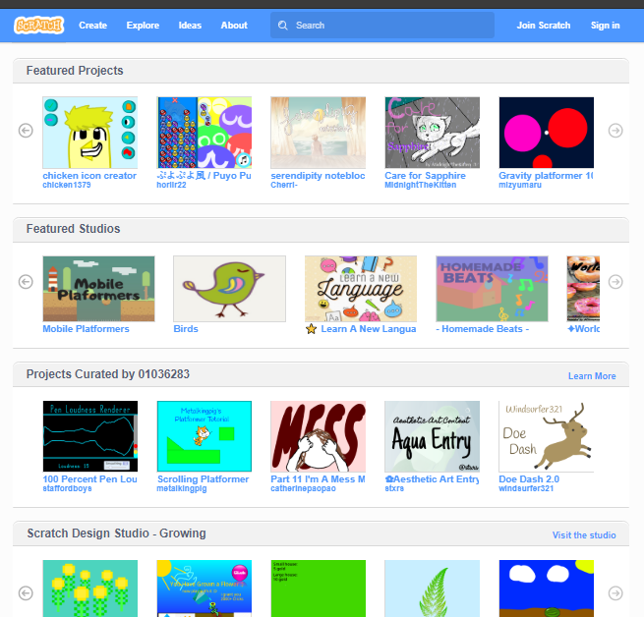
Research Question
The problem of discovery.
Current ways of discovering content.
Featured Projects, Featured Studios, Projects Curated by, Growing etc.
No personalised recommendations.
We try to explore ways recommend tailored content to the users.
Improved user involvement.?

Slide 5
Personalised recommendation
Recommender system is an information filtering technique, which provides user with information, he/she may be interested in.
Information overload problem.
Tasks -
Selecting neighborhood
Ex. 100 most similar neighbors
Scoring Items from neighborhood
Scoring can be Average, *Weighted average or a Multiple linear regression

Slide 6
Recommender system
Exploring the types
Content based Filtering
Information
Knowledge based
Collaborative Filtering
User-user
Item-Item
Dimensionality reduction
Others
Critique/Interview based recommendation
Hybrid techniques

Slide 7
Recommender system
Types
Computing similarities
Social network analysis
Algorithms
Pearson correlation
Spearman rank correlation
Weighting similarities.
Notes:
The Pearson correlation is also known as the “product moment correlation coefficient” (PMCC) or simply “correlation”.
It assesses how well the relationship between two variables can be described using a monotonic function.

Slide 8
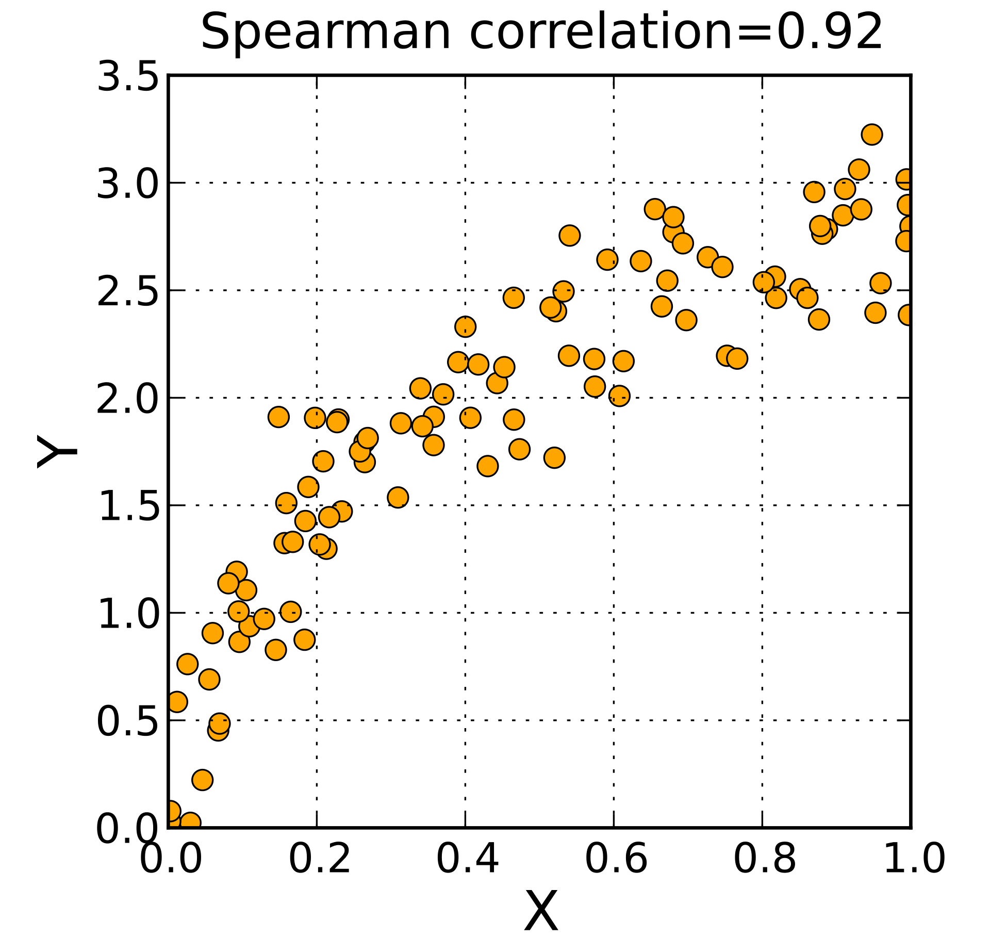
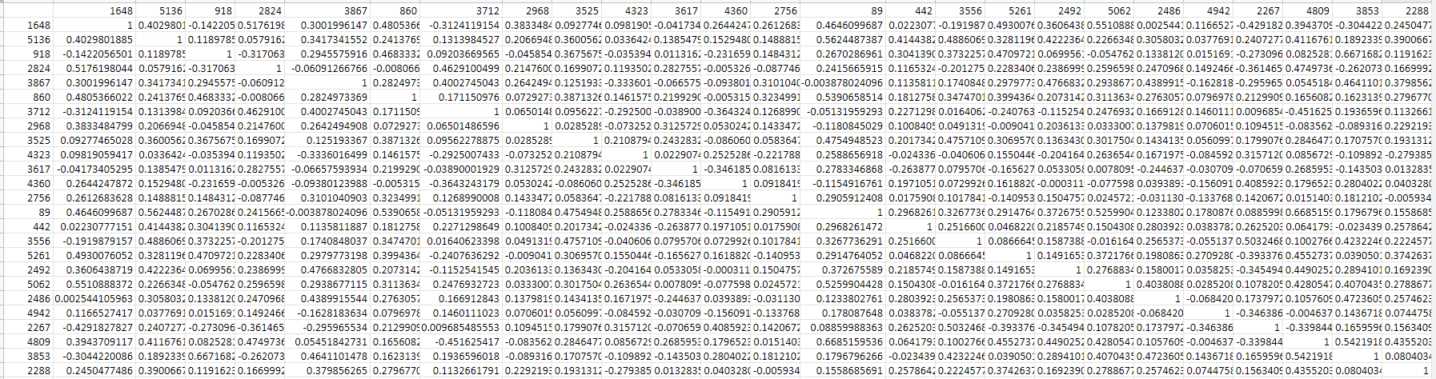
Preliminary Results
Progress soo far

Slide 9
Future plans
Pipeline for next month
Accuracy of prediction
Usefulness of recommendation
Correctness
Non-obviousness
Diversity
Computational Performance
Text mining on comments and code to find context and interest.
TFIDF on tag data to identify context / content-based filtering

Slide 10
Thank You

