Slide 1
SPRUCE
A training-free context compiler
82.3%
vs. 66.7% · compiled vs. dense
Notes:
Title. Last time SPRUCE was a learned sparse-attention selector. Since then the whole approach changed and the results got dramatically better.

Slide 2
Then
Learned sparse selector
O(log L)
17 / 25
25 / 25
selector, inside attention
recovered vs. dense
dense — kill switch missed
Notes:
The old SPRUCE trained a small scorer to prune attention inside the model, approximating dense attention cheaply. It missed its own kill switch: it recovered 17 of 25 retrieval cases where dense got all 25. Rather than tune it further, we asked why dense was the thing being approximated at all.

Slide 3
Dense isn't the ceiling
66.7%
dense accuracy, full document
40.0%
at 64K–128K, evidence early in the document
Notes:
On a sealed 288-question retrieval suite, dense reading of the whole document only got two-thirds right, and it got worse the farther the evidence sat from the question — 40 percent at 64K-128K for early-document answers. If dense degrades with length and distance, removing most of the document before the model reads it can be more accurate than reading everything, not just cheaper.

Slide 4
How it compiles
1
2
3
4
5
→
→
→
→
Sketch
Build
Descend
Compile
Read
No training. No paraphrasing. Exact source text.
Notes:
SPRUCE hashes the prompt into Boolean lexical sketches over 64-token blocks, builds a fixed radix-2 tree by union over children — no learned parameters — beam-searches it with width 16 to find 4 source blocks, expands and repairs them to paragraph boundaries, and hands the frozen model a short, exact packet to read with ordinary dense attention.

Slide 5
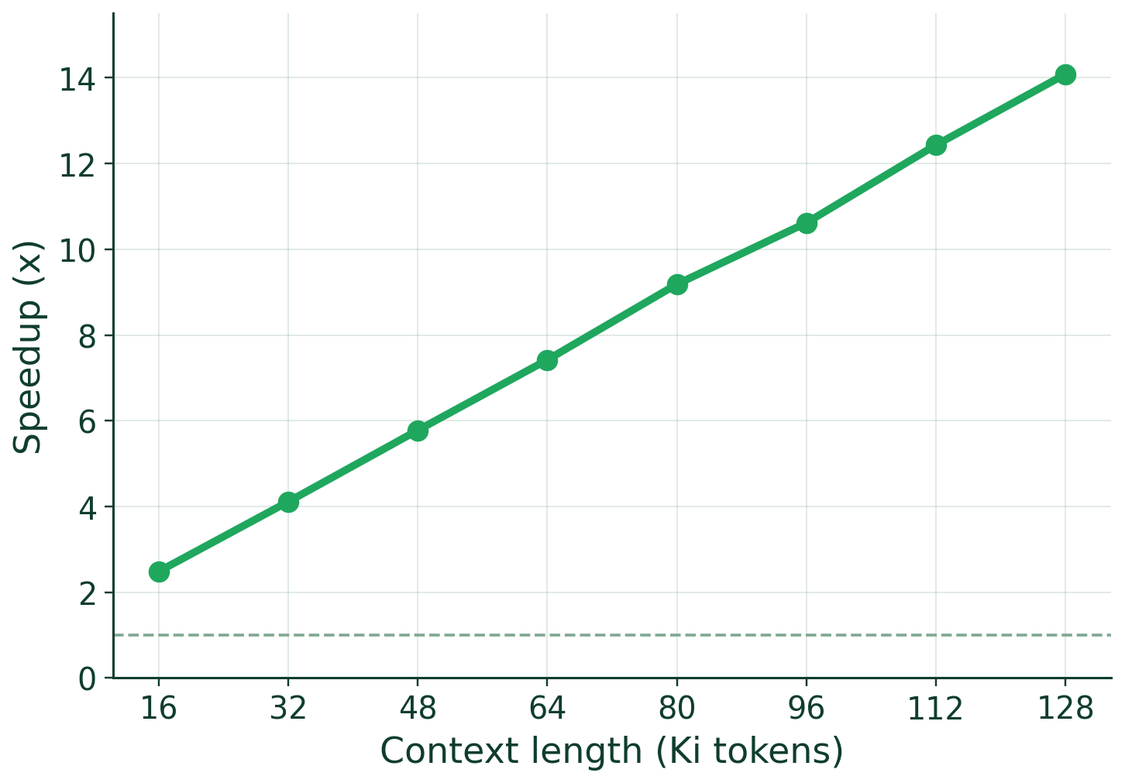
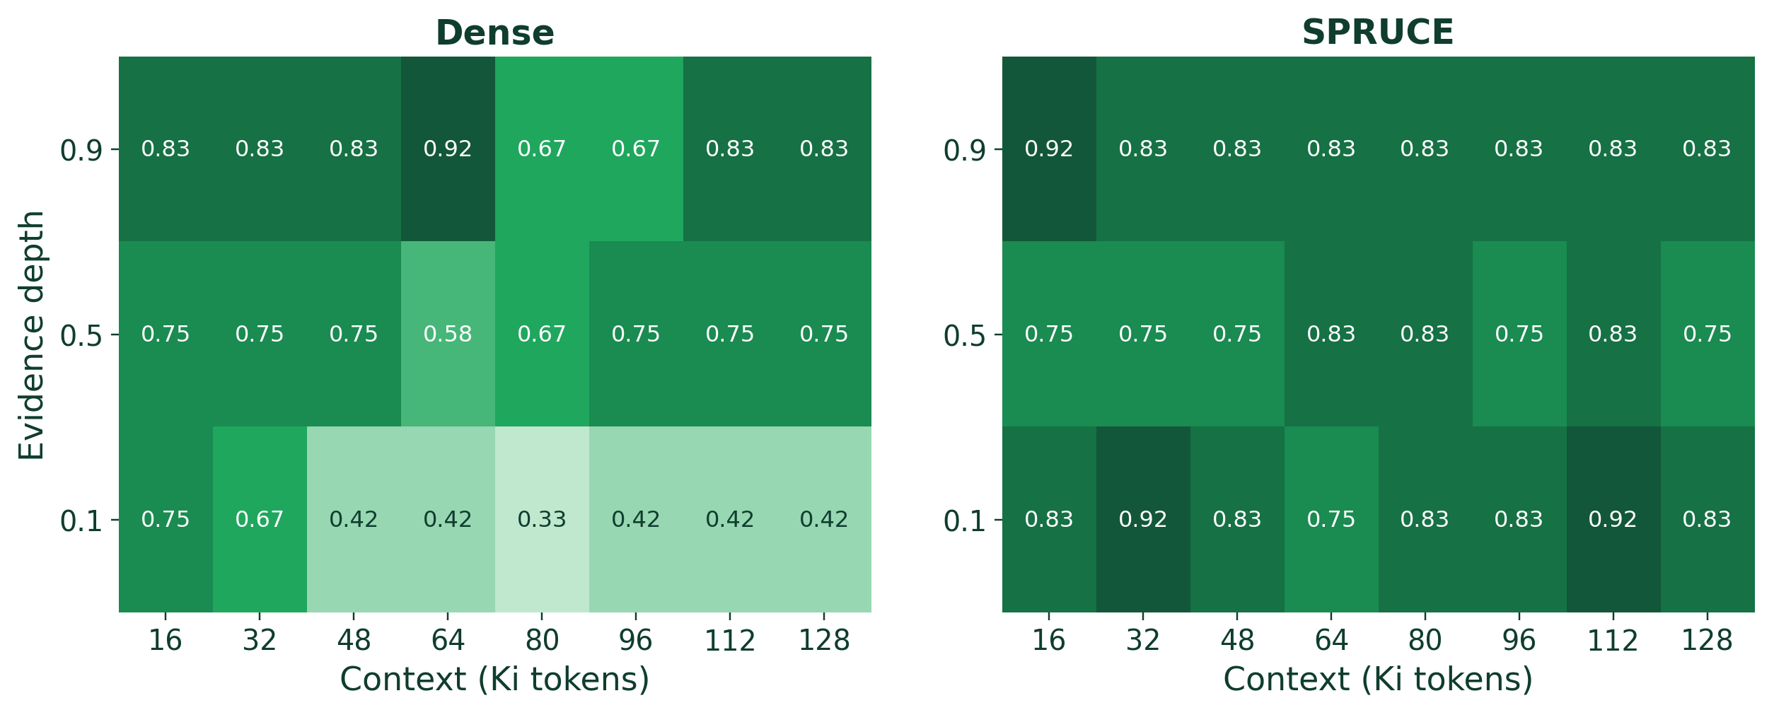
The scoreboard
192/288
237/288
40% → 83%
hardest case: shallow evidence, 64K–128K
Dense
SPRUCE
p = 5.2×10⁻⁷
63 wins vs. 18
Notes:
237 of 288 correct compiled versus 192 dense, a McNemar p of five-times-ten-to-the-minus-seven, 63 wins for the compiler against 18 for dense. The gain is largest exactly where dense was weakest: shallow evidence at long context, 40 percent up to 83 percent.

Slide 6
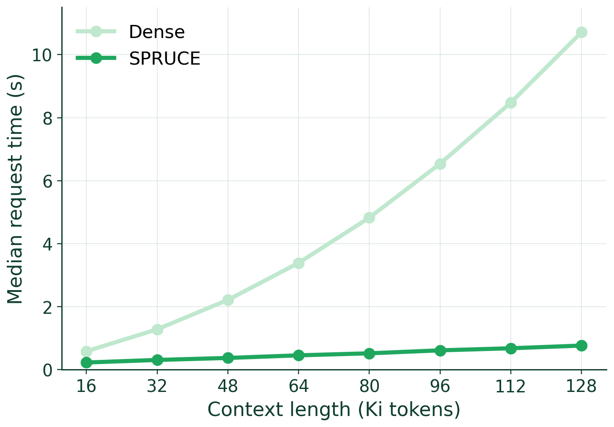
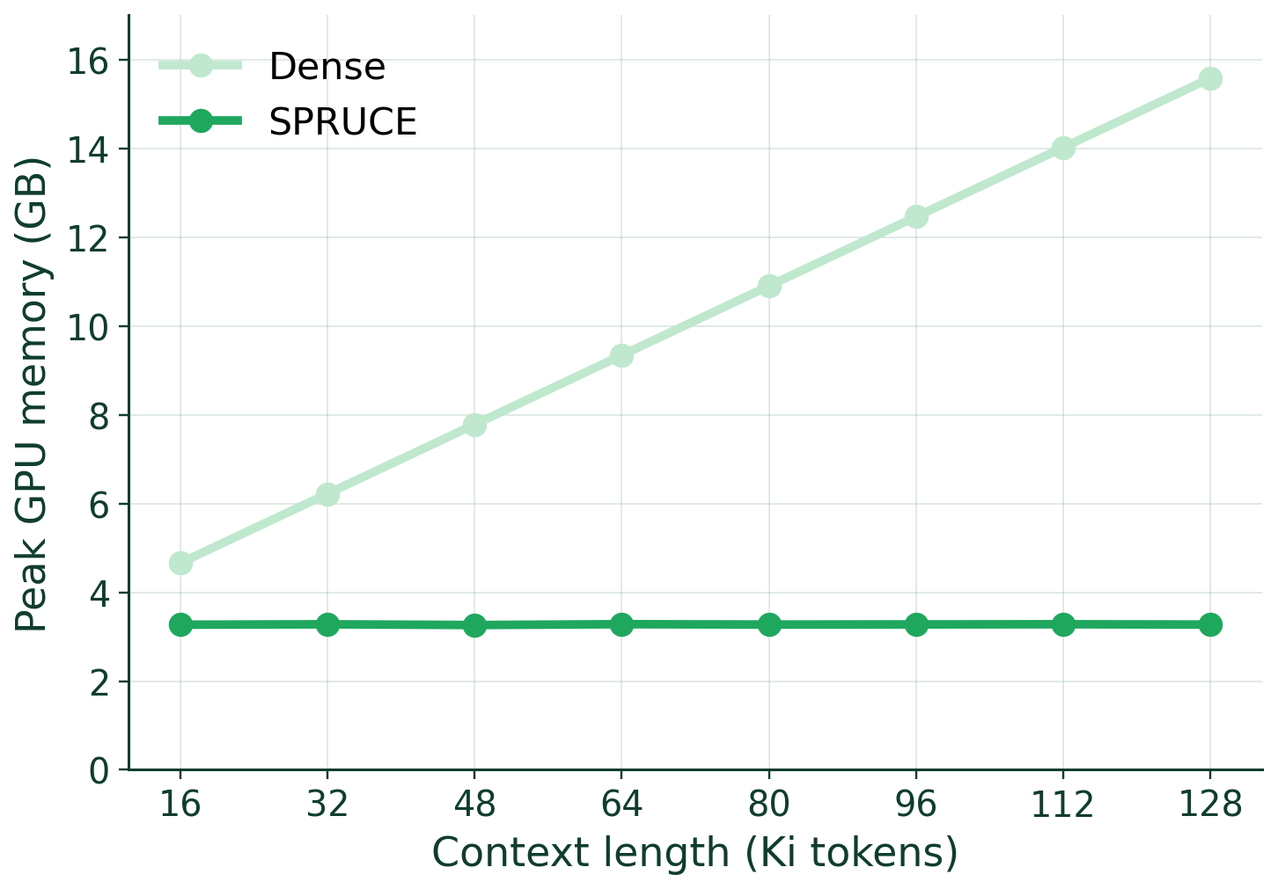
And it's cheaper
~1,850 tok
2.5–14×
3.27 GB flat
constant packet
faster
peak memory
Notes:
Because the packet is sized by the beam budget, not the document, the model sees a near-constant 1,850 tokens whether the prompt is 16K or 128K. That's 2.5 to 14 times faster at every length tested, with flat memory instead of dense's climb toward 16 gigabytes.

