Slide 1
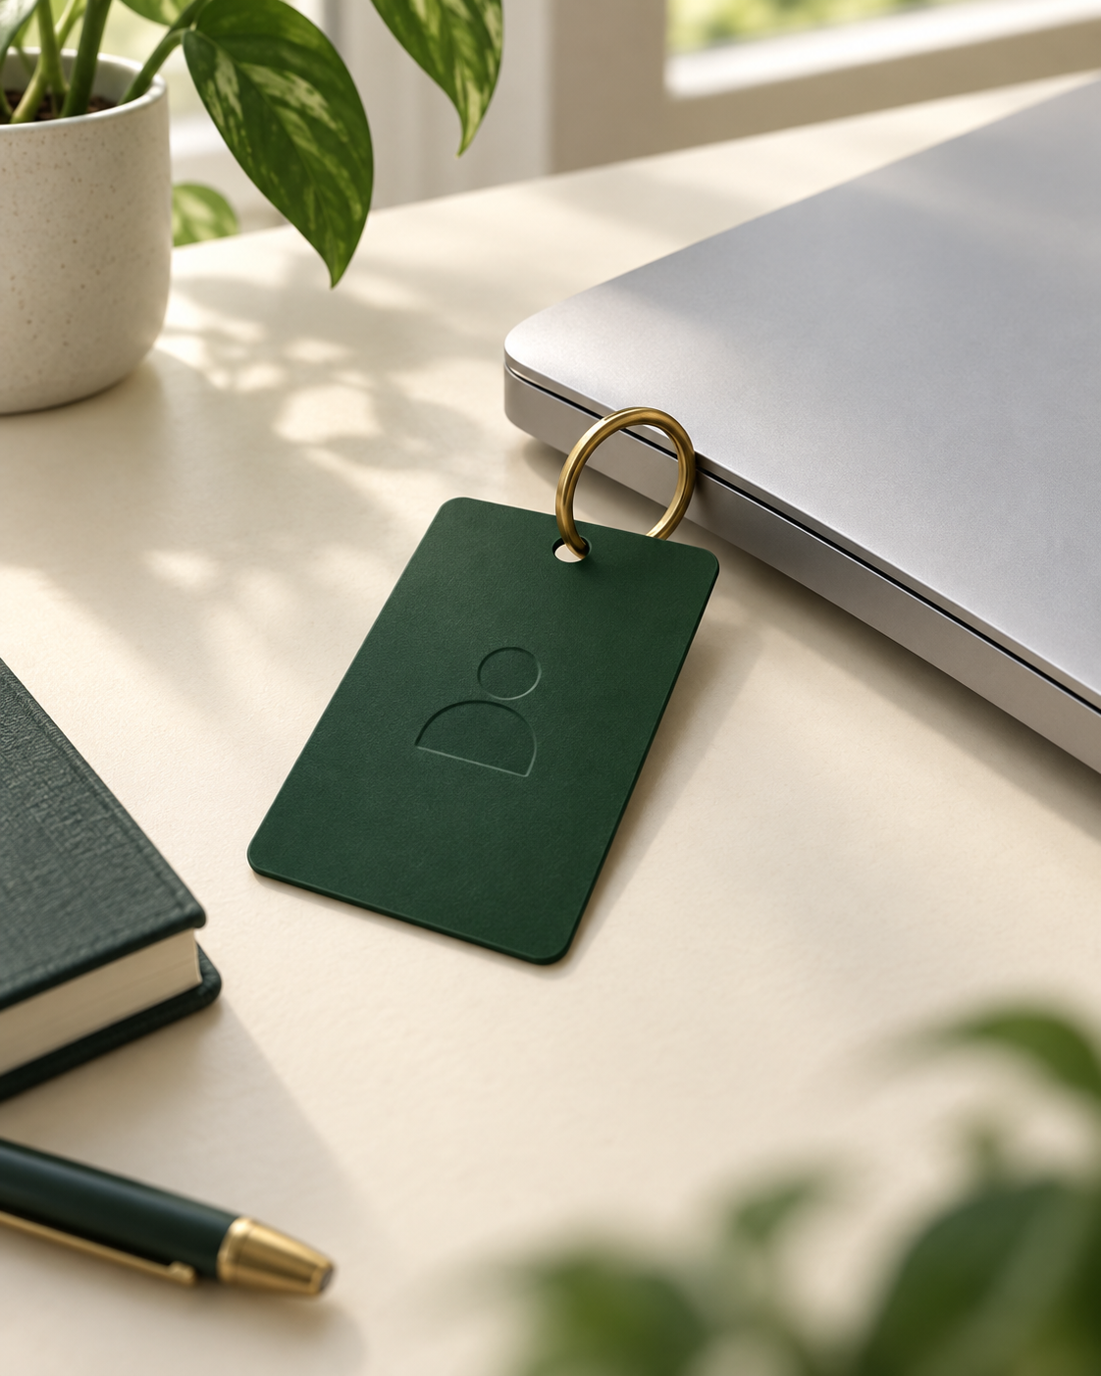
How logging
in works
Passwords, sessions and tokens
through a student quiz demo
Mayerfeld Practicum Program
AI Operations Specialist
Notes:
Introduce the group’s question: how does a website remember who you are, and what can someone do with a stolen token? We use invented Alice and Bob accounts in a dedicated Supabase project. The cover image is an illustrative access-card metaphor generated for this deck, not an app screenshot. Suggested introduction: 15 seconds.

Slide 2
The student portal
Public questions
Private results
Anyone can load the quiz.
The page asks three questions about login.
Alice and Bob submit their own answers.
Each account can read its own result.
Supabase determines the student from the token and calculates the score.
02
Notes:
The Node server only serves files. Supabase Auth checks credentials and tokens. Postgres stores attempts and applies row-level security. The browser sends answer numbers, and the database calculates the score. Repeated attempts are allowed and the app displays the latest one. This teaches authentication and ownership, not exam anti-cheating. Source: project add-student-quiz.sql and student/js/quiz.js.

Slide 3
Password sign-in
01
The browser sends the credentials
HTTPS protects the email and password while they travel to Supabase Auth.
02
Supabase checks the password
It checks against a salted bcrypt hash stored on the server.
03
Supabase returns a session
The browser receives tokens and clears the password field.
03
Notes:
Say: the password goes to the authentication service over HTTPS. Supabase stores a salted bcrypt hash rather than a recoverable plaintext password. Hashing and transport encryption serve different purposes. We observe the login request and session response, while the hashing explanation comes from the provider documentation. Browser password-manager saving is separate from our app.
Sources
https://supabase.com/docs/guides/auth/password-security

Slide 4
A session contains two different tokens
Item | Purpose | Used by this demo
Session | A signed-in relationship with the service | Saved across page reloads
Access token | Identifies the user on API requests | Attached as a bearer token
Refresh token | Obtains a new access token | Stored, but automatic refresh is absent
After the access token expires, sign in again to continue.
04
Notes:
The access token is a JWT with an expiry. A refresh token lets a client obtain a new token pair. This teaching app stores the pair but does not implement automatic refresh. A production client may manage refresh automatically. Avoid suggesting that every website stores sessions the same way.
Sources
https://supabase.com/docs/guides/auth/sessions

Slide 5
How the page remembers you
In this browser
After a reload
localStorage keeps the session under:
The page restores the token.
It fetches the result again.
Supabase checks the request again.
team3-student-session-v1
Other designs use cookies, including HttpOnly cookies that page JavaScript cannot read.
05
Notes:
Open DevTools, then Application, Local Storage, and the local site origin. Find the session key without sharing the full token values. Reload the page to show restoration. localStorage is specific to the browser origin, so localhost and 127.0.0.1 do not share the same storage. Page scripts can access localStorage, which is why script injection is a token-theft risk. Cookies are an alternative design, not part of this implementation. Source: student/js/state.js. Storage background: https://developer.mozilla.org/en-US/docs/Web/API/Window/localStorage and https://developer.mozilla.org/en-US/docs/Web/HTTP/Reference/Headers/Set-Cookie.

Slide 6
Inside an access token
Claim | Meaning | Illustrative value
sub | User identifier | Alice’s user UUID
email | Account email | alice@test.invalid
role | Database role | authenticated
exp | Expiry time | Unix timestamp
Decoding reads the claims. Supabase verifies the signature and validity.
06
Notes:
Expand Decoded token claims in Swagger after attaching a token. These slide values are illustrative labels, not a real JWT or full payload. JWTs have a header, payload and signature. Readable claims do not prove authenticity. Editing sub while retaining the signature caused HTTP 401 in our live checks. JWTs in this app do not contain the password.
Sources
https://supabase.com/docs/guides/auth/jwt-fields
https://supabase.com/docs/guides/auth/signing-keys

Slide 7
Authentication and permission
Authentication identifies the user. Authorization limits what that user can do.
Request | Token | Result in this app
Read Alice’s result | No bearer token | 401: sign in required
Read Alice’s result | Alice’s valid token | 200: Alice’s result
Read Bob’s result | Alice’s valid token | 403: access refused
Row-level security also protects direct table queries.
07
Notes:
Use the get_result RPC for the clear 401/200/403 comparison. The user ID in a request does not grant permission to access that user. Postgres RLS limits rows by auth.uid(). A direct SELECT for another user returns 200 with an empty array, which differs from the RPC’s explicit 403. Establish that Bob has a result before demonstrating the empty array. These cases passed real-provider checks. Sources: add-student-quiz.sql and VALIDATION.txt.
Sources
https://supabase.com/docs/guides/database/postgres/row-level-security

Slide 8
A copied token can submit as Alice
What the audience sees | What the server uses
Portal signed in as Bob | Bearer token in the Swagger request: Alice
Swagger submits [1,1,1] | Supabase records a new Alice attempt
Bob remains on the portal | Alice’s latest score changes to 1/3
The token attached to the request determines the account.
08
Notes:
This is the scenario we tested. Swagger keeps a separate bearer copy in memory. Signing in as Bob on the portal does not replace an already attached Alice token. Clicking Use portal session does replace it. With Alice’s bearer, wrong answers add a new Alice attempt, rather than changing an old row. Refresh Alice’s result to see the latest attempt. Compare the response student_id with the student roster to confirm ownership. All live credentials remain outside this deck. Source: user-confirmed demo behavior on 9 October 2026, student/swagger.js and add-student-quiz.sql.

Slide 9
What a stolen token allows
With Alice’s valid bearer
Limits in this demo
Read Alice’s quiz result.
Submit another attempt as Alice.
It does not disclose her password.
It cannot become Bob by editing sub.
Database permissions still apply.
09
Notes:
A bearer credential authorizes whoever presents it, so the server cannot distinguish the owner from someone holding the same stolen token. Our live tests covered reading and submitting as the owner, rejecting a modified signature, and rejecting another user’s records. Do not claim token theft can never affect passwords or other account settings: those operations depend on provider policy. Sources: VALIDATION.txt and the quiz API.
Sources
https://supabase.com/docs/guides/auth/signing-keys
https://supabase.com/docs/guides/database/postgres/row-level-security

Slide 10
Logout and expiry
01
The portal removes its saved session
Successful local sign-out also revokes refresh tokens for that session.
02
A copied access token can remain usable
The API can accept an already-issued JWT until its expiry.
Signing out of a tab does not erase copies held elsewhere.
10
Notes:
Demonstrate the copied token by attaching Alice’s session in Swagger, signing out on the portal, and calling the API again without refreshing Swagger. Existing access JWTs can remain valid until expiry. This app uses local sign-out scope and does not add an active-session lookup to every database call. We observed post-logout access, but did not wait through a natural expiry test.
Sources
https://supabase.com/docs/guides/auth/signout

Slide 11
Sign in with Google
01
The browser opens Google’s sign-in flow
Google handles the password or an existing Google session.
02
Supabase receives a code and checks Google’s identity response
The redirect flow uses OAuth 2.0 with OpenID Connect for identity.
03
Supabase creates the app’s session
The app receives its own session without receiving the Google password.
11
Notes:
This is a conceptual explanation for the teammate’s Google section. Our student app does not run live Google OAuth. In the redirect flow, the service exchanges the authorization code and validates Google’s response. Google authentication and the resulting Supabase application session are distinct. Explain that the password stays on Google’s sign-in surface. Provider and application tokens have different purposes.
Sources
https://supabase.com/docs/guides/auth/social-login/auth-google
https://developers.google.com/identity/openid-connect/openid-connect

Slide 12
Live walkthrough
Student portal
Swagger
1 Read a result as a guest: 401
2 Sign in and submit the quiz
3 Reload and inspect the session
4 Attach and remove the bearer
5 Ask for another student’s result
6 Replay Alice’s copied token
The response student_id tells us whose attempt the server saved.
12
Notes:
Rand’s live demo: allow about five minutes. Use PRESENTATION.txt for the detailed clicks. Run both pages on the same host and port. Seed a Bob attempt before the ownership check. To demonstrate replay, keep Alice’s token attached in Swagger, sign into Bob on the portal, submit [1,1,1] in Swagger, then sign into Alice and fetch her result. Do not click Use portal session while Bob is logged in unless you intend to switch the bearer to Bob. The portal does not automatically refresh after an external Swagger submission. No password or live token belongs in screenshots sent to the group.

Slide 13
What the demo proves
The server follows the token
attached to each request.
A saved session explains why you stay signed in.
Database policies keep one account out of another’s results.
A stolen bearer can still act within its owner’s permissions.
13
Notes:
Audience check: Bob is signed in on the portal, but Swagger sends Alice’s bearer. Whose latest quiz result changes? Answer: Alice’s. Ask why: the server verifies the request token, and the database uses its subject as the owner. A browser label is not the authority. Handoff to questions.

Slide 14
Assignment coverage
Requirement | Where we cover it
Password handling | HTTPS request and hashing explanation
Sessions and tokens | Access token, refresh token and expiry
Storage and remembered login | DevTools localStorage and page reload
Find and decode a token | Swagger’s local claims viewer
Sign in with Google | Conceptual explanation for the teammate
Stolen-token abilities and limits | Read, submit, cross-user denial and logout
Concrete working example | Real Supabase student portal and Swagger
Hashing and Google sign-in are explanations. The student API demonstrations run live.
14
Notes:
Appendix for the group. The original assignment asks how login works, where sessions live, Google sign-in, a token inspection example, and attacker capabilities. All topics have a place in this presentation. Google remains conceptual unless the teammate brings a separate demo. The implementation is a teaching example with invented users, repeated submissions and a visible source answer key. No additional app feature is needed to satisfy the assignment.

Slide 15
Sources
Supabase Auth
Password security, sessions and sign-out
Supabase JWT
Claims reference and signing keys
Supabase Database
Row-level security
Google Identity
OpenID Connect and Supabase Google sign-in
Our demo
Source code and observed API responses
Direct links appear in the notes of the relevant slides.
15
Notes:
Primary sources checked 9 October 2026. Full references follow.
https://supabase.com/docs/guides/auth/password-security
https://supabase.com/docs/guides/auth/sessions
https://supabase.com/docs/guides/auth/jwt-fields
https://supabase.com/docs/guides/auth/signing-keys
https://supabase.com/docs/guides/database/postgres/row-level-security
https://supabase.com/docs/guides/auth/signout
https://supabase.com/docs/guides/auth/social-login/auth-google
https://developers.google.com/identity/openid-connect/openid-connect
https://github.com/RandRise/supabase-login-explained
https://developer.mozilla.org/en-US/docs/Web/API/Window/localStorage
https://developer.mozilla.org/en-US/docs/Web/HTTP/Reference/Headers/Set-Cookie
The cover is an illustrative generated image. No live tokens, passwords or storage dumps appear in this file.

