Slide 1
Web Development
HTML
Lecture 2

Slide 2
Learning Outcomes
Describe HTML, XHTML, and HTML5
Notepad VS Dream weaver
Identify the markup language in a web page document
Use the html, head, body, title, and meta elements to code a template for a web page
Configure the body of a web page with headings, paragraphs, line breaks, divs, lists, and blockquotes
Formatting text with phrase elements
Configure special characters
Creating links
Inserting images

Slide 3
HTML stands for
Hyper Text Markup Language

Slide 4
It’s a markup language NOT a programming language
(set of Web Programming
standardized codes)
used to create Web pages with Hyperlinks.

Slide 5
Hyperlinks
Connect pages together.

Slide 6
What is an HTML document?
It is a Plain-text files (also known as ASCII) that contains the markup tags.
An HTML file is created using any text editor (e.g.: TextEdit on Macintosh, Notepad on a Windows machine).
• You do not need an Internet connection to compose and view HTML pages.
The World Wide Web Consortium (http://w3c.org) sets the standards for HTML and its related languages.

Slide 7
Q: What does Markup mean?
A: Markup is extra information placed with text to describe how the text is to be interpreted.
Interpretation can by accomplish by computer program such as a Web browsers

Slide 8
Difference between a markup language & programming language ?
Markup Language:
A language designed to format text.
Programming languages are compiled. But in markup language is just interpreted by the browser.
E.g. HTML.XML,XHTML and MML
Programming language:
It is an set of instructions to the computer to perform.
The computer hardware is responsible to execute an programming language and browser is needed for an markup language.
Few Programming Languages are JAVA,C++,COBOL,C++ and VB

Slide 9
Q: What can we do with HTML Document?
A: we can,
• Publish online documents with headings, text, tables, lists, photos, etc.
• Retrieve online information via hypertext links, at the click of a button.
•Design forms for conducting transactions with remote services, for use in searching for information, making reservations, ordering products, etc.
•Include spread-sheets, video clips, sound clips, and other applications directly in their documents.

Slide 10
Q: What is the best thing about HTML?
A: All computer platforms can understand it. Web pages created on a PC can be viewed, for example, on a Macintosh or a Unix computer.

Slide 11
Basic HTML Editors
There are many ways to write HTML code.
It can be done using
Notepad in Windows.
TextEdit in MAC.
OR
Edited by using a professional HTML editor like:
Adobe Dreamweaver

Slide 12
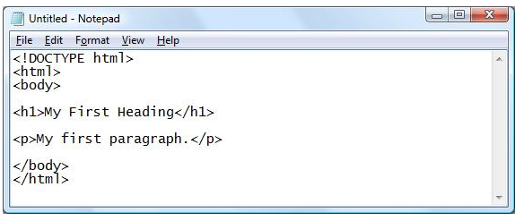
Notepad
To start the Notepad go to:
Start → All Programs → Accessories → Notepad
Create a shortcut on your desktop for a quick access

Slide 13
Better Editors
Notepad++ in Windows.
TextWrangler in MAC

Slide 14
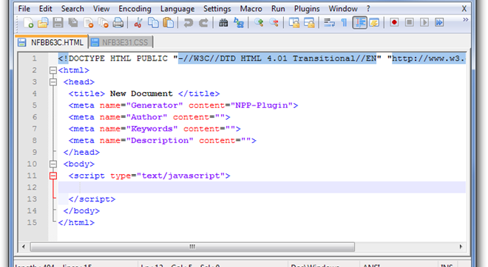
Notepad++

Slide 15
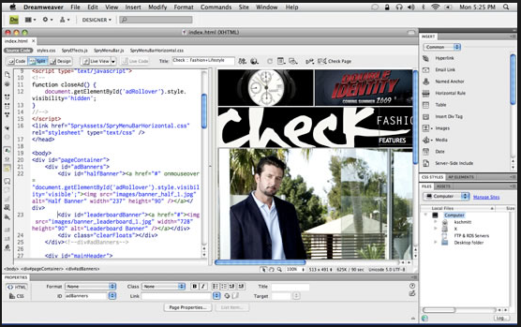
Dreamweaver
To start Dreamweaver go to:
Start → All Programs → Adobe Dreamweaver
Source: www.creativemac.com

Slide 16
Notepad VS. Dreamweaver
notepad++ starts up much faster than Dreamweaver.
stores your tabs from your last session.
GUI simplifies things
Dreamweaver has an auto-finish feature (but be careful sometimes its tricky and does not work properly)
Both Notepad++ and Dreamweaver offer colored code.

Slide 17
Notepad VS. Dreamweaver
There is no right or wrong.
It is what YOU prefer.

Slide 18

HTML 5
Newest draft version of HTML/XHTML
Supported by modern browsers
Safari, Google Chrome, Firefox, Internet Explorer 9
Intended to be backwards compatible
Adds new elements
Adds new functionality
Edit form data
Native video and audio
And more!

Slide 19
Lets start learning about webpages..

Slide 20
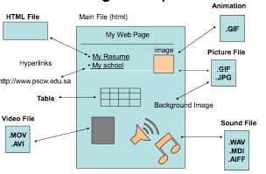
Web Page Components

Slide 21
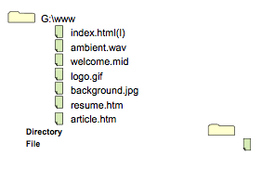
Website Files

Slide 22
Writing
HTML

Slide 23
Tags are keywords surrounded by angle brackets
<html>
Tags normally come
in pairs
<b>...</b>
The end tag looks like the start tag except for a forward slash (/)

Slide 24

elements should be in
lower case
CAPS LOCK?
Yea its kind of like that!

Slide 25
The Minimal HTML Document
Each document consists of head and body text.
The head contains the title, and the body contains the actual text that is made up of paragraphs, lists, and other elements.
<!DOCTYPE html>
<html>
<head>
</head>
<body>
</body>
</html>
This tells your browser that this is an HTML tag
This identifies the first part of your HTML-coded document that contains the title.
This identifies the body part of your HTML-coded document.

Slide 26
HTML Tags
In HTML there are two major types of markup tags:
– Empty tags are used for page formatting. They have no closing tag and so doesn’t enclose any text.
– Container tags are used to manipulate or control the contents placed within them. They have a starting tag and an ending tag (/ slash preceding the tag).

Slide 27
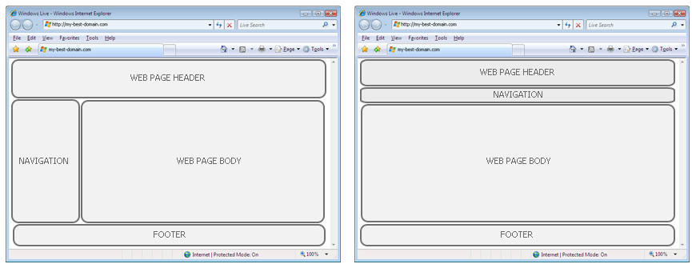

Slide 29
HTML Elements
An HTML element is everything from the start tag to the end tag
Element start tag/ opening tag.
<head>
Element content
</head>
Element
Element end tag/ closing tag.
Some HTML elements have empty content which are closed in the start tag.

Slide 30
HTML Files Extensions
Filename.htm
Filename.html

Slide 31
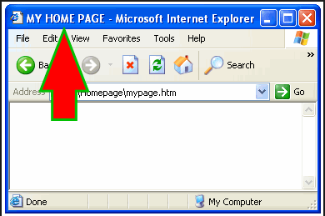
Start with a Title

Slide 32
Start with a Title
Every HTML document needs a title.
Here is what you need to type in the header part of your HTML document:
<title>
My first HTML document
</title>

Slide 33
Meta Tags
Used by Browsers and search engine and how your site info is displayed in the search results.
<meta> tags always go inside the <head> element.
Suggested Meta tags to include: charset, description, keywords, author and refresh.
Useful resource:
http://www.youtube.com/watch?v=aTaIMu01_bc

Slide 34
Meta Tags
Example:
<head>
<meta charest=“utf-8”>
<meta name=“description” content=“web development class, course code: is 211”>
<meta name=“keywords” content=“internet, pscw”>
<meta name=“author” content=“amal aleidi”>
<title>web development class web page</title>
</head>

Slide 35
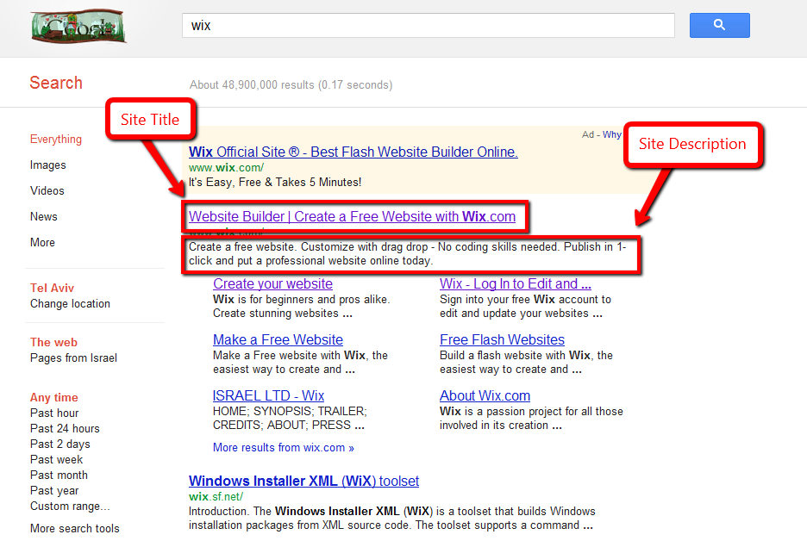
Meta Tags

Slide 36
A basic HTML5 web page template
The DTD (Document type definition). Always first line, identifies the type of the markup language.
<! DOCTYPE html>
<html lang=“en”>
<head>
<title> </title>
<meta charest=“utf-8”>
</head>
<body>
</body>
</html>
Optional, specifies spoken language of the document
Describes the characteristic of the webpage. Utf-8 is widely supported by the browser

Slide 37
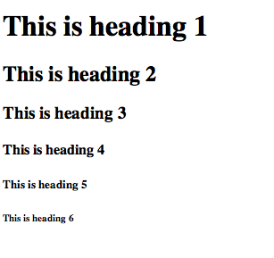
HTML Headings
Source Code
Result
<!DOCTYPE html>
<html>
<body>
<h1>This is heading 1</h1>
<h2>This is heading 2</h2>
<h3>This is heading 3</h3>
<h4>This is heading 4</h4>
<h5>This is heading 5</h5>
<h6>This is heading 6</h6>
</body>
</html>
http://www.w3schools.com

Slide 38

HTML Paragraphs
Source Code
Result
<!DOCTYPE html>
<html>
<body>
<p>This is a paragraph.</p>
<p>This is another paragraph.</p>
</body>
</html>

Slide 39
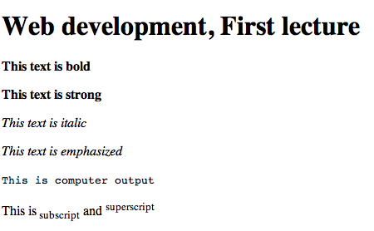
HTML Formatting
Source Code
Result
<!DOCTYPE html>
<html>
<body>
<p><h1> Web development, First lecture </h1></p>
<p><b>This text is bold</b></p>
<p><strong>This text is strong</strong></p>
<p><i>This text is italic</i></p>
<p><em>This text is emphasized</em></p>
<p><code>This is computer output</code></p>
<p>This is<sub> subscript</sub>
and <sup>superscript</sup></p>
</body>
</html>
http://www.w3schools.com

Slide 40
Practice 1
Create your first Webpage

Slide 41
Commenting Your Files
You might want to include comments in your HTML files. Comments in HTML are like comments in a computer program—the text you enter is not used by the browser in any formatting and is not directly viewable by the reader just as computer program comments are not used and are not viewable.
Comments such as the name of the person creating the file, the software and version used in creating a file, or the date that a minor edit was made are the norm.
To include a comment, enter:
<!-- your comments here -->
You must include the exclamation mark and the hyphens as shown.

Slide 42
HTML Attributes
HTML elements can have attributes
Attributes define an element
Attributes are always specified in the start tag
All attributes are made up of two parts: a name and a value
-The name is the property you want to set
- The value is what you want the value of the property to be

Slide 43
HTML Links
The HTML <a> tag defines a hyperlink.
href (hyperlink reference) is an attribute to specify a URL for the page
Source Code
<a href="http://www.psu.edu.sa/pscw">This is PSU Web site</a>
indicates the link’s destination
The URL
The link’s Text
Result
This is PSU Web site

Slide 44
HTML Links
By default, links will appear as follows in all browsers:
An unvisited link is underlined and blue
A visited link is underlined and purple
http://www.w3schools.com

Slide 45
HTML Links
Possible values for href:
An absolute URL (remote link)
– link to other websites:
<a href="http://yahoo.com">Yahoo</a>
A relative URL (local link)
- link to pages in your own site
<a href="index.htm">Home</a>
An anchor URL - points to an anchor within a page
(used a lot in back to top links)
href="#top” (local link)
Example: http://www.vfsglobal.co.uk/saudiarabia/applicationcentre.html#4
Note: A linked page is normally displayed in the current browser window, unless you specify another target.
http://www.w3schools.com

Slide 46
HTML Links (CTD)
Email Hyperlink:
Automatically launch the default mail program configured for the browser
If no browser default is configured, a message is displayed
<a href="mailto:me@anydomainname.com"> me@anydomainname.com</a>

Slide 47
Opening link in a new Window or tab
Add target="_blank“
Example: <a href=“http://www.yahoo.com“ target=“_blank“>Yahoo</a>

Slide 48
The Anchor Link
1. <a id=“CIS">identifying the anchor link</a>
2. Create a link to the “CIS School" inside the same document:
<a href="#CIS">Visit the CIS school section</a>
-------------------------------------------------
Or, create a link to the "Useful Tips Section" from another page:
<a href="http://www.psu.edu.sa/html_links.htm#CIS"> Visit CIS school</a>

Slide 49
Empty Tags
Stand-alone, or void tag (No closing tag)

Slide 50

Empty Tags
Line Break <br>
Causes the next element or text to display on a new line.
Source Code
Result
<!DOCTYPE html>
<html>
<body>
Jim Rohn:<br>
“Don't wish it were easier, <br> wish you were better"<br>
…

Slide 51
Empty Tags Line Break
XHTML syntax: <br />
HTML syntax: <br>

Slide 52
Empty Tags
Horizontal Rules <hr>
The <hr> tag In HTML5, the <hr> tag defines a thematic break.
A horizontal rule is useful to separate major sections of your document.
You will format this in CSS in later lectures

Slide 53
Adding Lists
HTML supports:
Unordered Lists (or Unnumbered lists)
Ordered Lists (or Numbered lists)
Definition lists (or Description lists)
You can nest lists too, but use this feature sparingly because too many nested items can get difficult to follow.

Slide 54
Unordered Lists
Starts with an opening list <ul> (for unordered list) tag
Enter the <li> (list item) tag followed by the individual item
End the entire list with a closing list </ul> tag
Source Code
Result
<ul>
<li> apples </li>
<li> bananas </li>
<li> oranges </li>
</ul>
Apples
Bananas
oranges
The <li> item can contain multiple paragraphs. Indicate the paragraphs with the <P> paragraph tags.

Slide 55
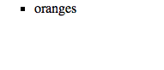
Unordered Lists
Changing bullets
Different types of bullets can be used.
Example:
<ul type=square>
<li>oranges </li>
</ul>
The “type” attribute in the ul tag is obsolete in HTML5. we will learn how to config this later.
Source Code
Result

Slide 56
Ordered Lists
A numbered list (also called an ordered list, from which the tag name derives) is identical to an unnumbered list, except is uses <ol> instead of <UL>.
• The items are tagged using the same <li> tag.
The following HTML code:
<ol>
<li>apples </li>
<li>bananas </li>
<li>oranges </li>
</ol>
Source Code
Result
Apples
Bananas
oranges

Slide 57
Ordered Lists
A start value can be mentioned as well as the type of symbol/character used:
• The items are tagged using the same <li> tag.
The following HTML code:
<ol start=3 type=i>
<li>apples </li>
<li>bananas </li>
<li>oranges </li>
</ol>
The “type” attribute in the ul tag is obsolete in HTML5. We will learn how to configure this later.
Source Code
Result
Apples
Bananas
oranges

Slide 58

Description List (Definition Lists )
The <dl> tag defines a description list.
It is used in conjunction with <dt> (defines terms) and <dd> (describes each term)
Web browsers generally format the definition on a new line and indent it
E.g http://www.w3.org/MarkUp/html3/deflists.html
<dl>
<dt>HTTP </dt>
<dd>Short for Hyper Text Transfer Protocol, the underlying protocol used by the World Wide Web.. </dd>
</dl>
Source Code
Result

Slide 59
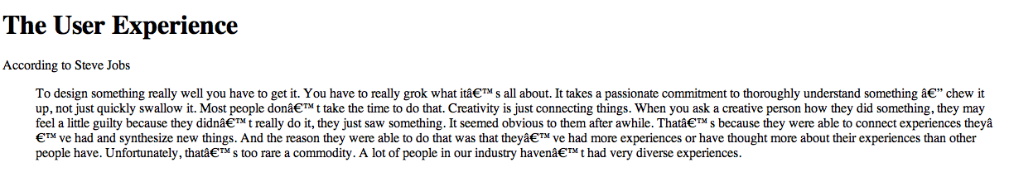
Blockquote
Display block quoted text in a special way (intended from both left and right margins)
Source Code
<h1>The User Experience </h1>
<p> According to Steve Jobs </p>
<blockquote> To design something really well you have to get it. You have to really grok what it’s all about. It takes a passionate commitment to thoroughly understand something — chew it up, not just quickly swallow it. Most people don’t take the time to do that. Creativity is just connecting things. When you ask a creative person how they did something, they may feel a little guilty because they didn’t really do it, they just saw something. It seemed obvious to them after awhile. That’s because they were able to connect experiences they’ve had and synthesize new things. And the reason they were able to do that was that they’ve had more experiences or have thought more about their experiences than other people have. Unfortunately, that’s too rare a commodity. A lot of people in our industry haven’t had very diverse experiences.</blockquote>
Result

Slide 60
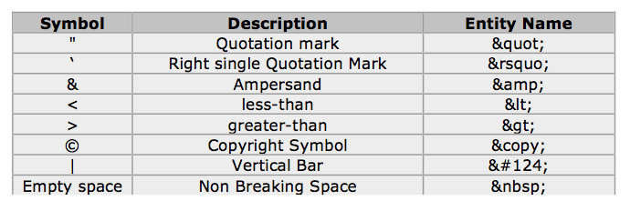
Special Characters
Some characters (symbols) are reserved in HTML5. For example, you cannot use the > and < signs or the copyright symbol © within your text because the browser could mistake them for markup. You need to use the special characters sometimes called Entity characters.

Slide 61
Characters Formatting
HTML has two types of styles for individual words or sentences: logical and physical.
Logical styles tag text according to its meaning.
Physical styles indicate the specific appearance of a section.

Slide 62
Phrase elements
Indicate the context and meaning of the text
Element | Example | Usage
<b> | bold text | Text that has no extra importance but is styled in bold font by usage and convention
<em> | emphasized text | Causes text to be emphasized in relation to other text; usually displayed in italics
<i> | italicized text | Text that has no extra importance but is styled in italics by usage and convention
<mark> | mark text | Text that is highlighted in order to be easily referenced (HTML5 only)
<small> | small text | Legal disclaimers and notices (“fine print”) displayed in small font-size
<strong> | strong text | Strong importance; causes text to stand out from surrounding text; usually displayed in bold
<sub> | _{sub} text | Displays a subscript as small text below the baseline
<sup> | ^{sup} text | Displays a superscript as small text above the baseline
<kbd> |  | Fixed space font

Slide 63
The div Element
Short for division. The div element configures structural block area on a web page with empty space above and below.
It is a container for grouping other HTML elements.
The div element tag:
<div> </div>

Slide 64
The div Element
Specify a unique name for your div using the id attribute.
The div element tag:
<div id=“……”> </div>
The id attribute can be used on any HTML element. Specifies a unique id for the element.
The id naming rules:
Must contain at least one character.
Never use space characters.

Slide 65
The div Element
Example of creating div’s:
<body>
<h1> this is a div example </h1>
<div id=“content”>
<p> this is the content division </p>
</div>
</body>

Slide 66
Inserting an image
Use the <img> tag to indicate the image
Use the src attribute to indicate the image location.
Include alt attribute that describe the image. Alt is short for alternative text.
Example:
<img src = "monkey.png” alt = "Picture of a happy monkey" />
P.S Make sure your image is in your web site directory folder

Slide 67
Image as a Link
<a href="http://www.website.com"><img src=”hyperlinkedImage.jpg" alt=”alternitavetext”> </a>

Slide 68
Writing Valid XHTML
Check your code for syntax errors
Benefit:
Valid code → more consistent browser display
W3C XHTML Validation Tool
http://validator.w3.org

Slide 69
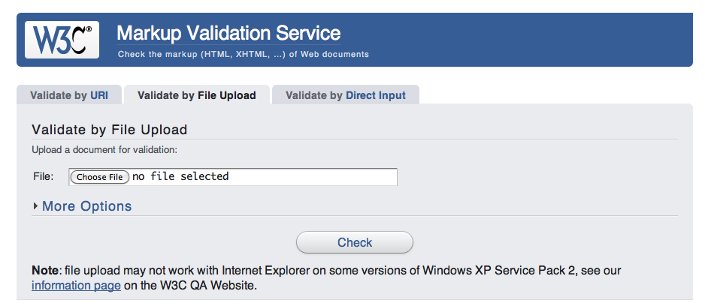
Writing Valid XHTML

Slide 70
Writing Valid XHTML
Use the validate by upload to upload your index.html file that we created in the tutorial. Browse and upload the file. Check the validation result.
Now Delete any opening tag of your HTML code and upload the file again and check the validation result.

Slide 71
Practice 1
create a folder in “My documents”
Rename the folder to: “firstWebsite”
Launch note pad
Type the HTML code (the template)
Go to file → Save as → navigate to your folder location → save your file under the name “index.html” (index is a common for the homepage)
Add a title and one paragraph
Test your page

Slide 72
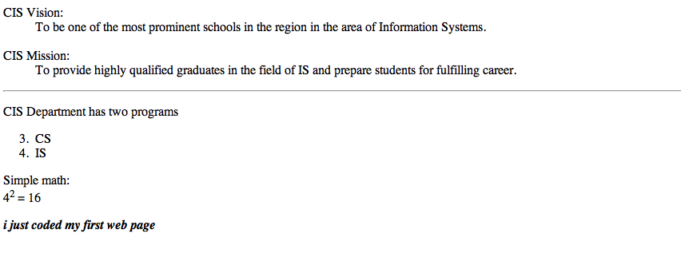
Tutorial 1A
Create this

Slide 73
Tutorial 1A Answer

Slide 74
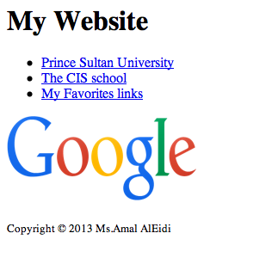
Tutorial 1B
Create this page:

Slide 75
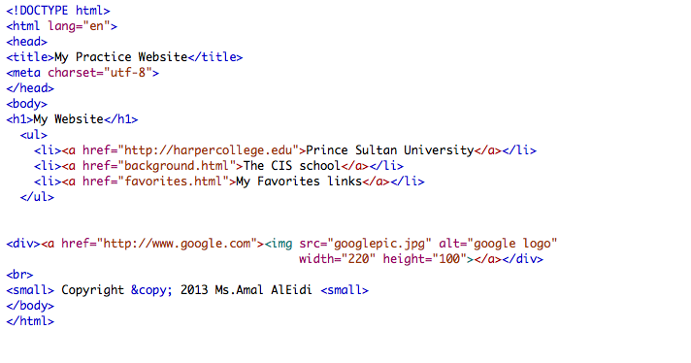
Tutorial 1B Answer

