Slide 1
Using Git and TortoiseGit

Slide 2



Team Members
Randall Porter James Runyon Colton Steeve

Slide 3
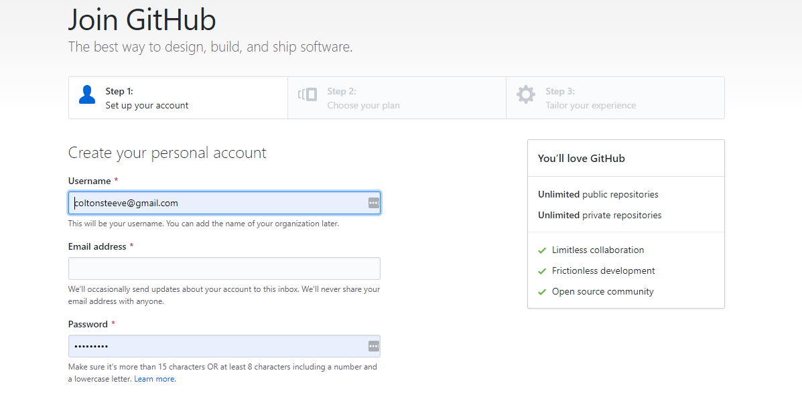
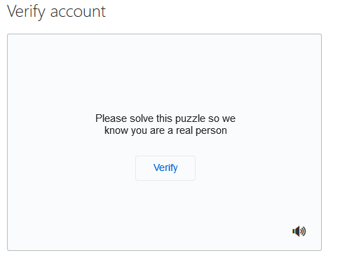
Setting up GitHub
You can go to https://github.com and click on Sign Up.
You will be asked to enter a username, email address, and password.
Next, you will have to solve a puzzle to verify the account.
You will be asked for some information and you will have to select a plan.
After that you can click on create a repository.
You will just have to name it and choose whether you want it to be public or private.

Slide 4
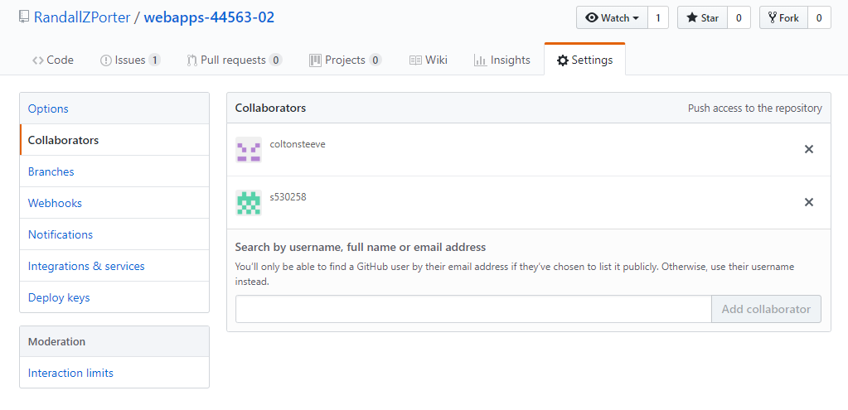
Adding Collaborators
The owner of a repository can allow other people to contribute by adding people to the Collaborators list
This is on a project’s GitHub page under Settings → Collaborators

Slide 5
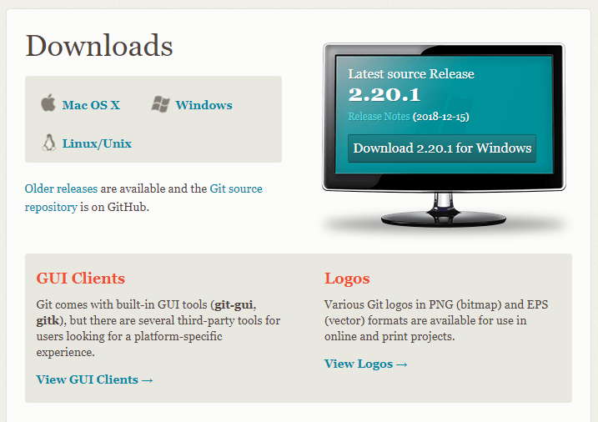
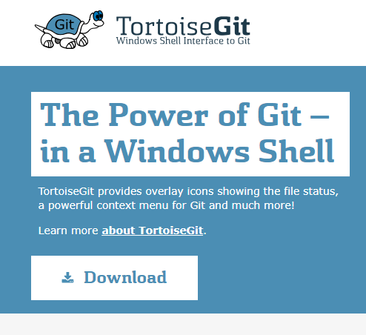
Installing TortoiseGit
You can install Git from https://git-scm.com/downloads
If you have Chocolatey installed, use “choco install tortoisegit” from an elevated command prompt
Otherwise, TortoiseGit is available from https://tortoisegit.org/

Slide 6
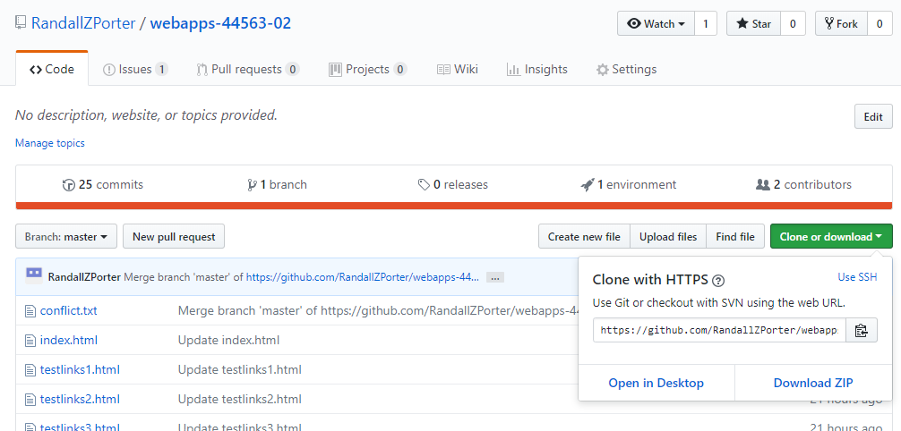
Cloning to Local Machine
Cloning a GitHub repository to your local machine is very simple:
On your project’s GitHub page, click the green button that says “Clone or Download”
A box will appear that contains a URL. Copy this URL.
Locally, pick a destination for your repository to be stored
Right click, choose “Git Clone”
Hit “Ok”
Done.

Slide 7
Pulling and Fetching Remote Changes
Fetching downloads objects from a remote repository and updates the corresponding branches.
Pulling downloads and merges the objects.
This can be accomplished by selecting from the drop down menu:
TortoiseGit -> Pull or TortoiseGit -> Fetch

Slide 8
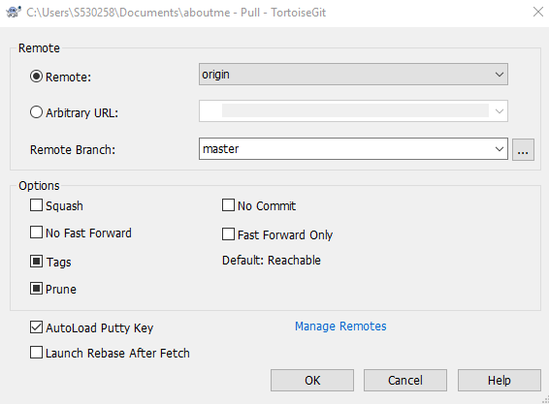
Pulling and Fetching Remote Changes
Once the option to fetch or pull has been selected a menu appears
Choosing remote allows you to
select a configured remote
repository, or there is an option
to add a link to another repository

Slide 9
Committing
Changes can be committed or “stored” easily using TortoiseGit
You can first check for local changes using the menu option TortoiseGit -> Check for modifications
If there are no conflicts and there are new changes to be committed, you can use the menu option Git Commit -> “Master”

Slide 10
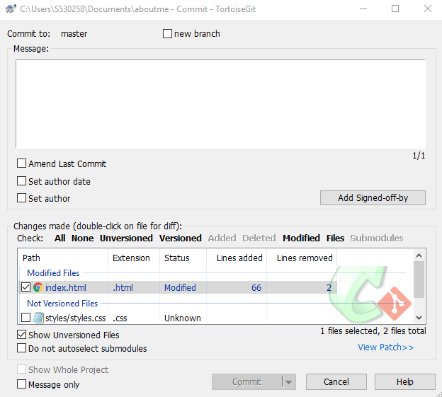
Committing
A new window will open
which allows for adjustments
to the newly committed files.
A message can be saved that
describes the premise of
your commit, and it is often
used to keep organized
logs of prior changes

Slide 11
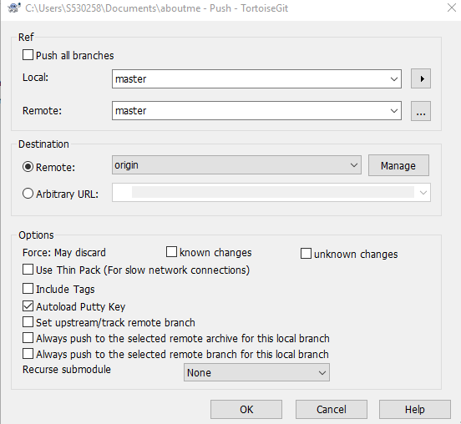
Pushing Local Changes
Pushing sends local changes
to the repository
The advanced menu for pushing
can be opened by selecting
TortoiseGit -> Push

Slide 12
Pushing Local Changes
The destination for a pushed change can be selected using the remote or arbitrary url option
Sometimes pushing code that has been committed requires the resolution of a merge conflict
If this is not possible or wanted, changes can be “forced” through
This option can sometimes cause the loss of commits, and either unknown or known changes to the remote branch, depending on the users selection

Slide 13
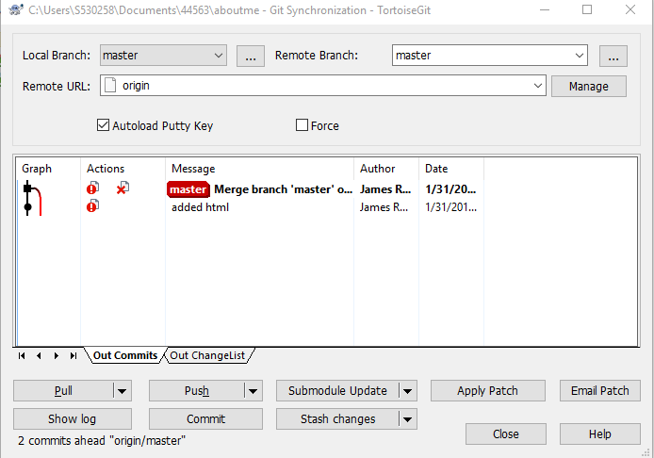
Syncing
Syncing executes numerous
commands at once.
These commands include
pushing, pulling, and fetching
A sync provides less dialog
and menu options than
if you activated each
command individually

Slide 14
Merge Conflicts
A merge conflict occurs when a two users’ branches interfere with each other upon committing and pushing the code. For example:
User A branches from the trunk
User B branches from the trunk
Both users make changes to the same file
Both users try to commit and push changes, in any order
To avoid merge conflicts, it helps to commit your changes as soon as possible after branching
To resolve merge conflicts, a user needs to select which parts to keep from each version of the file. This involves comparing the local file to the remote file.
On the following slides is a demonstration of how to resolve a merge conflict.

Slide 15
Activity: Creating Merge Conflicts
Partner with somebody near you
Pick one person to create a repository, and have them add you as a collaborator
Create a file, conflict.txt, in the repository
Clone the repository to your local machine
Edit the conflict.txt file
Commit and push the changes one person at a time
Whoever pushes last should get an error

Slide 16
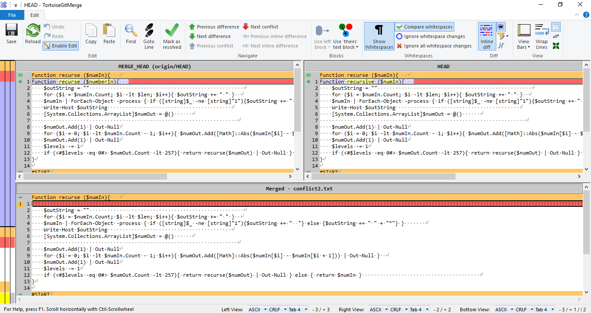
Activity: Resolving Merge Conflicts
Whichever partner got the error:
After the push fails, choose the Pull option
The pull should fail
Close the window
A new box will pop up, offering to show changes
Select Yes
Right click your file, then choose “Edit Conflicts”
From here, see local and remote changes
Use the buttons to choose which changes to merge from each version of the file
When you are finished, choose “Mark as Resolved”
You should now be able to commit and push your changes

