Slide 1

Kepler Data Analysis
Richard Anderson
Fork updates:
https://github.com/Rander417/KeplerExoplanet
New presentation
Raw data pulled from CSV initially
Pickled key data sets
Refactored all notebooks
Forked from team project:
https://github.com/tom-jj-G/KeplerExoplanets
Columbia University – Fu School of Engineering
Data Analytics 6mo Program
My role was building the ML pipeline
Data Cleaning
EDA
Preprocessing
Building the ML models
Teammates:
Damien Corr, Priscilla Lin, Tom Greff

Slide 2
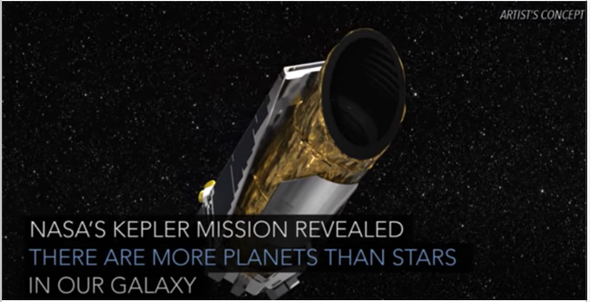
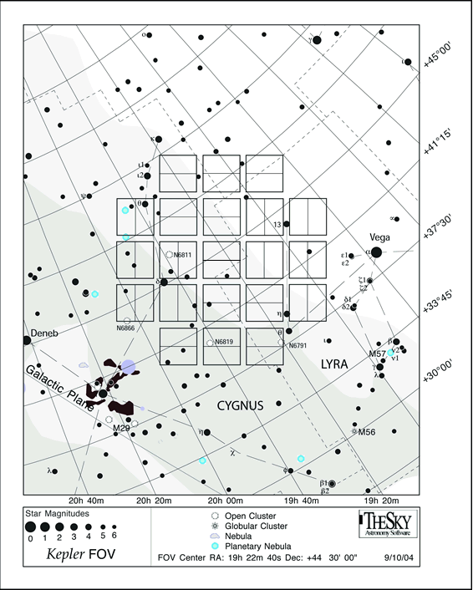
Kepler Mission Overview
The Kepler Telescope photometer consists of 21 CCD modules, each with two 2200x1024 pixel CCDs for a grand total of 94.6 million active pixels.
Source - https://keplerscience.arc.nasa.gov/the-kepler-space-telescope.html
https://www.nasa.gov/kepler/faq
Kepler Field of View (FOV)
https://www.nasa.gov/mission_pages/kepler/overview/index.html

Slide 3
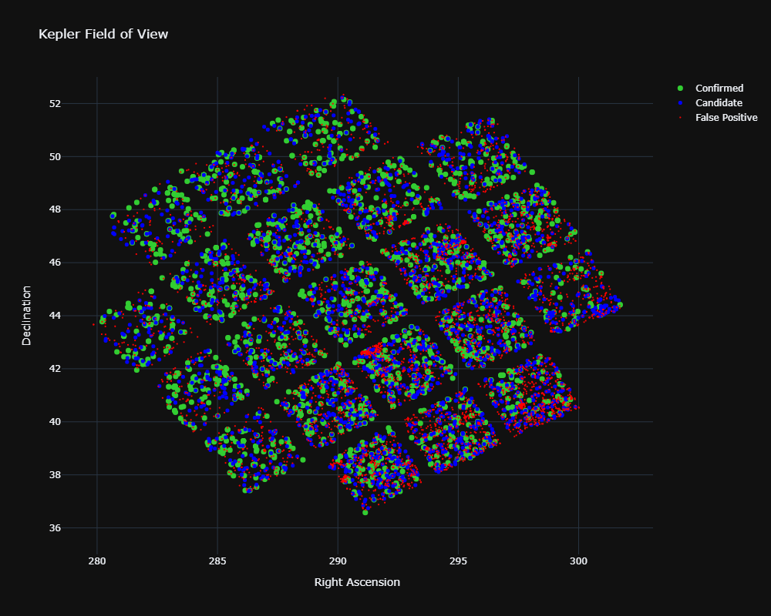
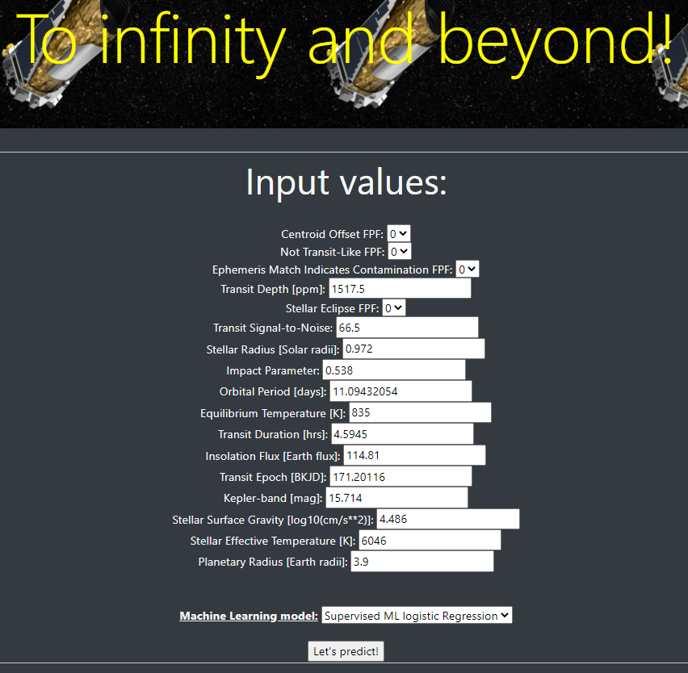
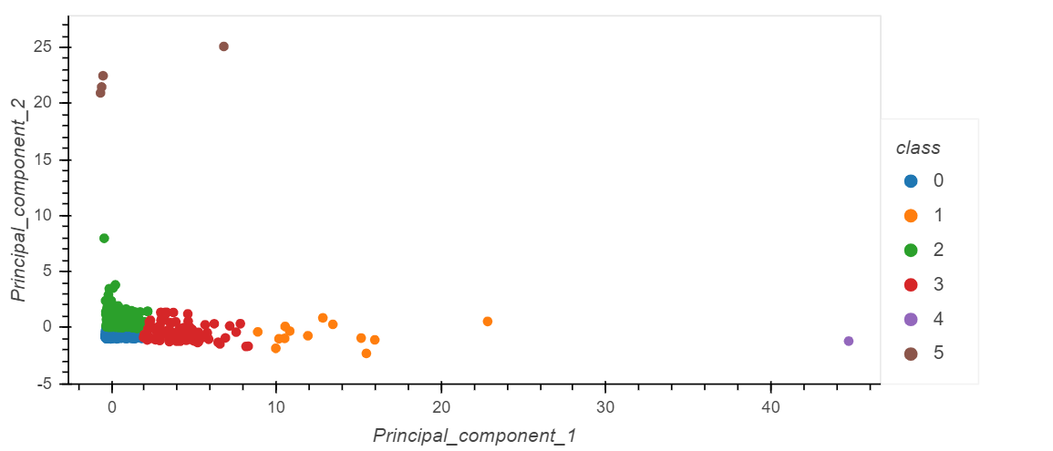
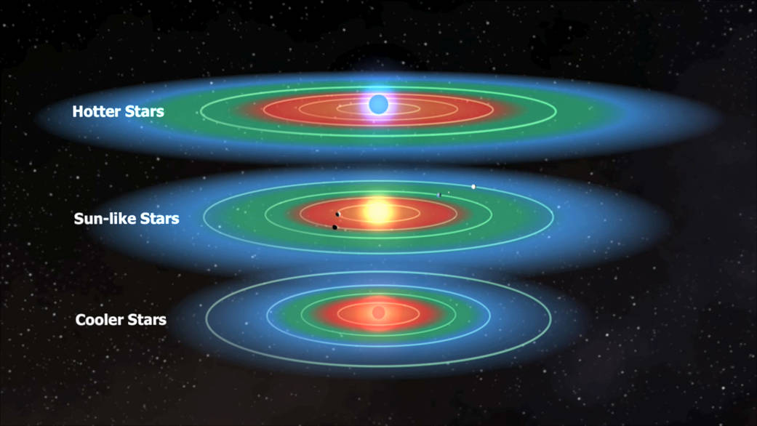
4 Big Questions
Is the Object of Interest an Exoplanet?
Can future observers use our models?
Does EDA reveal interesting groupings?
6 clusters found
Is the exoplanet in the habitable zone?
https://kepler-groupa.herokuapp.com/

Slide 4
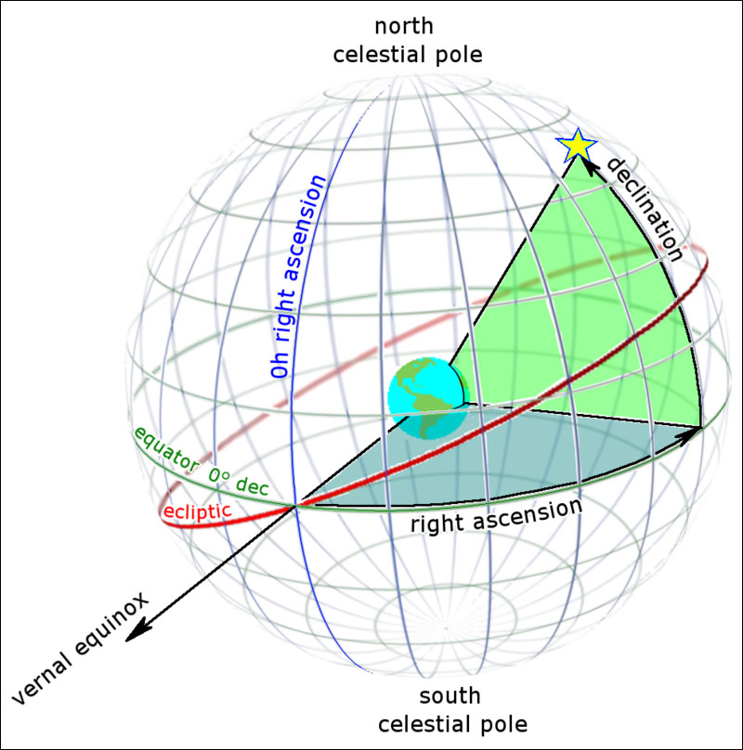
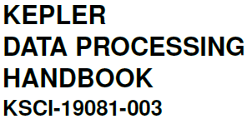
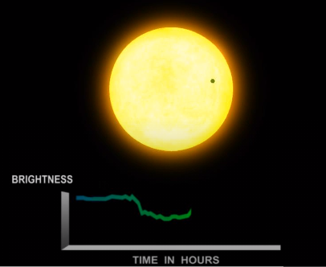
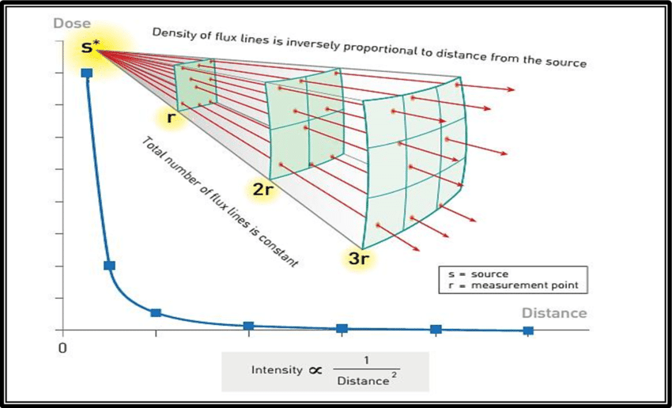
Domain knowledge
CHALLENGES
Astrophysics terminology
Cryptic acronyms & abbreviations
Koi_tce_delivname, koi_fpflag_nt...
Dense reference material
382 pages!
CELESTIAL COORDINATES
Declination corresponds to latitude &
Right Ascension to longitude
https://skyandtelescope.org/astronomy-resources/right-ascension-declination-celestial-coordinates/
TRANSIT
When one object crosses in front of another in space
FLUX
A star's apparent brightness
Transits by terrestrial planets produce a small change in a star's brightness of about 1/10,000 (100 parts per million, ppm), lasting for 2 to 16 hours.
https://exoplanets.nasa.gov/resources/1022/kepler-transit-graph/
https://bit.ly/2HBZvM3
https://bit.ly/34yWwNi

Slide 5
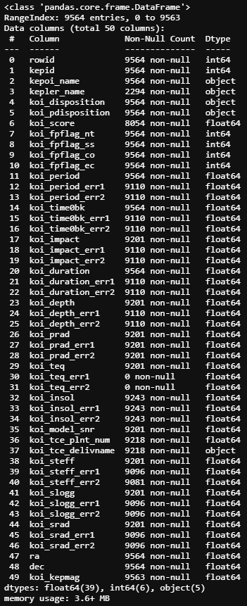
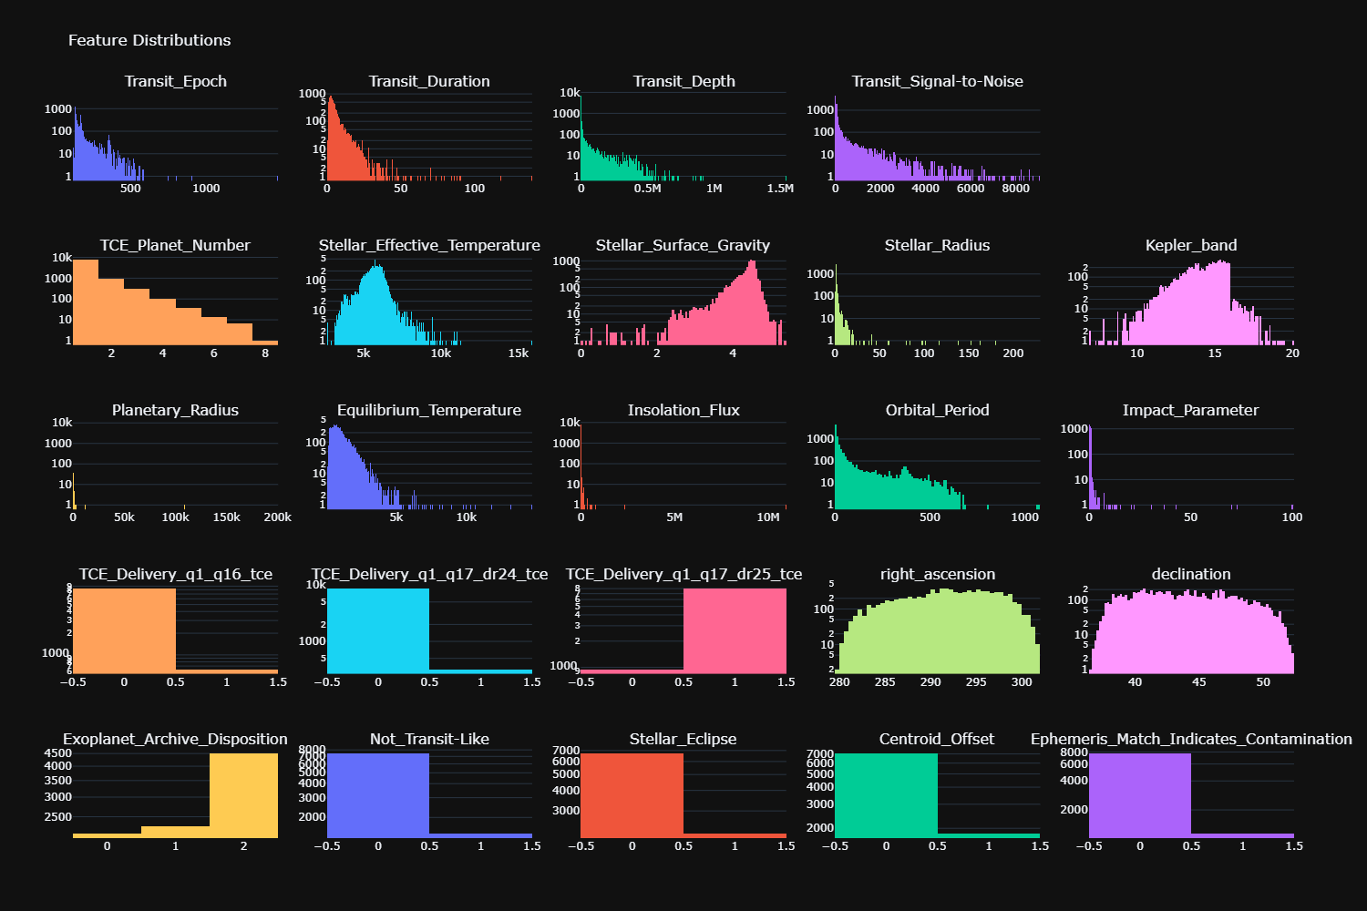
EDA & Preprocessing
Generally clean combination of numerical and categorical
Large number of nulls
Two Ys?!?
Unbalanced

Slide 6
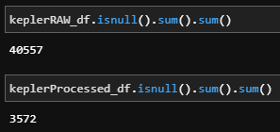
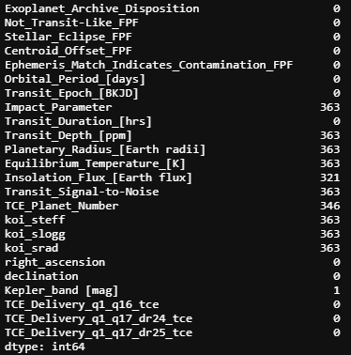
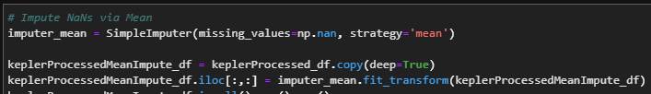
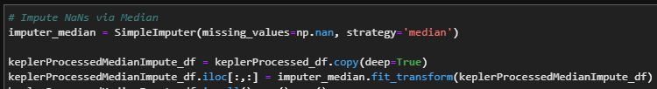
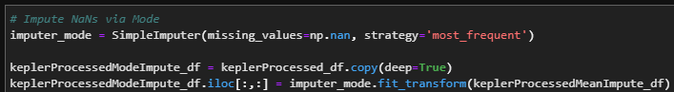
Handling Null Values
40k+ Null cells across 10k rows & 50 columns of data (500k cells)
363 rows with nulls after cleaning (including dropping +/- error columns)
We decided to drop the nulls due to their small volume & results of imputing
Impute methods evaluated:
Mean
Median
Mode
Mode had a negative f1 impact while Mean & Median had no discernable impact

Slide 7
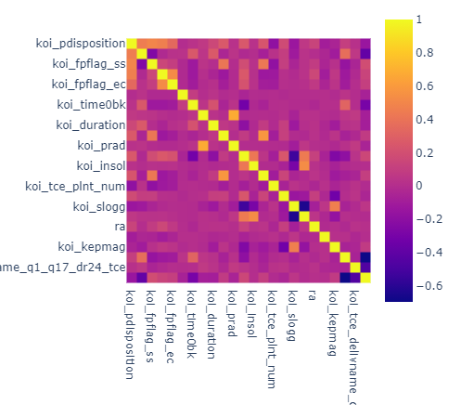
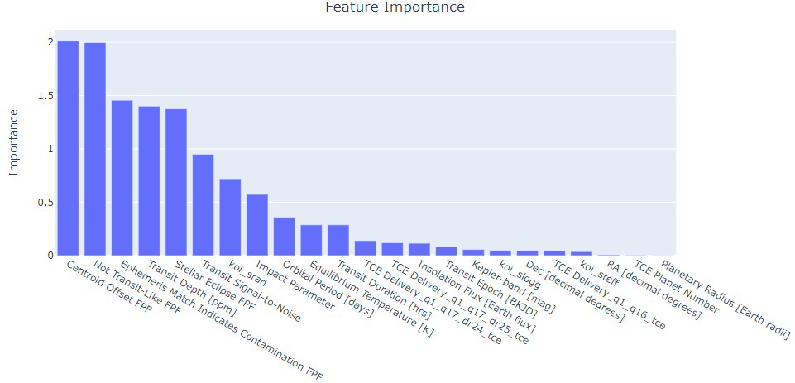
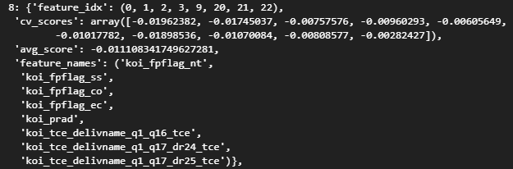
Feature Analysis & A Tale of Two Ys
Which target? Kepler Disposition vs Exoplanet Archive Disposition (EAD)
We chose EAD as it was the result of the most recent NASA analysis
ML models had a 99% f1 with kepler disposition
We analyzed our features using the methods below
"Sequential Feature Selection” is part of the mlxtend library - programmatically analyzes feature combinations
Feature Correlation
Feature Importance
Sequential Feature Selection
Future options
Variance Inflation Factor
Multicollinearity
Lasso regression

Slide 8
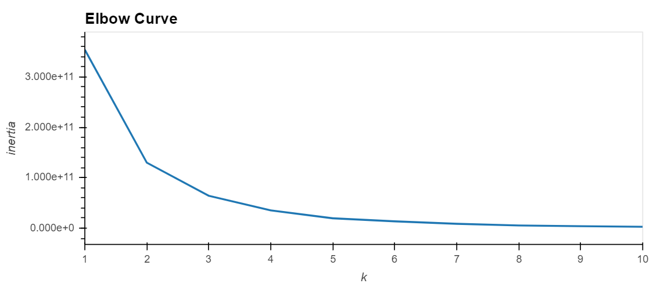
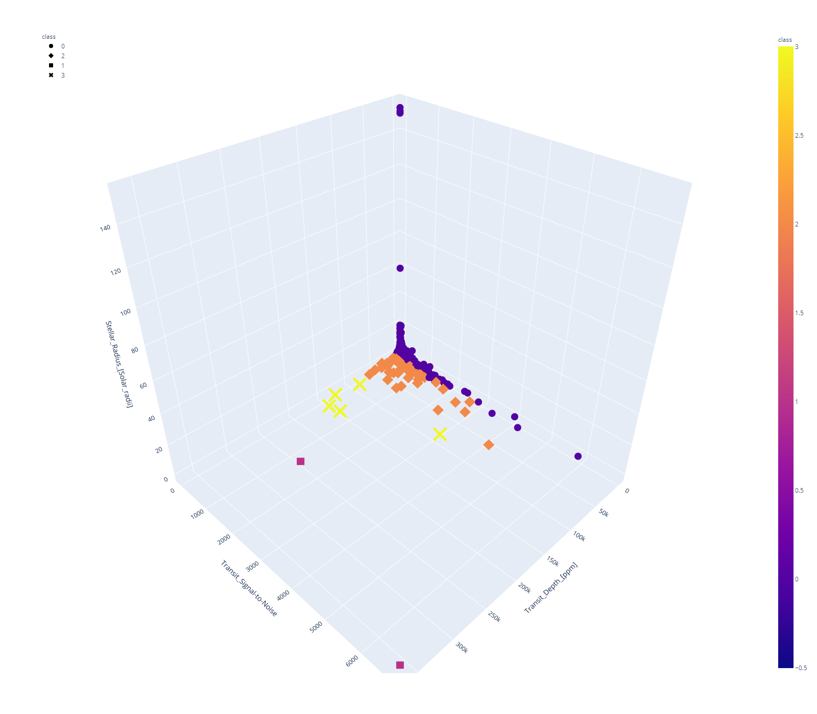
K-Means Clustering
4
⇒ For the three most important features, the major part of the object has a low transit depth (<20,000 parts/million), transit signal-to-lose (<2000) and stellar radius (<20 solar radii)
⇒ Object of interest are gathered for these important features

Slide 9
K-Means Clustering w/PCA
⇒ 6 clusters after using a new elbow curve
⇒ 36% of the information is lost when the four-dimension data were reduced to a two one
⇒ Confirmation that most of the data is consistent/homogeneous

Slide 10
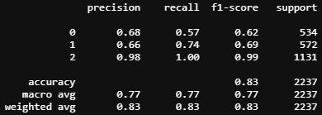
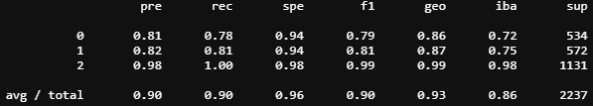
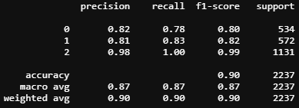
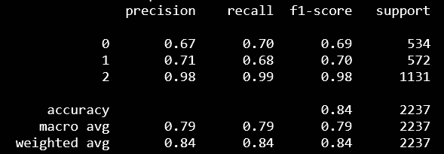
Supervised Machine Learning
Logistic Regression - 83% f1
Chosen since our questions are categorical
Weaker results due to unbalanced data
Random Forest - 90% f1
Alternative to better handle the data imbalance
Gradient Boosted Trees - 90% f1
Chosen to better handle the data imbalance
Deep Neural Network - 84% f1
Uses relu and softmax

Slide 11
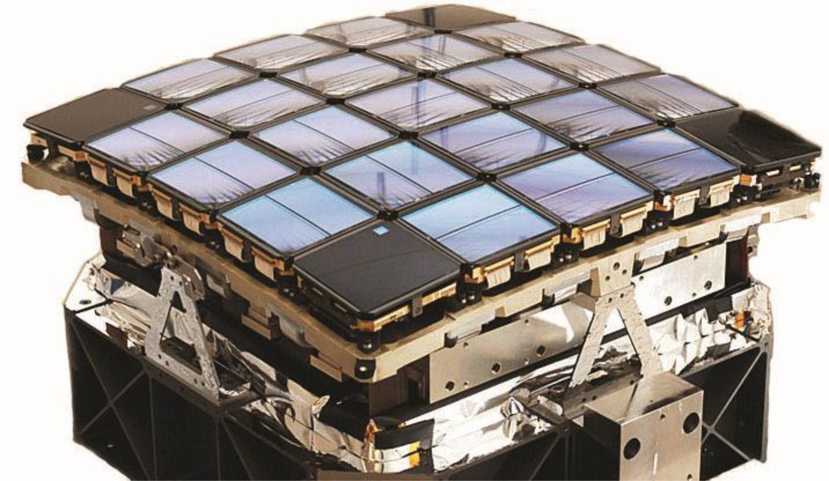
Graphing the results
Kepler Array

Slide 12
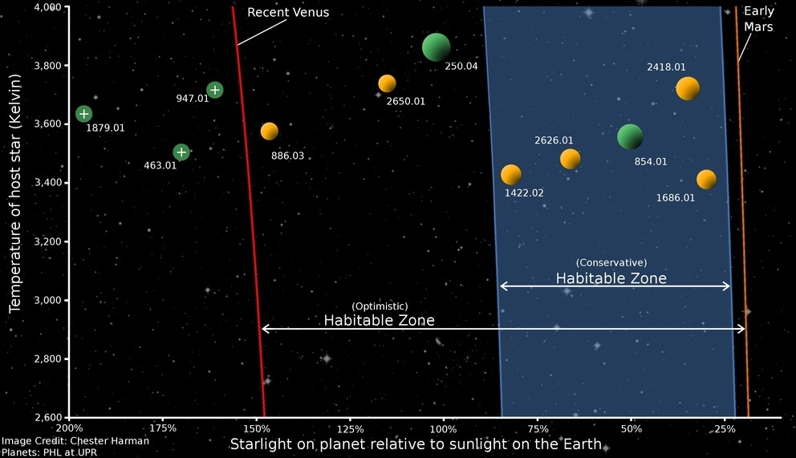
Habitable or Not? The Goldilocks Zone
Not too close…
…and not too far!

Slide 13
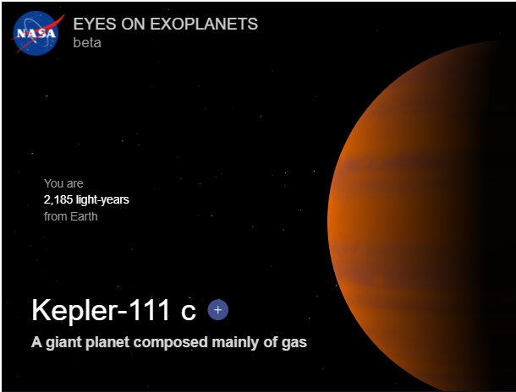
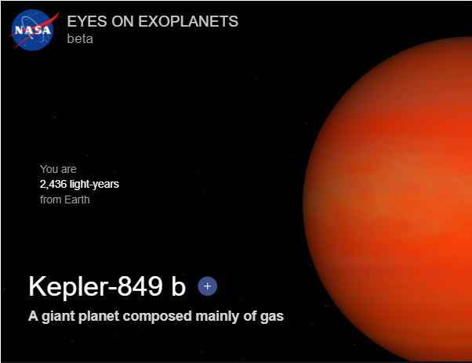
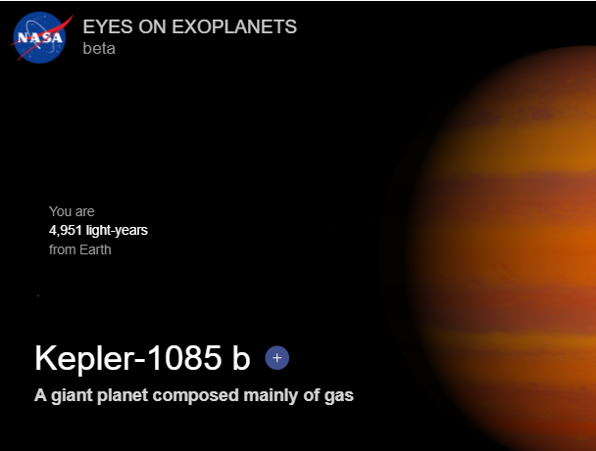
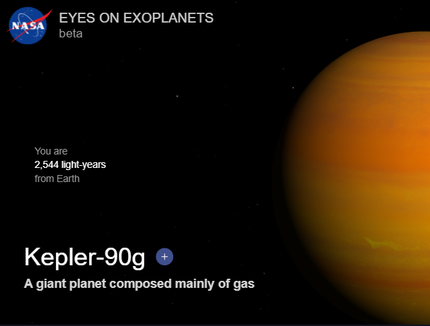
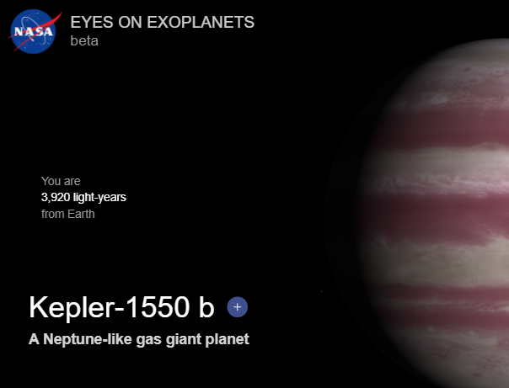
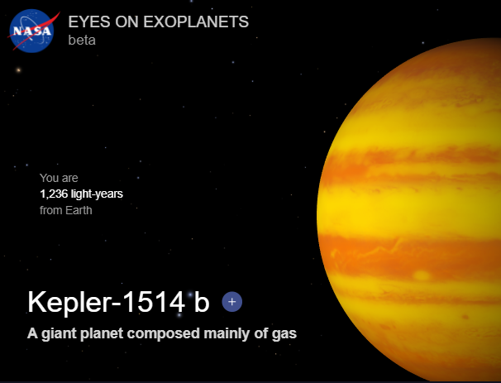
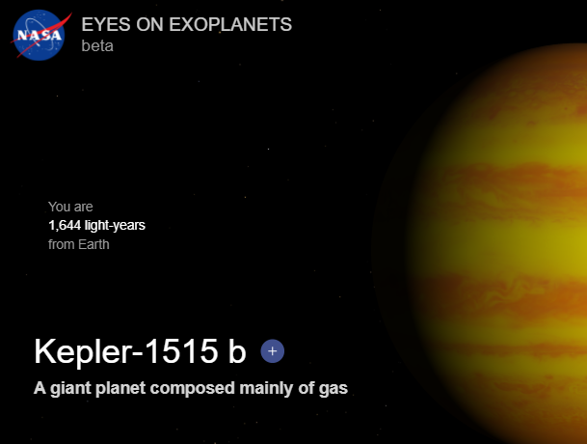

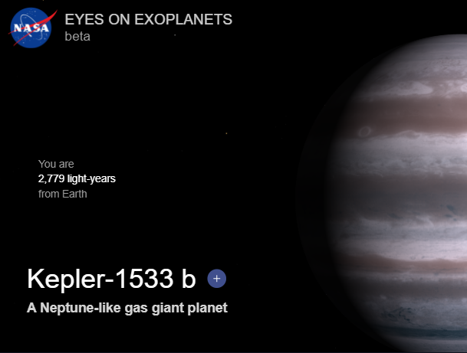
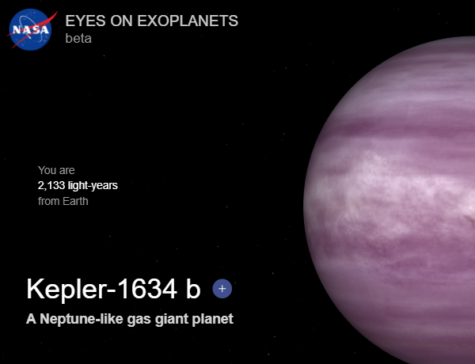
Is the Exoplanet in the Goldilocks Zone?
Habitable Criteria:
Orbital_period[days]: 200 ~ 400
Stellar_effective_temperature > 5500 ~ 6500
Stellar_radius[solar_radii]: 1 ~ 2
Stellar_surface_gravity[log10(cm/s**2)]: > 4
Stellar_metallicity: > 0
Confirmed & Candidates: 2248
Habitable: 10
Image sources: https://exoplanets.nasa.gov/exoplanet-catalog/

Slide 14
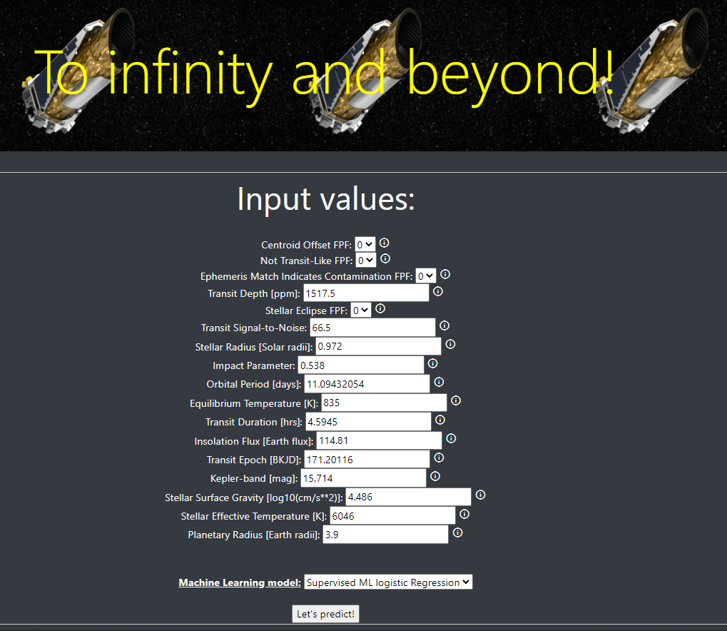
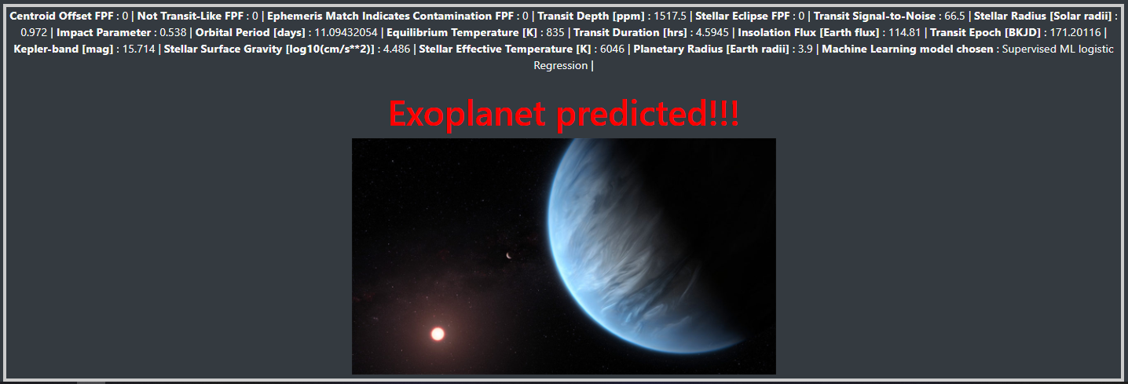
Prediction web-app
Takes new observations and predicts if the object is an exoplanet using our ML models
Built with ES6/HTML
Hosted online
https://kepler-groupa.herokuapp.com/

Slide 15















Technologies

