Slide 1
Kepler exoplanets
the 2026 refresh
Kepler Objects of Interest: honest models, the habitable zone done on insolation, and an app that runs in your browser.
Rich Anderson · August 2026
Refresh of the 2020 Columbia Engineering data-analytics bootcamp team project
2020 team: Rich Anderson (ML pipeline), Damien Corr, Priscilla Lin, Tom Greff
Code, notebooks, research log
github.com/Rander417/KeplerExoplanet
The app, in your browser (GitHub Pages)
rander417.github.io/KeplerExoplanet
Notes:
Title. The project began in 2020 as a four-person bootcamp capstone; this deck presents the 2026 refresh of Rich's fork: same questions, corrected science, modern tooling, and a shareable app. Everything quoted here comes from notebooks or scripts in the repository; the research log has the details.

Slide 2
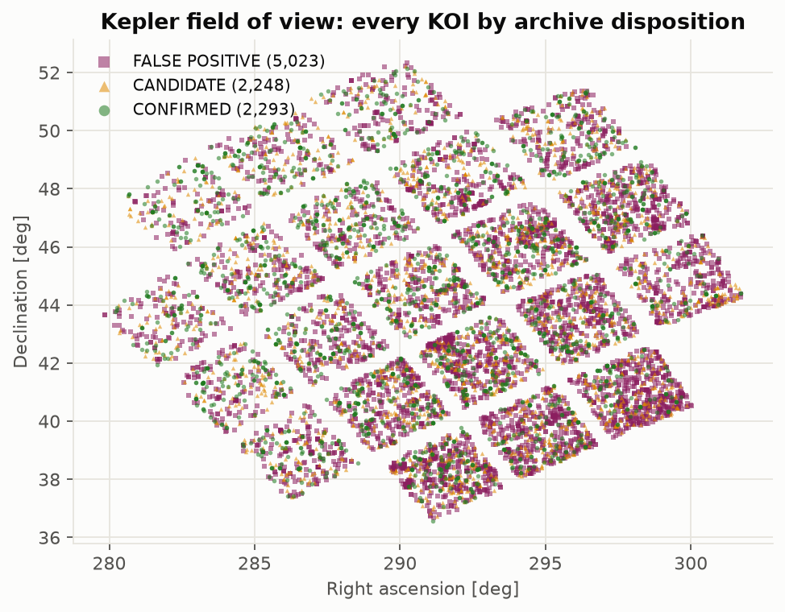
Kepler in one slide
A space telescope (2009–2018) that stared at ~150,000 stars in Cygnus and Lyra and measured their brightness continuously.
The transit method: a planet crossing its star dims it slightly and regularly. Earth crossing the Sun would dim it by about 84 parts per million.
A Kepler Object of Interest (KOI) is a repeating dip promising enough to track. The archive's cumulative table holds 9,564 of them, ids like K00752.01.
Each KOI carries the archive's verdict: CONFIRMED (a real planet), CANDIDATE (plausible, unsettled) or FALSE POSITIVE (eclipsing stars, a neighbour's light, noise).
This project asks how far the physics of the signal alone can predict that verdict, and which planets sit in their star's habitable zone.
The 9,564 KOIs on the sky, coloured by verdict (notebook 01)
Kepler exoplanets · 2026 refresh
Notes:
Kepler (2009-2018) watched ~150,000 stars in one patch of sky for periodic dips in brightness: transits. Each promising repeating dip is a Kepler Object of Interest. The NASA Exoplanet Archive's cumulative KOI table (9,564 rows) carries a verdict per KOI: CONFIRMED, CANDIDATE, or FALSE POSITIVE. Figure: our own sky map of the KOIs (notebook 01). Column definitions: exoplanetarchive.ipac.caltech.edu/docs/API_kepcandidate_columns.html

Slide 3
Three big questions — then and now
I
Is the KOI an exoplanet?
II
Is it in the habitable zone?
III
Can future observers use our models?
2020: 'GBT and Random Forest reach 90% f1' — with the vetting flags as features
2026: the flags are the vetting; physics alone reaches macro f1 0.75. Honest, and still useful
2020: 12 confirmed planets, chosen by orbital period and stellar properties
2026: 16 small confirmed planets, chosen by the starlight they receive (Kopparapu et al. 2014). The two lists share none
2020: a Flask app on Heroku (offline since 2022)
2026: trained on 2020 labels, the model predicted later confirmations with AUC 0.937 — and the app runs in any browser
Kepler exoplanets · 2026 refresh
Notes:
The same three questions the 2020 deck asked. 2020 answers came from the bootcamp work; 2026 answers from the refreshed notebooks (03, 05, 07, 08). Numbers: physics-only macro f1 0.747 ± 0.012 on today's labels; 16 confirmed planets ≤ 2 Earth radii in the conservative Kopparapu zone; out-of-time AUC 0.937.

Slide 4
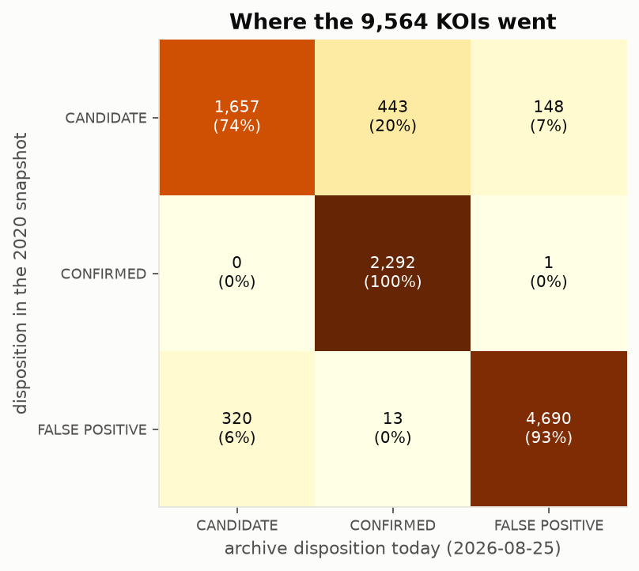
The data — a 2017-era snapshot and today's table
9,564
2020 snapshot: the Kaggle copy of the archive table, 50 columns.
2026 pull: the archive's TAP service, all 153 columns, provenance JSON with the query, time and hash.
443 candidates were confirmed, 148 dismissed; 320 'false positives' became candidates again; 13 former false positives are confirmed planets today.
One retraction: Kepler-503 b, CONFIRMED to FALSE POSITIVE.
KOIs in both tables — the same objects
925
verdicts changed since the snapshot (9.7%)
0
physics columns that changed (depth: rounding only)
Verdict in 2020 (rows) versus today (columns)
Kepler exoplanets · 2026 refresh
Notes:
Two sources, both tracked in data/raw with provenance: the Kaggle-era snapshot the 2020 team used (9,564 x 50) and a live pull of the archive's cumulative table via TAP on 2026-08-25 (9,564 x 153, SHA-256 recorded). Same KOIs, identical physics columns (koi_depth differs by rounding only); 925 verdicts (9.7%) changed. Notebook 08.

Slide 5
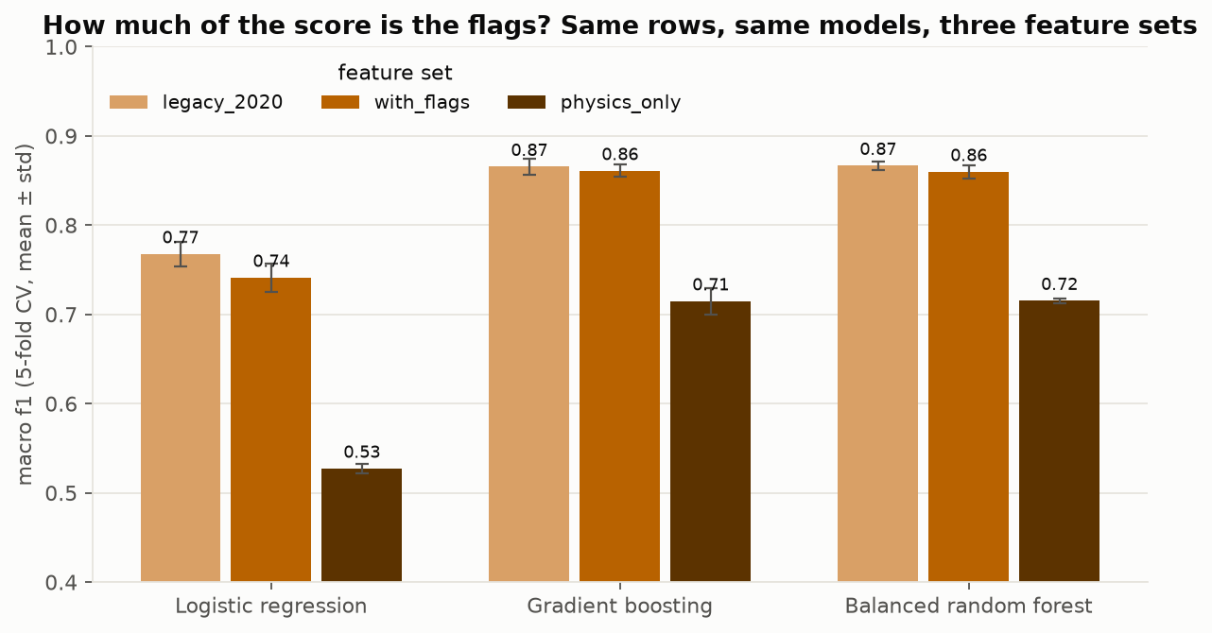
A tale of two Ys, revisited — the flags are the answer key
The 2020 models used the four koi_fpflag_* vetting flags as features. Any flag set means the pipeline already called it a false positive.
Between 2020 and today the archive re-decided 925 KOIs — and rewrote the flags with the verdicts (320 'false positives' became candidates with their flags cleared).
So a flag-fed model learns the vetting logic, not the planets: macro f1 0.86–0.87 with flags versus 0.72 on physics alone, same rows, same models.
On today's labels the gap is wider still: 0.90 with flags, 0.75 without.
The refresh reports both variants, always, and builds the app on physics only.
Same rows, same models, three feature sets (notebook 03, 5-fold CV)
Rule of the refresh: never quote a single f1 without saying which variant — with flags (reproduces the vetting) or physics only (has to earn it).
Kepler exoplanets · 2026 refresh
Notes:
Two disposition columns: koi_pdisposition (pipeline, 2 classes) and koi_disposition (archive, 3 classes; the target). The four koi_fpflag_* columns are the pipeline's reasons for calling a false positive; any flag set predicts the pipeline verdict 98% of the time. Between the snapshot and today, the flags were rewritten wherever the verdict changed (koi_fpflag_nt changed on 347 rows, _ss 207, _co 133): the flags are outputs of vetting, not measurements. Figure: notebook 03, 5-fold CV.

Slide 6
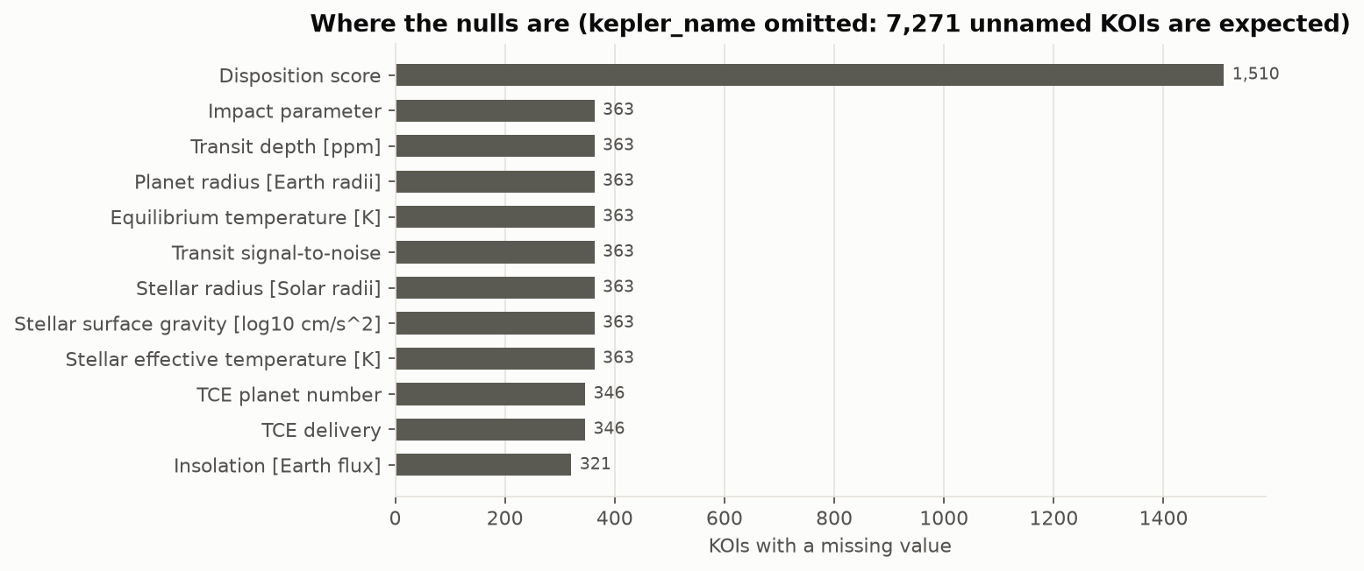
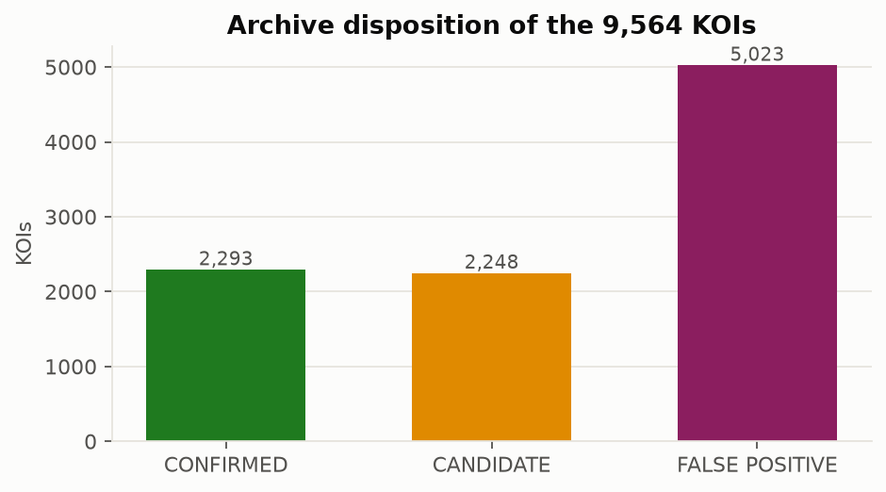
Cleaning and EDA — the gaps are information
2020
2026
Dropped the ± error columns, then the 363 rows with any remaining null.
Scaled everything and trained on a 75/25 split; scores quoted from one split.
Imputation tried (mean, median, mode) and rejected — reasonable.
All 9,564 rows kept: the gaps are not random, they track the verdict (most sit in false positives).
'Is this value missing' indicators + NaN-native boosting.
Every number from 5-fold cross-validation with error bars; nested CV for tuning.
Missing values by column (notebook 01)
+0.007
macro f1 from keeping the incomplete rows — none, but the catalogue is whole
Class balance: the three verdicts
Kepler exoplanets · 2026 refresh
Notes:
2020 dropped the 363 rows with any null after removing the error columns. 2026 keeps all 9,564 rows: missingness tracks the label (most gaps sit in FALSE POSITIVEs), so the model gets 'is this value missing' indicators and a NaN-native gradient boosting. Gain over dropping rows was about 0.007 macro f1 — none — but the catalogue stays complete. Figures: notebook 01.

Slide 7
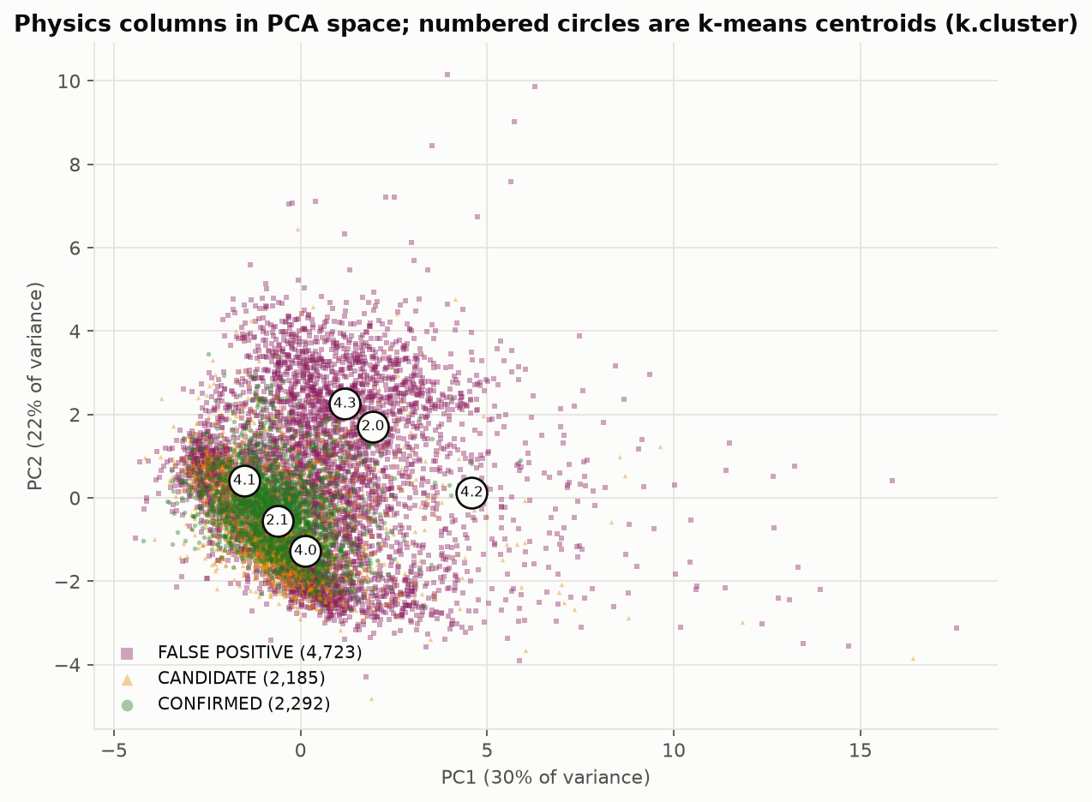
Clustering — a null result, recorded as one
2020
2026
k-means on confirmed planets only, unscaled
Elbow at 4 (3-D) and 6 (PCA); 'most of the data is consistent'
All classes, log1p on the heavy tails, standardised
Agreement with the verdicts: ARI ≤ 0.05, NMI ≈ 0 for every k
What it means. Unsupervised structure in these twelve measurements does not line up with what the archive decided. That is a finding, not a failure — it is why the supervised models earn their keep.
Scaled k-means on the physics, projected on two principal components (notebook 02)
Kepler exoplanets · 2026 refresh
Notes:
2020 ran k-means on the confirmed planets (elbow at 4, 'the data is homogeneous'). 2026 ran scaled k-means on all classes and scored the clusters against the verdicts: adjusted Rand index at or below 0.05 for every k. The clusters follow the heavy-tailed physics (depth, SNR, stellar radius), not the verdict. Notebook 02.

Slide 8
The models, re-labelled
Model | 2020 deck said | macro f1, with flags | macro f1, physics only
Logistic regression | 83% f1 | 0.768 ± 0.014 | 0.527 ± 0.006
Gradient boosting (2020 settings) | 90% f1 | 0.866 ± 0.009 | 0.715 ± 0.015
Balanced random forest | 90% f1 | 0.867 ± 0.005 | 0.715 ± 0.003
Deep neural net (2020, Keras) | 84% f1 | 0.79 (one split) | not run yet — Phase 4
Tuned boosting, all rows, nested CV | — | 0.862 ± 0.006 | 0.722 ± 0.006 (snapshot labels) 0.747 ± 0.012 (today's labels)
The 2020 deck's '83 / 90 / 90 / 84% f1' were accuracy and weighted f1 on one 75/25 split; macro f1 is the balanced number. Error bars: 5-fold cross-validation.
Why 'macro'? It averages the three verdicts' f1 equally, so the rare class counts as much as the common one. Accuracy and weighted f1 flatter a model that is good at the big class.
The physics-only ceiling sits at 0.72–0.75 in every construction we tried: different models, all rows, tuning on inner folds, calibration. Confirmation is a follow-up process; the physics cannot see it.
Kepler exoplanets · 2026 refresh
Notes:
The 2020 deck quoted 83 / 90 / 90 / 84 '% f1'. Those were accuracy and weighted f1 on one split; macro f1 (the balanced number) was 0.77 / 0.87 / 0.87 / 0.79, with the flags. On physics only the same models drop to 0.53 / 0.71 / 0.72. The tuned HistGradientBoosting with nested CV on all rows: 0.722 ± 0.006 on snapshot labels, 0.747 ± 0.012 on today's labels. The physics-only ceiling is about 0.72–0.75 in every construction. Table: reports/tables/03_baseline_metrics.csv and 07_models_v2_metrics.csv.

Slide 9
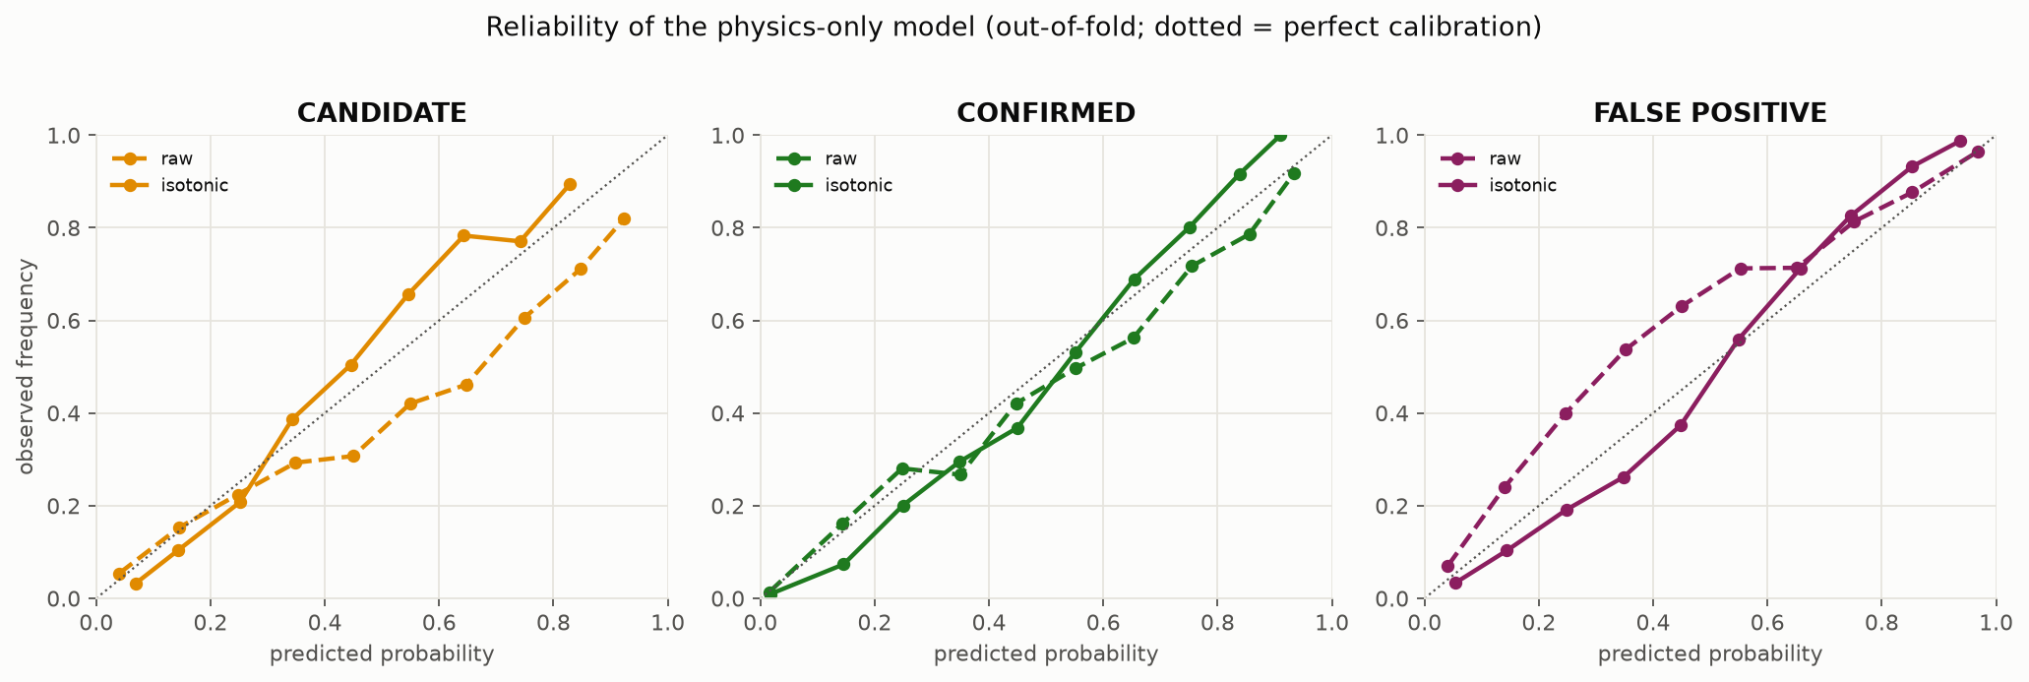
Probabilities you can take literally, and a rule you can read
The label rule
P(planet-like) = P(CANDIDATE) + P(CONFIRMED)
below 0.5 → FALSE POSITIVE
otherwise → the larger of CONFIRMED / CANDIDATE
The threshold is a slider in the app; no hidden argmax.
Reliability of the physics-only model, before and after calibration (notebook 07)
0.84 / 0.55 / 0.84
0.921
0.534 → 0.512
0.85 / 0.82
f1 for CONFIRMED / CANDIDATE / FALSE POSITIVE (out-of-fold, today's labels)
AUC, planet-like vs false positive
log loss, before → after calibration
precision / recall for 'planet-like' at 0.5
Physics separates planets from false positives well; it separates confirmed from candidate only moderately — confirmation is a follow-up-and-statistics process, not a measurement.
Kepler exoplanets · 2026 refresh
Notes:
Isotonic calibration on out-of-fold scores lowers log loss 0.534 to 0.512 and Brier 0.315 to 0.297 on today's labels; its argmax lowers macro f1 slightly, so the app shows probabilities and decides labels by an explicit rule (kepler.verdict). Out-of-fold rule metrics: macro f1 0.744; per class CANDIDATE 0.55, CONFIRMED 0.84, FALSE POSITIVE 0.84; P(planet-like) AUC 0.921; at 0.5 precision 0.848 / recall 0.823. Figure: notebook 07 reliability.

Slide 10
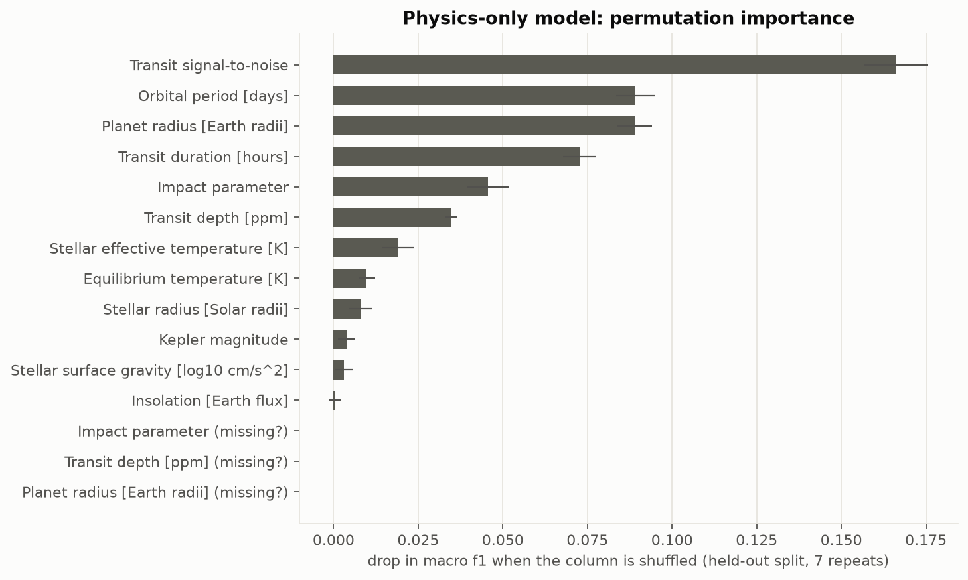
What the physics-only model actually looks at
Transit signal-to-noise leads by a wide margin: a clean, deep, repeated dip is the strongest single clue.
Orbital period and planet radius come next: very large 'planets' and very short periods are mostly eclipsing stars.
Transit duration and impact parameter carry shape information: grazing crossings and V-shaped dips point to stars, not planets.
Stellar temperature, gravity and radius matter less on their own — the planet radius already folds the star's size in.
Twelve columns, all measurable from the light curve and the star: nothing that encodes a human's verdict.
Permutation importance, physics-only model (notebook 07)
Kepler exoplanets · 2026 refresh
Notes:
Permutation importance on the out-of-fold physics-only model (notebook 07): transit signal-to-noise 0.166, orbital period 0.089, planet radius 0.089, transit duration 0.073 (drop in macro f1 when the column is shuffled). No flags, no koi_score, no koi_pdisposition anywhere in the inputs.

Slide 11
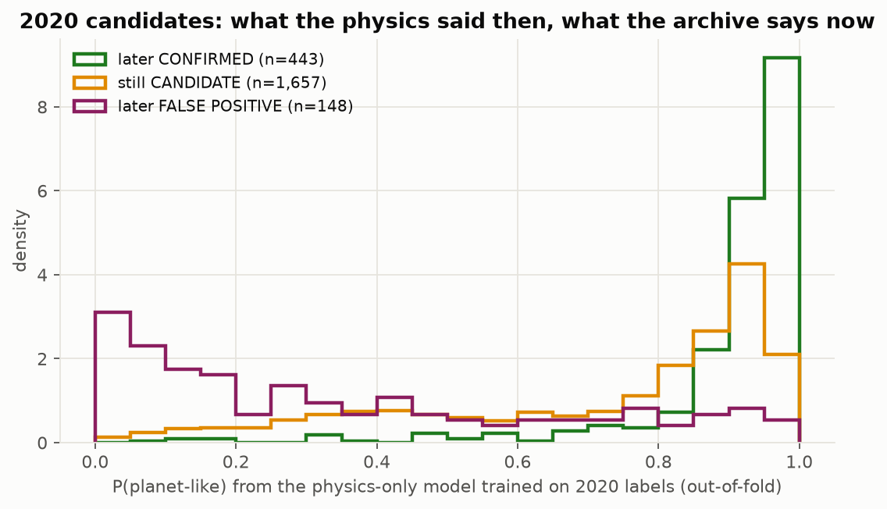
The out-of-time test — question III, answered honestly
AUC 0.937
later-confirmed vs later-dismissed, on verdicts the model never saw
2,248 KOIs were CANDIDATEs in 2020. Since then the archive confirmed 443 and dismissed 148.
The model, trained on 2020 labels, had rated the later-confirmed ones far more planet-like (median 0.95) than the later-dismissed ones (median 0.26).
That is a forecast checked against the future — the closest thing to 'can future observers use this?'
The vetting flags could not have passed this test: they were rewritten along with the verdicts.
What the 2020-trained model thought of the 2020 candidates, split by what happened next (notebook 08)
Kepler exoplanets · 2026 refresh
Notes:
Train the physics-only model on the 2020 labels only (out-of-fold), score the 2,248 KOIs that were candidates in 2020, and compare with what the archive decided later: 443 confirmed, 148 dismissed, 1,657 still open. Median P(planet-like): 0.946 for the later-confirmed, 0.826 for the still-open, 0.257 for the later-dismissed. AUC 0.937. The flags could not have passed this test: they were rewritten with the verdicts. Notebook 08.

Slide 12
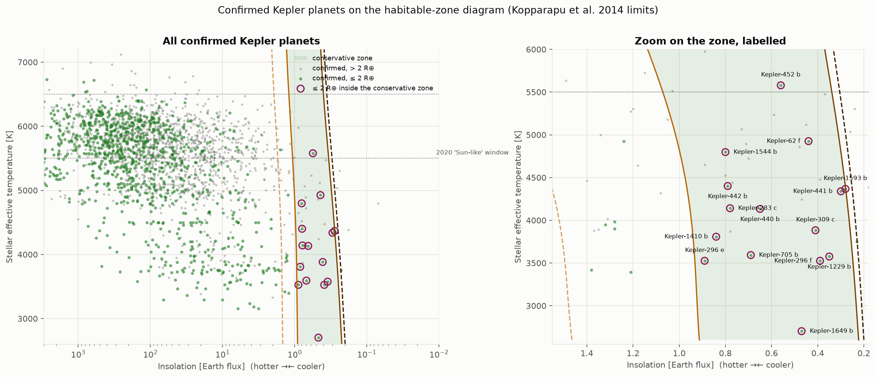
The habitable zone, done on insolation
16
confirmed planets ≤ 2 R⊕ in the conservative zone today (9 of them ≤ 1.6 R⊕, plausibly rocky)
0 of 12
of the 2020 list survive: period and star properties are not the planet's climate
Circled: confirmed planets ≤ 2 R⊕ in the conservative zone (notebook 05; today's table adds Kepler-1652 b)
Method. Kopparapu et al. 2014 give the insolation at which a rocky planet loses its water (runaway greenhouse) or freezes (maximum greenhouse) as a function of the star's temperature; Rogers 2015 finds most planets above 1.6 R⊕ are not rocky. Caveat: the table's stellar parameters are Kepler DR25 — Kepler-1649 c sits outside and its exo-Venus sibling 1649 b inside on those numbers. A screen, not a verdict.
Kepler exoplanets · 2026 refresh
Notes:
2020 filtered on orbital period (200-400 d), stellar temperature (5,500-6,500 K), radius, gravity and metallicity: star properties, never the planet's insolation, and 'super-Earth' meant the gas giants pictured on the 2020 slide. 2026 uses the Kopparapu et al. 2014 (ApJL 787, L29) stellar-temperature-dependent insolation limits and the Rogers 2015 (ApJ 801, 41) 1.6 Earth-radius rocky ceiling (2.0 loose). Today's table: 16 confirmed planets ≤ 2 R⊕ in the conservative zone (9 ≤ 1.6), 25 in the optimistic zone, 65 candidates ≤ 2 R⊕ in the conservative zone. The 2020 list of 12 shares none. Caveat: the KOI table's stellar parameters are DR25; Kepler-1649 c (Vanderburg et al. 2020) sits outside and Kepler-1649 b (an exo-Venus, Angelo et al. 2017) inside on those numbers. Notebooks 05 and 08.

Slide 13
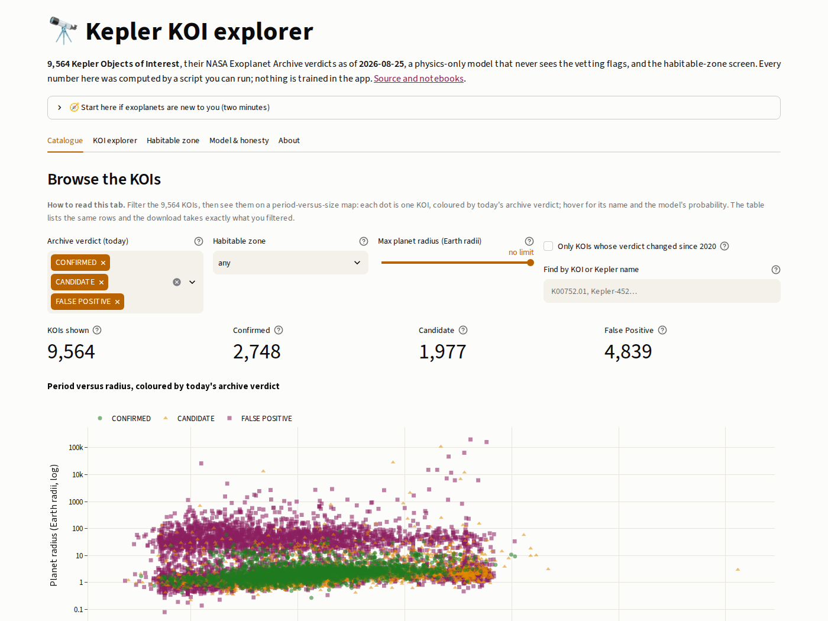
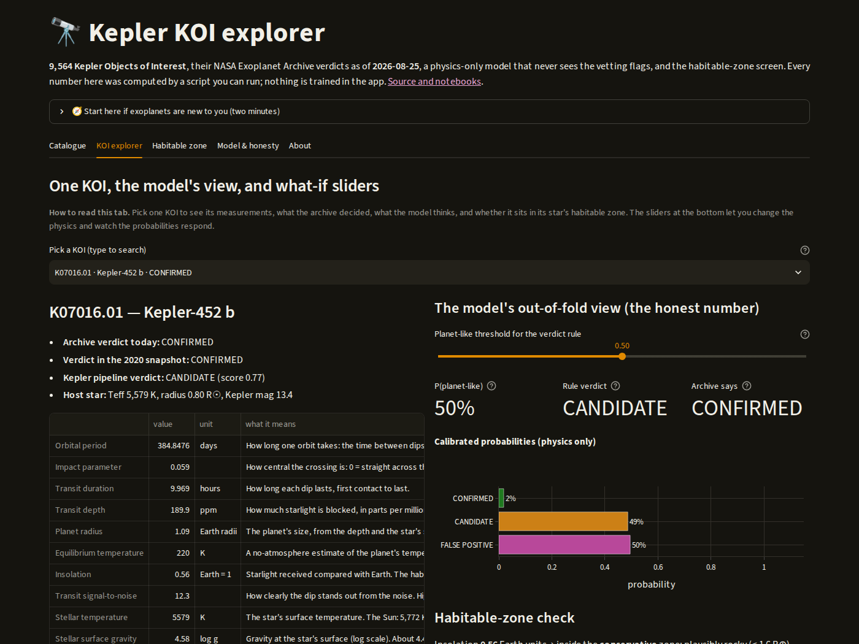
The app — one file, three ways to run it
Five tabs: Catalogue, KOI explorer, Habitable zone, Model & honesty, About.
Runs locally, on Streamlit Community Cloud, or entirely in your browser (GitHub Pages).
The model travels as plain numbers and is evaluated with numpy — the same model everywhere.
Plain-language help on every control; light and dark themes.
Catalogue: filter, plot, download
KOI explorer, dark mode: probabilities and what-if sliders
Try Kepler-452 b. The archive says CONFIRMED; the physics-only model says 50/50. Mullally et al. 2018 argued the planet 'can not be confirmed using a purely statistical validation approach'. Sometimes a coin flip is the honest answer.
Kepler exoplanets · 2026 refresh
Notes:
app/app.py runs locally (run_app.cmd), on Streamlit Community Cloud, and inside the visitor's browser via stlite on GitHub Pages: Python compiled to WebAssembly, static files, no server, nothing installed. The trained model ships as plain numbers (trees + calibration maps) evaluated with numpy; a test proves it reproduces scikit-learn's probabilities exactly. Every catalogue probability is out-of-fold. Default KOI: Kepler-452 b, where the model says 50/50 — in line with Mullally et al. 2018 (AJ 155, 210), who argue it 'should be considered a candidate planet'.

Slide 14
What we learned
1
Leakage settles arguments
The vetting flags were rewritten with the verdicts. Any score that uses them is a score for copying.
2
The ceiling is real
Physics alone tops out near 0.75 macro f1 in every construction. Confirmation is a process the measurements cannot see.
3
Forecasts beat fits
Trained on 2020, the model predicted the archive's later confirmations with AUC 0.937. That is the number to trust.
4
Ask the planet, not the star
Habitable-zone screens belong on insolation with temperature-dependent limits. The 2020 list of 12 had zero survivors.
5
Reproducibility is the deliverable
Locked environment, tracked data with hashes, 41 tests, every number regenerable — and an app anyone can open.
Kepler exoplanets · 2026 refresh
Notes:
Five takeaways. Each is backed by a notebook and a research-log entry in the repository.

Slide 15
Tools, credits, references
Tools
Python 3.12 · uv (locked environment)
pandas · numpy · scikit-learn 1.9
plotly · matplotlib · Streamlit
stlite (Streamlit in the browser) · GitHub Pages
NASA Exoplanet Archive TAP service
pytest (41 tests) · ruff · JupyterLab
Obsidian vault inside the repository
How it was built
A tag team: Claude (Cowork) authored notebooks, code and notes; Claude Code tested, committed and pushed; Rich set direction and reviewed every batch.
References
Kopparapu, R. K. et al. 2014, ApJL 787, L29 — habitable-zone insolation limits vs stellar temperature (arXiv:1404.5292)
Rogers, L. A. 2015, ApJ 801, 41 — 'the majority of 1.6 Earth-radius planets are too low density to be comprised of Fe and silicates alone' (arXiv:1407.4457)
Mullally, F. et al. 2018, AJ 155, 210 — Kepler-452 b 'should be considered a candidate planet' (arXiv:1803.11307)
Vanderburg, A. et al. 2020, ApJL 893, L27 — Kepler-1649 c, rescued from false-positive status (arXiv:2004.06725)
Angelo, I. et al. 2017, AJ 153, 162 — Kepler-1649 b, an exo-Venus (arXiv:1704.03136)
NASA Exoplanet Archive — KOI cumulative table, column definitions and TAP service
Credits
2020 team (Columbia Engineering data-analytics bootcamp): Rich Anderson — ML pipeline; Damien Corr, Priscilla Lin, Tom Greff. Original repo: tom-jj-G/KeplerExoplanets. 2026 refresh: Rich Anderson with Claude.
An educational analysis of public data, not a product of NASA or the Exoplanet Archive. Verdicts are the archive's; probabilities are ours.
Kepler exoplanets · 2026 refresh
Notes:
Tooling: uv-locked Python 3.12, pandas, scikit-learn 1.9, plotly, Streamlit, stlite on GitHub Pages, Obsidian vault in the repo, pytest (41 tests), ruff. The refresh was built as a tag team: Claude in Cowork authored notebooks, code and notes; Claude Code committed, tested and pushed on Rich's machine; Rich set direction and reviewed. 2020 team credited. References verified 2026-08-24/25.

