Slide 1
Special Topics in PDEs
1D Time-dependent Schrödinger equation modelling.
by Randhal Ramirez.

Slide 2
Motivation
The 1D Time-dependent Schrödinger Equation:
Mechanics is a very important topic, not only in physics, but also in math, because describing the position of one body in a certain time can lead to better models and deeper knowledge of the reality, in the early 1900s Einstein, Bohr, Heisenberg and many brilliant scientists were trying to understand how electrons were distributed along the volume of the atom, it is important because it can help to analyze how chemical reactions happens and also return conclusions of certain atomic phenomena previously observed. In 1926 the physicist Erwin Schrödinger published the famous Schrödinger equation, this equation describes the evolution of the electronic distribution in time within an atom using its kinetic energy and potential energy, in which the solution is known as “the wave function”.
The time-dependent Schrödinger equation (TDSE) is one of the most important equations in physics and modern science. Its significance lies in its ability to describe how quantum systems evolve over time, enabling predictions about the behavior of particles at atomic and subatomic scales. This equation states the basis of Quantum mechanics, Quantum Encryption, Quantum simulations and quantum algorithms (Like Shor and Grover.)

Slide 3
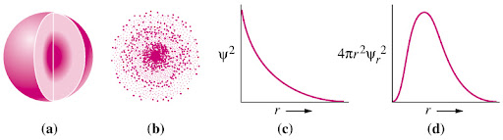
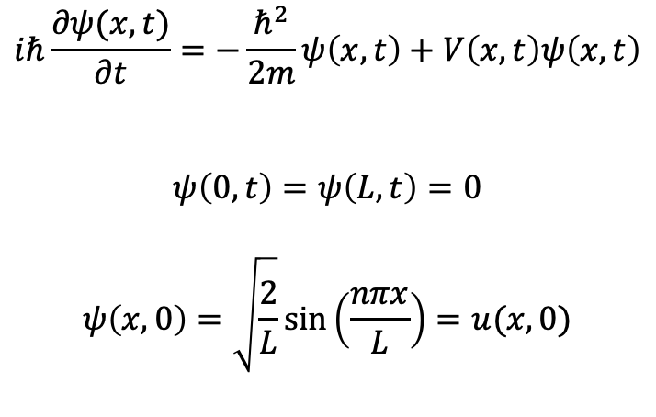
Background: Brief description of the equation.
The 1D Time-dependent Schrödinger Equation:
$$iℏ\frac{∂ψ(x, t)}{∂t}=−\frac{ℏ^{2}}{2m}ψ\left(x,t\right)+V\left(x, t\right)ψ\left(x,t\right)$$
$$ψ\left(0,t\right)=ψ\left(L, t\right)=0$$
$$ψ\left(x,0\right)=\sqrt{\frac{2}{L}}sin\left(\frac{nπx}{L}\right)=u(x,0)$$

Slide 4
Background: DL Method
How to proceed with PINNs in a complex domain?
A Physics‐Informed Neural Network (PINN) is a type of deep learning model that embeds the governing equations of a physical system, typically expressed as partial differential equations, directly into its loss function. Rather than learning solely from data, a PINN minimizes a combination of data-fitting terms (e.g., boundary and initial conditions) and a physics-residual term computed via automatic differentiation, which enforces that the network’s output satisfies the underlying differential operators. This is a very convenient meshless method
A complex-valued neural network extends this idea by allowing both the inputs, weights, activations, and outputs of the network to be complex numbers. By treating the real and imaginary components as coupled channels (or by using holomorphic activation functions), complex NNs naturally model phenomena—like quantum wavefunctions or electromagnetic fields—that inherently involve phase information, and they can capture oscillatory or wave-like behavior more compactly than purely real-valued architectures.

Slide 5
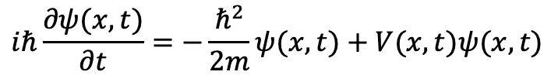

Method
The 1D Time-dependent Schrödinger Equation:
$$iℏ\frac{∂ψ(x, t)}{∂t}=−\frac{ℏ^{2}}{2m}ψ(x,t)+V(x, t)ψ(x,t)$$
For solving this complex problem, the original Schrödinger equation in 1D was splitted into two parts, this way, the problem becomes easier to solve:
$$ψ\left(x,t\right)=u(x,t)+iv(x,t)$$
$iℏ\frac{∂u(x, t)}{∂t}=−\frac{ℏ^{2}}{2m}v(x,t)+V\left(x, t\right)v(x,t)$ (Imaginary part)
$iℏ\frac{∂v(x, t)}{∂t}=\frac{ℏ^{2}}{2m}u(x,t)+V\left(x, t\right)u(x,t)$ (Real part)

Slide 6
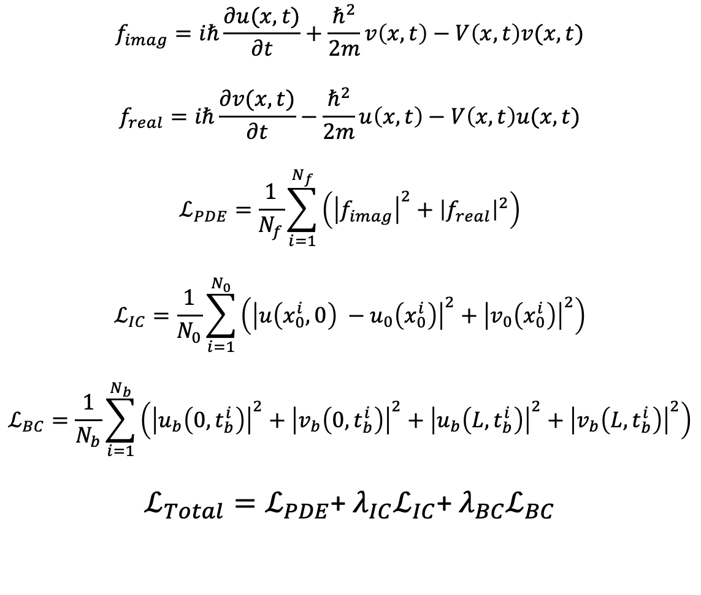
Method
The loss function
$$f_{imag}=iℏ\frac{∂u(x, t)}{∂t}+\frac{ℏ^{2}}{2m}v\left(x,t\right)−V\left(x, t\right)v(x,t)$$
$$f_{real}=iℏ\frac{∂v(x, t)}{∂t}−\frac{ℏ^{2}}{2m}u\left(x,t\right)−V\left(x, t\right)u(x,t)$$
$$ℒ_{PDE}=\frac{1}{N_{f}}\sum_{i=1}^{N_{f}}{\left({\left|f_{imag}\right|}^{2}+{\left|f_{real}\right|}^{2}\right)}$$
$$ℒ_{IC}=\frac{1}{N_{0}}\sum_{i=1}^{N_{0}}{\left({\left|u\left(x_{0}^{i},0\right) −u_{0}\left(x_{0}^{i}\right)\right|}^{2}+{\left|v_{0}\left(x_{0}^{i}\right)\right|}^{2}\right)}$$
$$ℒ_{BC}=\frac{1}{N_{b}}\sum_{i=1}^{N_{b}}{\left({\left|u_{b}\left({0, t}_{b}^{i}\right)\right|}^{2}+{\left|v_{b}\left({0, t}_{b}^{i}\right)\right|}^{2}+{\left|u_{b}\left({L, t}_{b}^{i}\right)\right|}^{2}+{\left|v_{b}\left({L, t}_{b}^{i}\right)\right|}^{2}\right)}$$
$ℒ_{Total}=ℒ_{PDE}$+ $λ_{IC}ℒ_{IC}$+ $λ_{BC}ℒ_{BC}$

Slide 7
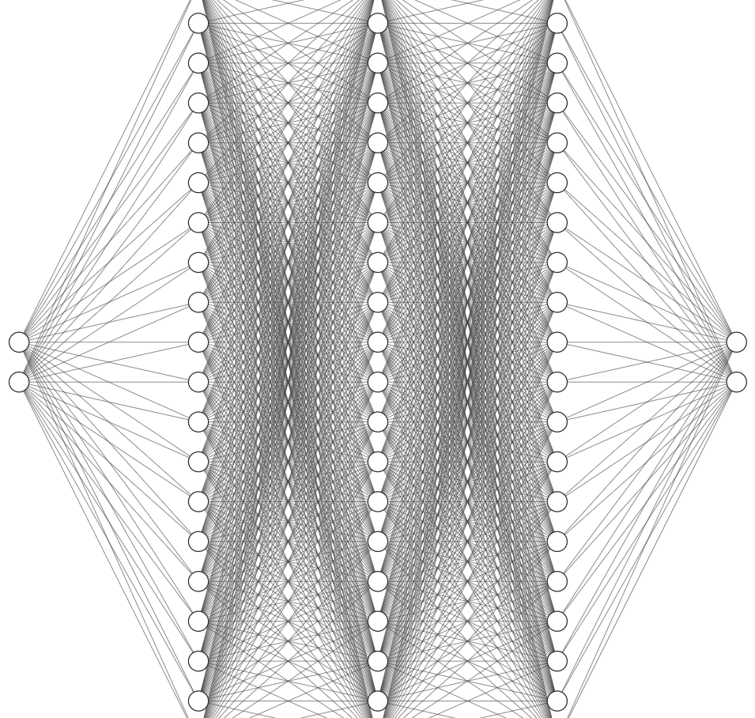
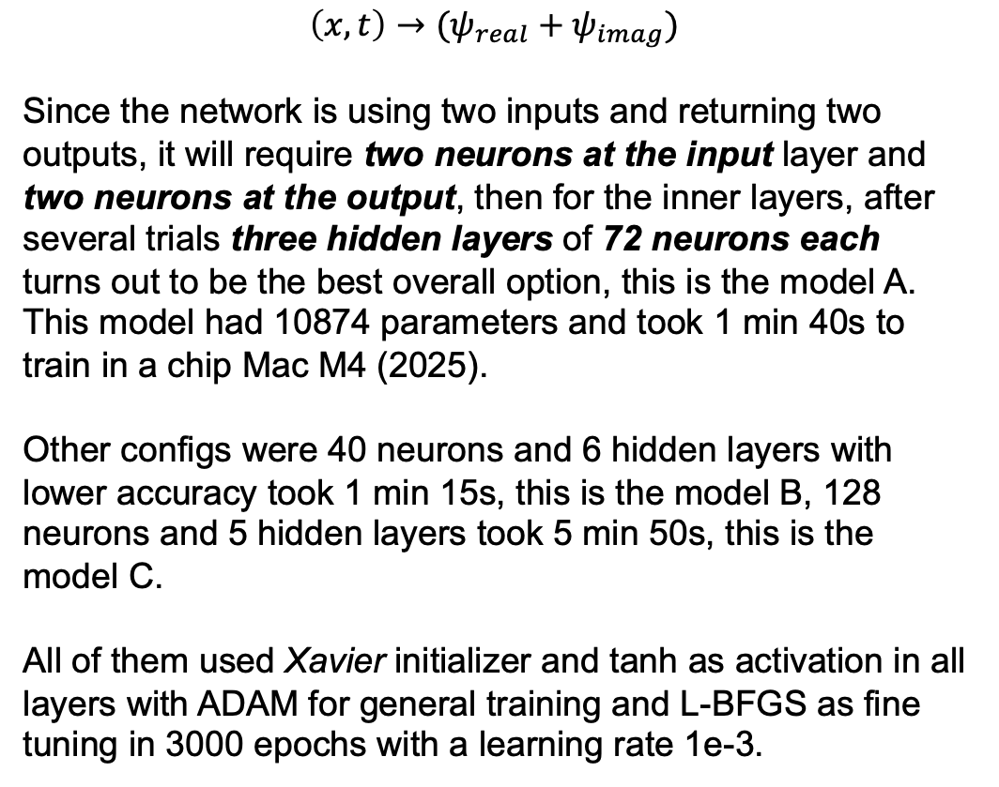
PINN architecture
$$\left(x, t\right)→(ψ_{real}+ψ_{imag})$$
Since the network is using two inputs and returning two outputs, it will require two neurons at the input layer and two neurons at the output, then for the inner layers, after several trials three hidden layers of 72 neurons each turns out to be the best overall option, this is the model A. This model had 10874 parameters and took 1 min 40s to train in a chip Mac M4 (2025).
Other configs were 40 neurons and 6 hidden layers with lower accuracy took 1 min 15s, this is the model B, 128 neurons and 5 hidden layers took 5 min 50s, this is the model C.
All of them used Xavier initializer and tanh as activation in all layers with ADAM for general training and L-BFGS as fine tuning in 3000 epochs with a learning rate 1e-3.

Slide 8
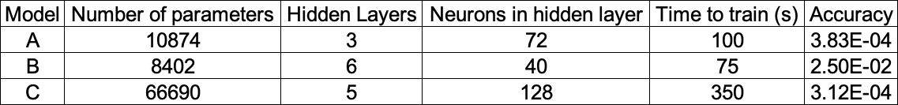
PINN architecture
Tested models

Slide 9
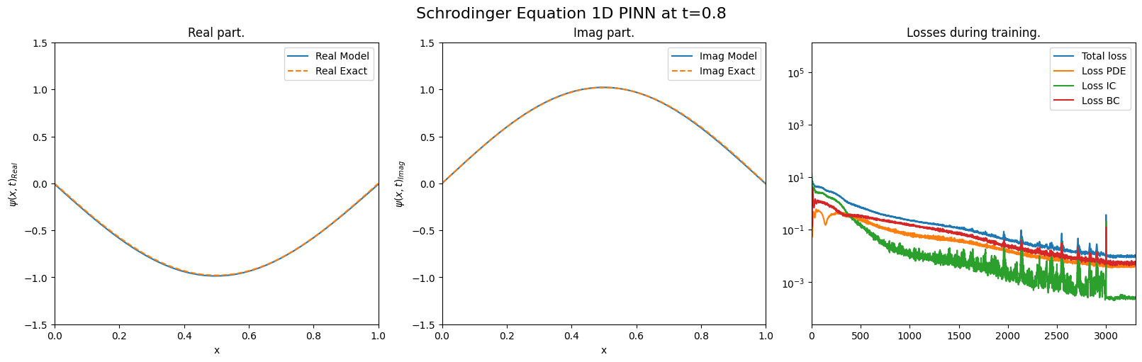
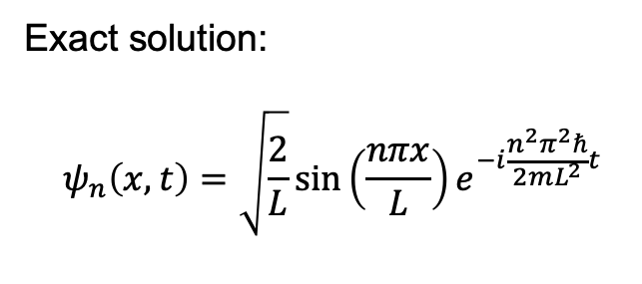
Tests results
Tested problems
Exact solution:
$$ψ_{n}\left(x,t\right)=\sqrt{\frac{2}{L}}sin\left(\frac{nπx}{L}\right)e^{−i\frac{n^{2}π^{2}ℏ}{2mL^{2}}t}$$
Case 1: Fundamental case n=1 (Conditions as described before.)

Slide 10
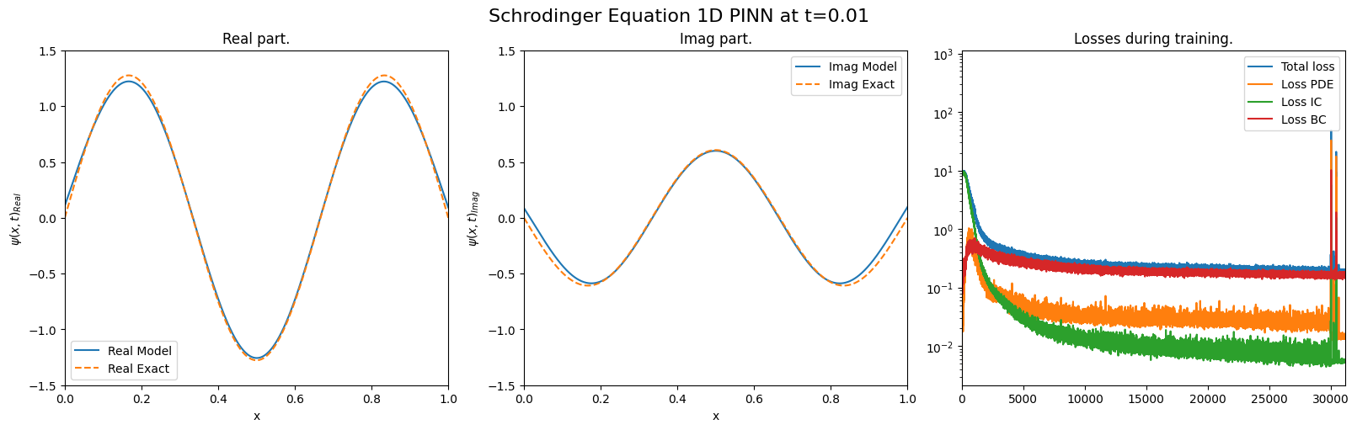
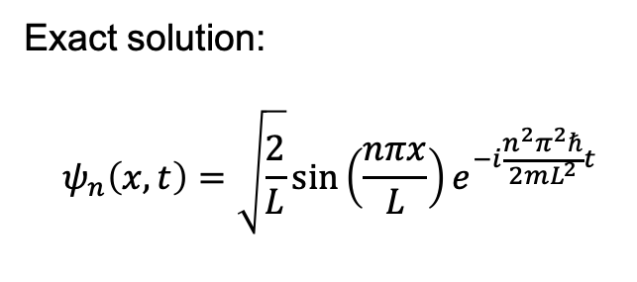
Tests results
Tested problems
Exact solution:
$$ψ_{n}\left(x,t\right)=\sqrt{\frac{2}{L}}sin\left(\frac{nπx}{L}\right)e^{−i\frac{n^{2}π^{2}ℏ}{2mL^{2}}t}$$
Case 2: Most energetic case n=3 (30000 epochs. And 5 min 52s training)

Slide 11
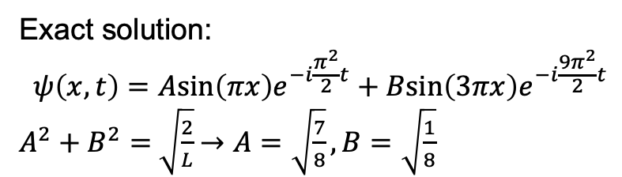
Tests results
Tested problems
Exact solution:
$$ψ\left(x,t\right)=Asin\left(πx\right)e^{−i\frac{π^{2}}{2}t}+Bsin\left(3πx\right)e^{−i\frac{{9π}^{2}}{2}t}$$
$A^{2}+B^{2}=$ $\sqrt{\frac{2}{L}}$ $→A=\sqrt{\frac{7}{8}},B=\sqrt{\frac{1}{8}}$
Case 3: Superposition n = 1 and n=3
(30000 epochs. And 5 min 52s training)

Slide 12
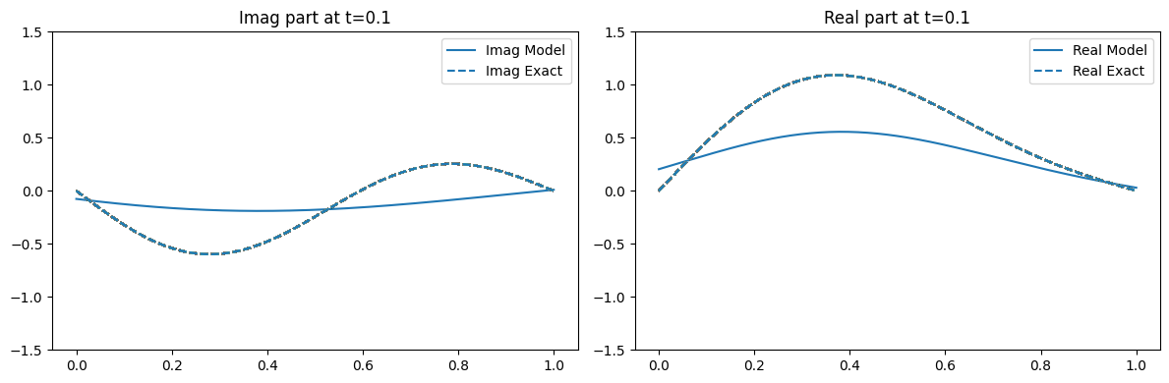
A bonus.

Slide 13

REPO
Code available at:
https://github.com/Randhal1/Special_topics

Slide 14
References
Raissi, M., Perdikaris, P., & Karniadakis, G. E. (2019). Physics‐Informed Neural Networks: A Deep Learning Framework for Solving Forward and Inverse Problems Involving Nonlinear Partial Differential Equations. Journal of Computational Physics, 378, 686–707.
Sirignano, J., & Spiliopoulos, K. (2018). DGM: A deep learning algorithm for solving partial differential equations. Journal of Computational Physics, 375, 1339–1364.
Mildenhall, B., Srinivasan, P. P., Tancik, M., Barron, J. T., Ramamoorthi, R., & Ng, R. (2020). NeRF: Representing Scenes as Neural Radiance Fields for View Synthesis. In Proceedings of the European Conference on Computer Vision (ECCV).
Sitzmann, V., Martel, J. N. P., Bergman, A. W., Lindell, D. B., & Wetzstein, G. (2020). Implicit Neural Representations with Periodic Activation Functions. In Advances in Neural Information Processing Systems (NeurIPS), 33.
Raissi, M., Yazdani, A., & Karniadakis, G. E. (2020). Hidden Fluid Mechanics: Learning Velocity and Pressure Fields from Flow Visualizations. Science, 367(6481), 1026–1030.
Lagaris, I. E., Likas, A., & Fotiadis, D. I. (1998). Artificial Neural Networks for Solving Ordinary and Partial Differential Equations. IEEE Transactions on Neural Networks, 9(5), 987–1000.
Wonderlick, J., & Cohen, T. (2021). A Primer on L-BFGS Optimization for Physics-Informed Neural Networks. Applied Numerical Mathematics, 160, 144–163.
Kutz, J. N. (2017). Deep Learning in Fluid Dynamics. Journal of Fluid Mechanics, 814, 1–4.
Kingma, D. P., & Ba, J. (2015). Adam: A Method for Stochastic Optimization. In International Conference on Learning Representations (ICLR).
Byrd, R. H., Lu, P., Nocedal, J., & Zhu, C. (1995). A Limited Memory Algorithm for Bound Constrained Optimization. SIAM Journal on Scientific and Statistical Computing, 16(5), 1190–1208.

