Slide 1
Lecture 3
September 9, 2025

Slide 2
Transcriptomics
Real-Time PCR (qPCR)
Microarray
Next generation sequencing

Slide 3
PCR
Amplification of DNA
Can be used for detection, cloning and sequencing of specified regions
Uses one or more primers

Slide 4
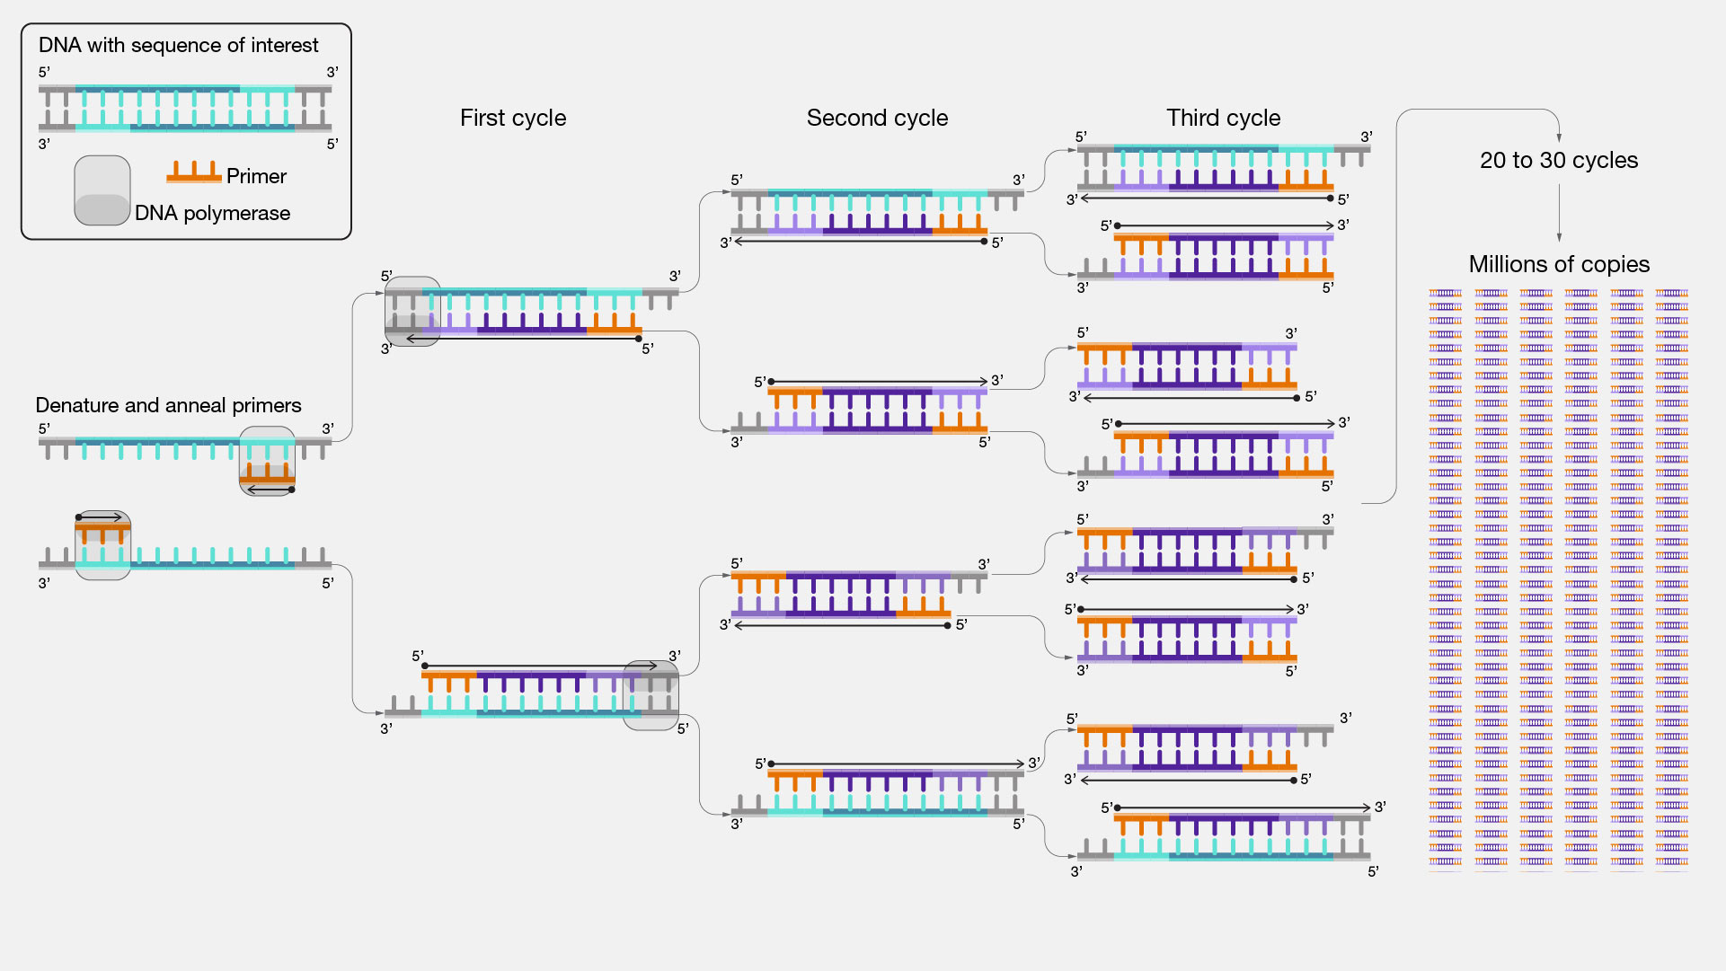
https://www.genome.gov/genetics-glossary/Polymerase-Chain-Reaction

Slide 5
Quantitative PCR
Reverse Transcription
Amplify
Capture fluorescence
Repeat Steps 2 and 3 for 29 more rounds
Determine Double Delta-CT
Gene of Interest Experimental (TE)
Gene of Interest Control (TC)
House Keeping Gene Experimental (HE)
House Keeping Gene Control (HC)

Slide 6
qPCR
Delta-CT
TE-HE (ΔCTE)
TC-HC (ΔCTC)
Double Delta-CT
ΔCTE – ΔCTEC= ΔΔCT
Calculate Fold Change
2^{-ΔΔCT}

Slide 7
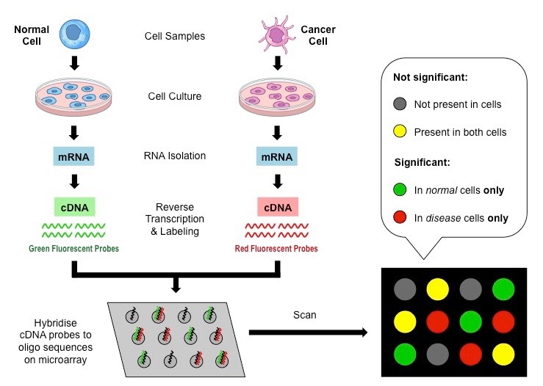
Microarrays
https://www.google.com/url?sa=i&url=https%3A%2F%2Fold-ib.bioninja.com.au%2Foptions%2Funtitled%2Fb4-medicine%2Fdna-microarrays.html&psig=
AOvVaw0nspQ4_Gkosoy0Vh5CxYaE&ust=1726064964795000&source=images&cd=vfe&opi=89978449&ved=0CBQQjRxqFwoTCOjfopvLuIgDFQAAAAAdAAAAABAE

Slide 8
Next Generation Sequencing
Total RNA
Poly-A Capture
Specific Probes

Slide 9
Why do transcriptomic experiments?
Exploratory vs confirmational experimentals
General gene discovery
Compare experimental treatments
Drug treatments
Knockout/Knockin studies
Toxicology
Developmental Stages

Slide 10
In Class Work
Split up into groups
Each group design an experiment to test changes in gene expression
State assumptions going into the experiment
List expected results
List potential pitfalls

