Slide 1
Networks

Slide 2
Network Terms
Parts of the network
Nodes
Edges
Leaves
Weighted vs Unweighted

Slide 3
Unweighted Graph
0 | 1 | 1 | 0 | 0
0 | 0 | 0 | 1 | 0
0 | 0 | 0 | 0 | 0
0 | 0 | 0 | 0 | 1
0 | 0 | 0 | 1 | 0
B
A
D
E
C

Slide 4
Weighted Graph
0 | 1.5 | 5 | 0 | 0
0 | 0 | 0 | 0.25 | 0
0 | 0 | 0 | 0 | 0
0 | 0 | 0 | 0 | 2
0 | 0 | 0 | 2 | 0
B
A
D
E
C

Slide 5
A cycle in a directed network
B
A
D
C

Slide 6
An acyclic directed network
B
A
D
C

Slide 7
Trees
A
B
C
D
E

Slide 8
Multilayer and Multiplex Networks
B
Multilayer – Different networks that connected by edges between the subnetworks
Multiplex – Nodes are the same, but the edges are different in the subnetworks
A
D
E
C
B
A
D
E
C

Slide 9
Degree of a node
The degree of a node is the number of edges connected to it
A = 2
B = 2
E = 1
B
A
D
E
C

Slide 10
Walks and Paths
Walks – A sequence of nodes that every consecutive pair of nodes in the sequence is connected by an edge
Self-avoiding walks
Length – The number of edges transversed, not the number of nodes
Paths – Walks that do not intersect themselves
There are many algorithms to identify the shortest path

Slide 11
Phylogenetic Trees
A
B
C
D
E

Slide 12
Gene Regulatory Networks
0 | 1.5 | 5 | 0 | 0
0 | 0 | 0 | 0.25 | 0
0 | -0.5 | 0 | 0 | 0
0 | 0 | 0 | 0 | 2
0 | 0 | 0 | 2 | 0
B
A
D
E
C

Slide 13
How to determine the GRNs
Transcriptomic studies
Knockout
Knockin
Drugs

Slide 14
Remember the Multiplex Networks
B
Different cell types
Different conditions
A
D
E
C
B
A
D
E
C

Slide 15
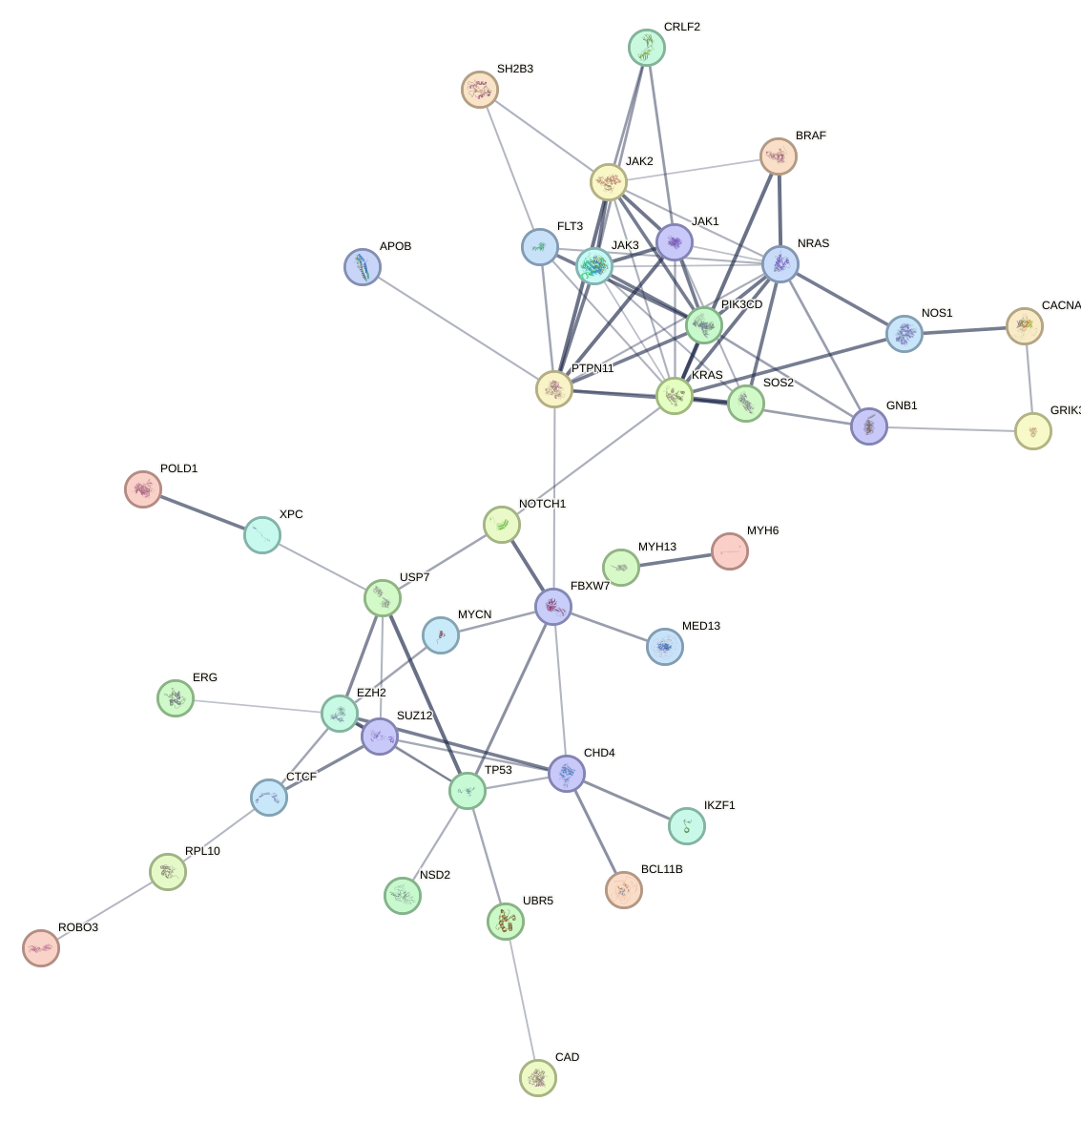
Protein – Protein Interactions

Slide 16
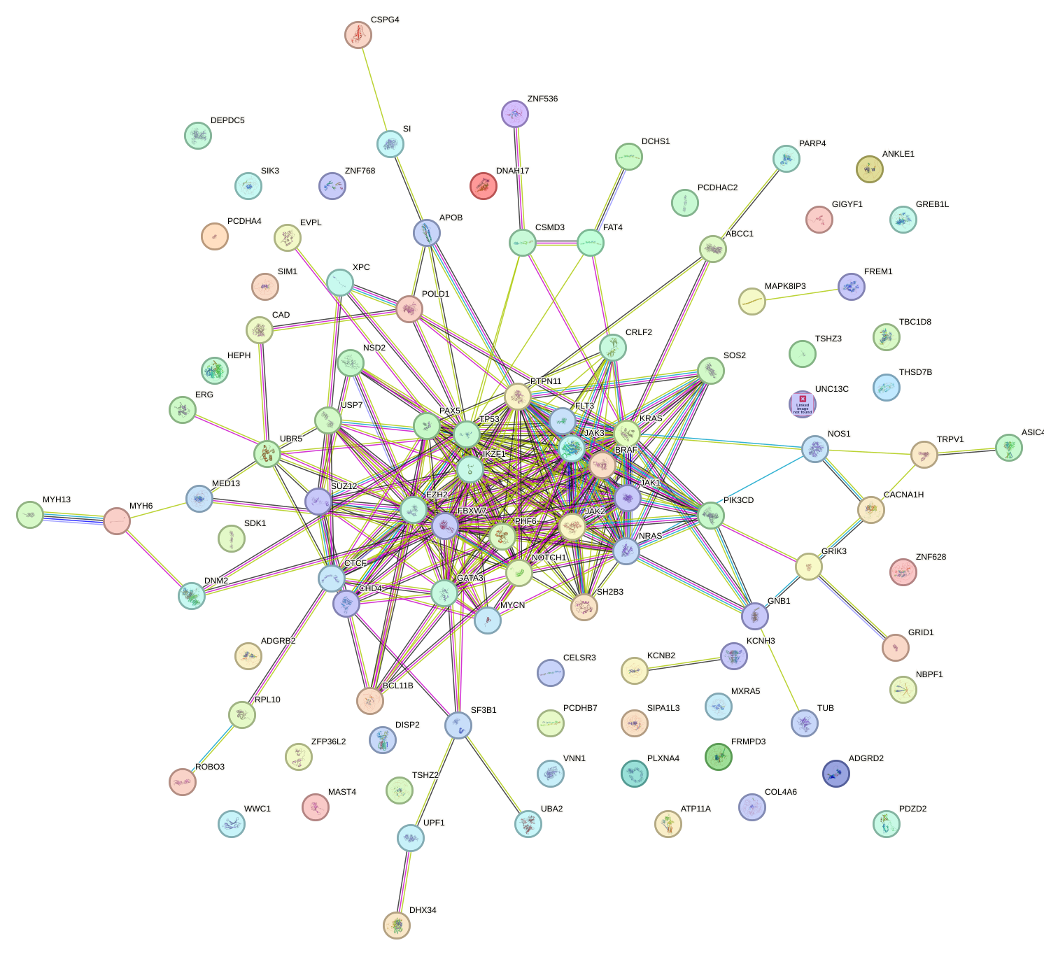
Warning: Use figures that you can clearly Explain

