Slide 1
Lecture 6
September 30, 2025

Slide 2
Outline
Machine learning Intro
Feature Selection
Decision Tree
Random Forest
KNN Classification

Slide 3
What is the difference?
Computer Science
Biological Sciences
Mathematical Sciences
Statistics

Slide 4
What is the difference?
Computer Science
Biological Science
Mathematical Science
Statistics
Computational Science
Data Science

Slide 5
Machine Learning
Biology
Computer Science
Mathematics/
Statistics

Slide 6
Defining the Problem
Classification vs Prediction?
More accurate or more sensitive or more specific?
High throughput or limited use?
What features are necessary?
What samples to use?
How many samples to use?

Slide 7
Classification vs Prediction
Classification
Categorize data into groups based on shared characteristics
Is this a GPCR?
Is this a hybrid duck?
Prediction
To determine the outcome of a future event
Will a site be glycosylated?
Will the stock market go up or down?

Slide 8
Feature Selection
How to decide what features are important?
Are things meaningful?
Correlations?

Slide 9
Feature Selection
When to select features?
Filter (Univariate & Multivariate) – Test for correlations
Wrapper –Selects and tests groups of features
Embedded – Part of the algorithm

Slide 10
Decision Tree
Height (>200cm)
Weight
(>50kg)
Male
Female
Weight (<65 kg)
Female
Male
Can work with continuous, discrete, and categorical data
General Algorithm
Determine the best split
Move the samples along the tree
Repeat the prior two steps

Slide 11
Random Forest
General Algorithm
Subset the various features with replacement
Construct decision trees
Ensemble method to perform final prediciton

Slide 12
Random Forest Variable Importance

Slide 13
Random Forest Variable Importance

Slide 14
Random Forest Variable Importance

Slide 15
K Nearest Neighbors
Helps groups a sample with the closest K matches
Supervised Classification
Uses K nearest neighbors, those that are the closest to the unknown, to determine the class of the unknown
Data must be binary or continuous
The data can be transformed, i.e. the use of principal component analysis
Uses distance matrices
Euclidean – The cartesian distance between two point.
Manhattan Distance – The absolute difference between the coordinates of the points in multiple dimensions
Jaccard similarity coefficient – Presence/absence between two sets

Slide 16
K - Means Clustering
Helps group samples into K clusters
Unsupervised Classification
Splits all the samples into K clusters, such that each sample is closest to an assigned centroid
Initially, centroids are determined by randomly selecting points in the data

Slide 17
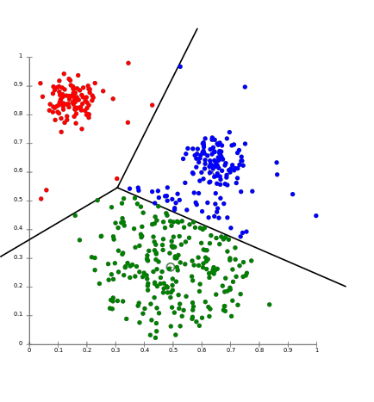
K-Means Clustering
https://aws.amazon.com/blogs/machine-learning/k-means-clustering-with-amazon-sagemaker/

