Slide 1
Project Book

Slide 2
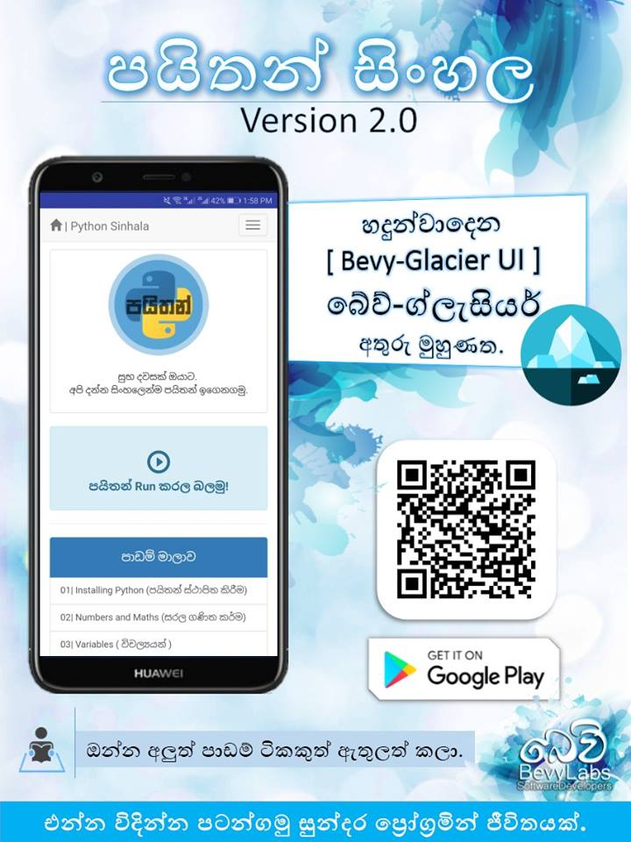
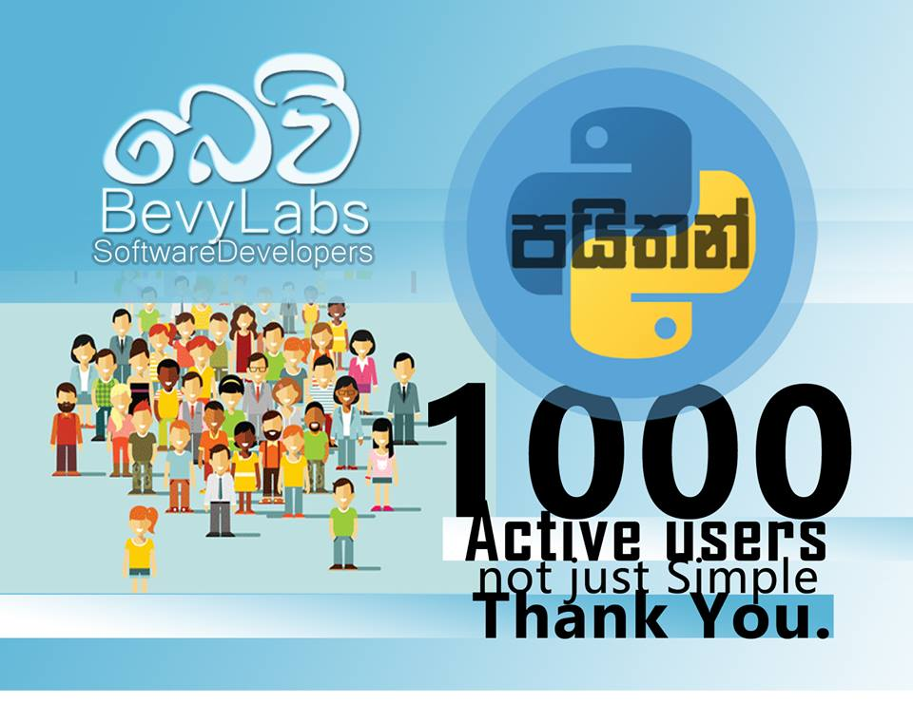
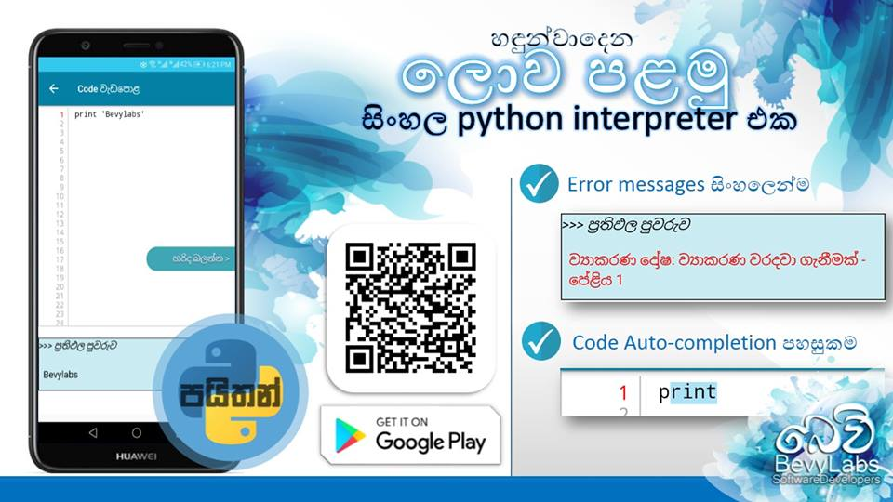
“Python Sinhala” -
An android application that helps people to startup
with programming.It has over 1000 active users through the
Google Playstore.

Slide 3
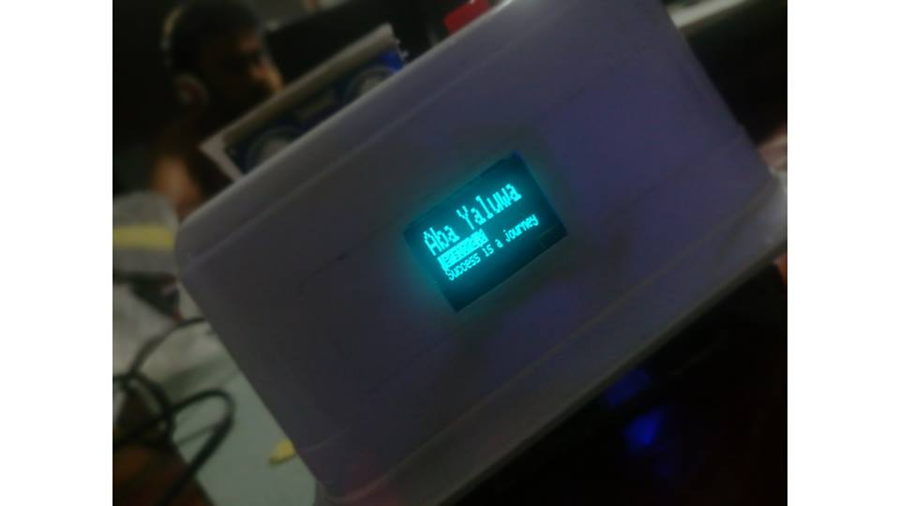
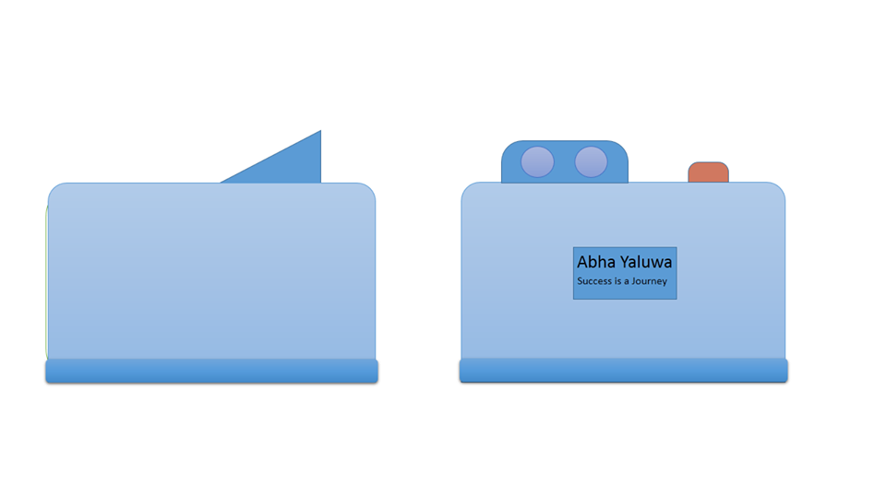
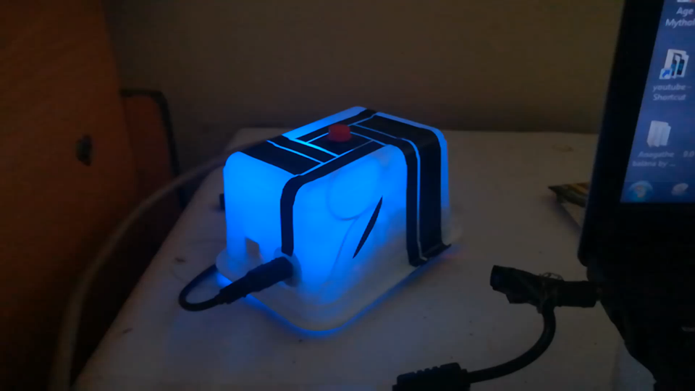
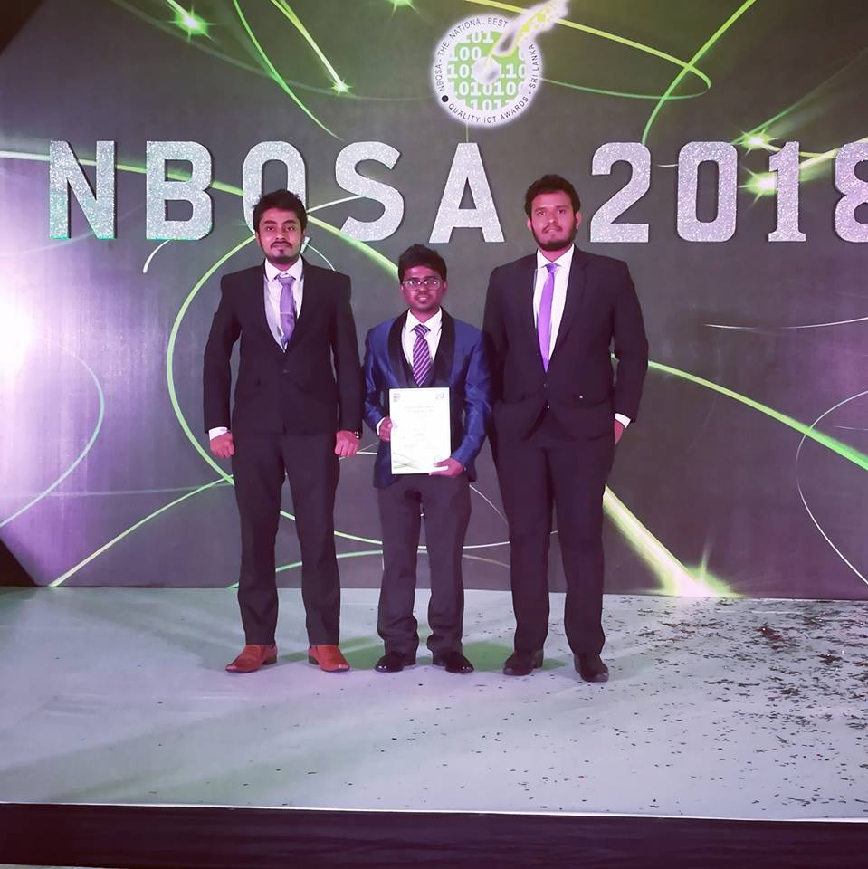
“Amba Yaluwa” -
A concentration device that based on psychology techniques
(Color psychology , Pomodoro technique)

Slide 4
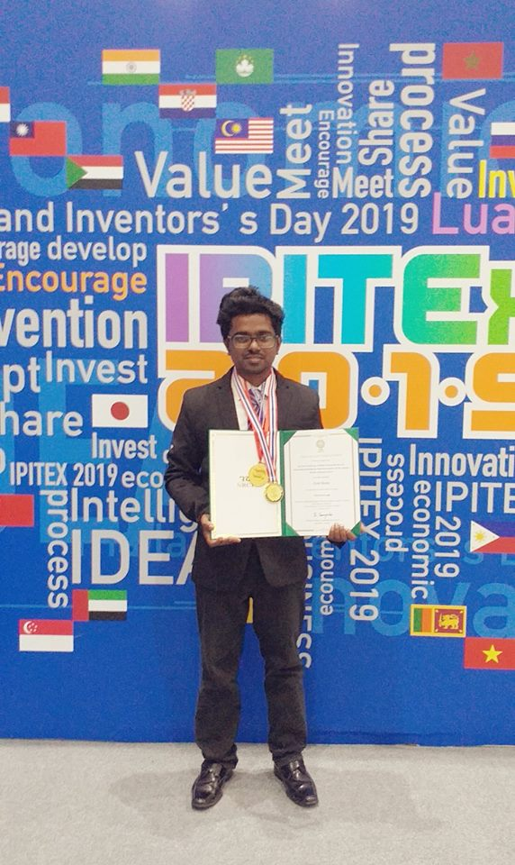
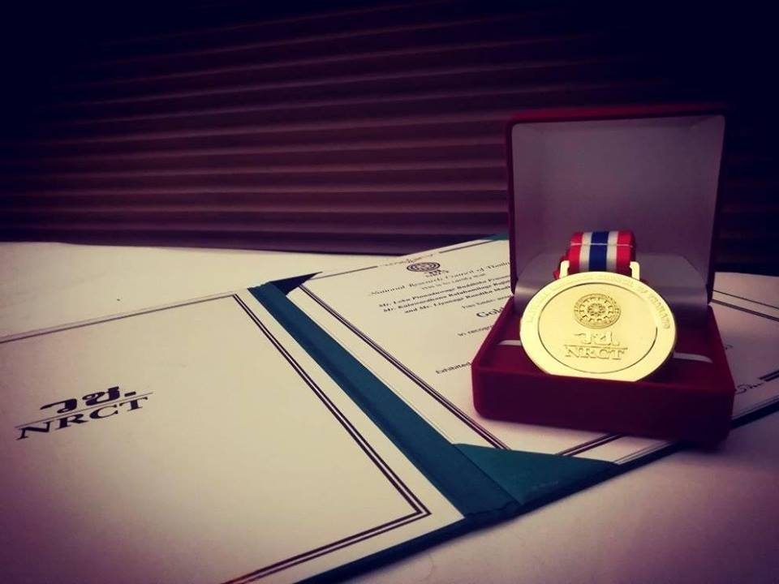
“NoteReview App” -
A solution for review notes and can evaluate the user
in less than in 2mins.

Slide 5

“Hithumathe Jeevithe” -
Sri Lanka’s first game with a rap music. A platformer action game.

Slide 6
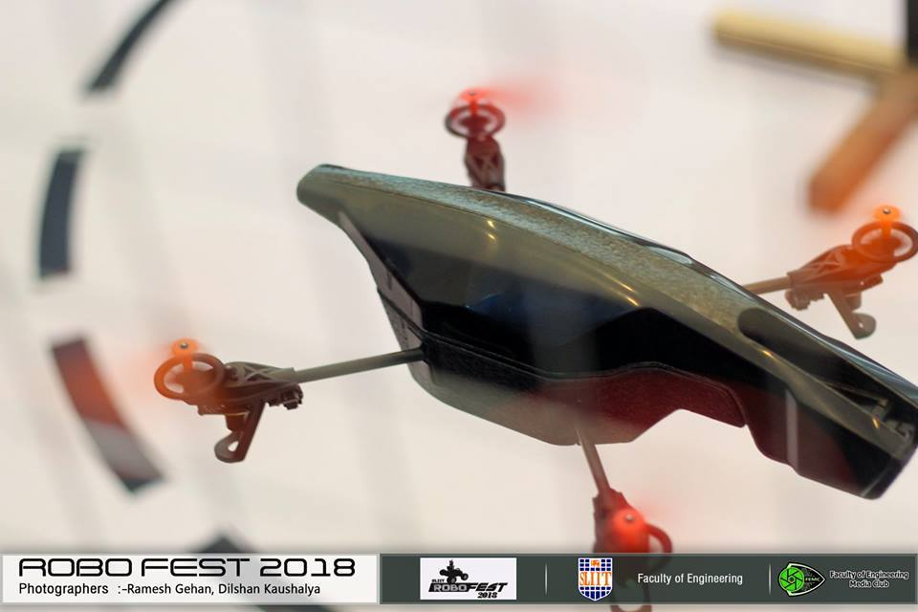
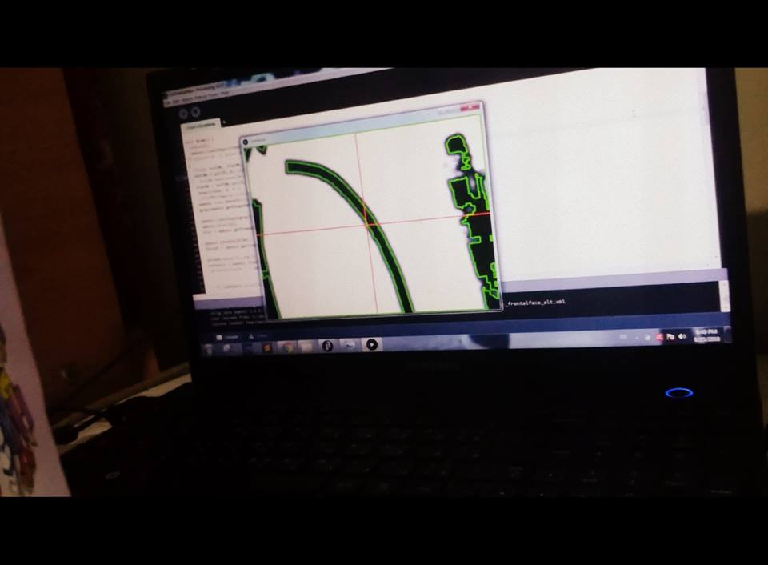
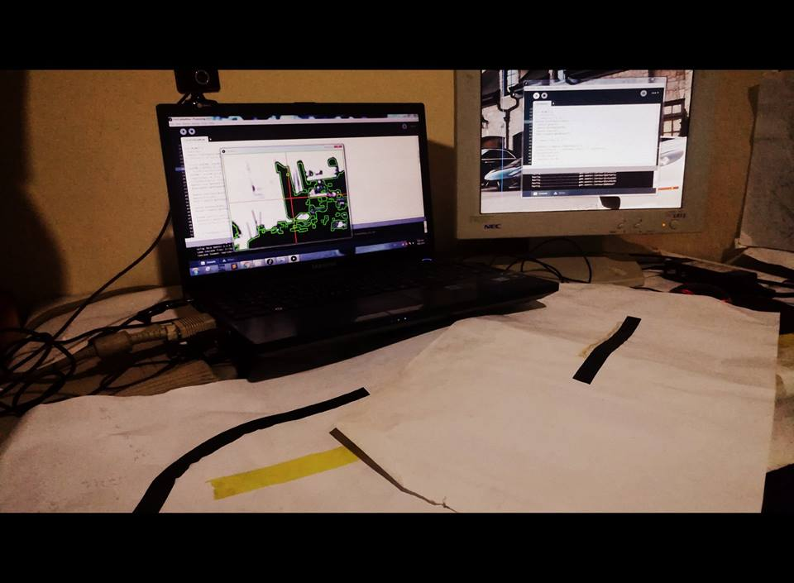
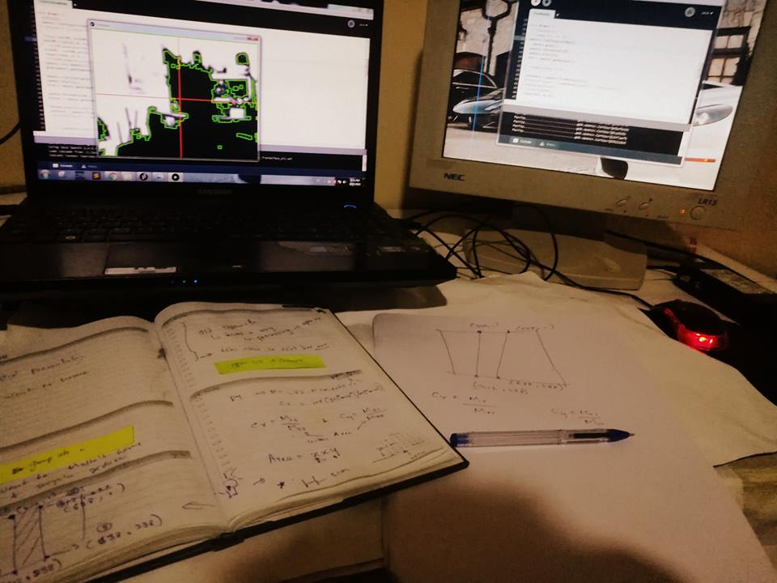
“BevyLabsFlyBee” -
An autonomous drone that can fly using detecting lines.

Slide 7
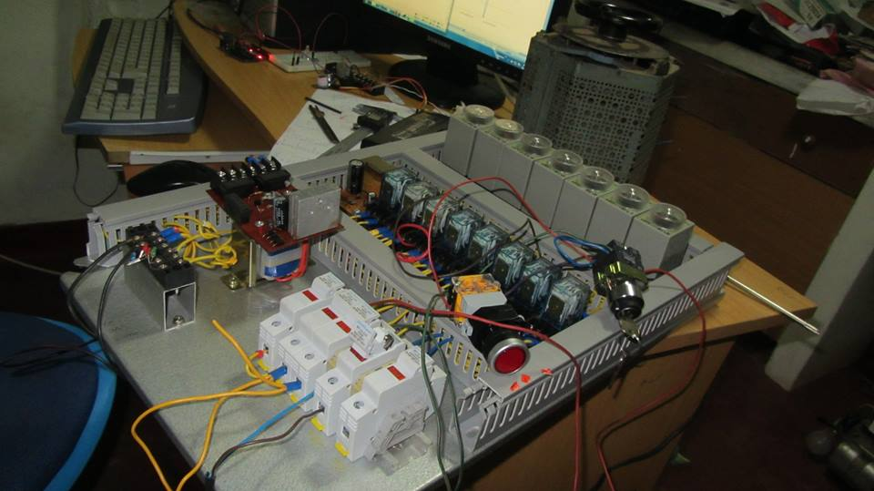
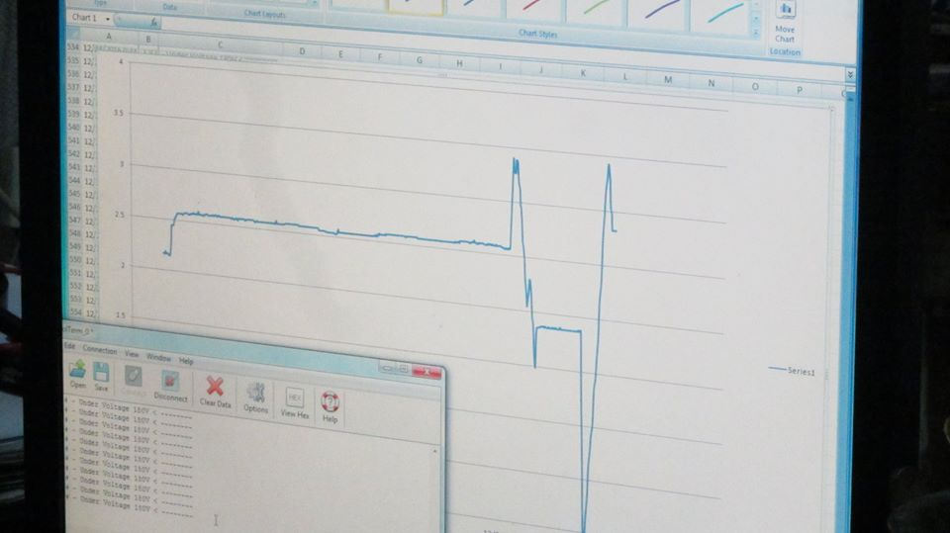
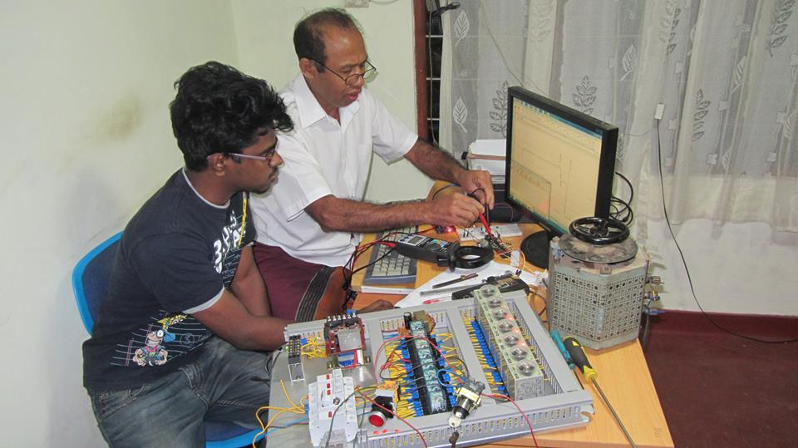
Project “GenACMS” -
A solution for measuring/indicating
A/C voltages levels with real-time monitoring system.

Slide 8
Project “Vibes” -
A mobile solution for who want to mark attendance
of a large number of people in less amount of time.

Slide 9
Concentration device
For increasing productivity through the improvement
of pomodoro technique using colour psychology
UWU International Research Symposium 2019
Automated collection of customer feedback
Using Facial expression and machine learning techniques
UWU International Research Symposium 2019
Sixty Seconds Robot
Rapid Development Robotics for Beginners
UWU International Research Symposium 2018
A customizable virtual reality application
For enhancement of Method of Loci
UWU International Research Symposium 2019

Slide 10
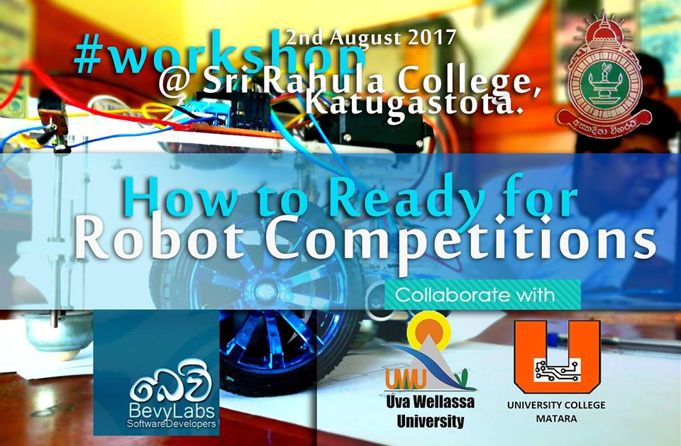
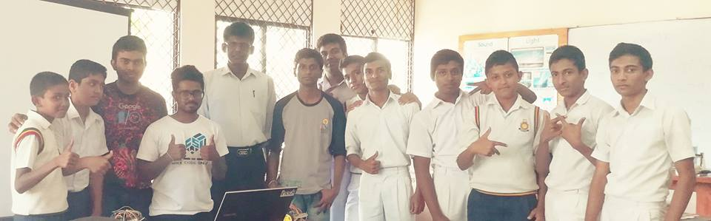
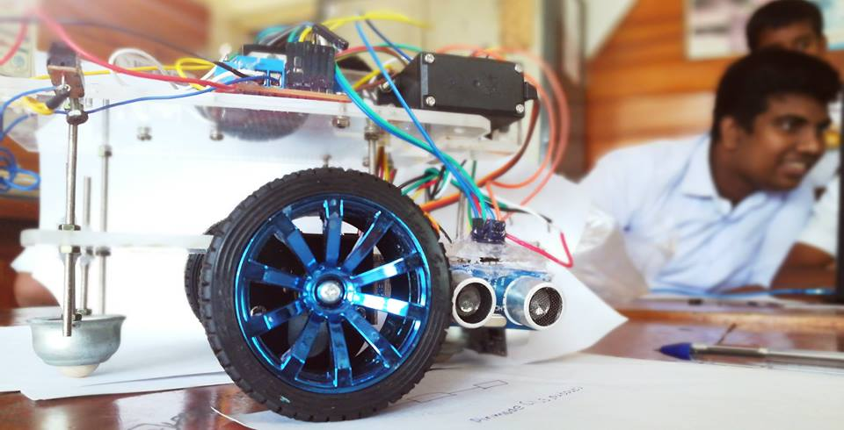
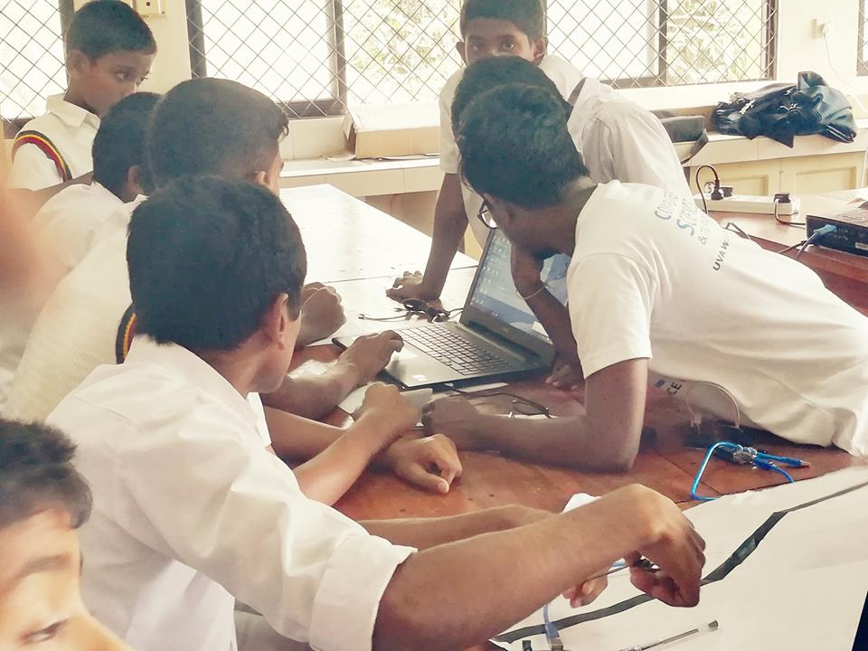
Workshops

Slide 11
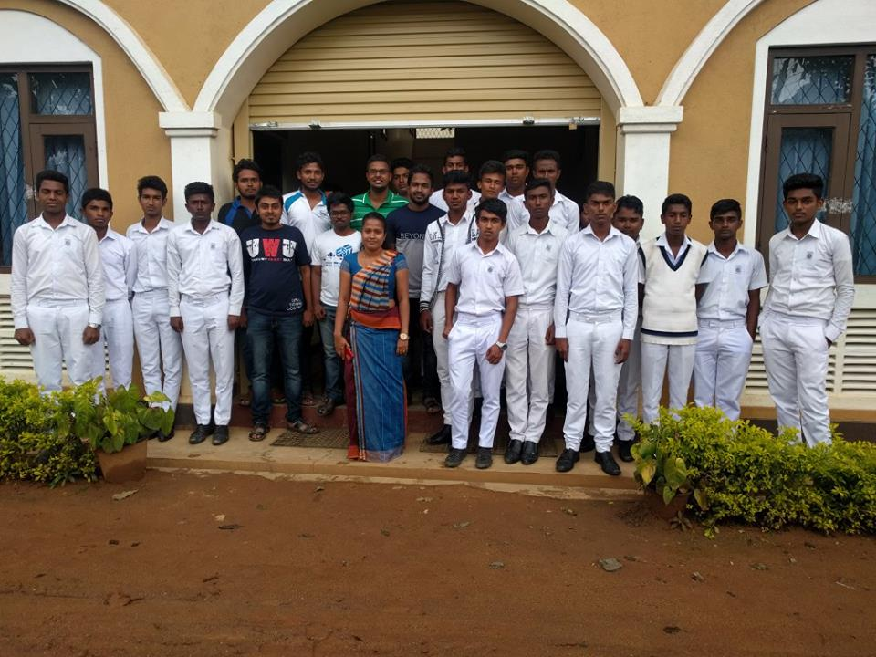
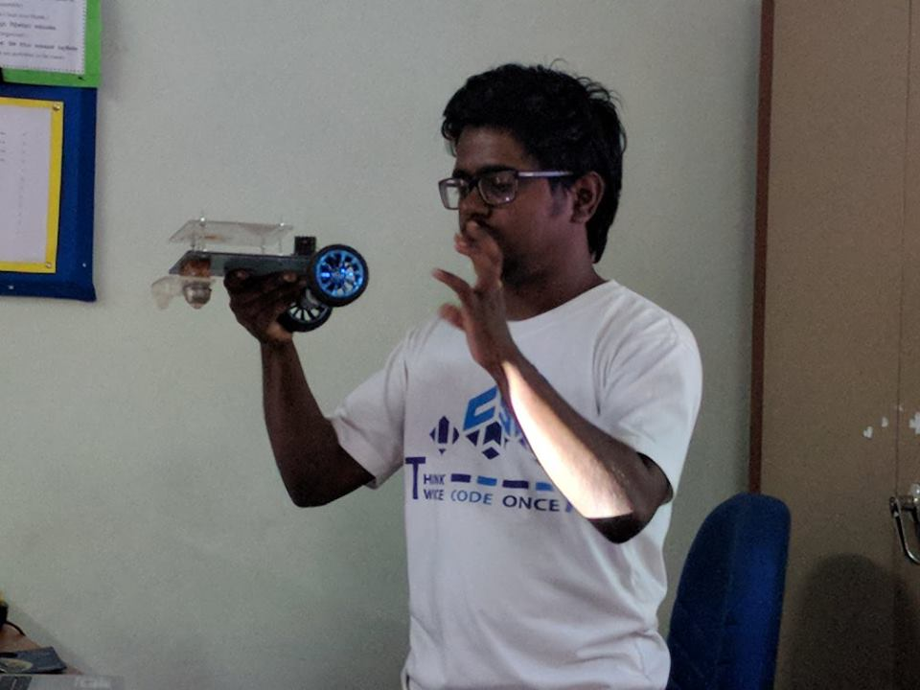
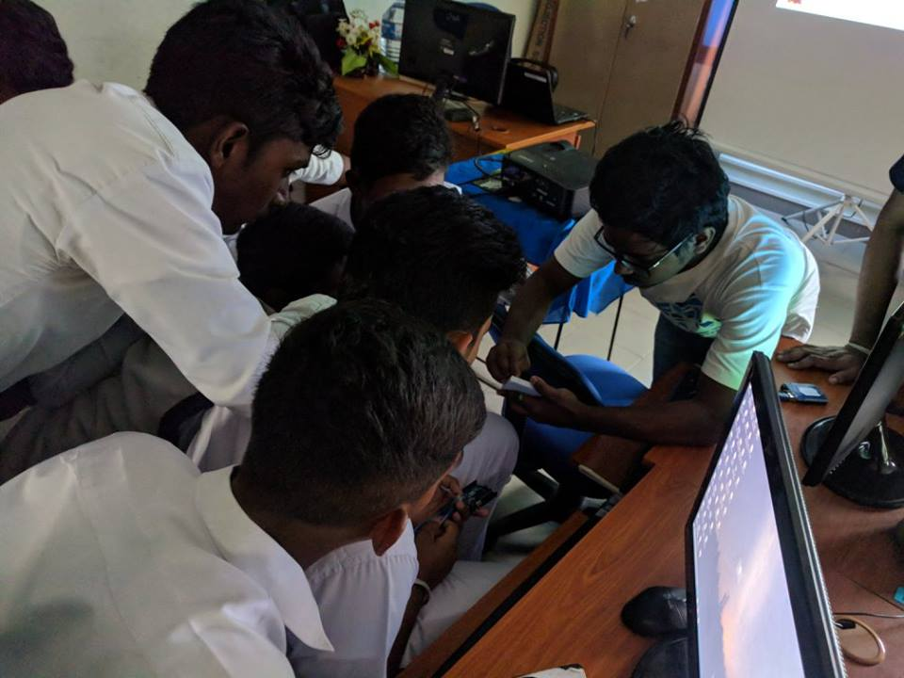

Slide 12
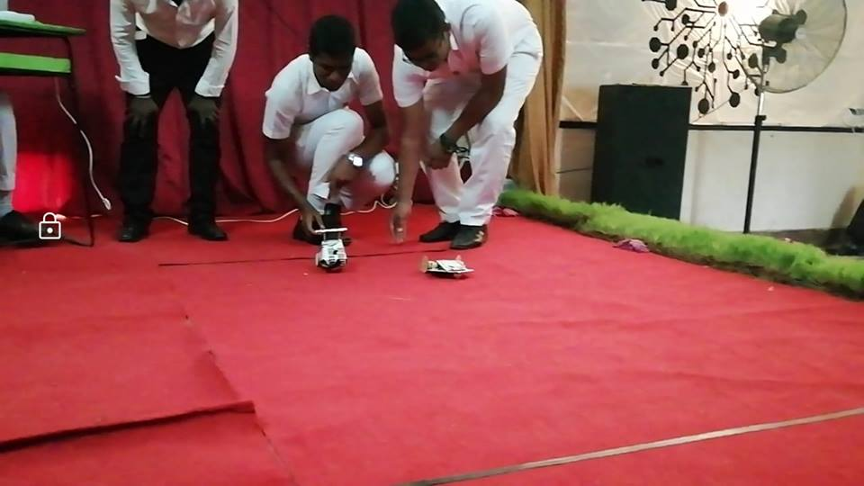
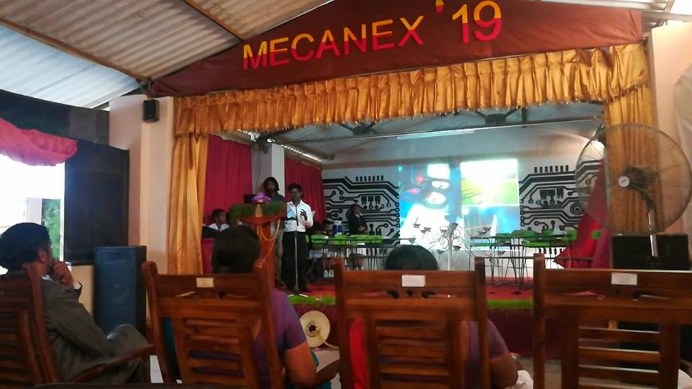

Slide 13
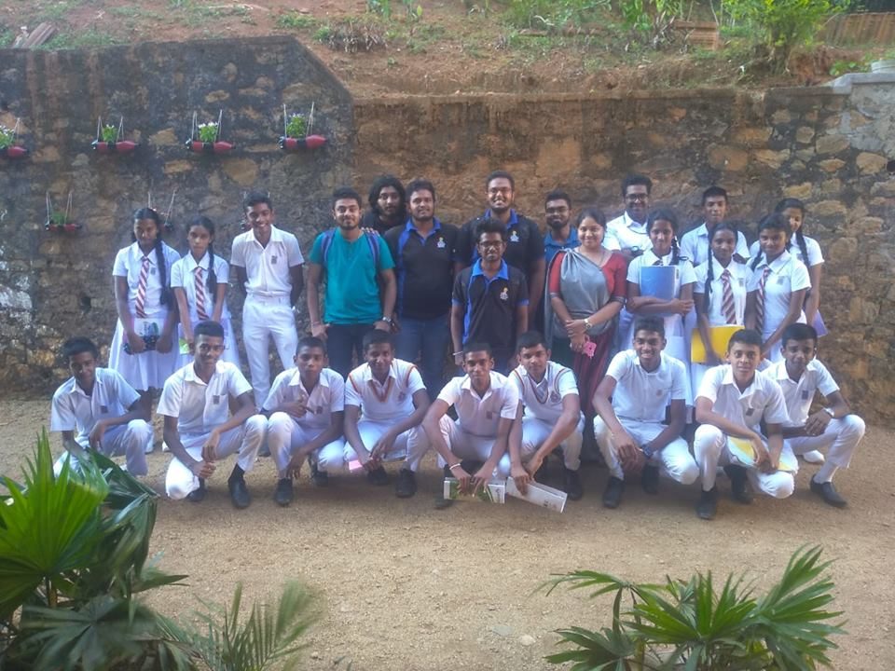
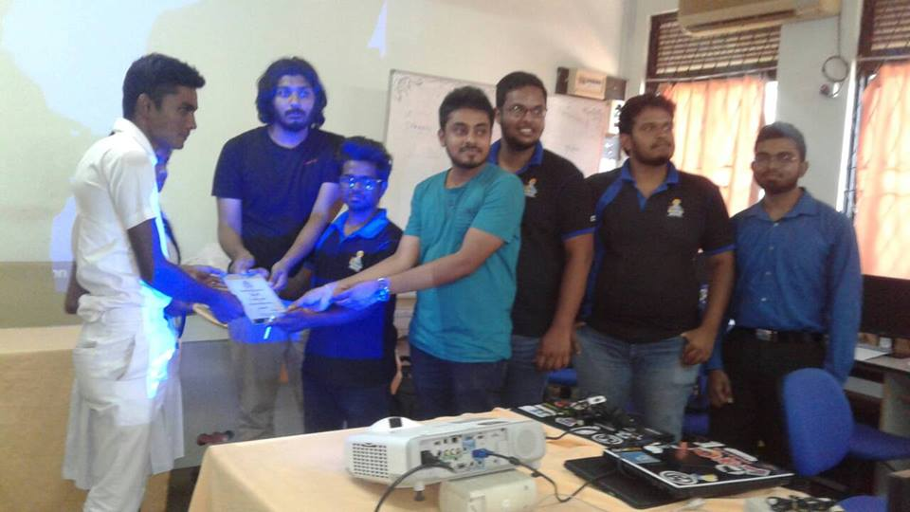

Slide 14



Slide 15
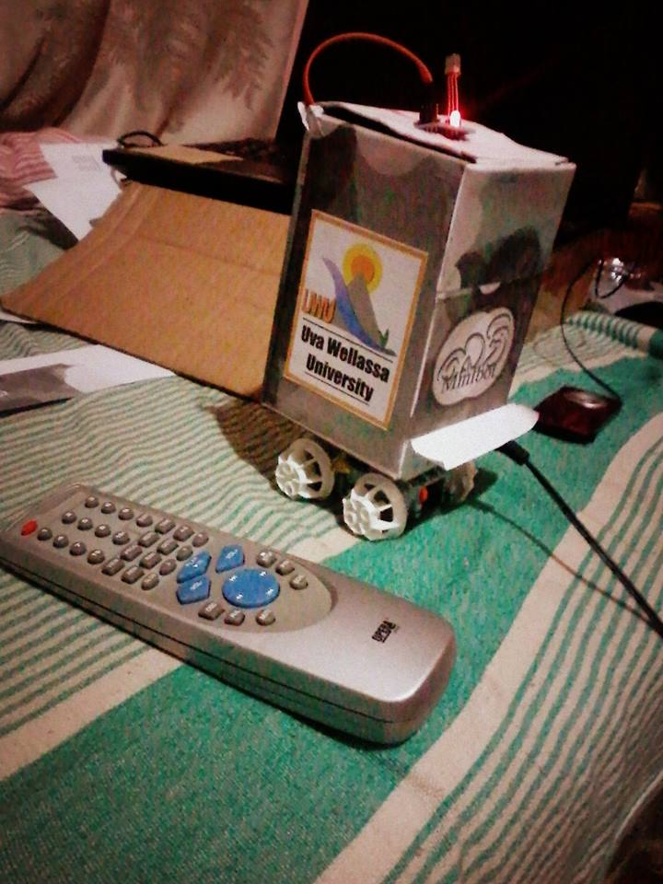
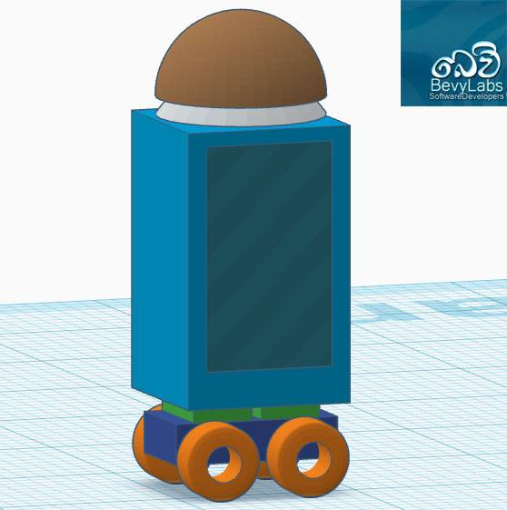
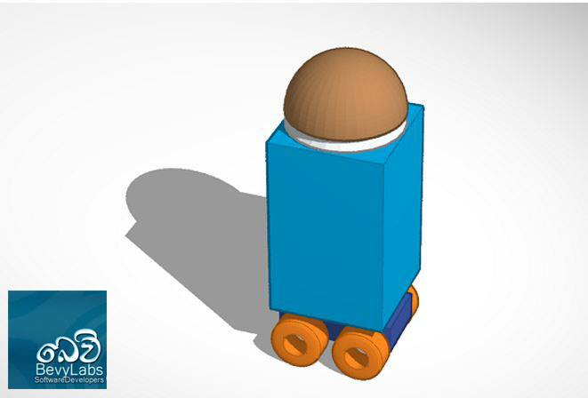
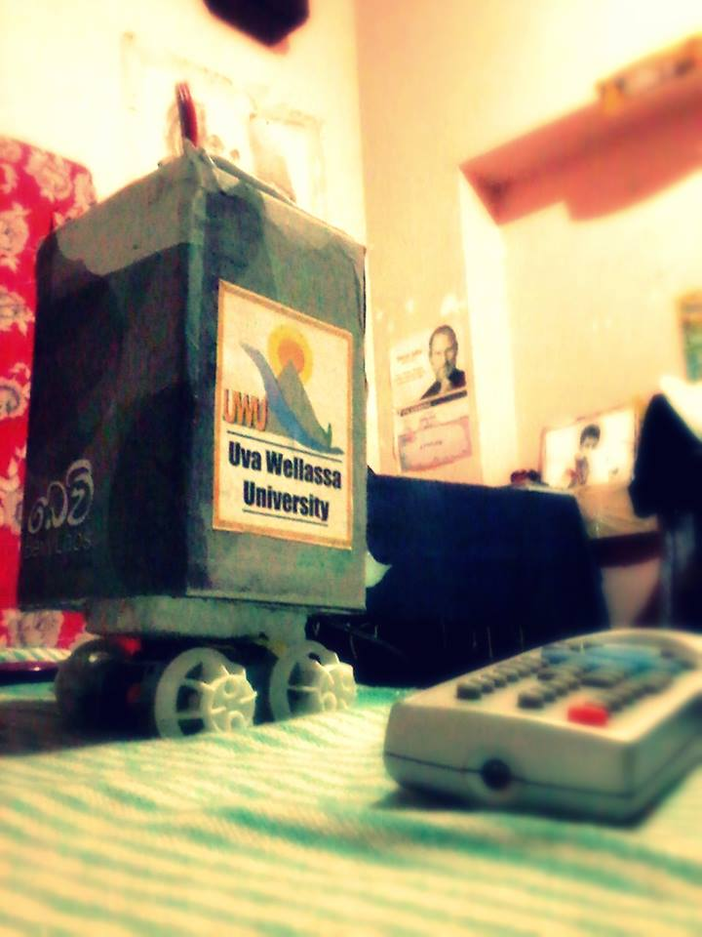
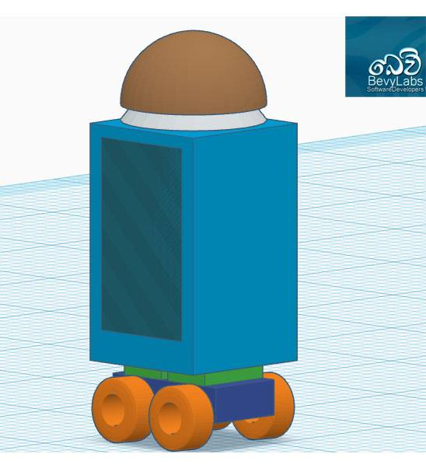

Slide 16
