Slide 1
Web Development Tools
Milton Acevedo
Jerry Jones

Slide 2
Web Development Tools
Do:
Allow developers to “drag and drop” items
Speed up website design
Don’t:
Do anything that can’t also be done by hand coding the HTML

Slide 3
Web Development Tools
Three main competitors:
Microsoft FrontPage 2002
Adobe GoLive 6.0
Macromedia Dreamweaver MX

Slide 4
Microsoft FrontPage 2002
Pros:
Easier to learn than others
Many templates and wizards
Cons:
Generates “sloppy” code
Has a poor reputation with professionals

Slide 5
Adobe GoLive 6.0
Pros:
Cleaner code than FrontPage 2002
Integrates well with Adobe suite of products
Cons:
Dynamic content not as easy as Dreamweaver MX

Slide 6
Macromedia Dreamweaver MX
Pros:
Very Clean Code
Dynamic content easy to create
Cons:
Intimidating to newcomers

Slide 7
Dreamweaver Tutorial
Create a simple site with:
Text
Image
Internal Link
External Link
Hotspot

Slide 8
Free Trials
As of July 24, 2002:
Download free trials of Golive 6.0 and Dreamweaver MX from their respective websites
Microsoft is offering a free trial of FrontPage 2002, but you must send away for CD
Students able to buy these products at a discount

Slide 9
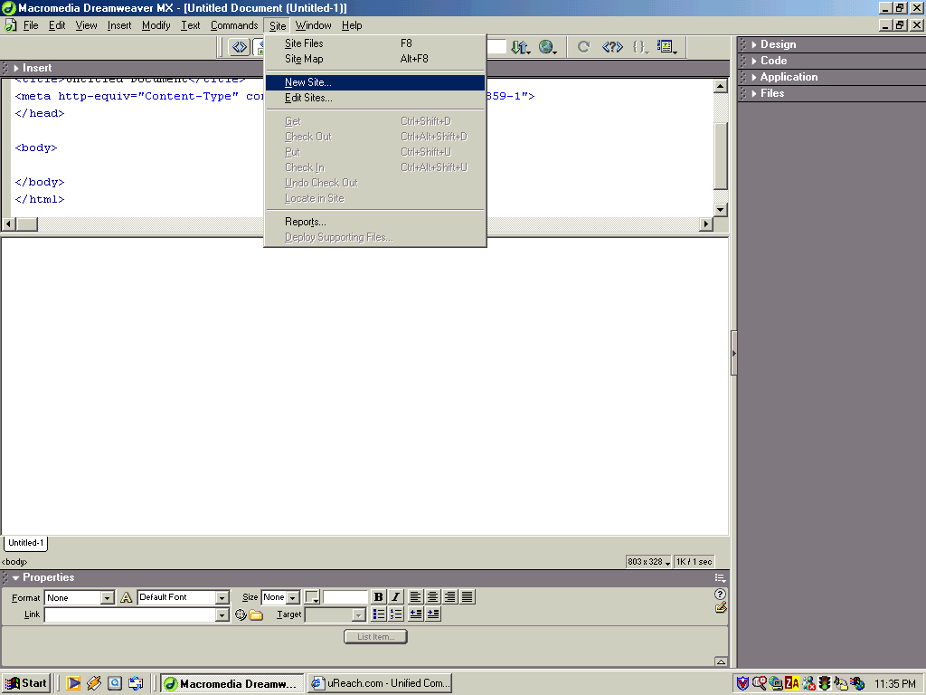
Defining a new site
Notes:
Go to the Site menu and select New Site from the menu list. A Site definition dialog appears

Slide 10
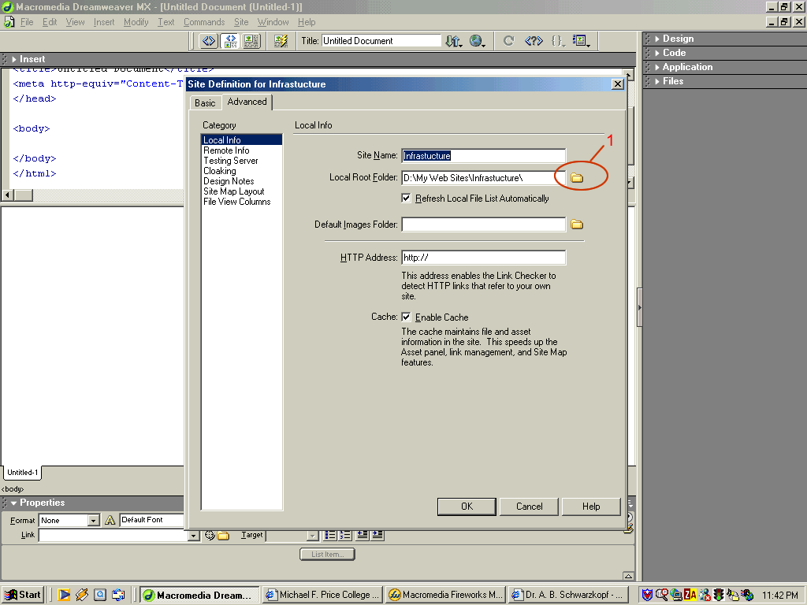
Defining a new site
Notes:
In the Site Name type the name that Dreamweaver will use to refer to the site you are creating. This name will only be used by Dreamweaver and doesn’t need to match the actual domain name of your web site nor the folder where you store it on your local machine.
Circle 1:Click the folder icon to the right of the Local Root Folder field. A message dialog will appear. Select the local folder where you want to store the web site. It is a good developing practice to use a folder exclusively for each site. Here we create a folder named Infrastructure. In this example it matches with the Site name but it doesn’t have to.

Slide 11
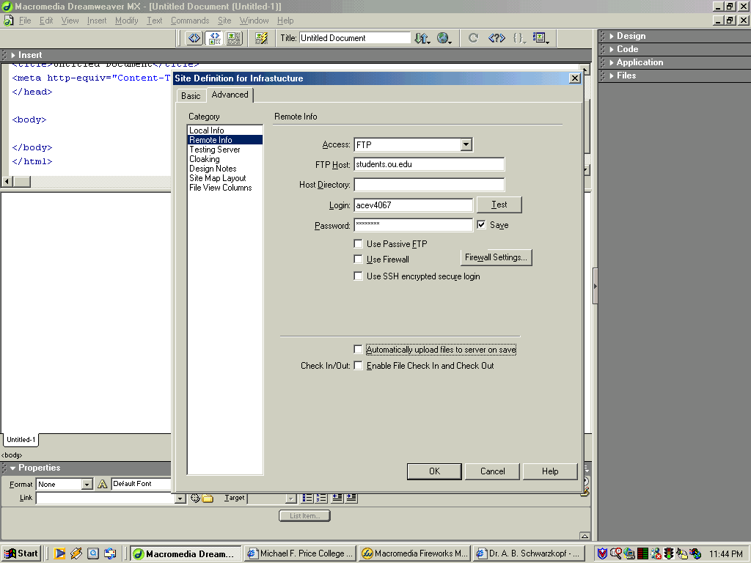
Defining a new site
Notes:
From the Category list select Remote Info. Here we can define how we will connect to the remote server when we upload the site.
From the Access drop-down list select FTP. Type the FTP Host. In our case students.ou.edu
Type your Login and password.

Slide 12
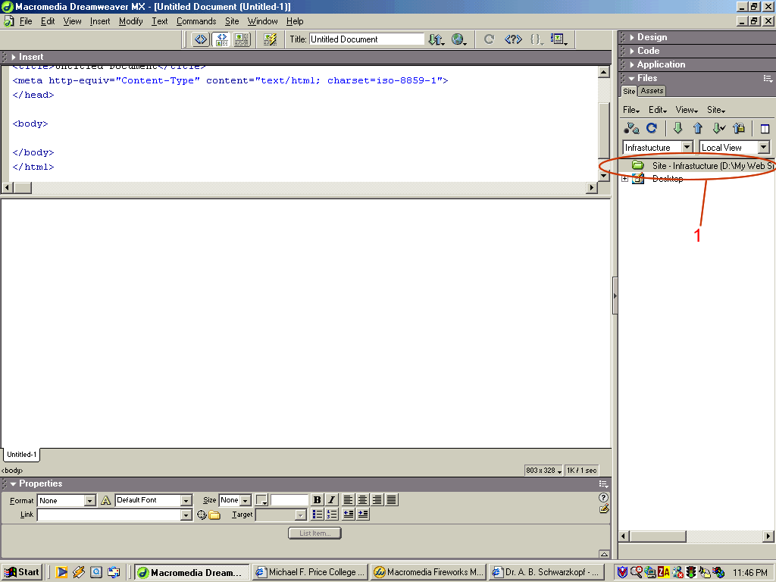
Creating the home page
Notes:
The site is defined, but so far we have only an empty folder. We can visualize that folder inside Circle 1
Right click that folder to create a new file.

Slide 13
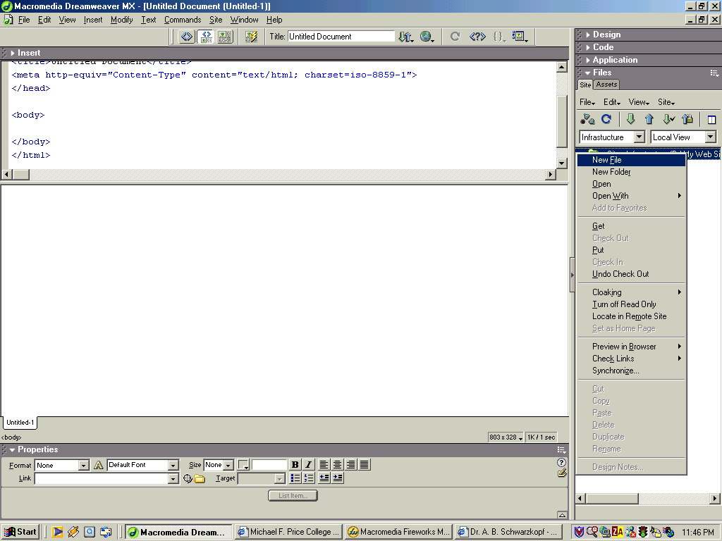
Creating the home page
Notes:
From the menu select New File.
This will create a file named untitled.htm Single clicking it we can rename it.
The new name for the file is index.htm. This will be the page our visitors will see when they first enter to our site. Some servers also support home.htm as the home page. We can use html instead of htm and the results will be similar. The decision of which extension to use will depend on the configuration of the server.

Slide 14
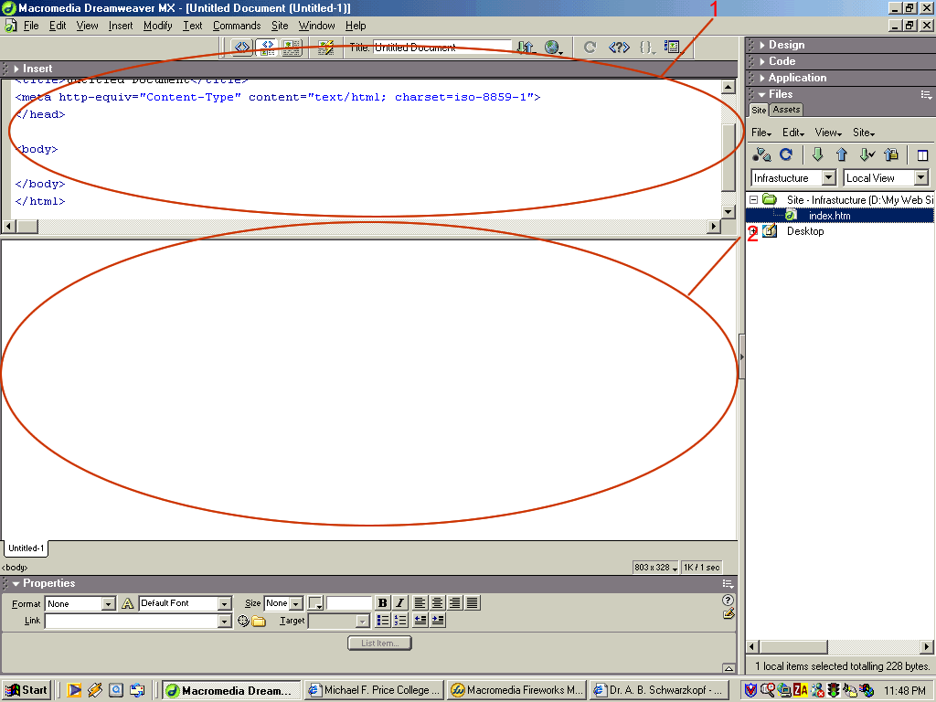
Creating the home page
Notes:
Circle 1 shows the Code View of the page
Circle 2 shows the Design View. If we want to see only one of these two views we can select the desired option from the View menu

Slide 15
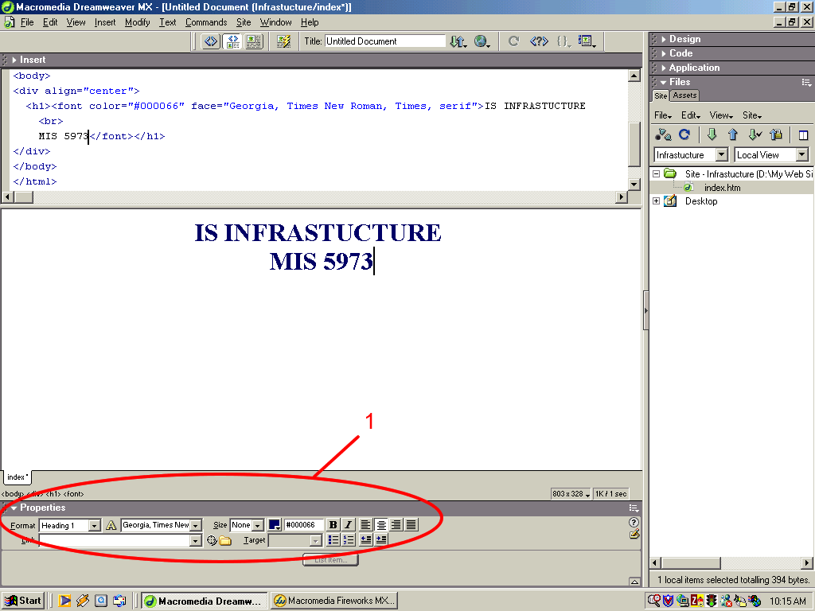
Adding text
Notes:
Set the cursor on the Design Panel and type the desired text. We can see how the code is automatically created in the Code Panel. Watching how the Code changes every time we modify the page is of great help to increase our HTML knowledge.
Circle 1: shows the Properties Panel. This panel changes according to the object being worked on. In this screen shot we are working with text, so the Properties panel displays the attributes of the text that we are typing. In our example we will select Heading 1 from the Format list, Georgia from the font list, we will set the Size to the default size value of the visitor’s browser and we will set the alignment to the center.

Slide 16
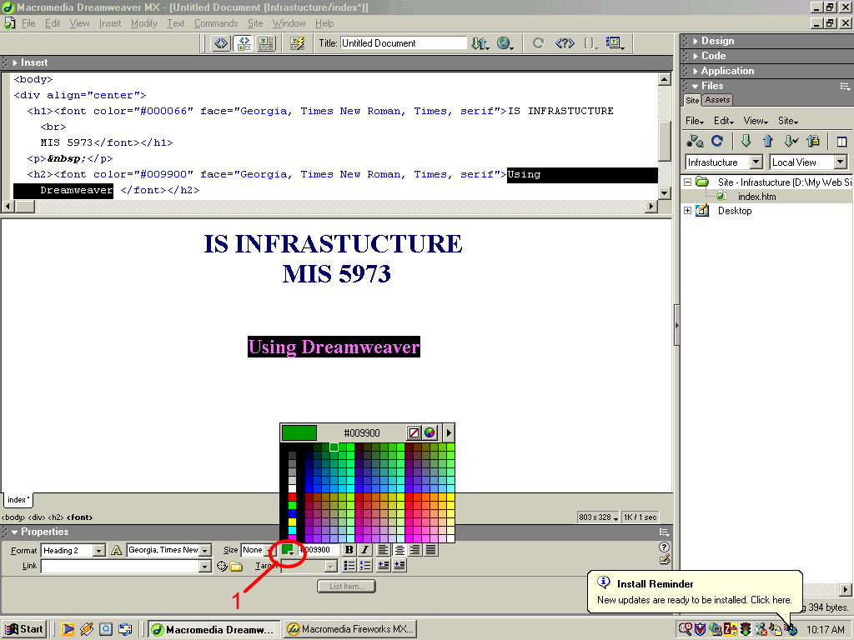
Adding text
Notes:
Type “Using Dreamweaver” in a new line. Change the format to Heading 2 and click on the color square showed inside Circle 1.
A color palette is displayed. We can select our desired color. Only the selected text will actually change.

Slide 17
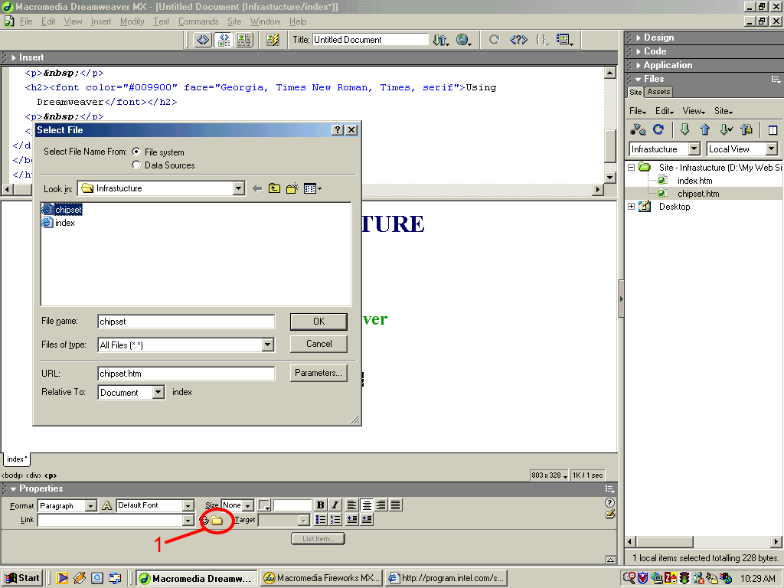
Creating a hyperlink
Notes:
Create an internal page and call it chipset.htm
Do this by following the same steps we used to create the home page. We will now create a hyperlink to that page.
Type the text that will contain the hyperlink. Here will type: See Intel’s latest chipset.
Select the text and click on the folder icon inside Circle 1. A Select File dialog appears. Choose chipset.

Slide 18
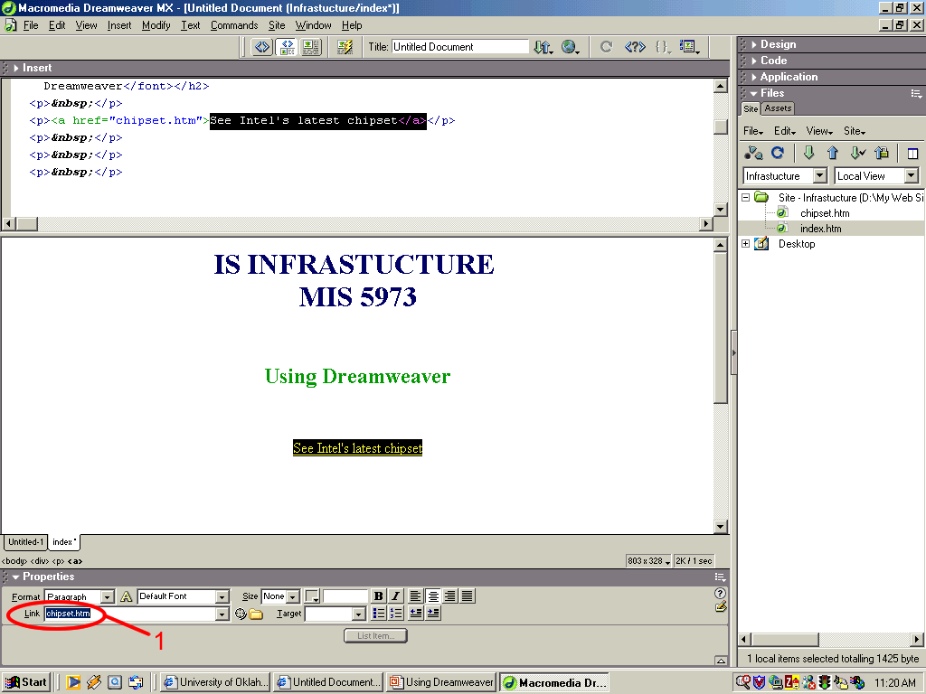
Creating a hyperlink
Notes:
We can see that the Link field inside Circle 1 has the value chipset.htm.
We could have typed this directly, but it is safer to use the Select File option to avoid misspellings that will generate broken links.
Although the chipset file doesn’t have any content yet, the link to that file already works, so if we upload our site and click on the hyperlink, it will take us to the empty chipset page.

Slide 19
Creating a hyperlink
Notes:
We can see that the Link field inside Circle 1 has the value chipset.htm.
We could have typed this directly, but it is safer to use the Select File option to avoid misspellings that will generate broken links.
Although the chipset file doesn’t have any content yet, the link to that file already works, so if we upload our site and click on the hyperlink, it will take us to the empty chipset page.

Slide 20
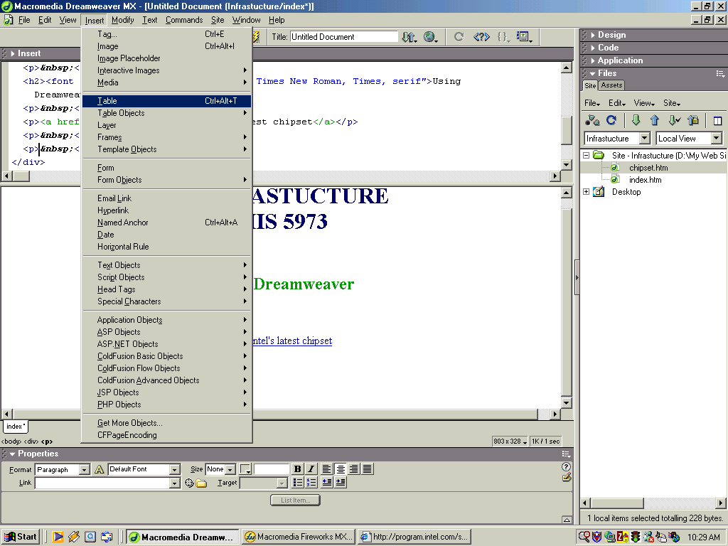
Creating a table
Notes:
Go to the Insert Menu and select Table. An Insert Table dialog appears.

Slide 21
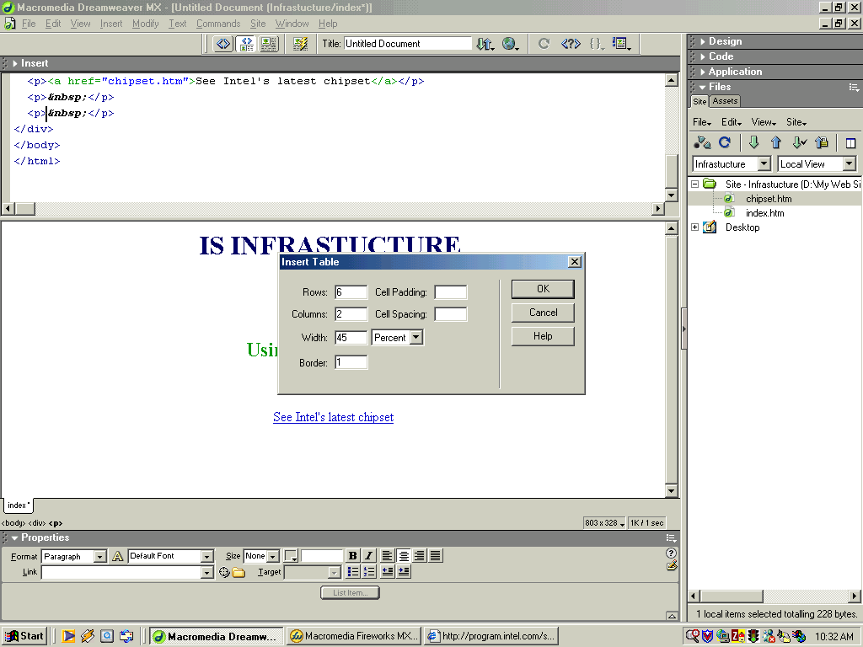
Creating a table
Notes:
Type six as the number of rows and 2 as the number of columns. Type 45 as the width and select Percent from the drop down list. Selecting Percent as opposed to Pixels give the page a more liquid design, so the size of the table will depend on the actual size of the viewer’s browser.
Type 1 in the Border field. If we use a table only for layout purposes and don’t want to show the cells border we can set this value to zero.

Slide 22
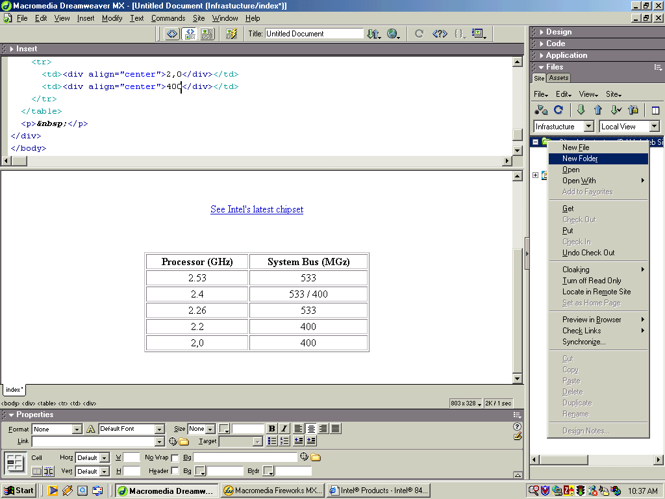
Creating a table
Notes:
Now we can type in each of the cells.
Notice that the Properties Panel now has additional options at the bottom. Those options correspond to the cells’ attributes.
Now will create new a folder. Right click the Infrastructure folder and select New Folder as shown on the screen shot. Name that folder “images”.
It is a good developing practice to store the images in a separate folder.

Slide 23
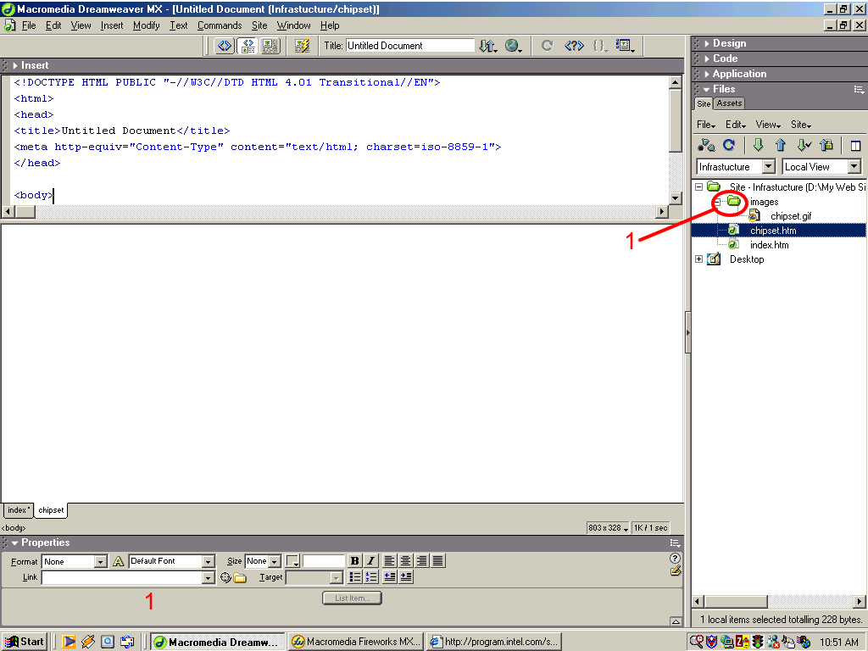
Inserting images
Notes:
Save the chipset.gif image into the images folder. You can do this outside of Dreamweaver or by dragging and dropping from Windows Explorer into the images folder inside Circle 1
Double click the chipset.htm file.
We can see that the Design panel is still empty.

Slide 24
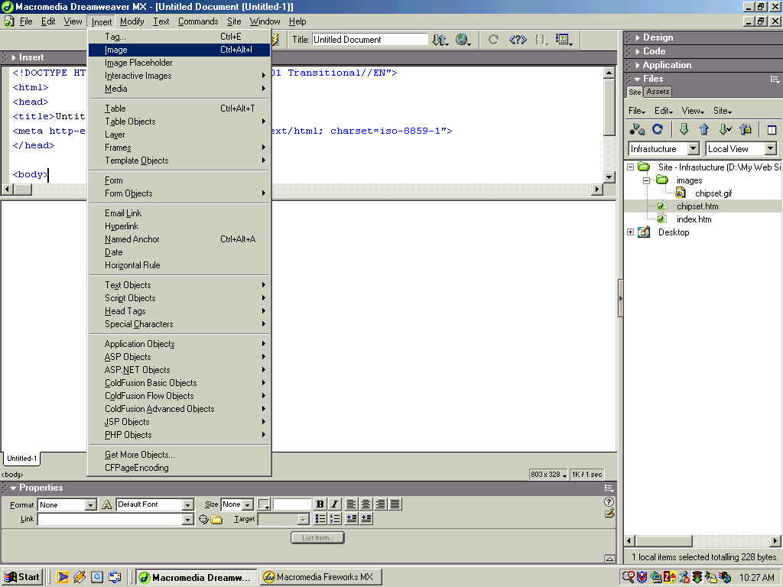
Inserting images
Notes:
Go to the Insert menu and select Image.
A Select Image Source dialog will appear.
Select the chipset.gif file.
The image will be displayed.
Select the image.
The Properties panel will display the image’s attributes
Align the image to the center, using the Align Center Tool.

Slide 25
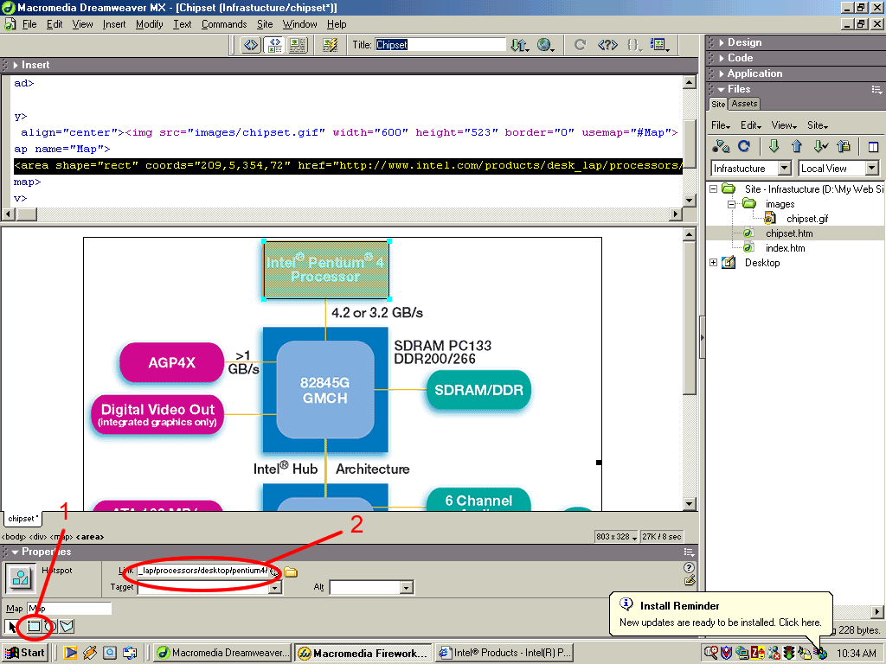
Inserting a Hotspot
Notes:
Click the Rectangular Hotspot Tool inside Circle 1
The image has to be selected in order to see this tool.
Draw a rectangle on the chipset image as shown on the screenshot.
On the link field inside Circle 2 type the following text: “http://www.intel.com/products/desk_lap/processors/desktop/pentium4/”. We don’t use the Select File option because this is an external link, it goes beyond the scope of our site.

Slide 26
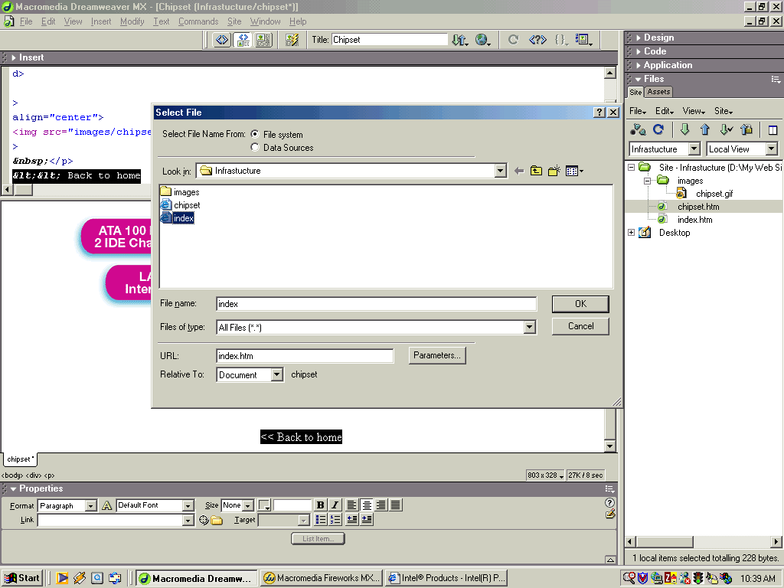
One more link
Notes:
Type “<< Back to home” and make a hyperlink to the index file as we did it in the hyperlink section.
Since we have already entered the remote server information, our site is ready for uploading!!!

Slide 27
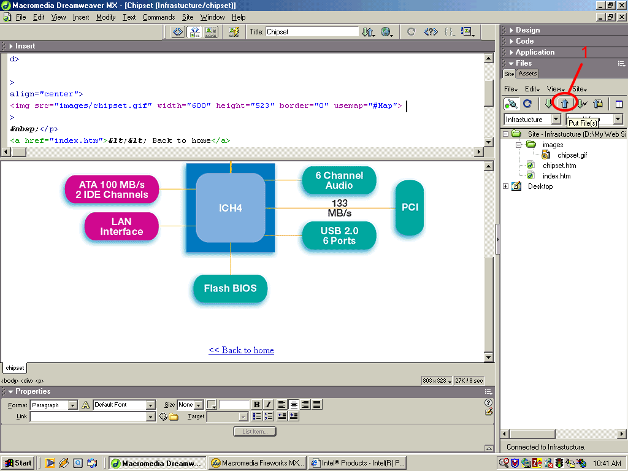
Uploading the site
Notes:
Select the Infrastructure folder and press the Put File(s) button inside Circle 1.
Our site now is uploaded and is available to hundreds of millions of people around the world.

