Slide 1
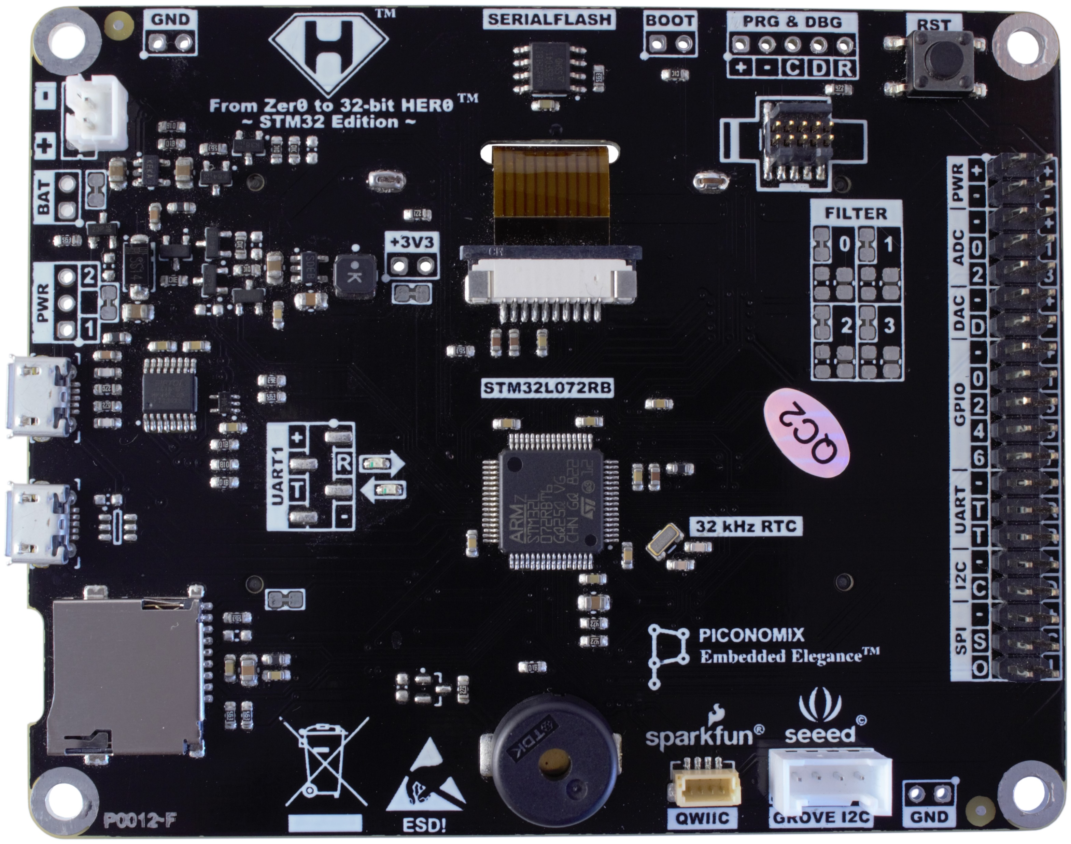
A
B
C
D
E
N
F
M
G
L
K
J
I
H

