Slide 1
Growing Into the Red
Where NorthByte Airlines makes and loses money, and how to restore profitability
[Team name] · BOLT UBC FirstByte 2026 · October 2026
Notes:
TITLE. ~15 sec. Title is a working draft. Swap in team name; file must be named [TeamName]_FirstByte2026.pdf. Deadline: Thu Oct 15, 11:59 PM, PDF only, one upload.

Slide 2
EXECUTIVE SUMMARY
NorthByte's spring 2025 expansion added ~45% more flights, but revenue grew only 5%
WHAT WE FOUND
WHAT WE RECOMMEND
[Recommendation 1]
[Recommendation 2]
[Recommendation 3]
[Expected impact: $X M contribution by FY27-28]
• FY25-26 revenue +5.2% to $190.0M; flight operating cost +23.5% to $238.4M
• Flight contribution fell from −$12.4M to −$48.4M before gate leases [reconcile vs. case's ~$40M]
• Losses began in Mar 2025, when monthly flights jumped ~46% with the expansion
• ~86% of cost growth is more flights, not higher fuel/crew prices
• A handful of hub-to-hub markets (led by Montréal–Vancouver) drive most of the decline
• Refunds, Rewards and ancillaries matter, but are an order of magnitude smaller
Source: NorthByte transactions, costs & gates (Sep 2024–Aug 2026); team analysis
2
Notes:
EXEC SUMMARY. ~45 sec. Answer first: problem, root cause, recommendation, impact. Left column = analysis (drafted). Right column = recommendations (to be filled once recs are decided). Keep every number here identical to the analysis slides.

Slide 3
SITUATION
Record revenue, record losses: leadership needs to know where the money goes before the budget cycle
$190M
−$48M
20
3
FY25-26 revenue, a record (+5%)
Flight contribution before gates [verify]
Airports, 4 hubs, 54 directional routes
New connections launched spring 2025
KEY QUESTION
What is really driving NorthByte's losses, and where should it invest or pull back to return to sustainable profit while keeping its commitments on safety, fairness and community service?
Source: FirstByte 2026 case package
3
Notes:
SITUATION / KEY QUESTION. ~40 sec. Set up the case from the brief: domestic carrier, 20 airports, 4 hubs (YVR, YYC, YYZ, YUL), FY = Sep–Aug. Spring 2025: 3 new connections (London, Moncton, Montréal–Ottawa). Finance only reviewed costs at company level, by category, never route by route; that gap is our angle. End on the key question. Values constraint (safety, fair to customers, connect communities) frames recs later.

Slide 4
DATA & APPROACH
We rebuilt a route-by-route P&L from three inconsistent systems
1 Clean
2 Join
3 Allocate
4 Diagnose
Normalize route codes
De-duplicate 1,856 txns
Resolve 3 date formats
Transactions + flight costs
by route × month
Fiscal year Sep–Aug
Gate leases → departing flights
Calendar → fiscal pro-rata
Estimate 2026-27 leases
Volume vs. price bridge
Route & market P&L
Refunds, Rewards, ancillaries
558,129 unique transactions · 28,801 flights (×4 cost rows) · 34 physical gates · 54 routes · 24 months
Key assumptions in Appendix A1. Not available in the data: seats, passengers per flight, load factor, distance.
Source: NorthByte transactions, costs & gates (Sep 2024–Aug 2026); team analysis
4
Notes:
DATA & APPROACH. ~40 sec. Data Analysis = 35% of score; show rigor quickly, push detail to appendix. Key points: route codes normalized (e.g. 'yvryeg' → YVR-YEG), 1,856 duplicate transactions removed ($1.23M), mixed date formats resolved, gate costs de-duplicated (source repeats each gate per route) and pro-rated from calendar lease years onto the Sep–Aug fiscal year. TODO: gate allocation must follow the case rule: airport total ÷ ALL flights departing that airport. Current analysis/ code splits equally across listed routes; redo before finalizing.

Slide 5
01
What happened
Revenue and cost trends, FY24-25 vs FY25-26
Notes:
Section divider. Optional: delete if time is tight (10 min talk).

Slide 6
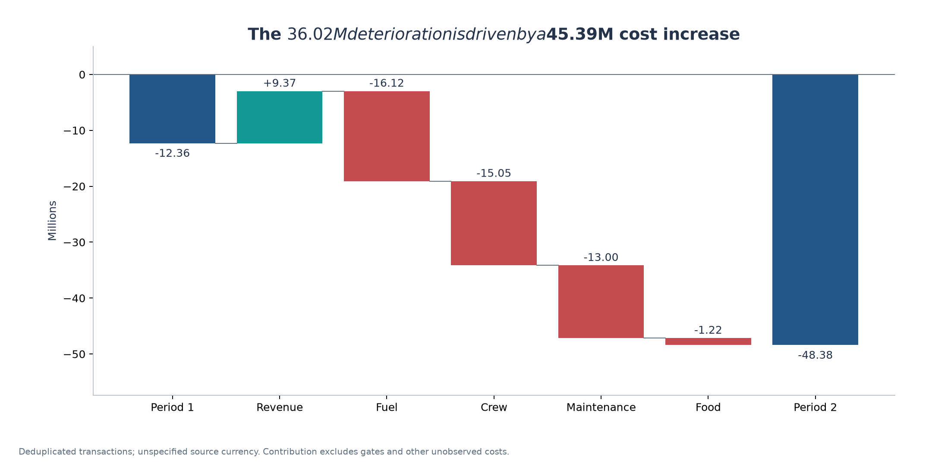
1 · WHAT CHANGED
Costs grew 4.5× faster than revenue, turning a $12M loss into a $48M loss
SO WHAT
• Revenue +$9.4M (+5.2%)
• Flight costs +$45.4M (+23.5%)
• Every cost line grew; fuel and crew largest in $
• [Add: gates pushes loss to ~$X M]
Source: NorthByte transactions, costs & gates (Sep 2024–Aug 2026); team analysis
6
Notes:
GUIDING Q1 (what changed). ~50 sec. Chart: period comparison or contribution bridge. Bridge story: +$9.4M revenue vs +$45.4M cost; fuel +$16.1M, crew +$15.1M, maint +$13.0M, food +$1.2M. TODO: reconcile our −$48.4M with the case's 'about $40M' (check whether difference = duplicates, refunds, or the case using a different cost basis). Swap in final chart.

Slide 7
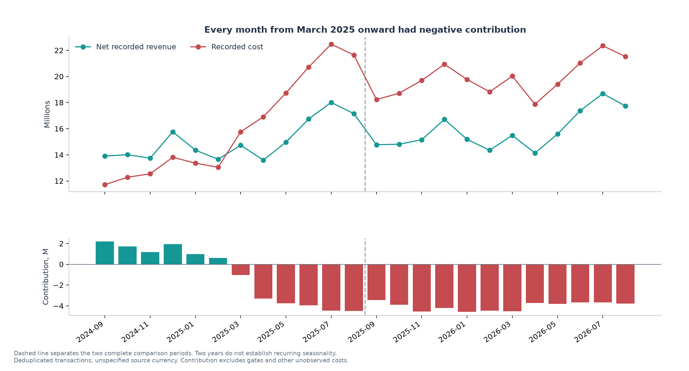
1 · WHEN IT TURNED
Margins went negative in March 2025, the month the expansion schedule started
SO WHAT
• Sep 2024–Feb 2025: profitable, +4.5% to +15.7% monthly margin
• Mar 2025 onward: every month negative (−7% to −31%)
• Flights/month +46% in one step; revenue/month did not follow
• Not seasonal: two summers, both losing
Source: NorthByte transactions, costs & gates (Sep 2024–Aug 2026); team analysis
7
Notes:
GUIDING Q1 (when). ~50 sec. Monthly flights jumped from ~790 (Feb 2025) to 1,157 (Mar) and ~1,250-1,480 after. Margin went from +4.5% (Feb) to −7% (Mar) to −24% (Apr) and never recovered. Case says losses since Feb 2025; our data shows Feb still +4.5%. Decide how to phrase; don't contradict the client without explaining. Annotate the chart with the expansion date.

Slide 8
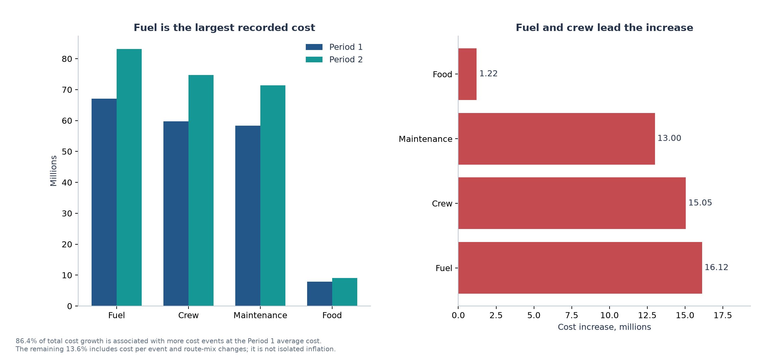
1 · WHY COSTS ROSE
It's flight volume, not fuel or crew prices: ~86% of cost growth comes from more flights
SO WHAT
• Flights +20% year over year (13,072 → 15,729)
• Cost per flight only +2.7%
• Fuel/crew price increases are real but secondary (~$6M)
• Problem is flying more without filling more
Source: NorthByte transactions, costs & gates (Sep 2024–Aug 2026); team analysis
8
Notes:
GUIDING Q1 + Q3 (fuel & crew). ~60 sec. KEY INSIGHT SLIDE. Volume/price decomposition: holding FY24-25 cost per flight fixed, extra flights explain $39.2M of $45.4M (86%); per-flight cost & mix explain $6.2M. Case states fuel/flight +3%, crew/flight +4%; verify against our cost-per-flight by category. Food cost/flight actually fell ($598 → $575). Suggested visual: stacked bar 'volume vs. price' by category.

Slide 9
02
Where the money is lost
Route, market and network performance
Notes:
Section divider. Optional: delete if time is tight (10 min talk).

Slide 10
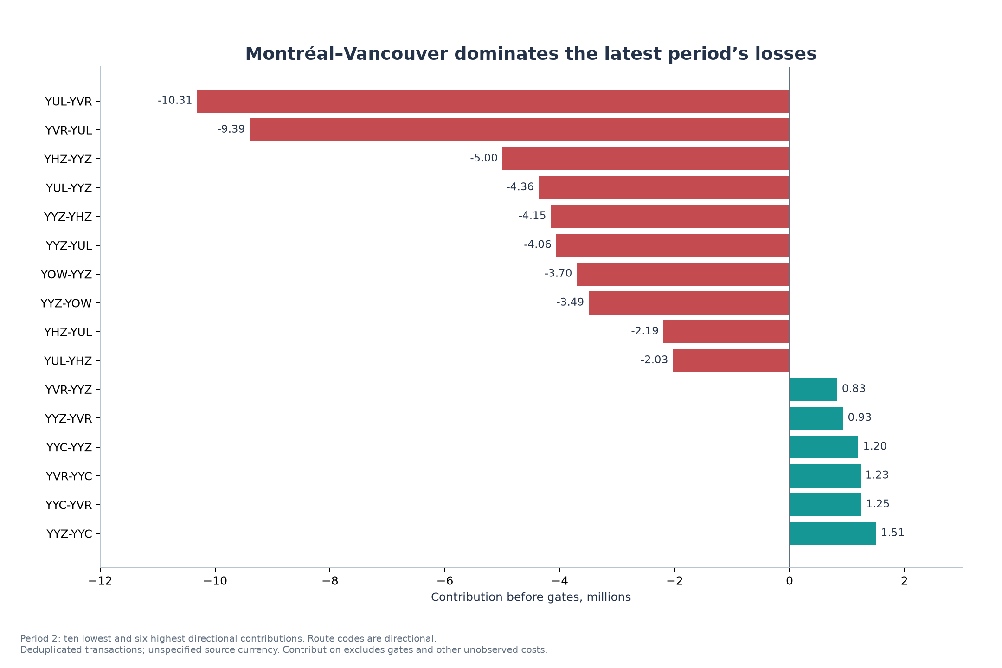
2 · NETWORK
A few hub-to-hub markets carry most of the losses; 26 routes are still profitable
SO WHAT
• Montréal–Vancouver: −$19.7M, ~⅓ of all route losses
• Top 8 routes = 71% of the decline
• Profitable routes (+$12.6M) can't offset losers (−$60.9M)
• [Add: hub vs. regional split]
Source: NorthByte transactions, costs & gates (Sep 2024–Aug 2026); team analysis
10
Notes:
GUIDING Q2. ~60 sec. Montréal–Vancouver (both directions) −$19.7M in FY25-26 = 32% of route losses; revenue +$0.4M vs cost +$12.0M. 8 worst routes = 71% of the decline. 26 profitable routes earn +$12.6M (Toronto–Calgary, Calgary–Vancouver lead). Both directions share the same sign in all 27 markets → talk in markets. TODO: re-run after gate allocation per case rule; show 'after gates' version.

Slide 11
2 · THE EXPANSION
[Headline: how the new routes and added frequencies performed]
[Chart: new routes vs. added frequency on existing routes
flights added · revenue per flight · contribution]
SO WHAT
• Like-for-like route-months: contribution −$31.1M
• New route-months: −$4.9M
• [Revenue per added flight vs. cost per flight]
Source: NorthByte transactions, costs & gates (Sep 2024–Aug 2026); team analysis
11
Notes:
GUIDING Q1/Q2. ~45 sec. TODO ANALYSIS. Two parts of the expansion: (a) the 3 new connections (London–Toronto from Feb 2025, Montréal–Ottawa from Mar, Moncton–Halifax from Apr: 6 directions) and (b) added frequencies on existing routes (most of the +~450 flights/month). Show contribution, revenue per flight and flights added for each group. Existing: like-for-like 612 route-months contribution still fell $31.1M, new route-months −$4.9M → most damage is added frequency on EXISTING routes.

Slide 12
03
What else matters
Refunds, Rewards, ancillaries and connecting passengers
Notes:
Section divider. Optional: delete if time is tight (10 min talk).

Slide 13
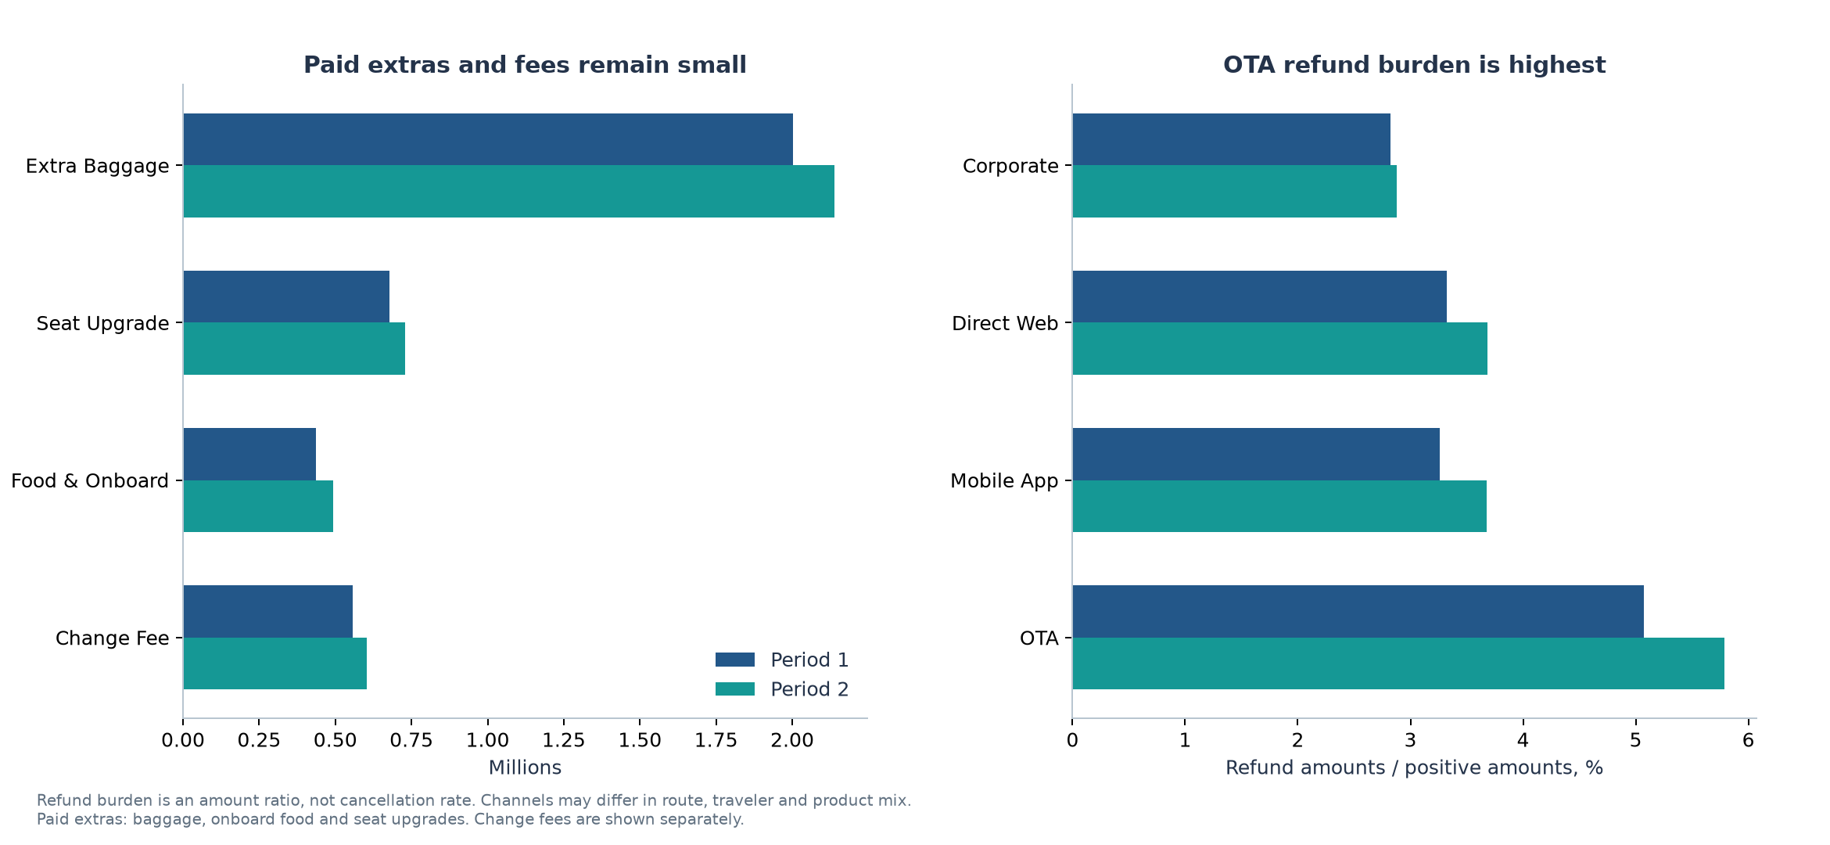
3 · REVENUE LEVERS
Refunds, Rewards and ancillaries are real but small next to the volume problem
SO WHAT
• Refunds +$1.15M; OTA bookings refunded most
• Ancillaries ≈ 2% of revenue; +10% adds only ~$0.3M
• [Rewards finding]
• [Connecting-passenger finding]
[Factor ranking: $ contribution of each factor to the $36M decline
volume · fuel price · crew price · refunds · Rewards · ancillaries]
Source: NorthByte transactions, costs & gates (Sep 2024–Aug 2026); team analysis
13
Notes:
GUIDING Q3 + Q4. ~60 sec. Refunds $6.7M → $7.8M (+17% vs +5.6% sales); OTA refund burden 5.8% vs 3.7% direct. Ancillaries ~1.8% of revenue ($3.4M paid extras + $0.6M change fees). TODO: (1) refunds by region × winter months (case hints Atlantic/North weather exposure); (2) Rewards cost: Points + Cash = 10.6% of revenue, tier mix; size the decline it explains; (3) connecting passengers: 12,912 bookings span multiple routes; revenue share & which hubs. Close with a 'factor ranking' bar: $ impact of each factor vs. the $36M decline.

Slide 14
4 · GATE LEASES
[Headline: gate lease change 2024-25 → 2025-26 and 2026-27 estimate]
[Chart: gate cost by airport
2024-25 vs 2025-26 vs 2026-27 est.]
[Gate cost per departing flight by airport, highlight idle gates]
SO WHAT
• Actual gate spend ~$9.7M → $9.9M (+2.2%), not the $17M row total
• [2026-27 estimate: $X M, method]
• [Most expensive airport per departure]
• [Loss after gates: $X M]
Source: NorthByte transactions, costs & gates (Sep 2024–Aug 2026); team analysis
14
Notes:
GUIDING Q5. ~45 sec. Raw rows double-count shared gates ($17.4M row sum vs $9.66M actual for 2024-25; $9.88M for 2025-26, +2.2%). TODO: (1) forecast 2026-27 by airport (state the method, e.g. apply per-airport growth rate); (2) pro-rate calendar leases onto fiscal years (FY = 4 mo of lease Y + 8 mo of lease Y+1); (3) allocate each airport's total evenly across ALL departing flights (case rule); (4) flag airports with idle gates (low departures per gate). Halifax A3 and Ottawa A2 have no routes assigned.

Slide 15
ROOT CAUSE
[Headline: one-sentence diagnosis tying volume, routes and secondary factors together]
[Driver tree or waterfall: FY24-25 contribution → FY25-26 contribution
added flights · per-flight cost inflation · refunds · Rewards · ancillaries · gates]
Source: NorthByte transactions, costs & gates (Sep 2024–Aug 2026); team analysis
15
Notes:
SYNTHESIS. ~30 sec. Bridge from analysis to issues. One visual that ranks drivers by $ impact. This is where 'not every factor matters equally' (case) gets answered explicitly.

Slide 16
04
What NorthByte should do
Issues, alternatives, recommendation, implementation, risks
Notes:
Section divider. Optional: delete if time is tight (10 min talk).

Slide 17
KEY ISSUES
[Headline: the 2-3 issues NorthByte must solve]
[Issue 1]
[Evidence]
[$ impact]
[Issue 2]
[Evidence]
[$ impact]
[Issue 3]
[Evidence]
[$ impact]
Evidence: slides 5–12
17
Notes:
ISSUES. ~30 sec. To be written. Each issue should map to evidence on slides 5-12 (cite slide #).

Slide 18
ALTERNATIVES
[Headline: options considered and how they compare]
Alternative | Profit impact | Cost / feasibility | Customer impact | Values fit | Time to impact
[Option A] | [ ] | [ ] | [ ] | [ ] | [ ]
[Option B] | [ ] | [ ] | [ ] | [ ] | [ ]
[Option C] | [ ] | [ ] | [ ] | [ ] | [ ]
[Option D] | [ ] | [ ] | [ ] | [ ] | [ ]
Evidence: slides 5–12
18
Notes:
ALTERNATIVES. ~45 sec. To be written. Score 3-4 options on consistent criteria; criteria include the case's values (safety, fair to customers, connecting communities) since judges will check fit.

Slide 19
RECOMMENDATION
[Headline: the recommendation and its $ impact]
SHORT TERM (0–12 months)
[Action 1]
[Action 2]
[$ impact]
LONG TERM (12+ months)
[Action 1]
[Action 2]
[$ impact]
CUSTOMERS
[effect]
EMPLOYEES
[effect]
COMMUNITIES
[effect]
Evidence: slides 5–12
19
Notes:
RECOMMENDATION. ~75 sec. Business Recommendation = 35% of score. To be written. Guiding Q6 asks for short- AND long-term actions and their effect on customers, employees and communities; the bottom strip covers that.

Slide 20
IMPLEMENTATION
[Headline: roadmap and milestones]
Phase 1 · 0–3 months
Phase 2 · 3–12 months
Phase 3 · 12+ months
[Actions]
[Owner]
[Actions]
[Owner]
[Actions]
[Owner]
[KPIs & targets]
Source: NorthByte transactions, costs & gates (Sep 2024–Aug 2026); team analysis
20
Notes:
IMPLEMENTATION. ~45 sec. To be written. Align phases to the budget cycle; add KPIs to track (e.g. contribution per flight, revenue per flight, refund rate, gate cost per departure).

Slide 21
RISKS
[Headline: key risks and how we mitigate them]
Risk | Likelihood | Impact | Mitigation
[Risk 1] | [ ] | [ ] | [ ]
[Risk 2] | [ ] | [ ] | [ ]
[Risk 3] | [ ] | [ ] | [ ]
[Risk 4] | [ ] | [ ] | [ ]
Source: NorthByte transactions, costs & gates (Sep 2024–Aug 2026); team analysis
21
Notes:
RISKS & MITIGATION. ~30 sec. To be written. Include data-limitation risk (no seats/load factor) and stakeholder risks (community service, crew, competitors).

Slide 22
Thank you
[One-line restatement of the recommendation] · Questions?
Notes:
CLOSE. 5 min Q&A follows; appendix slides are for answering questions.

Slide 23
A
Appendix
Backup for Q&A
Notes:
Section divider. Optional: delete if time is tight (10 min talk).

Slide 24
APPENDIX A1 · DATA CLEANING & ASSUMPTIONS
How we cleaned and joined the data
• Route codes: 'YYZYHZ', 'yvr-yeg', etc. normalized to XXX-XXX across all three files
• Duplicates: 1,856 repeated transaction IDs removed (all fields identical), −$1.23M revenue
• Dates: ISO, YYYY/MM/DD and DD/MM vs MM/DD formats; ambiguous ones resolved from transaction-ID order; 11 unresolved ($7.2k, immaterial)
• Categories & tiers: aliases and capitalization standardized; unknowns kept as 'Unknown'
• Flights: one flight = route + timestamp with exactly one Crew, Food, Fuel and Maintenance cost row
• Gates: each physical gate counted once; calendar lease years pro-rated to Sep–Aug fiscal years; airport total split evenly across departing flights (case rule); 2026-27 estimated [method]
• Revenue is recorded at transaction date (payment), not flight date
Source: NorthByte transactions, costs & gates (Sep 2024–Aug 2026); team analysis
24
Notes:
Backup for 'how did you handle X?' questions. Pull from analysis/ASSUMPTIONS.md and preparation_audit.json.

Slide 25
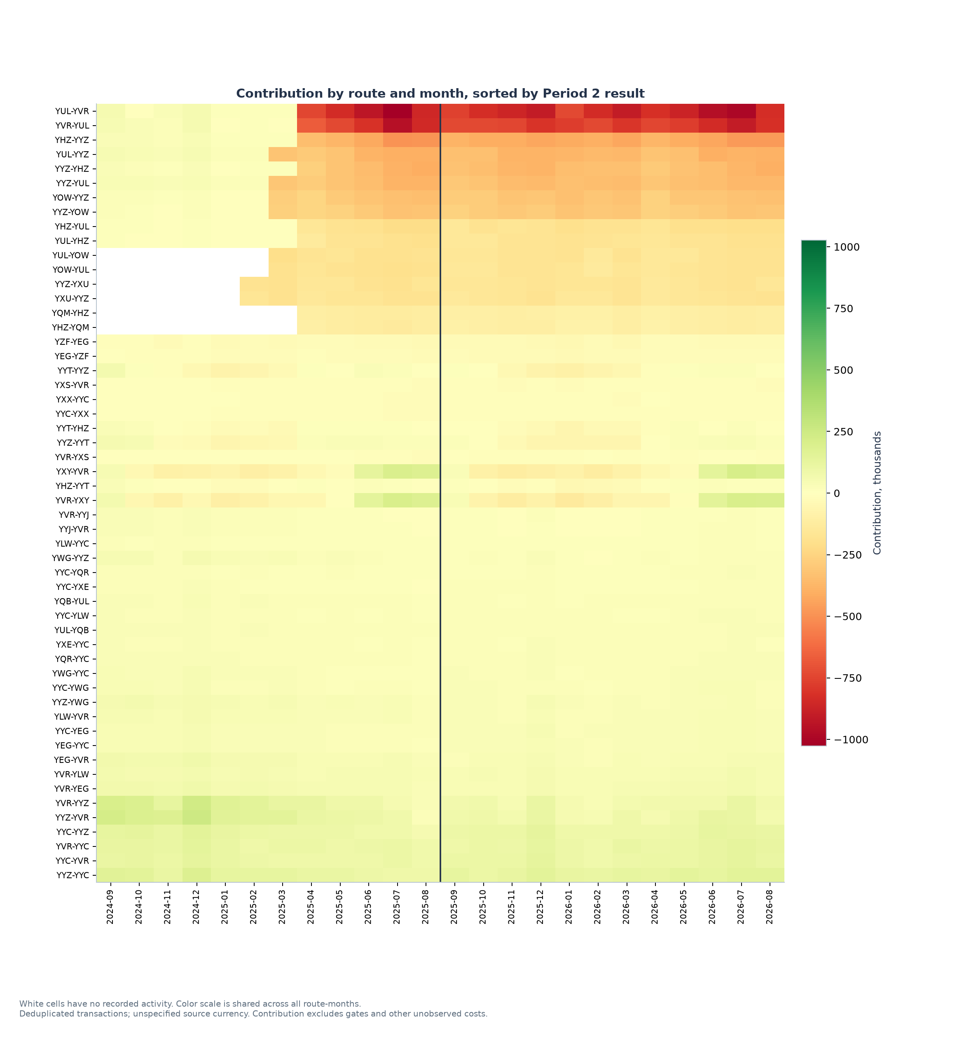
APPENDIX A2 · ROUTE × MONTH HEATMAP
Losses are persistent across months, not a single bad season
Source: NorthByte transactions, costs & gates (Sep 2024–Aug 2026); team analysis
25
Notes:
Backup for route/seasonality questions.

Slide 26
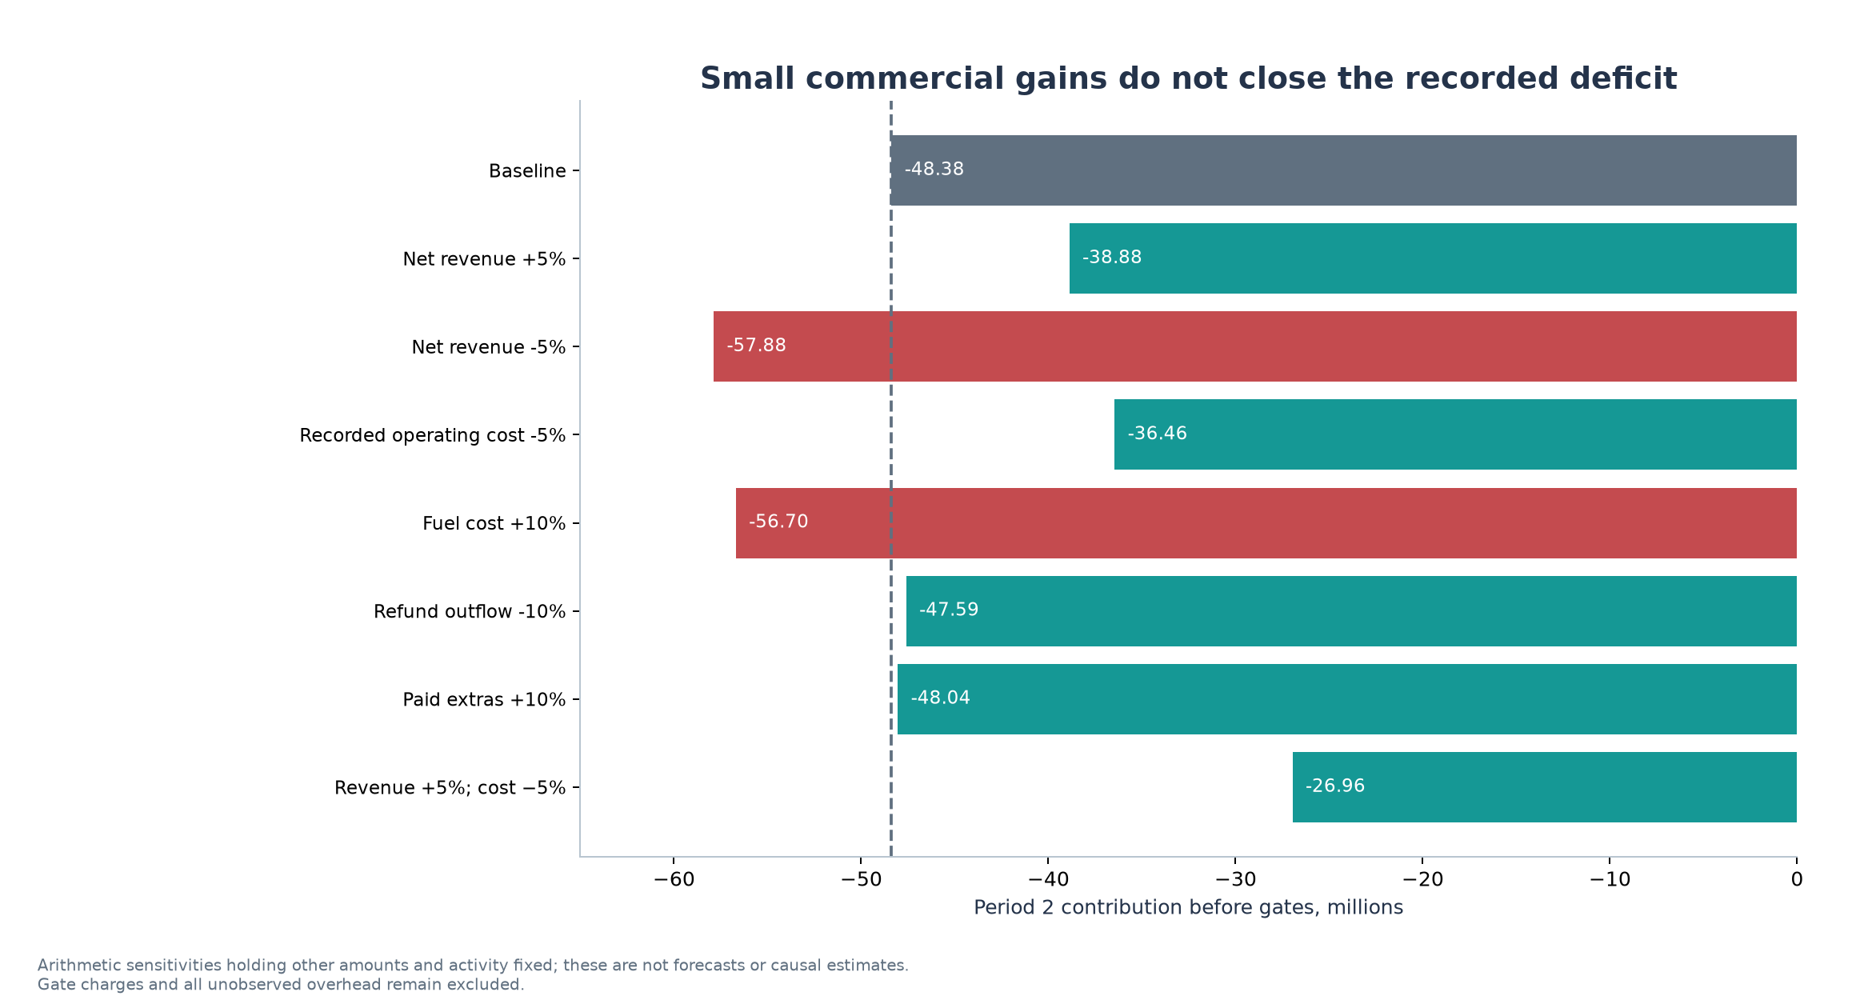
APPENDIX A3 · SENSITIVITY
Small ancillary or refund fixes can't close the gap alone
Source: NorthByte transactions, costs & gates (Sep 2024–Aug 2026); team analysis
26
Notes:
Backup: break-even needs ~25% more revenue or ~20% less cost with the other side fixed. Illustrative, not a forecast.

Slide 27
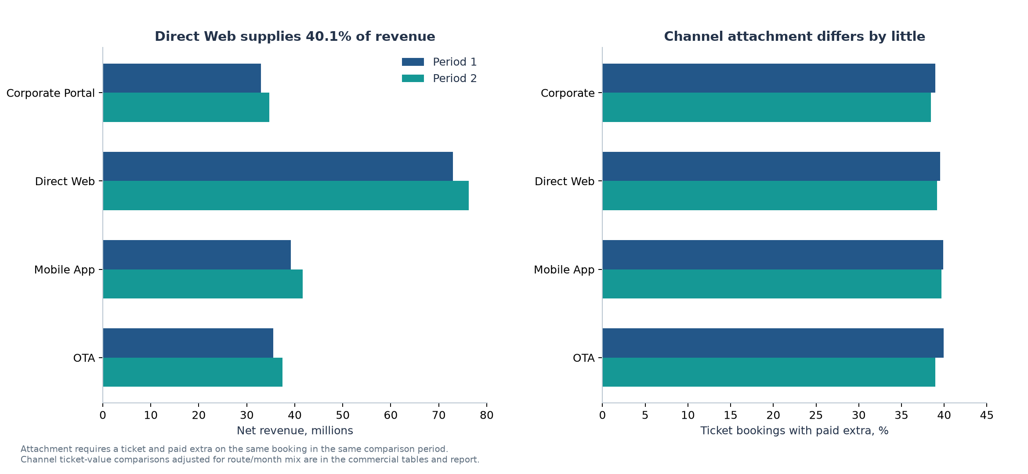
APPENDIX A4 · CHANNELS
Channel mix is stable; OTA has the highest refund burden
Source: NorthByte transactions, costs & gates (Sep 2024–Aug 2026); team analysis
27
Notes:
Backup for booking-channel questions. Direct Web 40%, App 22%, OTA 20%, Corporate 18% of FY25-26 revenue.

