Slide 1
Kredit Media
A Social Media Analytics Engine

Slide 2
High Lights
Kakfa :
  High Throughput Low Latency for handling real-time data feeds.
  massively scalable pub/sub message queue architect-ed as a distributed transaction log.
  Suitable for handling high volume data feeds from social media platforms(Linked in, twitter, Facebook).
  Distributed System by design ensures gracefull performance decay.

Slide 3
High Lights
Natural Language Processing
  RAKE ,scrapper to extract keywords from online blogs(Forbes, MIT Tech Review etc.) to gauge recent trends in technology.
  StackOverflow blog analysis to analyze the growth and decay of technologies.
  Twitter sentiment analysis for behavioral pattern recognition.*

Slide 4
High Lights
Neural Networks :
  Scalable, Flexible and Adaptable.
  Non-Deterministic systems capable of extracting highly non-linear patterns from data.
  Can be retrained to adapt to the rapidly changing trends.
  Resistant to noise and random variations in data acquired from Crowd-Sourcing.

Slide 5
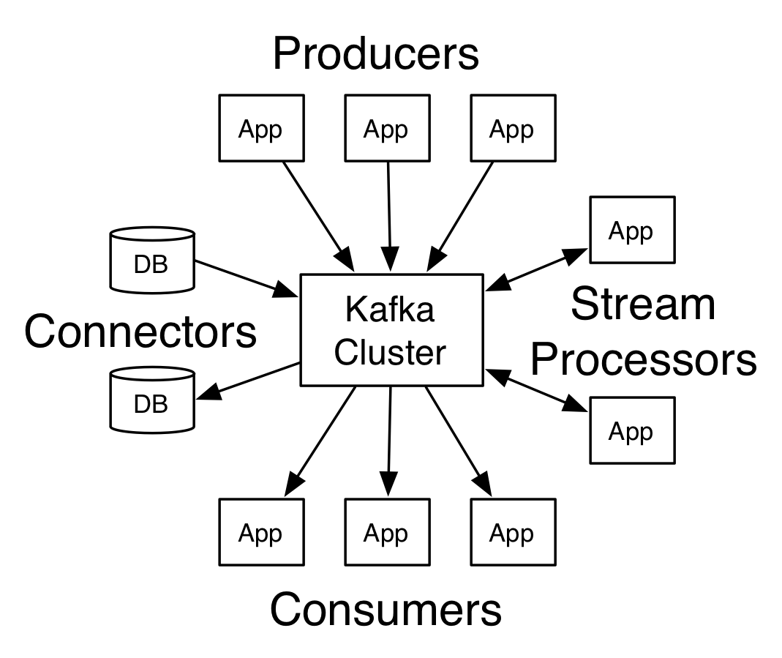
Current Architecture
General Kafka architecture

Slide 6
Current System Architecture
Linkedin
Producer
GlassDoor
Producer
GlassDoor
CEO rating
Comsmer
Linkedin Skill
Consumer
Kafka Cluster
GlassDoor
Company Review
Consumer
Linkedin Exp
Consumer
NEO Api Score
Neural
Network

Slide 7
Current System Architecture
Neural
Network
Employability Score

