Slide 1
Modern Operating Systems
Chapter 2 – Process&Thread
Zhang Yang
Autumn 2019

Slide 2
Content of this lecture
2.1 Processes
2.2 Threads

Slide 3
2.1 Processes
2.2 Threads

Slide 4
Modern Workstations and PCs
Multiple windows in personal computer doing completely independent things
  Word
  Excel
  Photoshop
  E-mail
  Music player, etc.

Slide 5
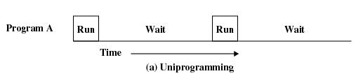
Multiprogramming (1)
When there is a single program running in the CPU, it leads to the degradation of the CPU utilization.
  Example: When a running program initiates an I/O operation, the CPU remain idle until the I/O operation is completed.
  Solution to this problem is provided by
Multiprogramming.

Slide 6
Multiprogramming (2)
What is Multiprogramming?
  A mode of operation that provides for the interleaved execution of two or more programs by a single processor.
Improving CPU utilization
  By allowing several programs to reside in main memory at the “same time” the CPU might be shared, such that when one program initiates an I/O operation, another program can be assigned to the CPU, thus the improvement of the CPU utilization.

Slide 7
Multiprogramming (3)
Degree of Multiprogramming
  The number of processes loaded simultaneously in memory is called degree of multiprogramming.

Slide 8
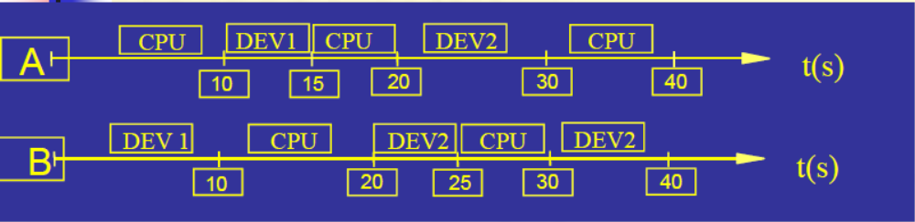
Concurrency (1)
Allows multiple applications to run “at the same time”.
Example
  In sequential environment, A executes first, then B.
Notes:
并发环境：一定时间内，物理机器上有两个或两个以上的程序同时处于开始运行但尚未结束的状态，并且次序不是事先确定的

Slide 9
Concurrency (2)
Example (ctd.)
  Concurrency
DEV2
CPU
CPU
DEV1
CPU
A
25
35
45
15
B
10
20
30
40
DEV1
CPU
DEV2
CPU
DEV2
Notes:
CPU利用率=40/80=50%
DEV1利用率= 15/80 =18.75% DEV2利用率= 25/80 =31.25%

Slide 10
Concurrency (3)
Benefits of Concurrency
  What are the limitations without concurrency?
    Long response time
    Resources under utilized
  Better resource utilization
    Resources unused by one application can be used by the others
  Better average response time
    No need to wait for other applications to complete
Notes:
引入并发的目的：
引入并发是为了提高资源利用率，从而提高系统效率
并发与并行概念的区别：
Concurrency，parallel

Slide 11
The Process Model (1)
The process is an OS abstraction for a running program.
Process: an executing program
  Program = static file (image)
  Process = executing program = program + execution state.
Processes are instances of a program
  Different processes may run different instances of the same program.
    E.g., my javac and your javac process both run the Java compiler

Slide 12

The Process Model (2)
Multiprogramming of four programs
Conceptual model of 4 independent, sequential processes
Only one program active at any instant
Real life analogy?
Notes:
A daycare teacher of 4 infants

Slide 13
Program and Process (1)
Analogy
  Program: steps for attending the lecture
    Step1: walk to A3
    Step2: enter 409
    Step3: find a seat
    Step4: listen and take notes (or sleep)
  Process: attending the lecture
    Action
    You are all in the middle of a process

Slide 14
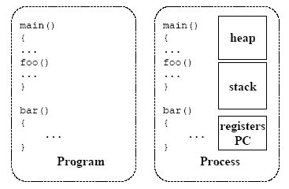
Program and Process (2)

Slide 15
Program and Process (3)
Differences between program and process
Program
The collection of instruction, static concept
A program can be the execution program of multiple process
Process
Describe concurrency, dynamic concept
A process include program ,data ,and PCB
Temporary
A process can call multiple program
Notes:
The code segment of two processes are the same program

Slide 16
Process Creation (1)
Process Creation Events
  System Initialization
    Reboot
      Foreground process
      Background process, daemon process
  Execution of a process creation system call
    fork()
  User request to create a new process
    Command line or click an icon
  Initiation of a batch job
Notes:
daemon processes（守护进程）

Slide 17
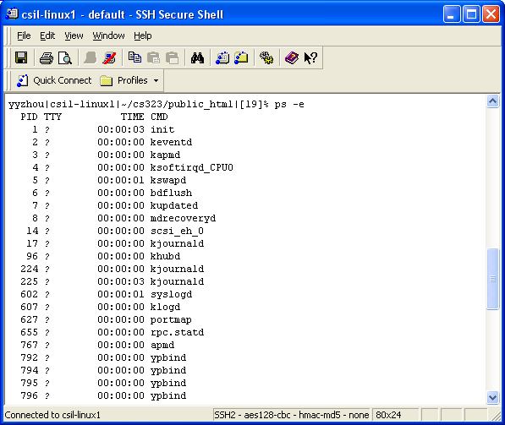
Process Creation (2)
Unix: ps
Notes:
ps命令用来查看当前系统中运行的进程的信息
-e显示所有进程的信息
PID：进程号
TTY：该进程建立时所对应的终端，“？”表示该进程不占用终端
TIME：报告进程累计使用的CPU时间。注意，尽管有些命令（如sh）已经运转了很长时间，但是它们真正使用CPU的时间往往很短。所以，该字段的值往往是00：00：00
CMD：执行进程的命令名

Slide 18
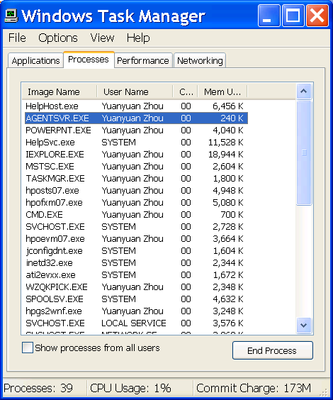
Process Creation (3)
Windows: Task Manager

Slide 19

Process Creation (4)
UNIX Example
  fork system call creates new process
  exec system call used after a fork to replace the process’ memory space with a new program
Notes:
fork clones a process
exec overlays the current process

Slide 20
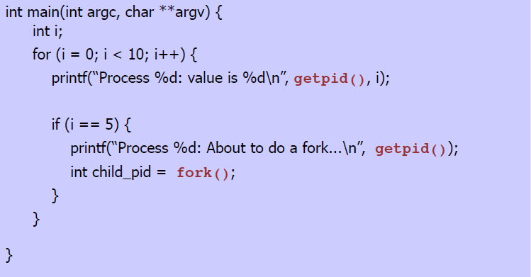
Process Creation (5)
UNIX Example (ctd.)
  Before fork
PC

Slide 21
Process Creation (6)
UNIX Example (ctd.)
  After fork
PC
PC
Parent Process
Child Process

Slide 22
Process Creation (7)
UNIX Example (ctd.)
  Output of sample program
    Process 4530: value is 0
    Process 4530: value is 1
    Process 4530: value is 2
    Process 4530: value is 3
    Process 4530: value is 4
    Process 4530: value is 5
    Process 4530: About to do a fork...
    Process 4531: value is 6
    Process 4530: value is 6
    Process 4530: value is 7
    Process 4531: value is 7
    Process 4530: value is 8
    Process 4531: value is 8
    Process 4530: value is 9
    Process 4531: value is 9
  What determines the order in which the two processes run???

Slide 23
Process Creation (8)
Windows Example
BOOL CreateProcess(
LPCTSTR lpApplicationName, // pointer to name of executable module
LPTSTR lpCommandLine, // pointer to command line string
LPSECURITY_ATTRIBUTES lpProcessAttributes, // process security attr.
LPSECURITY_ATTRIBUTES lpThreadAttributes, // thread security attr.
BOOL bInheritHandles, // handle inheritance flag
DWORD dwCreationFlags, // creation flags
LPVOID lpEnvironment, // pointer to new environment block
LPCTSTR lpCurrentDirectory, // pointer to current directory name
LPSTARTUPINFO lpStartupInfo, // pointer to STARTUPINFO
LPPROCESS_INFORMATION lpProcessInformation // pointer to
PROCESS_INFORMATION )

Slide 24
Process Termination
Process Termination Events
  Normal exit (voluntary)
    Unix: exit
    Windows: ExitProcess
  Error exit (voluntary)
    e.g., cc foo.c
  Fatal error (involuntary)
    Divide by 0, executing an illegal instruction, referencing nonexistent memory
  Killed by another process (involuntary)
    Kill , TerminateProcess
Notes:
Fatal error:在有些系统中，如Unix，进程可以通知操作系统，它希望自行处理某些类型的错误，在这类错误中，进程会收到信号（被中断），而不是在这类错误出现时终止

Slide 25
Process Hierarchies (1)
Parent creates a child process, a child process can create its own processes
Forms a hierarchy
  UNIX calls this a "process group"
Windows has no concept of process hierarchy
  All processes are created equal

Slide 26
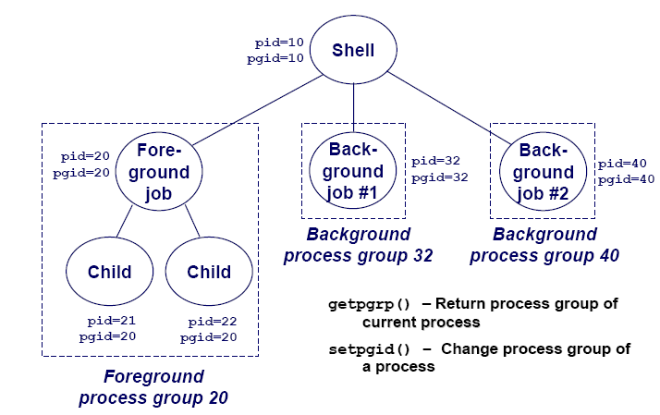
Process Hierarchies (2)
Every process belongs to exactly one process group (in Unix)

Slide 27
Process States (1)
Process States
  Running
    Process is currently using the CPU
  Ready
    Currently waiting to be assigned to a CPU
    That is, the process could be running, but another process is using the CPU
  Blocked
    Process is waiting for an event
      Such as completion of an I/O, a timer to go off, etc.
    Why is this different than “ready” ?

Slide 28
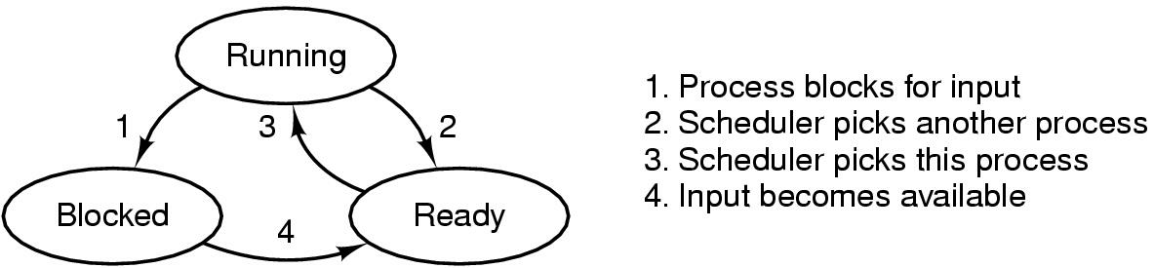
Process States (2)
Transitions between states
  Running—>Blocked
    A process discover that it cannot continue
  Running —>Ready, Ready —>Running
    Caused by process scheduler
  Blocked —>Ready
    The external event for which a process was waiting happens
Notes:
Question: in a single processor machine, how many process can be in running state?

Slide 29
Group Discussion (2 minutes)
Can the following transitions occur?
  Ready to blocked
  Blocked to running

Slide 30
Process Control Block (1)
Process Control Block (PCB, also called Task Control Block or Task Struct) is a data structure in the operating system kernel containing the information needed to manage a particular process.
OS maintains a PCB for each process.
A PCB keeps all the information needed to keep track of a process.
The PCB is identified by an integer process ID.
Notes:
用它来记录进程的外部特征，描述进程的运动变化过程（又称进程描述符、进程属性）
系统利用PCB来控制和管理进程，所以PCB是系统感知进程存在的唯一标志

Slide 31
Process Control Block (2)
The PCB is maintained for a process throughout its lifetime and is deleted once the process terminates.
The architecture of a PCB is completely dependent on operating system and may contain different information in different operating system.

Slide 32
Process Control Block (3)
PCB contains
  Process ID
    Unique identification for each of the process in the operating system
  State
    The current state of the process
  Pointer
    A pointer to parent process
  Priority
    Priority of a process
Process ID
State
Pointer
Priority
Program Counter
CPU Registers
I/O Info
Accounting Info
...

Slide 33
Process Control Block (4)
PCB contains
  CPU Registers
    Various CPU registers where process need to be stored for execution for running state.
  I/ Info
    I/O status information includes a list of I/O devices allocated to the process.
  Accounting Info
    This includes the amount of CPU used for process execution, time limits etc.
Process ID
State
Pointer
Priority
Program Counter
CPU Registers
I/O Info
Accounting Info
...

Slide 34
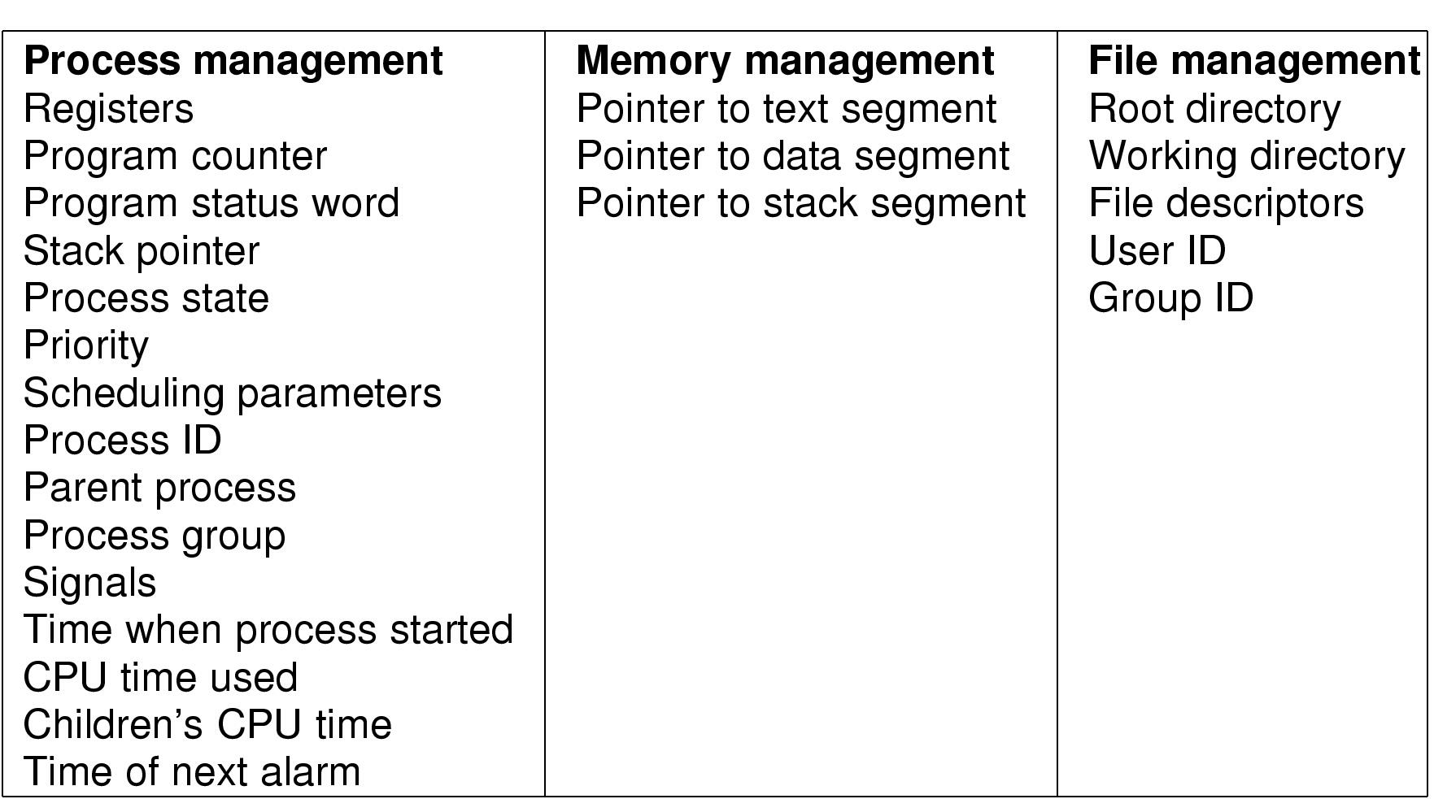
Process Control Block (5)
An Example of PCB
Figure 2-4 Fields of a process table entry

Slide 35
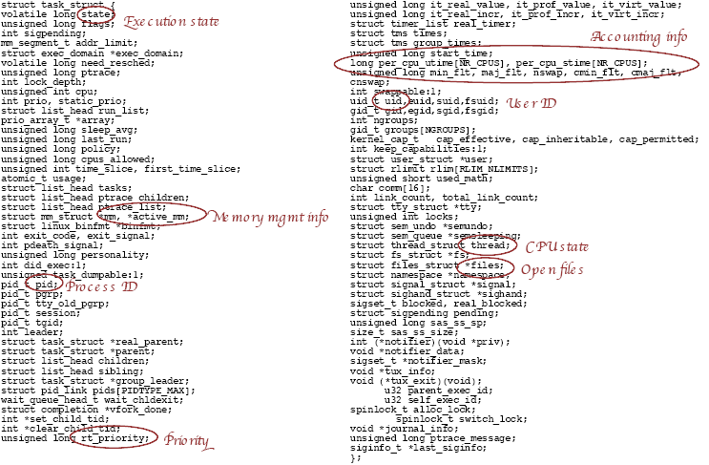
Process Control Block (6)
Linux PCB Structure: task_struct

Slide 36
Implementation of Processes (1)
State Queues
  The OS maintains a collection of queues that represent the state of all processes in the system.
  There is typically one queue for each state, e.g., ready, waiting for I/O, etc.
  Each PCB is queued onto a state queue according to its current state.
  As a process changes state, its PCB is unlinked from one queue and linked onto another.

Slide 37
Implementation of Processes (2)
State Queues (ctd.)
PCB A
PCB W
PCB G
Ready Queue Header
head ptr
tail ptr
Wait Queue Header
head ptr
tail ptr
PCB X
PCB M
There may be many wait queues, one for each
type of wait (specific device, timer, message,…).

Slide 38
Implementation of Processes (3)
PCB and State Queues
  PCBs are data structures, dynamically allocated in OS memory.
  When a process is created, a PCB is allocated to it, initialized, and placed on the correct queue.
  As the process computes, its PCB moves from queue to queue.
  When the process is terminated, its PCB is deallocated.

Slide 39
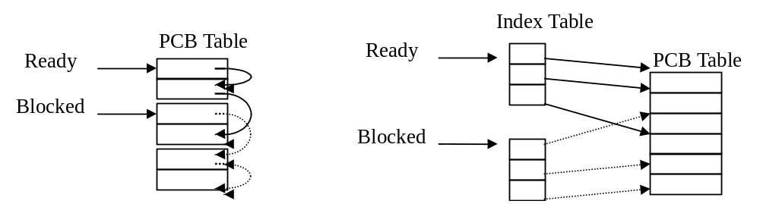
Implementation of Processes (4)
Process Table or PCB Table
  Os maintain a process table, each entry is PCB.
  The size of PCB table determine the concurrency degree of system.
  Two organization form
    Link
    Index
Notes:
系统把所有PCB组织在一起，并把它们放在内存的固定区域，就构成了PCB表
PCB表的大小决定了系统中最多可同时存在的进程个数，称为系统的并发度
注：多道程序中的多道与系统并发度不同
链接结构：
同一状态进程的PCB组成一个链表，不同状态对应多个不同的链表
就绪链表、阻塞链表
索引结构：对具有相同状态的进程，分别设置各自的PCB索引表，表明PCB在PCB表中的地址

Slide 40
Implementation of Processes (5)
What is In a Process? (Process Image)
  User Code
  User Data
  User Stack
    Used for procedure call and parameter passing
  PCB (Metadata)

Slide 41
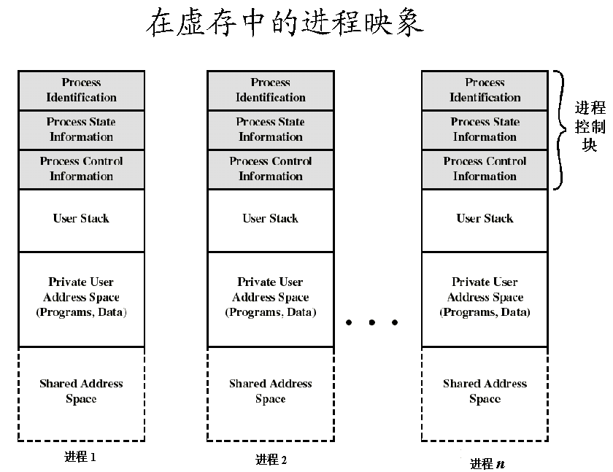
Implementation of Processes (6)

Slide 42
Context Switch (1)
Switch CPU from one process to another
Performed by scheduler (chapter 2.4)
It includes:
  Save PCB state of the old process;
  Load PCB state of the new process;
  Flush memory cache;
  Change memory mapping (TLB);
Context switch is expensive(1-1000 microseconds)
  No useful work is done (pure overhead)
  Can become a bottleneck
  Real life analogy?
Context switch overhead in Linux 2.4.21
  About 5.4 usec on a 2.4 GHz Pentium 4
  This is equivalent to about 13,200 CPU cycles!
    Not quite that many instructions since CPI > 1
Need hardware support

Slide 43

Context Switch (2)
CPU Switch From Process to Process

Slide 44
Process Summary (1)
What Is A Process?
  It’s one executing instance of a “program”
  It’s separate from other instances
  It can start (“launch”) other processes
What’s in a process?
  Code (text), data, stack
  Process control block

Slide 45
Process Summary (2)
Process vs. Program
Process Creation
Process Termination
Process States
  Running, Ready, Blocked
  State Transition
Context Switch

Slide 46

单选题
2分
1. System which allows only one process execution at a time, is called .
A
uniprogramming system
B
uniprocessing system
C
unitasking system
D
unioperation system
提交

Slide 47
单选题
2分
2. In operating system, each process has its own .
A
address space and global variables
B
open files
C
pending alarms, signals and signal handlers
D
all of the above
提交

Slide 48
单选题
2分
3. Address of a next instruction to be executed by current process is provided by the .
A
CPU registers
B
program counter
C
process stack
D
pipe
提交

Slide 49
单选题
2分
4. Ready state of a process means .
A
when process is scheduled to run after some execution
B
when process is unable to run until some task has been completed
C
when process is using the CPU
D
when process is stopped
提交

Slide 50
2.1 Processes
2.2 Threads

Slide 51
Concurrency in Processes (1)
Many programs want to do many things “at once”
  Microsoft Word
    Reading and interpreting keystrokes
    Formatting line and page breaks
    Displaying what you typed
    Spell checking
    Hyphenation
    ….
  Web Browser
    Download web pages, read cache files, accept user input, ...
  Web Server
    Handle incoming connections from multiple clients at once
  Scientific Programs
    Process different parts of a data set on different CPUs
Notes:
Need concurrency within same app

Slide 52
Concurrency in Processes (2)
In each case, would like to share memory across these activities.
  Microsoft Word
    Share same file
  Web Browser
    Share buffer for HTML page and inlined images
  Web Server
    Share memory cache of recently-accessed pages
  Scientific Programs
    Share memory of data set being processes

Slide 53
Why Need Threads? (1)
Concurrency in Processes
  Many activities are going on at once.
  Some of these activities may block from time to time.
Processes are not very efficient
  Each process has its own PCB and OS resources
  Typically high overhead for each process: e.g., 1.7 KB per task_struct on Linux!
  Creating a new process is often very expensive

Slide 54
Why Need Thread? (2)
Processes don't (directly) share memory
  Each process has its own address space
  Parallel and concurrent programs often want to directly manipulate the same memory
    e.g., When processing elements of a large array in parallel
Performance Consideration
  Overlap substantial computing and I/O activities.
Systems with Multiple CPUs
Notes:
Note: Many OS's provide some form of inter-process shared memory
cf., UNIX shmget() and shmat() system calls
Still, this requires more programmer work and does not address the efficiency issues.
shmget - allocates a shared memory segment
shmat()
功能:联接共享内存的操作

Slide 55

Thread Usage: Word Processor
Three threads: interactive thread, reformatting thread, disk backup thread
What if it is single-threaded?

Slide 56

Thread Usage: Multithread Web Server (1)

Slide 57
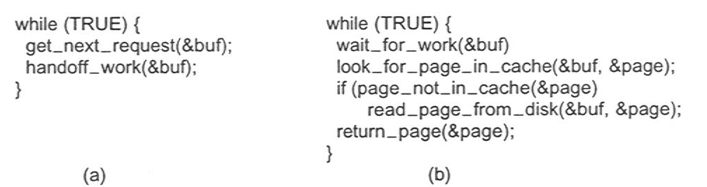
Thread Usage: Multithread Web Server (2)
Rough outline of code for previous slide
  (a) Dispatcher thread
  (b) Worker thread

Slide 58
Alternatives: Single Threaded Web Server Implementation (1)
Sequential Processing of Requests
  Gets request, processes it, gets next
  CPU idle while data is retrieved from disk
  Poor performance
Finite State Machine (IRP/event-driven program model)
  Use non-blocking system calls (read)
  Record state of current request
  Event: Get next request
  Event: On reply from disk (signal/interrupt) process data read
  Acceptable performance
  Complicated to develop, debug …

Slide 59
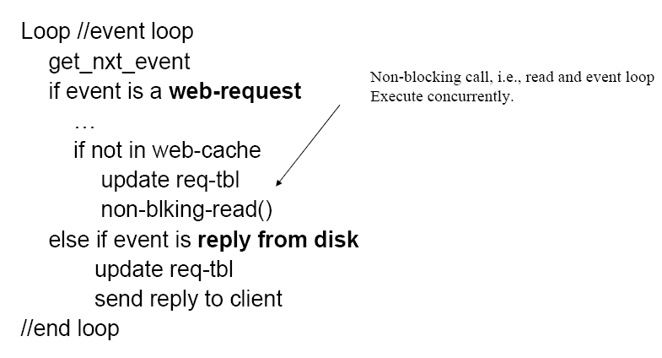
Alternatives: Single Threaded Web Server Implementation (2)
FSM Algorithm

Slide 60
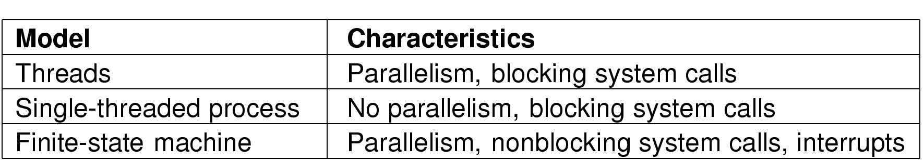
Alternatives: Single Threaded Web Server Implementation (3)
Tradeoffs
Figure 2-10. Three ways to construct a server

Slide 61
Blocking Vs. Non-blocking System Calls
Blocking system call
  Usually I/O related: read(), fread(), getc(), write()
  Doesn’t return until the call completes
  The process/thread is switched to blocked state
  When the I/O completes, the process/thread becomes ready
  Simple
  Real life example: attending a lecture
Using non-blocking system call for I/O
  Asynchronous I/O
  Complicated
  The call returns once the I/O is initiated, and the caller continue
  Once the I/O completes, an interrupt is delivered to the caller
  Real life example: apply for job

Slide 62
Discussion (1)
What can we share across all of these tasks?
What is private to each task?

Slide 63
Discussion (2)
What can we share across all of these tasks?
  Same code – generally running the same or similar programs
  Same data
  Same privileges
  Same OS resources (files, sockets, etc.)
What is private to each task?
  Execution state: CPU registers, stack, and program counter

Slide 64
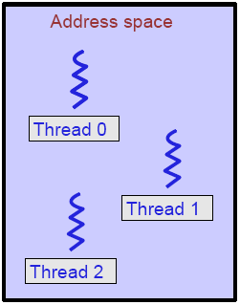
Threads (1)
What is a thread?
  A sequential execution stream within a process (also called lightweight process)
Threads separate the notion of execution from the Process abstraction
Notes:
如果将进程理解为在逻辑上OS所完成的任务，则线程表示完成该任务的许多可能的子任务之一。

Slide 65
Threads (2)
Threads in a process share the same address space
Each process has one or more threads “within” it
  Each thread has its own stack, CPU registers, etc.
  All threads within a process share the same address space and OS resources
    Threads share memory, so they can communicate directly!

Slide 66
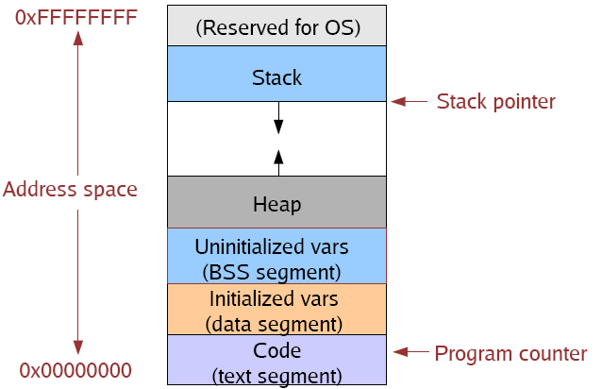
(Old) Process Address Space

Slide 67
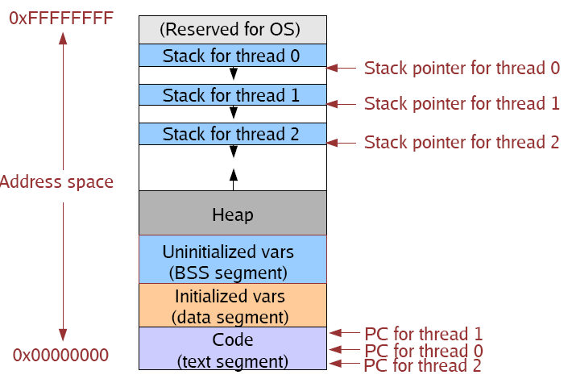
(New) Process Address Space with Threads

Slide 68

The Classical Thread Model (1)
Environment (resource)
execution
Figure 2-11
(a) Three processes each with one thread
(b) One process with three threads Multi-thread

Slide 69
The Classical Thread Model (2)
Multithreading
  The situation of allowing multiple threads in the same process.
  When a multithreaded process is run on a single-CPU system, the threads take turns running.

Slide 70
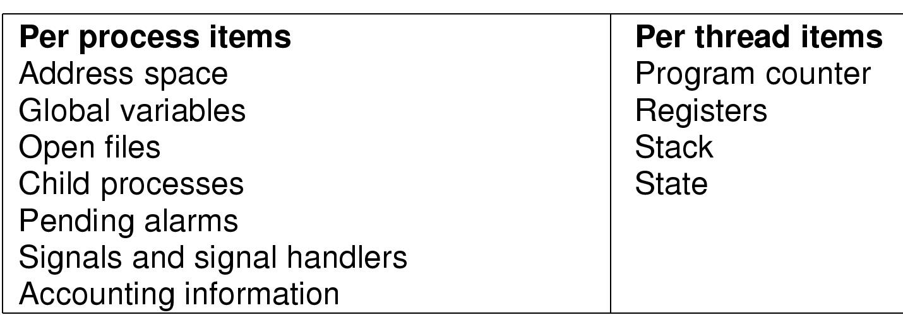
The Classical Thread Model (3)
Threads in the same process share resources
Each thread execute separately

Slide 71

The Classical Thread Model (4)
Why each thread has its own stack?
Figure 2-13. Each thread has its own stack
Notes:
通常每个线程会调用不同的过程，从而有一个各自不同的执行历程。

Slide 72
Multi-Cores
Switch overhead: low (only CPU state)
Thread creation: low
Protection
  CPU: yes
  Memory/IO: No
Sharing overhead: low (thread switch overhead low)
Process 1
Process N
threads
threads
Mem.
Mem.
…
IO
state
…
…
IO
state
CPU
state
CPU
state
CPU
state
CPU
state
CPU sched.
OS
4 threads at a time
core 1
Core 2
Core 3
Core 4
CPU

Slide 73
Common Thread Interface
thread_create(…): creates a thread
thread_wait(…): waits for a specific thread to exit
thread_exit(…): terminates the calling thread
thread_join(…): blocks the calling thread until a (specific) thread has exited
thread_yield(…): calling thread passes control on voluntarily to another thread
Notes:
thread_yield：这样一个调用是很重要的，不同于进程，（线程库）无法利用时钟中断强制线程让出CPU。

Slide 74
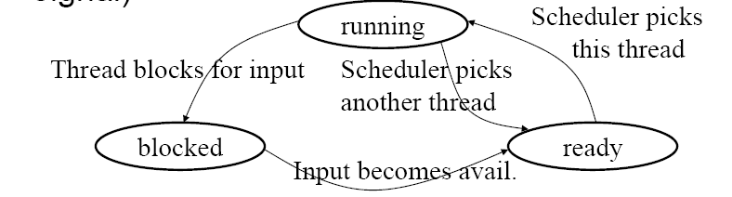
Thread States
Three states (implementation dependent):
  Running: currently active and using CPU
  Ready: runnable and waiting to be scheduled
  Blocked: waiting for an event to occur (I/O, signal)
. . .

Slide 75
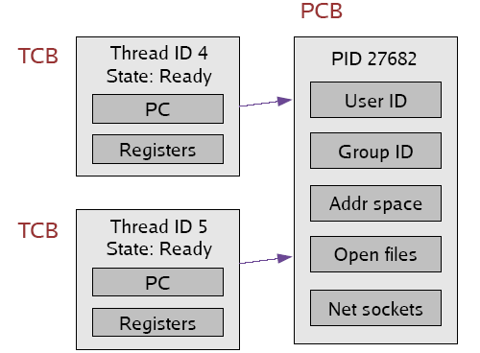
Implementing Threads
Given what we know about processes, implementing threads is“easy”
Idea: Break the PCB into two pieces:
  Thread-specific stuff: Processor state
  Process-specific stuff: Address space and OS resources (open files, etc.)

Slide 76
Thread Control Block (TCB)
TCB contains info on a single thread
  Execution State: CPU registers, program counter (PC), pointer to stack (SP)
  Scheduling info: state, priority, CPU time
  Various Pointers (for implementing scheduling queues)
  Pointer to enclosing process (PCB)
  Etc (add stuff as you find a need)
PCB contains information on the containing process
  Address space and OS resources ... but NO execution state!
TCB's are smaller and cheaper than processes
  Linux TCB (thread_struct) has 24 fields
  Linux PCB (task_struct) has 106 fields

Slide 77
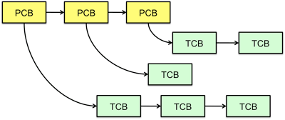
Multithreaded Processes
PCB points to multiple TCBs:
Switching threads within a block is a simple thread switch.
Switching threads across blocks requires changes to memory and I/O address tables.

Slide 78

Context Switching (1)
TCB is now the unit of a context switch
  Ready queue, wait queues, etc. now contain pointers to TCB's
  Context switch causes CPU state to be copied to/from the TCB

Slide 79
Context Switching (2)
Context switch between two threads in the same process:
  No need to change address space
Context switch between two threads in different processes:
  Must change address space, sometimes invalidating cache
  This will become relevant when we talk about virtual memory.

Slide 80
Threads Advantages
Creating a thread is (much) cheaper than a process (~10-20 times)
Switching to a different thread in same process is (much) cheaper (5-50 times)
Threads within same process can share data and other resources more conveniently and efficiently (without copying or messages)
Threads within a process are not protected from each other

Slide 81
Group Discussions (3 minutes)
Similarity between processes and threads
Difference between processes and threads
Real life examples?

Slide 82
Similarities between Process & Thread
Like processes, threads share CPU and only one thread is running at a time.
Like processes, threads within a process execute sequentially.
Like processes, threads can create children.
Like a traditional process, a thread can be in any of several states: running, ready, or blocked.
Like processes, threads have program counter, stack, registers and state.

Slide 83
Dissimilarities between Process & Thread
unlike processes, threads are not independent of one another.
Threads within a process share an address space.
unlike processes, threads are designed to assist one another. Note that processes might or might not assist one another because processes may be originated from different users.

Slide 84
Process vs. Thread
Process
  Unit of resource ownership with respect to the execution of a single program
  Can encompass more than one thread of execution
  Processes are largely independent
Thread
  Unit of execution
  Belongs to a process
  Threads are part of the same “job” and are actively and closely cooperating

Slide 85
Real Life Example
Process
  OS MP
  Different from DS’s MP
Thread
  OS MP1, MP2
  Each is different
  Share
    Nachos
    Textbook
    Personnel (TAs, instructors)
  Affect each other

Slide 86
POSIX Threads (1)
IEEE standard 1003.1c
  Provides a standard interface between threads and the library.
Pthreads
  API for thread creation and synchronization.
  API specifies behavior of the thread library, implementation is up to development of the library.
  Not concerned with the details of the implementation – can be implemented at the OS level or at the application level.
  Common in UNIX operating systems.

Slide 87
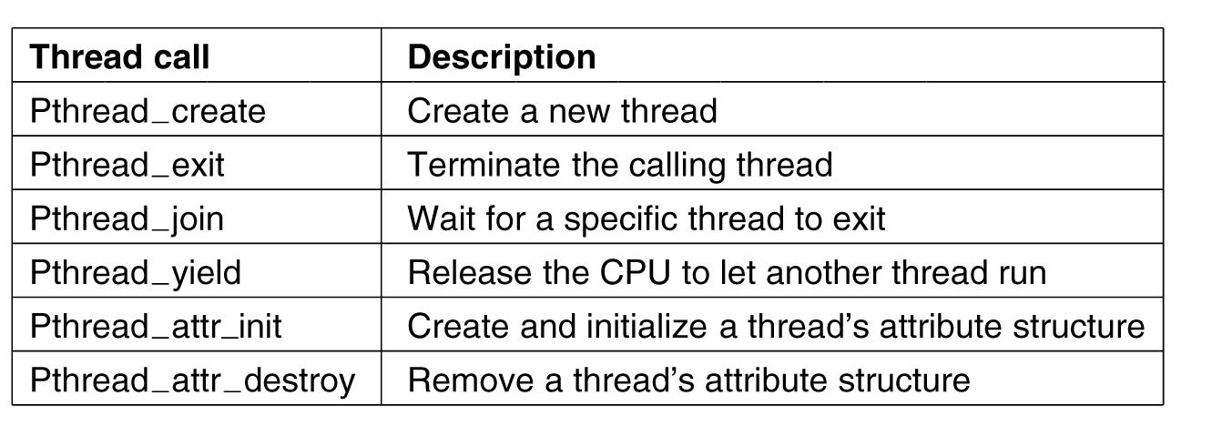
POSIX Threads (2)
Figure 2-14. Some of the Pthreads function calls.

Slide 88
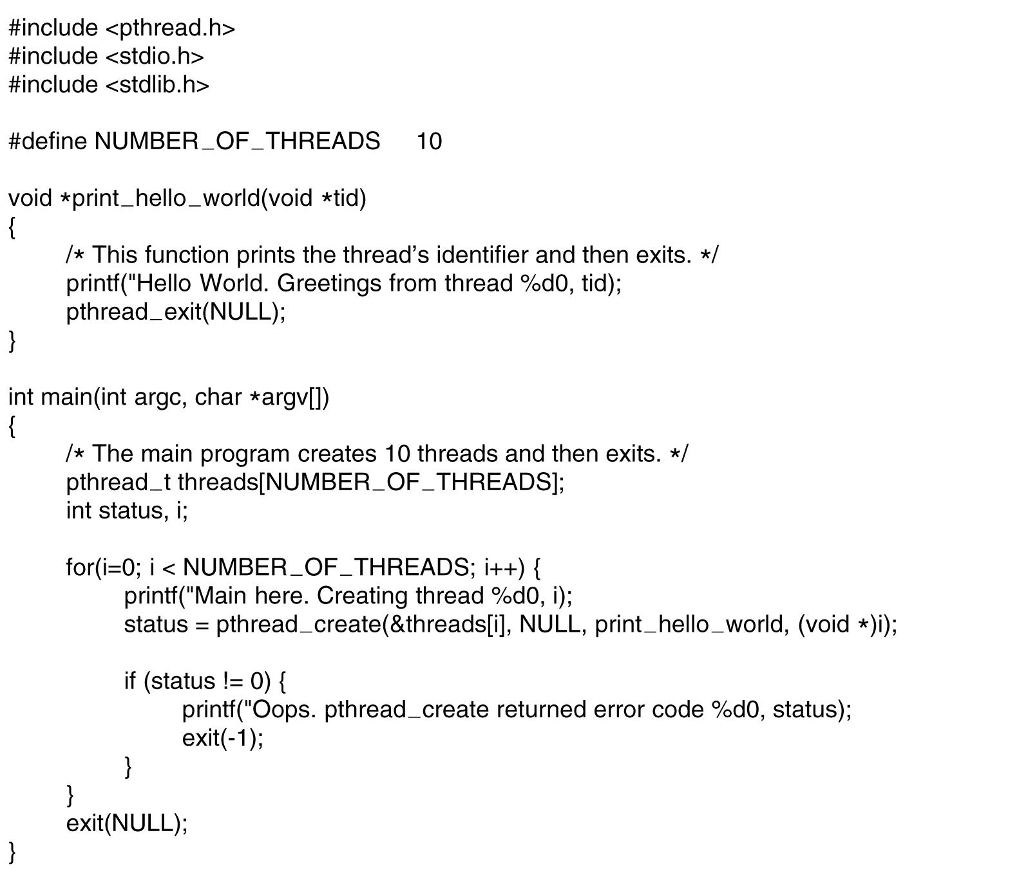
POSIX Threads (3)
. . .
Figure 2-15. An example program using threads.

Slide 89
User-level Threads (1)
To make threads cheap and fast, they need to be implemented at user level
  User-level threads are managed entirely by the run-time system (thread library)
User-level threads are small and fast
  A thread is simply represented by a PC, registers, stack, and small thread control block (TCB)
  Creating a new thread, switching between threads, and synchronizing threads are done via procedure call
    No kernel involvement
  User-level thread operations 100x faster than kernel threads

Slide 90
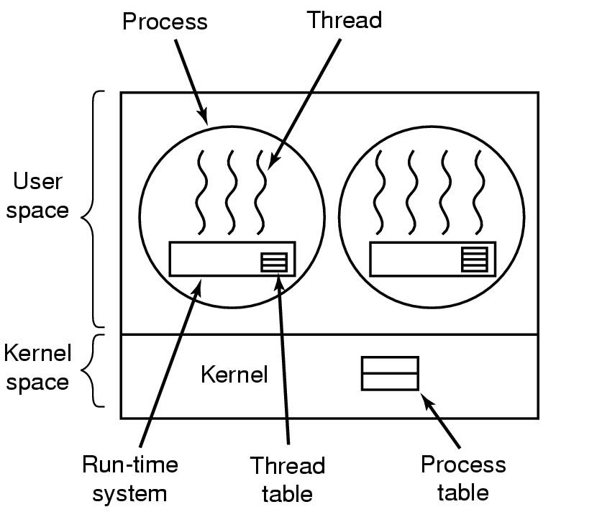
User-level Threads (2)
Implementing Threads in User Space
(old Linux)
Figure 2-16. (a) A user-level threads package

Slide 91
User-level Threads (3)
Advantages of User-level Threads
  ULTs can run on any OS. Only needs a thread library.
  Thread context switch is much faster than process context switch
    No kernel mode switch required
    Only registers are saved/loaded
    Thread may voluntarily yield (local call)
  Thread scheduling is very efficient
    May support per-process customized scheduling algorithms
  Better scalability (i.e., more threads, since no kernel access and data structures are required)
Notes:
一个应用程序可能倾向于简单的轮询调度算法，而另一个应用程序可能倾向于基于优先级的调度算法，调度算法可以适应应用程序，而不会扰乱底层的操作系统调度程序。

Slide 92
User-level Threads (4)
Issues of User-level Threads
  Most system calls are blocking and the kernel blocks processes. So all threads within the process will be blocked.
    Solutions
      1. Could change system calls to be all non-blocking.
        Requires major rewrite of OS.
      2. Tell in advance if a call will block.
        Requires rewriting parts of the system call library.
Notes:
在典型的操作系统中，许多系统调用会引起阻塞，因此当用户级线程执行一个系统调用时，不仅这个线程会被阻塞，进程中的所有线程都会被阻塞

Slide 93
User-level Threads (5)
Issues of User-level Threads (ctd.)
  The kernel can only assign processes to processors. Two threads within the same process cannot run simultaneously on two processors .
  Threads may monopolize CPU (no clocks in process).
  No use for compute-bound tasks (unless multiple CPUs).

Slide 94
Kernel-level Threads (1)
We have taken the execution aspect of a process and separated it out into threads
  To make concurrency cheaper
As such, the OS now manages threads and processes
  All thread operations are implemented in the kernel
  The OS schedules all of the threads in the system
OS-managed threads are called kernel-level threads or lightweight processes.
Most modern OSes support kernel-level threads
  Windows XP/2000, Solaris
  Linux , Tru64 UNIX
  Mac OS X

Slide 95
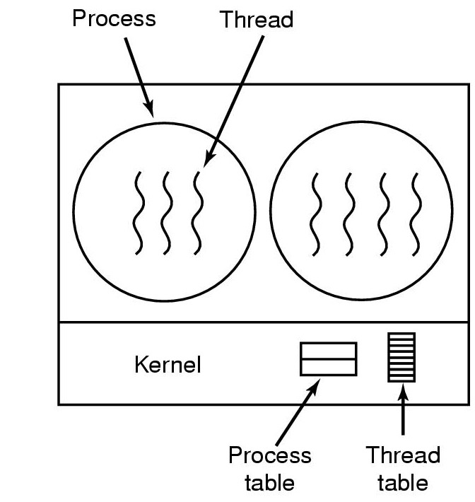
Kernel-level Threads (2)
Implementing Threads in the Kernel
Figure 2-16. (b) A threads package managed by the kernel

Slide 96
Kernel-level Threads (3)
Advantages of Kernel-level Threads
  Kernel can schedule another thread if current one does blocking I/O.
  Kernel can schedule multiple threads on different CPUs on SMP multiprocessor.
Issues of Kernel-level Threads
  Slower to schedule, create, delete than user-level threads
  OS must scale well with increasing number of threads.

Slide 97
User-level vs. Kernel-level Threads
Kernel-level Threads
  Integrated with OS (informed scheduling)
  Slow to create, manipulate, synchronize
User-level Threads
  Fast to create, manipulate, synchronize
  Not integrated with OS (uninformed scheduling)
Understanding the differences between kernel and user-level threads is important
  For programming (correctness, performance)
  For test-taking

Slide 98
Hybrid Implementations (1)
Hybrid of Kernel and user-level threads: m-to-n thread mapping
  Application creates m threads
  OS provides pool of n kernel threads
  Few user-level threads mapped to each kernel-level thread
Advantages
  Can get best of user-level and kernel-level implementations
  Works well given many short-lived user threads mapped to constant-size pool
Disadvantages
  Complicated…
  How to select mappings?
  How to determine the best number of kernel threads?
    User specified
    OS dynamically adjusts number depending on system load

Slide 99
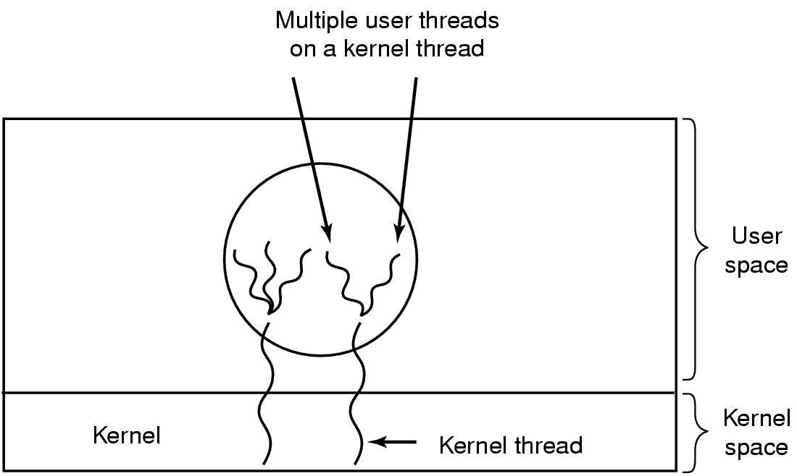
Hybrid Implementations (2) (Solaris)
Figure 2-17. Multiplexing user-level threads onto kernel- level threads

Slide 100
Pop-Up Threads (1)
Pop-Up Threads
  Created on “as needed” basis
Advantages of Pop-Up Threads
  Cheaper to start new thread than to restore existing one.
  No threads block waiting for new work; no context has to be saved, or restored.

Slide 101
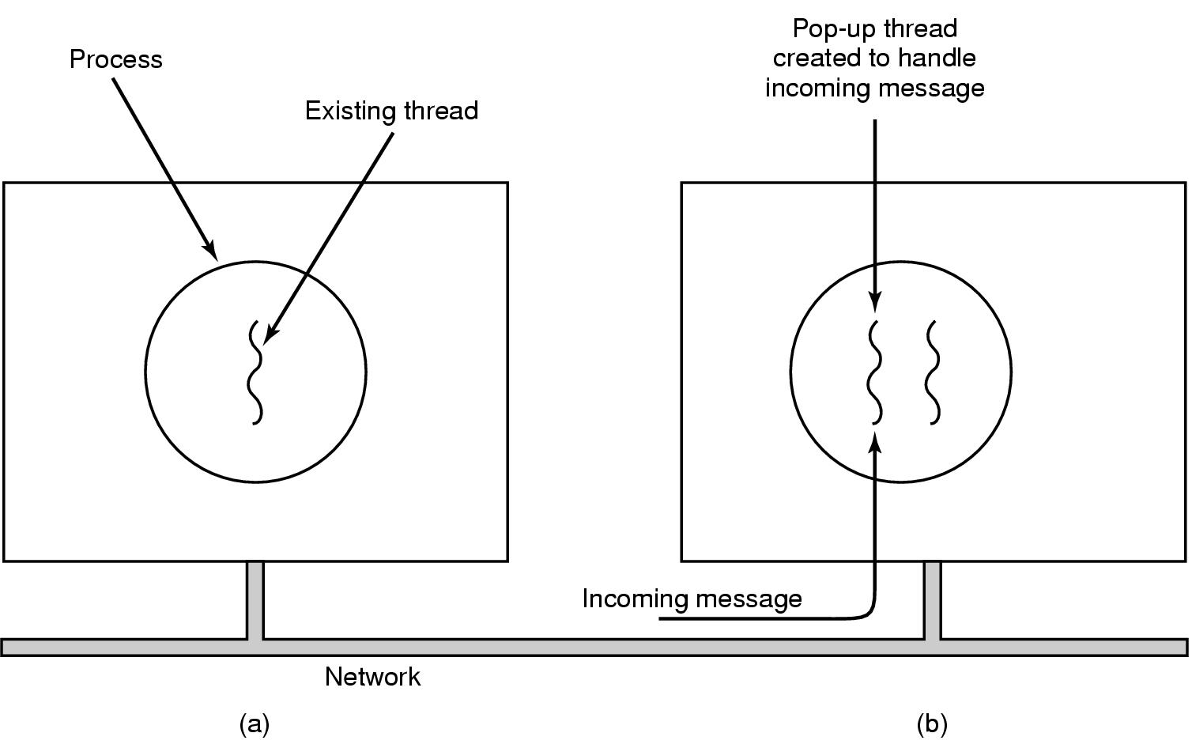
Pop-Up Threads (2)
Creation of a new thread when message arrives
  (a) before message arrives
  (b) after message arrives

Slide 102
Thread Summary
Why need threads?
What is thread?
Difference between process and thread
Thread Implementations and their tradeoffs
  User-level
  Kernel-level
  Hybrid
  Pop-up threads

Slide 103
Homework
P174 1,12,14,18

