Slide 1
Modern Operating Systems
Review
Zhang Yang
Autumn 2019

Slide 2
Chapter 1 Introduction (1)
What is an OS?
  It is an extended machine
  It is a resource manager
History of OS
  First generation, no OS
  Second generation, early batch system
  Third generation, multiprogramming, spooling and timesharing
  Fourth generation

Slide 3
Chapter 1 Introduction (2)
Operating System Structure
  Monolithic System
  Layered System
  Microkernel
  Client-Server Model
  Virtual Machine
  Exokernel

Slide 4
Chapter 2 Process (1)
Process Model
  Multiprogramming, concurrency
Process
  Definition: an executing program
  Process vs. program
Program
The collection of instruction, static concept
A program can be the execution program of multiple process
Process
Describe concurrency, dynamic concept
A process include program ,data ,and PCB
Temporary
A process can call multiple program

Slide 5
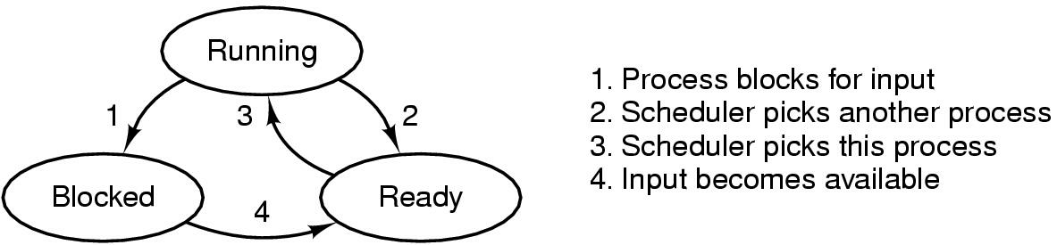
Chapter 2 Process (2)
Process States
  Three states: running, ready, block
  Transition between States
Process Control Block
  A data structure in the operating system kernel containing the information needed to manage a particular process.
  OS maintains a PCB for each process.

Slide 6
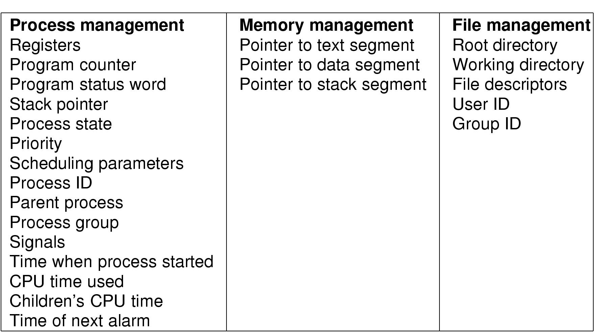
Chapter 2 Process (3)

Slide 7

Chapter 2 Process (4)
Process Context Switch
  Switch CPU from one process to another, performed by scheduler
  Expensive (1-1000ms), no useful work is done (pure overhead)

Slide 8
Chapter 2 Process (5)
Process Creation Events
  System Initialization
  Execution of a process creation system call
  User request to create a new process
  Initiation of a batch job
Linux Process Creation: fork( )
Process Termination Events
  Normal exit (voluntary)
  Error exit (voluntary)
  Fatal error (involuntary)
  Killed by another process (involuntary)

Slide 9
Chapter 2 Process (6)
Thread
  Definition: A sequential execution stream within a process (also called lightweight process)
  Advantages
    Creating a thread is (much) cheaper than a process (~10-20 times)
    Switching to a different thread in same process is (much) cheaper (5-50 times)
    Threads within same process can share data and other resources more conveniently and efficiently (without copying or messages)
    Threads within a process are not protected from each other

Slide 10
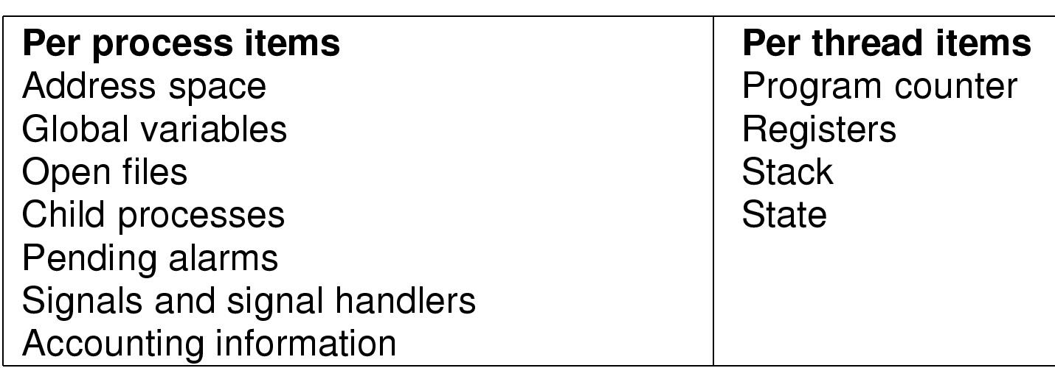
Chapter 2 Process (7)
Thread
  The Thread Model
  Implementation: user space, kernel space, hybrid

Slide 11
Chapter 2 Process (8)
Process vs.Thread
  Process
    Unit of resource ownership with respect to the execution of a single program
    Can encompass more than one thread of execution
    Processes are largely independent
    Expensive creation
    Expensive context switching
  Thread
    Unit of execution
    Belongs to a process
    Threads are part of the same “job” and are actively and closely cooperating
    Inexpensive creation
    Inexpensive context switching

Slide 12
Chapter 2 Process (9)
User-Level vs. Kernel Threads
Kernel-Level
Managed by kernel
Consumes kernel resources
Context switching expensive
Number limited by kernel resources
Simpler to use
Kernel-Level
Managed by kernel
Consumes kernel resources
Context switching expensive
Number limited by kernel resources
Simpler to use
User-Level
Managed by application
Kernel not aware of thread
Context switching cheap
Create as many as needed
Must be used with care
User-Level
Managed by application
Kernel not aware of thread
Context switching cheap
Create as many as needed
Must be used with care
Key issue: kernel threads provide virtual processors to user-level threads,
but if all of kthreads block, then all user-level threads will block
even if the program logic allows them to proceed

Slide 13
Chapter 2 Process (10)
IPC
  Race condition
    The situation where several processes access and manipulate shared data concurrently. The final value of the shared data depends upon which process finishes last.
  Critical region or section
    Part of the process code that affects the shared resource.
    Four requirements
    Software & hardware solution to critical section problem

Slide 14
Chapter 2 Process (11)
IPC (ctd.)
  Semaphore and PV operations
  Using semaphore to solve process mutual exclusion and synchronization problem
  Classical IPC problems
    Producer-Consumer Problem
    Readers and Writers Problem
    Dining Philosophers Problem
  Monitor

Slide 15
Semaphore as Synchronization Tool
Execute B in Pj only after A executed in Pi
Use semaphore S initialized to 0
Code:
    Pi Pj
    A P(S)
    V(S) B

Slide 16
Chapter 2 Process (12)
Process Schedule
  When to schedule
    A new process starts
    The running process exits
    The running process is blocked
    I/O interrupt (some processes will be ready)
    Clock interrupt (e.g. every 10 milliseconds)
  Goal

Slide 17
Chapter 2 Process (13)
Process Schedule (ctd.)
  Schedule Algorithm
    Batch Systems
      First-Come First-Served (FCFS)
      Short Job First (preemptive & non-preemptive)
    Interactive Systems
      Round Robin
      Priority Scheduling
      Multi Queue & Multi-level Feedback
      Lottery scheduling

Slide 18
Chapter 3 Memory Management (1)
Basic Memory Management
  Static Relocation
    At load time, OS adjusts addresses in process to reflect position in memory
    OS cannot move process after relocation
  Dynamic Relocation
    Run-time mapping of virtual address into physical address with the support of some hardware mechanism
    Hardware adds relocation register (base) to virtual address to get physical address
  Compaction
  Free Space Management
    Bit map
    Linked list

Slide 19
Chapter 3 Memory Management (2)
Basic Memory Management (ctd.)
  Overlay and Swapping
  Storage Placement Strategy
    First fit
    Next fit
    Best fit
    Worst fit
Paging
  Address translation scheme
  Page tables, TLB, multi-level page tables, inverted page tables
  Page Fault
  Advantages & disadvantages

Slide 20
Chapter 3 Memory Management (3)
Page Replacement Algorithm
  Optimal
  FIFO: Belady’s anomaly
  Second chance
  NRU
  Clock
  LRU
  NFU
  Aging
  Working set
    A process's working set is the set of pages that it currently “needs”.
    Thrashing (result, how to solve)
  Working set clock

Slide 21
Chapter 3 Memory Management (4)
Fetching Policies in Paging
  Demand paging
  Pre-paging
Design Issues for Paging
  Resident set management
  Page size
  PFF Algorithm
  Shared Pages – Copy on write
Segmentation
  Address translation scheme
  Advantages & disadvantages
Segmentation with paging
  Address translation scheme

Slide 22
Chapter 4 File System (1)
File
  A named collection of related information that is recorded on secondary storage.
File System
  A method for storing and organizing files and the data they contain to make it easy to find and access them.
Basic Functions of File System
  Present logical (abstract) view of files and directories
  Facilitate efficient use of storage devices
  Support sharing
File Types
  Regular file: ASCII, Binary
  Directory
  Character special file
  Block special file

Slide 23
Chapter 4 File System (2)
Directory
  One-level directory system
  Two-level directory system
  Hierarchical directory system
File Storage Implementation
  Contiguous allocation
  Linked list allocation & FAT
  Indexed allocation: i node

Slide 24
Chapter 4 File System (3)
Shared Files
  Hard link
  Symbolic link
Disk Space Management
  Block size
  Keeping Track of Free Blocks
    Linked list
    Bit map
File System Backup
  Logical-dump Algorithm

Slide 25
Chapter 4 File System (4)
File System Consistency
  Checking block
  Checking directory
MS-DOS File System
  FAT-12, FAT-16, FAT-32
Unix V7 File System
  i-node structure

Slide 26
Chapter 5 Input/Output (1)
Goals of I/O software
  Device Independence
  Uniform Naming
  Error Handling
  Synchronous vs. Asynchronous Transfer
  Buffering
  Sharable vs. Dedicated Devices File access
Principals of I/O Software
  Programmed I/O
  Interrupt-driven I/O
  I/O using DMA

Slide 27
Chapter 5 Input/Output (2)
I/O Software Layers
  Interrupt Handlers
  Device Drivers
    Accept abstract read/write requests from the device-independent software above and translate them into concrete I/O-module-specific commands
    Schedule requests: optimize queued request order for best device utilization (eg: disk arm)
    Initialize the device, if needed
    Manage power requirements and log device events

Slide 28
Chapter 5 Input/Output (3)
I/O Software Layers (ctd.)
  Device independent OS Software
    Uniform interfacing to device derivers
    Buffering
    Error reporting
    Allocating and releasing dedicated devices
    Providing a device-independent block size
  User-level I/O Software

Slide 29
Chapter 5 Input/Output (4)
Disk
  Cylinder Skew
  Sector Interleaving
  Disk Arm Scheduling Algorithm
    FCFS
    SSF
    Elevator Algorithm (SCAN)

Slide 30
Chapter 6 Deadlock (1)
Deadlock
  Definition
  Deadlock, livelock, starvation
Conditions for Deadlock
  Mutual exclusion condition
  Hold and wait condition
  No preemption condition
  Circular wait condition

Slide 31
Chapter 6 Deadlock (2)
Methods for Handling Deadlock
  Detection
    Single resource per type: resource allocation graph, algorithm
    Multiple resources of each type: algorithm
  Recovery
    Through preemption
    Through rollback
    Through killing process
  Avoidance
    Safe state
    Banker’s algorithm

Slide 32
Chapter 6 Deadlock (3)
Methods for Handling Deadlock (ctd.)
  Prevention
    Attacking mutual exclusion
    Attacking hold and wait
    Attacking no preemption condition
    Attacking circular wait condition

Slide 33
考试题型
选择题
简答题
综合题

