Slide 1
Modern Operating Systems
Chapter 1,2 – Homework

Slide 2
Chapter1 Homework
P81 1,3
Chapter2 Homework
P174 1,12,14,18,34,39,50,60
IPC部分补充题
  有一个阅览室，共有100个座位，读者进入时必须先在一张登记表上登记，该表为每一座位列一表目，包括座号和读者姓名等，读者离开时要消掉登记的信息，试用PV操作描述读者进程之间的同步关系。

Slide 3
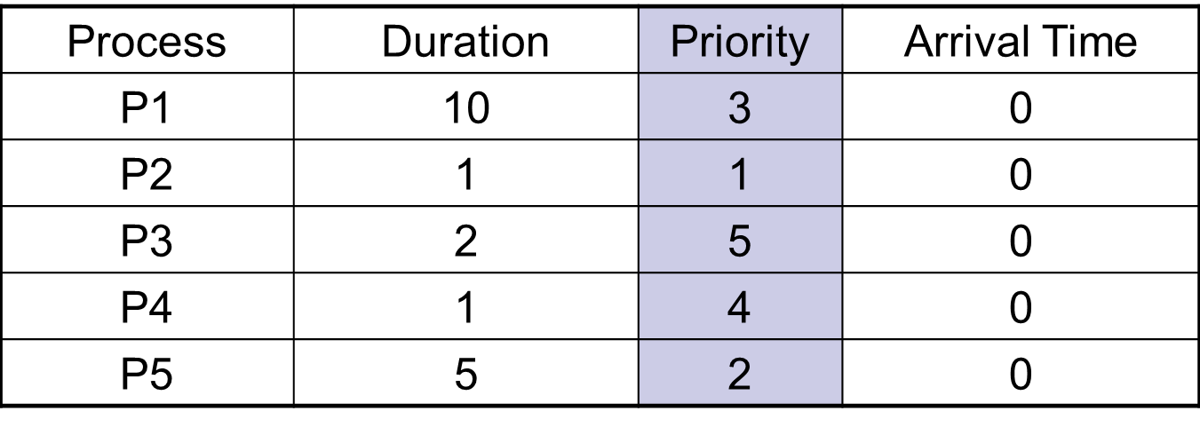
Chapter2 Homework
调度部分补充题
1. Consider the following set of processes, with the length of CPU burst time given in milliseconds

Slide 4
Chapter2 Homework
调度部分补充题 （续）
1. The processes are assumed to have arrived in the order of P1,P2,P3,P4,P5 all at time 0.
a. Draw four Gantt chart illustrating the execution of these processes using FCFS, SJF, a non-preemptive priority (a smaller priority number implies a higher priority) and RR scheduling (time quantum=1).
b. What is the turn around time of each process for each scheduling algorithm in part a?
c. What is the waiting time of each process for each scheduling algorithm in part a?
d. Which of the schedules in part a results in the minimal average waiting time?

Slide 5
Chapter2 Homework
调度部分补充题
2. There are five jobs A, B, C, D, E, whose arrival time and running time are shown in the table below. The quantum is set to 4. Compute the average turnaround time when the round-robin scheduling strategy is adopted.
Job | A | B | C | D | E
Arrival Time | 0 | 1 | 2 | 5 | 6
Running Time | 8 | 4 | 10 | 2 | 3

