Slide 1
Modern Operating Systems
Chapter 2 – Scheduling
Zhang Yang
Autumn 2019

Slide 2
Content of this lecture
2.4 Scheduling
  What is Scheduling?
  Classification of Scheduling Activity
  Process Behavior
  When to Schedule?
  Scheduling Algorithms
  Summary

Slide 3


What is Scheduling?
Deciding which process/thread should occupy the resource (CPU, disk, etc)
(CPU (horsepower))
I want to ride it
Whose turn is it?
Process 1
Process 2
Process 3

Slide 4
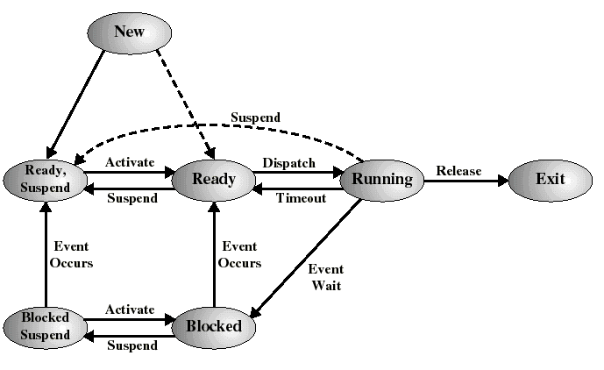
A Seven-State Process Model (1)

Slide 5
A Seven-State Process Model (2)
New
  A process that has been created, but not yet accepted in the pool of executable processes by OS
  Typically, a new process has not yet been loaded into main memory
Ready
  The process is in main memory and available for execution.
Blocked
  The process is in main memory and awaiting an event.

Slide 6
A Seven-State Process Model (3)
Blocked, Suspend
  The process is in secondary memory and awaiting an event.
Ready, Suspend
  The process is in secondary memory but is available for execution as soon as it is loaded into main memory.
Exit
  A process that has been released from the pool of executable processes by the OS
  Completed or due to some errors

Slide 7
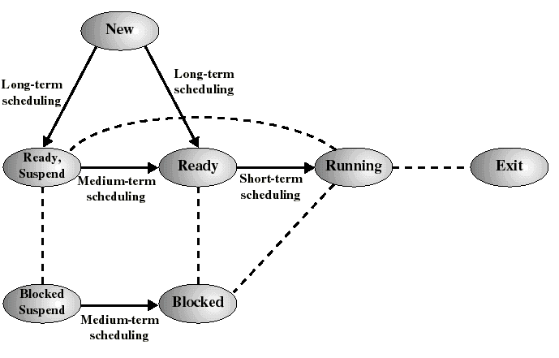
Classification of Scheduling Activity
Long-term: which process to admit
Medium-term: which process to swap in or out
Short-term: which ready process to execute next

Slide 8
Long-Term Scheduling
Determines which programs are admitted to the system for processing
Controls the degree of multiprogramming
If more processes are admitted
  Less likely that all processes will be blocked
  Better CPU usage
  Each process has less fraction of the CPU
The long term scheduler will attempt to keep a mix of processor-bound and I/O-bound processes

Slide 9
Medium-Term Scheduling
Swapping decisions based on the need to manage multiprogramming
Done by memory management software
  See resident set allocation and load control

Slide 10
Short-Term Scheduling
Determines which process will execute next (also called CPU scheduling)
The short term scheduler is known as the dispatcher.
Is invoked on a event that may lead to choose another process for execution:
  Clock interrupts
  I/O interrupts
  Operating system calls and traps
  Signals

Slide 11
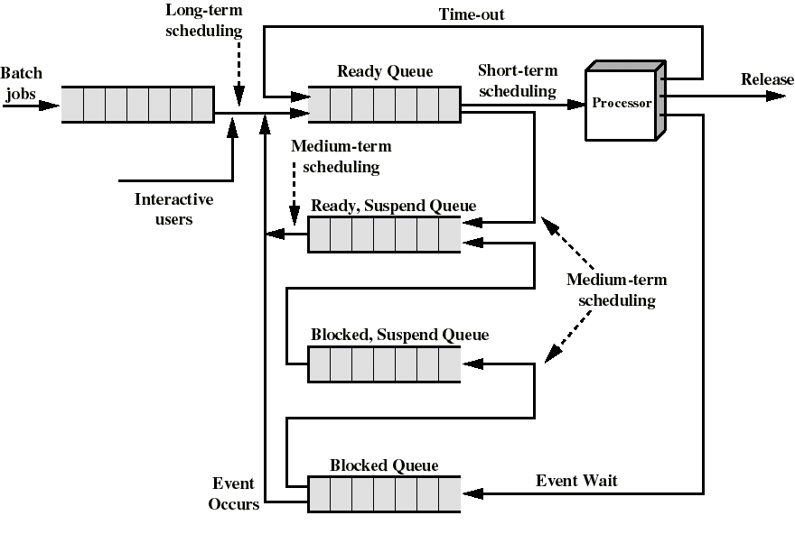
Queuing Diagram for Scheduling

Slide 12
Process Behavior (1)
Processes typically consist of
  CPU Bursts
    A period of time when a process needs the CPU is called a CPU burst
  I/O Bursts
    A period of time when a process needs I/O is called an I/O burst.
Duration and frequency of bursts vary greatly from process to process
  CPU-bound few very long CPU bursts
    Number crunching tasks, image processing
  I/O-bound many short CPU bursts
Maximum CPU utilization obtained with multiprogramming and mixing CPU and I/O bound tasks for maximal parallel resource utilization

Slide 13

Process Behavior (2)
Alternating Sequence of CPU And I/O Bursts

Slide 14

Process Behavior (3)
Long CPU bursts and infrequent I/O waits
Short CPU bursts and frequent I/O waits
Figure 2-38 Bursts of CPU usage alternate with periods of I/O wait
  (a) a CPU-bound process
  (b) an I/O bound process

Slide 15
CPU Scheduling
Problem to Solve
  When (scheduling opportunity)
  when to allocate CPU to process ?
  What (scheduling algorithm)
  what is the principle of allocation ?
  How (context - switch)
  How to allocate CPU? scheduling- process?

Slide 16
When to Schedule?
A new process is created
The running process exits
The running process is blocked
I/O interrupt (some processes will be ready) or Clock interrupt (e.g. every 10 milliseconds)

Slide 17
Preemptive vs. Non-preemptive
Non-preemptive Scheduling
  The running process keeps the CPU until it voluntarily gives up the CPU
    Process exits
    Switches to blocked state
    1and 4 only (no 3)
Preemptive Scheduling
  The running process can be interrupted and must release the CPU (can be forced to give up CPU)
Running
4
Terminated
3
1
Ready
Blocked

Slide 18
Categories of Scheduling Algorithms
Batch
  Non-preemptive algorithms
  Preemptive algorithms with long time periods for each process
Interactive
  Preemption is essential
Real-Time
  Preemption is sometimes not needed

Slide 19
Scheduling Algorithm Goals (1)
All Systems
  Fairness
    No process should suffer starvation
  Policy Enforcement
    Seeing that stated policy is carried out
  Efficiency
    Keep resources as busy as possible

Slide 20
Scheduling Algorithm Goals (2)
Batch Systems
  Throughput
    Number of jobs processed per unit of time
  Turnaround Time
    Time from submission to completion (batch jobs)
  Processor Utilization
    Percent of time CPU is busy

Slide 21
Scheduling Algorithm Goals(3)
Interactive Systems
  Response Time
    Amount of time from when a request was first submitted until first response is produced.
  Proportionality
    Meet users' expectation
Real-Time Systems
  Deadline
    Meet all deadlines
  Predictability
    Same time/cost regardless of load on the system
Notes:
Predictability:jobs should take about the same time to run &
responsiveness should be similar when run multiple
times
可预测性是指系统能够对实时任务的执行时间进行判断，确定是否能够满足任务的时限要求。

Slide 22
Single Processor Scheduling Algorithms
Batch Systems
  First-Come First-Served (FCFS)
  Short Job First
Interactive Systems
  Round Robin
  Priority Scheduling
  Multi-level Queue & Multi-level Feedback
  Shortest Process Next
  Guaranteed Scheduling
  Lottery Scheduling
  Fair Sharing Scheduling

Slide 23

First-Come, First-Served (1)
Process that requests the CPU FIRST is allocated the CPU FIRST.
Also called FIFO
Non-preemptive
Used in Batch Systems
Real life analogy: Fast food restaurant

Slide 24
First-Come, First-Served (2)
Implementation: FIFO queues
  A new process enters the tail of the queue
  An unblocked process re-enters at the tail of the queue
  The scheduler selects from the head of the queue.
Performance Metric: Average Waiting Time
Waiting Time: The total amount of time that a process is in the ready queue.

Slide 25
FCFS Example (1)
Process | Duration | Order | Arrival Time
P1 | 24 | 1 | 0
P2 | 3 | 2 | 0
P3 | 4 | 3 | 0
The final schedule:
P1 (24)
P2 (3)
P3 (4)
0
24
27
31
P1 waiting time: 0
The average waiting time:
(0+24+27)/3 = 17
P2 waiting time: 24
P3 waiting time: 27

Slide 26
FCFS Example (2)
Suppose that the processes arrive in the order
P₂ , P₃ , P₁
The Gantt chart for the schedule is:
Waiting time for P₁ = 7; P₂ = 0; P₃ = 3
Average waiting time: (7 + 0 + 3)/3 = 3.3
Much better than previous case.
P2 (3)
P3 (4)
P1 (24)
0
3
7
31

Slide 27
FCFS Discussion
Advantage
  Very simple implementation
Disadvantages
  Waiting time depends on arrival order (non-preemptive)
  Potentially long wait for jobs that arrive later (not optimal AWT)
  Convoy effect: Short jobs stuck waiting for long jobs
    Hurts waiting time of short jobs
    Reduces utilization of I/O devices

Slide 28
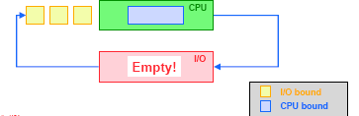
Convoy Effects (1)
All I/O devices idle even when the system contains lots of I/O jobs
  CPU bound jobs get CPU and holds it
  I/O bound jobs move onto ready queue and waits

Slide 29
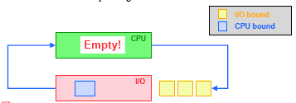
Convoy Effects (2)
CPU idle when even if system contains CPU bound jobs
  I/O jobs get CPU and finish quickly and goes back to I/O
  Now CPU may be idle!
  later I/O bound jobs again wait for CPU

Slide 30
Shortest Job First (SJF)
Schedule the job with the shortest elapse time first
Use FCFS if jobs are of same length
Scheduling in Batch Systems
Two Versions of SJF
  Non-preemptive
  Preemptive
Requirement: the elapse time needs to know in advance
Optimal if all the jobs are available simultaneously (provable)
  Gives the best possible AWT (average waiting time)

Slide 31
Non-preemptive SJF: Example
Process | Duration | Order | Arrival Time
P1 | 6 | 1 | 0
P2 | 8 | 2 | 0
P3 | 7 | 3 | 0
P4 | 3 | 4 | 0
P4 (3)
P1 (6)
P3 (7)
P2 (8)
0
3
9
16
24
P4 waiting time: 0
The total time is: 24
The average waiting time (AWT):
(0+3+9+16)/4 = 7
P1 waiting time: 3
P3 waiting time: 9
P2 waiting time: 16

Slide 32
Comparing to FCFS
Process | Duration | Order | Arrival Time
P1 | 6 | 1 | 0
P2 | 8 | 2 | 0
P3 | 7 | 3 | 0
P4 | 3 | 4 | 0
P1 (6)
P2 (8)
P3 (7)
P4 (3)
0
6
14
21
24
The total time is the same.
The average waiting time (AWT):
(0+6+14+21)/4 = 10.25
(comparing to 7)
P1 waiting time: 0
P2 waiting time: 6
P3 waiting time: 14
P4 waiting time: 21

Slide 33
SJF is not always optimal (1)
Is SJF optimal if all the jobs are not available simultaneously?
Example
Process | Duration | Order | Arrival Time
P1 | 10 | 1 | 0
P2 | 2 | 2 | 2
P1 (10)
P2 (2)
0
2 (p2 arrives)
10
12
P1 waiting time: 0
The average waiting time (AWT):
(0+8)/2 = 4
P2 waiting time: 8

Slide 34
SJF is not always optimal (2)
Example (ctd.)
  What if the scheduler waits for 2 time units? (Do it yourself)
P2 (2)
P1 (10)
0
2
4
14
P2 waiting time: 0
The average waiting time (AWT):
(0+4)/2 = 2
However: waste 2 time units of CPU
P1 waiting time: 4

Slide 35
Preemptive SJF
Also called Shortest Remaining Time Next (SRTN)
  Schedule the job with the shortest remaining time required to complete
Requirement: the elapse time needs to be known in advance

Slide 36
Preemptive SJF: Same Example
Process | Duration | Order | Arrival Time
P1 | 10 | 1 | 0
P2 | 2 | 2 | 2
P1 (2)
P2 (2)
P1 (8)
0
2
4
12
The average waiting time (AWT):
(0+2)/2 = 1
No CPU waste!!!
P1 waiting time: 4-2 =2
P2 waiting time: 0

Slide 37
SJF Discussion
Advantages
  Provably optimal for minimizing average wait time (with no preemption)
    Moving shorter job before longer job improves waiting time of short job more than it harms waiting time of long job
  Helps keep I/O devices busy
Disadvantages
  Not practical: Cannot predict future CPU burst time
    OS solution: Use past behavior to predict future behavior
  Starvation: Long jobs may never be scheduled
SJF implicitly incorporates priorities
  Shortest jobs are given preferences.

Slide 38
Starvation
In some condition, a job is waiting for ever
  Example: SJF
    Process A with elapse time of 1 hour arrives at time 0
    But ever 1 minute, a short process B with elapse time of 2 minutes arrive
    Then C, D…
    Result of SJF: A never gets to run

Slide 39
Interactive Scheduling Algorithms
Usually preemptive
  Time is sliced into quantum (time intervals)
  Scheduling decision is also made at the beginning of each quantum
Performance Criteria
  Min Response time
  Best proportionality
Representative Algorithms
  Round-robin Scheduling
  Priority Scheduling
  Multi-level Queue & Multi-level Feedback Queue
  Shortest Process Next
  Guaranteed Scheduling
  Lottery Scheduling
  Fair Sharing Scheduling

Slide 40
Round-robin Scheduling(1)
One of the oldest, simplest, most commonly used scheduling algorithm
  Each process gets a small unit of CPU time
  (time quantum or time slice), usually 10-100 milliseconds.
  A process is allowed to run until the time slice period has expired, then a clock interrupt occurs and the running process is put on the ready queue.
  If the process has blocked or finished before the quantum has elapsed, the CPU switching is done.
Notes:
This relies on hardware timer interrupts and is completely
transparent to the processes

Slide 41
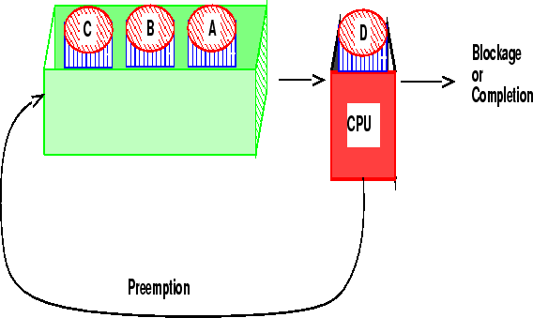
Round-robin Scheduling (2)
Assumes all processes have same priority
  Guaranteed to be starvation-free
Preemptive FCFS
Ready queue treated as circular queue
Processes that exceed their time slice return to the end of the ready queue

Slide 42
Round-robin Scheduling (3)
n processes in the ready queue and time quantum q
  Each process gets 1/n of the CPU time in chunks of at most q time units at once.
  No process waits more than (n-1)q time units.
    Good response time
Notes:
假定就绪队列中有n个进程、时间量为q, 则每个进程每次得到1/n的、不超过q单位的成块CPU时间，没有任何一个进程的等待时间会超过(n-1) q单位

Slide 43
Round-robin: Example
Process | Duration | Order | Arrival Time
P1 | 3 | 1 | 0
P2 | 4 | 2 | 0
P3 | 3 | 3 | 0
Suppose time quantum is: 1 unit, P1, P2 & P3 never block
P1
P2
P3
P1
P2
P3
P1
P2
P3
P2
0
10
P1 waiting time: 4
P2 waiting time: 6
P3 waiting time: 6
The average waiting time (AWT):
(4+6+6)/3 = 5.33

Slide 44
Time Quantum (1)
Time quantum too large
  If quantum size is large enough to finish most processes within a single quantum →Low context switch overhead
  If quantum size is too large → FCFS behavior, poor response time
Time quantum too small
  Too many context switches (overheads)
    Context switch time= 0.1-1ms
  Inefficient CPU utilization

Slide 45

Time Quantum (2)
Quantum Size vs. Context Switch Tradeoff

Slide 46
Time Quantum (3)
Actual Choices of Time Quantum
  Initially, UNIX time slice is 1 second
    Worked ok when UNIX was used by one or two people.
    What if three compilations going on? 3 seconds to echo each keystroke!
  In practice, need to balance short-job performance and long-job throughput:
    Typical time slice today is between 10ms – 100ms
    Typical context-switching overhead is 0.1ms – 1ms
    Roughly 1% overhead due to context-switching

Slide 47
Round-robin Discussion (1)
Advantages
  Fair allocation of CPU across jobs, no starvation
  Low average waiting time when job lengths vary
  Shortest jobs finish relatively quickly
  Turnaround time typically larger than SRTF but better response time
Disadvantages
  Poor average waiting time with similar job lengths
    Example: 3 jobs each requiring 3 time slices
      RR: AWT=(4+5+6)/3=5
      FCFS performs better! AWT=(0+3+6)/3=3
Notes:
Increases average waiting time, especially if CPU bursts are the same length and need more than one time quantum.

Slide 48
Round-robin Discussion (2)
Disadvantages (ctd.)
  Performance depends on length of time-slice
    If time-slice too short, pay overhead of context switch
    If time-slice too long, degenerate to FCFS
  Do not consider priority
  High overhead due to frequent context switches

Slide 49
Priority Scheduling (1)
Each job is assigned a priority.
FCFS within each priority level.
Select highest priority job over lower ones.
Rational: higher priority jobs are more mission-critical
  Example: DVD movie player vs. send email
SJF is priority scheduling where priority is inversely proportional to length of next CPU burst.

Slide 50
Priority Scheduling (2)
Priority Setting
  Two Approaches
    Static (for system with well known and regular application behaviors)
    Dynamic (otherwise)
  Priority may be based on
    Cost to user
    Importance of user
    Process type
    Requirement to resource
    Aging
    Percentage of CPU time used in last X hours.

Slide 51
Priority Scheduling (3)
Dynamic Priority Example
  Assign priority depending on the fraction of quantum each process has used
  P = 1/ f, f is the fraction of the last quantum that a process used
  Time slice: 50ms
  process A uses 1ms, f=1/50, priority = 50
  process B uses 50 ms, f=50/50, priority = 1

Slide 52
Priority Scheduling: Example
Process | Duration | Priority | Arrival Time
P1 | 6 | 4 | 0
P2 | 8 | 1 | 0
P3 | 7 | 3 | 0
P4 | 3 | 2 | 0
P2 (8)
P4 (3)
P3 (7)
P1 (6)
0
8
11
18
24
P2 waiting time: 0
P4 waiting time: 8
P3 waiting time: 11
P1 waiting time: 18
The average waiting time (AWT):
(0+8+11+18)/4 = 9.25
(worse than SJF 7)

Slide 53
Non-preemptive SJF: Example
Process | Duration | Order | Arrival Time
P1 | 6 | 1 | 0
P2 | 8 | 2 | 0
P3 | 7 | 3 | 0
P4 | 3 | 4 | 0
P4 (3)
P1 (6)
P3 (7)
P2 (8)
0
3
9
16
24
P4 waiting time: 0
P1 waiting time: 3
P3 waiting time: 9
P2 waiting time: 16
The total time is: 24
The average waiting time (AWT):
(0+3+9+16)/4 = 7

Slide 54
Priority Scheduling Discussion
Advantages
  Static priorities work well for real time systems
  Dynamic priorities work well for general workloads
Disadvantages
  Low priority jobs can starve
    Solution: Can avoid by aging processes: increase priority as they spend time in the system
  May not give the best AWT

Slide 55
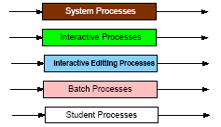
Multi-Level Queue (1)
Extension of priority scheduling, which also combines other strategies
Used in scenarios where the processes can be classified into groups based on property like process type, CPU time, IO access, memory size, etc.
Split the Ready Queue in several queues, processes assigned to one queue permanently.

Slide 56
Multi-Level Queue (2)
Scheduling between queues
  Fixed Priorities
    E.g. Serve all from foreground then from background
    Possibility of starvation
  Time Slice – each queue gets a certain amount of CPU time which it can schedule amongst its processes (% CPU spent on queue)
    E.g. 80% to foreground，20% to background
  Each queue with its own scheduling algorithm
    E.g. interactive processes: RR, background processes: FCFS/SRTF

Slide 57
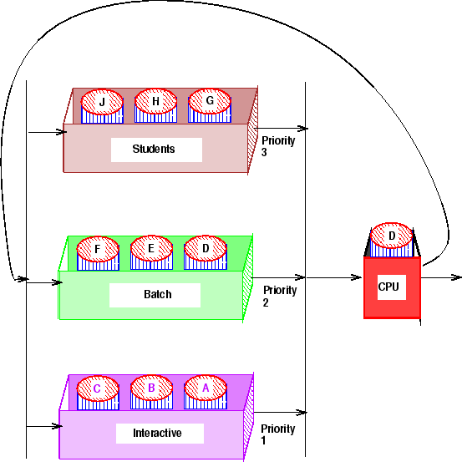
Multi-Level Queue (3)
Scheduling between queues (ctd.)
  Example
20%
30%
50%

Slide 58
Multi-Level Queue (4)
Real Life Analogy
  Tasks (to-do list) for poor Bob
    Class 1 priority (highest) : tasks given by his boss
      Finish the project (50%)
    Class 2 priority: tasks for his wife
      Buy a valentine present (30%)
    Class 3 priority (lowest): Bob’s tasks
      Watch TV (20%)

Slide 59
Multi-Level Feedback Queue (1)
First described in 1962 in CTSS.
Processes move between queues.
  Start each process in a high-priority queue; as it finishes each CPU burst, move it to a lower-priority queue
  Feedback = use the past to predict the future — favor jobs that haven’t used the CPU much in the past — close to SRTN!
Each queue represents jobs with similar CPU usage.
Jobs in a given queue are executed with a given time slice.

Slide 60
Multi-Level Feedback Queue (2)
Example
  Three queues:
    Q₀ – time quantum 8 milliseconds
    Q₁ – time quantum 16 milliseconds
    Q₂ – FCFS
  Scheduling
    A new job enters queue Q₀ which is served FCFS. When it gains CPU, job receives 8 milliseconds. If it does not finish in 8 milliseconds, job is moved to queue Q₁.
    At Q₁ job is again served FCFS and receives 16 additional milliseconds. If it still does not complete, it is preempted and moved to queue Q₂.

Slide 61
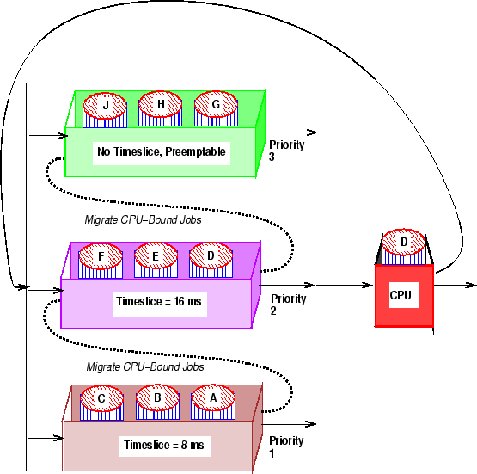
Multi-Level Feedback Queue (3)

Slide 62
Multi-Level Feedback Queue (4)
Advantages
  Good for separating processes based on CPU burst needs.
  Let I/O bound processes run often.
  Give CPU-bound processes longer chunks of CPU.
Disadvantages
  Priorities get controlled by the system. A process is considered important because it uses a lot of I/O.
  Processes whose behavior changes may be poorly scheduled.

Slide 63
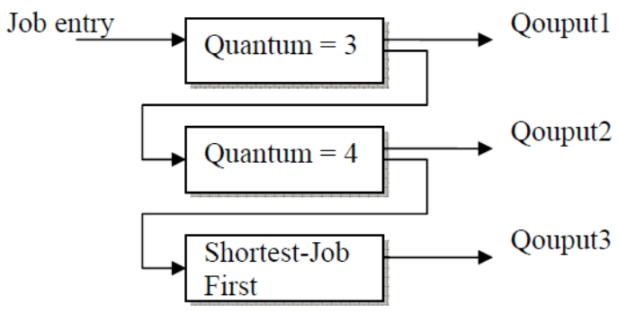
Multi-Level Feedback Queue: Exercise (1)
Problem: Show your schedule with timeline and Calculate the average turnaround time when use the multi-level feedback queue as below. (Please take arrival time into account.) Note that the priority of the top 2 queues is based on arrival times.
Process ID | Arrival Time | Burst Time
A | 0 | 7
B | 2 | 9
C | 5 | 4
D | 7 | 8
E | 8 | 2

Slide 64
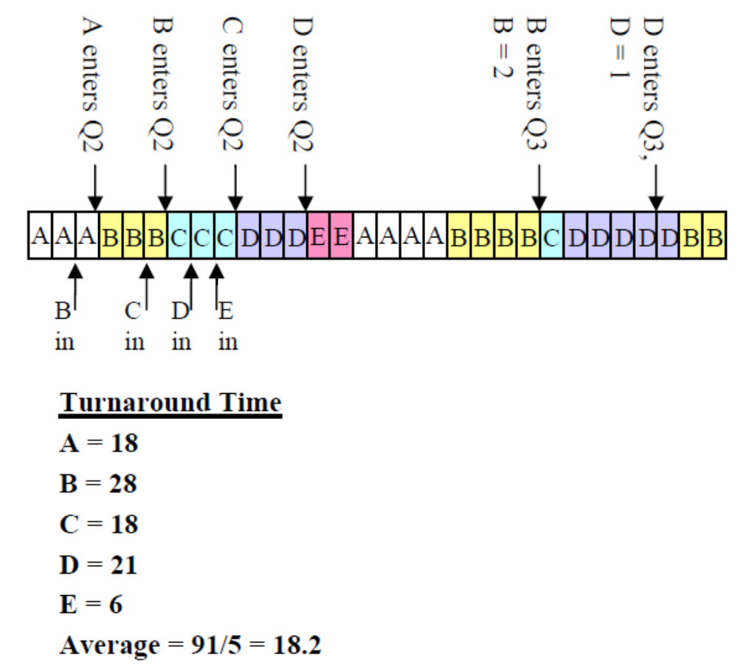
Multi-Level Feedback Queue: Exercise (2)
Solution:

Slide 65
Shortest Process Next
Scheduler selects process with smallest time to finish
  Lower average wait time than FCFS
    Reduces the number of waiting processes
  Nonpreemptive
    Results in slow response times to arriving interactive requests
  Relies on estimates of time-to-completion
    Can be inaccurate or falsified
  Unsuitable for use in modern interactive systems

Slide 66
Guaranteed Scheduling (QoS)
Make real promises to the users about performance and then live up to them
Example
  If there are n users, the scheduler makes sure that each will get 1/n of the CPU time.
  If there are n processes on a single-user system , the scheduler makes sure that each will get 1/n of the CPU time.
Scheduling
  Compute the ratio of actual CPU time consumed to CPU time entitled (the time since creation divided by n)
  Select the one with the lowest ratio.
  Switch to another process when the ratio of the running process has passed its “goal ratio”

Slide 67
Guaranteed Scheduling (QoS)
Make real promises to the users about performance and then live up to them
Example
  With n processes running, the scheduler makes sure that each one gets 1/n of the CPU cycles.
  If there are n users, the scheduler makes sure that each will get 1/n of the CPU time.
Scheduling
  Compute the ratio of actual CPU time consumed to CPU time entitled (the time since creation divided by n)
  Select the one with the lowest ratio
  Switch to another process when the ratio of the running process has passed its “goal ratio”
Notes:
Can it lead to starvation?

Slide 68

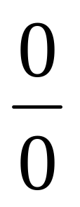
Guaranteed Scheduling: Example (1)
0
Process 1
Process 2
Process 3

Slide 69
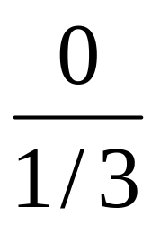
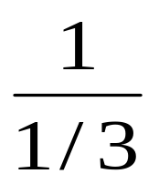
Guaranteed Scheduling: Example (2)
1
Process 1
Process 2
Process 3

Slide 70
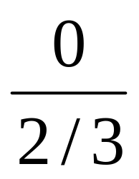
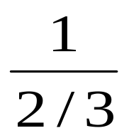
Guaranteed Scheduling: Example (3)
2
Process 1
Process 2
Process 3

Slide 71
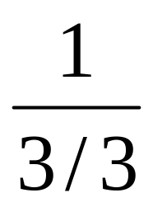
Guaranteed Scheduling: Example (4)
3
Process 1
Process 2
Process 3

Slide 72
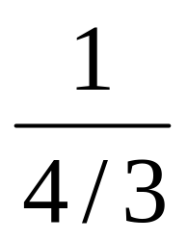
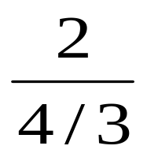
Guaranteed Scheduling: Example (5)
4
Process 1
Process 2
Process 3

Slide 73
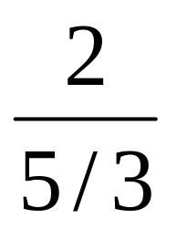
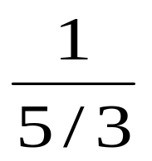
Guaranteed Scheduling: Example (6)
5
Process 1
Process 2
Process 3

Slide 74
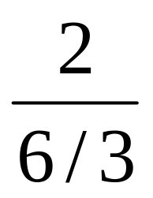
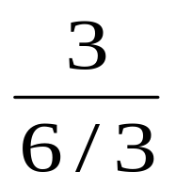
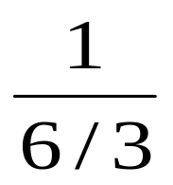
Guaranteed Scheduling: Example (7)
6
Process 1
Process 2
Process 3

Slide 75
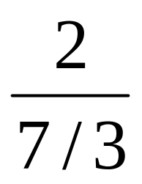
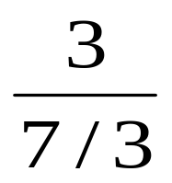
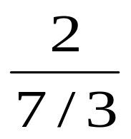
Guaranteed Scheduling: Example (8)
7
Process 1
Process 2
Process 3

Slide 76
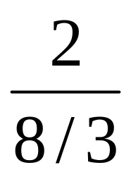
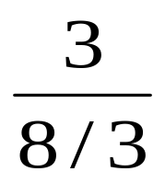
Guaranteed Scheduling: Example (9)
8
Process 1
Process 2
Process 3

Slide 77
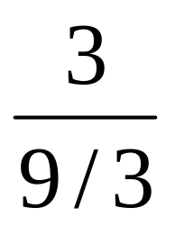
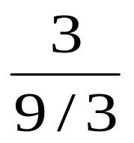
Guaranteed Scheduling: Example (10)
9
Process 1
Process 2
Process 3

Slide 78
Lottery Scheduling (1)
More commonly used
Probability-based
  Give processes lottery tickets. At scheduling time, a lottery ticket is chosen at random, and the process holding that ticket gets that resource.
Give more tickets for higher priority processes
On average: CPU time proportional to # of tickets

Slide 79
Lottery Scheduling (2)
Example
  Short jobs: 10 tickets each
  Long jobs: 1 ticket each
# short jobs/# long jobs | % of CPU for each short job | % of CPU for each long job
1/1 | 91% | 9%
0/2 | 0% | 50%
2/0 | 50% | 0%
10/1 | 10% | 1%
1/10 | 50% | 5%

Slide 80
Lottery Scheduling (3)
How to use?
  Approximate priority: low-priority, give few tickets, high-priority give many
  Approximate SJF: give short jobs more tickets, long jobs fewer. Key: If job has at least 1, will not starve
Advantages
  Simple
  Highly responsive
  Can support cooperation between processes
  Easy to support priority and proportion requirement

Slide 81
Fair-Share Scheduling
Is Round-robin fair?
  Yes, it is (from process point of view)
  No, it may be not (from user point view)
User-based fair share scheduling
  Each user gets fair share
Example
  Alice has 4 processes: A1, A2, A3, A4
  Bob has 1 process: B1
  Then A1, A2, A3, A4 are entitled only to 50% CPU, while B1 alone is entitled to 50%

Slide 82
Real-Time Systems (1)
Real-Time Systems
  Systems whose correctness depends on their temporal aspects as well as their functional aspects.
Real-Time Demands
  We don’t always need a LOT of CPU time but we may need it at the right intervals.
    E.g., Decode 30 frames per second of video
  We might have tight deadlines
    E.g., Complete task within the next 500 ms

Slide 83
Real-Time Systems (2)
Start Time
  The time at which a task starts execution.
Deadline
  The time before which a task should be completed to avoid damage to the system.
Finishing Time
  The time at which a task finishes execution.
Hard Deadline
  Disastrous or very serious consequences may occur if the deadline is missed.

Slide 84
Real-Time Systems (3)
Soft Deadline
  Ideally, the deadline should be met for maximum performance. The performance degrades in case of deadline misses.
Hard Real-Time Systems
  Required to complete a critical task within a guaranteed amount of time.
  Failure to meet deadline can result in disaster.
  E.g., air bag controller, autopilot system in plane, nuclear plant control system

Slide 85
Real-Time Systems (4)
Soft Real-Time Systems
  Missing an occasional deadline is undesirable, but nevertheless tolerable.
  Failure to meet deadline results in degraded performance.
  E.g, the sound system in your computer, mobile communication

Slide 86
Scheduling in Real-Time Systems (1)
Earliest Deadline First (EDF)
  For hard real-time systems, process must finish by a certain time.
  Turnaround time and wait time are irrelevant.
  We need to know maximum service time for each process.
  Deadline must be met for each period in a process’s life.
  A task with a shorter deadline has a higher priority.
  Executes a task with the earliest deadline.

Slide 87
Scheduling in Real-Time Systems (2)
Earliest Deadline First (EDF) (ctd.)
  Example
i t(pi) Deadline
i t(pi) Deadline
0 350 575
1 125 550
2 475 1050
3 250 (none)
4 75 200
0 75 200 550 1025 1275
P4
P1
P0
P2
P3

Slide 88
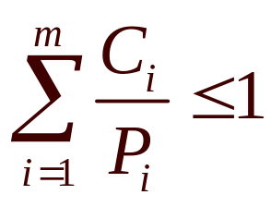
Schedulability in Real-Time Systems (1)
Events in Real-Time System
  Periodic (occurring at regular intervals)
  Aperiodic (unpredictable)
Schedulability
  Property indicating whether a real-time system (a set of real-time tasks) can meet their deadlines.
  Consider m periodic events, event i occurs with period Pi and requires Ci second of CPU time the system is schedulable if:

Slide 89
Schedulability in Real-Time Systems (2)
Example
  Multimedia System: three processes A, B, C
  A is periodic, T = 30ms, and uses 10 ms of CPU time
  B is periodic, f = 25 Hz (T=40ms) and uses 15 ms of CPU time
  C is periodic, f = 20 Hz, (T=50ms) and uses 5 ms of CPU time
  Schedulability ? 10/30 + 15/40 + 5/50 = 0.808 < 1

Slide 90
Policy versus Mechanism (1)
Given a particular task
  Policy refers to what needs to be done (i.e. activities to perform).
  Mechanism refers to how to do it (i.e. implementation to enforce policy).
Policy vs Mechanism Example
  A website requires users to login to the system. (policy)
  Users can login using a user name and password pair. (mechanism)
  Users can also login using their QQ or Wechat accounts. (another mechanism)

Slide 91
Policy versus Mechanism (2)
Scheduling policy answers the question: Which process/thread, among all those ready to run, should be given the chance to run next?
  For example, is it priority based ? or just round robin ?

Slide 92
Policy versus Mechanism (3)
Scheduling mechanisms are the tools for supporting the process/thread abstractions and affect how the scheduling policy can be implemented.
  How the process or thread is represented to the system - process or thread control blocks.
  What happens on a context switch.
  When do we get the chance to make these scheduling decisions (timer interrupts, thread operations that yield or block, user program system calls)

Slide 93
Policy versus Mechanism (4)
Separation of Policy and Mechanism
  Separation of policy and mechanism is a design principle to achieve flexibility.
  The scheduling algorithm is parameterized in some way, but the parameters can be filled in by user processes.
  The policy is set by a user process, the mechanism is in the kernel.

Slide 94
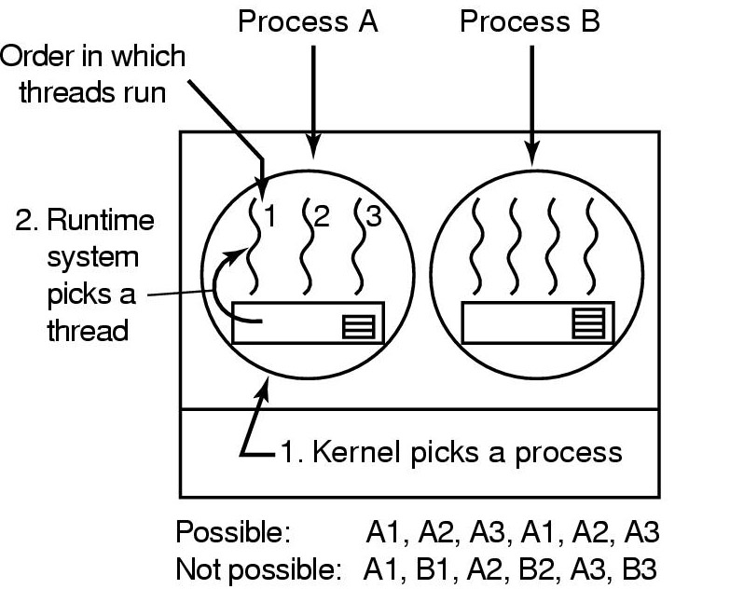
User-Level Thread Scheduling
Possible Scheduling
50-msec process quantum
run 5 msec/CPU burst

Slide 95
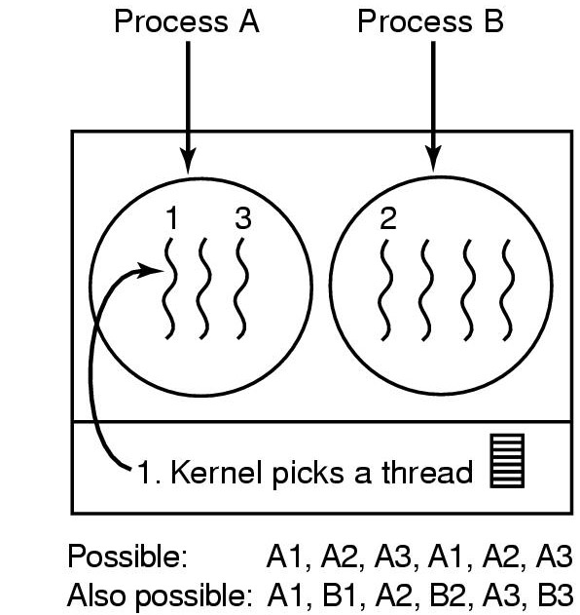
Kernel-Level Thread Scheduling
Possible scheduling
50-msec time quantum
threads run 5 msec/CPU burst

Slide 96
Summary (1)
What is scheduling?
Batch System Scheduling
  FCFS
  Shortest Job first (SJF)
  Shortest Remaining Time Next (SRTN)
Interactive System Scheduling
  Round-robin
  Priority
  Multi-level Queue & Multi-level Feedback Queue

Slide 97
Summary (2)
Interactive System (ctd.)
  Shortest Process Next
  Guaranteed Scheduling
  Lottery Scheduling
  Fair Sharing Scheduling
Scheduling for Real-time systems
  Schedulability
Thread Scheduling
  User-level thread scheduling
  Kernel-level thread scheduling

Slide 98
Homework (1)
Reading assignment: Chapter 10.3
P178 50
补充题
1. Consider the following set of processes, with the length of CPU burst time given in milliseconds
Process | Duration | Priority | Arrival Time
P1 | 10 | 3 | 0
P2 | 1 | 1 | 0
P3 | 2 | 5 | 0
P4 | 1 | 4 | 0
P5 | 5 | 2 | 0

Slide 99
Homework (2)
补充题 （续）
1. The processes are assumed to have arrived in the order of P1,P2,P3,P4,P5 all at time 0.
a. Draw four Gantt chart illustrating the execution of these processes using FCFS, SJF, a non-preemptive priority (a smaller priority number implies a higher priority) and RR scheduling (time quantum=1).
b. What is the turn around time of each process for each scheduling algorithm in part a?
c. What is the waiting time of each process for each scheduling algorithm in part a?
d. Which of the schedules in part a results in the minimal average waiting time?

Slide 100
Homework (3)
补充题
2. There are five jobs A, B, C, D, E, whose arrival time and running time are shown in the table below. The quantum is set to 4. Compute the average turnaround time when the round-robin scheduling strategy is adopted.
Job | A | B | C | D | E
Arrival Time | 0 | 1 | 2 | 5 | 6
Running Time | 8 | 4 | 10 | 2 | 3

