Slide 1
Modern Operating Systems
Chapter 3 – Design & Implementation Issues for Paging
Zhang Yang
Autumn 2019

Slide 2
Content of the Lecture
3.5 Design Issues for Paging Systems
3.6 Implementation Issues for Paging Systems

Slide 3
Design Issues for Paging System
Resident Set Management
  Replacement Scope
  Resident Set Size
Page Fault Frequency (PFF)
Load Control
Page Size
Separate Instruction and Data Space
Shared Pages
Shared Libraries
Mapped Files
Cleaning Policy

Slide 4
Resident Set Management (1)
The OS must decide how many frames to allocate to each process.
  Allocating small number permits many processes in memory at once.
  Too few frames results in high page fault rate.
  Too many frames/process gives low multiprogramming level.
  Beyond some minimum level, adding more frames has little effect on page fault rate.

Slide 5
Resident Set Management (2)
Resident Set
  Set of a process' pages which are in main memory.
Resident Set Management
  Replacement Scope
    Local Replacement
    Global Replacement
  Resident Set Size
    Fixed Allocation
    Variable Allocation

Slide 6
Replacement Scope (1)
The set of frames to be considered for replacement when a page fault occurs.
Local Replacement Policy
  Choose only among frames allocated to the process that faulted.
Global Replacement Policy
  Any unlocked frame in memory is candidate for replacement.
  High priority process might be able to select frames among its own frames or those of lower priority processes

Slide 7
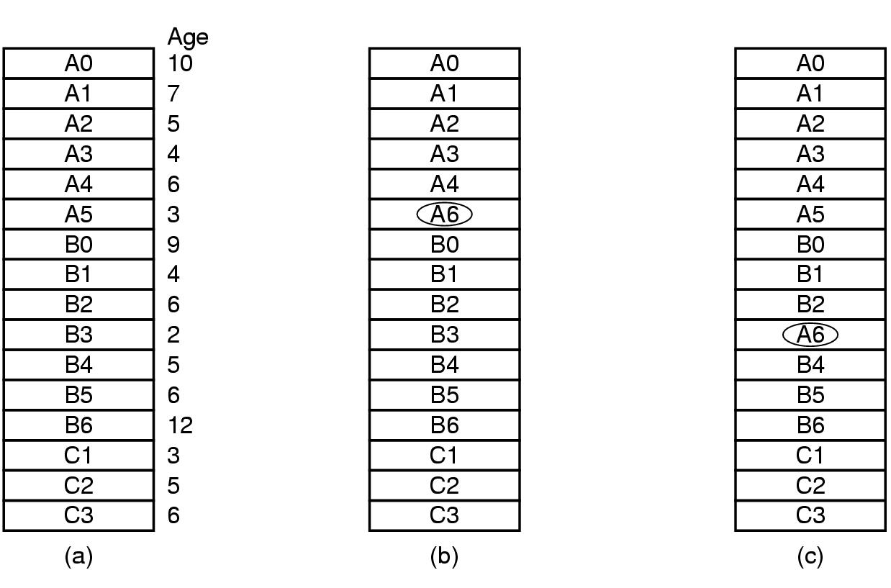
Replacement Scope (2)
Example
  Processes A, B, and C make up the set of runnable processes. Suppose A gets a page fault.
Figure 3-22 Local versus global page replacement
(a) Original configuration
(b) Local page replacement
(c) Global page replacement

Slide 8
Replacement Scope (3)
Comparison
  Local Replacement
    Might slow a process unnecessarily as less used memory not available for replacement.
  Global Replacement
    Process can’t control own page fault rate – depends also on paging behavior of other processes (erratic execution times).
    Generally results in greater throughput.
    More common method.

Slide 9
Resident Set Size (1)
Fixed Allocation Policy
  Allocates a fixed number of frames to a process at load time by some criteria:
    Equal allocation
      E.g., with 12416 available page frames and 10 processes, each process gets 1241 frames, the remaining 6 go into a pool to be used when page faults occurs.
    Proportional allocation
      E.g. a 300-KB process gets 30 times the allotment of a 10-KB process.
    Priority allocation
      Use a proportional allocation scheme using process priorities rather than size.

Slide 10
Resident Set Size (2)
Variable Allocation Policy
  The number of frames for a process may vary over time.
    Increase if page fault rate is high.
    Decrease if page fault rate is very low.
  Requires OS overhead to assess behavior of active processes.

Slide 11
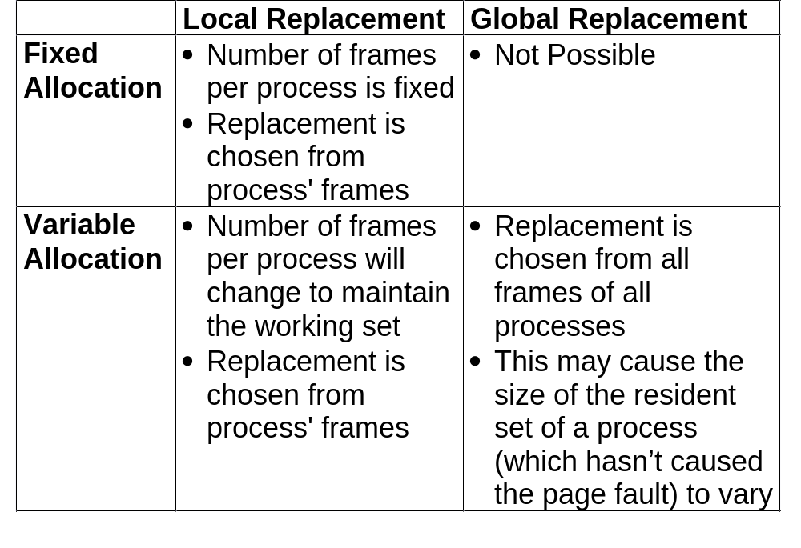
Allocation vs Scope

Slide 12
Fixed Allocation, Local Scope
Frame number per process is decided beforehand and can't be changed.
  Determined at load time and depends on application type.
Problem: difficult to determine ahead of time a good number for the allocated frames.
  Too Small: High page faults, poor performance.
  Too Large: Small number of processes, high processor idle time and/or swapping.
Example: P223 Figure 3-22 (b)

Slide 13
Variable Allocation, Global Scope
Easiest to implement
  Adopted by many OS (like Unix SVR4).
When a page fault occurs, a free frame is added to the resident set of the process who experiences a page fault and the page is brought up in that frame.
Harder to determine who should lose a page; the selection is made among all the frames in the memory (except the locked ones), there is no discipline to determine which process should lose a page from its resident set.
  May remove a page from a process that needs it.
Example: P223 Figure 3-22 (c)

Slide 14
Variable Allocation, Local Scope
May be the best combination (used by Windows NT).
Allocate at load time a certain number of frames to a new process based on application type.
  Use either pre-paging or demand paging to fill up the allocation.
When a page fault occurs, select the page to replace from the resident set of the process that suffers the fault.
Example: working set model

Slide 15
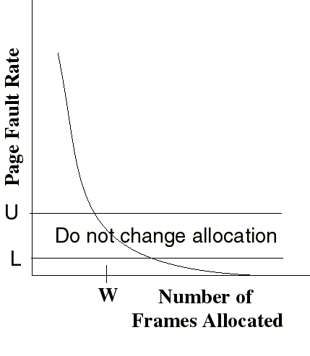
Page Fault Frequency Algorithm (PFF)
Define an upper bound U and lower bound L for page fault rates.
Allocate more frames to a process if fault rate is higher than U.
Allocate fewer frames if fault rate is < L.
The resident set size should be close to the working set size W.
Suspend a process if the PFF > U and no more free frames are available
thrashing
Add frames
Decrease frames

Slide 16
Load Control (1)
Load Control
  How many processes may be started to run and reside in main memory simultaneously.
Despite good designs, system may still thrash.
  Whenever the combined working sets of all processes exceed the capacity of memory, thrashing can be expected.
  When PFF algorithm indicates
    Some processes need more memory.
    But no processes need less.

Slide 17
Load Control (2)
Solution: Reduce number of processes competing for memory.
  Swap one or more to disk, divide up pages they held.
  Note: When deciding which process to swap out, consider not only process size and paging rate, but also its characteristics and what characteristics the remaining processes have.

Slide 18
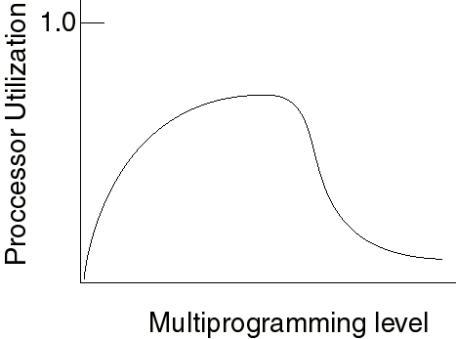
Load Control (3)
Reconsider degree of multiprogramming-- Determines the number of processes that will be resident in main memory (ie: the multiprogramming level)
  Too few processes: often all processes will be blocked and the processor will be idle.
  Too many processes: the
  resident size of each
  process will be too small
  and flurries of page faults
  will result thrashing.

Slide 19
Page Size (1)
How to select a page size?
  Tradeoffs
    Memory utilization-better with smaller pages because of internal fragmentation.
    Capturing locality-better with smaller pages because of better resolution.
    Size of the page table-to keep it relatively small, we need bigger pages
    I/O time-latency/throughput characteristics call for bigger pages

Slide 20
Page Size (2)
Small Page Size
  Advantages
    Less internal fragmentation
    Better with locality of reference
  Disadvantages
    Larger page table
    More page faults
    More overhead in reading/writing of pages

Slide 21
Page Size (3)
Big Page Size
  Advantages
    Smaller page table
    Less page faults
    Less overhead in reading/writing of pages
  Disadvantages
    More internal fragmentation
    Worse locality of reference

Slide 22

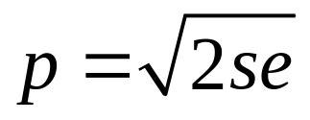
Page Size (4)
Overhead due to page table and internal fragmentation
  Where
    s = average process size in bytes
    p = page size in bytes
    e = page entry size in bytes
page table space
internal fragmentation
Optimized when
s=1MB, e=8, p=4KB

Slide 23
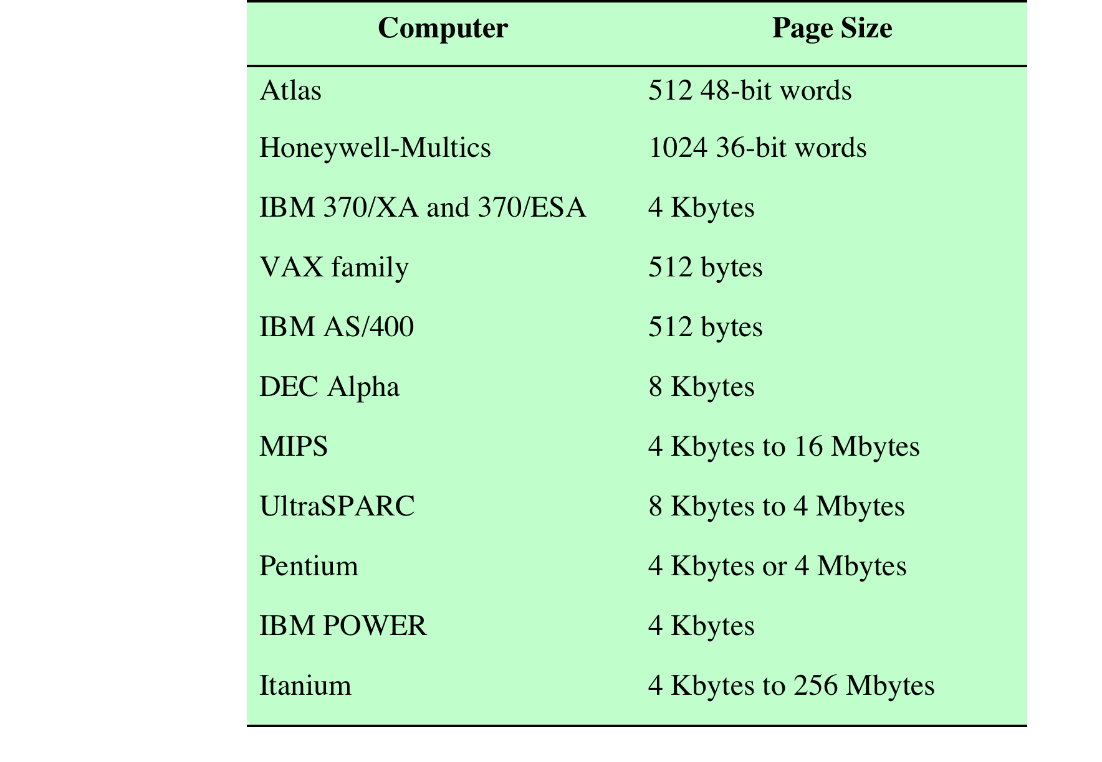
Page Size (5)
Example Page Size

Slide 24
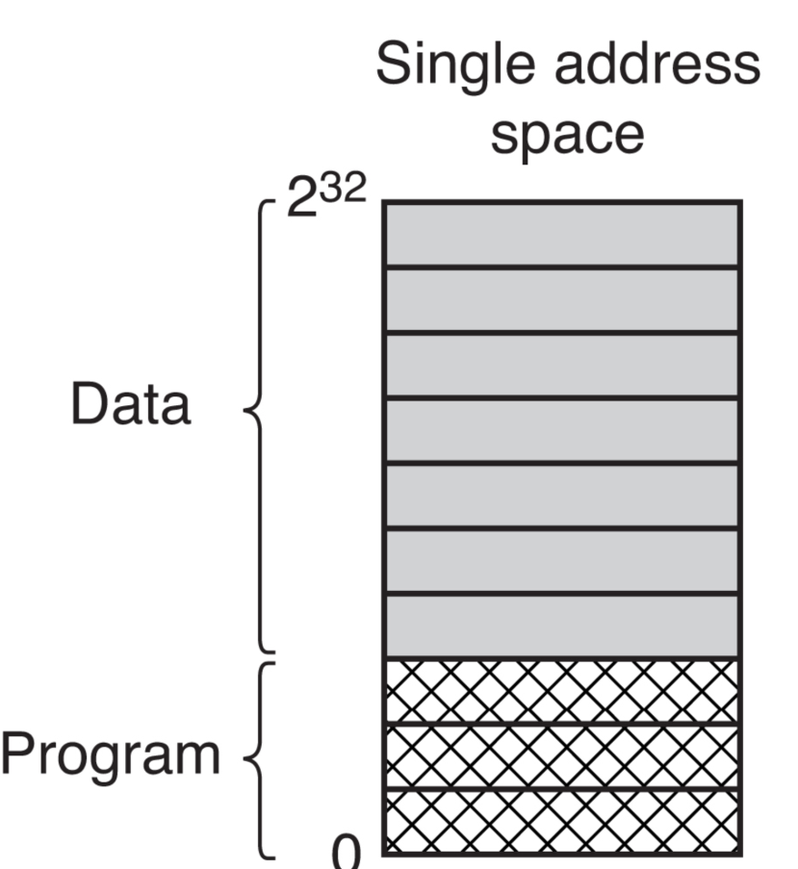
Separate Instruction and Data Spaces (1)
Most computers have a single address space.
What if it’s too small?
Figure 3-24 (a) One address space

Slide 25
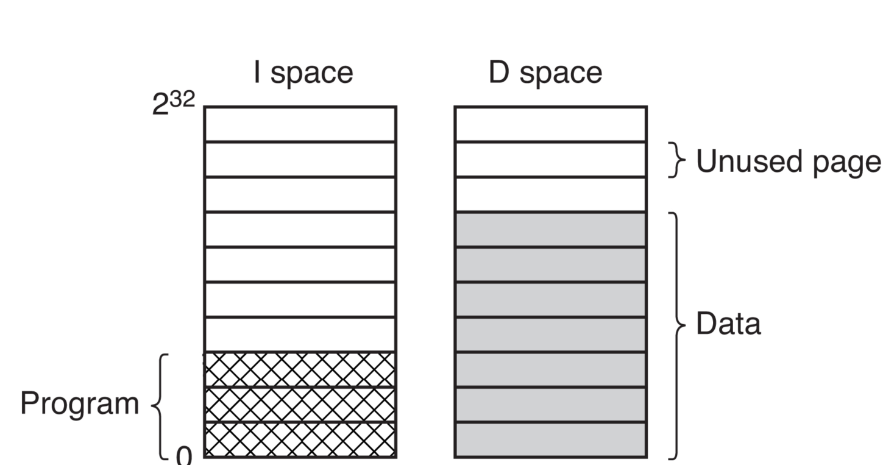
Separate Instruction and Data Spaces (2)
Solution in 16-bit PDP-11 Machines
  Separate data and program address spaces.
  Two independent spaces, two paging systems.
  The linker must know about the two address spaces.
Figure 3-24 (b) Separate I and D spaces

Slide 26
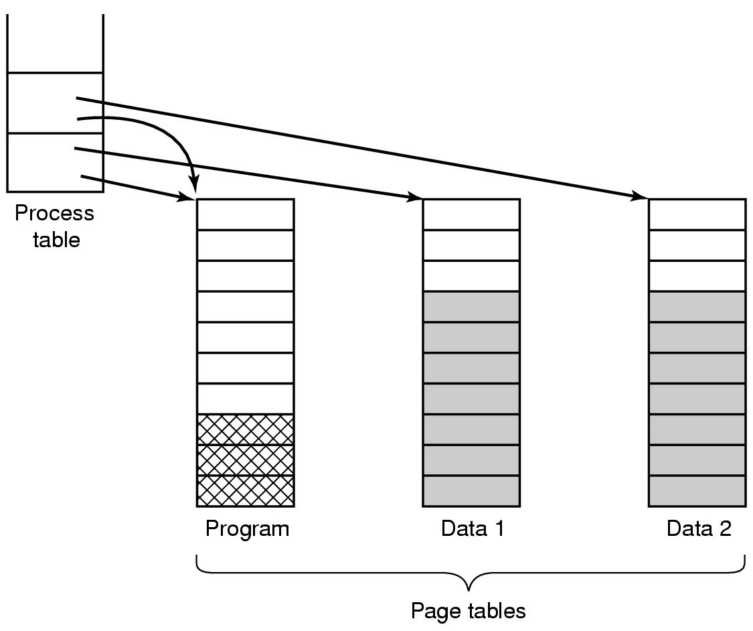
Shared Pages (1)
Sharing code: Pages that are read-only can be shared.
Separate instruction and data space, easy to share code.
  Example: Two processes share the same program by using the same I-space page table and different D-space page table.
Figure 3-25
Notes:
A relative jump forward to a location on the same page is position independent code. So is an offset of a data byte in a data structure if the data structure can be stored on one page.
However, virtual addresses cannot be stored in a shared page if they refer to page addresses that are mapped differently in the different virtual memories that share them.

Slide 27
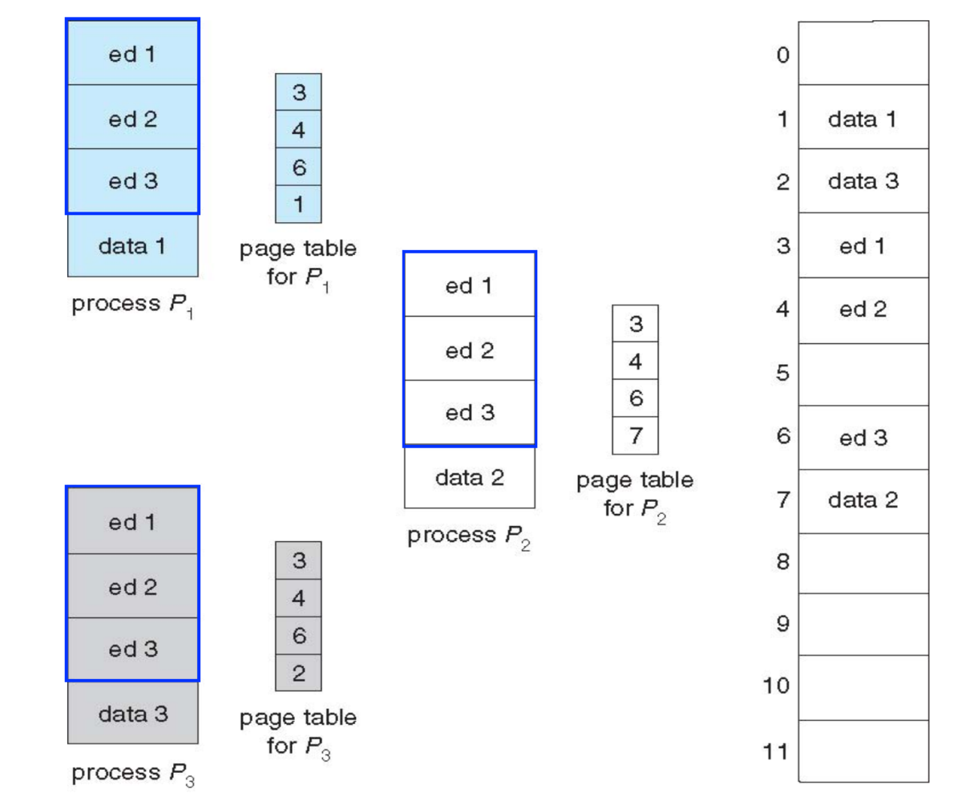
Shared Pages (2)
Unite instruction and data space, complex to share code.
  Example: a text editor
  What if scheduler
  removes a process
  from memory?
  What if a process
  terminates?

Slide 28
Shared Pages (3)
Sharing Data
  In UNIX, after a fork system call, the parent and child are required to share both program text and data.
  No copying pages is done at fork time.
    Give the parent and the child process its own page table.
    Have both processes point to the same set of pages.
    Shared data pages must be read only.
  Question: What if either process updates a memory word?

Slide 29
Shared Pages (4)
Sharing Data (ctd.)
  Copy-on-Write (COW)
    If a process writes to a frame
      Trap to kernel.
      Kernel allocates new frame.
      Copy the old frame.
      Restart the write instruction.

Slide 30
Shared Pages (5)
Sharing Data (ctd.)
  Copy-on-Write Example
physical memory
process₁
process₂
page A
page B
page C
Fig. Before process₁ modifies page C.

Slide 31
Shared Pages (6)
Sharing Data (ctd.)
  Copy-on-Write Example (ctd.)
physical memory
process₁
process₂
page A
page B
page C
Copy of page C
Fig. After process₁ modifies page C.

Slide 32
Shared Pages (7)
Question
  Can a page be in two working sets at the same time? Explain.
Solution
  If pages can be shared, yes. For example, if two users of a timesharing system are running the same editor at the same time, and the program text is shared rather than copied, some of those pages may be in each user’s working set at the same time.

Slide 33
Shared Libraries (1)
Source
(.c, .cc)
From Source to
Execution
  Most compilers produce
  relocatable object code.
  The linker combines
  multiple object files and
  library modules into a
  single executable file.
  The Loader reads the
  executable file.
Compiler
Object
(.o)
Other Objects
(.o)
Linker
Static libraries
(.a)
Executable
Dynamic libraries
(.dll)
Loader
In-memory Image
From Source to Execution

Slide 34
Shared Libraries (2)
Static Linking
  Static linking is the process of copying all relocatable object files and library modules used in the program into the final executable image.
  Carried out only once to produce an executable file.
  Static linking is performed by programs called linkers.
  If static libraries are called, the linker will copy all the modules referenced by the program to the executable.

Slide 35
Shared Libraries (3)
Static Linking (ctd.)
Printf.c
HelloWorld.c
gcc
Static Library
gcc
Printf.o
ar
HelloWorld.o
Linker
a.Out
(or name of
your command)
Loader
Memory

Slide 36
Shared Libraries (4)
Static Libraries
  Consist of routines that are compiled and linked directly into your program.
  Windows: .lib; linux: .a
  Advantage
    Easy to use; no dependency problem after compilation.
  Disadvantages
    The executable size will be larger.
    Require re-linking when libraries changed.

Slide 37
Shared Libraries (5)
Dynamic Linking
  Complete linking postponed until running time.
  Program only includes a stub for each library routine. When stub is first executed, the routine is loaded into memory, and the stub is replaced with the address of the routine.
  If shared libraries are called
    Only copy a little reference information when the executable file is created.
    Completing the linking during loading time or running time.

Slide 38
Shared Libraries (6)
Dynamic Linking (ctd.)
Printf.c
HelloWorld.c
gcc
gcc
Printf.o
HelloWorld.o
Linker
ar
a.Out
(or name of
your command)
Shared Library
Run-time
Loader
Loader
Memory

Slide 39
Shared Libraries (7)
Shared Libraries
  Consist of routines that are loaded into your application at run time.
  Allow multiple processes to share the same code segment.
  Windows: .dll; linux: .so
  Advantages
    Making executable files smaller and saving space in memory.
    If a function in a shared library is updated to remove a bug, it is not necessary to recompile the programs that call it.

Slide 40
Shared Libraries (8)
Shared Libraries (ctd.)
  Disadvantages
    Slow application at start time.
    Dependent on the libraries when execution.

Slide 41
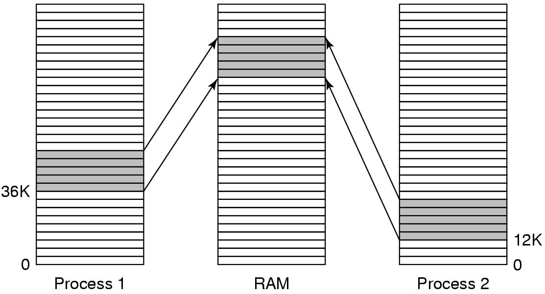
Shared Libraries (9)
Problem in Shared Libraries
  A 20KB shared library located at a different address in each process. Suppose that the first function in the library has to jump to address 16 in the library.
Figure 3-26. A shared library being used by two processes.

Slide 42
Shared Libraries (10)
Problem in Shared Libraries (ctd.)
  Solution
    Copy-on-Write? Defeats the purpose of sharing the library.
    Compile shared libraries with a special compiler flag telling the compiler not to produce any instructions that use absolute addresses.
      Jump forward/backward by n bytes
      Code must be position independent
      At runtime, references are resolved as
      Library_relative_address + library_base_address

Slide 43
Mapped Files (1)
Memory-Mapped Files
  A process can issue a system call to map a file onto a portion of its virtual space.
    E.g. mmap( ) in Linux
  Shared libraries are really a special case of memory-mapped files.
Virtual Address space
Foo.txt

Slide 44
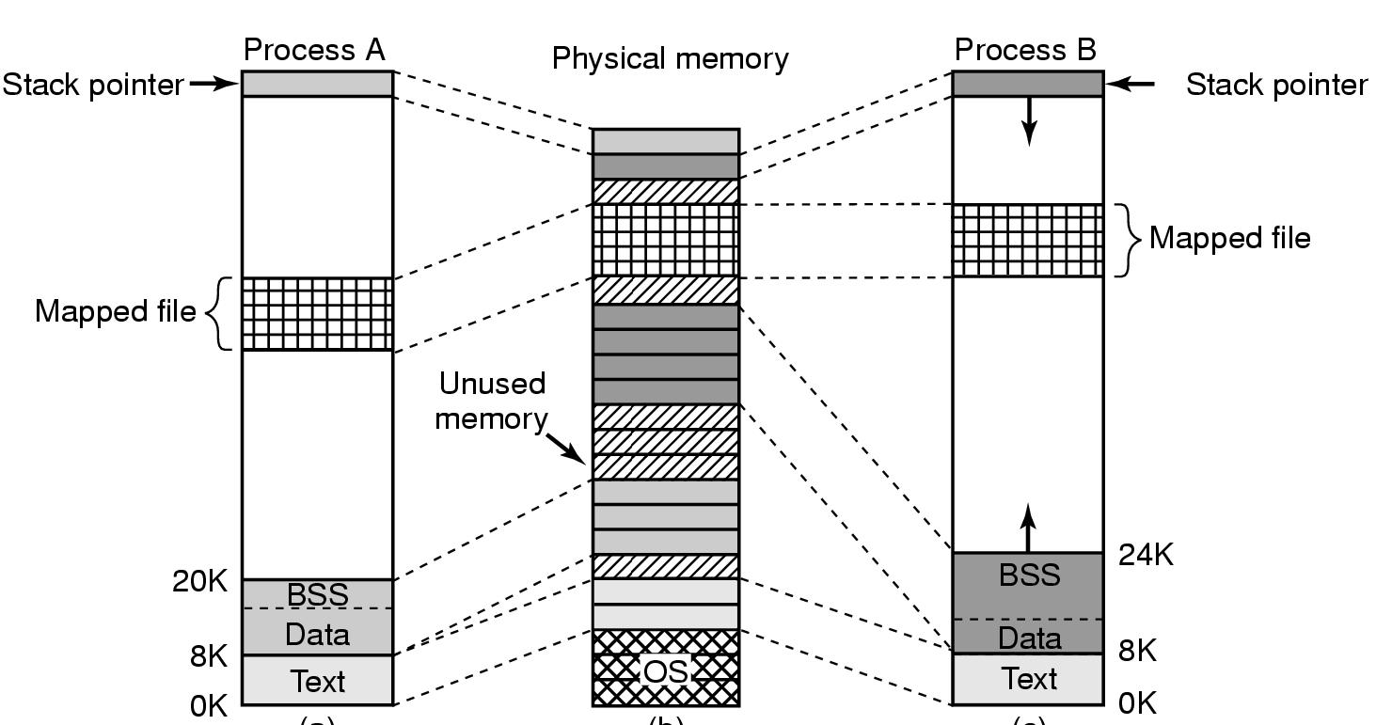
Mapped Files (2)
Example of Sharing Memory Mapped File
Figure 10-13. Two processes can share a mapped file.
Notes:
cs431-cotter

Slide 45
Cleaning Policy
Cleaning Policy
  Deciding when a modified page should be written out to secondary memory.
Demand Cleaning
  Write page out only when its frame has been selected for replacement (the process that page faulted has to wait for 2 page transfers).
Precleaning
  Modified pages are written in batches before their frames are needed
    But some of these pages get modified a second time before their frames are needed.

Slide 46
Implementation Issues for Paging
Operating System Involvement with Paging
Page Fault Handling
Instruction Backup
Locking Pages in Memory
Backing Store

Slide 47
Operating System Involvement with Paging (1)
Four times when OS is involved with paging
  Process Creation Time
    Determine program and data size
    Create page table
    Allocate memory space for page table & initialize
    Allocate space in disk swap area & initialize
    Record info about page table and disk swap area in process table
  Process Execution Time
    Reset the MMU for new process
    Flush the TLB
    Copy page table of new process

Slide 48
Operating System Involvement with Paging (2)
Four times when OS is involved with paging (ctd.)
  Page Fault Time
    Determine virtual address causing fault, compute the needed page, locate the page on the disk.
    Swap target page out, needed page in.
    Back up PC, restart faulting instruction.
  Process Termination Time
    Release page table
    Return pages to the free pool

Slide 49
Page Fault Handling (1)
Sequence of Events on a Page Fault
  1. The hardware traps to the kernel, saving the PC on the stack. Save some info about the instruction in special CPU registers.
  2. Save the general registers and other volatile info.
  3. OS determines which virtual page needed
  4. OS checks validity of virtual address and the protection consistent with the access
    No, kill or send a signal to the process
    Yes, seek free page frame or run page rep algorithm

Slide 50
Page Fault Handling (2)
Sequence of Events on a Page Fault (ctd.)
  5. If selected frame is dirty, write it to disk. Suspend the process, let another process run until the disk transfer completed.
  6. OS brings/schedules new page in from disk. Suspend the process and let another available process run.
  7. Transfer completed, disk interrupt. Page tables updated.
  8. Faulting instruction backed up to when it began.
  9. Faulting process scheduled.
  10. Registers restored, program continues.

Slide 51
Instruction Backup (1)
Problem: page fault happens in the middle of instruction execution
  Stopped part way through, traps to OS for fault handling, OS returns to instruction.
  Must re-start instruction.
  Easier said than done!

Slide 52
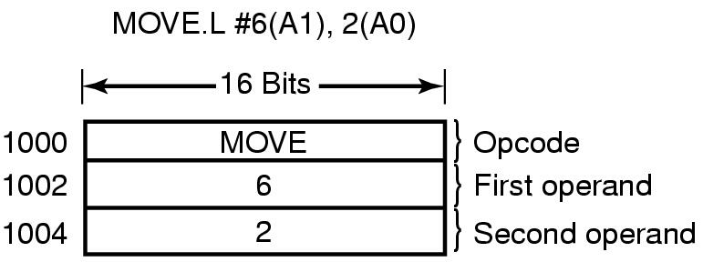
Instruction Backup (2)
Example
  Consider a CPU that has instructions with two addresses.
  MOV.L #6(A1), 2(A0) (instruction length=6 bytes)
  Page fault may occur in 1000, 1002, or 1004
  Where to re-start the instruction? PC depends on which part of the instruction actually faulted. If it faults at 1002, how does OS know that instruction starts at 1000?.

Slide 53
Instruction Backup (3)
Worse yet: Auto-incrementing loads registers either before or after instruction is executed. Do it before and needs to be un-done. Do it afterwards and must not do it.
Hardware Solution to Instruction Backup
  Copy the PC to a hidden internal register before each instruction is executed.
  A second register telling which registers have already been incremented or decremented, and by how much.
OS uses info provided by hardware to undo all the effects of the faulting instruction.

Slide 54
Locking Pages in Memory (1)
Virtual memory and I/O occasionally interact.
P1 issues call for read from device into buffer.
  While it’s waiting for I/O, P2 runs.
  P2 has a page fault.
  P1’s I/O buffer might be chosen to be paged out.
  This can create a problem because an I/O device is going to write to the buffer on P1’s behalf.

Slide 55
Locking Pages in Memory (2)
Solution1: Allow some pages to be locked into memory.
  Locked pages are immune from being replaced.
  Pages only stay locked for (relatively) short periods.
Solution2: Do all I/O to kernel buffers, and then copy the data to user pages later.

Slide 56
Backing Store (1)
Pages removed from memory are stored on disk.
Where are they placed?
  A swap area is designated where chunks of it are allocated to the processes when started.
    The swap area can be initialized with an entire copy of the process image. Any pages can be brought in as needed. (Static partition)
    Or load the entire process in memory and let it be pages out as needed. (Dynamic partition)

Slide 57
Backing Store (2)
Static Partition: Allocate fixed partition to process when it starts up.
  Manage as list of free chunks. Assign big enough chunk to hold process.
  Starting address of partition kept in process table. Page offset in virtual address space corresponds to address on disk.
  Can assign different areas for data, text , stack as data and stack can grow.

Slide 58
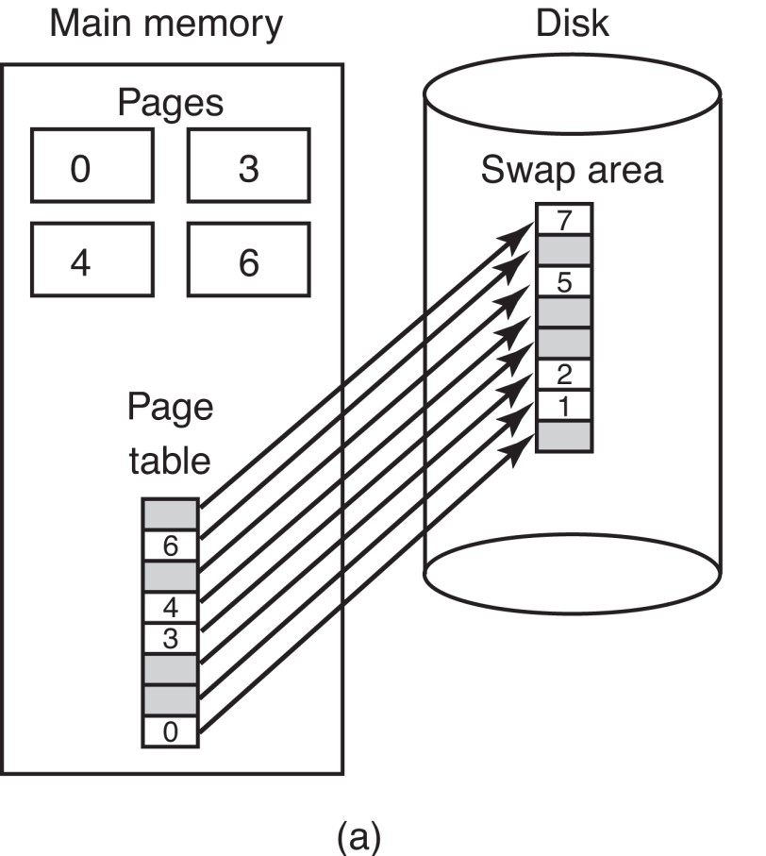
Backing Store (3)
Figure 3-28 (a)Paging to a static swap area

Slide 59
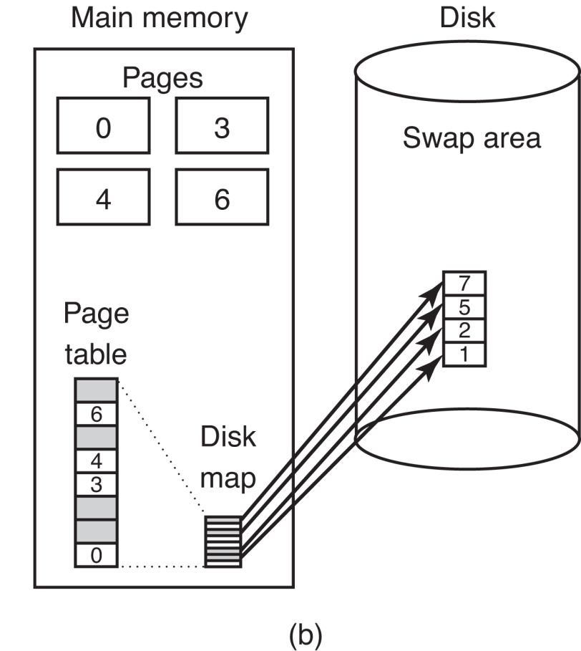
Backing Store (4)
Dynamic Partition
  Don’t allocate disk space in advance. Swap pages in and out as needed.
  Need disk map in memory.
Figure 3-28 (b)Backing up pages dynamically

Slide 60
Homework
P258: 38

