Slide 1
Modern Operating Systems
Chapter 3 – Memory Management
Zhang Yang
Autumn 2019

Slide 2
Contents of the Lecture
3.1 No Memory Abstraction
  Mono program without memory abstraction
    Overlays
  Multiple programs without memory abstraction
3.2 A Memory Abstraction: Address Spaces
  The notion of an address space
  Dynamic Relocation
  Swapping
  Managing Free Memory
  Storage Placement Strategy

Slide 3
Storage Hierarchy (1)
Ideally programmers want memory that is
  Large
  Fast
  Cheap
  Nonvolatile
Memory Hierarchy
  Small amount of fast, expensive, volatile cache memory
  Some medium-speed, medium price, volatile main memory (RAM)
  Gigabytes of slow, cheap, nonvolatile disk storage
Memory manager handles the memory hierarchy.

Slide 4
Storage Hierarchy (2)
Cost
Size
CPU Reg
Cache
Memory
Secondary Storage

Slide 5
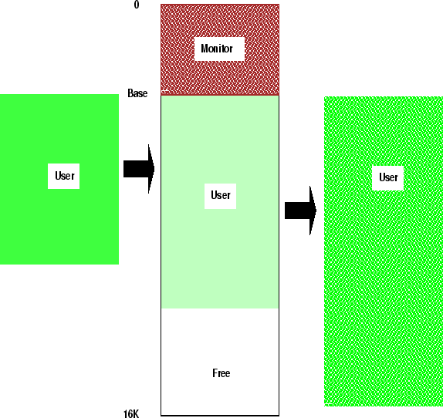
Memory Manager
Manage memory hierarchy
  Monitor used and free memory
  Allocate memory to processes
  Reclaim (De-allocate) memory
  Swapping between main memory and disk

Slide 6
Memory Allocation Schemes
Contiguous Memory Allocation (3.1 & 3.2)
  Each programs data and instructions are allocated a single contiguous space in memory.
Non-Contiguous Memory Allocation
  Each programs data and instructions are allocated memory space that is not continuous.
  E.g. Virtual Memory- Paging

Slide 7
No Memory Abstraction
Early mainframe, early minicomputers, early personal computers had no memory abstraction…
  E.g.MOV REGISTER1, 1000
    Here 1000 means move the content of physical memory address1000 to register
No abstraction memory still used in embedded and smart card systems.
  Radios
  Washing machines
  Microwave ovens
  …

Slide 8
Mono Program without Memory Abstraction (1)
Three different ways to organize memory
  (a) OS at the bottom of memory in RAM; was used in mainframes and minicomputers; not used anymore.
  (b) OS is in ROM at the top of memory; is used in some palm-tops and embedded systems
  (c) Device drivers are in ROM at the top of memory and the rest is in RAM; was used by early PCs (e.g., running MS-DOS), where the portion in the ROM is called BIOS (Basic Input Output System).
  Disadvantage of (a) and (c) : A bug in the program can wipe out the OS, possibly with disastrous results (such as garbling the disk)

Slide 9

Mono Program without Memory Abstraction (2)
Three different ways to organize memory (ctd.)
Figure 3-1. Three simple ways of organizing memory with an operating system and one user process.
Notes:
(a)和（c）的缺点是用户程序出现的错误可能摧毁操作系统。

Slide 10
Mono Program without Memory Abstraction (3)
Single Partition Allocation
Advantages
  It is simple.
  It is easy to understand and use.
Disadvantages
  It leads to poor utilization of processor and memory.
  Users job is limited to the size of available memory.
What to do when program size is larger than the amount of memory/partition (that exists or can be) allocated to it?
  Overlays (past)
  Dynamic Linking (Libraries – DLLs)(now)

Slide 11
Overlays
If a process is larger than the amount of memory, a technique called overlays can be used.
Overlays is to keep in memory only those instructions and data that are needed at any given time.
When other instructions are needed, they are loaded into space that was occupied previously by instructions that are no longer needed.
Overlays are implemented by programmer, no special support needed from operating system, programming design of overlay structure is complex.
Notes:
The programmer divided the program into a number of logical sections. A small portion of the program had to remain in memory at all times, but the remaining sections (or overlays) were loaded only when they were needed.

Slide 12
Overlays Example (1)
Consider a two-pass assembler
  Pass1 constructs a symbol table.
  Pass2 generates machine-language code.
  Assume the following:
  To load everything at once, we need 200k of memory.
 | Size (k = 1024 bytes)
Pass1 | 70k
Pass2 | 80k
Symbol table | 20k
Common routines | 30k
Total size | 200k

Slide 13
Overlays Example (2)
Consider a two-pass assembler (ctd.)
  If only 150K memory is available, we cannot run our process.
  Note: Pass1 and Pass2 do not need to be in memory at same time.
  Define two overlays:
    Overlay A: symbol table, common routines, and Pass1.
    Overlay B: symbol table, common routines, and Pass2.
  Overlay Manager/Driver
    Responsible for loading and unloading on overlay segment as per requirement.

Slide 14
Overlays Example (3)
Consider a two-pass assembler (ctd.)
  Add overlay driver 10k and start with overlay A in memory.
  When finish Pass1, we jump to overlay driver, which reads overlay B into memory overwriting overlay A and transfer control to Pass2.
  Overlay A needs 130k and Overlay B needs 140k.
Symbol table (20k)
Common routines(30k)
Overlay driver(10k)
Pass1 (70k)
Pass2 (80k)

Slide 15
Problems of Overlays
Difficult for programmers to manage
  Requires programmers to organize overlay structure of program with the help of file structures etc.
  Requires programmers to specify which overlay to load at different circumstances.
Not possible to access overlays that are not loaded in the memory.

Slide 16
Memory and Multiprogramming
Memory needs two things for multiprogramming:
  Relocation
  Protection
Relocation
  Process may not be placed back in same main memory region!
  How does a task or process run in different locations in main memory?
Protection
  How does the system prevent processes interfering with each other?
  Must be ensured by processor (hardware) rather than OS.

Slide 17
Multiple Programs Without Memory Abstraction
With Swapping Technique
Without Swapping Technique

Slide 18
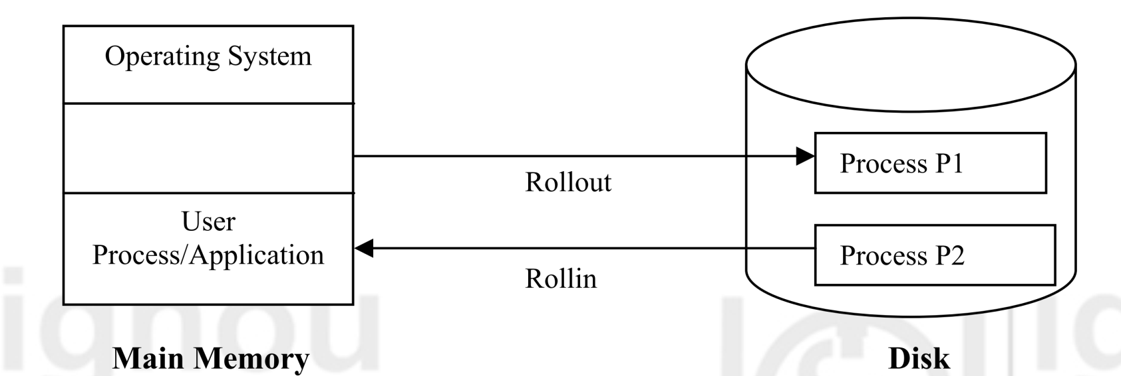
With Swapping
Swapping is an approach for memory management by bringing each process in entirely, running it and then putting it back on the disk, so that another program may be loaded into that space.

Slide 19
Without Swapping (1)
With the addition of some special hardware, it is possible to run multiple programs concurrently.
Protection Solution of Early IBM 360
  Divide main memory into 2KB blocks.
  Assign each block a 4-bit protection key held in special registers inside the CPU.
    E.g. A machine with a 1M memory
      Need 512 4-bit registers→256 bytes of key storage
  Each process also has a protection key value associated with it. (kept in PSW)
  On a memory access the hardware checks that the current process's protection key matches the value associated with the memory block being accessed; if not, an exception occurs.

Slide 20
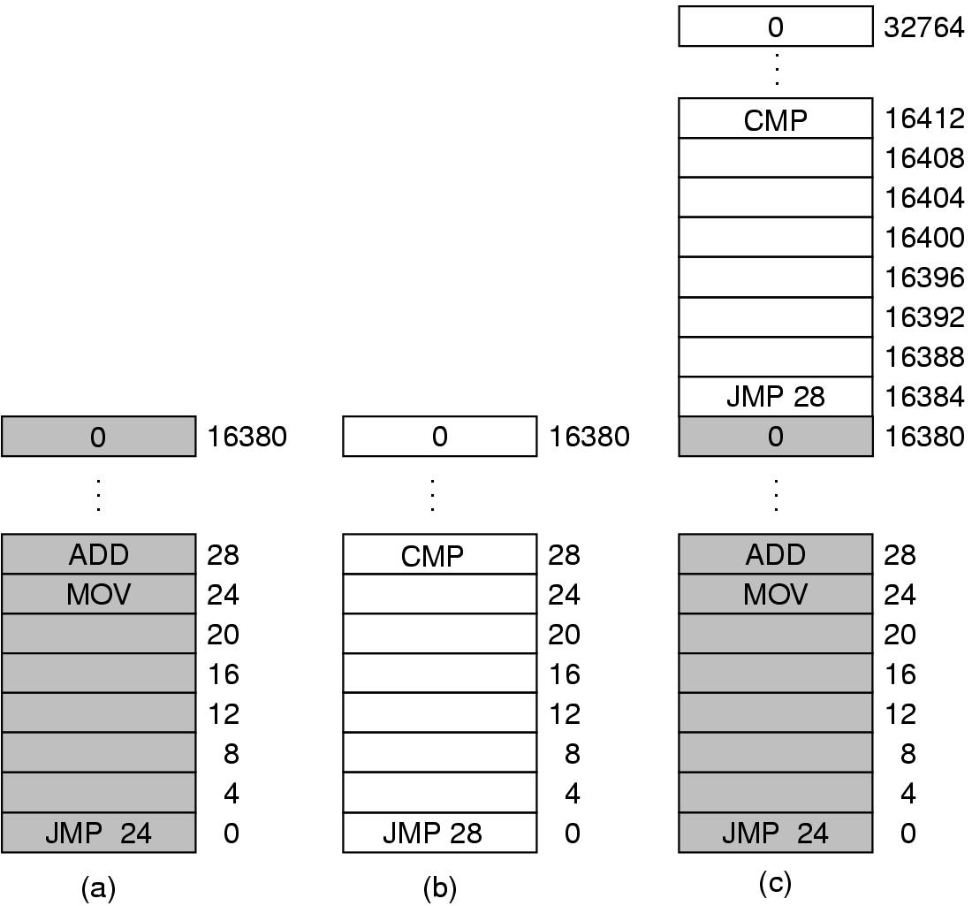
Without Swapping (2)
Relocation Problem of Early IBM 360
  Example: two programs, each is 16KB.
    (a) 16 KB program runs alone. Finishes.
    (b) OS loads new 16KB program. Finishes
    (c) OS tries to run multiple programs. Instead of
    evicting old program, adds new one above it.
  Problem
    Two programs both
    reference static, physical
    addresses.
    JMP 28 causes an error!
Figure 3-2. Illustration of the relocation problem.

Slide 21
Without Swapping (3)
Static Relocation
  Modify addresses statically (similar to linker) when load process.
  Example: two programs, each is 16KB.
    28+16384=16412
JMP 16412

Slide 22
Without Swapping (4)
Static Relocation (ctd.)
  Advantage
    Requires no hardware support.
  Disadvantages
    Slows down loading.
    Once loaded, the code or data of the program can’t be moved into the memory without further relocation.
    The loader needs some way to tell what is an address and what is a constant.
      E.g. MOVE REGISTER1, 28
data or address?

Slide 23
A Memory Abstraction: Address Space (1)
Major drawbacks of exposing physical memory to process
  If user programs can address every byte of memory, they can easily trash the operating system.
  It is difficult to have multiple programs running at once (take turns, if there is only one CPU).

Slide 24
A Memory Abstraction: Address Space (2)
Recall: Memory needs two things for multiprogramming.
  Relocation
    How does a task or process run in different locations in main memory?
  Protection
    How does the system prevent processes interfering with each other?

Slide 25
A Memory Abstraction: Address Space (3)
The Notion of an Address Space
  Address Space
    The set of addresses that a process can use to address memory (abstract memory for programs to live in).
  Each process has its own address space; independent of other processes.
  Address Binding
    The process of associating program instructions and data (addresses) to physical memory addresses is called address binding, or relocation.

Slide 26
A Memory Abstraction: Address Space (4)
Dynamic Relocation (Dynamic Binding)
  Map each process’s address space onto a different part of physical memory.
  Require Hardware Support
    Equip CPU with two special hardware registers: base and limit
    Base register: start location for address space
    Limit register: size limit of address space
    These values are set when the process is loaded and when the process is swapped in.

Slide 27
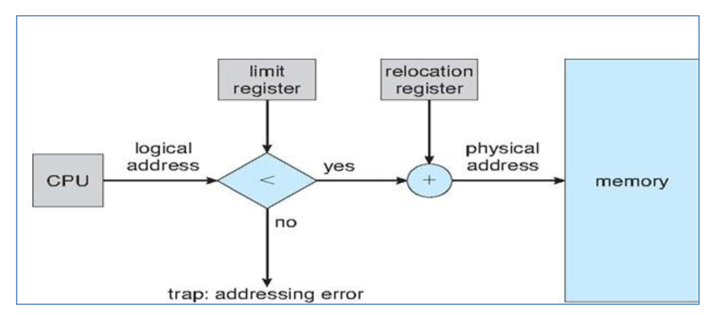
A Memory Abstraction: Address Space (5)
Dynamic Relocation (ctd.)
  Relocation Address Calculation
base register

Slide 28
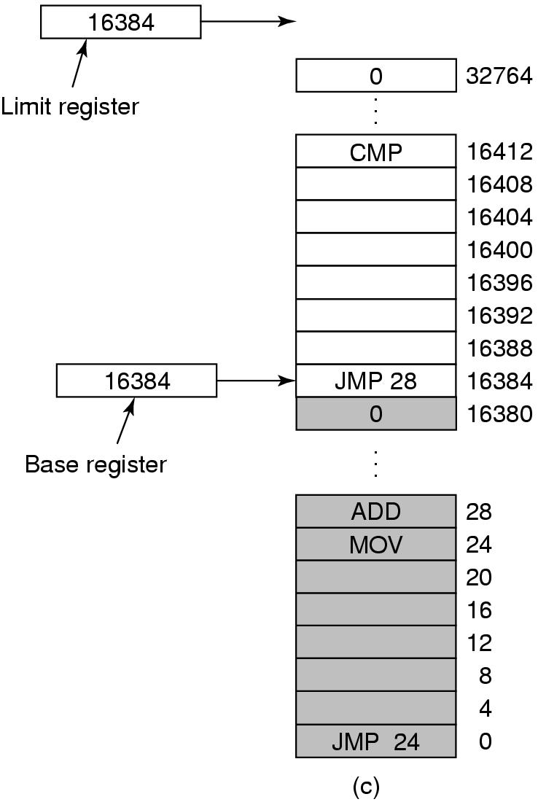
A Memory Abstraction: Address Space (6)
Dynamic Relocation (ctd.)
  Example: two programs,
  each is 16KB.
    First program
      Base register: 0
      Limit register: 16384
    Second program
      Base register: 16384
      Limit register: 16384
Figure 3-3. Base and limit registers can be used to give each process a separate address space.

Slide 29
A Memory Abstraction: Address Space (8)
Dynamic Relocation (ctd.)
  Advantages
    OS can easily move process during execution.
    OS can allow process to grow over time.
      OS just changes limit register or moves it
    Simple, fast hardware
      Two special registers, add, & compare
  Disadvantages
    Slows everything (add on every reference)
    Can’t share memory between processes
    Process limited to physical memory size
    Complicates memory management

Slide 30



Address Binding (1)
Address binding of instructions
and data to memory addresses
can happen at three different
stages.
  Compile time
  Load time
  Execution time
Multi-step Processing of a User Program

Slide 31
Address Binding (2)
Compile-Time Binding
  Location of program in physical memory must be known at compile time.
  The compiler or assembler translates symbolic addresses (e.g., variables) to absolute addresses.
  Loading ≡ copying executable file to appropriate location in memory
  If starting location changes, program will have to be recompiled
  Example: .COM programs in MS-DOS
Notes:
relocatable address - relative address (14 bytes from the beginning of this module)

Slide 32
Address Binding (3)
Load-Time Binding
  Compiler generates relocatable code
    Compiler binds names to relative addresses (offsets from starting address)
    Compiler also generates relocation table
  Linker resolves external names and combines object files into one loadable module
  (Linking) loader converts relative addresses to physical addresses
  No relocation allowed during execution

Slide 33
Address Binding (4)
Run-Time Binding
  Programs/compiled units may need to be relocated during execution.
  CPU generates relative addresses
  Relative addresses bound to physical addresses at runtime based on location of translated units.
  Suitable hardware support required.

Slide 34
Two Relocation Policies (1)
Depending upon when and how the addresses translation from the logical address to physical address of main memory, takes place
Static Relocation
  Programs are loaded into consecutive memory locations wherever there is room and without relocation during loading.
  At load time, OS adjusts addresses in process to reflect position in memory.
  OS cannot move process after relocation.
  Example: OS/MFT

Slide 35
Two Relocation Policies (2)
Dynamic Relocation
  Run-time mapping of logical address into physical address with the support of some hardware mechanism.
  Hardware adds base register to logical address to get physical address.

Slide 36
Swapping (1)
If there isn’t room enough in memory for all processes, some processes can be swapped out to make room.
  OS swaps a process out by storing its complete state to disk.
  OS can reclaim space used by ready or blocked processes.
When process becomes active again, OS must swap it back in (into memory)
  With static relocation, the process must be replaced in the same location.
  With dynamic relocation, OS can place the process in any free partition (must update the base and limit registers).
Swapping and dynamic relocation make it easy to increase the size of a process and to compact memory (although slow!)

Slide 37

Swapping (2)
Example
Figure 3-4. Memory allocation changes as processes come into memory and leave it. The shaded regions are unused memory.

Slide 38
Swapping (3)
Context Switch
  Swapped in & out cost too much
  Assume: process size 1MB, disk transfer rate 5MB/sec, average latency 8ms
    Transfer time =1MB / (5MB/sec) = 1/5 sec = 200 ms
    Swap time = 208 ms
    Swap out & in = 416 ms
  Major part of swap time is transfer time.
  For RR scheduling, time quantum should >> 416ms
Modified versions of swapping are found on many systems (i.e., UNIX, Linux, and Windows).

Slide 39
Swapping (4)
How to allocate when a process is created or swapped in?
  If process are created with a fixed size, OS allocates exactly what is needed.
  What if most processed will grow as they run?
    E.g. one growing segment: data segment
    E.g. two growing segment: stack segment and data segment

Slide 40

Swapping (5)
Solution for Growing Process
Figure 3-5. (a) Allocating space for growing data segment.
(b) Allocating space for growing stack, growing data segment.

Slide 41
Problems of Swapping (1)
Problem 1
  Swapping creates holes in memory (external fragmentation).
    Can be solved using compaction.
Compaction
  Memory contents shuffled to place all free memory together in one large block.
  Dynamic relocation (run-time binding) needed.

Slide 42
Problems of Swapping (2)
Compaction Example
  Assumes programs are all relocatable
  Processes must be suspended during compaction
  Need be done only when fragmentation gets very bad
1
Monitor
Job 7
Job 5
Job 3
Job 8
Free
Job 6
2
Monitor
Job 7
Job 5
Job 3
Job 8
Free
Job 6
3
Monitor
Job 7
Job 5
Job 3
Job 8
Free
Job 6
4
Monitor
Job 7
Job 5
Job 3
Job 8
Free
Job 6
5
Monitor
Job 7
Job 5
Job 3
Job 8
Job 6
Free

Slide 43
Problems of Swapping (3)
Problem 2
  Process must fit into physical memory (impossible to run larger processes)
    Can be solved using overlays

Slide 44
Managing Free Memory
How to keep track of memory usage
  Bitmaps and free lists
Bitmap
  Dividing memory into small units; corresponding to each unit is a bit in the bitmap; 0 if the unit is free, 1 if units is occupied.
  When allocate, memory manager has to find consecutive 0 bits.
Linked Lists
  Each entry in the list specifies a hole or a process, the address it starts, the length, and a pointer to the next entry.

Slide 45
Memory Management with Bitmaps
Memory is divided into allocation units.
  One allocation unit corresponds to 1bit in the bitmap
  0: free, 1: allocated
Allocation unit size determines efficiency
  At 1 bit per 4KB chunk, we need just 256 bits (32 bytes) per MB of memory
  For smaller chunks, we need more memory for the bitmap
  Can be difficult to find large contiguous free areas in bitmap
A
B
C
D
8
16
24
32
Memory regions
11111100
00111000
01111111
Bitmap
11111000

Slide 46
Memory Management with Linked Lists (1)
Keep track of free/allocated memory regions with a linked list
  Each entry in the list corresponds to a contiguous region of memory
  Entry can indicate either allocated or free (and, optionally, owning process)
  May have separate lists for free and allocated areas
Efficient if allocation unit size is large
  Fixed-size representation for each region
  More regions => more space needed for free lists
A
B
C
D
8
16
24
32
Memory regions
A
0
6
H
6
4
B
10
3
H
13
4
C
17
9
D
26
3
H
29
3

Slide 47
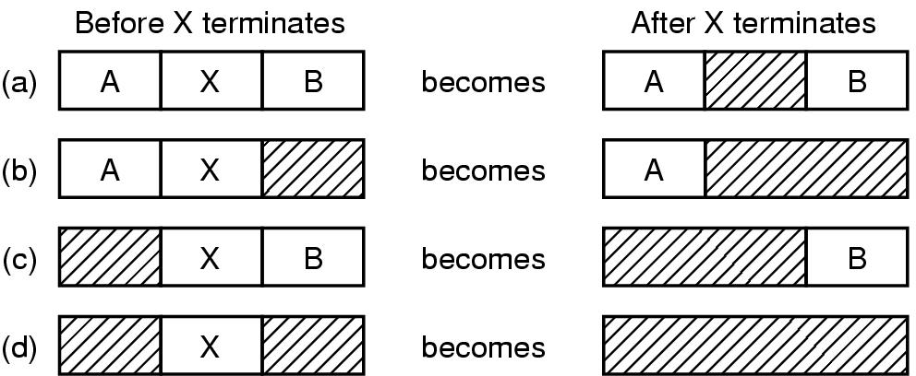
Memory Management with Linked Lists (2)
Four neighbor combinations for the terminating process X

Slide 48
Storage Placement Strategies (1)
How to satisfy a request of size n from a list of free holes?
First Fit
  Scan the list, use the first available hole whose size is sufficient to meet the need.
    If larger in size, break it into an allocated and a free part
  May have many processes loaded in the front end of memory that must be searched over when trying to find a free block (a bit inefficient)
  May have lots of unusable holes at the beginning
    External fragmentation

Slide 49
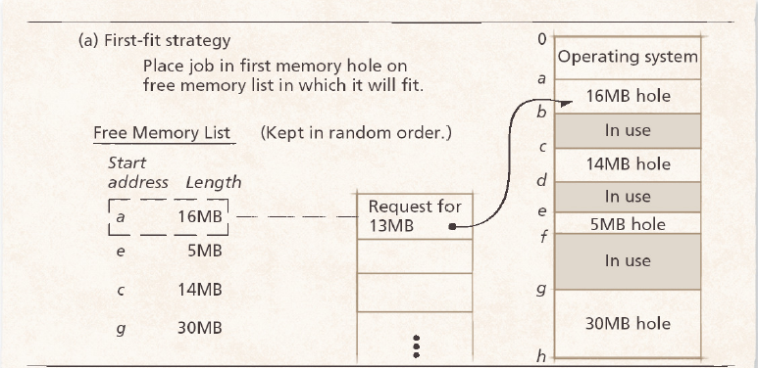
Storage Placement Strategies (2)
First Fit (ctd.)
  Example

Slide 50
Storage Placement Strategies (3)
Next Fit
  Minor variation of first fit
  It begins its search from that point in the list where the last request succeeded
  Problem
    Slightly worse performance than first fit.
Best Fit
  Use the hole whose size is equal to the need, or if none is equal, the hole that is larger but closest in size.
  Problem
    Often have to search the complete list
    Creates small holes that can't be used

Slide 51
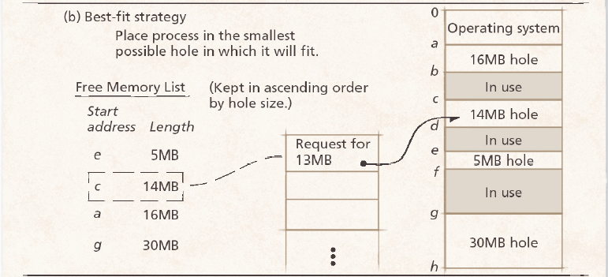
Storage Placement Strategies (4)
Best Fit (ctd.)
  Example

Slide 52
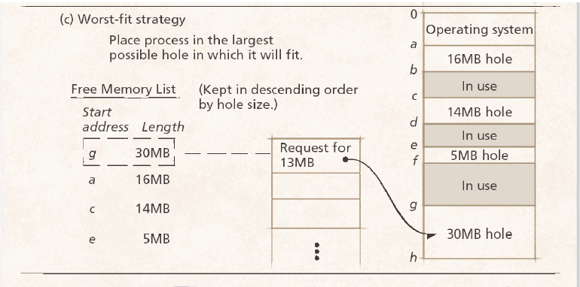
Storage Placement Strategies (5)
Worst Fit
  Use the largest available hole.
  Problem
    Often has to search complete list
    Gets rid of large holes making it difficult to run large programs

Slide 53
Storage Placement Strategies (6)
Quick Fit
  Maintains separate lists for some of the more common sizes requested.
  When a request comes for placement it finds the closest fit.
  This is a very fast scheme, but a merge is expensive. If merge is not done, memory will quickly fragment in a large number of holes into which no processes fit.

Slide 54
Summary
Memory Allocation
  Contiguous Allocation
  Non-contiguous Allocation
Contiguous Allocation
  Relocation
    Static Relocation
    Dynamic Relocation
  Overlays
  Swapping
Managing Free Memory
  Bitmap
  Link list
Storage Placement Stategies
  First fit
  Next fit
  Best fit
  Worst fit
  Quick fit

Slide 55
Homework
P254 3, 4

