Slide 1
Modern Operating Systems
Chapter 3 – Page Replacement
Zhang Yang
Autumn 2019

Slide 2
Content of the Lecture
3.4 Page Replacement Algorithms
  Paging Policies
  Page Replacement Algorithms
    1. OPT
    2. FIFO
    3. NRU
    4. Second Chance
    5. Clock
    6. LRU
    7. NFU
    8. Aging
    9. Working Set
    10.WSClock

Slide 3
Paging Policies
Fetch Policy (discussed later)
  When should a page be brought into primary (main) memory from secondary (disk) storage?
Placement Policy
  When a page is brought into primary storage, where is it to be put?
Replacement Policy
  Which page now in primary storage is to be removed from primary storage when some other page is to be brought in and there is not enough room?

Slide 4
Placement Policy
Determines where in real memory a process piece resides
For pure segmentation systems:
  First-fit, next fit... are possible choices (a real issue)
For paging (and segmentation with paging):
  The hardware decides where to place the page: the chosen frame location is irrelevant since all memory frames are equivalent (not an issue)

Slide 5
Basic Page Replacement (1)
Find location of page on disk.
Find a free page frame.
  If there is a free page frame then use it.
  Otherwise, select a victim frame using the page replacement algorithm.
  Write the selected page to the disk and update any necessary tables.
Read the requested page from the disk.
Restart the user process.

Slide 6

Basic Page Replacement (2)

Slide 7
How to Select a Victim Frame?
Hopefully, kick out a less-useful page.
  Dirty pages require writing, clean pages don’t.
    Hardware has a dirty bit for each page frame indicating this page has been updated or not.
  Where do you write? To “swap space”.
Problem: how do you determine utility?
  Heuristic: temporal locality exists
  Kick out pages that aren’t likely to be used again.

Slide 8
Page Replacement Algorithm (1)
Objectives
  Achieve a low page fault rate. (Main Objective)
    Insure that heavily used pages stay in memory.
    The replaced page should not be needed for some time.
  Reduce latency of a page fault.
    Efficient code.
    Replace pages that do not need to be written out.
Notes:
Why? Page fault is very expensive – 10 msec. to fetch from disk; on a 100 MIPS machine, 10 msec. is equal to 1 Million instructions

Slide 9
Page Replacement Algorithm (2)
Reference String
  Reference string is the sequence of pages being referenced.
  Example: If user has the following sequence of addresses:
    123, 215, 600, 1234, 76, 96
    If the page size is 100, then the reference string is: 1, 2, 6, 12, 0, 0

Slide 10
Page Replacement Algorithm (3)
Usage of Reference String
  Evaluate a page replacement algorithm by running it on a particular string of memory references (reference string).
  Compute the number of page faults on that string.
Most page replacement algorithms operate on some data structure that represents physical memory.
  Bitmap or
  Link list

Slide 11
Page Replacement Algorithms (4)
The Optimal Algorithm (OPT or MIN)
  Selects for replacement that page for which the time to the next reference is the longest.
First-in First-Out (FIFO) Algorithm
  Replace the page that has been in primary memory the longest.
Second Chance Algorithm
  Variant of FIFO.
Clock Algorithm
  Better implementation of second chance.
NRU Algorithm
  Enhanced second chance.

Slide 12
Page Replacement Algorithms (5)
LRU Algorithm
  Replace the page that has not been used for the longest time.
NFU Algorithm
  Simulated LRU.
Aging Algorithm
  Modified NFU.
Working Set Algorithm
  Keep in memory those pages that the process is actively using.
WS Clock Algorithm
  The modified working set algorithm based on clock algorithm.

Slide 13
The Optimal Algorithm (1)
Selects for replacement that page for which the time to the next reference is the longest.
It can be shown that this algorithm results in the fewest number of page faults.
This algorithm provides a basis for comparison with other schemes.
  Often used for comparative studies, i.e., algorithm X is within Y of optimal.
Impractical because it needs future references!

Slide 14
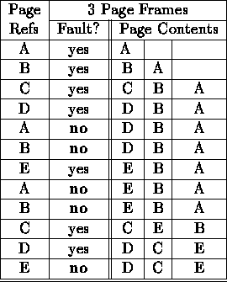
The Optimal Algorithm (2)
Example
  12 references, 7 faults

Slide 15
First-in First-out (FIFO) (1)
Replace the page which has been in memory for the longest time.
Implementation (FIFO queue)
  Maintain a list of allocated pages.
  When the length of the list grows to cover all of physical memory, pop first page off list and allocate it.
Why might FIFO be good?
  Maybe the page allocated very long ago isn't being used anymore.
Why might FIFO not be so good?
  Doesn’t consider locality of reference!
  Suffers from Belady's Anomaly: Performance of an application might get worse as the size of physical memory increases!!!

Slide 16
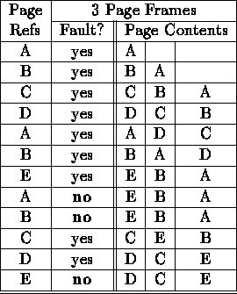
First-in First-out (2)
Example
  12 references, 9 faults

Slide 17

Belady's Anomaly (1)
Belady discovered more page frames might not always have fewer page faults. This is called Belady's anomaly.
While the normal case is as the following figure:

Slide 18
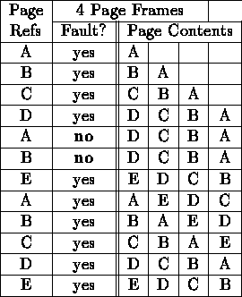
Belady's Anomaly (2)
Example
  12 references, 10 faults
  As the number of page frames increase, so does the fault rate.

Slide 19
The Second Chance Algorithm(1)
Variant of FIFO.
Only use one referenced bit in the page table entry.
  R=0, Initially
  R=1, When a page is referenced.
Choose “victim” to evict
  Select head of FIFO.
  If the page has reference bit set, then
    It’s reference bit is cleared (R=0), and its arrival time is reset to the current time.
    It is put onto the end of the list of pages.
  Select next page in FIFO list.
  Keep processing until reach page with zero referenced bit and page that one out.
What if all pages have R=1?
Notes:
If all pages have R=1, the algorithm degenerates to FIFO

Slide 20
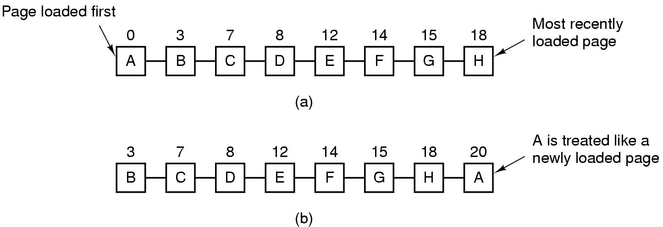
The Second Chance Algorithm(2)
Example
Figure 3-15. Operation of second chance.
(a) Pages sorted in FIFO order.
(b) Page list if a page fault occurs at time 20 and A has its R bit set. The numbers above the pages are their load times.

Slide 21
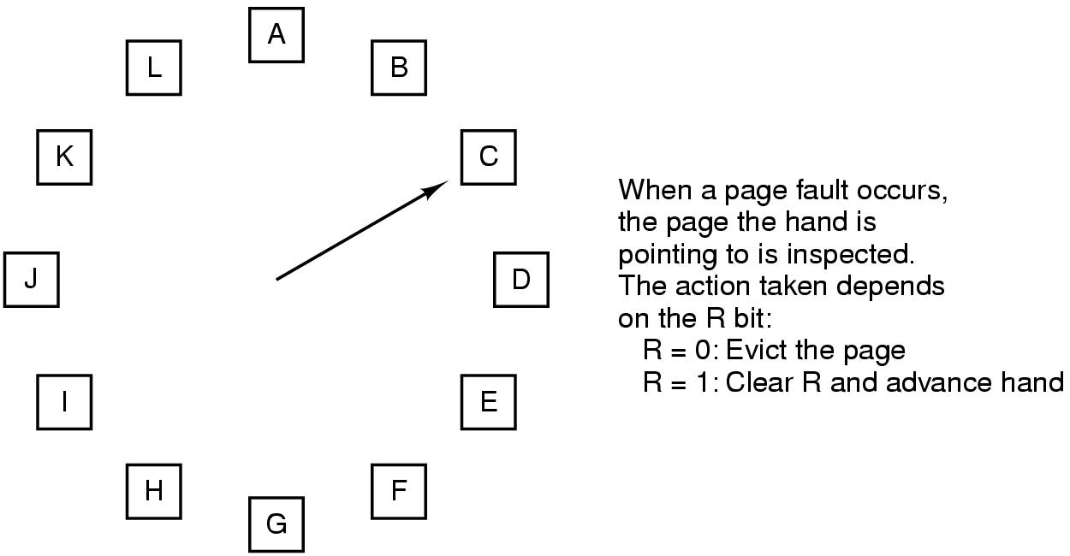
The Clock Algorithm (1)
Better implementation of second chance.
Basic Idea
Figure 3-16. The clock replacement algorithm

Slide 22

The Clock Algorithm (2)
Implementation: circular queue

Slide 23
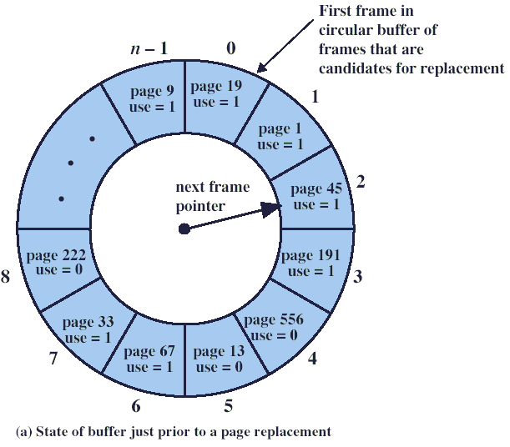
The Clock Algorithm (3)
Example
  A page fault occurs, because page 727 is currently not in main memory.

Slide 24
The Clock Algorithm (4)
Example (ctd.)
0

Slide 25
The Clock Algorithm (5)
Example (ctd.)
0
0

Slide 26
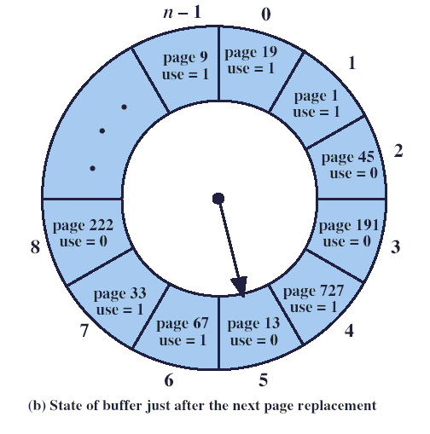
The Clock Algorithm (6)
Example (ctd.)

Slide 27
Not-Recently-Used (NRU) (1)
Enhanced second chance.
Replace the page which is not used recently.
Use the referenced (R) & modified (M) bits in the page table entry.
  R bit is set when the page is referenced (read or written).
  M bit is set when the page is modified (contents changed - written).

Slide 28
Not-Recently-Used (NRU) (2)
Initially, all pages have
  Referenced Bit = 0
  Modified Bit = 0
Periodically (e.g. whenever a timer interrupt occurs) clear the referenced bit.
  To distinguish pages that have been referenced recently.
Note
  Can’t clear modified bit!!!
    Needed to indicate which pages need to be flushed to disk.

Slide 29
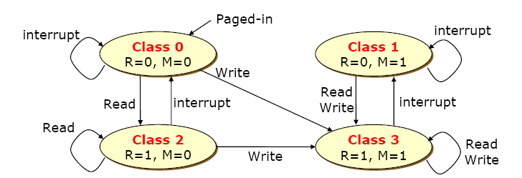
Not-Recently-Used (NRU) (3)
Categorize each page into a class:
  Class 0: Referenced = 0 Modified = 0
  Class 1: Referenced = 0 Modified = 1
  Class 2: Referenced = 1 Modified = 0
  Class 3: Referenced = 1 Modified = 1
Notes:
这种分类比较笼统，在同一类页面里，我们没有办法分辨出哪一类被访问时间更近一些。
时间的分辨度粗到一个访问位清零的周期。

Slide 30
Not-Recently-Used (NRU) (4)
Algorithm: remove a page from the lowest non-empty class.
  Select a page at random from that class.
  Randomly choose a victim page from class 0 … why?
  If none, randomly choose a page from class 1 … why?
  If none, randomly choose a page from class 2 … why?
  If none, randomly choose a page from class 3 … why?

Slide 31
Not-Recently-Used (NRU) (5)
Implementation
  Hardware
    R & M bits are set by hardware on every memory reference.
  Software
    R & M bits in the page table entry is modified at page faults.
Advantages
  Easy to understand and implement.
  Performance adequate (though not optimal).

Slide 32
Least Recently Used (LRU) (1)
Approximate OPT under certain assumptions.
LRU associates with each page the time of that page’s last use.
Based on principal of “Locality of Reference”.
  A page that has been used in the near past is likely to be used in the near future.
Replace the page which has been unused for the longest time.
  Keep track of when pages are referenced to make a better decision.
  Use past behaviour to predict future behaviour.
    LRU uses past information, while OPT uses future information.
Notes:
if we use the recent past as an approximation of the near future, then will select as
victim the page that has been used least recently

Slide 33
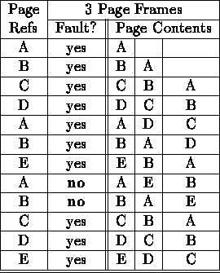
Least Recently Used (LRU) (2)
Example
  12 references, 10 faults
Question: When does
LRU work well,
and when does it not?
Notes:
If the past is a good predictor of the future, LRU is a good approximation to OPT.
LRU does not work well when the next reference is the least recently used page (i.e., a reference string of ABCDABCDABCD).

Slide 34
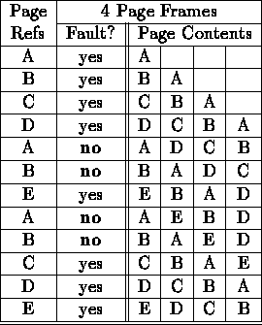
LRU Discussion (1)
Advantages
  Quite efficient, good to approximate OPT.
  Does not suffer from Belady's anomaly (also OPT).
    Example: 12 references, 8 faults

Slide 35
LRU Discussion (2)
Disadvantages
  Its implementation is not very easy.
  Its implementation may require substantial hardware assistance.
Several ways to implement this algorithm, but very expensive.

Slide 36
Implementation of LRU (1)
Implementation #1 linked list (Hardware)
  Maintain the LRU order of accesses in frame list by hardware.
  On every memory reference, move that page to the front of the list.
  The page at the tail of the list is replaced.
  Problem
    Expensive!!“on every memory reference...”
Page 6
Page 7
Page 1
Page 2
Head
Tail (LRU)
Notes:
Keep linked list representing order in which pages have been used

Slide 37
Implementation of LRU (2)
Implementation #2 counter (Hardware)
  MMU maintains a 64-bit counter C.
  Increment C after every clock cycle.
  Every time a page table entry is used, MMU writes the counter value to the entry “timestamp” / “time-of-last-use” field.
  When a page fault occurs, software looks through the page table.
  Identifies the entry with the oldest timestamp.

Slide 38
Implementation of LRU (3)
Implementation #2 counter (Hardware) (ctd.)
  Problems
    The number of counters is equal to the number of virtual pages. So the space cost much.
    Each page table entry has a field large enough to include the value of the counter. So the space cost much.
    When we choose page to replace, we need compare all counters. So the time cost much.

Slide 39
Implementation of LRU (4)
Few computers have the necessary hardware to implement full LRU.
  Linked-list method impractical in hardware.
  Counter-based method could be done, but it’s slow to find the desired page.
  Both approaches require large processing overhead, more space, or hardware support.
What if we don’t have hardware support?
  Software simulated.

Slide 40
Not Frequently Used (NFU) (1)
Simulated LRU
There is a software counter for each page.
The counter is initially zero. At each clock interrupt , the OS looks at each page
  If the Reference Bit is set (R=1)
    Add the R bit to a software counter for each page & clear the bit.
  If the Reference Bit is not set (R=0)
    Add the R bit to a software counter for each page
Remove page with lowest counter value.

Slide 41
Not Frequently Used (NFU) (2)
Problem
  Some page may be heavily used. (Its counter is large.)
  The program’s behavior changes.(Now, this page is not used ever again (or only rarely).)
  But this algorithm never forgets!
  This page will never be chosen for replacement!

Slide 42
Not Frequently Used (NFU) (3)
Differences between LRU and NFU
  LRU updated after every instruction so it’s resolution is very fine.
  NFU is coarse (updated after n instructions execute between clock interrupts).
    A given page referenced by n-1 instruction is given equal weight to a page referenced by only 1 instruction (between clock interrupts).
    n/2 references to a given page at the beginning of the interval are given equal weight with n/2 references to another page at the end of the interval.

Slide 43
The Aging Algorithm (1)
Modified NFU: NFU + forgetting
Take NFU but…
At each clock interrupt
  Right shift the counters (divide by 2)
  Add the R bit to the left (MSB)
    More weight given to more recent references!
As for NFU, remove pages with the lowest counter.
Note: this is different from LRU since the time granularity is a clock tick and not every memory reference!
Notes:
Reduce counter values over time
Divide by two every clock cycle (use right shift)

Slide 44
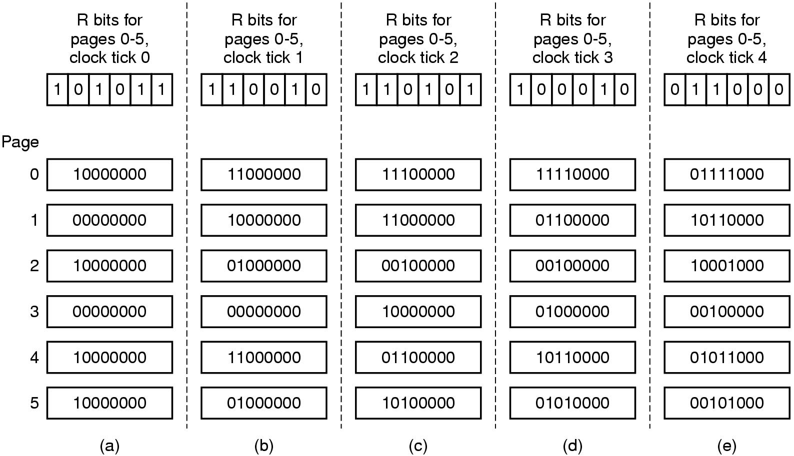
The Aging Algorithm (2)
The aging algorithm simulates LRU in software
Note 6 pages for 5 clock ticks, (a) – (e)

Slide 45
Fetch Policy
When should a page be loaded into main memory?
Demand Paging Policy
  Pages are loaded on demand, not in advance.
  Process starts up with none of its pages loaded in memory; page faults load pages into memory.
Pre-paging Policy
  Load pages before process runs.
  Need a working set of pages to load on context switches.
Few systems use pure demand paging, but instead, does pre-paging.

Slide 46
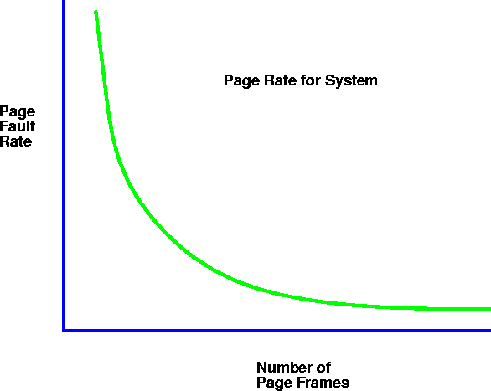
Thrashing (1)
Thrashing ≡ a process is busy swapping pages in and out. (spends more time paging than executing)
Why Thrashing?
  Too few page frames allocated to a process!
Notes:
Computations have locality
As page frames decrease, the page frames available are not large enough to contain the locality of the process.
The processes start faulting heavily
Pages that are read in, are used and immediately paged out.

Slide 47

Thrashing (2)
Results of Thrashing
  If a process does not have “enough” pages, the page-fault rate is very high. This leads to
    Low CPU utilization.
    OS thinks that it needs to increase the degree of multiprogramming.
    Another process will be added to the system.
bringing more processes
Notes:
As the page fault rate goes up, processes get suspended on page out queues for the disk.
The system may start new jobs.
Starting new jobs will reduce the number of page frames available to each process, increasing the page fault requests.
System throughput plunges.

Slide 48
Solutions to Thrashing
Approach 1
  Working Set
    Provide a process as many frames as it needs
Approach 2
  Page Fault Frequency (discussed in Chapter 3.5)
Working Set
  A process's working set is the set of pages that it currently “needs”. (Denning’s)
  Example (next page)

Slide 49
Working Set Example (1)
1
Routine 1
Program Execution
  Start with main program (page 8)
  Main program loads the main loop (pages 4,5,6,7)
  Program executes in the main loop for 20 seconds
  Then routine 1 is called (page 1) which executes 2 seconds
  Finally routine 2 (pages 2, 3) is called to execute for 3 seconds
2
Routine 2
3
4
5
Main loop
6
7
8
Main program

Slide 50
Working Set Example (2)
In the previous example, the process needs pages 4, 5, 6, 7 for most of the time (20 seconds in a total of 25 seconds execution time)
If these pages are kept in memory the number of page faults will decrease. Otherwise, thrashing may occur
Rule
  Do not run a process if its working set can not be kept in memory

Slide 51
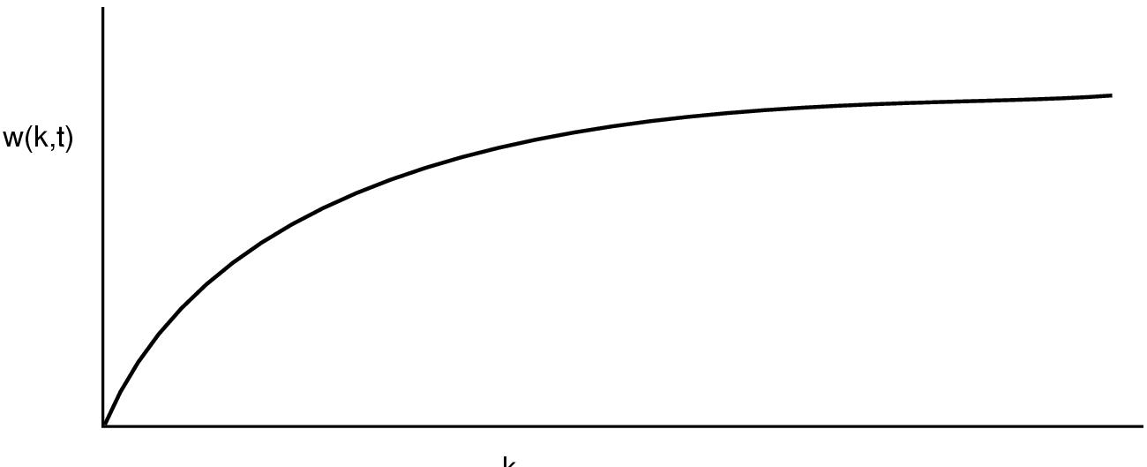
Working Set Model (1)
k
The working set is the set of pages used by the k most recent memory references.
The function w(k,t) is the size of the working set at time t.
  w(k, t) is a monotonically nondecreasing function of k.
  The limit of w(k, t) is finite.

Slide 52
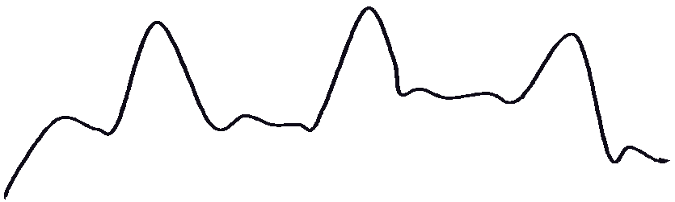
Working Set Model (2)
Working set size
t
transition stable
When a process first starts up, its working set grows.
Then stabilizes by the principle of locality.
Grows again when the process shifts to a new locality. (transition period)
  Up to a point where the working set contains pages from two localities.
Then decreases (stabilizes) after it settles in the new locality.

Slide 53

Working Set Model (3)
k or Δ
  working set window= a fixed number of page references
  Example Δ=10
Approximate Working Set
  The set of pages of a process used in the last τ seconds

Slide 54
The Working Set Algorithm (1)
Basic Idea
  When a page fault occurs, find a page that is not in the working set and evict it.
  Working set: the set of pages used in the k most recent memory references
Approximation
  Drop the idea of counting back k memory references and use execution time.
  Current Virtual Time: The amount of CPU time a process has actually used since it started is called its current virtual time.
  The working set of a process is the set of pages it has referenced during the past τ seconds of virtual time.

Slide 55
The Working Set Algorithm (2)
WS Algorithm in Practice
  On each clock tick, clear all R bits and record process virtual time t.
  When looking for eviction candidates, scan all pages of process in physical memory:
    If R == 1
      Store t in LTU (last time used) of PTE and clear R.
    If R == 0
      If (t – LTU) > τ, evict the page (because it is not in working set).
      If (t – LTU) <= τ, record the page of greatest age.
      age = current virtual time – last time used

Slide 56
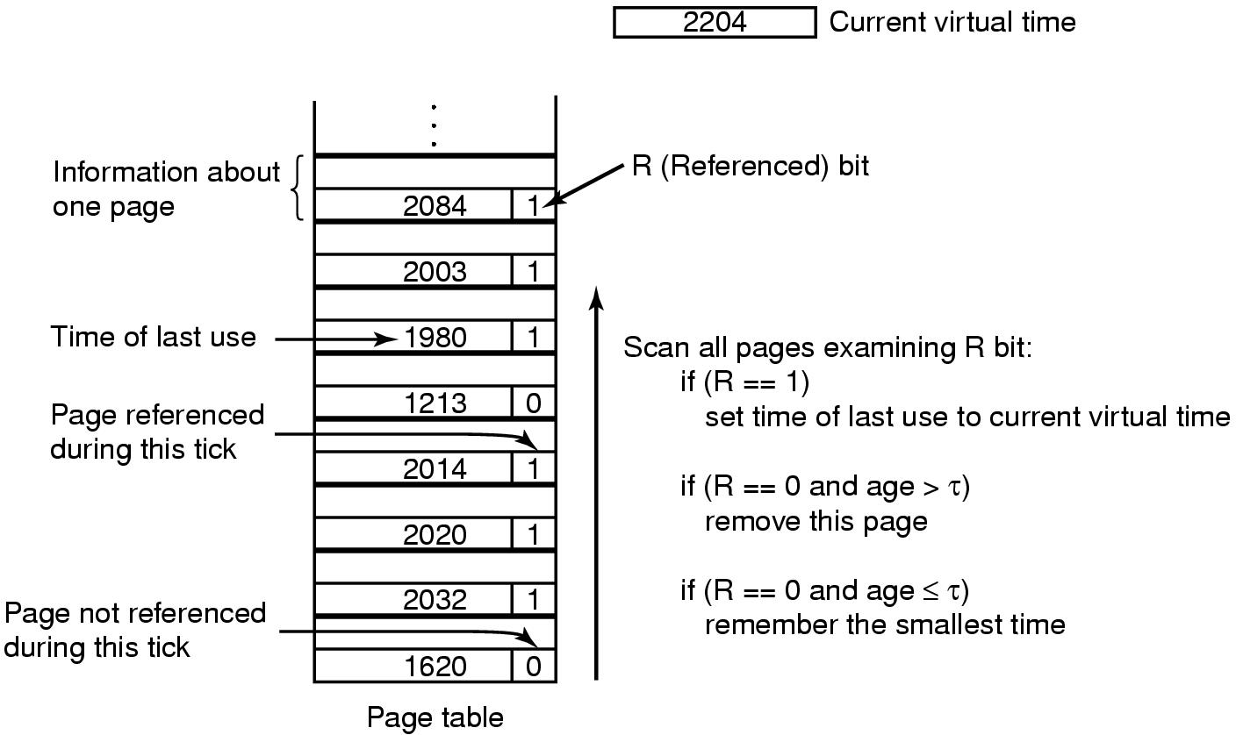
The Working Set Algorithm (3)
WS Algorithm Example
age = current virtual time – last time used
← (greatest age/least virtual time) and choose that one if no better candidate exists.

Slide 57
The Working Set Algorithm (4)
What happens if the entire table is scanned without finding a candidate to evict?
  If one or more pages with R=0 were found, the one with the greatest age is evicted.
  The worst case: no page with R=0, choose one page at random (preferably a clean page).

Slide 58
The WSClock Algorithm (1)
Previous WS algorithm requires entire page table be scanned at each page fault.
An improved algorithm
  Simple, efficient, widely used.
  Based on the clock algorithm.
  Also uses the working set information.
  Uses circular list of page frames.
WSClock Algorithm
  All pages are kept in a circular list.
  As pages are added, they go into the ring.
  The “clock hand” advances around the ring.
  Each entry contains R, M, time of last use.

Slide 59
The WSClock Algorithm (2)
WSClock (ctd.)
  Upon a page fault
    If R = 1, set R=0 and update “time of last use” field. Advance the hand and keep looking for.
    If R = 0
      If age <= τ, advance the hand and keep looking for.
      If age > τ, and if clean, then claim it.
      if age > τ, and if dirty, then schedule a disk write. Advance the hand and keep looking for.
Very common in practice.

Slide 60
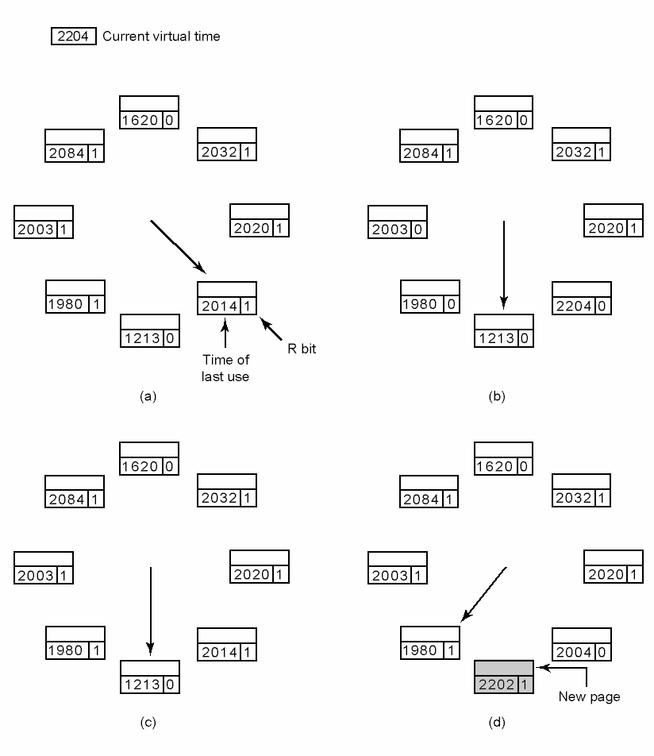
The WSClock Algorithm (3)
WSClock Example
Replace old and advance.
Figure 3-20 Operation of the WSClock algorithm

Slide 61
The WSClock Algorithm (4)
What happens if the hand comes all the way around to its starting point?
  Case1: At least one write has been scheduled.
    The first clean page encountered is evicted.
  Case 2: No writes have been scheduled (all pages are in working set)
    Claim any clean page and use it.
    If no clean pages exist, the current page is chosen and written back to disk.

Slide 62
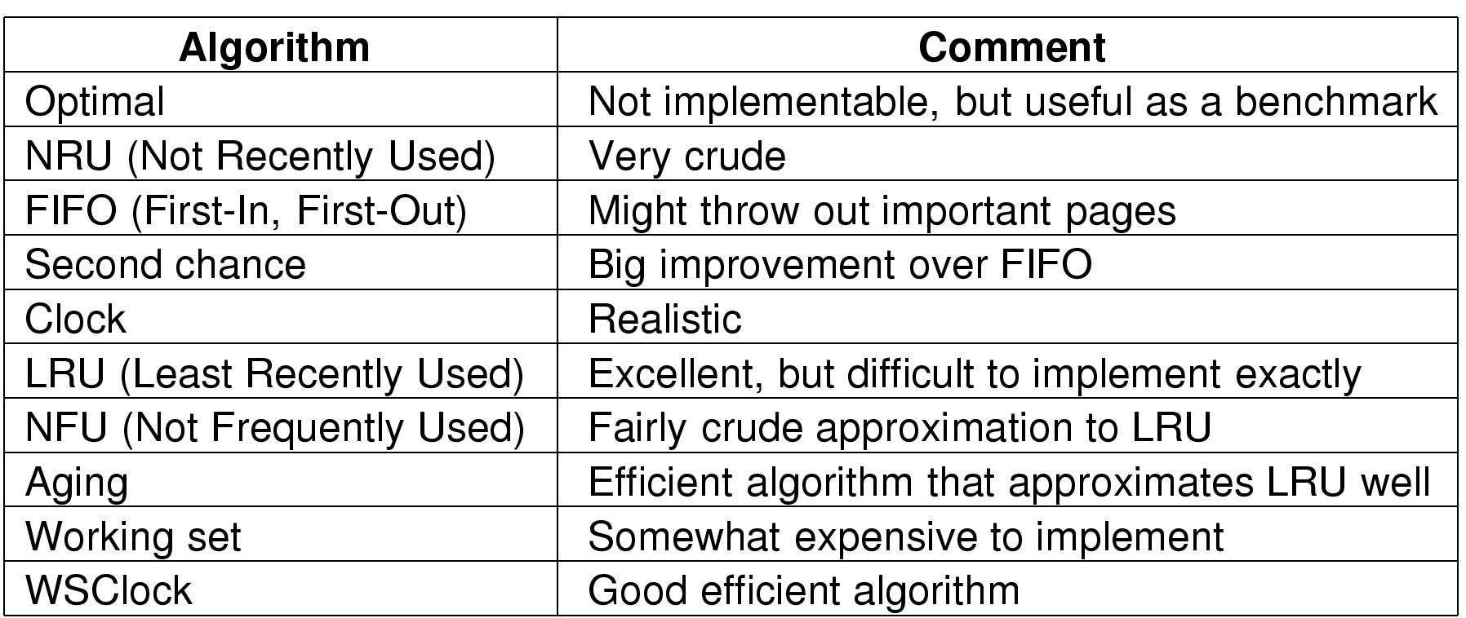
Summary of Page Replacement Algorithms
Two Best Algorithms
  Aging
  WSClock

Slide 63
Homework
P256: 28, 30, 33, 36

