Slide 1
Modern Operating Systems
Chapter 3 – Paging
Zhang Yang
Autumn 2019

Slide 2
Content of the Lecture
3.3 Virtual Memory
  Virtual Address
  Paging
  Address Translation Scheme
  Page Table
  Translation Lookaside Buffer
  Multi-level Page Table
  Inverted Page Table

Slide 3
Virtual Memory (1)
How to Manage Bloatware?
  Run programs that are too large to fit in memory.
  Have systems that can support multiple programs running simultaneously.
  Overlays?
  Swapping?
Need for Virtual Memory
  Separation of user logical memory from physical memory.
  Only PART of the program needs to be in memory for execution.
  Logical address space can therefore be much larger than physical address space.
  Need to allow pages to be swapped in and out.

Slide 4
Virtual Memory (2)
Implementation of Virtual memory
  Paging
    Modern approach
    Paging is presently most common.
  Segmentation
    Basic early approach
    Typically very simple
    Probably better suited to behavior of process, although it can be harder to use and harder to implement.
  Combined paging and segmentation

Slide 5
Virtual Memory (3)
Support needed for Virtual Memory
  Hardware Support
    Memory Management Unit (MMU)
    Translation Lookaside Buffer (TLB)
  OS Support
    Virtual memory system to control the MMU and TLB.

Slide 6
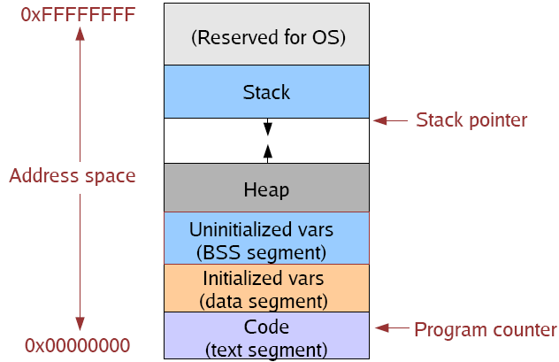
Virtual Address (1)
A virtual address is a memory address that a process uses to access its own address space.
  The virtual address is not the same as the physical RAM address in which it is stored.
  When a process accesses a virtual address, the MMU hardware translates the virtual address into a physical address
  The OS determines the mapping from virtual address to physical address.

Slide 7
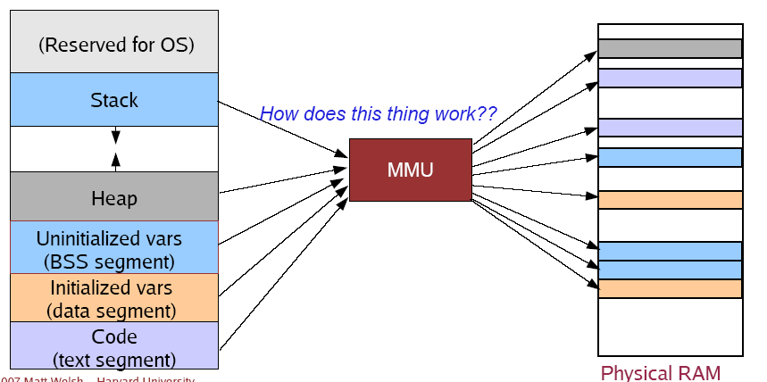
Virtual Address (2)
Virtual Addresses allow isolation
Virtual Addresses allow relocation

Slide 8
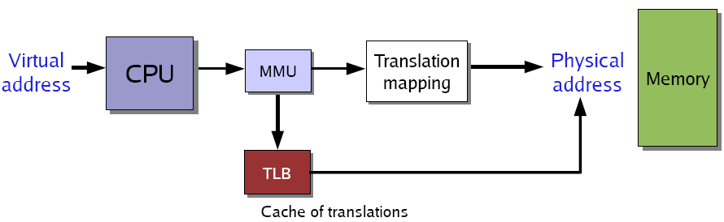
MMU and TLB
MMU
  Hardware that translates a virtual address to a physical address.
  Each memory reference is passed through the MMU.
TLB
  Cache for MMU virtual-to-physical address translations
  Just an optimization, but an important one!

Slide 9
Paging (1)
Physical Memory
  Divided into page frames (fixed-sized blocks)
  Size is power of 2, e.g. 512 bytes –64KB
Logical Memory
  Divided into pages
  The same size as page frames.

Slide 10
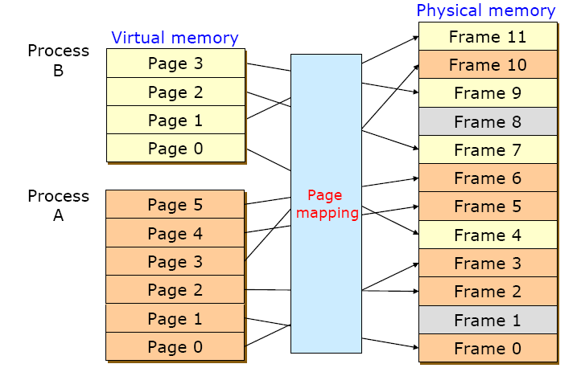
Paging (2)
Example

Slide 11
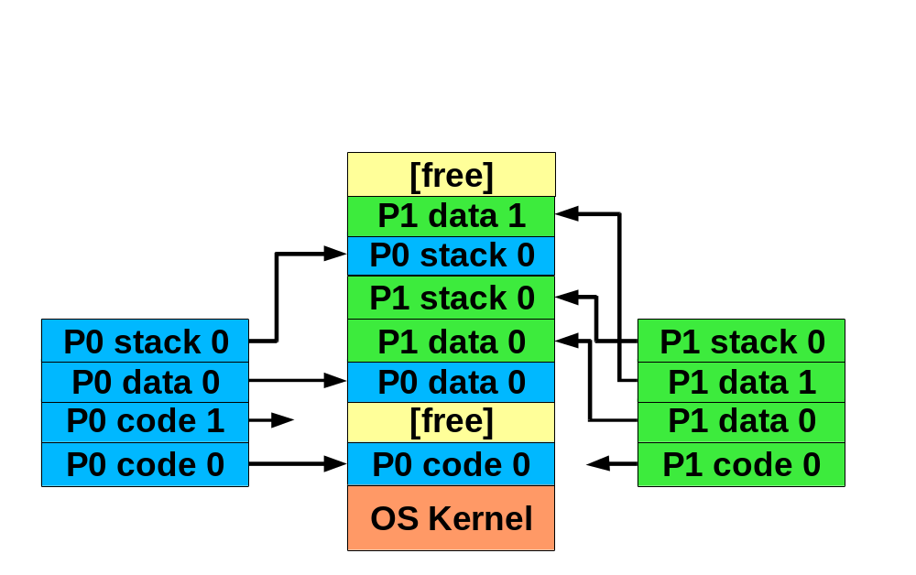
Paging (3)
Partial Residence Example

Slide 12
Paging (4)
Operating System Responsibilities
  Maintain the page table.
    A Page table is an array that translates from pages to frames.
  Allocate sufficient pages from free frames to execute a program.
    To run a program of size n pages, need to find n free page frames and load program.
  OS keeps track of all free frames.
    Set up a page table to translate logical to physical addresses.

Slide 13
Paging (5)
Advantages
  Permits the physical address space of a process to be noncontiguous and be allocated as needed.
  Easy to allocate physical memory.
  Easy to “page out”/swap chunks of memory.
Issue
  Internal Fragmentation

Slide 14
Address Translation Scheme (1)
Address generated by CPU is divided into
  For given logical address space 2^{m} and page size 2^{n}
  Page number (p)
    Used as an index into the page table
    Page table contains base address of each page in physical memory
  Page offset (d)
    Combined with base address to define the physical memory address sent to the memory unit.
page number
page offset
p
d
m - n
n

Slide 15

Address Translation Scheme (2)
Physical Address
  Frame number (f)
  Page offset (d)

Slide 16

Address Translation Scheme (3)
Example
  Internal operation of MMU with 16 4KB pages
Figure 3-10

Slide 17
Page Tables
Managed by OS.
Map VPN (Virtual Page Number) to PFN
  VPN is the index into the table that determines PFN
One page table entry (PTE) per page in virtual address space, i.e. one PTE per VPN.
Most operating systems allocate a page table for each process.

Slide 18

Structure of Page Table Entry
Page frame number: Map the frame number
Present/absent bit: 1/0 indicates valid/invalid entry
Protection bit: What kinds of access are permitted.
Modified (dirty bit): Set when modified and writing to the disk occur
Referenced: Set when page is referenced (help decide which page to evict)
Caching disabled - Cache is used to keep data that logically belongs on the disk in memory to improve performance.
Notes:
Memory-mapped I/O的机器不需要caching disabled这一位

Slide 19
Page Tables: Design Issues (1)
Fast Access Issue
  Often need to make 2 or more page table references per instruction, so fast access is necessary!
Page Table for Large Memories Issue
  Average waste due to internal fragmentation is ½ page per process, so want small page size
  But, small page size many pages
  large page table page tables (for each process) will take up a lot of memory space

Slide 20
Page Tables: Design Issues (2)
Solution to Fast Access Issue
  TLB : translation look-aside buffer
Solution to Page Table for Large Memories
  Multi-level Page Tables
  Inverted Page Tables

Slide 21
Translation Lookaside Buffer (1)
Each virtual address reference requires 2 physical memory references.
  1:To page table to get mapping
  2:To page frame itself
Eliminate #1 by caching recent mappings in translation lookaside buffer (TLB)
  Take advantage of fact that most programs reference small number of pages often.
  TLB is part of MMU
  Each TLB entry is a page table entry (has same elements as PTE).
  TLB is a special hardware (called associative memory) – searches all PTE’s in TLB at once in parallel.
  Approximately 64-256 PTE’s in TLB.

Slide 22
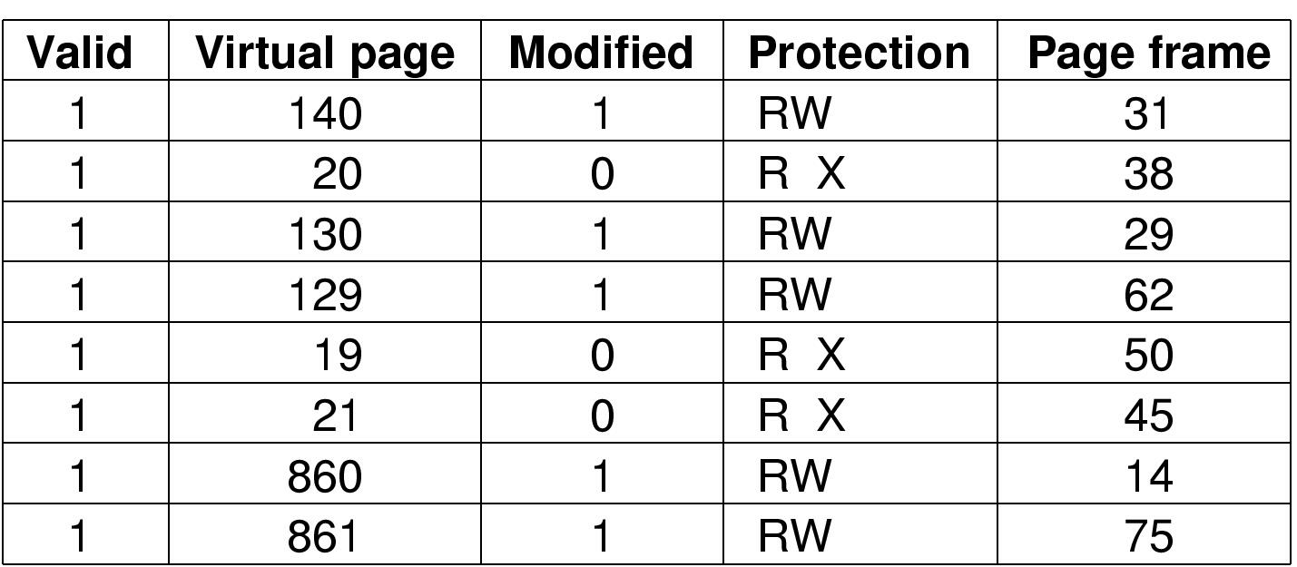
Translation Lookaside Buffers (2)
Figure 3-12. A TLB to speed up paging.

Slide 23
Translation Lookaside Buffer (3)
If a virtual address is presented to MMU, the hardware checks TLB by comparing all entries simultaneously (in parallel).
If match is valid, the page is taken from TLB without going through page table.
If match is not valid
  MMU detects miss and does an ordinary page table lookup.
  It then evicts one page out of TLB and replaces it with the new entry, so that next time that page is found in TLB.

Slide 24

Translation Lookaside Buffer (4)

Slide 25
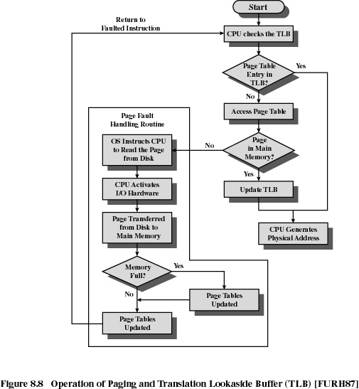
Translation Lookaside Buffer (5)

Slide 26
Hardware TLB Management
On a TLB miss
  Hardware loads the PTE into the TLB.
    Need to write back if there is no free entry.
  Generate a fault if the page containing the PTE is invalid.
  OS performs fault handling.
On a TLB hit, hardware checks the valid bit.
  If valid, pointer to page frame in memory.
  If invalid, the hardware generates a page fault.
    Perform page fault handling.
    Restart the faulting instruction.

Slide 27
Software TLB Management
RISC machines (SPARC, MIPS, Alpha) do page management in software. If virtual address is not in the TLB, TLB fault occurs and is passed to OS.
On a miss in TLB, OS
  Write back if there is no free entry.
  Check if the page containing the PTE is in memory.
  If no, perform page fault handling.
  Load the PTE into the TLB.
  Restart the faulting instruction.
Soft Miss
  A soft miss occurs when the page referenced is not in the TLB, but is in memory.
Hard Miss
  A hard miss occurs when the page itself is not in memory (and of course, also not in the TLB).

Slide 28
Hardware vs. Software TLB Management
Hardware Approach
  Efficient
  Inflexible
  Need more space for page table.
Software Approach
  Flexible
  Software can do mappings by hashing.
    PP# → (Pid, VP#)
    (Pid, VP#) → PP#
  Can deal with large virtual address space.

Slide 29
Recall: Page Tables Design Issues
Solution to Fast Access Issue
  TLB : translation look-aside buffer
Solution to Page Table for Large Memories
  Multi-level Page Tables
  Inverted Page Tables

Slide 30
Multi-level Page Tables
Suppose
  4KB (2¹²) page size,64-bit address space, 8-byte PTE
  Would need a 32,000 TB page table!
    (2⁶⁴ /2¹²) * 2³ = 2⁵⁵ bytes
Since the page table can be very large, one solution is to page the page table
Tree of Page Tables
  Lowest-level tables hold PTEs (page table entries).
  Upper-level tables hold pointers to lower-level tables.
  Different parts of VPN used to index different levels.

Slide 31
Two-Level Paging (1)
A logical address (on 32-bit machine with 4K page size) is divided into:
  A page number consisting of 20 bits.
  A page offset consisting of 12 bits.
Since the page table is paged, the page number is further divided into:
  A 10-bit page number.
  A 10-bit page offset.

Slide 32
Two-Level Paging (2)
Thus, a logical address is as follows:
Where p1 is an index into the outer page table, and p2 is the displacement within the page of the outer page table.
page number
page offset
p₁
p₂
d
10
10
12

Slide 33

Two-Level Paging (3)
Address Translation Scheme

Slide 34
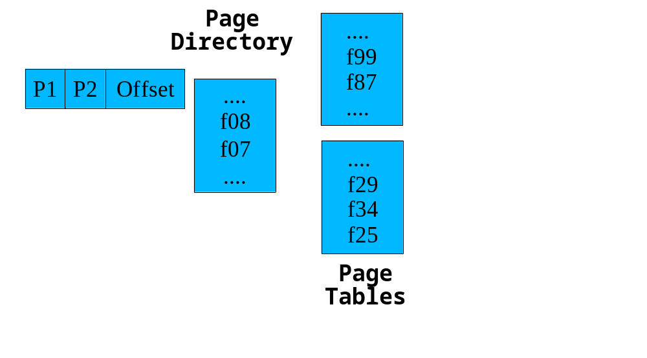
Two-Level Paging (4)
Example 1

Slide 35
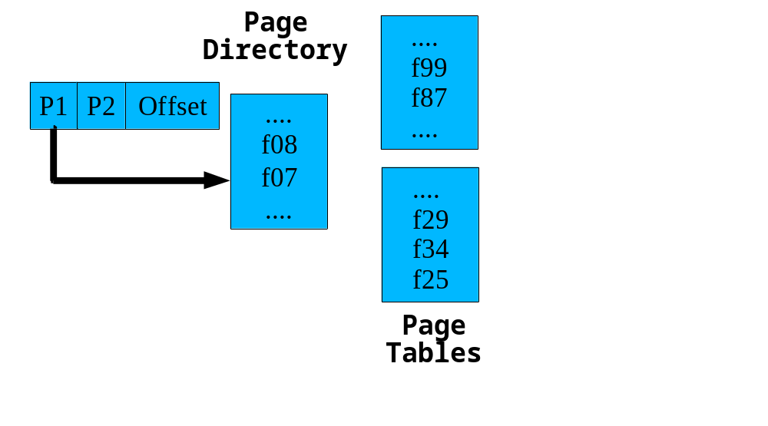
Two-Level Paging (5)
Example 1 (ctd.)

Slide 36
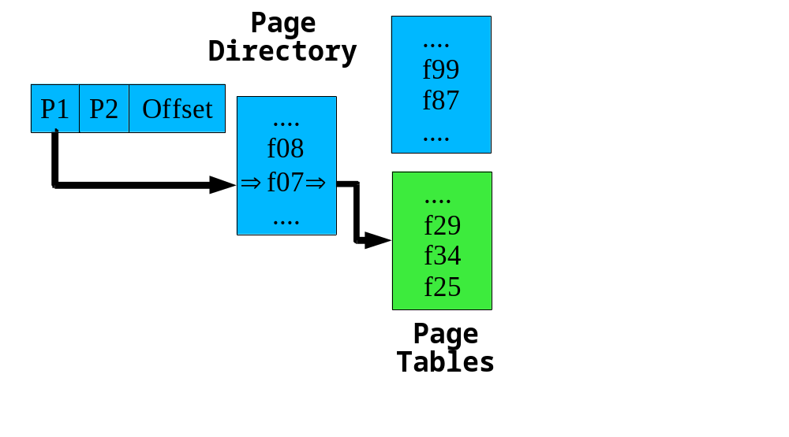
Two-Level Paging (6)
Example 1 (ctd.)

Slide 37
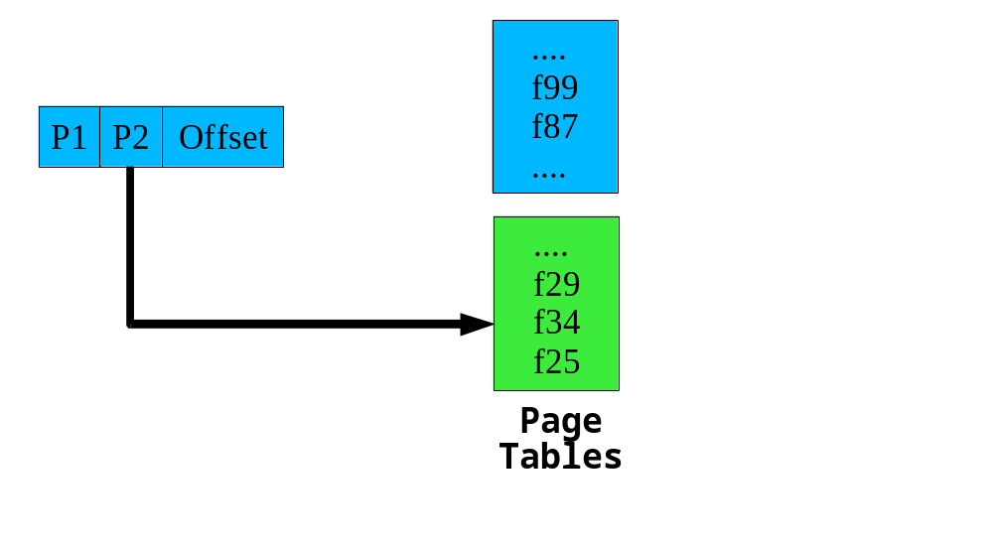
Two-Level Paging (7)
Example 1 (ctd.)

Slide 38
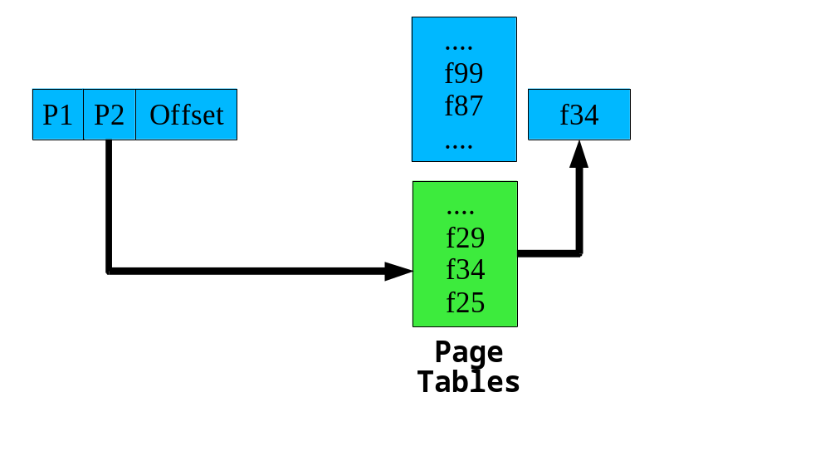
Two-Level Paging (8)
Example 1 (ctd.)

Slide 39
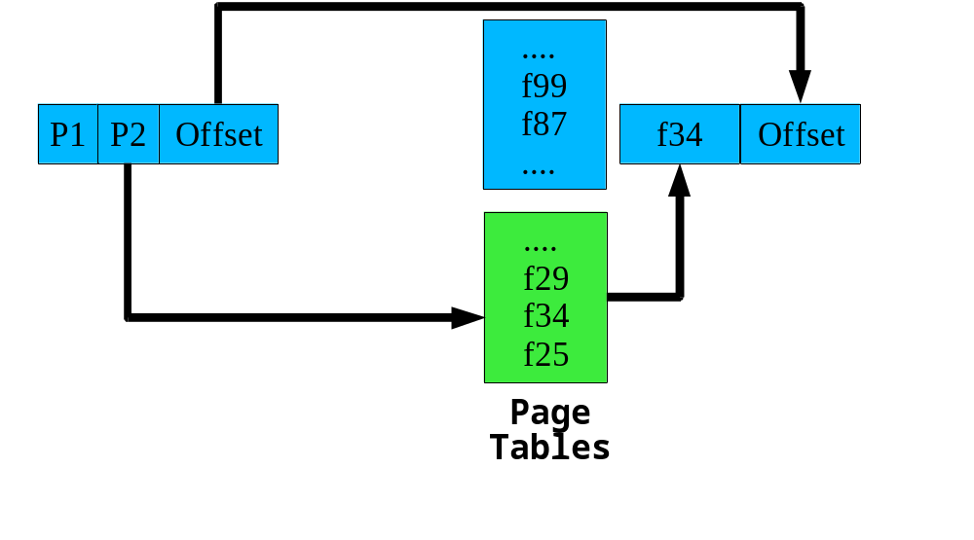
Two-Level Paging Example (9)
Example 1 (ctd.)

Slide 40

Two-Level Paging (10)
Example 2
  Textbook P199
Second-level page tables
Top-level
page table
Figure 3-13 (a) 32 bit address with 2 page table fields
(b) Two-level page tables

Slide 41


Three-level Paging Scheme

Slide 42
Generalizing
Early architectures used 1-level page tables.
VAX, x86 used 2-level page tables.
SPARC uses 3-level page tables.
Alpha 68030 uses 4-level page tables.
Notes:
Key thing is that the outer level must be wired down (pinned in physical memory) in order to break the recursion

Slide 43
Why Inverted Page Table? (1)
Question
  Consider a system in which the virtual address space is 64 bits, the page size is 4KB, and the amount of physical memory is 512MB. Assume that each table entry would require about 4 bytes. How much space would a simple single-level page table take?
Solution
  Such a table contains one entry per virtual page, or
  2 ⁽⁶⁴⁻¹²⁾=2⁵² entries. so the total page table size is 4*2⁵² =2⁵⁴bytes=16petabytes. And this is for each process! (1PB=(1024²)GB)

Slide 44
Why Inverted Page Table? (2)
Discussion of Solution
  Multi-level Page Table
    Of course, a process is unlikely to use all 64 bits of address space, so how about using multilevel page tables?
    How many levels would be required to ensure that each page table require only a single page?
    Assuming an entry takes a constant 4 bytes of space, each page table can store 1024 entries, or 10 bits of address space. Thus 5 levels are required. But this results in 6 memory accesses for each address translation!
12
10
10
10
10
12

Slide 45
Why Inverted Page Table? (3)
Discussion of Solution (ctd.)
  Inverted Page Table
    But notice that there are only 512MB of memory in the system, or 2⁽²⁹⁻¹²⁾ = 2¹⁷ = 128K physical pages.
    If we can somehow manage to store only a single page table entry per physical page, the page table size decreases considerably, to 2MB assuming each entry takes 16 bytes.

Slide 46
Linear Inverted Page Table (1)
One global page table
  One entry for each real page of memory.
  Entry consists of the virtual address of the page stored in that real memory location, with information about the process that owns that page. (process, virtual page)
  The physical page number is not stored, since the index in the table corresponds to it.

Slide 47

Linear Inverted Page Table (2)
Implementation
  TLB access eliminates search most of the time
Address Translation Scheme

Slide 48
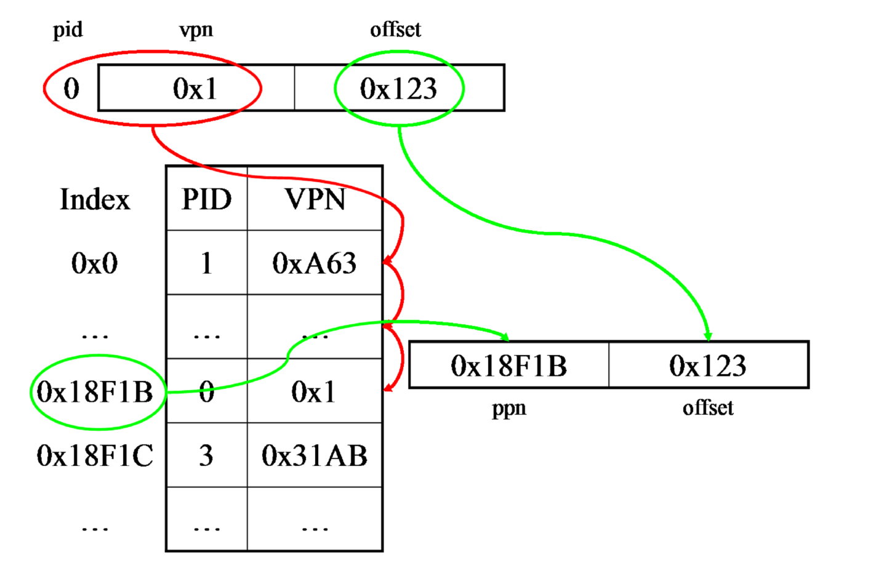
Linear Inverted Page Table (3)
Example
  Translation procedure using a linear inverted page table. Info bits exist in each entry, though they are not shown.

Slide 49
Linear Inverted Page Tables (4)
Pros
  Small page table for large address space.
Cons
  Lookup is difficult. Increases time needed to search the table when a page reference occurs. Slower memory access because of searching.
    E.g. In the previous example, the worst scenario, will search for 2¹⁷ entries of the inverted page table.

Slide 50
Hashed Inverted Page Tables (1)
Common in address spaces > 32 bits.
Linear inverted page tables require too many memory accesses.
Keep another level before actual inverted page table (hash anchor table).
  Contains a mapping of process ID and virtual page number to page table entries.
    Use separate chaining for collisions.
Lookup in hash anchor table for page table entry.
  Compare process ID and virtual page number
    If match, then found.
    If not match, check the next pointer for another page table entry and check again.

Slide 51

Hashed Inverted Page Tables (2)

Slide 52
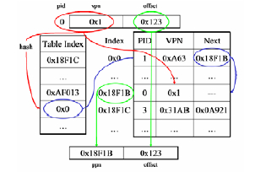
Hashed Inverted Page Tables (3)
Example

Slide 53
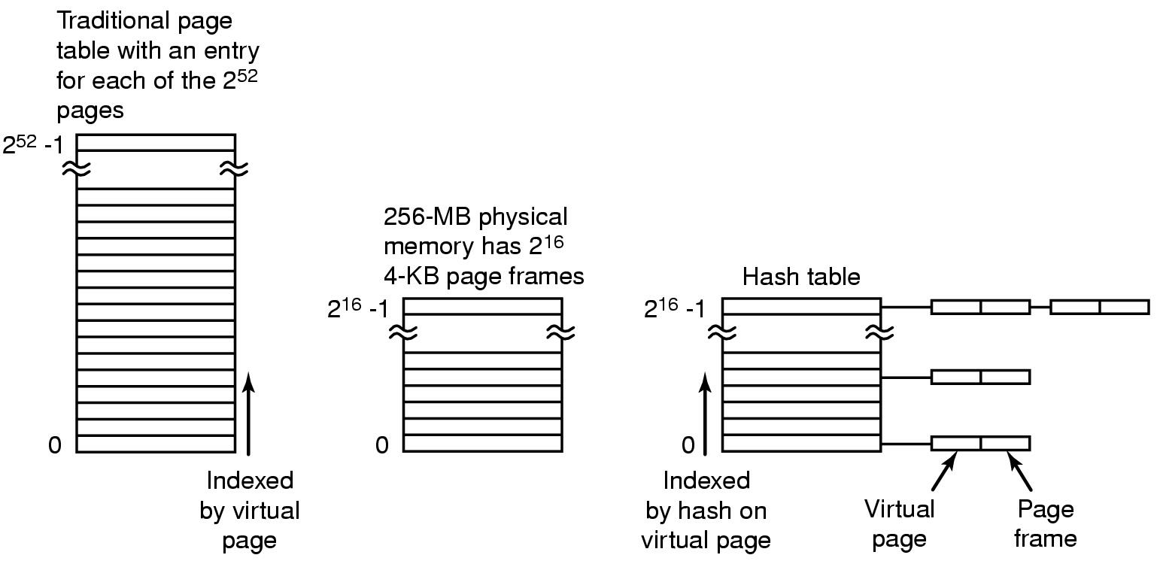
Hashed Inverted Page Tables (4)
Comparison of a traditional page table with an inverted page table

Slide 54
Hashed Inverted Page Tables (5)
Pros
  With a good hashing scheme and a hashmap proportional to the size of physical memory, O(1) time. Very efficient!
Cons
  Overhead of managing hash chains, etc

Slide 55
Summary
Paging
Address Translation Scheme
Page Table
TLB
Multilevel Page Table
Inverted Page Table

Slide 56
Homework
P254: 6,7,15,17

