Slide 1
Modern Operating Systems
Chapter 3 – Segmentation
Zhang Yang
Autumn 2019

Slide 2
Content of the Lecture
3.7 Segmentation
  Segmentation
  Segmentation with Paging

Slide 3
Problem in One-Dimensional Address Space (1)
The virtual memory solution so far is paging
  Paging is a “flat” memory model which means that the programmer sees addresses that start at address 0 to some maximum address.
  For some applications, it may be useful to allow for entirely different address spaces within a single process...

Slide 4

Problem in One-Dimensional Address Space (2)
Example
  A compiler has 5 tables
  Consider what happens
  if a program has a much
  larger than usual
  number of variables
  but a normal amount of
  everything else.
Figure 3-30 In a one-dimensional address space with growing tables,
one table may bump into another.

Slide 5
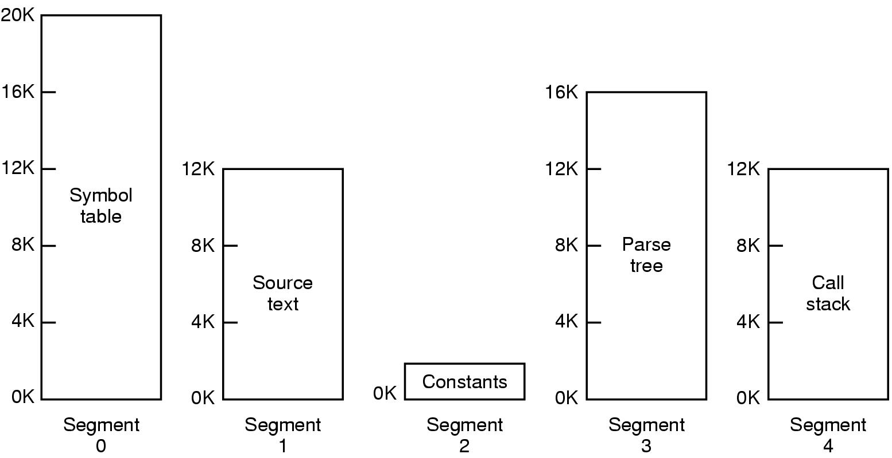
Problem in One-Dimensional Address Space (3)
Example (ctd.)
  Solution: To provide the machine with many completely independent address spaces, called segments.
Figure 3-31 A segmented memory allows each table to grow or shrink, independently

Slide 6
Segmentation (1)
Memory management scheme that supports user view of memory.
The entire logical address space is considered as collection of segments with each segment having a number and a length.
Segment
  A self-contained unit, which consists of a linear sequence of address from 0 to some maximum.
  A segment usually does not contain a mixture of different type.

Slide 7
Segmentation (2)
Segment (ctd.)
  The length of each segment can vary in size, from 0 to the maximum allowed.
  Segment lengths may change during execution without affecting each other.
  A segment is a logical entity, which the programmer is aware of and uses as a single logical entity.

Slide 8

Segmentation (3)
User’s View of A Program
  A program is a collection of segments. A segment is a logical unit such as:
    Main program
    Procedure
    Function
    Symbol table
    Stack

Slide 9
Segmentation (4)
Logical View of Segmentation
1
1
4
2
3
2
4
3
user space
physical memory space

Slide 10
Address Translation Scheme (1)
Logical or Virtual Address
  Virtual Segment Number (s)
  Offset (d)
Segment Table (maintained by OS)
  Maps two-dimensional physical addresses.
  The virtual segment number is used as an index to the segment table.
  Each table entry has:
    base – contains the starting physical address where the segments reside in memory
    limit – specifies the length of the segment

Slide 11
Address Translation Scheme (2)
Address Translation
  When CPU generates a logical address, that address is sent to MMU. The MMU uses the segment number of logical address as an index to the segment table.
  The offset is compared with the segment limit and if it is greater, invalid-address error is generated.
  Otherwise, the offset is added to the segment base to form the physical address.

Slide 12

Address Translation Scheme (3)
Address Translation (ctd.)
  Figure

Slide 13

Address Translation Scheme (4)
Example

Slide 14
Address Translation Scheme (5)
Exercise
  Using the following segment table, compute the physical address for the logical address consisting of segment and offset as follows:
    Segment 2 and offset 247
    Segment 4 and offset 439
base
limit
0
5432
350
1
115
100
2
2200
780
3
4235
1100
4
1650
400
Segment Table

Slide 15
Address Translation Scheme (6)
Exercise (ctd.)
  Solution
    Segment = 2, Offset = 247
    From the segment table, limit of segment 2 = 780 and segment base = 2200
    Since the offset is less than the limit,
    Physical address = Offset + Segment base = 247 + 2200 = 2447
base
limit
0
5432
350
1
115
100
2
2200
780
3
4235
1100
4
1650
400
Segment Table

Slide 16
Address Translation Scheme (7)
Exercise (ctd.)
  Solution
    Segment = 4, Offset = 439
    From the segment table, limit of segment 4 = 400 and segment base = 1650
    Since the offset is greater than the limit, invalid-address error is generated.
base
limit
0
5432
350
1
115
100
2
2200
780
3
4235
1100
4
1650
400
Segment Table

Slide 17
Advantages of Segmentation
May be possible to shrink/grow segments.
Each segment can be given its own protection information...this is a much easier protection scheme than trying to protect each page of memory.
Linking programs is a trivial task.
Code can be shared between processes easily. Just load the code segment once. Copies of the same program access the same segment.
Notes:
For linking programs...explain how object code is created for individual files...and then put together by the linker with all the address realignment and such.

Slide 18
Disadvantages of Segmentation
Programmer must be aware of the memory model in use (at the assembly level, anyway).
Just like with swapping systems, fragmentation can waste much memory.
Segments may be too large to fit in physical memory.

Slide 19

Paging vs. Segmentation
Figure 3-32 Comparison of paging and segmentation

Slide 20
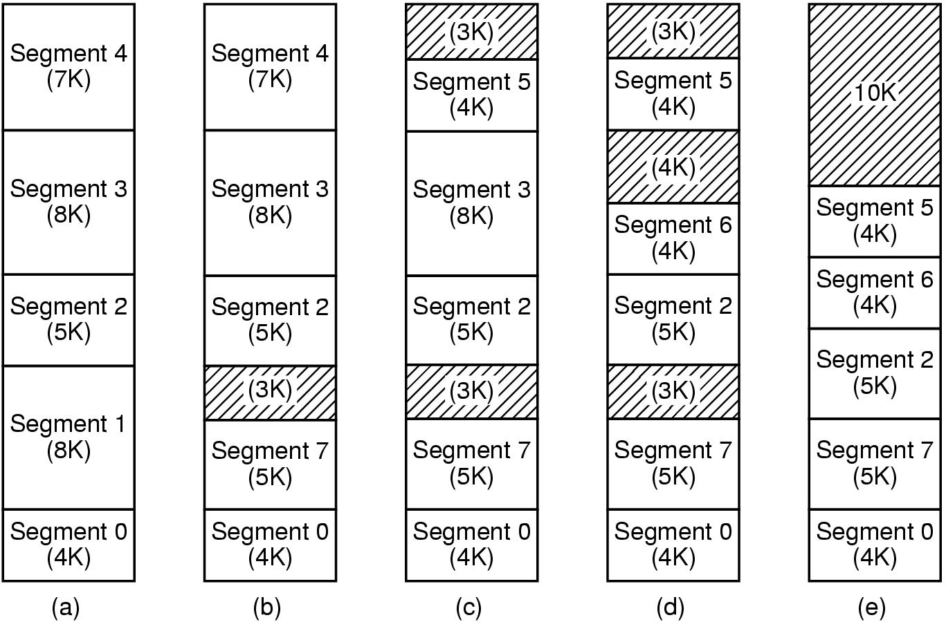
Implementation of Pure Segmentation
Pure segmentation was once implemented by Burroughs in the B5500.
Figure 3-33 (a)-(d) Development of checkerboarding
(e) Removal of the checkerboarding by compaction

Slide 21
Segmentation with Paging (1)
Treat virtual address space as a collection of segments (logical units) of arbitrary sizes.
Treat physical memory as a sequence of fixed size page frames.
Segments are typically larger than page frames, ⇒ Map a logical segment onto multiple page frames by paging the segments.
Physical memory contains only the demanded pages of a segment, not the full segment.

Slide 22
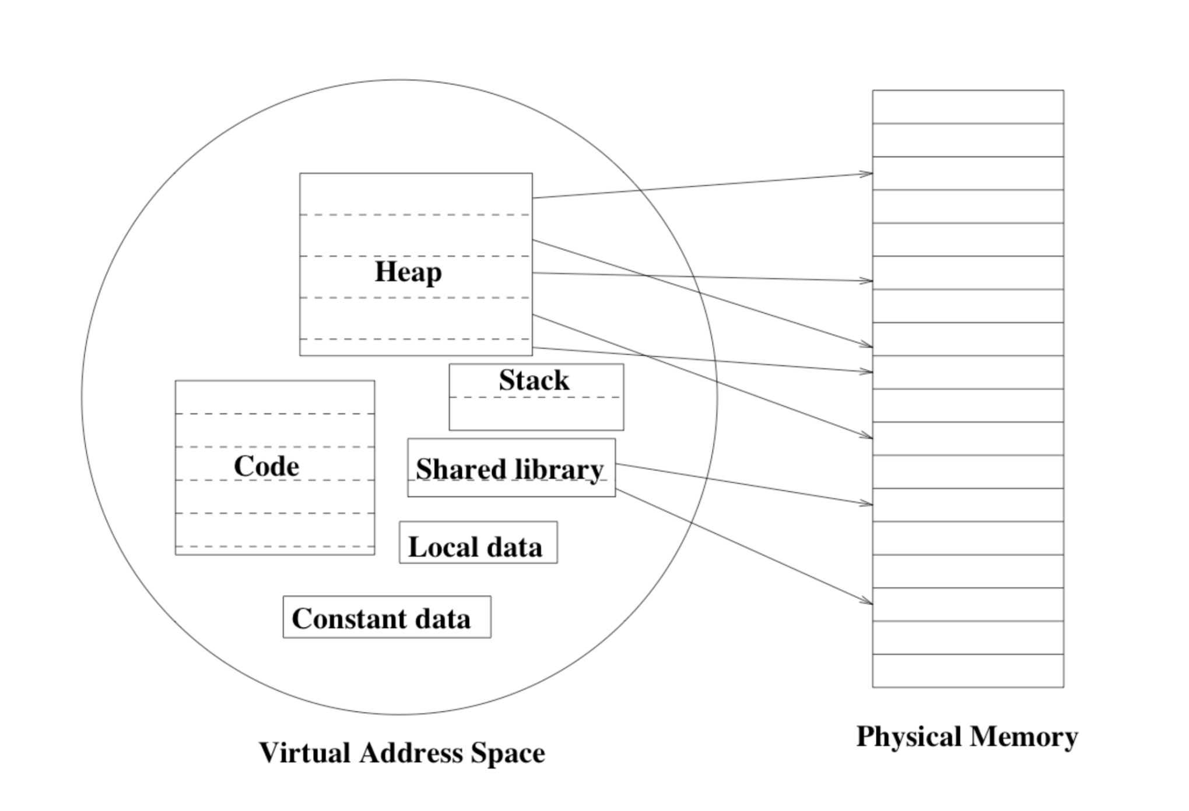
Segmentation with Paging (2)

Slide 23
Segmentation with Paging (3)
Each process needs a segment table.
  This table may be segmented and paged itself!
Each segment is divided into a number of pages.
To keep track of these pages, a page table is maintained for each segment.
  Each entry in the segment table points to the page table for that segment.

Slide 24
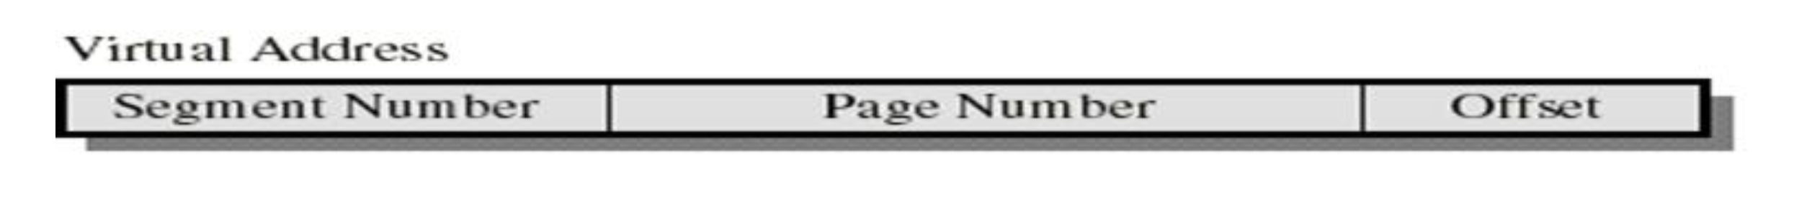
Address Translation Scheme (1)
The virtual address has three components
  Segment Number
    Used to index the segment table who’s entry gives the starting address of the page table for that segment.
  Page Number
    Used to index that page table to obtain the corresponding frame number.
  Offset
    Used to locate the word within the frame.

Slide 25
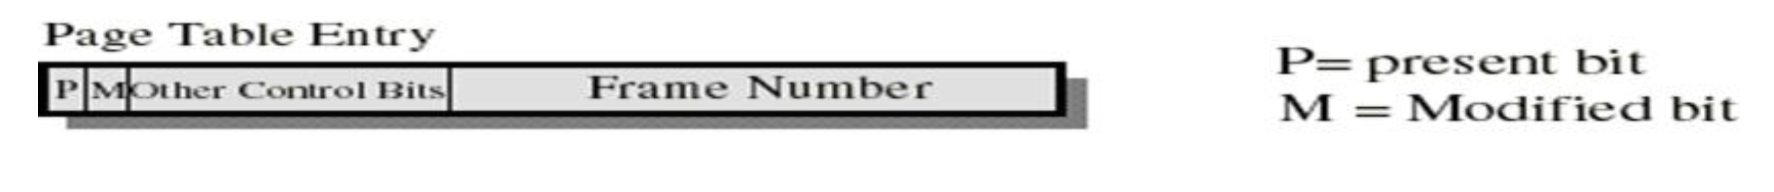
Address Translation Scheme (2)
Segment Table Entry
  The Segment Base field is the physical address of the page table of that segment.
  Protection and sharing info most naturally resides in segment table entry.
    E.g., a read-only/read-write bit, a kernel/user bit...
Page Table Entry
  Present/modified bits are present only in page table entry.

Slide 26
Address Translation Scheme (3)
Translation Scheme
  The segment number indexes into the segment table which yields the base address of the page table for that segment.
  Check the remainder of the address (page number and offset) against the limit of the segment.
  Use the page number to index the page table. The entry is the frame. (The rest of this is just like paging.)
  Add the frame and the offset to get the physical address.

Slide 27
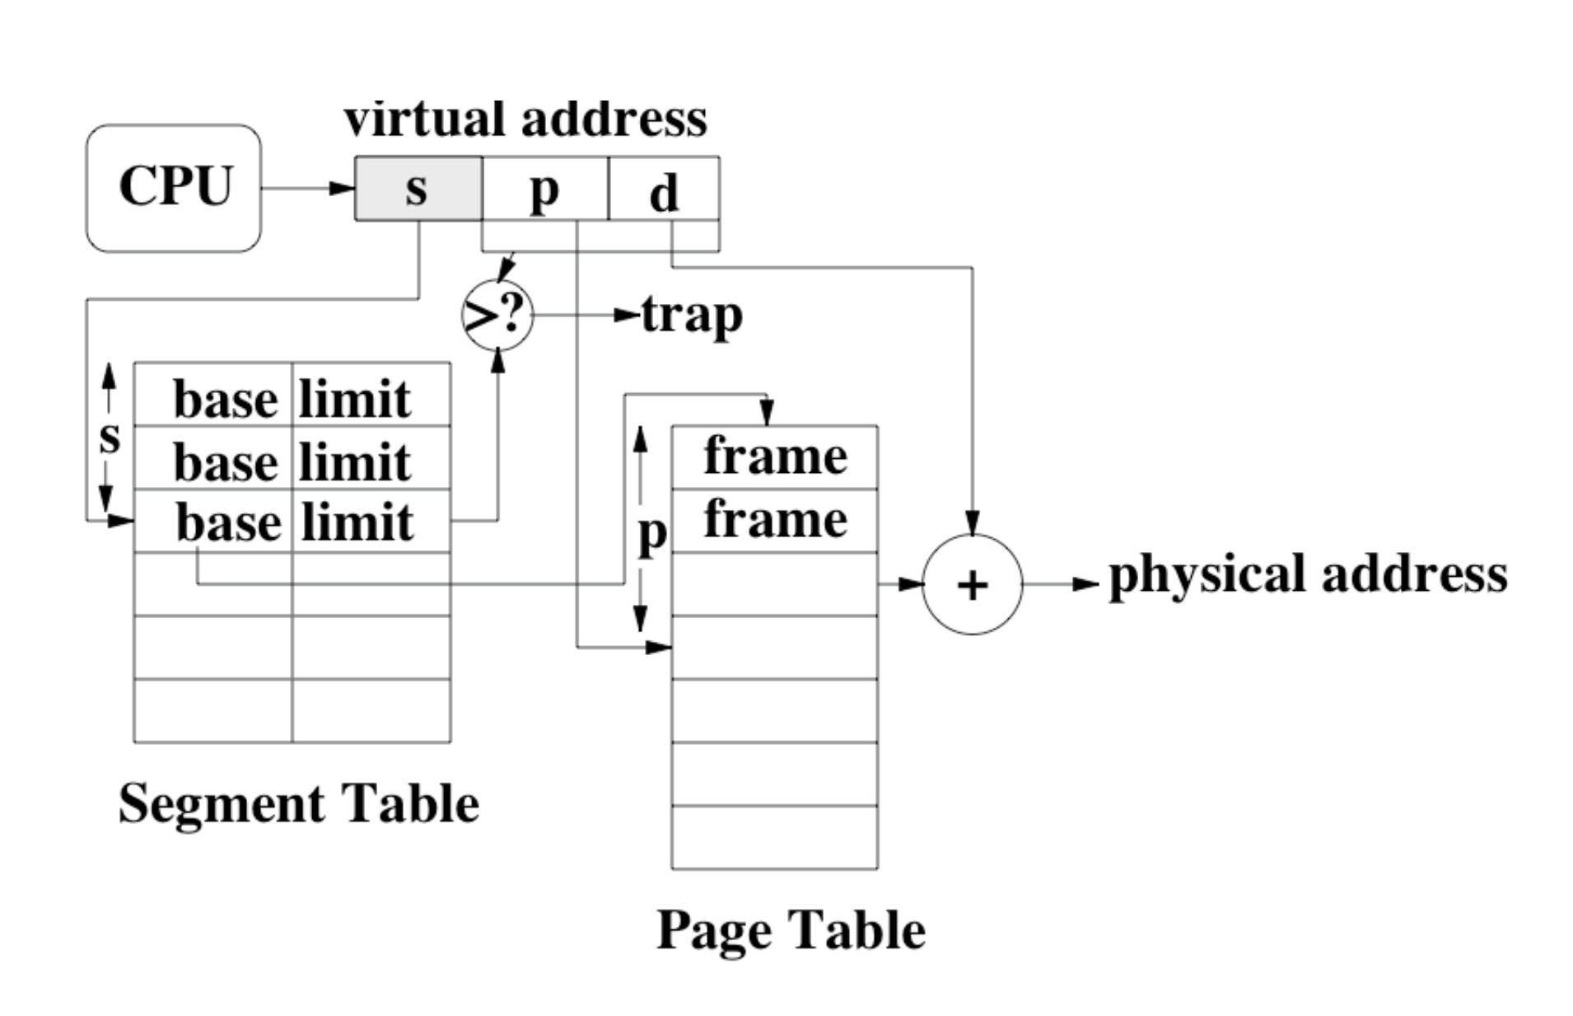
Address Translation Scheme (4)
Address Translation Figure

Slide 28
Exercise
Given
  A memory size of 256 addressable words
  A page table indexing 8 pages,
  A page size of 32 words, and
  8 logical segments
Question:
  1. How many bits is a physical address?
  2. How many bits is a virtual address?
  3. How many bits for the seg #, page #, offset?
  4. How many segment table entries do we need?
  5. How many page table entries do we need?

Slide 29
Segmentation with Paging: MULTICS (1)
MULTICS Introduction
  Multiplexed Information and Computing Service
  Developed by MIT, GE and Bell Laboratories as the successors to MIT’s CTSS (Compatible Time Sharing System).
  One of the first operating systems to implement virtual memory.
  A mainframe timesharing operating system begun in 1965 and used until 2000.
  Sold by honeywell in Honeywell 6000 machines + descendents.
  MULTICS source was open by MIT.

Slide 30
Segmentation with Paging: MULTICS (2)
MULTICS Introduction (ctd.)
  The Multics hardware (GE-645) was word addressable, with 36-bit words.
  Each virtual address was 34-bits in length
  Per program: virtual memory of max. size 2¹⁸ = 256K segments (max. size 64K 36-bit word long)
    Each segment of size up to 2⁶=64 pages. Each page is of size 2¹⁰ (36-bit) words.
  16-word high speed TLB

Slide 31
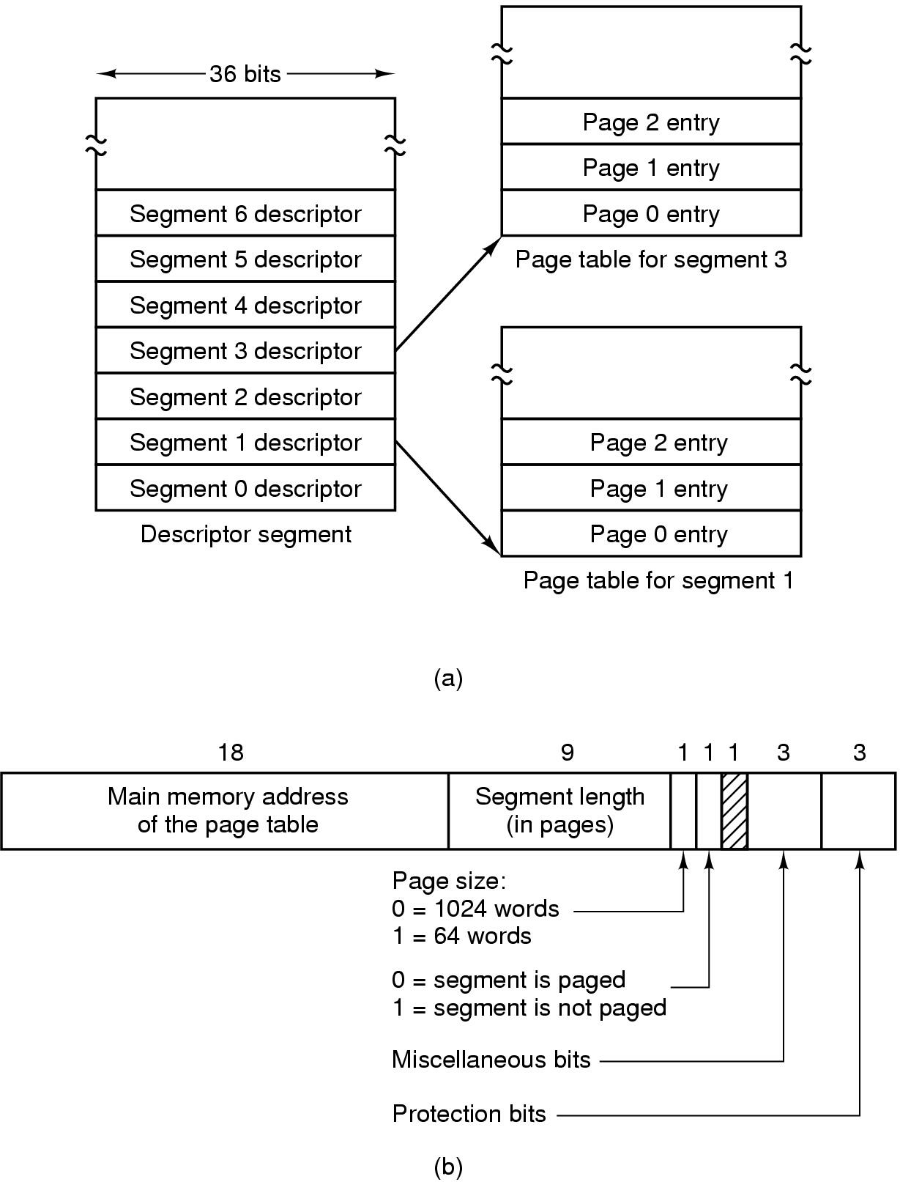
Segmentation with Paging: MULTICS (3)
MULTICS Virtual Memory
  Descriptor Segment: Segment table
    Up to 256K segment descriptors
  Segment Descriptor: segment table entry
64K
Figure 3-34 (a) Descriptor segment points to page tables

Slide 32
Segmentation with Paging: MULTICS (4)
MULTICS Virtual Memory (ctd.)
  Segment Descriptor Structure
    Because physical addresses were 24-bit and pages were aligned on
    64 byte boundaries,
    only 18 bits for main memory
    address.
    The address of the segment in
    secondary memory was in another
    table used by the segment fault handler.
Figure 3-34 (b) Segment descriptor – numbers are field lengths

Slide 33
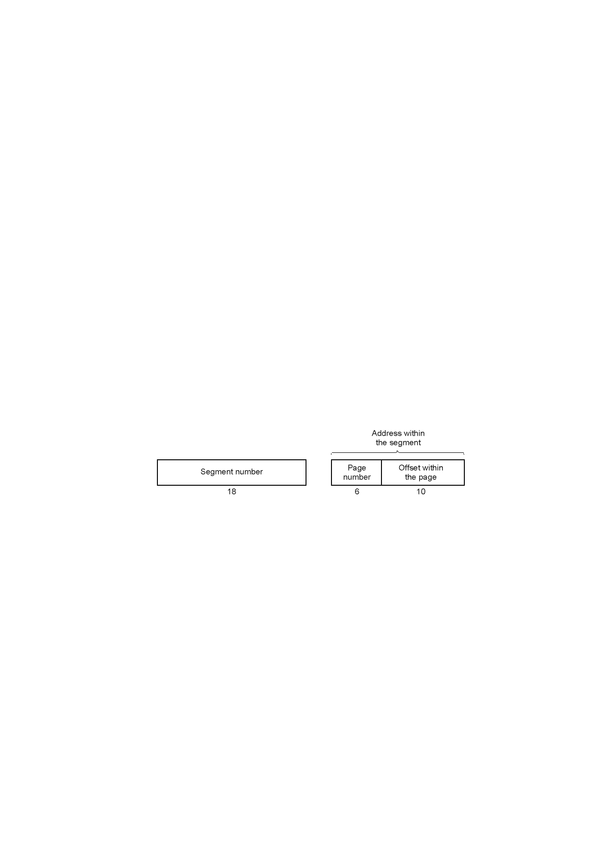
Segmentation with Paging: MULTICS (5)
MULTICS Virtual Memory (ctd.)
  Virtual Address Structure
Figure 3-35 A 34-bit MULTICS virtual address

Slide 34
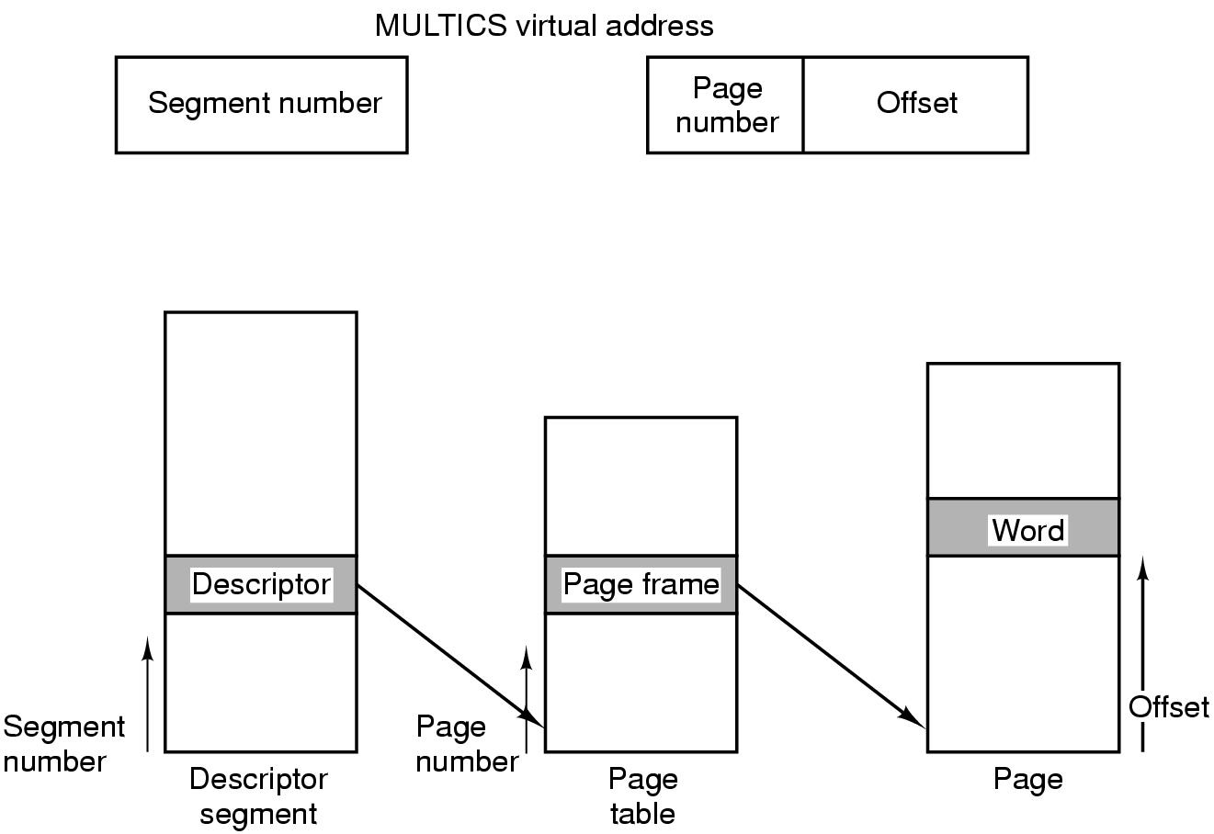
Segmentation with Paging: MULTICS (6)
MULTICS Virtual Memory (ctd.)
  Address Translation (Ignoring descriptor segment was paged)
Figure 3-36 Conversion of a 2-part MULTICS address into a main memory address

Slide 35
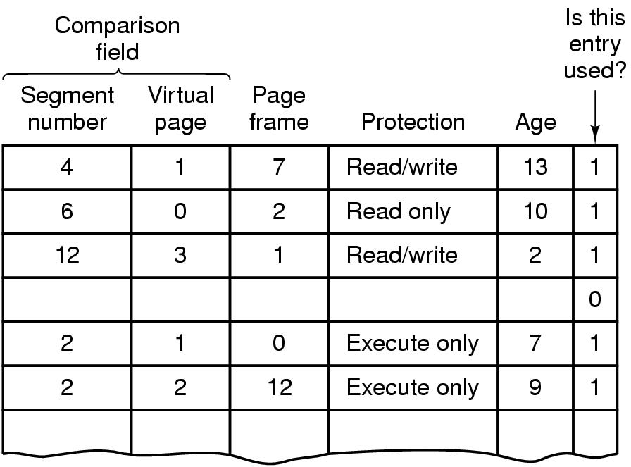
Segmentation with Paging: MULTICS (7)
MULTICS Virtual Memory (ctd.)
  MULTICS TLB
    The first system to have a TLB.
Figure 3-37 Simplified version of the MULTICS TLB.
Existence of 2 page sizes makes actual TLB more complicated

Slide 36
Segmentation with Paging: The Intel x86 (1)
The Intel x86
  x86 is a family of backward-compatible instruction set architectures based on the Intel 8086 CPU and its Intel 8088 variant.
  The 8086 was introduced in 1978 as a fully 16-bit extension of Intel's 8-bit-based 8080 microprocessor, with memory segmentation as a solution for addressing more memory than can be covered by a plain 16-bit address.
  The term "x86" came into being because the names of several successors to Intel's 8086 processor end in "86", including the 80186, 80286, 80386 and 80486 processors.
  1978 (16-bit), 1985 (32-bit), 2003 (64-bit)
  Support for segmentation removed in x86-64.

Slide 37
Segmentation with Paging: The Intel x86 (2)
Each program could have up to 16K segments, each segment could be up to 1 billion(32-bit) words long.
Each program has its own LDT .
Local Descriptor Table (LDT)
  Describes segments local to each program, including its code, data, stack, …
A single GDT shared by all programs on the computer.
GDT (Global Descriptor Table)
  Describes system segments, including the OS itself.

Slide 38
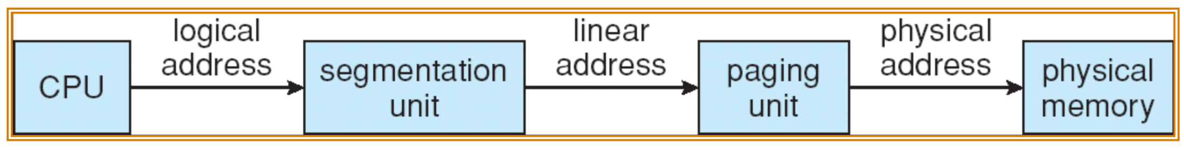
Segmentation with Paging: The Intel x86 (3)
x86 Address Translation
  CPU generates logical address (segment selector, offset)
  Gives it to segmentation unit, which produces linear addresses.
  Linear address given to paging unit, which generates physical address in main memory.

Slide 39
Segmentation with Paging: The Intel x86 (4)
x86 Segment Selector
  Logical address: segment selector + offset
  Segment selector stored in segment registers (or selector registers) (16-bit)
    cs: code segment selector
    ss: stack segment selector
    ds: data segment selector
    es, fs, gs: for OS to use freely
  To access a segment, a x86 program first loads a selector for that segment into one of the machine’s 6 segment register.

Slide 40
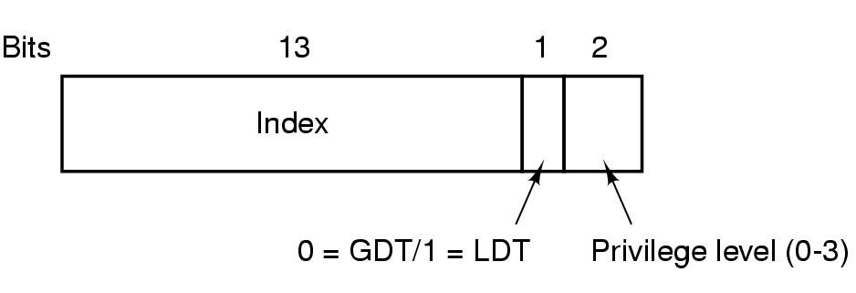
Segmentation with Paging: The Intel x86 (5)
x86 Segment Selector (ctd.)
  Consists three fields
    Index Field: Specify LDT or GDT entry number. Theses tables are restricted to hold 8K segment descriptors.
Figure 3-38 A x86 selector

Slide 41
Segmentation with Paging: The Intel x86 (6)
Segment Descriptor
  Actual attributes of a segment are contained in the segment descriptor.
  Segment descriptors are 64 bits (8 bytes in size).
  Reside in Global or Local descriptor tables of up to 8192 entries.
  Entry 0 always represents an invalid segment.

Slide 42
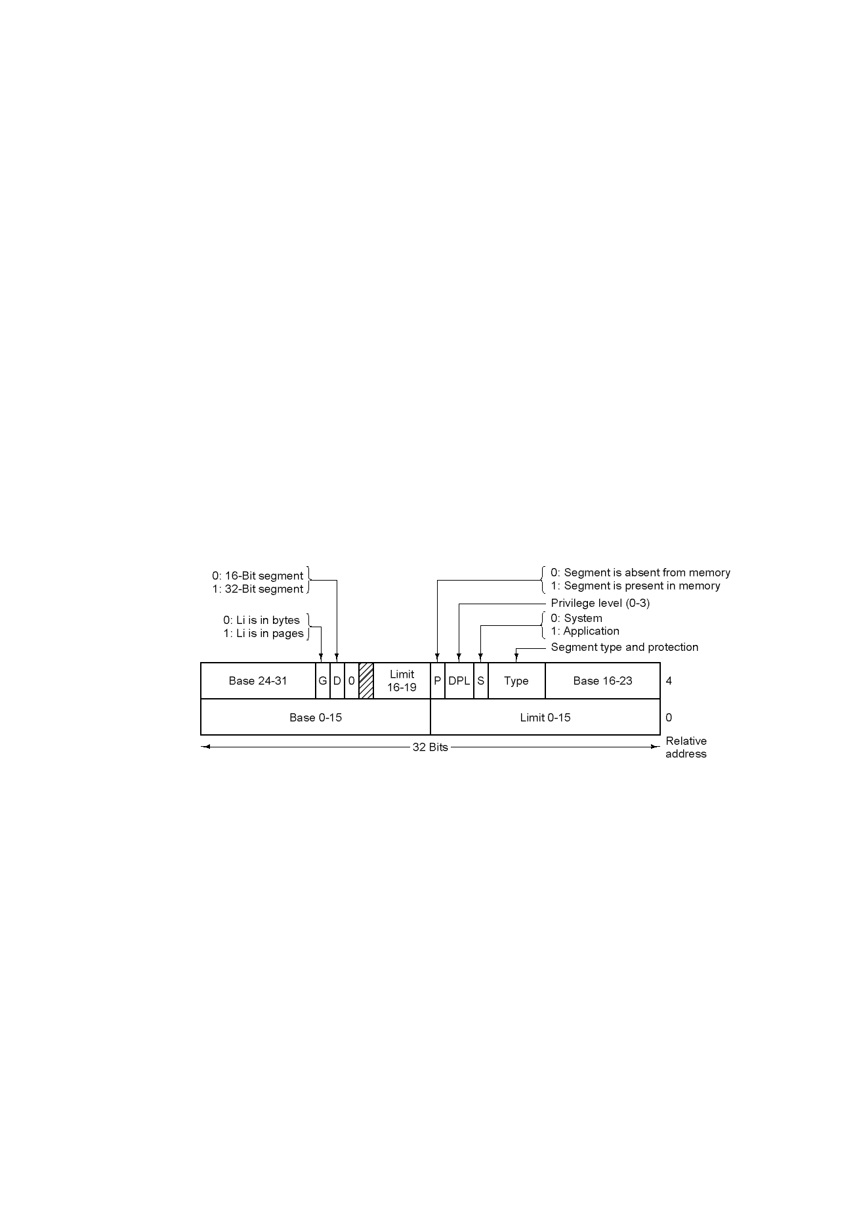
Segmentation with Paging: The Intel x86 (7)
Segment Descriptor (ctd.)
  G Field: granularity flag. G=0, Limit: 1B～1MB. G=1, Limit: 4KB～4GB
  Base Field: for compatibility with 286, broken into 3 pieces.
Figure 3-39 x86 code segment descriptor (Data segments differ slightly)

Slide 43
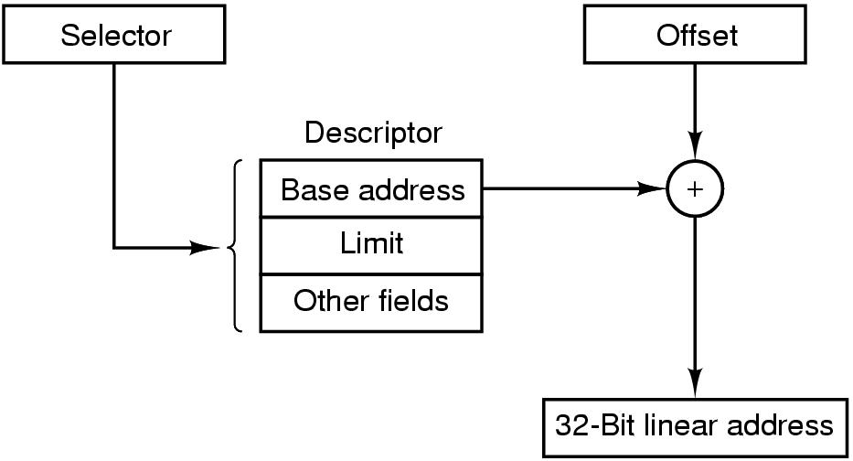
Segmentation with Paging: The Intel x86 (8)
Translation from Logical Address to Linear Address
Check: offset <= limit
Figure 3-40 Conversion of a (selector, offset) pair to a linear address

Slide 44
Segmentation with Paging: The Intel x86 (8)
Translation from Logical Address to Linear Address (ctd.)
  If pure segmentation, the linear address is interpreted as the physical address.
  If paging enabled, the linear address is interpreted as a virtual address.
    Need mapping to physical address.

Slide 45
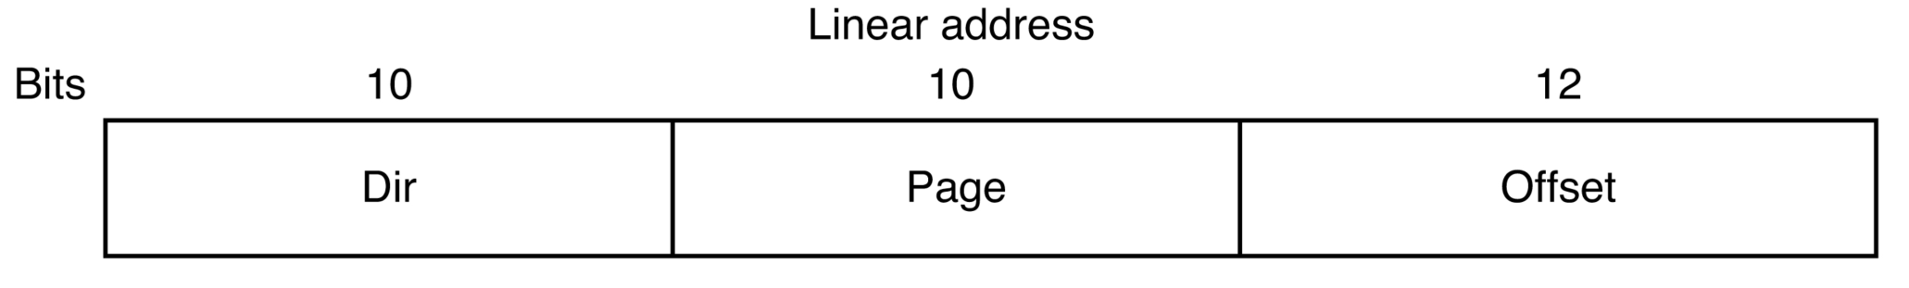
Segmentation with Paging: The Intel x86 (9)
Mapping from Linear Address to Physical Address
  32 bit virtual address, 4KB page size
  Two-level paging
  Linear Address Structure
Figure 3-41 (a)

Slide 46
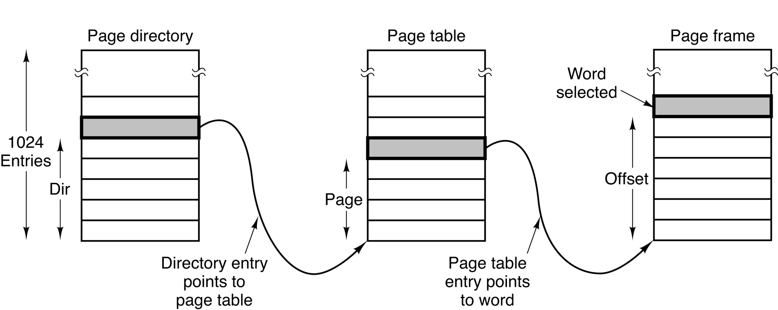
Segmentation with Paging: The Intel x86 (10)
Mapping from Linear Address to Physical Address (ctd.)
  Each running program has a page directory consisting of 1K 32-bit entries.
  Each entry in this directory points to a table also containing 1K 32-bit entries.
Figure 3-41 (b) Mapping of a linear address onto a physical address

Slide 47

Segmentation with Paging: The Intel x86 (11)
From Logical Address to Physical Address

Slide 48
Homework
P259: 45, 47

