Slide 1
Modern Operating Systems
Chapter 4 – Example File Systems
Zhang Yang
Autumn 2018

Slide 2
Content of the Lecture
4.5 Example File Systems

Slide 3
Example File Systems
The MS-DOS File System
Windows 98 File System (supplemented)
Windows NT File System (see chapter 11.8)
UNIX V7 File System
Linux Ext2 File System (see chapter 10.6.3)
CD-ROM File System

Slide 4
Example File Systems Overview
Many file systems, sometimes many within an operating system
  Each with its own format (CD-ROM is ISO 9660; Unix has UFS, FFS; Windows has FAT, FAT32, NTFS as well as floppy, CD, DVD Blu-ray, Linux has more than 40 types, with extended file system ext2 and ext3 leading; plus distributed file systems, etc.)
  New ones still arriving – ZFS, GoogleFS, Oracle ASM, FUSE

Slide 5
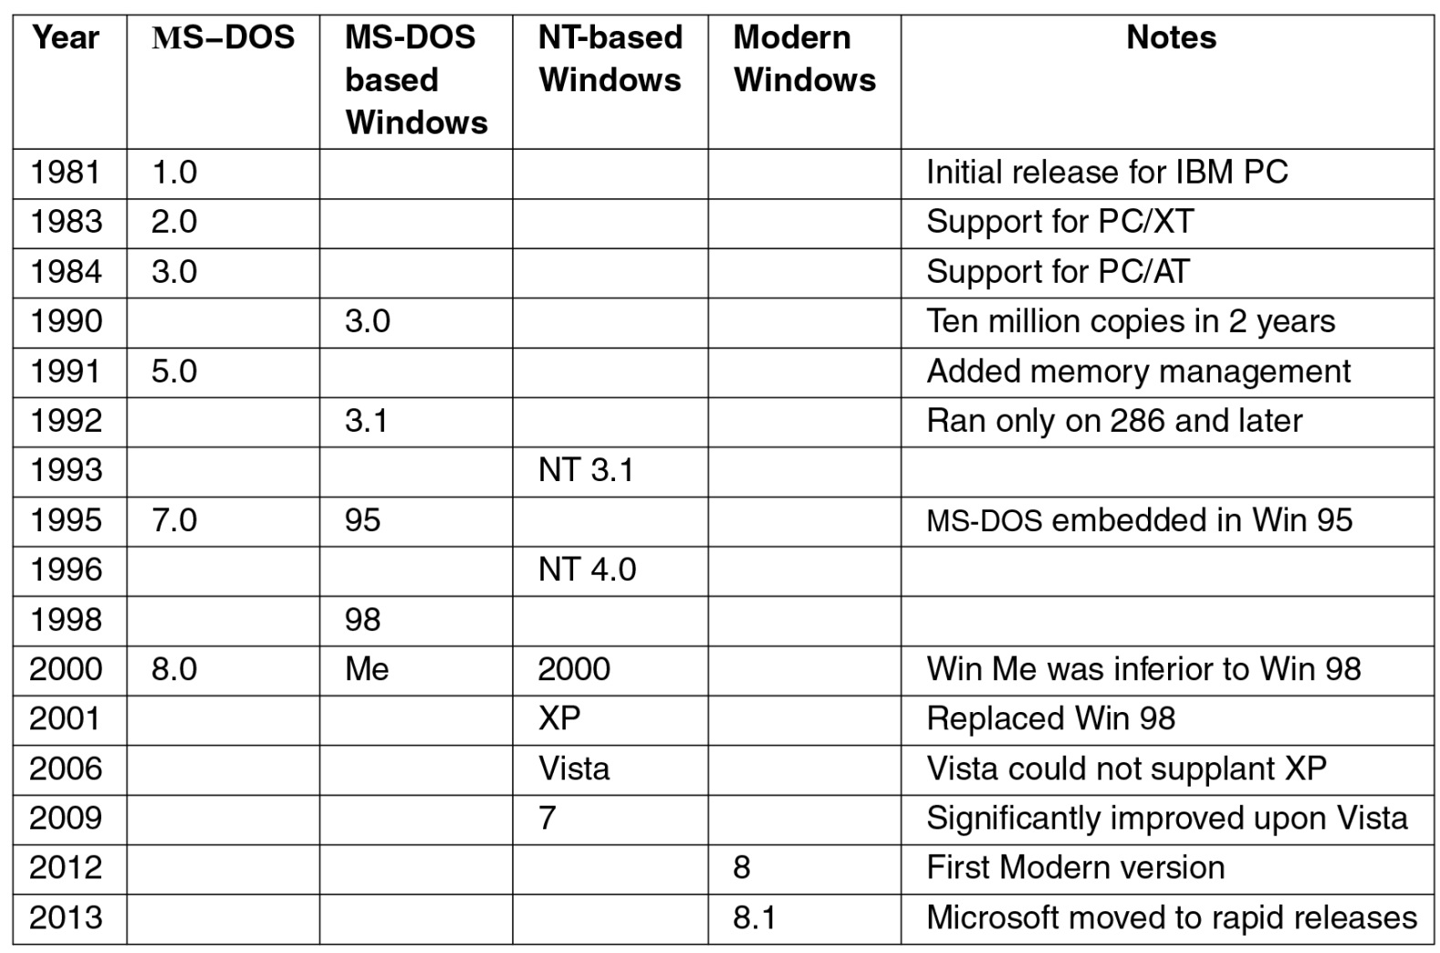
History of Windows
2015 10
Figure 11-1. Major releases in the history of Microsoft operating systems for desktop PCs.

Slide 6
The MS-DOS File System (1)
The first IBM PC used.
Main file system of Windows 98 and Windows ME.
Still supported on Windows 2000, Windows XP, and Windows Vista.
MS-DOS file system and its extension (FAT-32) have become widely used for many embedded systems.

Slide 7
The MS-DOS File System (2)
Use 8+3 file names.
DOS 1.0 limited to one directory.
Later versions allows hierarchical file system.
  Directory can nested to an arbitrary depth.
Directories are variable sized.
But directory entries are fixed size of 32 bytes.

Slide 8
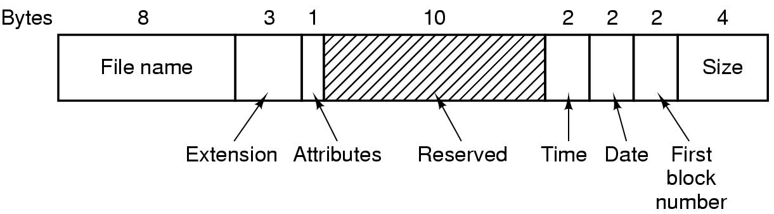
The MS-DOS File System (3)
Directory Entry
  Attributes: indicate a file is read-only, archived, hidden, or system file.
  Time: hours (5 bits), minutes (6 bits), seconds (5 bits)
  Date: year (7 bits), month (4 bits), day (5 bits)
  Size: in theory can be 4GB, but in fact 2GB or less.
Figure 4-30 The MS-DOS directory entry

Slide 9
The MS-DOS File System (4)
The highest expressible year in MS-DOS is 2107.
  The counter starts at 1980.
Use file allocation table to keep track of file addresses.
Each directory entry only gives the first block number.
  Which is used to index into the FAT table.

Slide 10
The MS-DOS File System (5)
FAT file system has three versions for MS-DOS: FAT-12, FAT-16, FAT-32.
  Each differs from the bits a disk address contains.
  FAT-32 introduced with 2nd release of Windows 95.
Disk blocks are multiples of 512 bytes.
  Can be different for each partition.
Allowable block size differing by variants.

Slide 11
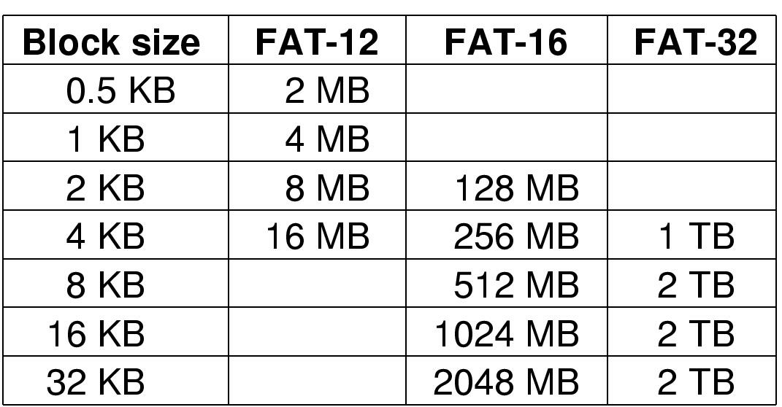
The MS-DOS File System (6)
FAT-32
  28-bit disk address
  Partition size: theoretically max 8TB (2²⁸×2¹⁵ bytes), but usually limited to 2TB.
Figure 4-31 Maximum partition for different block sizes. The empty boxes represent forbidden combinations

Slide 12
The MS-DOS File System (7)
Advantages of FAT-32 over FAT-16
  Support larger disks.
  An 8-GB disk using FAT-32 can be a single partition. Using FAT-16 has to be four partitions.
  For a given size disk partition, a smaller block size can be used.

Slide 13
The MS-DOS File System (8)
Exercise
  Problem: The MS-DOS FAT-16 table contains 64K entries. Suppose that one of the bits had been needed for some other purpose and that the table contained exactly 32768 entries instead. With no other changes, what would the largest MS-DOS file have been under this condition?
  Solution: The largest block is 32KB. With 32,768 of these blocks, the biggest file would be 1 GB.

Slide 14
The Windows 98 File System (1)
To accommodate long file names
  Up to 255 characters
To provide backwards compatibility to MS-DOS files
  Must use the MS-DOS directory structure
Idea: keep two names for each file
  Create a MS-DOS name from the given (long) name.
  Both name are then stored in the directory structure.

Slide 15
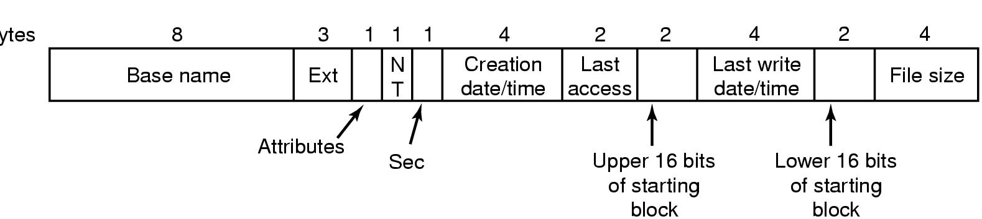
The Windows 98 File System (2)
Bytes
The extended MOS-DOS directory entry used in Windows 98
NT: compatibility with Windows NT
Sec: solve the problem that it is not possible to store the time of day in a 16-bit field. (Creation time is accurate to 10 msec)
Creation time
Last access
Upper 16bits of starting block

Slide 16
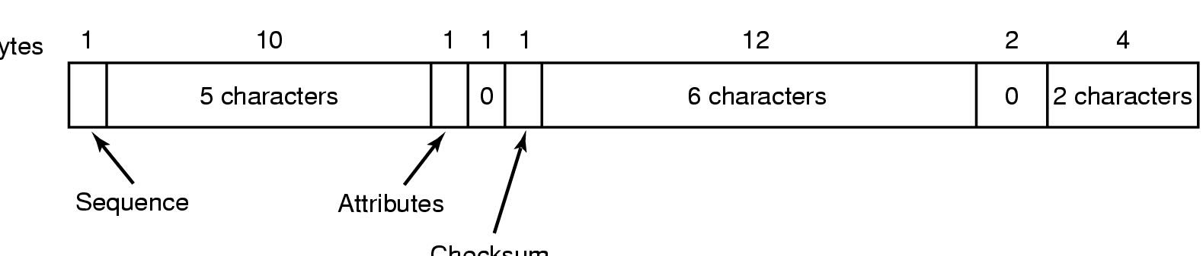
The Windows 98 File System (3)
Bytes
Checksum
An entry for (part of) a long file name in Windows 98
sequence: 6 bit. The maximum file name = 63 * 13 = 819. But in fact limited to 260 chars for historical reasons.
Attributes field = 0x0f for long file name

Slide 17
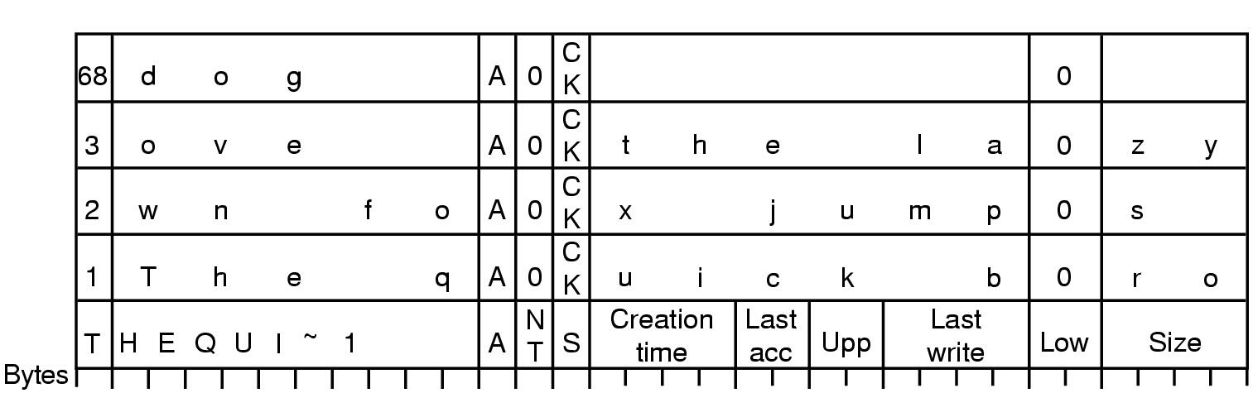
The Windows 98 File System (4)
An example of how a long name is stored in Windows 98

Slide 18
The Windows NT File System (1)
See textbook P952 11.8
The developers of Windows NT designed a new file system, the New Technology File System (NTFS) which is intended to meet high-end requirements for workstations and servers.
Key features of NTFS:
  Recoverability
  Security
  Large disks and large files
  Multiple data streams
  Journaling
  Compression and encryption
  Hard and symbolic links

Slide 19
The Windows NT File System (2)
From Windows XP, NTFS became the default file system.
NTFS makes use of the following disk storage concepts:
  Sector
    The smallest physical storage unit on the disk.
    The data size in bytes is a power of 2 and is almost always 512 bytes.
  Cluster
    One or more contiguous sectors
    The cluster size in sectors is a power of 2.

Slide 20
The Windows NT File System (3)
NTFS makes use of the following disk storage concepts: (ctd.)
  Cluster (ctd.)
    The cluster is the fundamental unit of allocation in NTFS, which does not recognize sectors.
    The clusters allocated to a file need not be contiguous; it is permissible to fragment a file on the disk.
    Currently, the maximum file size supported by NTFS is 2³² clusters, which is equivalent to a maximum of 2⁴⁸ bytes. A cluster can have at most 2¹⁶ bytes.
Notes:
The cluster is the fundamental unit of allocation in NTFS, which does not
recognize sectors. For example, suppose each sector is 512 bytes and the system is
configured with two sectors per cluster (one cluster 1K bytes). If a user creates
a file of 1,600 bytes, two clusters are allocated to the file. Later, if the user updates
the file to 3,200 bytes, another two clusters are allocated. The clusters allocated to a
file need not be contiguous; it is permissible to fragment a file on the disk. Currently,
the maximum file size supported by NTFS is 232 clusters, which is equivalent to a
maximum of 248 bytes. A cluster can have at most 216 bytes.
The use of clusters for allocation makes NTFS independent of physical sector
size. This enables NTFS to support easily nonstandard disks that do not have a
512-byte sector size and to support efficiently very large disks and very large files
by using a larger cluster size. The efficiency comes from the fact that the file system
must keep track of each cluster allocated to each file; with larger clusters, there are
fewer items to manage.

Slide 21
The Windows NT File System (4)
NTFS makes use of the following disk storage concepts: (ctd.)
  Volume
    A logical partition on a disk, consisting of one or more clusters and used by a file system to allocate space.
    Can be all or a portion of a single disk or it can extend across multiple disks.
    The maximum volume size for NTFS is 2⁶⁴ bytes.
Notes:
The cluster is the fundamental unit of allocation in NTFS, which does not
recognize sectors. For example, suppose each sector is 512 bytes and the system is
configured with two sectors per cluster (one cluster 1K bytes). If a user creates
a file of 1,600 bytes, two clusters are allocated to the file. Later, if the user updates
the file to 3,200 bytes, another two clusters are allocated. The clusters allocated to a
file need not be contiguous; it is permissible to fragment a file on the disk. Currently,
the maximum file size supported by NTFS is 232 clusters, which is equivalent to a
maximum of 248 bytes. A cluster can have at most 216 bytes.
The use of clusters for allocation makes NTFS independent of physical sector
size. This enables NTFS to support easily nonstandard disks that do not have a
512-byte sector size and to support efficiently very large disks and very large files
by using a larger cluster size. The efficiency comes from the fact that the file system
must keep track of each cluster allocated to each file; with larger clusters, there are
fewer items to manage.

Slide 22
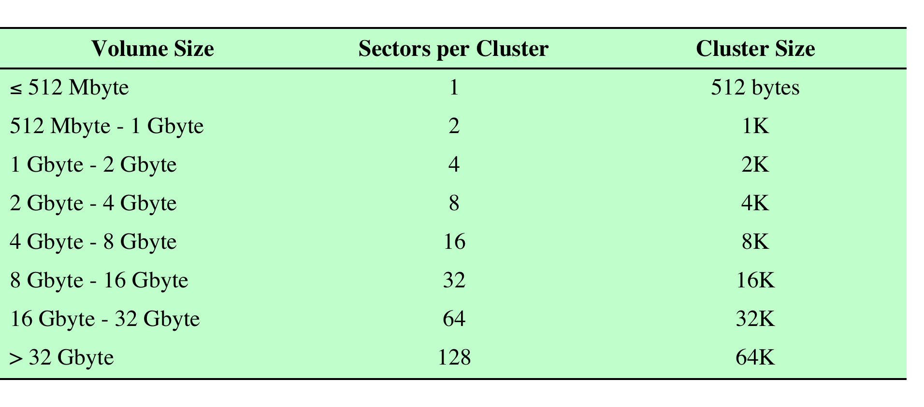
The Windows NT File System (5)
Windows NTFS Partition and Cluster Sizes

Slide 23
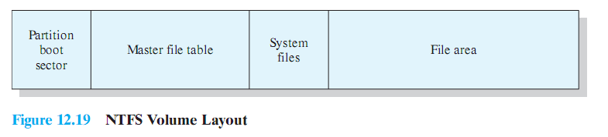
The Windows NT File System (6)
NTFS Volume Layout
  Every element on a volume is a file, and every file consists of a collection of attributes.
    Even the data contents of a file is treated as an attribute.
NTFS Volume Layout

Slide 24
The Windows NT File System (7)
Master File Table
  The heart of the Windows file system is the MFT.
  The MFT is organized as a table of 1,024-byte rows, called records.
  Each MFT record describes one file or one directory on this volume.
    It contains the file’s attributes and the list of disk addresses where its blocks are located.
  If a file is extremely large, it is sometimes necessary to use two or more MFT records.
    The first MFT record is called the base record, points to the additional MFT record.

Slide 25
The Windows NT File System (8)
Master File Table
  Each MFT record consists of a record header followed by a sequence of (attribute header, value) pairs.
    The recorder header contains
      A magic number used for validity checking
      A sequence number updated each time the record is reused for a new file
      A count of reference to the file
      The actual number of bytes in the record used
      The identifier (index, sequence number) of the base record (used only for extension records)
      Some other miscellaneous fields

Slide 26
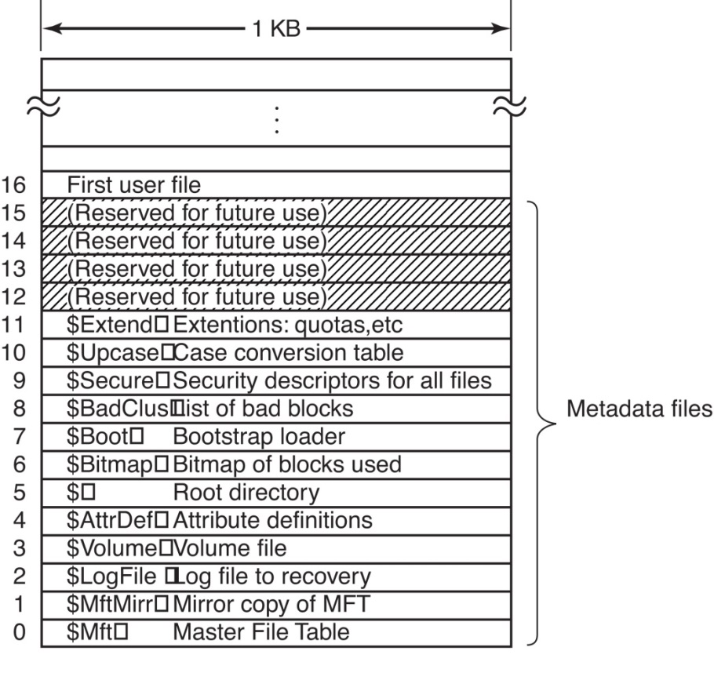
The Windows NT File System (9)
Master File Table (ctd.)
  Record 0-15
    Reserved for NTFS metadata files.
    $ indicates it is a metadata file.
  Record 0
    MFT itself is treated as a file.
    Can be placed anywhere within the
    Volume. Thus eliminating the problem
    with defective sectors in the first track.
    Record 0 describes the MFT file
    itself. In particular, it tells where the
    blocks of the MFT file are located so
    that the system can find the MFT file.
Figure 11-39 The NTFS master file table

Slide 27
The Windows NT File System (10)
Master File Table (ctd.)
  Record 1
    A duplicate of the early portion of
    the MFT file.
  Record 2
    The log file
  Record 3
    Contains information about
    the volume, such as its size,
    Label, and version.
Figure 11-39 The NTFS master file table

Slide 28

The Windows NT File System (11)
Master File Table (ctd.)
  Record 4
    Defines attributes.
  Record 5
    Describes root directory.
  Record 6
    Describes bitmap file keeping
    track of free space on the volume
Figure 11-39 The NTFS master file table

Slide 29
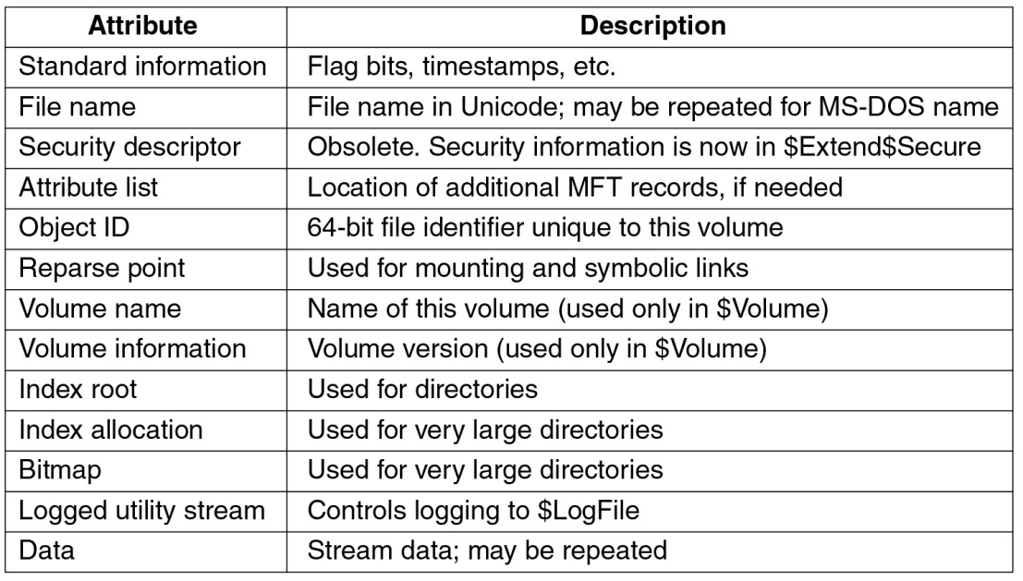
The Windows NT File System (12)
Master File Table (ctd.)
  Each record in the MFT consists of a set of attributes that serve to define the file (or folder) characteristics and the file contents.
Figure 11-40 The attributes used in MFT records

Slide 30
The Windows NT File System (13)
NTFS Storage Allocation
  NTFS File
    An NTFS file is not just a linear sequence of bytes.
    Instead, a file consists of multiple attributes, each represented by a stream of bytes.
    Most files have a few short streams, such as the name of the file and its 64-bit object ID, plus one long (unnamed) stream with the data.
    However, a file can also have two or more (long) data streams as well.
    Each stream has a name consisting of the file name, a colon, and the stream name.
      E.g. foo: stream1

Slide 31
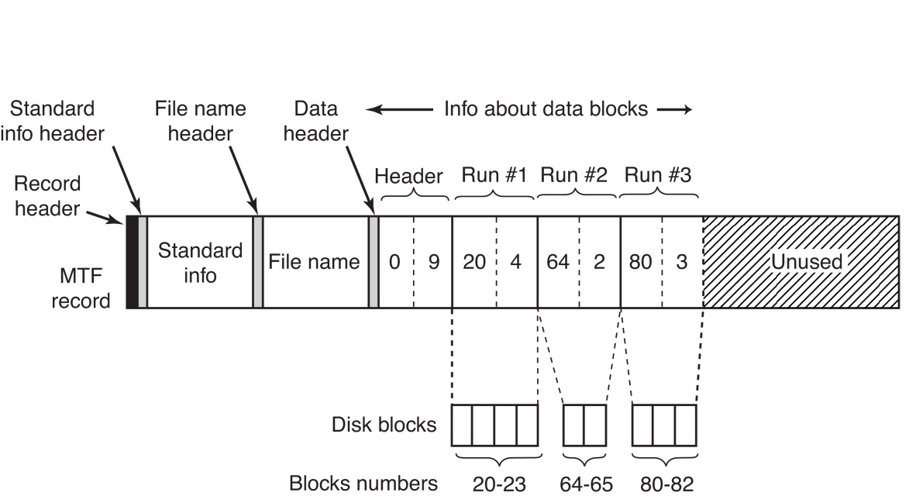
The Windows NT File System (14)
NTFS Storage Allocation (ctd.)
  Disk blocks are assigned in runs of consecutive blocks.
  The blocks in a stream are described by a sequence of records, each one describing a sequence of logically contiguous blocks.
  Example
    A MFT record for a
    short stream
Figure 11-41 An MFT record for a three-run, nine-block stream

Slide 32
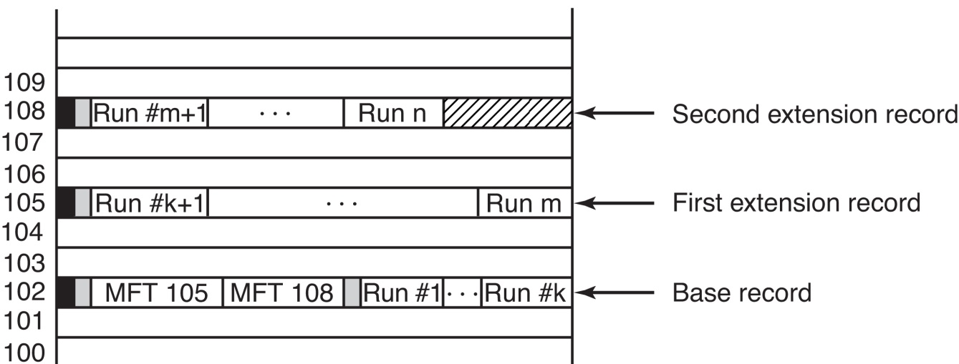
The Windows NT File System (15)
NTFS Storage Allocation (ctd.)
  What happens if the file is so large or highly fragmented that the block information does not fit in one MFT record?
Figure 11-42 A file that requires three MFT records to store all its runs

Slide 33
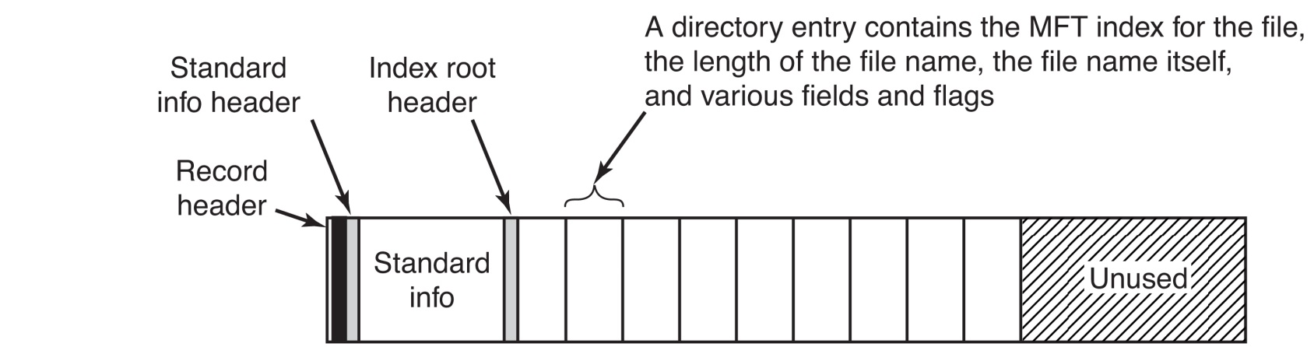
The Windows NT File System (16)
NTFS Storage Allocation (ctd.)
  MFT Entry for A Small Directory
Figure 11-43 The MFT record for a small directory

Slide 34
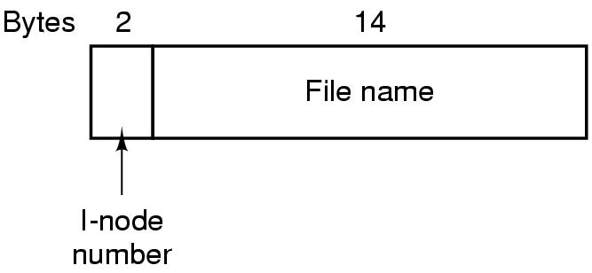
The UNIX V7 File System (1)
Introduced in PDP-11.
Organized in the form of a tree starting from root.
File names are up to 14 characters and can contain any ASCII characters except / and NUL.
Each directory entry has two fields:
  File name, and the # of i-node for that file (2 bytes)
Number of files in the file system limited to 64K.
Figure 4-32 A UNIX V7 directory entry

Slide 35
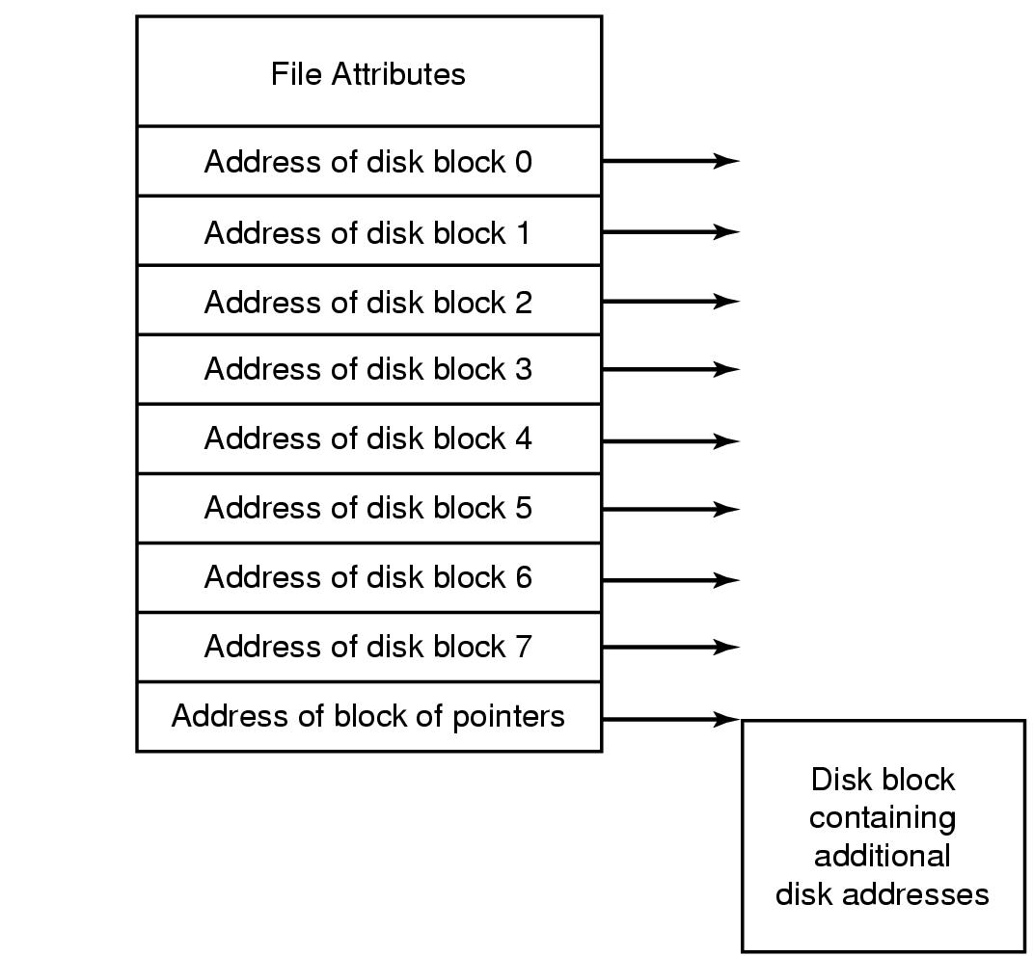
The UNIX V7 File System (2)
File Attributes:
  File size
  Creation, last access, last modification time
  Owner
  Group
  Protection
  Count
Figure 4-13 An Example i-node

Slide 36
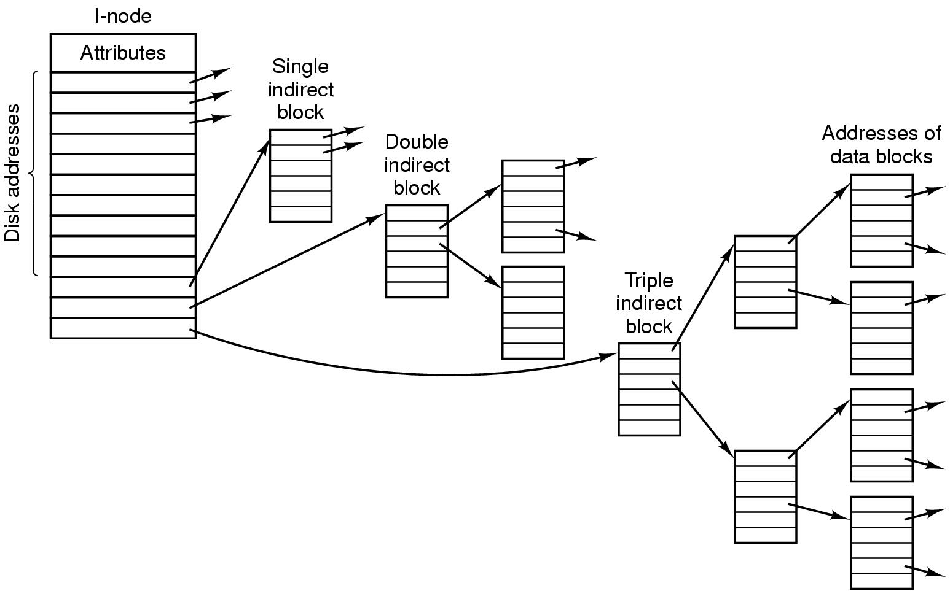
The UNIX V7 File System (3)
Figure 4-33 A UNIX i-node

Slide 37
The UNIX V7 File System (4)
The steps in looking up /usr/ast/mbox:
  The file system locates the root directory. It can be anywhere on the disk, but its i-node is located at a fixed place.
  The file system looks up the first component of the path (usr) and find its i-node number. From this i-node, the system locates the directory for /usr and looks up the next component (ast) in it.
  When the entry for ast is found in directory /usr, i-node for the directory /usr/ast can be obtained. From this i-node it can find the directory itself and lookup mbox.
  The i-node for this file is then read into memory and kept there until the file is closed.

Slide 38
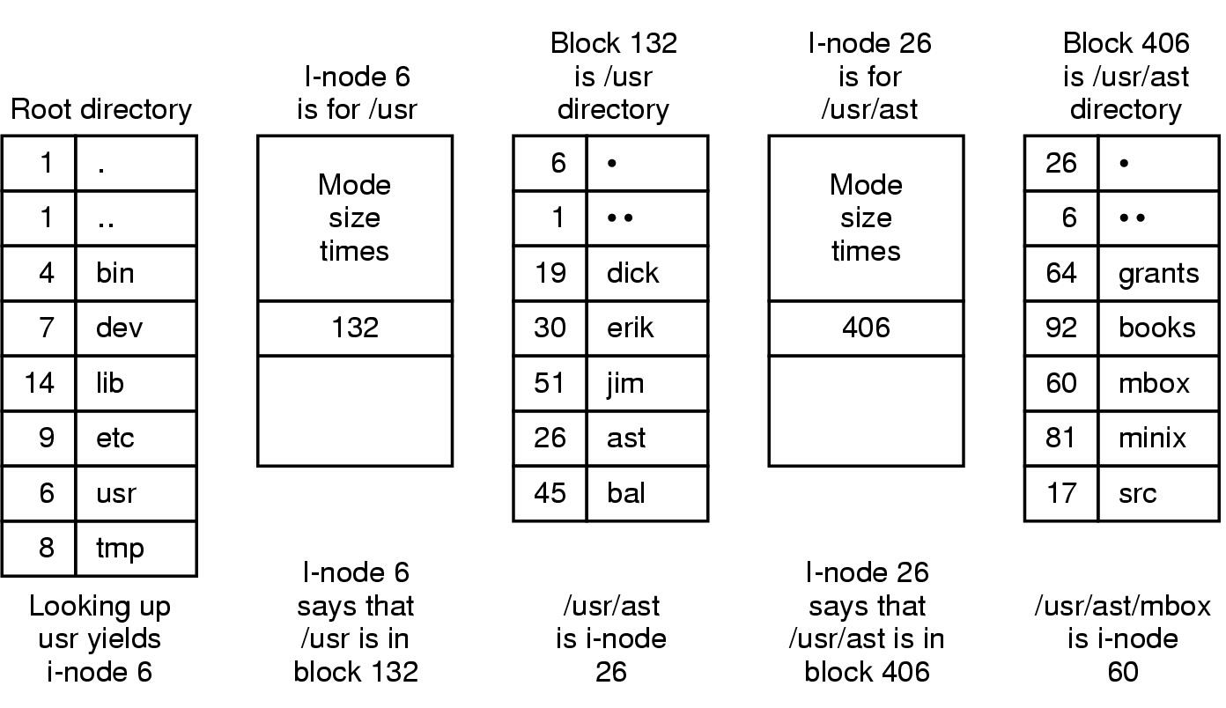
The UNIX V7 File System (5)
Figure 4-35 The steps in looking up /usr/ast/mbox

Slide 39
The UNIX V7 File System (6)
Exercise
  Problem1: A Unix file system has 1KB blocks and 4 byte disk address. What is the maximum file size if i-nodes contain 10 direct entries, and one single, double and triple indirect entry each?
  Solution: The i-node holds 10 pointers. The single indirect block holds 256 pointers. The double indirect block is good for 256^2 pointers. The triple indirect block is good for 256^3 pointers. Adding these up, we get a maximum file size of 16,843,018 blocks, which is about 16.06 GB.

Slide 40
The UNIX V7 File System (7)
Exercise
  Problem2:How many disk operations are needed to fetch the i-node for the file /usr/ast/course/os/handout.t? Assume that the i-node for the root directory is in memory, but nothing else along the path is in memory. Also assume that all directories fit in one disk block.

Slide 41
The UNIX V7 File System (8)
Exercise
  Solution: The following disk reads are needed:
    directory for /
    i-node for /usr
    directory for /usr
    i-node for /usr/ast
    directory for /usr/ast
    i-node for /usr/ast/courses
    directory for /usr/ast/courses
    i-node for /usr/ast/courses/os
    directory for /usr/ast/courses/os
    i-node for /usr/ast/courses/os/handout.t
  In total, 10 disk reads are required.

Slide 42
The Linux Ext2 File System (1)
See textbook P785 10.6.3
Linux supports many file systems, some of them are as follows: ext, ext2, xia, minix, umsdos, msdos, vfat, proc, smb, ncp, iso9660, sysv, hpfs, affs and ufs.
Minix was the first file system of Linux.
EXT was released in April 1992, and was the first to use the VFS API.
The Second Extended Filesystem (Ext2) was introduced in 1994.

Slide 43
The Linux Ext2 File System (2)
Disk Layout
  In any Ext2 partition, the first block is reserved for the partition boot sector. The rest of the Ext2 partition is split into block groups.
  The whole area is divided into several block groups, and block groups contains several blocks.
  Files in the same directory are stored in the
  same block group.
  Files in different directories are spread
  among the block groups.

Slide 44
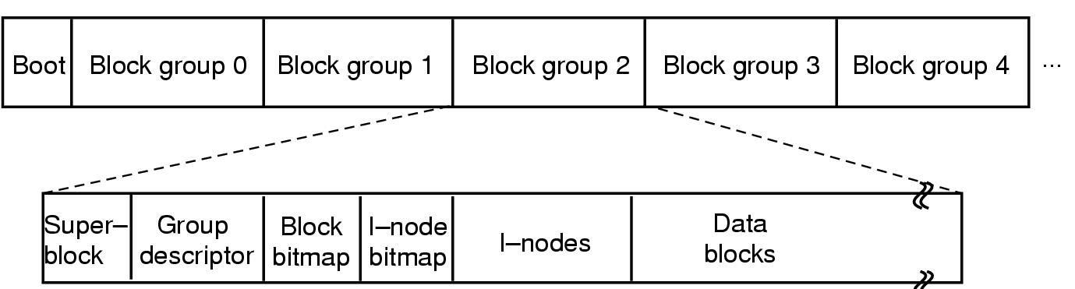
The Linux Ext2 File System (3)
Disk Layout (ctd.)
  Each block group is organized as follows
Figure 10-31 Disk Layout of the Linux ext2 file system

Slide 45
The Linux Ext2 File System (4)
Metadata Concepts
  Superblock
    The Ext2 superblock is located 1024 bytes from the start of the file system and is 1024 bytes in size. ( The first two sectors are used to store boot code if necessary).
    Back up copies are typically stored in the first file data block of each block group.
    It contains information about the layout of the file system, including the number of i-nodes, the number of disk blocks, and the start of the list of free blocks.

Slide 46
The Linux Ext2 File System (5)
Metadata Concepts (ctd.)
  Block Group Descriptor Table
    It contains a group descriptor data structure for every block group.
    It contains information about the location of the bitmaps, the number of free blocks and i-nodes in the group, and the number of directories in the group.
  Bitmaps
    The block bitmap manages the allocation status of the blocks in the group.
    The inode bitmap manages the allocation status of the inodes in the group.

Slide 47
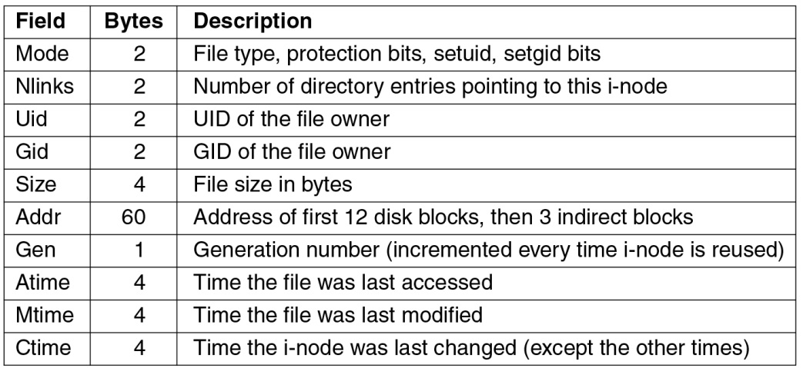
The Linux Ext2 File System (6)
Metadata Concepts (ctd.)
  Inodes
    Each inode corresponds to one file, and it stores file’s primary metadata, such as file’s size, ownership, and temporal information.
    Inode is typically 128 bytes in size and is allocated to each file and directory.
Figure 10-33. Some fields in the i-node structure in Linux

Slide 48
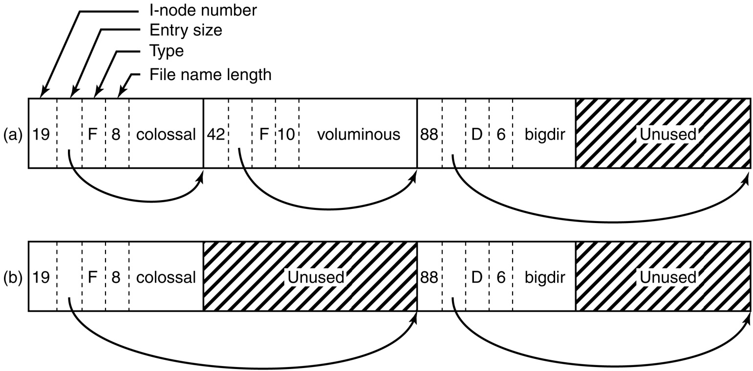
The Linux Ext2 File System (7)
Directory
Figure 10-32. (a) A Linux directory with three files. (b) The same directory after the file voluminous has been removed.

Slide 49
The Linux Ext2 File System (8)
To improve the robustness of the file system, Linux relies on journaling file systems.
Ext3
  Successor of the Ext2 file system
  A journaling file system
Ext4
  A follow-on of Ext2
  Also a journaling file system
  Changes the block addressing scheme

Slide 50
CD-ROM File Systems (1)
Introduction to CD-ROM
  A single disc can hold more than 600 megabytes of data (~ 400 books of the textbook’s size)
  CD-ROM is read only. i.e., it is a publishing medium rather than a data storage and retrieval like magnetic disks.
  CD-ROM Strengths: High storage capacity, inexpensive price, durability.
  CD-ROM Weaknesses: extremely slow seek performance (between 1/2 a second to a second) ==> Intelligent File Structures are critical.

Slide 51
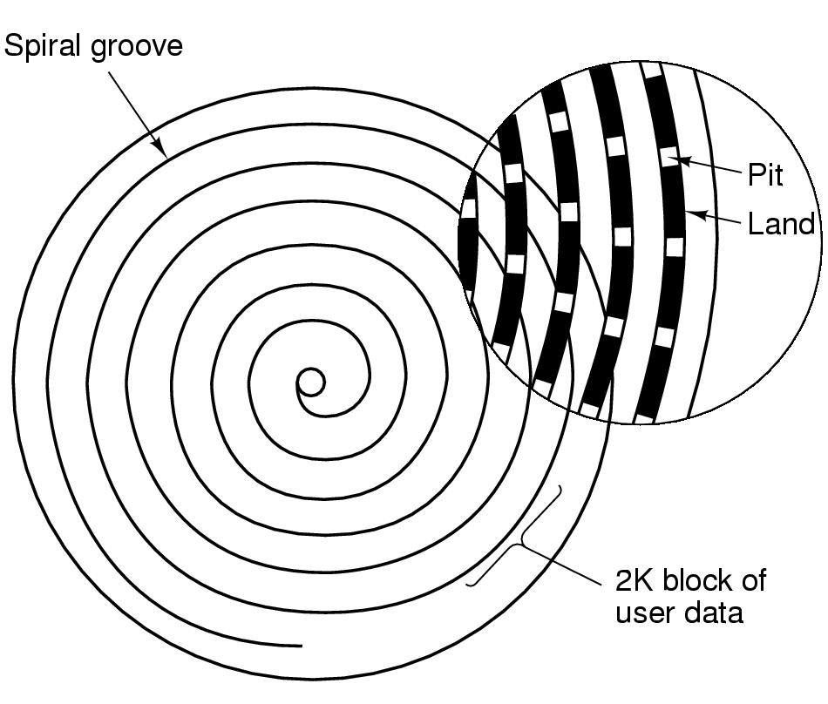
CD-ROM File Systems (2)
Data Organization
  Data on a CD-ROM is stored in a single, spiral track. This allows the data to be packed as tightly as possible since all the sectors have the same size (whether in the center or at the edge).

Slide 52
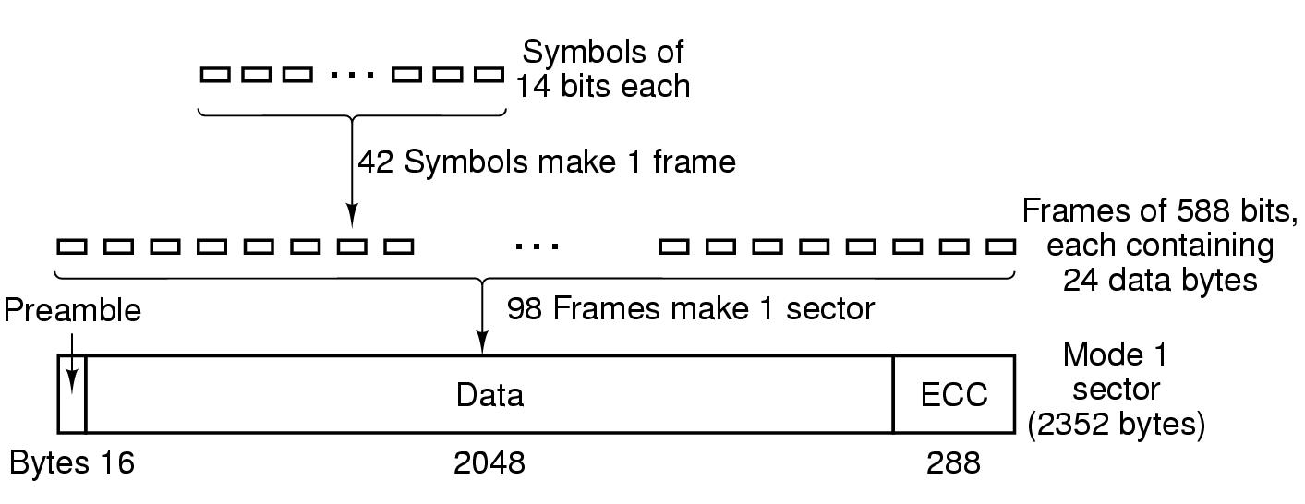
CD-ROM File Systems (3)
Data Organization (ctd.)
  One Format of Mode 1
    Encode every byte in a 14-bit symbol.
    A group of 42 consecutive symbols forms a 588-bit frame.
    Group 98 frames into a CD-ROM sector.

Slide 53
CD-ROM File Systems (4)
The ISO 9660 File System
  The most common standard for CD-ROM file systems.
  Adopted as an International Standard in 1988.
  Virtually every CDROM currently on the market is compatible with this standard, sometimes with the extensions to be discussed below.
  1 Logic block or logic sector = 2352 bytes
  Supports CD-ROM sets with as many as (2¹⁶ − 1) CDs in the set.
  The individual CD-ROMs may also be partitioned into logical volumes (partitions).

Slide 54
CD-ROM File Systems (5)
The ISO 9660 File System (ctd.)
  For a single unpartitioned CD-ROM
    First 16 blocks
      Whose function is not defined by the standard.
      May used by manufacturer for a bootstrap program or for other purpose.
    Primary Volume Descriptor (1 block )
      Some general information about the CD-ROM
        System identifier (32 bytes)
        Volume identifier (32 bytes)
        Publisher identifier (128 bytes)
        Data preparer identifier (128 bytes)
      The names of 3 files
        Contain the abstract, copyright notice, and bibliographic information

Slide 55
CD-ROM File Systems (6)
The ISO 9660 File System (ctd.)
  For a single unpartitioned CD-ROM (ctd.)
    Primary Volume Descriptor (1 block ) (ctd.)
      Certain key numbers
        Logical block size
        The number of blocks on the CD-ROM
        The creation and expiration dates of the CD-ROM
      A directory entry for the root directory
        Where to find it on the CD-ROM
    Supplementary Volume Descriptor
      Similar to Primary Volume Descriptor

Slide 56
CD-ROM File Systems (7)
The ISO 9660 File System (ctd.)
  For a single unpartitioned CD-ROM (ctd.)
    All directories consist of a variable number of entries.
    The directory entries themselves are also variable length.
    Each directory entry consists of 10 to 12 fields
      ASCII Fields
      Numerical Fields in binary
        Encoded twice, one for little-endian format, one for big-endian format
        Thus a 16-bit number uses 4 bytes and a 32-bit number uses 8 bytes.
        The use of this redundant coding was necessary to avoid hurting anyone’s feelings when the standard was developed.

Slide 57
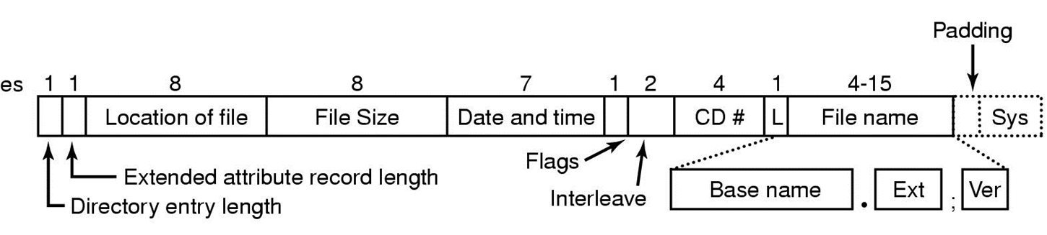
CD-ROM File Systems (8)
The ISO 9660 File System (ctd.)
  For a single unpartitioned CDROM (ctd.)
    Figure 4-30 The ISO9660 Directory Entry
      Flags Field: flag to hide the entry in listings, flag to distinguish an entry that is a file from an entry that is a directory, flag to enable the use of the extended attributes, flag to mark the last entry in a directory, etc.
      Interleave Field: not used in the simplest version of ISO 9660
      Padding Field: force every directory entry to be an even number of bytes

Slide 58
CD-ROM File Systems (9)
The ISO 9660 File System (ctd.)
  No explicit limit to the number of entries in a directory.
  There is a limit to the depth of nesting. The maximum depth of directory nesting is 8.
  Three Levels
    Level 1: most restrictive, can be read on every computer
      File names: 8+3 characters
      All files are contiguous
      Directory names limit to 8 characters with no extensions
    Level 2
      File names and directory names up to 31 characters
    Level 3
      The same name limits as level 2
      Files can be non-contiguous

Slide 59
CD-ROM File Systems (10)
Rock Ridge Extensions
  Unix Community extension
  The extensions use the System Use field in order to make Rock Ridge CD-ROMs readable on any computer.
  All the other fields retain their normal ISO 9660 meaning.
  Any system not aware of the Rock Ridge extensions just ignores them and sees a normal CD-ROM.

Slide 60
CD-ROM File Systems (11)
Rock Ridge Extensions (ctd.)
  The extensions are divided up into the following fields:
    1. PX - POSIX attributes.
    2. PN - Major and minor device numbers.
    3. SL - Symbolic link.
      Allows a file on one file system to refer to a file on a different file system.
    4. NM - Alternative name.
      Allows a second name to be associated with the file.
    5. CL - Child location.
    6. PL - Parent location.
    7. RE - Relocation.
    8. TF - Time stamps.
      Create time
      Last modified time
      Last access time

Slide 61
CD-ROM File Systems (12)
Joliet Extensions
  Microsoft Extension
  Designed to allow Windows file systems to be copied to CD-ROM and then restored
  The major extensions provided by Joliet are
    1. Long file names.
      Up to 64 characters
    2. Unicode character set.
    3. Directory nesting deeper than eight levels.
    4. Directory names with extensions.

Slide 62
Homework
P335 35, 38, 41

