Slide 1
Modern Operating Systems
Chapter 4 – File System Implementation
Zhang Yang
Autumn 2019

Slide 2
Content of the Lecture
4.3 File System Implementation
  File System Layout
  Implementing Files
  Implementing Directory
  Shared Files

Slide 3
Overview
Implementer’s view on file systems (4.3)
  How files and directories are stored?
  How disk space is managed?
  How to make everything work efficiently and reliably?
  …

Slide 4
File System Layout (1)
Sector 0: “Master Boot Record” (MBR)
  Contains the partition map
Rest of disk divided into “partitions”
  Partition: sequence of consecutive sectors.
Each partition can hold its own file system
  Unix file system
  Windows file system
  Apple file system
  …
Every partition starts with a “boot block”
  Contains a small program
  This “boot program” reads in an OS from the file system in that partition
OS Startup
  BIOS reads MBR , then reads & execs a boot block

Slide 5
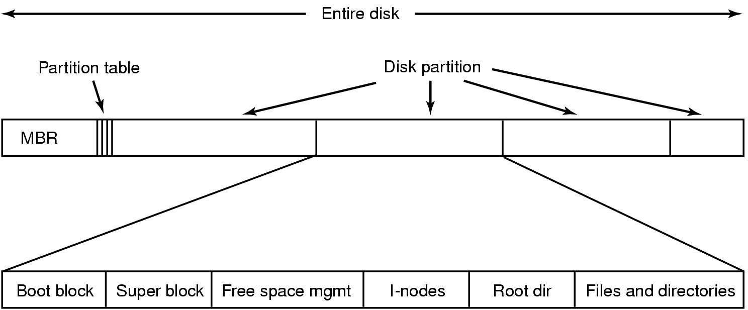
File System Layout (2)
Describes the state of the file system: the total size of the partition, the block size, pointers to a list of free blocks, the inode number of the root directory, magic number, etc.
Unix File System
Figure 4-9 A possible file-system layout

Slide 6
File Bytes vs Disk Sectors
Files are sequences of bytes
  Granularity of file I/O is bytes.
Disks are arrays of sectors (512 bytes)
  Granularity of disk I/O is sectors.
  Files data must be stored in sectors.
File systems define a block size
  block size = 2^{n} *sector size
  Contiguous sectors are allocated to a block.
File systems view the disk as an array of blocks.
  Must allocate blocks to file.
  Must manage free space on disk.

Slide 7
Allocation Methods
Allocation Method
  Refers to how disk blocks are allocated for files.
Three Methods
  Contiguous Allocation
  Linked List Allocation
  Indexed Allocation
Key Metrics
  Fragmentation (internal & external)?
  Grow file over time after initial creation?
  Fast to find data for sequential and random access?
  Easy to implement?
  Storage overhead?

Slide 8

Contiguous Allocation (1)
Each file occupies a set of contiguous blocks on the disk.
Used by IBM VM/CMS.
After deleting D and F...

Slide 9

Contiguous Allocation (2)
Advantages
  Simple to implement (Need only starting sector & length of file).
  Easy to recover in
  event of system crash.
  Performance is good
  (suits for sequential
  access and direct
  access).
Notes:
Fast, often requires no head movement and when it does, head only moves one track

Slide 10
Contiguous Allocation (3)
Disadvantages
  External Fragmentation
    Will need periodic compaction (time-consuming).
    Will need to manage free lists.
      Must know a file’s maximum possible size ... at the time it is created!
  Files cannot grow.
Good for CD-ROMs, DVDs and other write-once optical media.
  All file sizes are known in advance.
  Files are never deleted.

Slide 11

Linked List Allocation (1)
Each file is a linked list of disk blocks: blocks may be scattered anywhere on the disk.
block =
pointer
Figure 4-11 Storing a file as a linked list of disk blocks

Slide 12

Linked List Allocation (2)
Advantages
  No external fragmentation.
  Directory entries are simple(Need only starting & end block number).
  A file can continue to grow as long as free blocks are available.
  Good for sequential access.

Slide 13
Linked List Allocation (3)
Disadvantages
  Random access into the file is slow!
  The amount of data storage in a block is no longer a power of two.
  Fragile: a pointer can be lost or damaged.

Slide 14
Linked List Allocation Using FAT(1)
Important variation on linked list allocation method.
File Allocation Table (FAT)
  Keep a table in memory:
    One entry per block on the disk.
    Each entry contains the address of the “next” block.
    End of file marker (-1).
    A special value (-2) indicates the block is free.
Used by OS/2 and MS-DOS.

Slide 15
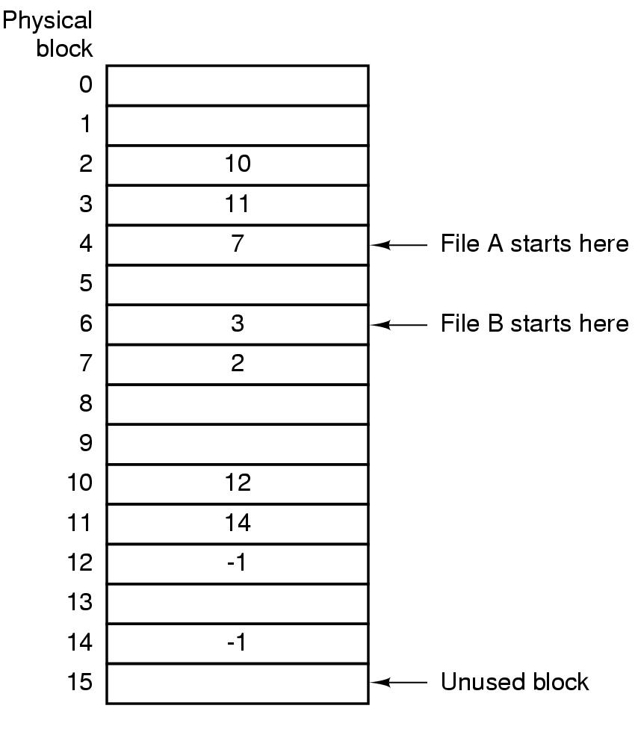
Linked List Allocation Using FAT(2)
Linked list allocation using a file allocation table in RAM
Figure 4-12 Linked-list allocation using a file-allocation table in main memory.

Slide 16

Linked List Allocation Using FAT(3)
Advantages
  The entire block is available for data.
  Random access...
    Search the linked
    list (but all in
    memory)
  Directory entry needs
  only one number.
    Starting block
    number

Slide 17
Linked List Allocation Using FAT(4)
Disadvantage
  Entire table must be in memory all at once!
    Example
      200 GB = disk size
      1 KB = block size
      4 bytes = FAT entry size
      800 MB of memory used to store the FAT

Slide 18

Indexed Allocation (1)
Bring all the pointers together into one location (index block or i-node)
Each file has its own index block.
Loading the index block into memory when the file is opened makes it available all times for random access.
Example: Index block

Slide 19
Indexed Allocation (2)
Advantages
  Easy to implement.
  No external fragmentation.
  Files can be easily grown with the limit of the index block size.
  Fast lookups and random accesses.
Disadvantages
  File blocks may be scattered all over the disk.
    Poor sequential access
    Needs defragmenter
  Space overhead for index blocks.
  Needs to reallocate index block as the file size increases.

Slide 20
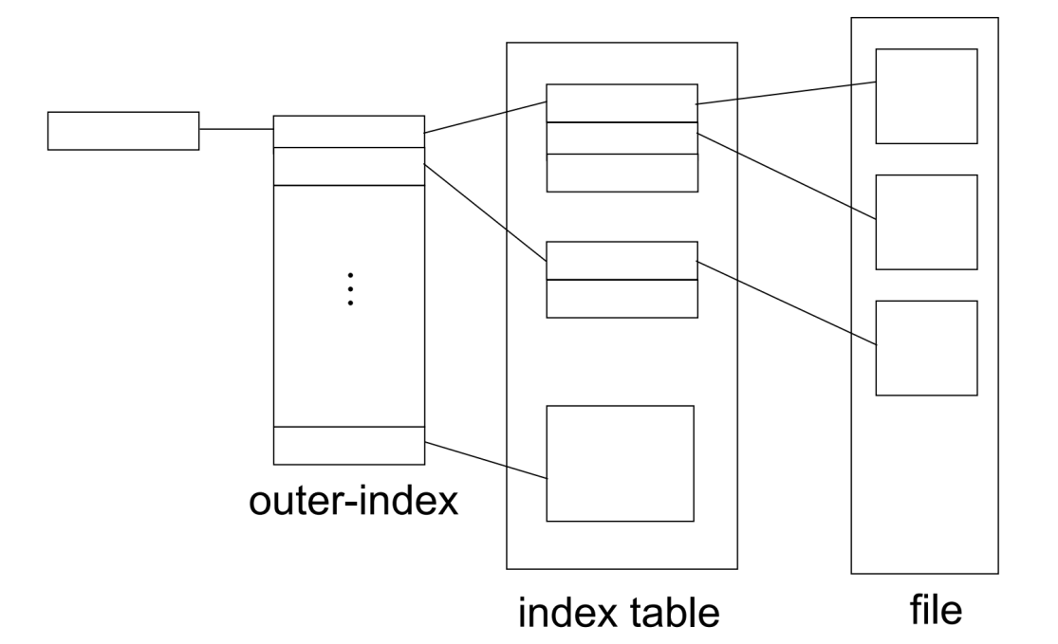
Multi-level Indexed Allocation (1)
  Question: If each i-node has room for a fixed number of disk addresses, what happens when a file grows beyond this limit?
  Certain index entries point to index blocks, as opposed to data blocks (e.g., Linux ext2).
  Block index has multiple levels.

Slide 21

Multi-level Indexed Allocation (2)
Example
  A single indirect block contains pointers to data blocks.
  A double indirect block contains pointers to single indirect blocks.
  A triple indirect block
  contains pointers to
  double indirect blocks.

Slide 22
Multi-level Indexed Allocation (3)
Advantages
  No external fragmentation.
  Files can be easily grown with much larger limit compared to one-level index.
  Fast random access.
    Use index block.
Disadvantages
  Implementation can be complex.
  Large space overhead (due to index).
  Sequential access may be slow.
    Must allocate contiguous block for fast access.

Slide 23
Implementing Directories (1)
Directories are stored like normal files.
  Directory entries are contained inside data blocks.
The file system assigns special meaning to the content of these files.
  A directory file is a list of directory entries.
  In Unix/Linux, a directory entry contains file name, attributes, and the file’s i-node number.
    Maps human-oriented file name to a system-oriented name.

Slide 24
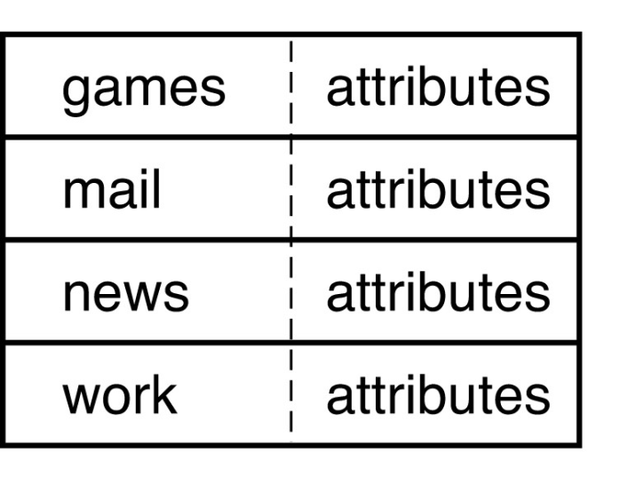
Implementing Directories (2)
The Location of File Attributes
  In the directory entry
    Fixed size entries
    Disk addresses and attributes in directory entry
    Used by MS-DOS/Windows
Figure 4-14 (a) A simple directory, fixed size entries, disk addresses and attributes in directory entry

Slide 25
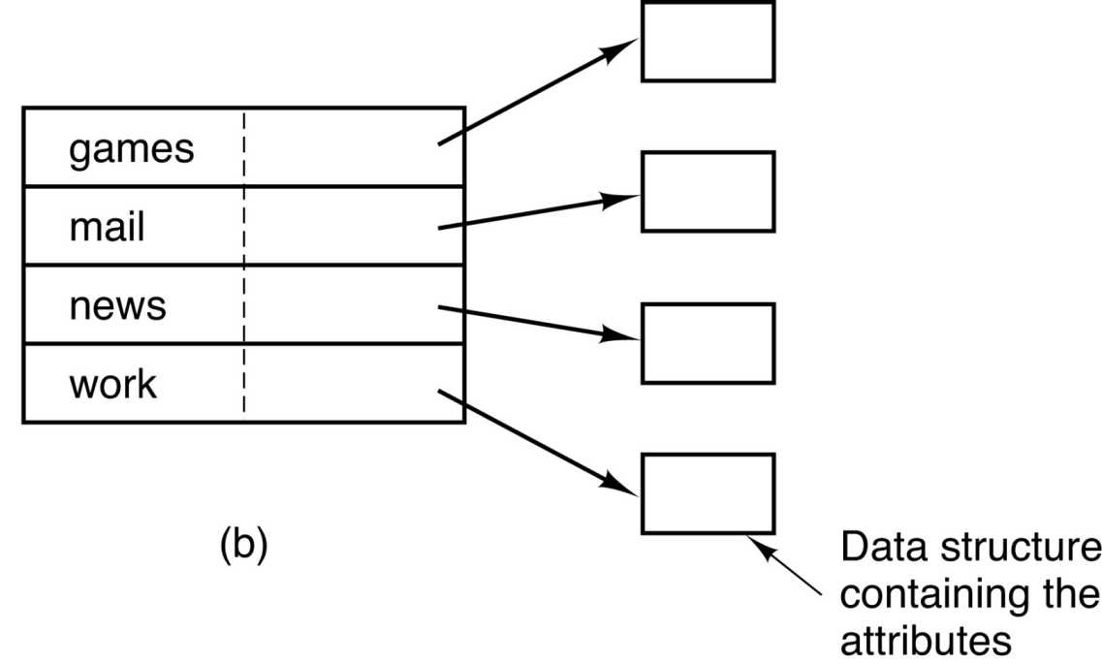
Implementing Directories (3)
The Location of File Attributes (ctd.)
  In the separate data structure (e.g., i-node)
    Directory entry contains
      File Name
      i-node Number
    i-node contains file
    attributes.
    Used by Unix.
Figure 4-14 (b) Directory in which each entry just refers to an i-node

Slide 26
Implementing Directories (4)
File Names
  Short, Fixed Length Names
    MS-DOS
      File name: 1-8 chars, file extension:1-3 chars
      Each directory entry has 11 bytes for the name.
    Unix V7
      Max 14 chars.
  Variable Length Names
    Unix (today)
      Max 255 chars.
      Directory structure gets more complex.

Slide 27
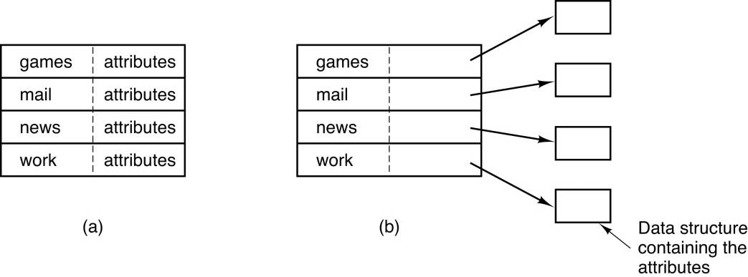
Implementing Directories (5)
What if files have large, variable-length names?
Handling Long File Names
  Solution1: Set a limit on file name length, use one of the designs of figure 4-14.
    Typically 255 chars.
    Simplest.
    Waste a great deal
    of directory space.
Figure 4-14

Slide 28
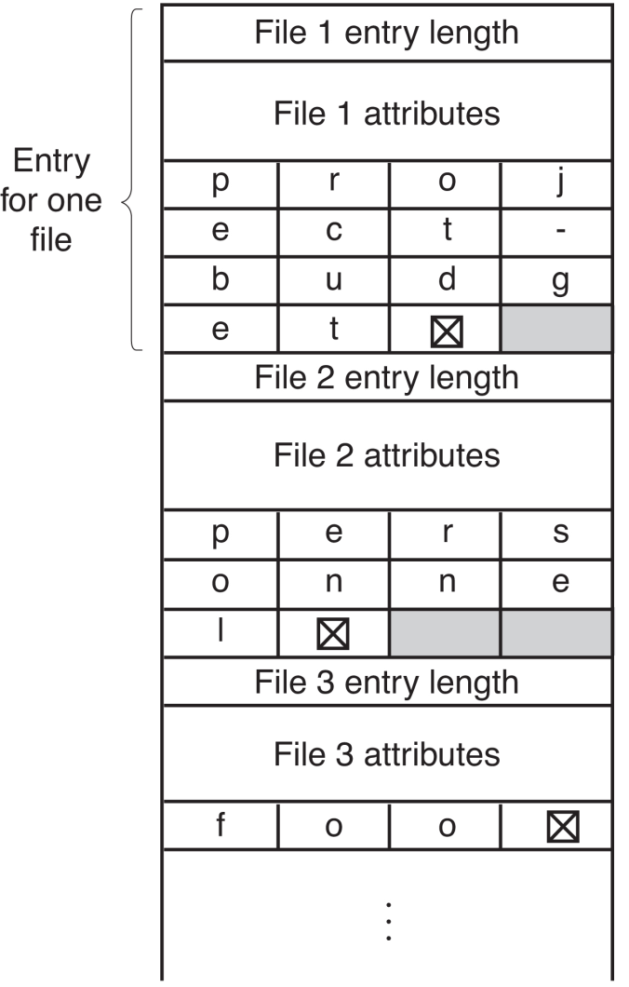
Implementing Directories (6)
Handling Long File Names (ctd.)
  Solution 2: Directory entry comprises fixed and variable portion.
    Fixed part starts with entry size, followed by attributes.
    Variable part has the file name.
    Save space.
    Holes on removal, need compaction.
    A single directory entry may span multiple pages, so a page fault may occur while reading a file name.
Fixed
Varia-ble
Figure 4-15 (a) In line

Slide 29
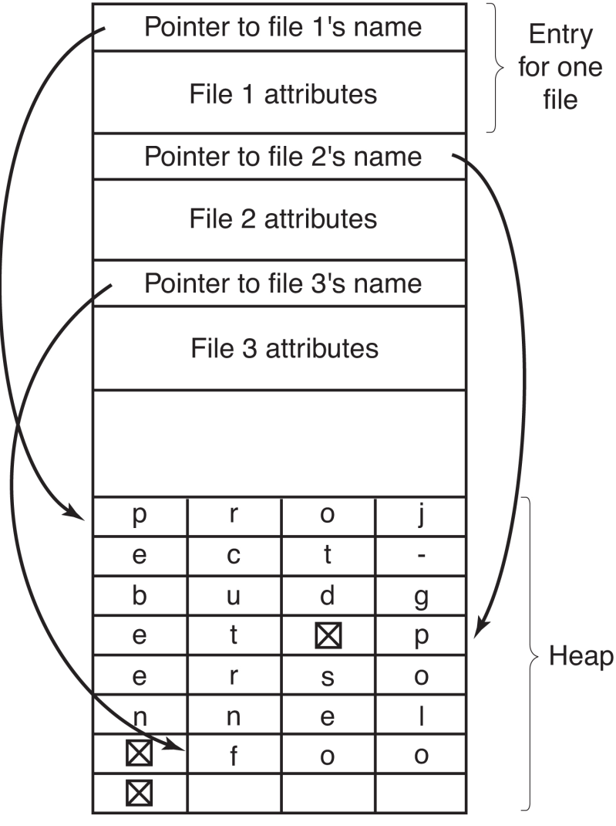
Implementing Directories (7)
Handling Long File Names (ctd.)
  Solution3: Directory entries are fixed in length, pointer to file name in heap.
    Easy removal, no compaction.
    No filler characters are needed after file names.
    The heap must be managed.
    Page faults can still occur while processing file names.
Figure 4-15 (b) In a heap

Slide 30
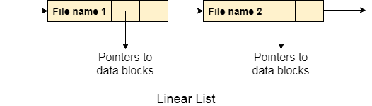
Implementing Directories (8)
Directory Implementation
  Linear List
    All the files in a directory are maintained as singly lined list. Each file contains the pointers to the data blocks which are assigned to it and the next file in the directory.
    When a new file is created, then the entire list is checked whether the new file name is matching to a existing file name or not. In case, it doesn't exist, the file can be created at the beginning or at the end.

Slide 31
Implementing Directories (9)
Directory Implementation (ctd.)
  Linear List (ctd.)
    Requires a linear search to find a particular entry.
    Simple to program but time-consuming to execute.
  Hash Table
    This approach suggests to use hash table along with the linked lists.
    A key-value pair for each file in the directory gets generated and stored in the hash table. The key can be determined by applying the hash function on the file name while the key points to the corresponding file stored in the directory.
Notes:
Uses a linear list to stores directory entries but uses hashing to find the entry

Slide 32
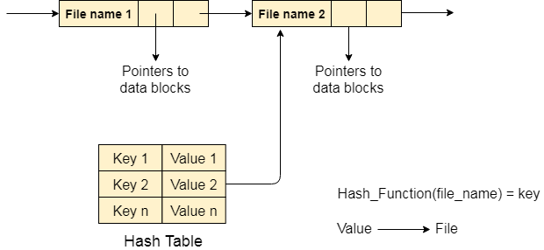
Implementing Directories (10)
Directory Implementation (ctd.)
  Hash Table (ctd.)
    Hashing can greatly decrease the directory search time.
    Major difficulties with a hash table are its fixed size and dependence on the hash function.
    Handle collisions – situations where two file names hash to the same location
Notes:
The major difficulties with a hash table are its generally fixed size and the dependence of the hash function on that size. For example, assume that we make a linear-probing hash table that holds 64 entries. The hash function converts file names into integers from 0 to 63, for instance, by using the remainder of a division by 64. If we later try to create a 65th file, we must enlarge the directory hash table—say, to 128 entries. As a result, we need a new hash function that must map file names to the range 0 to 127, and we must reorganize the existing directory entries to reflect their new hash-function values.
Alternatively, a chained-overflow hash table can be used. Each hash entry can be a linked list instead of an individual value, and we can resolve collisions by adding the new entry to the linked list. Lookups may be somewhat slowed, because searching for a name might require stepping through a linked list of colliding table entries.
Still, this method is likely to be much faster than a linear search through the entire directory.

Slide 33
Shared Files (1)
One file appears in several directories.
Tree → DAG (Directed Acyclic Graph)
/
A
B
C
i
D
j
E
F
k
l
m
What if the file changes?
New disk blocks are used.
Better not store this info
in the directories!!!
G
H
link
n
o
p
q

Slide 34
Shared Files (2)
Link
  The connection between a directory and the shared file is called a link.
In Unix
  Hard Links
    Both directories point to the same i-node.
  Symbolic Links (Soft Links)
    One directory points to the file’s i-node.
    Other directory contains the “path”.

Slide 35
Shared Files (3)
Hard Links
  Assume i-node number of “n” is 45.
Directory “D”
/
“m”
123
“n”
45
A
B
C
•
•
•
•
•
•
i
D
j
E
F
k
l
Directory “G”
“n”
45
m
G
H
“o”
87
•
•
•
•
•
•
n
o
p
q

Slide 36
Shared Files (4)
The file may have a
different name in
each directory
Hard Links (ctd.)
/B/D/n1
/C/F/G/n2
Directory “D”
/
“m”
123
“n”
45
A
B
C
•
•
•
•
•
•
i
D
j
E
F
k
l
Directory “G”
“n”
45
m
G
H
“o”
87
•
•
•
•
•
•
n
o
p
q

Slide 37
Shared Files (5)
Symbolic Links
  Assume i-node number of “n” is 45.
Directory “D”
/
“m”
123
“n”
45
A
B
C
•
•
•
•
•
•
Hard Link
i
D
j
E
F
k
l
Directory “G”
“n”
/B/D/n
m
G
H
“o”
87
•
•
•
•
•
•
n
o
Symbolic Link
p
q

Slide 38
Shared Files (6)
Symbolic Links (ctd.)
Directory “D”
/
“m”
123
“n”
45
A
B
C
•
•
•
•
•
•
i
D
j
E
F
k
l
Directory “G”
“n”
91
m
n
G
H
“o”
87
•
•
•
•
•
•
Separate file
i-node = 91
“/B/D/n”
o
Symbolic Link
p
q

Slide 39
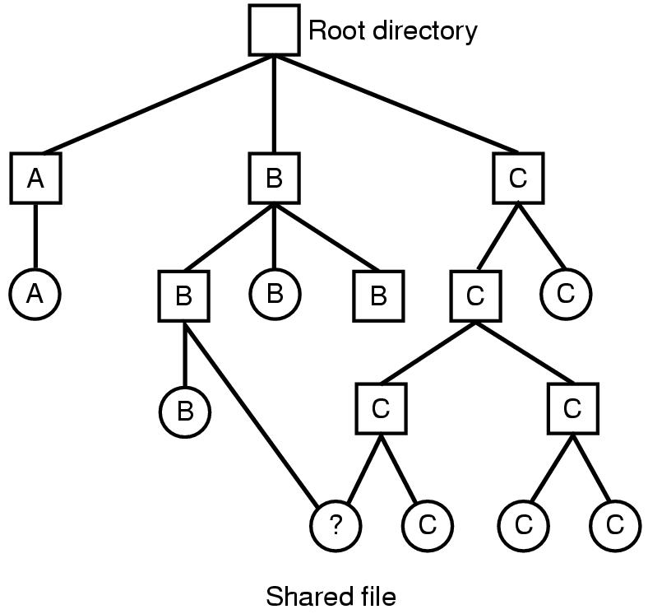
Shared Files (7)
When deleting a file
  Directory entry is removed from directory.
  All blocks in file are returned to free list.
  What about sharing???
    Multiple links to one file (in Unix)
Figure 4-16 File system containing a shared file

Slide 40
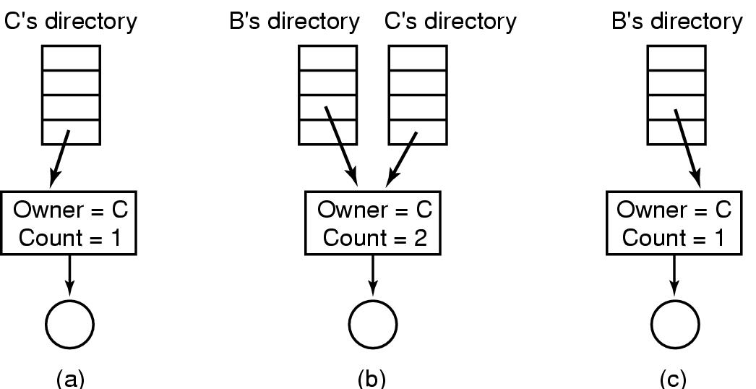
Shared Files (8)
Hard Links
  Put a “reference count” field in each i-node.
  Counts number of directories that point to the file.
  When removing file from directory, decrement count.
  When count goes to zero, reclaim all blocks in the file.
  Example
Figure 4-17
(a) Situation prior to linking
(b) After the link is created
(c) After the original owner removes the file

Slide 41
Shared Files (9)
Symbolic Link
  Remove the real file... (normal file deletion)
  Symbolic link becomes “broken”.

Slide 42
Homework
P333 12, 18, 20, 21

