Slide 1
Modern Operating Systems
Chapter 4 – File System Management
Zhang Yang
Autumn 2019

Slide 2
Content of the Lecture
4.4 File System Management and Optimization
  Disk Space Management
  File System Backups
  File System Consistency
  File System Performance

Slide 3
Disk Space Management
Block Size
Keeping Track of Free Blocks
Disk Quotas

Slide 4
Block Size (1)
Must choose a disk block size...
  = Page Size?
  = Sector Size?
  = Track size?
Large block sizes
  Internal fragmentation
  Last block has (on average) 1/2 wasted space
  Lots of very small files; waste is greater.
Small block sizes
  More seeks; file access will be slower.

Slide 5
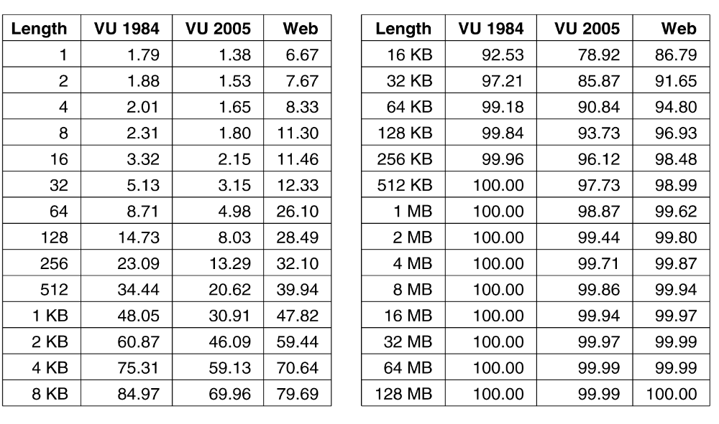
Block Size (2)
Tanenbaum’s Result (2006)
  Studied the file-size distribution.
Figure 4-20. Percentage of files smaller than a given size (in bytes).

Slide 6
Block Size (3)
Tanenbaum’s Result (2006) (ctd.)
  Conclusions
    With a block size of 1KB, only about 30-50% of all files fit in a single block.
    With a block size of 4KB, about 60-70% of all files fit in a single block.
    Other data show that with a 4-KB block, 93% of the disk blocks are used by the 10% largest files.
      Wasting space at the end of each small file hardly matters.

Slide 7
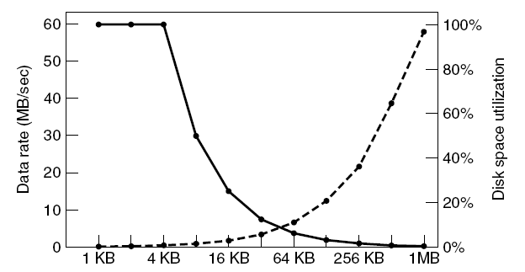
Block Size (4)
Performance and space utilization are inherently in conflict.
Higher block size: higher data rate, lower space utilization
Lower block size: lower data rate, higher space utilization
disk space utilization
data rate
Figure 4-21. The solid curve (left-hand scale) gives the data rate of a disk. The dashed curve (right-hand scale) gives the disk space efficiency. All files are 4 KB.

Slide 8
Block Size (5)
Typical Block Sizes
  Historically, file systems have chosen sizes in the 1-KB to 4-KB range, but with disks now exceeding 1 TB, it might be better too increase the block size to 64KB and accept the wasted disk space.
  Unix
    Block size in UNIX is basically the size of chunk memory in which, block devices transfer data inside the system.
    Usually in modern system it is 4KB, 8KB etc.
  MS-DOS
    Variable, N*512 (“cluster size” represents the OS “Block Size”)

Slide 9
Block Size (6)
Typical Block Sizes (ctd.)
  MS-DOS (ctd.)
    Determined by other issues
    Limited number of bits for block addresses
    To accommodate larger disk sizes-->use bigger blocks
      FAT-12: 512B, 1KB, 2KB, 4KB
      FAT-16: 2KB, 4KB, 8KB, 16KB, 32KB
      FAT-32: 4KB, 8KB, 16KB, 32KB
  Windows
    Default 4K
    Go to "My Computer" --> manage --> Disk Defragmenter --> select any disk --> click on "analyze" button , then it will present us a report and in that report "Cluster Size“.

Slide 10
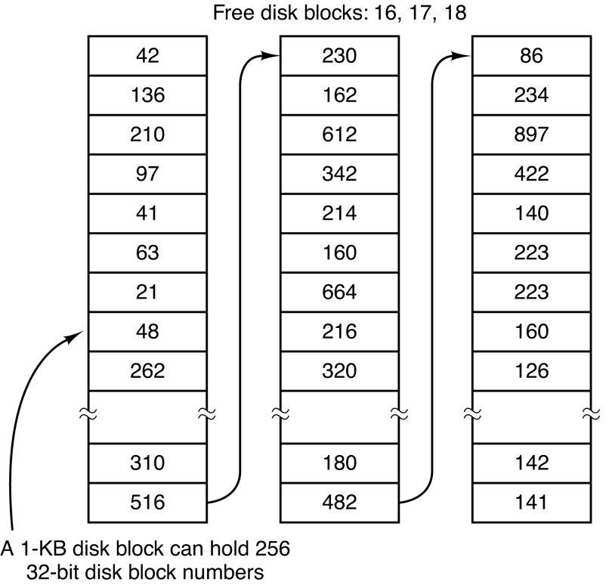
Keeping Track of Free Blocks (1)
Linked List
  Each block holds as many free disk block numbers as will fit.
  Example:16GB disk has 2²⁴ 1-KB block and requires 2²⁴/255 = 65793 blocks. (Assuming 32-bit block number)
Figure 4-22
(a) Storing the free list on a linked list

Slide 11
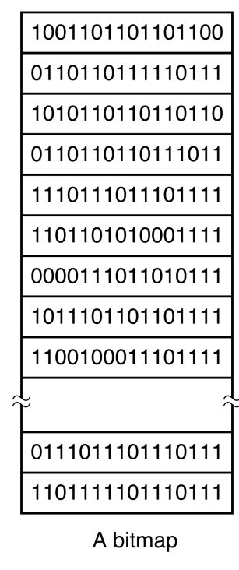
Keeping Track of Free Blocks (2)
Bit Map
  A disk with n blocks requires a bit map with n bits.
  Free blocks are represented by 1's.
  Allocated blocks represented by 0's.
  Example:16GB disk has 2²⁴ 1-KB block and requires 2²⁴ bits ➔ 2048 blocks
Figure 4-22 (b) A bit map

Slide 12
Problem of Linked List Method (1)
Only one block of pointers need be kept in main memory. Under certain circumstance, this method leads to unnecessary disk I/O.
  When the block of pointers is almost empty, a series of short-lived temporary files can cause a lot of disk I/O.
  Example: Figure 4-23 (a) (b)
Solution
  Keep most of the pointer blocks on disk full (to minimize disk usage), but keep the one in memory about half full.
  Example: Figure 4-23 (c)

Slide 13
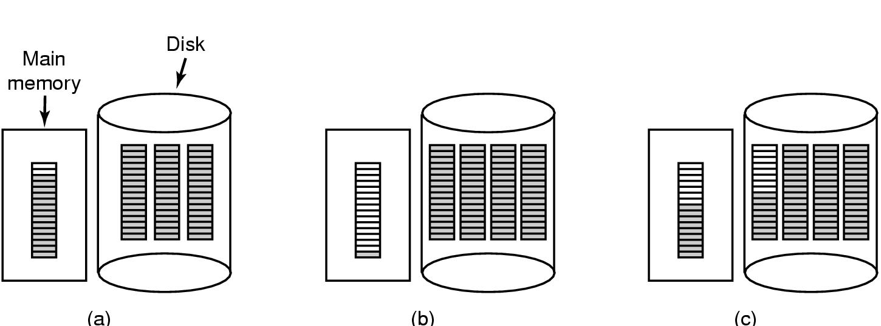
Problem of Linked List Method (2)
3 blocks of pointers on disk.
Figure 4-23
(a) Almost-full block of pointers to free disk blocks in RAM.
(b) Result of freeing a 3-block file
(c) Alternative strategy for handling 3 free blocks
shaded entries are pointers to free disk blocks

Slide 14
Disk Quotas (1)
Prevents people from getting too much disk space.
Use a second table in the open file table structure. For each user...
  OS will maintain a record.
  Example
    Amount of disk space used (in blocks)
      Current
      Maximum allowable
    Number of files
      Current
      Maximum allowable
  Soft Limits
    When exceeded, print a warning
  Hard Limits
    May not be exceeded, error

Slide 15
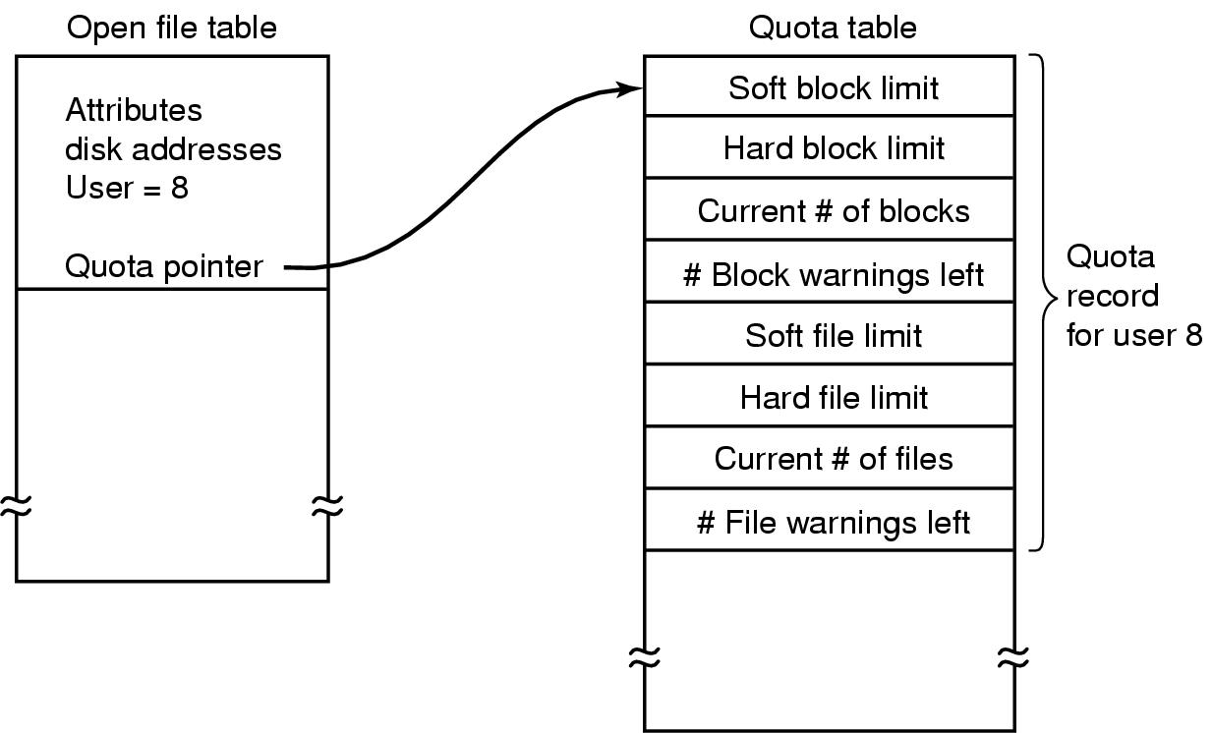
Disk Quotas (2)
Figure 4-24 Quotas for keeping track of each user’s disk use

Slide 16
Disk Quotas (3)
Windows Disk Quota Management
  Enable quota management: Sets up quota management and starts tracking disk usage.
  Deny disk space to users exceeding quota limits: Users can’t write new information after reaching their quotas.
  Do not limit disk usage: Tracks disk usage without imposing quotas.
  Limit disk space to: Sets the default amount of disk space for all users.

Slide 17
Disk Quotas (4)
Windows Disk Quota Management (ctd.)
  Set warning level to: Sets the default disk space that users can occupy that will trigger a warning message.
  Log event when a user exceeds their quota limit: An event is entered in the System log when a user reaches his or her quota.
  Log event when the user exceeds the warning level: An event is entered in the System log when a user receives a warning that he or she is approaching the quota.

Slide 18
File System Reliability
File System Back Up
  Data in a file system should be permanent.
  Implemented through backup and replication.
File System Consistency
  Data in a file system should be good.
  Implemented through logging , transactions, and shadowing.

Slide 19
File System Backups (1)
Backup to Tapes
  Recover from disaster
    Get the computer running again after a disk crash, fire, flood, or other natural catastrophe.
  Recover from stupidity
    Users often accidently remove files that they later need again.
Backup Issues
  Backup all or part of the system? Back up only specific directories and everything in them rather than the entire file system.
  Don’t backup file if not changed. Incremental Dumps.

Slide 20
File System Backups (2)
Backup Issues (ctd.)
  Compression of backup or not? A single bad spot on the backup tape can foil the decompression algorithm. The decision to compression should be carefully considered.
  Difficulty of backup while file system active.
  Physical security of backup media.
Two Strategies for Dumping a Disk to Tape
  Physical Dump
  Logical Dump

Slide 21
File System Backups (3)
Physical Dump
  Approach
    Start at block 0 on the disk.
    Copy each block, in order.
  Concerns
    Blocks on the free list?
      Should avoid copying them.
    Bad sectors on disk?
      Controller remaps bad sectors.
      Backup utility need not do anything special!
        OS handles bad sectors.
        Backup utility must avoid copying them!

Slide 22
File System Backups (3)
Physical Dump (ctd.)
  Advantages
    Simple
    Great speed (run at the speed of disk)
  Disadvantages
    Inability to skip selected directories.
    Inability to make incremental dump.
    Inability to restore individual files upon request.

Slide 23
File System Backups (4)
Logical Dump
  Most common form.
  Start at one or more specified directories and recursively dumps all files and directories found there that have changed since some given base date.
Logical Dump: Incremental dumping of files and directories
  Will copy only files that have been modified since last incremental backup.
  Must also copy the directories containing any modified files.

Slide 24
File System Backups (5)
Logical Dump Algorithm
  Phase 1: begin at the starting directory and examines all the entries in it. Marked each modified file and each directory (whether or not modified).
  Phase 2: recursively walks the directory tree, unmarking any directories that have no modified files or directories in them or under them.
  Phase 3: dump all the marked directories
  Phase 4: dump all the marked files
  Example: Figure 4-25, 4-26

Slide 25
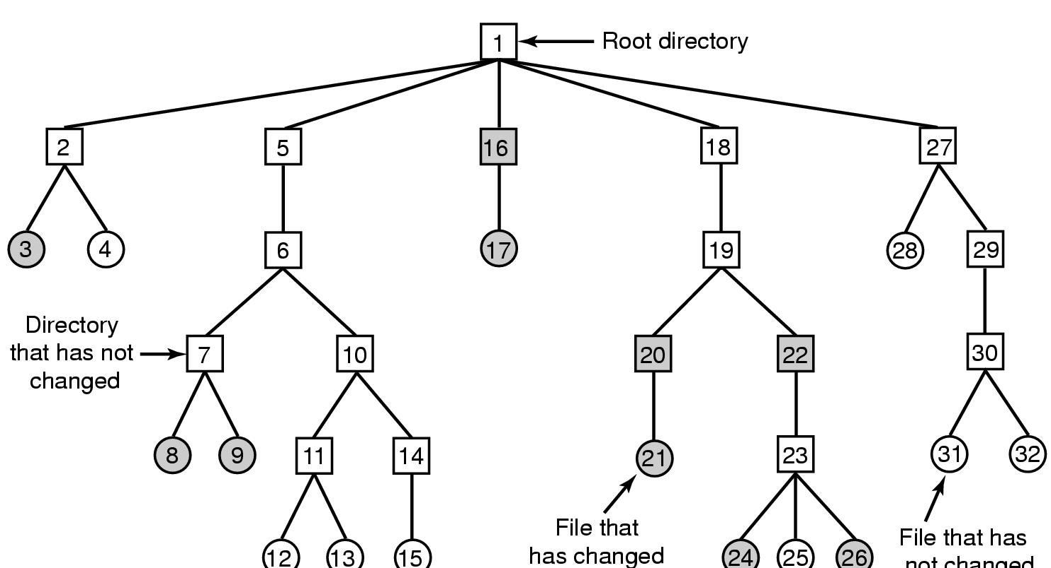
File System Backups (6)
File that has
not changed
Figure 4-25 A file system to be dumped
  squares are directories, circles are files
  shaded items, modified since last dump
  each directory & file labeled by i-node number

Slide 26
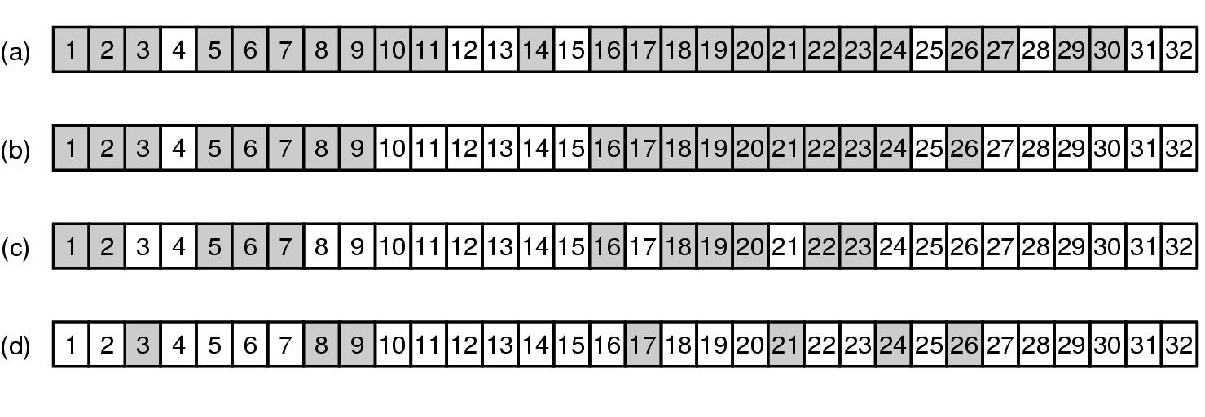
File System Backups (7)
Figure 4-26 Bit maps used by the logical dumping algorithm

Slide 27
File System Consistency (1)
Multi-step updates cause problems for consistency.
  If crash happens in the middle.
  E.g. transfer $100 from my account to Janet’s
    (1) deduct $100 from my account
    (2) add $100 to Janet’s account
  What happens if you crash between step 1 and 2?

Slide 28
File System Consistency (2)
Most systems have a utility program that checks file system consistency.
  Windows: scandisk
  UNIX: fsck
    Checking blocks
    Checking directories
fsck: checking blocks
  Basic fact: Each disk block must be in a file (or directory), or on the free list.
  Build 2 tables, each contains a counter for each block.
  Reads all the i-nodes and mark used blocks.
  Examines the free list and mark free blocks.

Slide 29
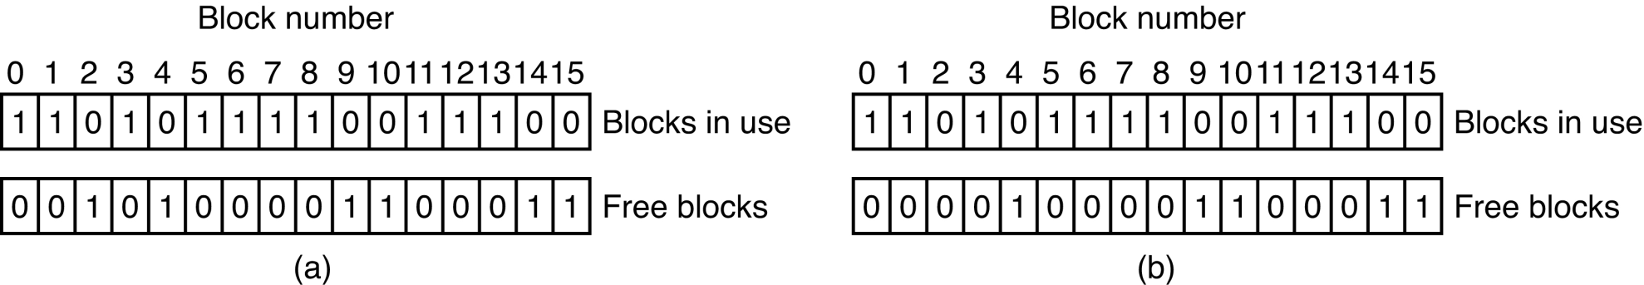
File System Consistency (3)
Block Inconsistent States
  Some block is not in a file or on free list (“missing block”)
    Example: Figure 4-27 (b)
  Add it to the free list.
Figure 4-27 File System States
  (a) consistent
  (b) missing block

Slide 30
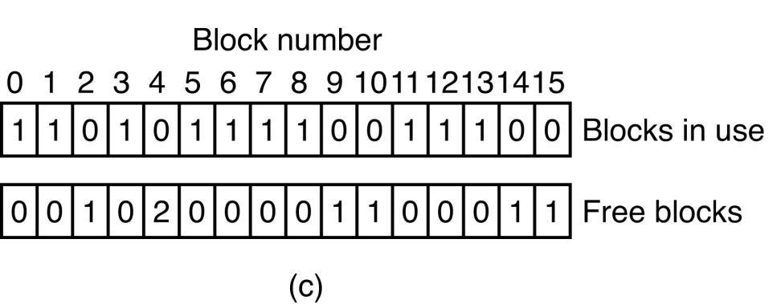
File System Consistency (4)
Block Inconsistent States (ctd.)
  Some block is on the free list more than once
    Can’t happen when using a bitmap for free blocks.
    Example: Figure 4-27 (c)
  Fix the free list so the block appears only once.

Slide 31
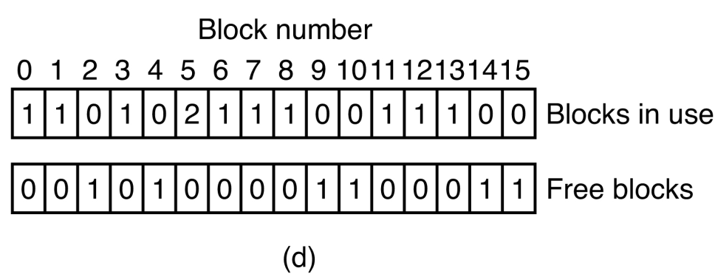
File System Consistency (5)
Block Inconsistent States (ctd.)
  Some block is in more than one file
    Example: Figure 4-27 (d)
  Allocate another block.
  Copy the block.
  Put each block in each file.
  Notify the user that one file may contain data from another file.

Slide 32
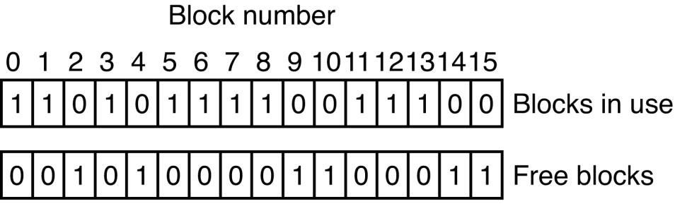
File System Consistency (6)
Block Inconsistent States (ctd.)
  Some block is on free list and is in some file
    Example
    Remove it from the free list.
1

Slide 33
File System Consistency (7)
Exercise
  Problem: Consider Fig. 4-27. Is it possible that for some particular block number the counters in both lists have the value 2?
  Solution:
    It should not happen, but due to a bug somewhere it could happen. It means that some block occurs in two files and also twice in the free list.
    The first step in repairing the error is to remove both copies from the free list. Next a free block has to be acquired and the contents of the sick block copied there. Finally, the occurrence of the block in one of the files should be changed to refer to the newly acquired copy of the block. At this point the system is once again consistent.

Slide 34
File System Consistency (8)
fsck: checking directories
  Recursively descends the tree from the root directory, for file counting the number of links each file. One counter for each file.
  Compare these numbers with the link counts stored in the i-nodes.
  The reference count in each i-node must be equal to the number of hard links to the file.
D1:
D2:
D3:
A
B
C
X
Y
F
G
C

Slide 35
File System Consistency (9)
Directory Inconsistent State
  Two Inconsistent States Solution
    Force the link count in the i-node to the actual number of directory entries.
  Reference count is too large
    The “rm” command will delete a hard link.
    When the count becomes zero, the blocks are freed.
    Permanently allocated; blocks can never be reused.
  Reference count is too small
    When links are removed, the count will go to zero too soon!
    The blocks will be added to the free list, even though the file is still in some directory!

Slide 36
File System Performance (1)
Caching
  Avoid disk I/O overhead
Block Read Ahead
  Improve buffer cache hit rate
Reducing Disk Arm Motion
  Avoid seek overhead

Slide 37
Caching (1)
Many files are used repeatedly.
  Option: read it each time from disk.
  Better: keep a copy in memory.
File System Cache
  Maintain a block cache or buffer cache in memory.
  A cache is a collection of blocks that logically belong on the disk but are being kept in memory for performance reasons.
  Set of recently used file blocks.
  Keep blocks just referenced.
  When a process tries to read a block check the cache first.

Slide 38
Caching (2)
File System Cache (ctd.)
  If it is, the read request can be satisfied without a disk access.
  If the block is not in the cache, it is first read into the cache, and then copied to wherever it is needed.
Cache Organization
  Many blocks (e.g., 1000s)
  Indexed on block number
  For efficiency, use a hash table
key
device block#

Slide 39
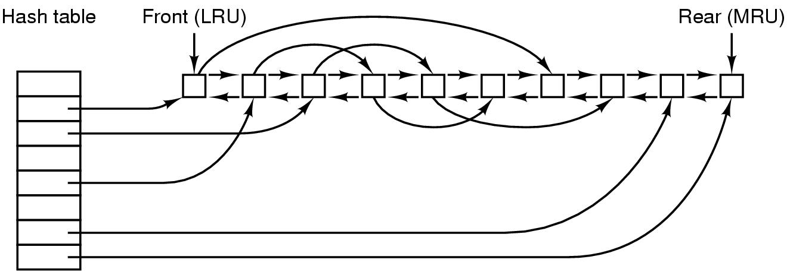
Caching (3)
The buffer cache data structures
  Collision chain
  Bidirectional list: running through all the blocks in the order of recently used usage, with the least recently used block on the front of this list and the most recently used block at the end of the list.
Figure 4-28 The buffer cache data structures

Slide 40
Caching (4)
What if the cache full and the user request a new block not in cache?
  Throw out old, unused blocks.
  Same kinds of algorithms as for virtual memory. Similar to paging system, FIFO, Second Chance, LRU, etc. can be used.
  More effort per reference is OK: file references are a lot less frequent than memory references.
  LRU is a reasonable block replacement policy.
    Can be implemented precisely: Bidirectional list in figure 4-28

Slide 41
Caching (5)
To implement precise LRU, consider the following situations:
  If a critical block (such as File Control Block, or i-node) is read into the cache and modified, but not re-written to the disk, a crash will leave the file system in an inconsistent state.
  If the i-node block is put at the end of the LRU chain, it may be quite a while before it reaches the front and is rewritten to the disk.
  Some blocks, such as i-node blocks, are rarely referenced two times within a short interval.

Slide 42
Caching (6)
Consider a modified LRU scheme, taking two factors into account:
  1. Is the block likely to be needed again soon?
  2. Is the block essential to the consistency of the file system?
For factors 1 and 2
  Blocks can be divided to categories
    i-node blocks, indirect blocks, directory blocks, full data blocks, partially full data blocks, etc.
  Blocks that will probably not be needed again soon go on the front, rather than the rear of the LRU list.
  Blocks that might be needed again soon go on the end of the list.

Slide 43
Caching (7)
For factor 2
  If the block is essential to the file system consistency, and it has been modified, it should be written to disk immediately, regardless of which end of the LRU list it is put on.
  Okay to delay writes to data blocks.
  Note: It is undesirable for keeping data blocks in the cache too long before writing them out.
    30 seconds Later
      The Unix “sync” system call
    Immediately
      MS-DOS “Write-through cache”

Slide 44
Block Read Ahead (1)
This method means
  Try to get blocks into the cache before they are needed.
  Increase hit rate by prefetching anticipated blocks.
Approach
  User requests ‘k’ block.
  FS gets ‘k’ block.
  FS checks of ‘k+1’ block is in cache, if not, FS will get ‘k+1’ block from disk anticipating that it will be needed in the future.

Slide 45
Block Read Ahead (2)
Advantage
  If user needs ‘k+1’ block, the access is fast – great method for video playback
Disadvantage
  If user does not need ‘k+1’ block, extra unnecessary work has been done
This technique helps only if access is sequential.

Slide 46
Block Read Ahead (3)
What if the file is not being read sequentially?
  FS keeps track of access patterns to open files
    Sequential access mode
    Random access mode
  FS may use a bit associated with each file to keep track of access pattern (1 for sequential access, 0 for random access)

Slide 47
Reducing Disk Arm Motion (1)
Seek time dominates disk access time.
  Reducing disk arm motion improved performance.
  Reducing disk arm motion by putting blocks that are likely to be accessed in sequence close to each other, preferably in the same cylinder.
When an output file is writing
  If the system uses a bitmap for the free blocks, it can allocate a new block for a file close to the previous block (guessing that the file will be accessed sequentially).

Slide 48
Reducing Disk Arm Motion (2)
When an output file is writing (ctd.)
  If the system uses a link list for the free blocks, the system can perform allocations in super-blocks, consisting of several contiguous blocks.
    The block cache and I/O requests are still in blocks not super-blocks.
    If the file is accessed sequentially, consecutive blocks of a super-block will be accessed in sequence and these are contiguous on the disk.

Slide 49
Reducing Disk Arm Motion (3)
In systems using i-nodes or anything equivalent to i-nodes, another performance bottleneck is that reading even a short file requires two disk accesses.
  Normally all i-nodes go together, and all data go together.
  Idea is to put i-node closer to actual file data.
Improvement
  Solution 1: Put the i-nodes in the middle of the disk, thus reducing the average seek between the i-node and the first block by a factor of two.
  Solution 2: Break disk into regions--“Cylinder Groups”. Put blocks that are “close together” in the same cylinder group.
    Example: figure 4-29 (b)
    Try to allocate i-node and blocks in the file within the same cylinder group.

Slide 50

Reducing Disk Arm Motion (4)
Figure 4-29
(a) i-nodes placed at the start of the disk
(b) Disk divided into cylinder groups, each with its own blocks and i-nodes

Slide 51
Summary
File System Management and Optimization
  Disk Space Management
    Block Size
    Keeping Track of Free Blocks
  File System Backups
    Logical Dump Algorithm
  File System Consistency
    Unix fsck: block consistency, directory consistency
  File System Performance
    Caching
    Block Read Ahead
    Reducing Disk-Arm Motion

Slide 52
Homework
P334 23, 25

