Slide 1
Modern Operating Systems
Chapter 4 – Files&Directories
Zhang Yang
Autumn 2019

Slide 2
Content of the Lecture
4.1 Files
4.2 Directories

Slide 3
Files
File Naming
File Structure
File Types
File Access
File Attributes
File Operations
An Example Program Using File System Calls

Slide 4
Storing Information (1)
Applications can store it in the process address space.
Why is it a bad idea?
  Size is limited to size of virtual address space.
    May not be sufficient for airline reservations, banking, etc.
  The data is lost when the application terminates.
    Even when computer doesn’t crash!
  Multiple process might want to access the same data.
    Imagine a telephone directory part of one process.

Slide 5
Storing Information (2)
Three criteria for long-term information storage:
  Should be able to store very large amount of information.
  Information must survive the processes using it.
  Should provide concurrent access to multiple processes.
Solution
  Store information on disks in units called files.
  Files are persistent, and only owner can explicitly delete it.
  Files are managed by the OS.

Slide 6
File System Overview (1)
File Systems: How the OS manages files!
Recall that
OS: an extended machine or virtual machine
OS: a resource manager
  Processor management
  Memory management
  I/O management
  File system management

Slide 7
File System Overview (2)
User’s view on file systems (4.1, 4.2)
  What constitutes a file?
  How files are named and protected?
  What operations are allowed on them?
  What the directory tree looks like?
  …

Slide 8
File and File System
File
  A named collection of related information that is recorded on secondary storage.
    Persistent through power failures and system reboots.
  OS provides a uniform logical view of information storage via files.
  OS maps the File to the Physical device.
    A logical representation of how files are stored on the physical device.
      Mapping varies from one OS to another.
File System
  A method for storing and organizing files and the data they contain to make it easy to find and access them.
Notes:
Computers store information on different [physical] media
 Flash Drives, Magnetic disk, Optical Disks, Magnetic Tapes
To access data in low-level format is cumbersome
Need to know about tracks and sectors
From a user’s perspective, a file is the smallest allotment of
logical secondary storage; that is, data cannot be written to
secondary storage unless they are within a file
OS provides a uniform logical view ( file) of various information
storage devices by abstracting from the physical properties of
storage devices

Slide 9
Basic Functions of File System
Present logical (abstract) view of files and directories.
  Hide complexity of hardware devices.
Facilitate efficient use of storage devices.
  Optimize access, e.g., to disk
Support sharing.
  Provide protection.

Slide 10
File Naming (1)
Motivation
  Files abstract information stored on disk
  You do not need to remember block, sector, …
  We have human readable names.
Very important. A major function of the file system is to supply uniform naming.
How does it work?
  Process creates a file, and gives it a name.
  Other processes can access the file by that name.

Slide 11
File Naming (2)
Naming Conventions
  OS dependent
  Textual Names
    Strings of letters, digits, and special characters.
  Number of characters
    All current OS allow strings of 1 to 8 characters as legal file names.
    Many OS support up to 255 characters.
  Case Sensitive
    UNIX family
      E.g. three distinct files: maria, Maria, MARIA

Slide 12
File Naming (3)
Naming Conventions
  Case Insensitive
    MS-DOS and Windows
      E.g. the same file: maria, Maria, MARIA
File Extension
  The extensions are suffixes attached to the file names.
  Usually indicate something about a file.
  Tied to type of file.
  Used by applications.
  Size of extension
    MS-DOS: 1 to 3 characters
    Unix: up to the user.

Slide 13
File Naming (4)
File Extension (ctd.)
  In UNIX, extensions are not enforced by OS.
    However C compiler might insist on its extensions.
      These extensions are very useful for C
  Windows attaches meaning to extensions.
    Tries to associate applications to file extensions.

Slide 14
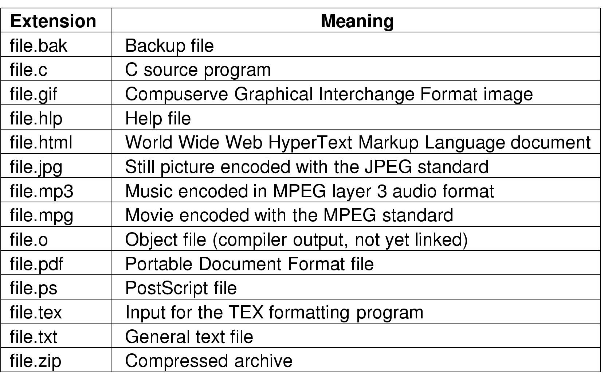
File Naming (5)
File Extension (ctd.)
  Typical File Extensions
Figure 4-1 Typical file extensions.

Slide 15
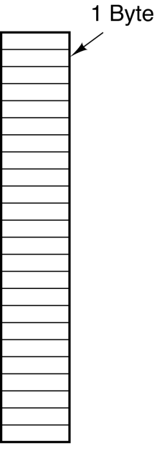
File Structure (1)
  No structure: Byte Sequence
  Simplifies file management for the OS.
  Applications can impose their own structure.
  Used by UNIX, Windows, most modern Oses.
Figure 4-2 Three kinds of files
  (a) Byte sequence

Slide 16
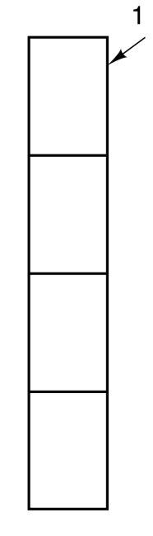
File Structure (2)
Record
  Simple record structure: Record Sequence
  Collection of bytes treated as a unit.
  Example: employee record
  Operations at the level of records (read_rec, write_rec)
  File is a collection of similar records.
  OS can optimize operations on records.
Figure 4-2 Three kinds of files
  (b) Record sequence

Slide 17
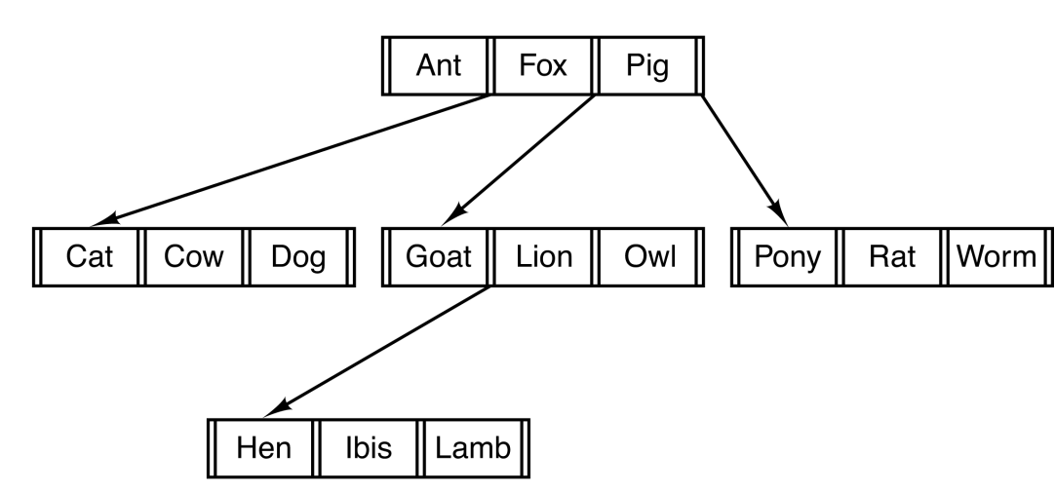
File Structure (3)
  Complex Structures: Tree
  Records of variable length.
  Each has an associated key.
  Record retrieval based on key.
  Used on some data processing systems (mainframes)
      Mostly incorporated into modern databases.
Figure 4-2 Three kinds of file (c) Tree

Slide 18
File Types (1)
Files may have types
  Understood by file systems.
    Device, directory, symbolic link, etc.
  Understood by other parts of OS or runtime libraries.
    Executable, dll, source code, object code, text, etc.
  Understood by application programs.
    jpg, mpg, avi, mp3, etc.
Common File Types
  Regular File
  Directory
  Character Special File (Unix)
    Used to model serial I/O devices, such as terminals, printers, etc.
  Block Special File (Unix)
    Used to model disks.

Slide 19
File Types (2)
Regular Files
  Regular files are the ones that contain user information.
  ASCII Files
    A text file in which each byte represents one character according to the ASCII code.
    Consist of lines of text.
    Lines need not all be of the same length.
    Advantages
      Can be displayed, printed, edited with any text editor.
      Facilitate information exchange.

Slide 20
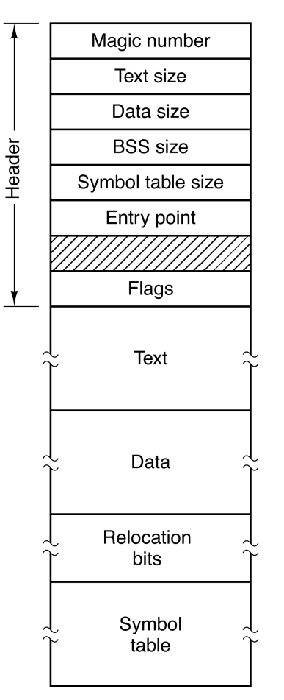
File Types (3)
Regular Files (ctd.)
  Binary Files
    A binary file is a file whose content must be interpreted by a program or a hardware processor that understands in advance exactly how it is formatted.
    Have internal structure.
    Example: An Unix executable file
      Header
      Text
      Data
      Relocation bits
      Symbol table
Figure 4-3 (a) An executable file

Slide 21
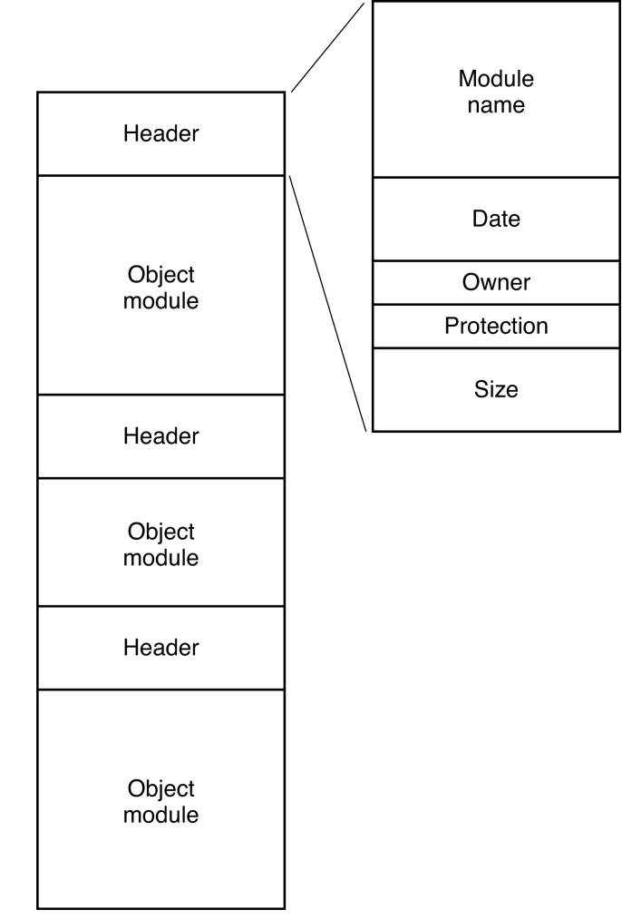
File Types (4)
Regular Files (ctd.)
  Binary Files (ctd.)
    Example: An Unix archive file
      Consists of a collection of
      library procedures compiled
      but not linked.
Figure 4-3 (b) An archive

Slide 22
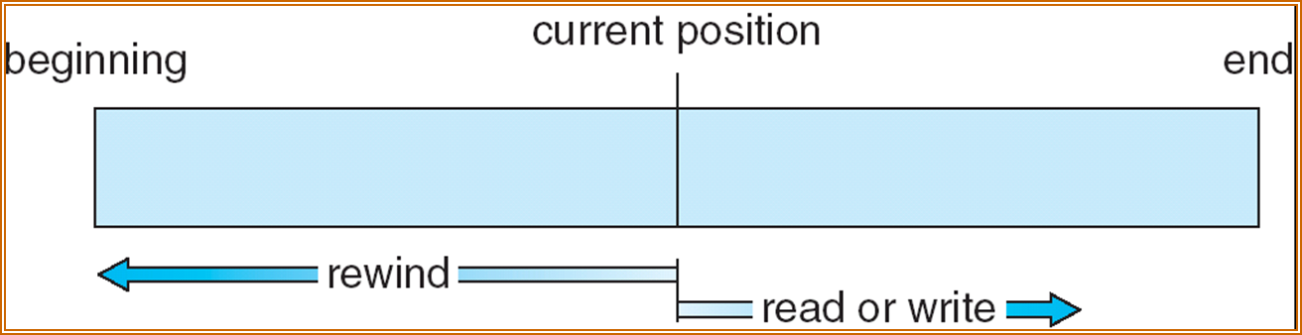
File Access (1)
Sequential Access
  Read all bytes/records from the beginning.
  Cannot jump around, could rewind or back up.
  Convenient when medium was magnetic tape.
  Read Operation (read next) – reads next portion of file and advances the file pointer.
  Write Operation (write next) – appends to end of file (eof) and advances file pointer to the new eof.
  File Pointer tracks I/O location
    Allows file to be reset at the beginning.

Slide 23
File Access (2)
Random Access
  Bytes/records read in any order.
  Essential for database systems.
  Read can be …
    Move file marker (seek), then read or …(Unix and Windows).
    Read and then move file marker.
  Read Operation (read n): "n" is a number relative to the beginning of file, not relative to an absolute physical disk location.
  Write Operation (write n)
  Convenient when medium was magnetic disk.
  Random Access File
    The file is viewed as a numbered sequence of blocks or records.

Slide 24
File Access (3)
Question
  Systems that support sequential files always have an operation to rewind files. Do systems that support random-access files need this, too?

Slide 25
File Attributes (1)
Dependent on OS
  Name – Symbolic file name is only information kept in human-readable form.
  Type – needed for systems that support different types of files.
  Location – pointer to file location on device.
  Size – current file size.
  Protection – controls who can do reading, writing, executing.
  Time, date, and user identification – data for protection, security, and usage monitoring.
Information about files are kept in the directory structure, which is maintained on the disk.

Slide 26
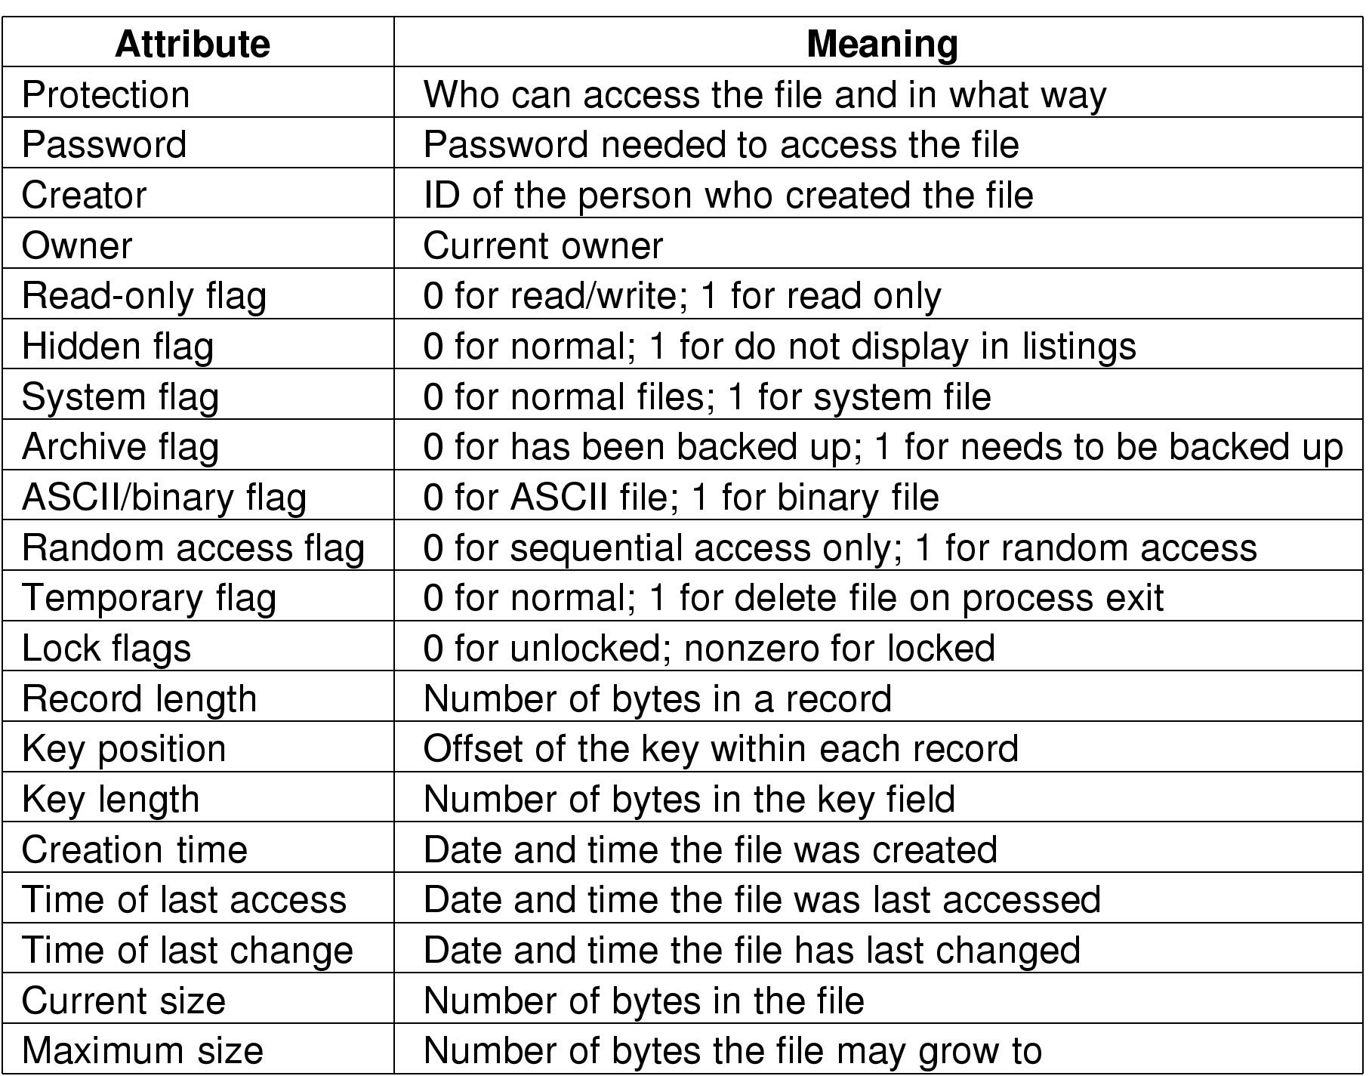
File Attributes (2)
Possible File Attributes
Figure 4-4 Possible File Attributes

Slide 27
File Operations (1)
Operations for “sequence of bytes” files
  Create: Announce that file is coming and set attributes and allocate space.
  Delete: Free disk space, adjust directory structure.
  Open: Allow the system to fetch the attributes and list of disk addresses into main memory.
  Close: Release internal table space and writing the file’s last block.
  Read: Data read from the file and put into memory for user access.
  Write: Data are written to the file usually at the current position.

Slide 28
File Operations (2)
Operations for “sequence of bytes” files (ctd.)
  Append: Adds data to the end of file.
  Seek: Random access data from the file, repositioning the file pointer for reading.
  Rename: Change the name of the file.
  Get & Set Attributes: Get attributes of file or set attributes of a file (e.g., get and set read only attribute )
  A few more on directories: talk about this later

Slide 29
File Related System Calls
fd = open (name, mode)
byte_count = read (fd, buffer, buffer_size)
byte_count = write (fd, buffer, num_bytes)
close (fd)

Slide 30
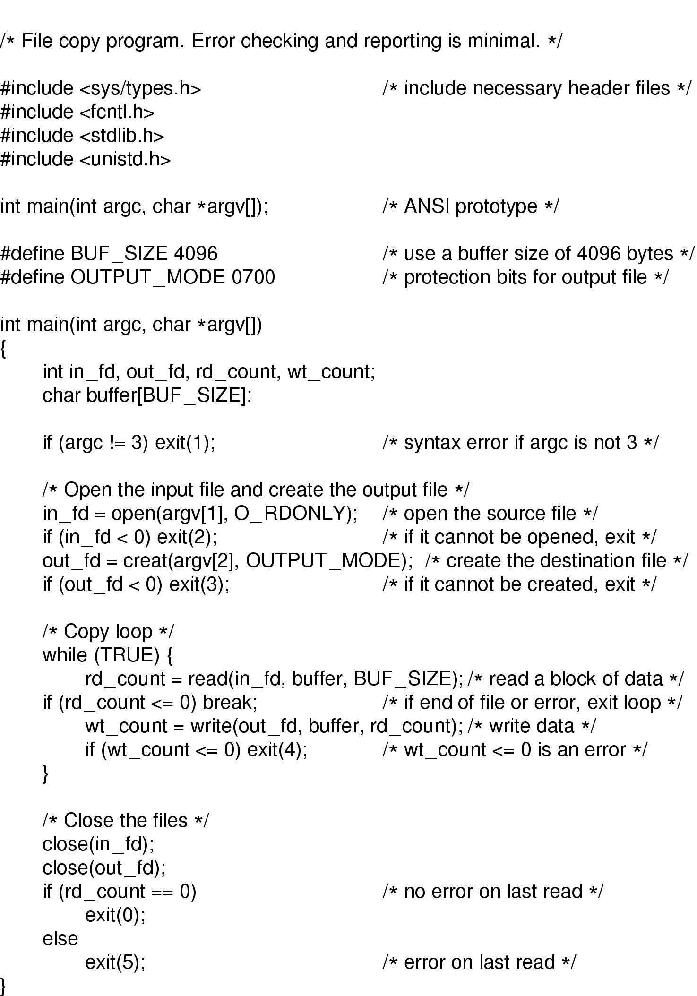
An Example Program Using File System Calls (1)
copyfile Program
  E.g. copyfile abc xyz (copy the file abc to xyz)
argc: how many strings were presented
argv: an array of pointers to the arguments

Slide 31
An Example Program Using File System Calls (2)
copyfile Program (ctd.)

Slide 32
Exercise (1)
Some operating systems provide a system call rename to give a file a new name. Is there any difference at all between using this call to rename a file and just copying the file to a new file with the new name, followed by deleting the old one?

Slide 33
Exercise (2)
Solution
  Yes.
  The rename call does not change the creation time or the time of last modification, but creating a new file causes it to get the current time as both the creation time and the time of last modification.
  Also, if the disk is full, the copy might fail.

Slide 34
Directory
Directory Structures
  Single-level Directory System
  Two-level Directory System
  Hierarchical Directory System
Path Names
Directory Operations

Slide 35
Directory (1)
Directory is a file containing correspondence between filenames and file locations.
Directory entries contain infomation about a file.
  i.e. its attributes
Directory entries are created when the files they describe are created and removed when files are deleted.

Slide 36
Directory (2)
A collection of nodes containing information about all files.
Directory
Files
F 1
F 2
F 3
F 4
F n
Both the directory structure and the files reside on disk.
Backups of these two structures are kept on tapes.

Slide 37
Directory Contents
File name: symbolic name
File type: indicates format of file
Location device and location
Size
Protection
Creation, access, and modification date
Owner identification

Slide 38
Organize the Directory (Logically) to Obtain
Efficiency – locating a file quickly
Naming – convenient to users
  Two users can have same name for different files
  The same file can have several different names
Grouping – logical grouping of files by properties, (e.g., all Java programs, all games, …)

Slide 39
Directory Structures
Single-Level Directory System
Two-Level Directory System
Hierarchical Directory System

Slide 40
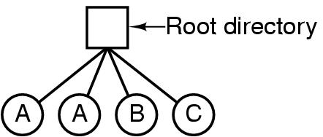
Single-Level Directory Systems
A single directory for all users
Example: A single level directory system
  Contains 4 files
  Owned by A, B, and C
Advantage
  Easy to support and understand
Problems
  Naming Problem (Name Collision Problem)
    All files must have unique names
  Grouping Problem
    Difficult to remember file names in a large file system

Slide 41
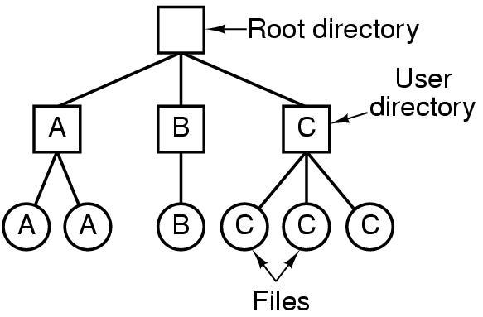
Two-level Directory Systems (1)
Separate directory for each user.
File names only need to be unique within a given user's directory.
A separate directory is generally needed for system
( executable ) files.
A user name and a file name define a path name.
Example
Letters indicate owners of the directories and files

Slide 42
Two-level Directory Systems (2)
Advantages
  Resolves name-collision problem
    Can have the same file name for different user
  Efficient searching
  File sharing and protection
Disadvantage
  Grouping problem not resolved
Notes:
较高的查找速度：要找到一个目录项，平均需要查找的目录项个数为主目录的目录项总数与一个用户的子目录的目录项总数的和的一半
文件共享：允许不同用户使用不同文件名来共享同一个文件，原则上只要把对应目录项指向同一物理位置的文件即可
文件保护：任何文件的存取，都通过主文件目录，于是可以检查访问者的存取权限，避免未授权用户访问别人的文件

Slide 43
Hierarchical Directory Systems (1)
Generalization of two-level directory (with arbitrary height).
Leaf nodes are files.
Interior nodes are directories.
Each user has a current directory (working directory).
  Can change current directory via cd command or system call.
Path names can be absolute or relative.

Slide 44
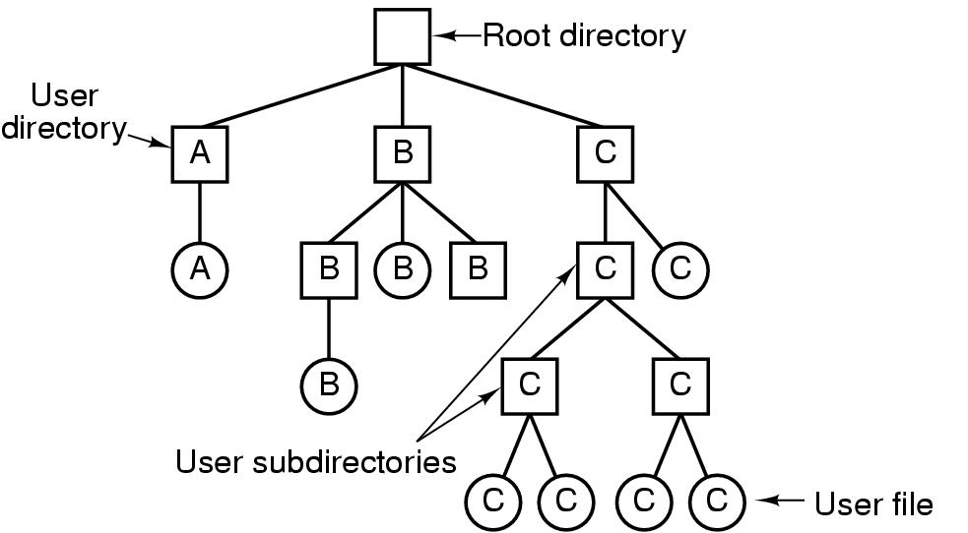
Hierarchical Directory Systems (2)
Example
Figure 4-7 A hierarchical directory system

Slide 45
Hierarchical Directory Systems (3)
Advantages
  Resolves name-collision problem
    Can have the same file name for different user
  Efficient searching
  File sharing and protection
  Grouping capability
Notes:
Tree has root dir
 Unique path name for files
Users can create
subdirectories….
提高了检索效率:设某文件系统管理N个文件，若采用单级目录，则要检索一个指定的文件，最多需要查找N个目录项；而若采用多级目录（不妨设为i级）目录，则每检索一个指定的文件，最多可能要查找近I*(N)个目录项。如果再结合当前目录和相对路径名进行检索，则效率会更高
通过对子目录设置存取权限，可保护用户子目录下的文件不会被未授权用户访问

Slide 46
Path Names (1)
MULTICS
  >usr>harry>mailbox
Windows
  \usr\harry\mailbox
Unix
  /usr/harry/mailbox
Absolute Path Name
  /usr/harry/mailbox
  Unique
  Start from root
Relative Path Name
  working directory (or current directory)
Each process has its own
working directory

Slide 47
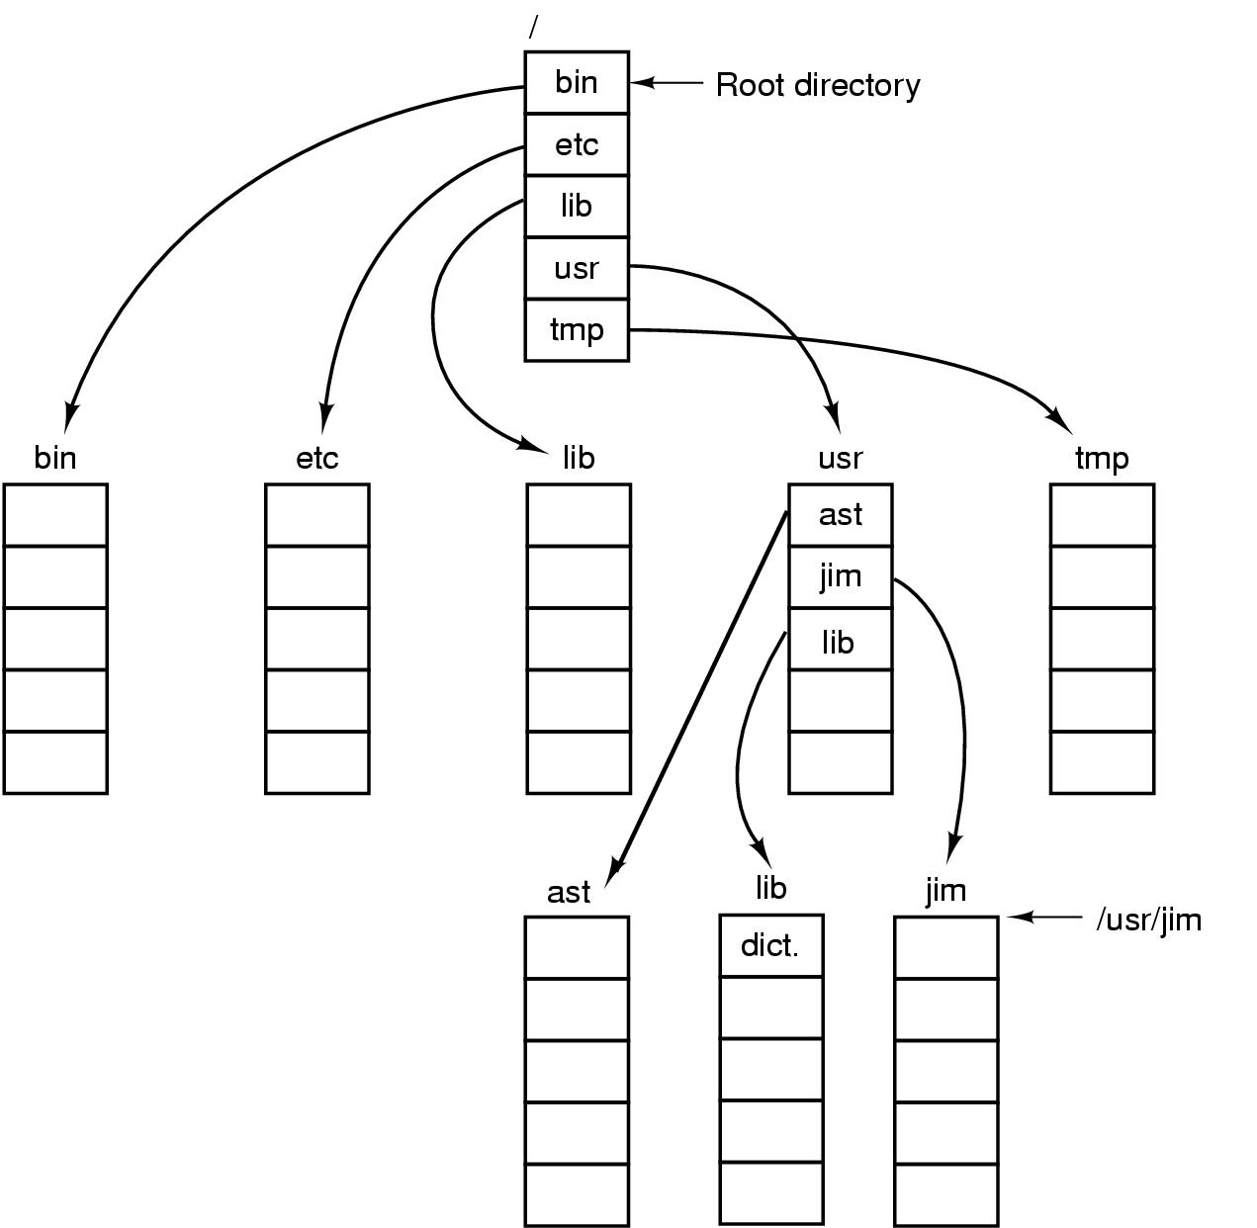
Path Names (2)
. is the “current directory”
.. is the parent
working dir /usr/ast
Example
cp /usr/lib/dictionary .
cp ../lib/dictionary .
Figure 4-8 A UNIX Directory Tree

Slide 48
Directory Operations
Directory Operations including:
  Create a new directory
  Delete a directory
  Open a directory for reading
  Close a directory to free up internal table space
  Readdir - return next entry in the directory
    Returns the entry in a standard format, regardless of the internal representation
  Rename a directory
  Link
    Create a link from the existing file to a path name. (ie. Make a “hard link”.)
  Unlink
    Remove a “hard link”

Slide 49
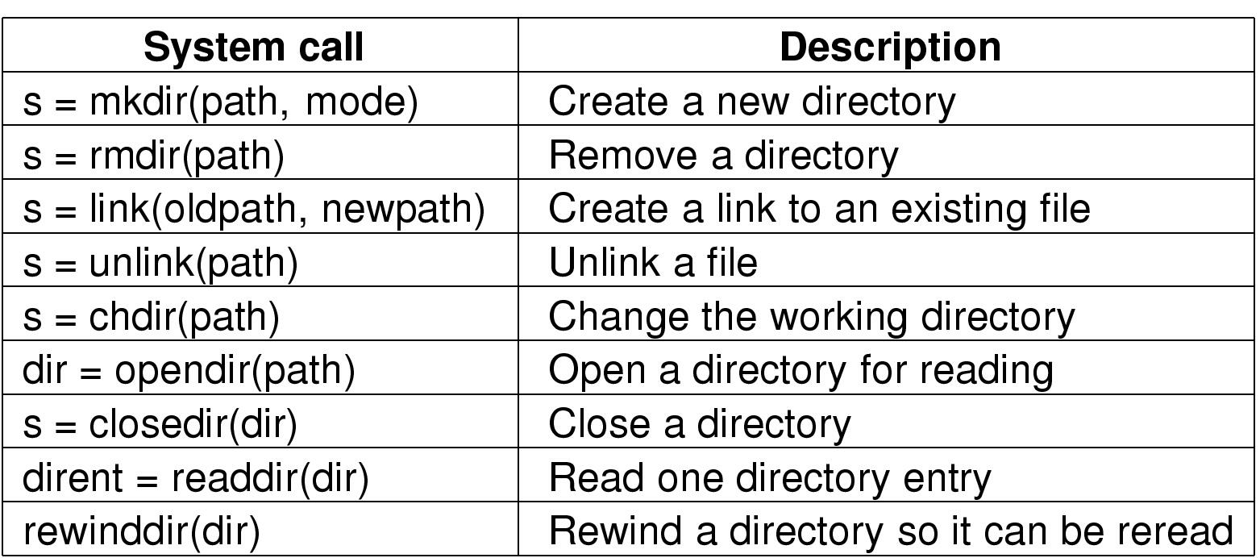
Unix Directory Related Syscalls
s = error code
dir = directory stream
dirent = directory entry

Slide 50
Linux Directory Structure (1)
Linux file system is based on a tree hirarchy.
The Linux filesystem structure has evolved from Unix file structure.
The file structure has been somewhat convoluted over the years by different flavors of Unix.
There are few common directory names that are used for common functions.

Slide 51
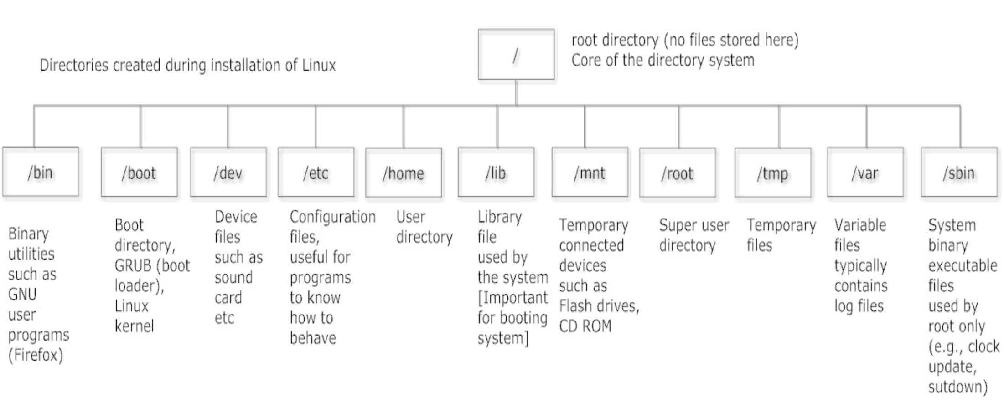
Linux Directory Structure (2)
Linux System Directory

