Slide 1
Modern Operating Systems
Chapter 5 – Disks
Zhang Yang
Autumn 2019

Slide 2
Content of the Lecture
5.4 Disks
  Disk Hardware
    Magnetic Disks
    RAID
  Disk Formatting
  Disk Arm Scheduling Algorithm
  Error Handling

Slide 3
Magnetic Disks (1)
Organized into cylinders
  Each cylinders contains tracks whose number is equal to the number of heads in the disk drive.
    Each track is divided into a number of sectors.
      E.g. for floppy disks, 8-32 sectors/track.
    The sector size is usually 512 bytes.
There are IDE, SCSI, Fiber Channel, and SATA hard disks.

Slide 4
Magnetic Disks (2)
One cylinder
One sector
One track

Slide 5
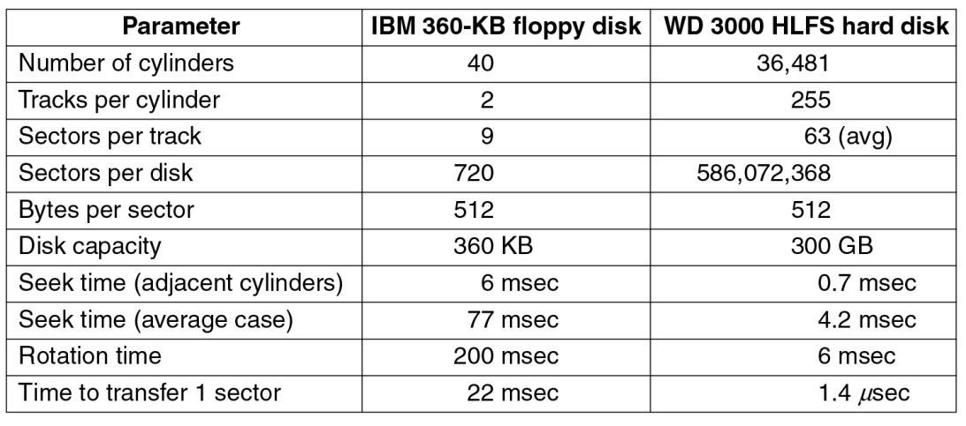
Magnetic Disks (3)
Disk Parameters Comparison
800000
9
16000
Figure 5-18 Disk parameters for the original IBM PC 360-KB floppy disk and a Western Digital WD 3000 HLFS hard disk
Notes:
C

Slide 6
Magnetic Disks (4)
A Hard Disk
Disk Arm
Disk Head
One
platter
Arm motion
path

Slide 7
Magnetic Disks (5)
Zone Bit Recording (ZBR)
  Outside tracks are longer than inside tracks.
  Two options
    Bits are “bigger”
    More bits (transfer faster)
  Modern hard drives use second option
    Placing more sectors per zone on outer tracks than on inner tracks.
  Disk divided into “zones”
    Constant sectors per track in each zone.
    8–20 (or more) zones on a disk

Slide 8
Magnetic Disks (6)
Disk Virtual Geometry
  To hide the details of how many sectors each track has, most modern disks have a virtual geometry that is presented to the OS.
  (x cylinders, y heads, z sectors)
  The controller remaps a request for (x, y, z) to the real cylinder, head and sector.

Slide 9
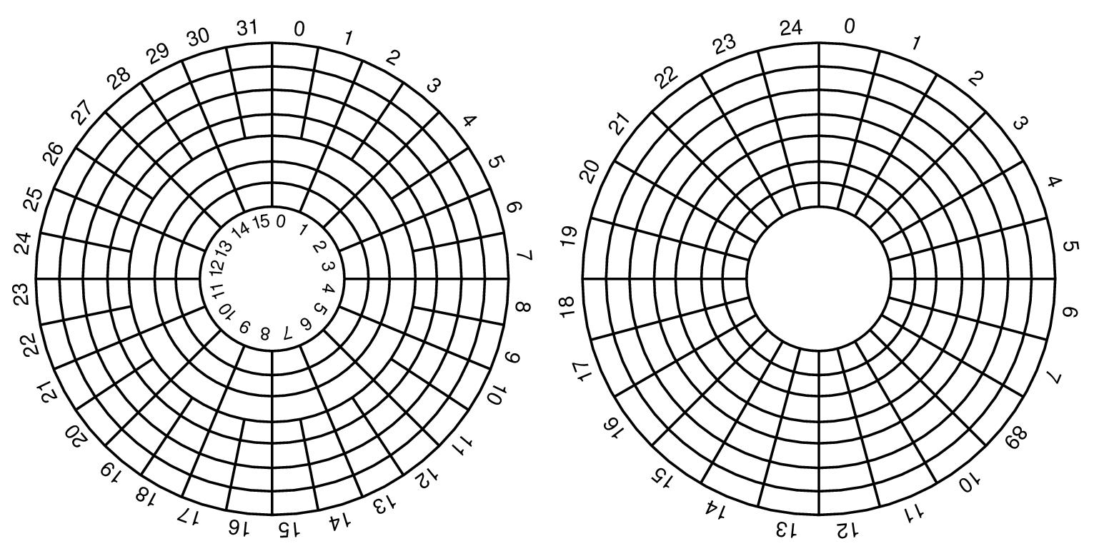
Magnetic Disks (7)
Disk Virtual Geometry (ctd.)
Inner zone 16 sectors
Total 192 sectors
Outer zone 32 sectors
Figure 5-19 (a) Physical geometry of a disk with two zones (b) A possible virtual geometry for this disk

Slide 10
Magnetic Disks (8)
Methods used for specifying the location of blocks of data
  CHS
  LBA (Logical Block Addressing)
CHS Method
  CHS addressing is the process of identifying individual sectors on a disk by their position in a track, where the track is determined by the head and cylinder numbers. (cylinder,head, sector).
  An early method for giving addresses to each physical block of data on a hard disk drive.

Slide 11
Magnetic Disks (9)
CHS Method (ctd.)
  CHS did not map well to devices other than hard disks (such as tapes and networked storage), and was generally not used for them.
  It is still important for partitioning mass storage devices like hard disks and SSDs.
  Operating systems that are sensitive to BIOS-reported drive geometry include Solaris, DOS and Windows NT family, where NTLDR (NT, 2000, XP, Server 2003) or WINLOAD (Vista, Server 2008, Windows 7 and Server 2008 R2) use Master Boot Record which addresses the disk using CHS.

Slide 12
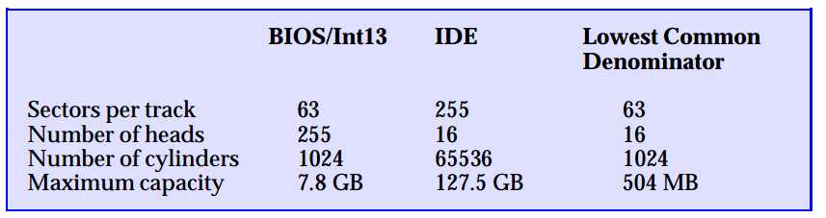
Magnetic Disks (10)
CHS Method (ctd.)
  The designers of the PC BIOS and of IDE had independently set different maximum limits for the number of cylinders, heads and sectors (CHS) a hard disk could have.
  LBA has replaced the CHS scheme in order to overcome its limitations.

Slide 13
Magnetic Disks (11)
LBA Method
  LBA is a particularly simple linear addressing scheme.
  In the LBA addressing scheme, sectors are numbered as integer indexes. with the first block being LBA=0, the second LBA=1, and so on.
  x86-64 and Itanium versions of Windows can partition the drive with GUID Partition Table which uses LBA addressing.

Slide 14
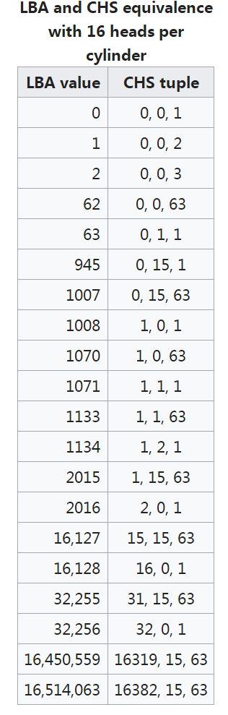
Magnetic Disks (12)
LBA Method (ctd.)
  Conversion between CHS to LBA
    C, H and S are the cylinder number, the head number, and the sector number.
    LBA is the logical block address.
    HPC is the number of heads per cylinder.
    SPT is the number of sectors per track.

Slide 15
RAID (1)
Mass Storage
  Many systems today need to store many terabytes of data.
  Don’t want to use single, large disk.
    Too expensive
    Failures could be catastrophic
  Would prefer to use many smaller disks.

Slide 16
RAID (2)
RAID
  Redundant Array of Inexpensive Disks
  Basic idea is to connect multiple disks together to provide
    Large storage capacity
    Faster access to reading data
    Redundant data
  Many different levels of RAID systems
    Differing levels of redundancy, error checking, capacity, and cost.

Slide 17
RAID (3)
Striping
  Take file data and map it to different disks.
  Allows for reading data in parallel.
file data
block 0
block 1
block 2
block 3
Disk 0
Disk 1
Disk 2
Disk 3

Slide 18
RAID (4)
RAID Level 0
  Often called striping
  Break a file into blocks of data
  Stripe the blocks across disks in the system
  Simple to implement
    disk = file block % number of disks
    sector = file block / number of disks
  Provides no redundancy or error detection.
    Important to consider because lots of disks means low Mean Time To Failure (MTTF)
      MTTF is the average time that an item will function before it fails.

Slide 19
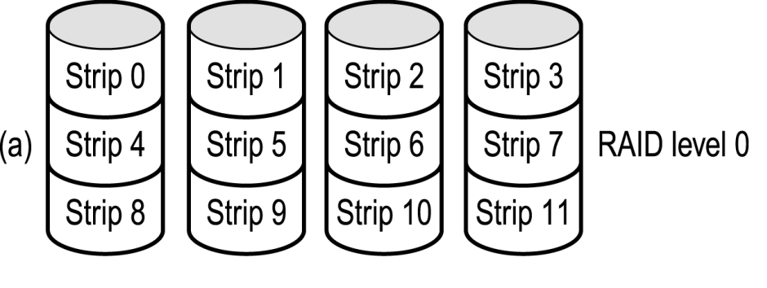
RAID (5)
RAID Level 0 (ctd.)
  If array has n disks failure rate is n times the failure rate of a single disk.
  Figure 5-20 (a)

Slide 20
RAID (6)
RAID Level 1
  A complete file is stored on a single disk.
  A second disk contains an exact copy of the file.
  Provides complete redundancy of data.
  Read performance can be improved.
    File data can be read in parallel
  Write performance suffers.
    Must write the data out twice
  Most expensive RAID implementation.
    Requires twice as much storage space.

Slide 21
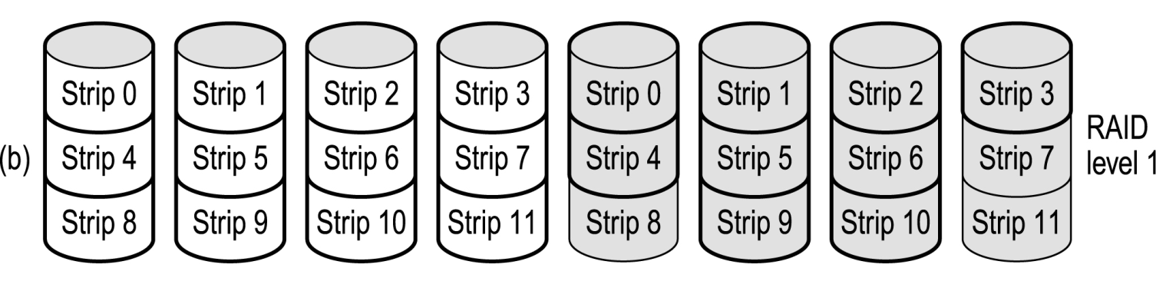
RAID (7)
RAID Level 1 (ctd.)
  Figure 5-20 (b)

Slide 22
RAID (8)
RAID Level 2
  Stripes data across disks similar to Level-0
    Difference is data is bit interleaved instead of block interleaved.
  Uses ECC to monitor correctness of information on disk.
  Multiple disks record the ECC information to determine which disk is in fault.
  Very bad idea because disk drives either work correctly or do not work at all.

Slide 23
RAID (9)
RAID Level 2 (ctd.)
file data
block 0
block1
block 2
block 3
block 4
Data Disk
Data Disk
ECC Disk
ECC Disk

Slide 24
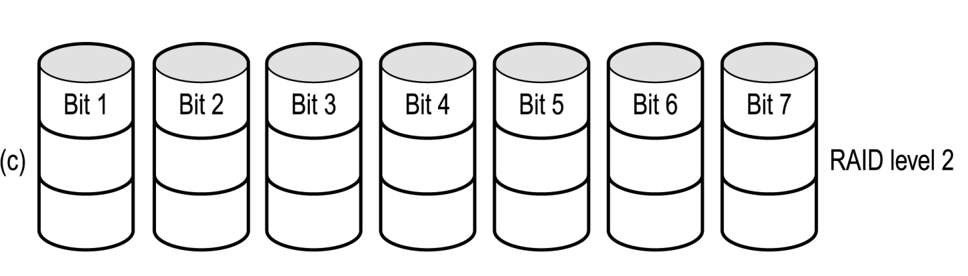
RAID (10)
RAID Level 2 (ctd.)
  Example: Figure 5-20 (c)
Check bit
Check bit
Check bit

Slide 25
RAID (12)
RAID Level 3
  One big problem with Level-2 are the disks needed to detect which disk had an error.
  Modern disks can already determine if there is an error.
    Using ECC codes with each sector.
  So just need to include a parity disk
    If a sector is bad, the disk itself tells us, and use the parity disk to correct it.

Slide 26
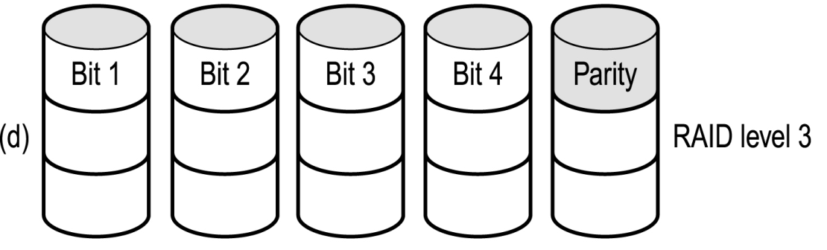
RAID (13)
RAID Level 3 (ctd.)
  Figure 5-20 (d)

Slide 27
RAID (14)
RAID Level 4
  Big problem with Level-2 and Level-3 is the bit interleavening.
    To access a single file block of data, must access all the disks.
    Allows good parallelism for a single access but doesn’t allow multiple I/O’s.
  Level-4 interleaves file blocks.
    Allows multiple small I/O’s to be done at once
  Still use a single disk for parity.
  Now the parity is calculated over data from multiple blocks
    Level-2,3 calculate it over a single block.
  If an error detected, need to read other blocks on other disks to reconstruct data.

Slide 28
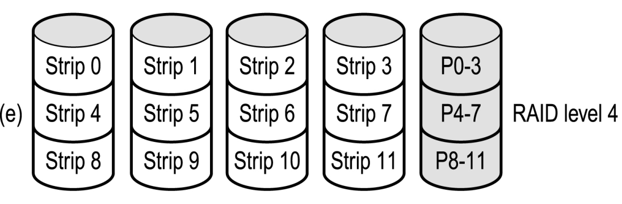
RAID (15)
RAID Level 4 (ctd.)
  Figure 5-20 (e)

Slide 29
RAID (16)
RAID Level 5
  Level-5 stripes file data and check data over all the disks.
    No longer a single check disk.
    No more write bottleneck.
  Drastically improves the performance of multiple writes.
    They can now be done in parallel.
  Slightly improves reads
    one more disk to use for reading

Slide 30
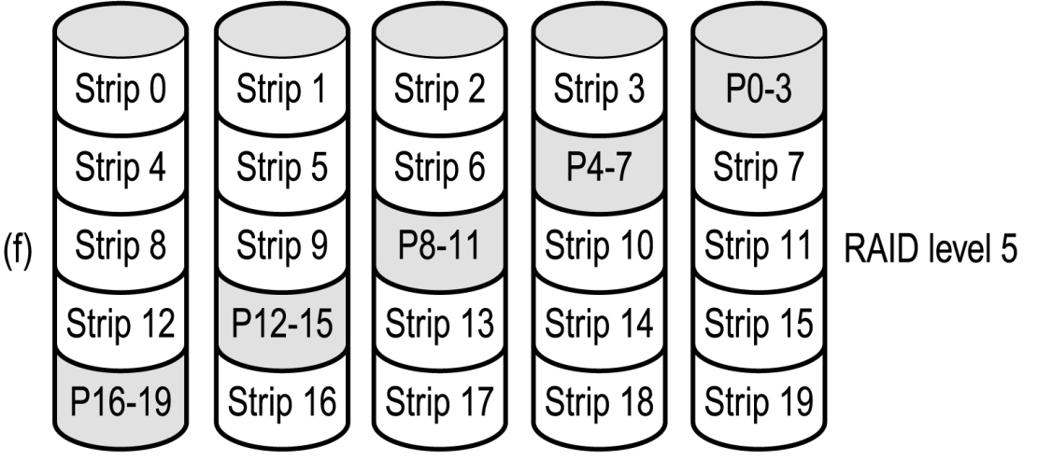
RAID (17)
RAID Level 5 (ctd.)
  Figure 5-20 (f)

Slide 31
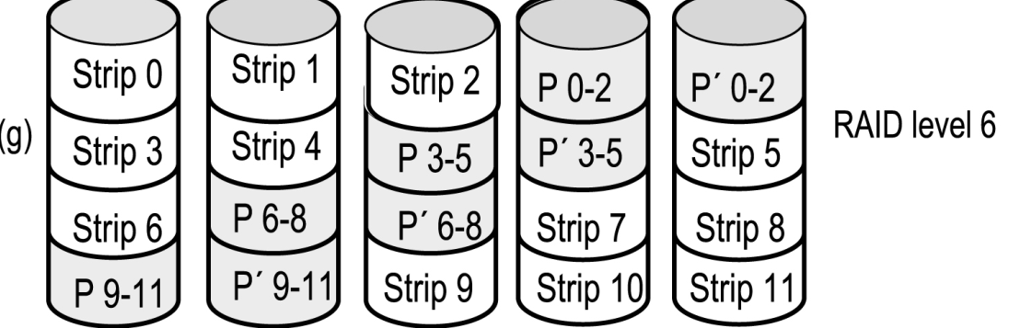
RAID (18)
RAID Level 6
  Two check disks
  Tolerates two disk failures
  More complex update

Slide 32
Disk Formatting (1)
After manufacturing, there is no information on the disk.
  Just empty bits
Each platter need to have
  A low-level format
  A high-level format
before disk can be used.
Low-level Formatting
  Dividing a disk into sectors that the disk controller can read and write.
  Low-level formatting is usually done by vendors

Slide 33
Disk Formatting (2)
Low-Level Formatting (ctd.)
  Each track should have formatted in the following way:
    Sectors and inter-sector-gap between them.
    A sector will be have format like the following:
      Preamble – data (512 bytes) – Checksum
sector
sector
sector
preamble
Data (512 bytes)
ECC (~16 bytes)
certain bit pattern
cylinder number
sector number

Slide 34
Disk Formatting (3)
Low-Level Formatting (ctd.)
  Cylinder Skew
    When reading sequential blocks, the seek time can result in missing block 0 in the next track.
    Disk can be formatted using a cylinder skew to avoid this.
    Cylinder Skew: Start cylinders at different points to give the head time to jump from one to the next.

Slide 35
Disk Formatting (4)
Direction of rotation
23
0
22
1
21
16
17
18
2
15
20
14
20
21
19
3
19
22
13
18
23
20
19
17
24
4
12
21
> time to change
track (cyclinder)
16
0
18
11
15
1
22
5
17
10
14
2
23
6
13
3
9
12
0
16
11
4
7
Sweep path
8
10
6
5
1
15
7
9
7
2
8
14
6
5
3
9
4
13
12
11
10

Slide 36
Disk Formatting (5)
Low-Level Formatting (ctd.)
  Cylinder Skew
    Example: 10000rpm disk drive, 300 sectors per track, seek time 800us, the cylinder skew is 40 sectors
      10000 rpm
        Drive rotates in 6 ms
      Track has 300 sectors
        New sector every 20 µs
      If track seek time 800 µs
        40 sectors pass on seek

Slide 37
Disk Formatting (6)
Low-Level Formatting (ctd.)
  Interleaving
    If we have ONE sector buffer in the disk controller, after we have transferred one sector of data from hard-disk to controller buffer:
      We will copy the controller buffer to the memory.
      During this time, the disk-head will pass the start of the next sector.
      Therefore, the next logical sector, should not be the next physical sector in hard-disk.
        There should be some interleaving.

Slide 38
Disk Formatting (6)
registers
MEMORY
16
17
18
15
CPU
14
20
21
19
19
22
13
18
23
20
12
17
24
21
16
0
(2)
(3)
11
22
15
1
(1)
10
14
2
23
13
3
9
12
0
11
4
Disk Controller
8
10
6
5
1
7
9
7
2
1 sector
buffer
6
5
3
registers
4

Slide 39
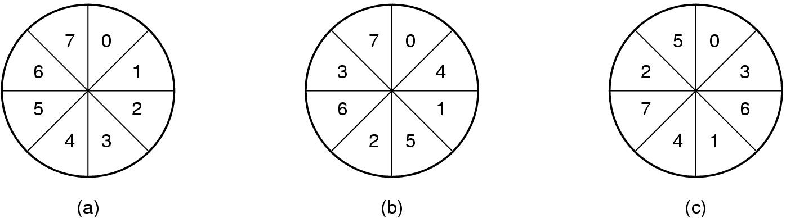
Disk Formatting (7)
Low-Level Formatting (ctd.)
  Interleaving (ctd.)
    (a) No interleaving
    (b) Single interleaving (more common)
      Skipping one sector between reads
    (c) Double interleaving
      Skipping two sectors between reads

Slide 40
Disk Formatting (8)
Low-Level Formatting (ctd.)
  Interleaving (ctd.)
    Modern drives overcome interleaving type issues by simply reading the entire track (or part thereof) into the on-disk controller and caching it.

Slide 41
Disk Formatting (9)
Disk Partitioning
  Each partition is like a separate disk.
  Sector 0 is MBR. (CHS (0,0,1))
    Bootstrap code: 446 bytes
      Look up the active partition from the partition table.
      Reads boot sector from that partition.
    Master partition table: 64 bytes
      Partition table has starting sector and size of each partition.
    Boot Signature: 2 bytes
      Used by the BIOS to determine if the selected boot drive is actually bootable or not.
      0x55AA

Slide 42
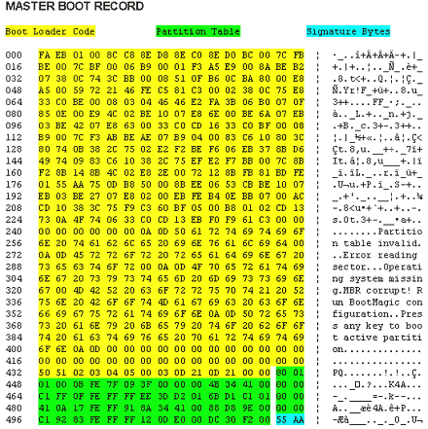
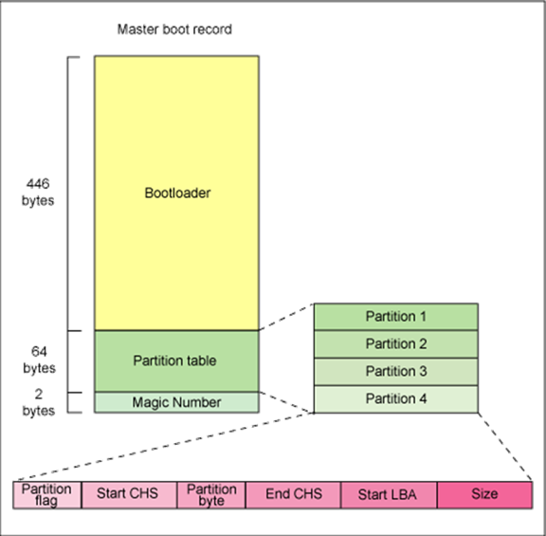
Disk Formatting (10)
Disk Partitioning (ctd.)
  MBR Figure

Slide 43
Disk Formatting (11)
Disk Partitioning (ctd.)
  What happens on boot?
    BIOS loads MBR, boot program checks to see active partition.
    Reads boot sector from that partition that then loads OS kernel, etc.
  High-level Formatting
    Done for each partition.
    Specifies boot block, free list, root directory, empty file system.

Slide 44
Disk Queues (1)
Each disk has a queue of jobs waiting to access disk.
  Read jobs
  Write jobs
Each entry in queue contains the following:
  Pointer to memory location to read/write from/to
  Sector number to access
  Pointer to next job in the queue
OS usually maintains this queue.

Slide 45
Disk Queues (2)
Entry 3
Entry 2
Entry 1
Sector Z
Mem Ptr 2
next entry
Sector Y
Mem Ptr 1
next entry
Sector X
Mem Ptr 0
next entry
head
tail
Disk

Slide 46
Disk Arm Scheduling (1)
How long does it take to read a block (sector)
  Positioning Time + Transfer Time
  Positioning Time
    Seek Time
      Move arm to the correct cylinder.
    Rotational Delay
      Wait until correct sector comes under head.
  Actual data transfer time
For most systems, the seek time dominates the other two times.

Slide 47
Disk Arm Scheduling (2)
Assume the disk is heavily loaded.
  There are a lot of requests for disk blocks that are arriving to the hard disk driver.
  The drivers queues the requests.
    The driver knows for each block request, where in hard disk the block should be stored (the cylinder number).
  Since moving between cylinders (seek time) is costly, we should try to minimize these seek times.

Slide 48
Disk Arm Scheduling (3)
Disk Driver
  Keeps a table of requests.
  Table is indexed by the cylinder number.
  Blocks requests for the same cylinder are put in a linked list.
Initial position
x
x
x
x
x
0
5
10
15
20
cylinder
number
pending requests

Slide 49
Disk Arm Scheduling Algorithms
Goal: Minimize positioning time
  Performed by both OS and disk itself.
Several Algorithms Exist
  First Come First Served (FCFS)
    Advantage: Fair
    Disadvantage: High seek cost and rotation
  Shortest Seek First (SSF)
    Advantage: Reduces arm movement (seek time)
    Disadvantage: Unfair, can starve some requests
  Elevator Algorithm (SCAN)
    Advantage: More fair to requests, similar performance as SSTF
  C-SCAN
    Provides a more uniform wait time than SCAN.

Slide 50
FCFS (1)
Serve the request in the order they arrive (don’t look to the cylinder numbers)
Example
  Assume the current position is cylinder 11.
  The following requests arrive in the given time order: 1, 36, 16, 34, 9, 12
  The request will be served in the same order.
  The head will go to:
    Cylinder 1 first (10 cylinder motion)
    Cylinder 36 next (35 cylinder motion)
    Cylinder 16 next (20)
    Cylinder 34 next (18)
    Cylinder 9 next (25)
    Cylinder 12 next (3)
    Total of 111 cylinders are skipped. Cost = 111

Slide 51
FCFS (2)
New request arrival sequence: 1, 36, 16, 34, 9, 12
Initial head position
0
5
10
15
20
25
30
35
x
x
x
x
x
x
x

Slide 52
Shortest Seek First (SSF) (1)
Satisfy the request that need shortest seek from the current position.
In the previous example, this algorithms moved the head to cylinders in the order given below.
  12, 9, 16, 1, 34, and 36.
Moving the head to these cylinders require:
  1, 3, 7, 15, 33, and 2 arm motions (that many cylinders are skipped at every request).
  Total cost = 61.

Slide 53
Shortest Seek First (SSF) (2)
New request arrival sequence: 1, 36, 16, 34, 9, 12
Initial head position
0
5
10
15
20
25
30
35
x
x
x
x
x
x
x

Slide 54
Shortest Seek First (SSF) (3)
Issue
  The goals of minimal response time and fairness are in conflict here.
  Example
New request arrival sequence: 1, 36, 16, 34, 9, 12
After going to 16, a new request for 8 is present, then 13.
Initial head position
0
5
10
15
20
25
30
35
x
x
x
x
x
x
x

Slide 55
Elevator Algorithm (1)
Also called SCAN algorithm.
Do like what an elevator does.
  1. Move in one direction until all request in that direction is served
  2. Then change direction.
  3. Move in the new direction until all request in that direction are server.
  Repeat steps 1, 2, and 3.
In the previous example
  Assume initial position was 11 and initial direction was up (going to higher numbered cylinders).

Slide 56
Elevator Algorithm (2)
The request are server in the following order:
  12, 16, 34, 36, 9, 1
Arm motions (# of cylinder skips)
  1, 4, 18, 2, 27, 8
  Total cost = 60 cylinders.
Performs good and is fair.
Software should maintain 1 bit to know the direction. Elevator also should know whether it is going UP or DOWN

Slide 57
Elevator Algorithm (3)
New request arrival sequence: 1, 36, 16, 34, 9, 12
Initial head position
0
5
10
15
20
25
30
35
x
x
x
x
x
x
x

Slide 58
C-SCAN (1)
Provides a more uniform wait time than SCAN.
The head moves from one end of the disk to the other.
  Servicing requests as it goes.
  When it reaches the other end it immediately returns to beginning of the disk.
    No requests serviced on the return trip.
Treats the cylinders as a circular list.
  That wraps around from the last cylinder to the first one.
Circular SCAN

Slide 59

C-SCAN (2)

Slide 60
Selecting a Disk Scheduling Algorithm
SSF is common and has a natural appeal.
SCAN and C-SCAN perform better for systems that place heavy load on the disk.
Performance depends on the number and types of requests.
Requests for disk service are influenced by the file allocation method.

Slide 61
Error Handling (1)
Disk defect cause bad blocks
If the defect is small, let the ECC correct
Otherwise, let entire sector go bad and
deal with bad sector in controller or OS
Two approaches to handle bad sectors
  Deal with them in controller.
    Disk tested before shipping.
    Bad sector marked and substituted with spare.
    Example (next page)
  Deal with them in operating system.
    OS check for bad sectors and record them.

Slide 62
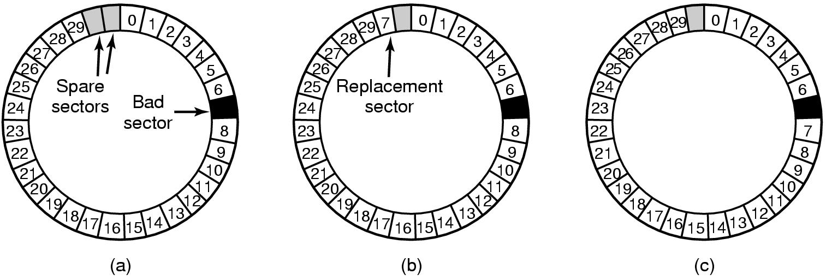
Error Handling (2)
Figure 5-30
(a) A disk track with a bad sector
(b) Substituting a spare for the bad sector
(c) Shifting all the sectors to bypass the bad one

Slide 63
Homework
P429 27, 28, 31

