Slide 1
Modern Operating Systems
Chapter 5 – Input/Output
Software
Zhang Yang
Autumn 2019

Slide 2
Content of the Lecture
5.1 Principles of I/O Hardware
5.2 Principles of I/O Software
5.3 I/O Software Layers

Slide 3
Principles of I/O Hardware
I/O Devices
Device Controllers
Interfacing with Controllers
DMA
Interrupt

Slide 4
I/O Devices (1)
I/O Devices Types
  Block Device
    Information is stored and accessed in fixed-size blocks.
    Block addressable, not byte addressable.
    Common block size: 512 bytes-32768 bytes.
    Hard Disk, blu-ray discs, USB Sticks, etc.
  Character Device
    Send or receive streams of characters.
    NOT byte or block addressable.
    Printer, Network Interface, Mouse, etc.
  Classification not perfect.
    What about
      Clocks?
      Memory-mapped screens?

Slide 5
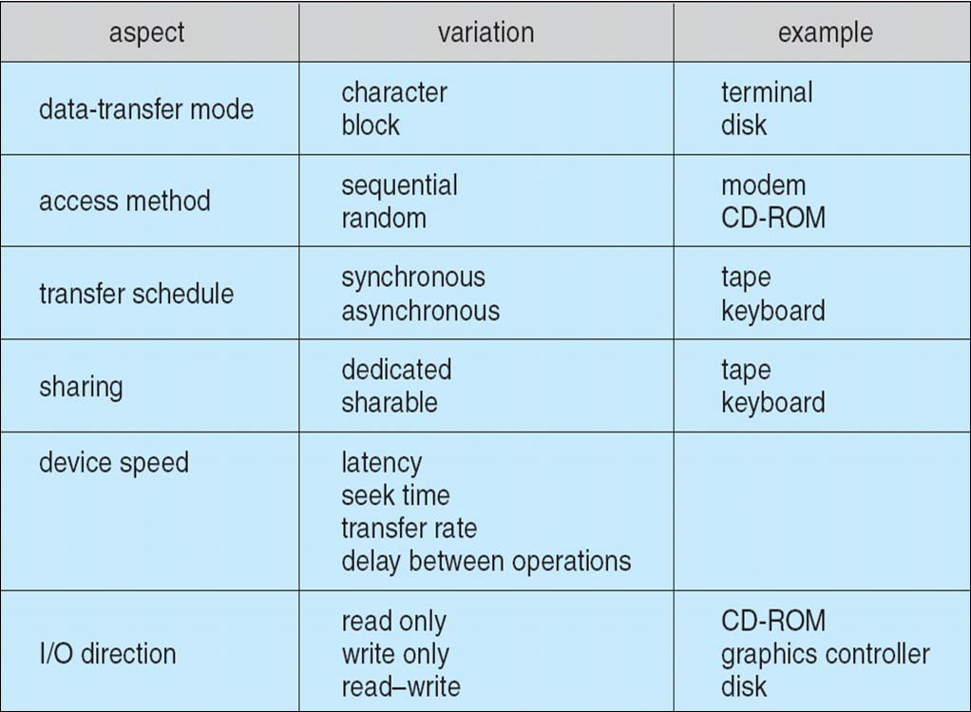
I/O Devices (2)
Characteristics of I/O Devices

Slide 6
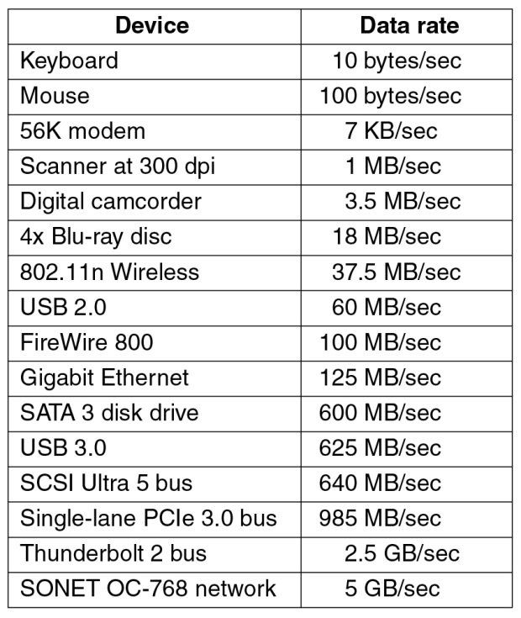
I/O Devices (3)
Typical Device Data Rates
Figure 5-1 Some device, network, and bus data rates

Slide 7
Device Controllers (1)
I/O devices have components
  Mechanical component
  Electronic component
Electronic component controls the device
  Device Controller or Adapter
  May be able to handle multiple devices. (e.g., daisy chained)
  May be more than one controller per mechanical component (e.g., hard drive).
  May implement a standard interface (SCSI/EIDE/USB)
Controller's Tasks
  Convert serial bit stream to block of bytes.
  Perform error correction as necessary.
  Make available to main memory.

Slide 8
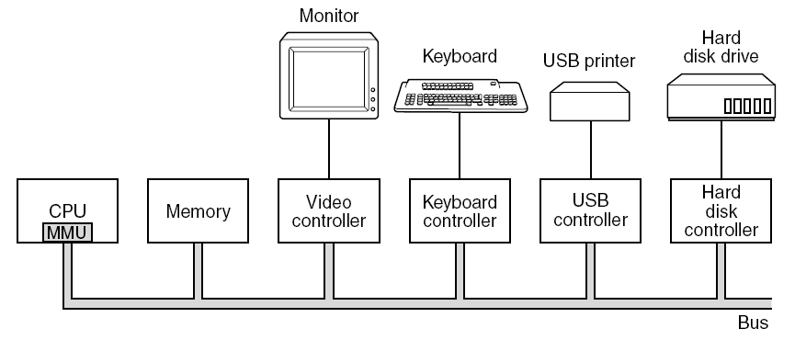
Device Controllers (2)
Figure 1-6. Some of the components of a simple personal
computer.

Slide 9
Interfacing with Controllers (1)
The OS interacts with a controller
  By writing/reading registers (command/status)
  By writing/reading memory buffers (actual data)
Port-Mapped I/O (Isolated I/O)
  Each controller is assigned a special address called a port.
  The set of all the I/O ports form the I/O port space.
  Using a special I/O instruction.
    E.g. IN REG, PORT
  The address space for memory and I/O are different.

Slide 10
Interfacing with Controllers (2)
Port-Mapped I/O (ctd.)
  Advantage of Port-Mapped I/O
    Useful for CPU with small addressing capability (e.g. 16-bit).
  Disadvantages of Port-Mapped I/O
    Need separate I/O instructions.
    Limited instruction set.

Slide 11
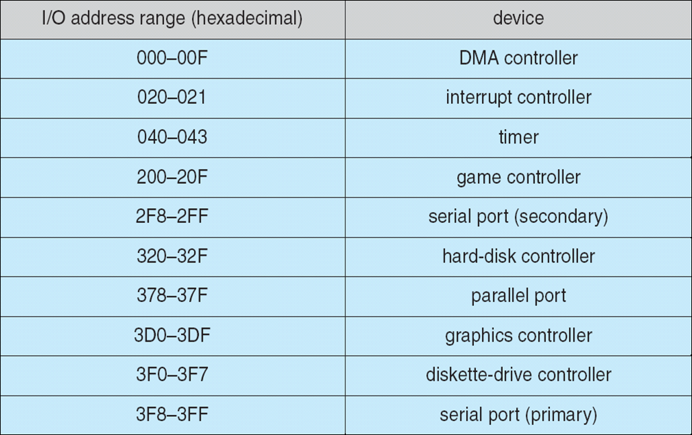
Interfacing with Controllers (3)
Port-Mapped I/O (ctd.)
  Device I/O Port Locations on PCs (partial)

Slide 12
Interfacing With Controllers (4)
Memory-Mapped I/O
  Introduced in PDP-11.
  Controller Registers are part of regular address space.
  Usually flags in special registers indicate that the memory access is for memory-mapped I/O.
  Used by Motorola 680x0 processors.
Hybrid
  Memory-mapped I/O data buffers and separate I/O ports.
  E.g. Intel x86
    640K – 1M-1 reserved for device data buffer
    0 – 64K-1 for I/O ports

Slide 13
Interfacing With Controllers (5)
Memory
0xFFF…
I/O ports
0
Separate
I/O & memory
space
Memory-mapped I/O
Hybrid: both
memory-mapped &
separate spaces

Slide 14
Interfacing With Controllers (6)
When a controller’s registers has to be accessed
  CPU puts address on the bus.
  CPU sets a line that tells if this address is a memory address or an I/O port.
  In case the register/buffer is memory-mapped, the corresponding controller is responsible for checking the address and service the request if the address is in its range.

Slide 15
Interfacing With Controllers (7)
Advantages of Memory-Mapped I/O
  With memory-mapped I/O, a I/O device driver can be written entirely in C. Without it, some assembly code is needed.
  With memory-mapped I/O, no special protection mechanism is needed to keep user processes from performing I/O.
  With memory-mapped I/O, every instruction can reference memory can also reference control registers.
    LOOP: TEST PORT_4 //check if port 4 is 0
    BEQ READY //if it is 0, go to ready
    BRANCH LOOP //otherwise, continue
    testing
    READY:

Slide 16

Interfacing With Controllers (8)
Disadvantages of Memory-Mapped I/O
  Most computers have capability of caching memory words. Caching a device control register would be disastrous.
    Solution: The hardware has to be equipped with the ability to selectively disable caching.

Slide 17
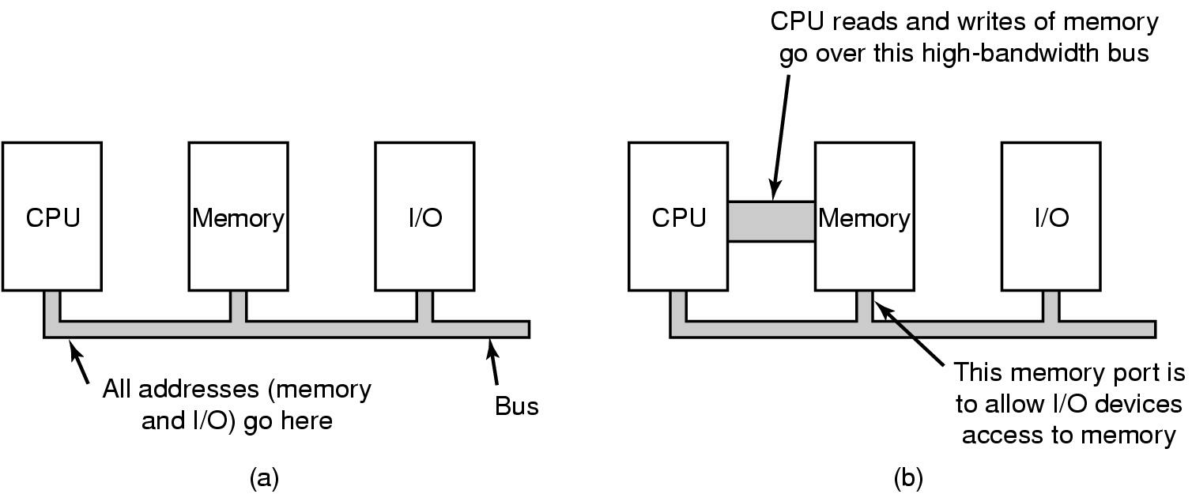
Interfacing With Controllers (9)
Disadvantages of Memory-Mapped I/O (ctd.)
  In some computer systems, the I/O devices have no way of seeing memory addresses as they go by on the memory bus, so they have no way of responding to them.

Slide 18
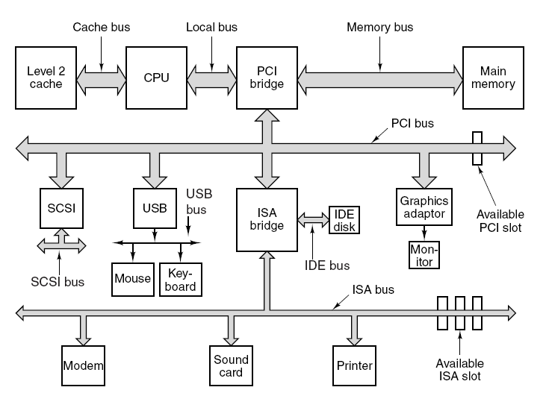
Interfacing With Controllers (10)
Disadvantages of Memory-Mapped I/O (ctd.)
  In some computer systems, the I/O devices have no way of seeing memory addresses as they go by on the memory bus, so they have no way of responding to them.

Slide 19
Direct Memory Access (1)
Direct Memory Access (DMA) is a capability provided by some computer bus architectures that allows data to be sent directly from an attached device (such as a disk drive) to the memory on the computer's motherboard.
Used mainly for block devices.
DMA Operations:
  CPU program the DMA controller
  DMA requests transfer to memory
  Data transferred
  The disk controller sends an acknowledgement

Slide 20

Direct Memory Access (2)
Figure 5-4 Operations of a DMA transfer

Slide 21

Interrupts (1)
Hardware’s View of Interrupts
Bus
How interrupts happens. Connections between devices and interrupt controller actually use interrupt lines on the bus rather than dedicated wires

Slide 22
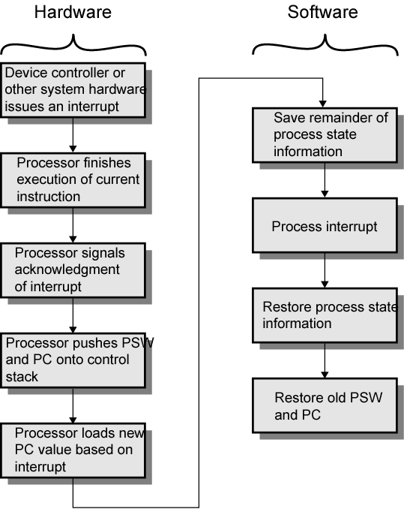
Interrupts (2)
Interrupt Processing

Slide 23
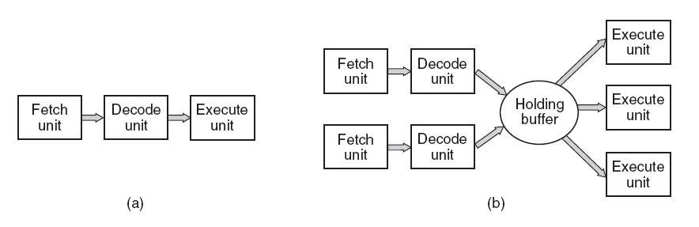
Interrupts (3)
In interrupt processing, restoring CPU state is easier said then done when instructions may end up... half-baked (in case of pipelining).
Pipeline and superscalar technologies complicate interrupt handling.
Figure 1-7. (a) A three-stage pipeline. (b) A superscalar CPU.

Slide 24
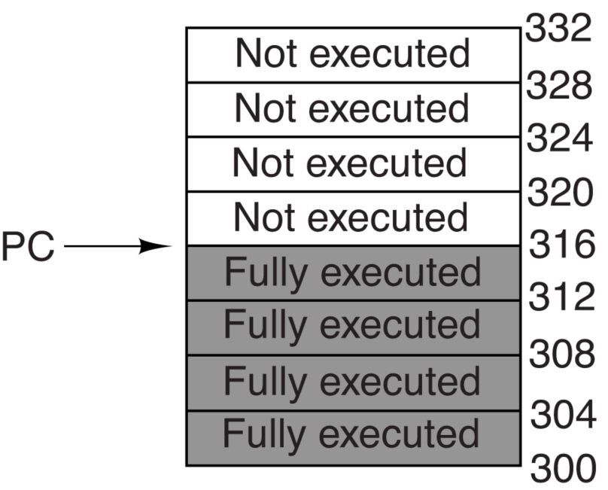
Interrupts (4)
Figure 5-6 (a) A precise interrupt
Precise Interrupt
  An interrupt that leaves the machine in a well-defined state is called a precise interrupt.
  Precise interrupts preserve the model that instructions execute in program-generated order, one at a time.
    If an interrupt occurs, the processor can recover from it.
precise state at interrupt
• all instructions older than interrupt are complete.
• all instructions younger than interrupt haven’t started.

Slide 25
Interrupts (5)
Precise Interrupt (ctd.)
  What happens on a precise interrupt?
    Identify the instruction that caused the interrupt.
    Let the instructions before faulting instruction finish.
    Disable writes for faulting & subsequent instructions.
    Force trap instruction into pipeline.
    Trap routine
      Save the state of the executing program
      Correct the cause of the interrupt
      Restore program state
    Restart faulting & subsequent instructions.

Slide 26
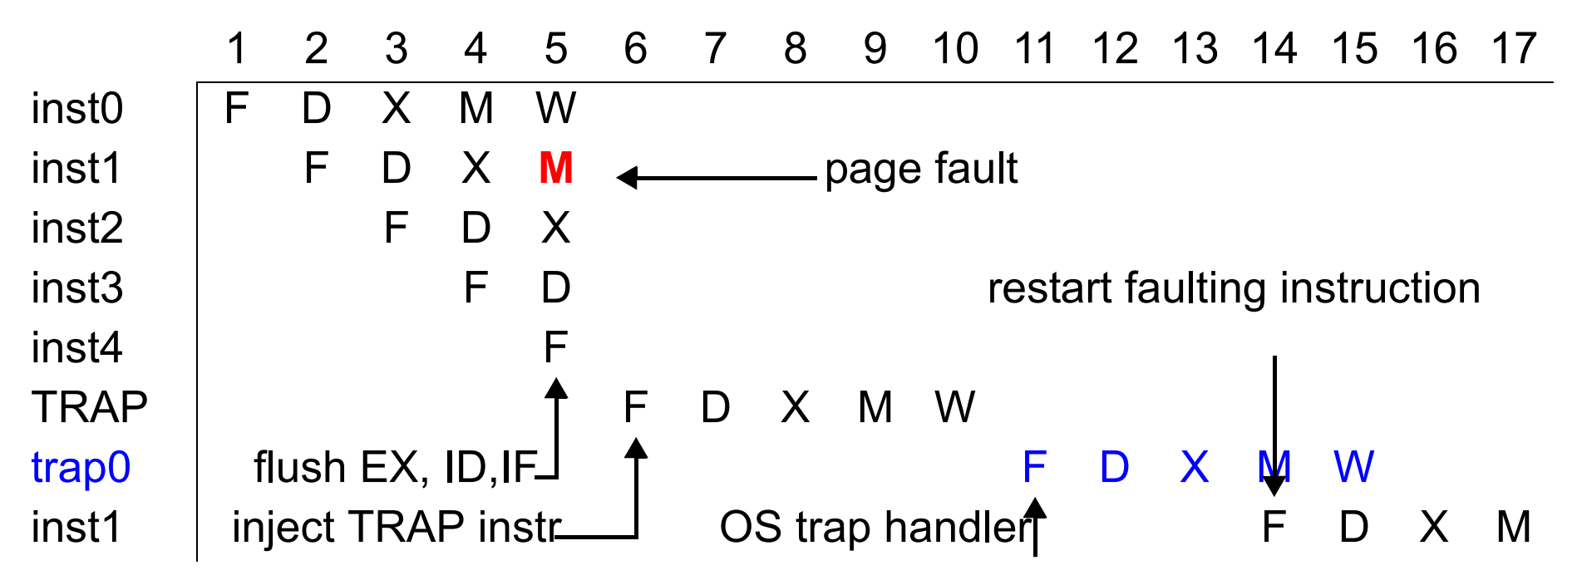
Interrupts (6)
Precise Interrupt (ctd.)
  Interrupt Example: Data page fault
    Squash (effects of) younger instructions
    Inject fake TRAP instruction into IF
    From here, like a SYSCALL

Slide 27
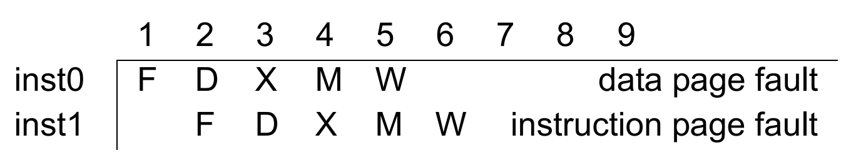
Interrupts (7)
Precise Interrupt (ctd.)
  More Interrupt Example
    Interrupts can occur at different stages
      IF, MEM: page fault, misaligned data, protection violation
      ID: illegal/privileged instruction
      EX: arithmetic exception
    Too complicated to draw what goes on here
    Cycle2: instruction page fault, flush inst1, inject TRAP
    Cycle4: data page fault, flush inst0, inst1, TRAP
      Can get into an infinite loop here (with help of OS page placement)

Slide 28
Interrupts (8)
Precise Interrupt (ctd.)
  Four Properties
    The PC (Program Counter) is saved in a known place.
    All instructions before the one pointed to by the PC have fully executed.
    No instruction beyond the one pointed to by the PC has been executed.
    The execution state of the instruction pointed to by the PC is known.

Slide 29
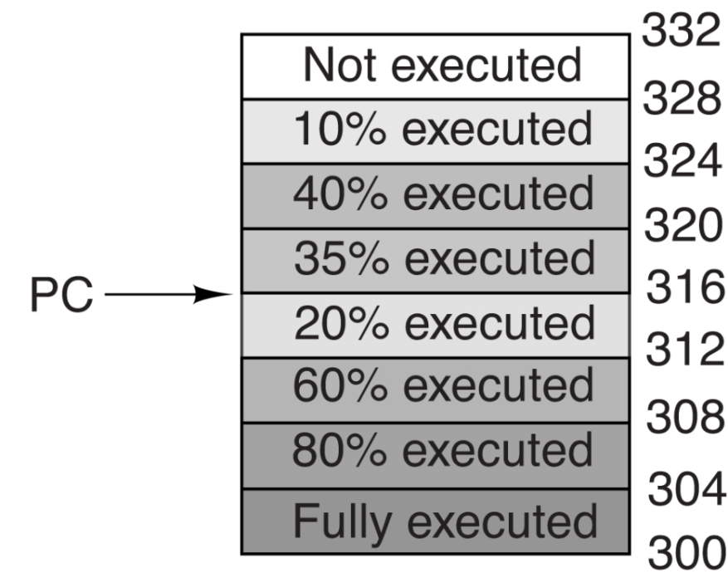
Interrupts (9)
Imprecise Interrupt
  An interrupt that does not meet these four requirements is called an imprecise interrupt.
Figure 5-6. (b) An imprecise interrupt.

Slide 30
Interrupts (10)
Precise Interrupt vs. Imprecise Interrupt
  Some computers are designed so that some kinds of interrupts and traps are precise and others are not.
  Some machines have a bit that can be set to force all interrupts to be precise.
  Some superscalar machines, such as the x86 family, have precise interrupts to allow old software to work correctly.

Slide 31
Principles of I/O Software
Goals of I/O Software
  Device Independence
  Uniform Naming
  Error Handling
  Synchronous vs. Asynchronous Transfer
  Buffering
  Sharable vs. Dedicated Devices
I/O Operation
  Programmed I/O
  Interrupt-driven I/O
  I/O Using DMA

Slide 32
Goals of I/O Software (1)
Device Independence
  Read and Write from Floppy, Disk, CD-ROM without modifying. (Programs can access any I/O device without specifying device in advance.)
  I/O software should abstract the device details.
  E.g. sort <input> output

Slide 33
Goals of I/O Software (2)
Uniform Naming
  The way we specify a file or device should be done in the same way.
  Name of a file or device is a string or an integer not depending on which machine.
    Different devices of same type have similar name.
  In UNIX, all I/O is integrated with the file system.

Slide 34
Goals of I/O Software (3)
Error Handling
  Handle the errors close to the hardware as possible.
  Propagate errors up only when lower layer cannot handle it.
  Hide errors as much as possible—many HW errors are transient.

Slide 35
Goals of I/O Software (4)
Synchronous vs. Asynchronous Transfers
  Blocking transfers vs. Interrupt-driven
  Most I/O hardware operates asynchronously.
  Synchronous read/write at application level.
  Synchronous (blocking) read/write easier to program.
  It is up to OS to make I/O operations that are actually interrupt-driven look blocking to the user program.

Slide 36
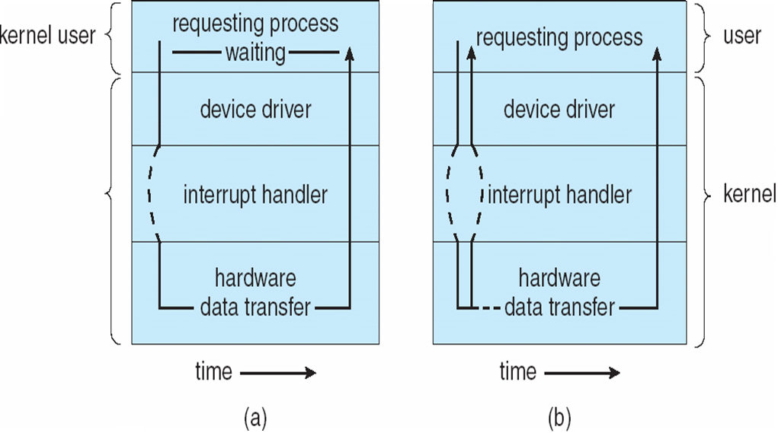
Goals of I/O Software (5)
Synchronous vs. Asynchronous Transfers (ctd.)
Blocking/Synchronous I/O
Interrupt-driven/Asynchronous I/O

Slide 37
Goals of I/O Software (6)
Buffering
  Data coming off a device cannot be stored in final destination.
Sharable vs. Dedicated Devices
  E.g. disks are sharable
  E.g. tape drives are dedicated, may introduce a variety of problems, such as deadlock.
  OS must be able to handle both shared and dedicated devices in a way that avoids problem.
    Make dedicated devices appear sharable. E.g printers

Slide 38
I/O Software
System call in user-space.
Data is copied from user space to kernel space.
I/O software can operate in several modes.
  Programmed I/O
    Polling/Busy waiting for the device.
  Interrupt-Driven I/O
    Operation is completed by interrupt routine
  DMA-based I/O
    Set up controller and let it deal with the transfer

Slide 39
Programmed I/O (1)
CPU is always busy with I/O until I/O gets completed.
  Fine for single process systems.
    MS-DOS
    Embedded systems
  But not a good approached for multi-programming and time-sharing systems.

Slide 40
Programmed I/O (2)
Programmed I/O Operations (output)
  Data copied to kernel space from user space.
  OS then enters a tight loop (Polling) the device (usually checking a status register) to see if the device is ready for more data.
  Once the device is ready to accept more data, the OS will copy the data to the device register.
  Once all data has been copied control is returned to the user program.

Slide 41
Programmed I/O (3)
Printing String Example
  Assume a program that wants to print a string to a printer.
  Assume the string is “ABCDEFGH”.
    8 character long string
  Assume printer has 1 byte of data buffer to put the character that needs to be printed.

Slide 42
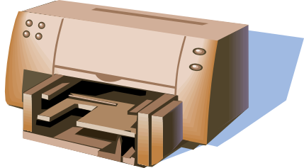
Programmed I/O (4)
String
to be printed
Main Memory
Application Buffer
Application Program
User Address Space
A
B
C
D
E
F
G
H
CPU
CPU
registers
Kernel Buffer
Kernel Address Space
REG
REG
Kernel
Printed
Page
(empty)
REG
BUS
status
data
Printer Controller
Controller registers

Slide 43
Programmed I/O (5)
Main Memory
Application Program
Data is copied into
Kernel Buffer
CPU
A
B
C
D
E
F
G
H
REG
REG
Kernel
Printed
Page
(empty)
REG
BUS
status
data
Printer Controller

Slide 44
Programmed I/O (6)
Main Memory
Application Program
CPU
A
B
C
D
E
F
G
H
REG
A
(1)
(3)
Kernel
A
REG
REG
(2)
BUS
(4)
status
data
A
Printer Controller

Slide 45
Programmed I/O (7)
Main Memory
Application Program
CPU
A
B
B
C
D
E
F
G
H
REG
B
(1)
(3)
Kernel
A
B
REG
REG
(2)
BUS
status
data
B
(4)
Printer Controller

Slide 46
Programmed I/O (8)
Printing String Example (ctd.)
  How would we implement copy in kernel?
/*
buffer is user buffer
p is kernel buffer
count is number of bytes to be copied
*/
copy_from_user(buffer, p, count);
for (i=0; i < count; ++i) /* loop in every character */
{
while (*printer_status_register != READY)
{}; /*busy waiting – loop until ready*/
*printer_data_register = p[i]; /* output one character */
}
return_to_user();

Slide 47
Programmed I/O (9)
What is good about programmed I/O?
  Usually simple to implement.
What is bad about programmed I/O?
  Since we are tying up the CPU checking to see if we can access a device, we are in a state of “busy waiting”. No “real” work is being done.
  Assume printer prints at a rate 100 chars/second
    Each character takes 10ms to print.
    During this 10 ms, CPU will be busy with checking the status register of printer (controller).
    This is waste of CPU.
    During 10ms period something else can be made (Another process can be run).

Slide 48
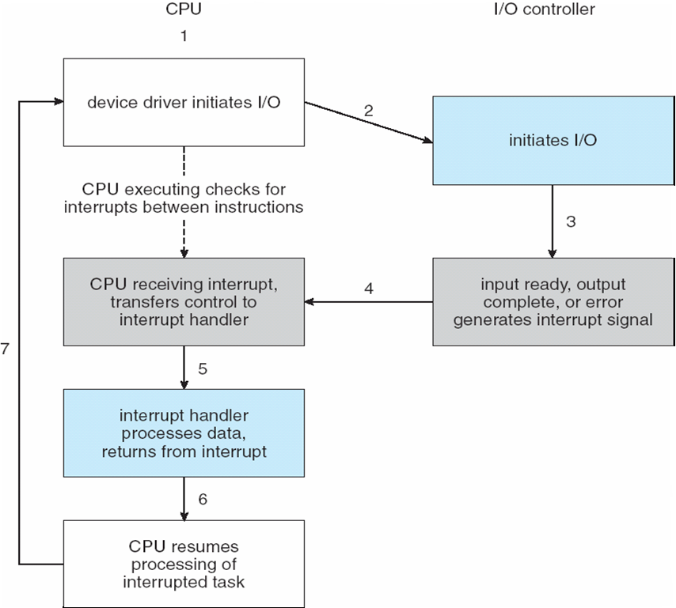
Interrupt Driven I/O (1)
Interrupt Driven I/O Cycle

Slide 49
Interrupt Driven I/O (2)
Printing String Example
  The user program makes a system call telling the OS to print the string.
  After copying application buffer content into kernel buffer, and sending 1 character to printer:
    CPU does not wait until printer is READY again.
    Instead the scheduler() is called and some other process is run.
    The current process is put into blocked state until the entire string is printed.
    Printer controller generates an hardware interrupt when the printer has printed the character and is ready again.

Slide 50
Interrupt Driven I/O (3)
Printing String Example (ctd.)
  Code executed in kernel when the print() system call is made by the application process.
copy_from_user(buffer, p, count);
enable_interrupts();
while (*printer_status_reg != READY)
{
}; /* loop until printer controller becomes READY */
*printer_data_register = p[0]; // send to the first character to the printer controller */
scheduler(); /* do some other task */

Slide 51
Interrupt Driven I/O (4)
Printing String Example (ctd.)
  Interrupt Service Routine that is executed when the printer controller becomes READY for one more byte again.
If (count == 0) { /* we are finishes printing the string */
unblock_user(); /* unblock the user process that wanted to print the string */
} else {
/* copy one more character to the controller buffer */
*print_data_register = p[i];
count = count – 1;
i = i + 1;
}
acknowledge interrupt();
return_from_interrupt(); /* finished serving the interrupt */

Slide 52
Interrupt Driven I/O (5)
Printing String Example (ctd.)
  Q: In the previous interrupt service procedure, interrupt is not acknowledged until after the next character has been output to the printer. Could it have equally well been acknowledged right at the start of the interrupt service routine? If so, give one reason for doing it at the end, as in the text. If not, why not.

Slide 53
Interrupt Driven I/O (6)
Printing String Example (ctd.)
  A: It could have been done at the start.
  A reason for doing it at the end is that the
  code of the interrupt service procedure is very short. By first outputting another character and then acknowledging the interrupt, if another interrupt happens immediately, the printer will be working during the interrupt, making it print
  slightly faster.
  A disadvantage of this approach is slightly longer dead time when other interrupts may be disabled.

Slide 54
Interrupt Driven I/O (7)
Advantages of Interrupt-Driven I/O
  Its faster than Programmed I/O.
  Efficient too.
Disadvantages of Interrupt-Driven I/O
  It can be tricky to write if using a low level language.
  It can be tough to get various pieces to work well together.

Slide 55
I/O Using DMA (1)
Disadvantage of Interrupt Driven I/O is that interrupt occurs on every character.
In essence, DMA is programmed I/O, only with the DMA controller doing all the work, instead of the main CPU.
Printing String Example
  DMA controller will feed the characters from kernel buffer to the printer controller.
    CPU is not bothered during this transfer.
  After transfer of whole buffer (string) is completed, then the CPU is interrupted.

Slide 56
I/O Using DMA (2)
Printing String Example (ctd.)
  Code executed in Kernel when the print() system call is made by the application process.
  Interrupt Service Routine that is executed when a ‘transfer completed interrupt’ is received from DMA.
copy_from_user(buffer, p, count);
setup_DMA_controller();
scheduler();
acknowledge_interrupt();
unblock_user();
return_from_interrupt();

Slide 57
I/O Using DMA (3)
What is good about I/O using DMA?
  Reducing the number of interrupts from one per character to one per buffer printed.
What is bad about I/O using DMA?
  The DMA controller is usually much slower than the main CPU.

Slide 58
I/O Software Layers
Overview of the I/O Software
Interrupt Handlers
Device Drivers
Device Independent I/O Software
User Space I/O Software

Slide 59
Overview of the I/O Software (1)
The I/O component of the OS is organized in layers.
  Interrupt Handlers
  Device Drivers
  Device-independent I/O
  User-level I/O System Calls
Abstraction, encapsulation and layering
  Any complex software engineering problem.
  Layers can be modified independently without affecting layers above and below.

Slide 60
Overview of the I/O Software (2)
User-Level I/O Software
User Space
Device Independent Operating System
Software
Device Drivers
Kernel Space
Interrupt Handlers
Hardware
Figure 5-11 Layers of the I/O Software System

Slide 61
Interrupt Handlers (1)
Interrupt handlers are best hidden.
  So as little of OS know about it as possible.
Best way to hide is to have the driver starting an I/O operation block until interrupt notifies of completion.
  A down on a semaphore
  A wait on a condition variable
  A receive on a message
  …
Interrupt handler does the actual work and then unblocks driver that started it.
Mechanism works best if device drivers are threads in the kernel.

Slide 62
Interrupt Handlers (2)
Interrupt Handler Routines
  Interrupts (asynchronous, external to process) basically use the same mechanism as exceptions and traps (synchronous, internal to process)
  When an interrupts happen, the CPU saves a small amount of state and jumps to an interrupt-handler routine at a fixed address in memory.
  The interrupt routine’s location is determined by an interrupt vector.

Slide 63
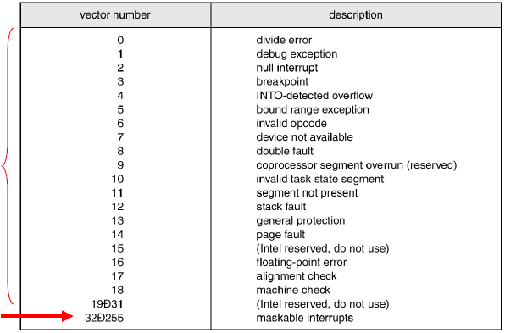
Interrupt Handlers (3)
Interrupt Handler Routines (ctd.)
  Intel Pentium processor event-vector table
Non-maskable, used for various error conditions
Maskable, used for device-generated interrupts

Slide 64
Interrupt Handlers (4)
Typical steps followed by an interrupt routine
  Save regs not already saved by interrupt hardware.
  Set up context for interrupt service procedure: TLB, MMU, and page table.
  Set up stack for interrupt service procedure.
  Ack interrupt controller, reenable interrupts.
  Copy registers from where saved to the process table.
  Run service procedure.
  Choose which process to run next.
  Set up MMU context for process to run next.
  Load new process' registers.
  Start running the new process.
  Interrupt processing is a complex operation that takes a great number of CPU cycles, especially with virtual memory.

Slide 65
Device Drivers (1)
A device driver is a specific module that manages the interaction between the device controller and the OS.
  device independent request -> device driver -> device dependent request
Generally written by device manufacturers.
  Not necessarily by OS writers.
A driver can be written for more than one OS.
Each driver can handle one type of device or one class (e.g. SCSI)

Slide 66
Device Drivers (2)
Driver usually part of OS kernel
  Unix – kernel compiled with device drivers.
  Linux – uses loadable modules which are chunks of code loaded into kernel while system is running.
  Windows – dynamically loaded into system at startup and plug-n-play.

Slide 67
Device Drivers (3)
A driver has several functions
  Accept abstract read/write requests from the device-independent software above and translate them into concrete I/O-module-specific commands.
  Schedule requests: optimize queued request order for best device utilization (eg: disk arm)
  Initialize the device, if needed.
  Manage data transfer.
  Maintain the integrity of driver and kernel data structures.
  Manage power requirements and log device events.

Slide 68
Device Drivers (4)
Typical code organization of a device driver
  Check validity of input parameters coming from above.
    If valid, translate to concrete commands, e.g., convert block number to head, track & sector in a disk’s geometry.
  Check if device currently in use; if yes, queue request; if not, possibly switch device on, warm up, initialize, etc.
  Issue appropriate sequence of commands to controller.
  If needs to wait, block.
  Upon interrupted from blocking, check for errors and pass data back.
  Process next queued request.

Slide 69
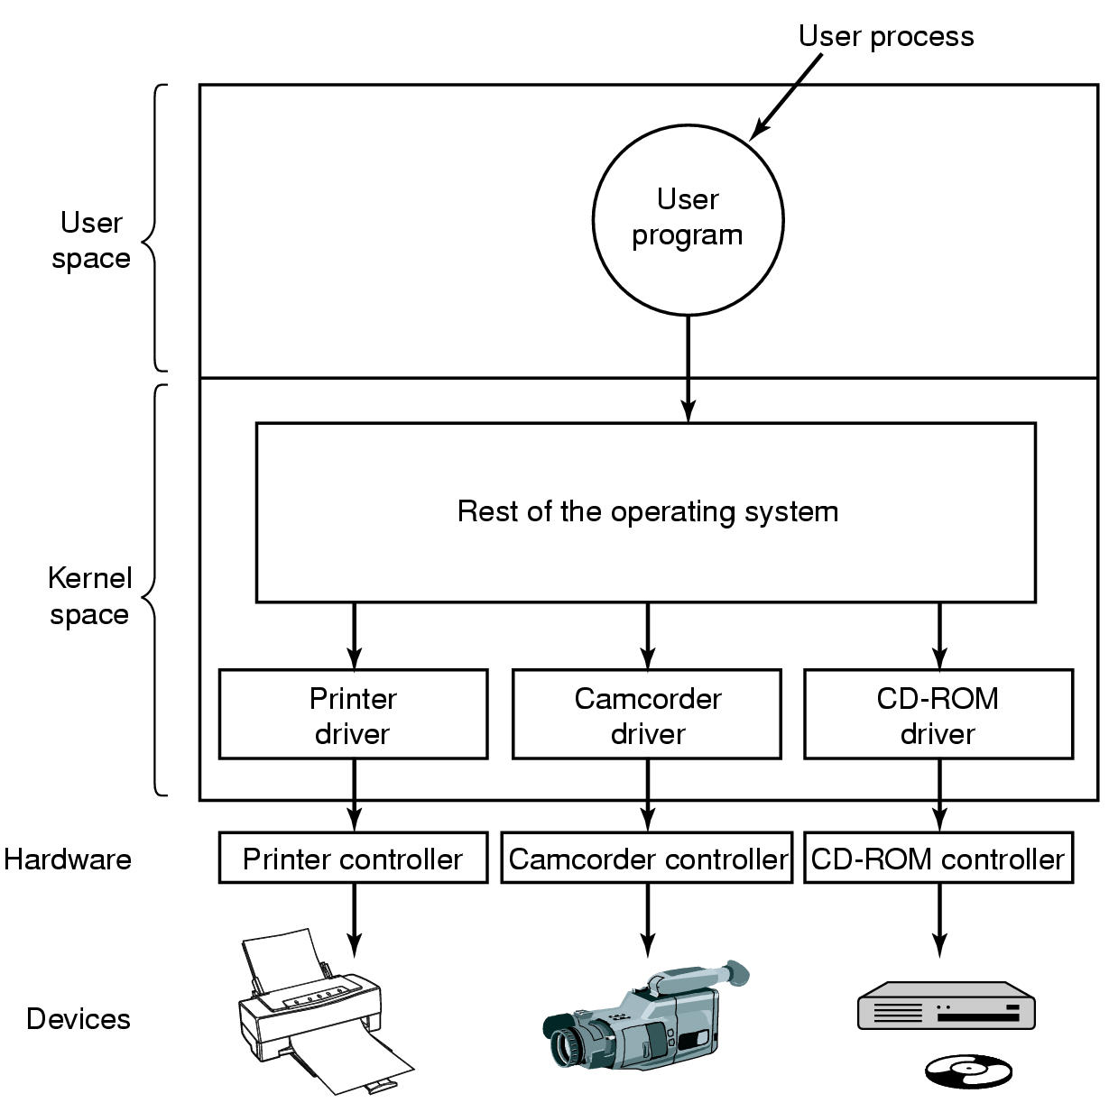
Device Drivers (5)
Figure 5-12 Logical position of device drivers is shown here
Communications between drivers and device controllers goes over the bus

Slide 70
Device Drivers (6)
Operating system and driver communication
  Commands and data between OS and device drivers
Driver and hardware communication
  Commands and data between driver and hardware
Device Driver Types
  Block: fixed sized block data transfer
  Character: variable sized data transfer
  Terminal: character driver with terminal control
  Network: streams for networking
Most OS define a standard interfaces for device driver. The interface consists of a number of
procedures that the rest of OS can call.

Slide 71
Device Drivers (7)
Character Device Interface
  read( deviceNumber, bufferAddr, size )
    Reads “size” bytes from a byte stream device to “bufferAddr”.
  write( deviceNumber, bufferAddr, size )
    Write “size” bytes from “bufferAddr” to a byte stream device.
Block Device Interface
  read( deviceNumber, deviceAddr, bufferAddr )
    Transfer a block of data from “deviceAddr” to “bufferAddr”.
  write( deviceNumber, deviceAddr, bufferAddr )
    Transfer a block of data from “bufferAddr” to “deviceAddr”.
  seek( deviceNumber, deviceAddress )
    Move the head to the correct position.
    Usually not necessary.

Slide 72
Device Drivers (8)
Some Other Issues
  A driver code must be reentrant as they can be called by another process while a process is already blocked in the driver.
    Re-entrant: Code that can be executed by more than one thread (or CPU) at the same time
  A driver code needs to handle pluggable devices.
  Drivers are not allowed to make system calls, but they may call kernel procedures.
    E.g. Manage MMU, timers, DMA controller, interrupt controller, etc.

Slide 73
Device-Independent I/O Software
Boundary between device driver and device-independent software varies between systems and devices.
Device-Independent I/O Software Functions
  Uniform interfacing to device derivers
  Buffering
  Error reporting
  Allocating and releasing dedicated devices
  Providing a device-independent block size

Slide 74
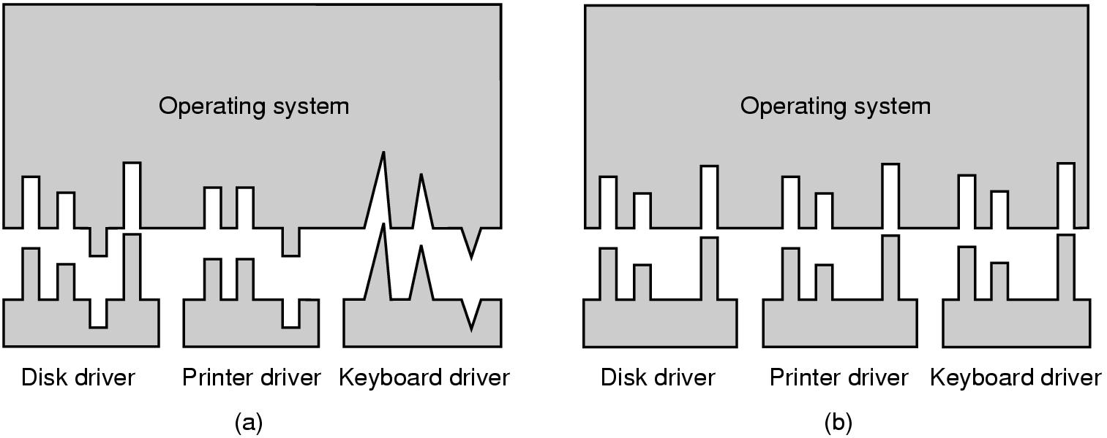
Uniform Interfacing (1)
The interface between the device driver and the rest of the OS.
Figure 5-14 (a) Without a standard driver interface (b) With a standard driver interface

Slide 75
Uniform Interfacing (2)
Uniform device interface for kernel code
  Allows different devices to be used the same way.
    No need to rewrite file-system to switch between SCSI, IDE or RAM disk.
  Allows internal changes to device driver with fear of breaking kernel code.
Uniform kernel interface for device code
  Drivers use a defined interface to kernel services (e.g. kmalloc, install IRQ handler, etc.)
  Allows kernel to evolve without breaking existing drivers.
Together both uniform interfaces avoid a lot of programming implementing new interfaces.

Slide 76
Uniform Interfacing (3)
How I/O devices are named?
  Device-independent software maps symbolic device names onto the proper driver.
  In Unix, devices are modeled as special files.
    They are accessed through the use of system calls such as open(), read(), write(), close(), ioctl(), etc.
    A file name is associated with each device.
    Major device number locates the appropriate driver.
    Minor device number (stored in i-node) is passed as a parameter to the driver in order to specify the unit to be read or written.
The usual protection rules for files also apply to I/O devices.

Slide 77
Uniform Interfacing (4)
i-node
i-node
i-node
name: /dev/disk0
name: /dev/disk1
name: /dev/fd0
major number: 3
major number: 3
major number: 4
minor number: 0
minor number: 1
minor number: 0
…..
4
3
…
Hard Disk
Driver
Floppy
Driver
0
Disk Controller
1
Disk Controller
Floppy Controller
Mapping symbolic I/O device names to their appropriate drivers

Slide 78
Buffering (1)
Memory area that stores data in kernel space while transferred between device and application.
Cope with a speed mismatch between producer and consumer.
  E.g. modem thousand times slower than disk.
Adapt between services with different data-transfer sizes.
  E.g. fragmentation and reassembly of network packets)

Slide 79
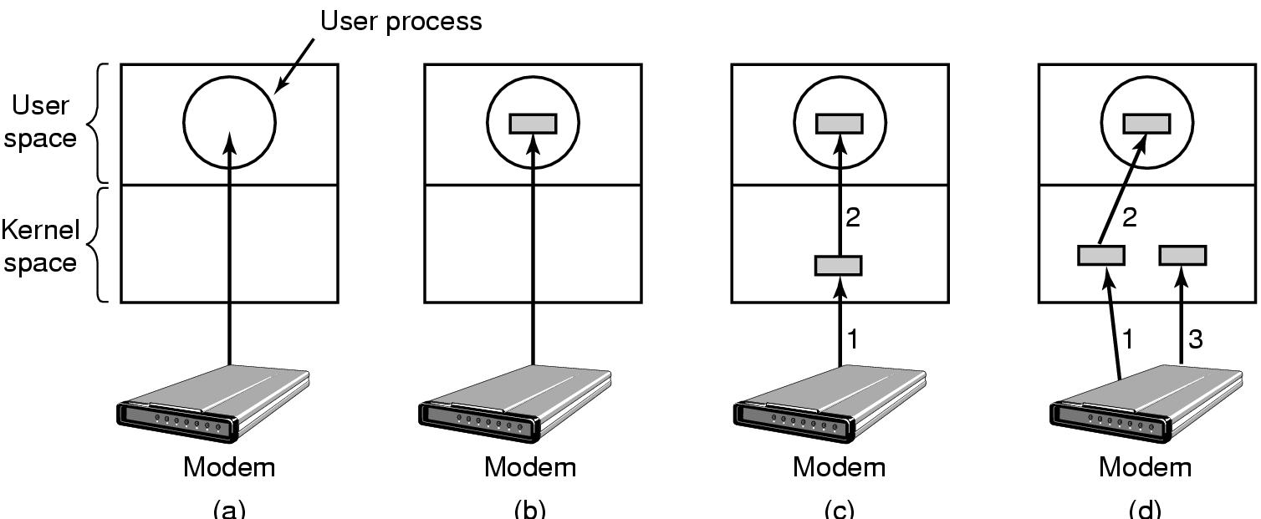
Buffering (2)
Example: consider a process that wants to read data from a modem.
Figure 5-15
(a) Unbuffered input
(b) Buffering in user space
(c) Buffering in the kernel followed by copying to user space
(d) Double buffering in the kernel

Slide 80
Buffering (3)
No Buffering
  Process must read/write a device a byte/word at a time.
    Each individual system call adds significant overhead.
    Process must wait until each I/O is complete.
      Blocking/interrupt/waking adds to overhead.
      Many short runs of a process is inefficient (poor CPU cache temporal locality).

Slide 81
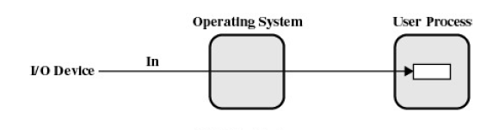
Buffering (4)
User-level Buffering
  Process specifies a memory buffer that incoming data is placed in until it fills.
    Filling can be done by interrupt service routine.
    Only a single system call, and block/wakeup per data buffer.
      Much more efficient

Slide 82
Buffering (5)
User-level Buffering (ctd.)
  Issue
    What happens if buffer is paged out to disk?
      Could lose data while buffer is paged in.
      Could lock buffer in memory (needed for DMA), however many processes doing I/O reduce RAM available for paging. Can cause deadlock as RAM is limited resource

Slide 83
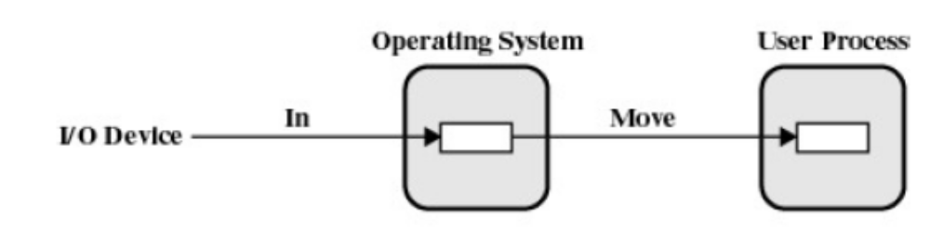
Buffering (6)
Single Buffer
  Operating system assigns a buffer in main memory for an I/O request.
  Stream-oriented
    Used a line at time.
    User input from a terminal is one line at a time with carriage return signaling the end of the line.
    Output to the terminal is one line at a time.

Slide 84
Buffering (7)
Single Buffer
  Block-oriented
    Input transfers made to buffer.
    Block moved to user space when needed.
    Another block is moved into the buffer.
      Read ahead
    User process can process one block of data while next block is read in.
    Swapping can occur since input is taking place in system memory, not user memory.
    Operating system keeps track of assignment of system buffers to user processes.

Slide 85
Buffering (8)
Single Buffer (ctd.)
  What happens if kernel buffer is full, the user buffer is swapped out, and more data is received???
    We start to lose characters or drop network packets.

Slide 86
Buffering (9)
Double Buffer
  Use two system buffers instead of one.
  A process can transfer data to or from one buffer while the operating system empties or fills the other buffer.
  May be insufficient for really bursty traffic.
    Lots of application writes between long periods of computation.
    Long periods of application computation while receiving data.
    Might want to read-ahead more than a single block for disk.

Slide 87
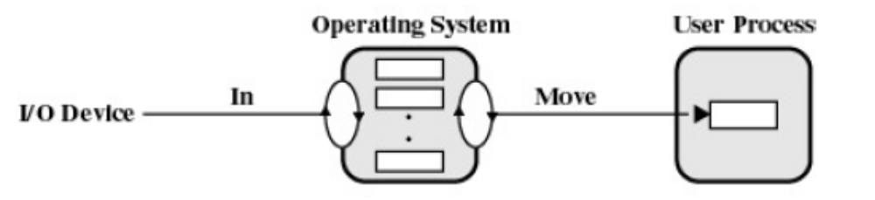
Buffering (10)
Circular Buffer
  More than two buffers are used.
  Each individual buffer is one unit in a circular buffer.
  Used when I/O operation must keep up with process.

Slide 88
Buffering (11)
Notice that buffering, double buffering, and circular buffering are all Bounded Buffer Problem (Producer-Consumer Problem).
Buffering in Fast Networks
  Networking may involve many copies.
  Copying reduces performance.
    Especially if copy costs are similar to or greater than computation or transfer costs.
  Super-fast networks put significant effort into achieving zero-copy.

Slide 89
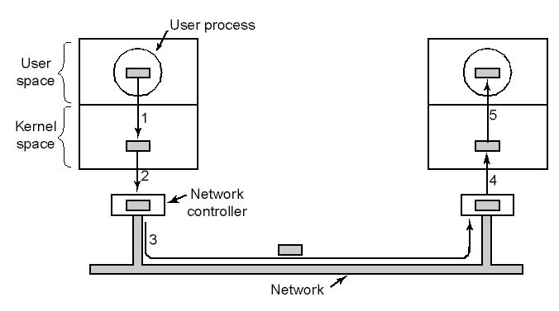
Buffering (12)
Figure 5-16 Networking may involve many copies

Slide 90
Error Reporting
Some errors are handled by device controllers.
  E.g., Checksum incorrect, re-correct the block by using redundant bits.
Some by device derivers.
  E.g., disk block could not be read, re-issue the read operation for block from disk.
Some by the device-independent software layer of OS.
  Retry I/O or report to user with error code.
  Identifies programming error vs. I/O error
  Programming errors
    E.g., Attempt to write to a read-only device.
  Actual I/O errors
    E.g., The camcorder is shut-off, therefore we could not read. Return an indication of this error to the calling application.

Slide 91
Allocating& Releasing Dedicated Devices
Do not allow concurrent accesses to dedicated devices such as CD-RWs.
Require processes to perform open()’s on the special files for devices directly.
  The process retries if open() fails.
Have special mechanisms for requesting and releasing dedicated devices.
  An attempt to acquire a device that is not available blocks the caller.

Slide 92
Device-independent Block Size
There are different kind of disk drives. Each may have a different physical sector size.
A file system uses a block size while mapping files into logical disk blocks.
This layer can hide the physical sector size of different disks and can provide a fixed and uniform disk block size for higher layers, like the file system
  Several sectors can be treated as a single logical block.

Slide 93
User-Space I/O Software
This includes
  The I/O libraries that provides the implementation of I/O functions which in turn call the respective I/O system calls.
    These libraries also implemented formatted I/O functions such as printf() and scanf()
  Some programs that does not directly write to the I/O device, but writes to a spooler.

Slide 94
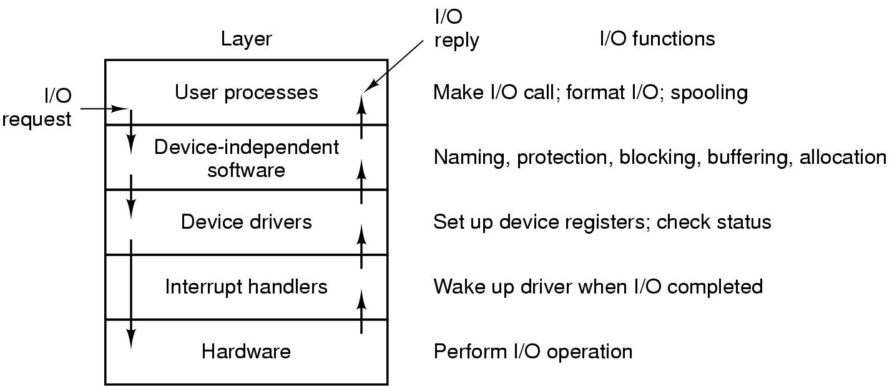
Summary of I/O Software
Layers of the I/O system and the main functions of each layer

Slide 95
Homework
P428 3, 9, 11

