Slide 1
Modern Operating Systems
Chapter 6 - Deadlock
Zhang Yang
Spring 2018

Slide 2
Content of this lecture
6.1 Resources
6.2 Deadlock
6.3 Ostrich Algorithm
6.4 Deadlock Detection & Deadlock Recovery
6.5 Deadlock Avoidance
6.6 Deadlock Prevention
6.7 Other Issues
Summary

Slide 3
Resources (1)
A resource is anything that can be used by a single process at any instant of time.
Deadlocks may occur when …
  Processes are granted exclusive access to devices, files, and so forth.
  We refer to the objects granted as resources
Resource Types R1, R2, . . ., Rm
  CPU cycles, memory space, I/O devices ,record in a database…
Each resource type Ri has Wi instances.

Slide 4
Resources (2)
Resources can be either:
  Reusable Resources
    Used by one process at a time and not depleted by that use
    Processes obtain resources that they later release for reuse by other processes
    E.g., CPU, memory, disk space, I/O devices, files, databases, semaphores.
      Acquire → Use → Release
  Consumable Resources
    Created (produced) and destroyed (consumed) by a process
    E.g., messages, buffers of information, interrupts.
      Create → Acquire → Use
      Resource ceases to exist after it has been used, so it is not released.

Slide 5
Resources (3)
Resources can also be either:
  Preemptible Resources
    Can be taken away from a process with no ill effects
    E.g., CPU, memory
    No deadlock
  Non-preemptible Resources
    One that cannot be taken away from its current owner without causing the computation to fail.
    Will cause the process to fail if taken away
    E.g., Tape Drives, CD Recorder
    Deadlock possible

Slide 6
Resources (4)
And resources can be either:
  Shared among several processes
    E.g., Read-only files
  Dedicated exclusively to a single process
    E.g., Printers
Each process utilizes a resource as follows:
  Request the resource
  Use the resource
  Release the resource
Must wait if request is denied
  Requesting process may be blocked
  May fail with error code
Assume that when a process is denied a resource request, it is put to sleep.

Slide 7
Resources (5)
Processes need access to resources in reasonable order.
Suppose a process holds resource A (e.g. scanner) and requests resource B (e.g. CD recorder)
  At same time another process holds B and requests A
  Both are blocked and remain so
Deadlocks occur when …
  Processes are granted exclusive access to devices

Slide 8
Using Semaphore to Share Resource
1
Process P();
{ A.Down();
B.Down();
use both resource
B.Up();
A.Up(); }
Process Q();
{ A.Down();
B.Down();
use both resource
B.Up();
A.Up(); }
1
2
6
3
4
5
1
External Semaphore A(1), B(1);
2
External Semaphore A(0), B(1);
3
External Semaphore A(0), B(0);
4
External Semaphore A(0), B(1);
5
External Semaphore A(1), B(1);

Slide 9
But Deadlock can Happen!
1
Process P();
{ A.Down();
B.Down();
use both resources
B.Up();
A.Up(); }
Process Q();
{ B.Down();
A.Down();
use both resources
A.Up();
B.Up(); }
1
2
3
DEADLOCK
1
External Semaphore A(1), B(1);
2
External Semaphore A(0), B(1);
3
External Semaphore A(0), B(0);

Slide 10
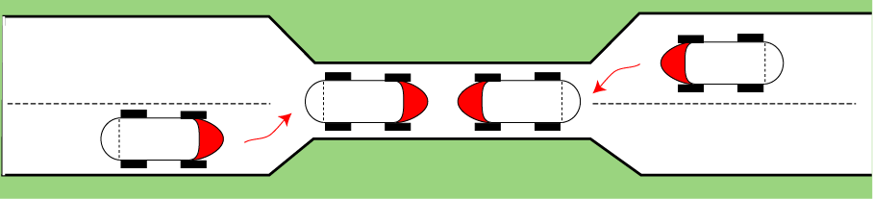
Bridge Crossing Example
Traffic only in one direction.
Each section of a bridge can be viewed as a resource.
Deadlock can occur if two cars enter the bridge from opposite sides
  If a deadlock occurs, it can be resolved if one car backs up (preempt resources and rollback).
Several cars may have to be backed up if a deadlock occurs.
Starvation is possible
  Timid driver hesitates to enter bridge

Slide 11
Introduction to Deadlocks (1)
Formal Definition
A set of processes is deadlocked if each process in the set is waiting for an event that only another process in the set can cause.
  Assume that processes have only a single thread
  Assume that there are no interrupts possible to wake up a blocked process
  Usually the event is release of a currently held resource
  The number of processes and the number and kind of resources possessed and requested are unimportant.

Slide 12
Introduction to Deadlocks (2)
If deadlock, none of the processes can …
  Run
  Release resources
  Be awakened
Is deadlock the same as starvation (or indefinitely postponed)?
  A process is indefinitely postponed if it is delayed repeatedly over a long period of time while the attention of the system is given to other processes. I.e., logically the process may proceed but the system never gives it the CPU.

Slide 13
Group Discussion
Conditions for Deadlock
  What conditions should exist in order to lead to a deadlock?
  Can use real life analogy such as
    “You take the monitor, I grab the keyboard”
    Cars in intersection

Slide 14
Four Conditions for Deadlock (1)
Mutual exclusion condition
  Each resource assigned to 1 process or is available
Hold and wait condition
  Process holding resources can request additional
No preemption condition
  Previously granted resources cannot forcibly taken away
  They must be explicitly released by the process holding them
Circular wait condition
  There exists a set of processes {P1, P2, … PN}, such that, P1 is waiting for P2, P2 for P3, …. and PN for P1

Slide 15
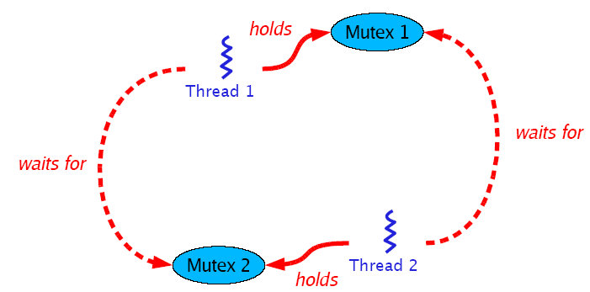
Four Conditions for Deadlock (2)
Circular wait condition (ctd.)
  Example
Deadlock can arise if four conditions hold simultaneously.

Slide 16
Conditions Analysis
Deadlock occurs if and only if the circular wait condition is not resolvable.
The circular wait condition is not resolvable when the first 3 policy conditions hold.
Therefore, the four conditions taken together constitute the necessary and sufficient conditions for deadlock!

Slide 17
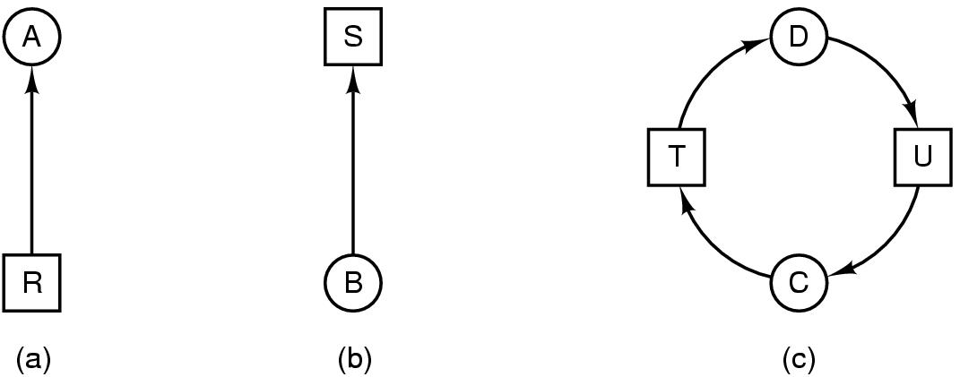
Deadlock Modeling (1)
Modeled with directed graphs
  Resource R assigned to process A
  Process B is requesting/waiting for resource S
  Process C and D are in deadlock over resources T and U C-T-D-U-C

Slide 18
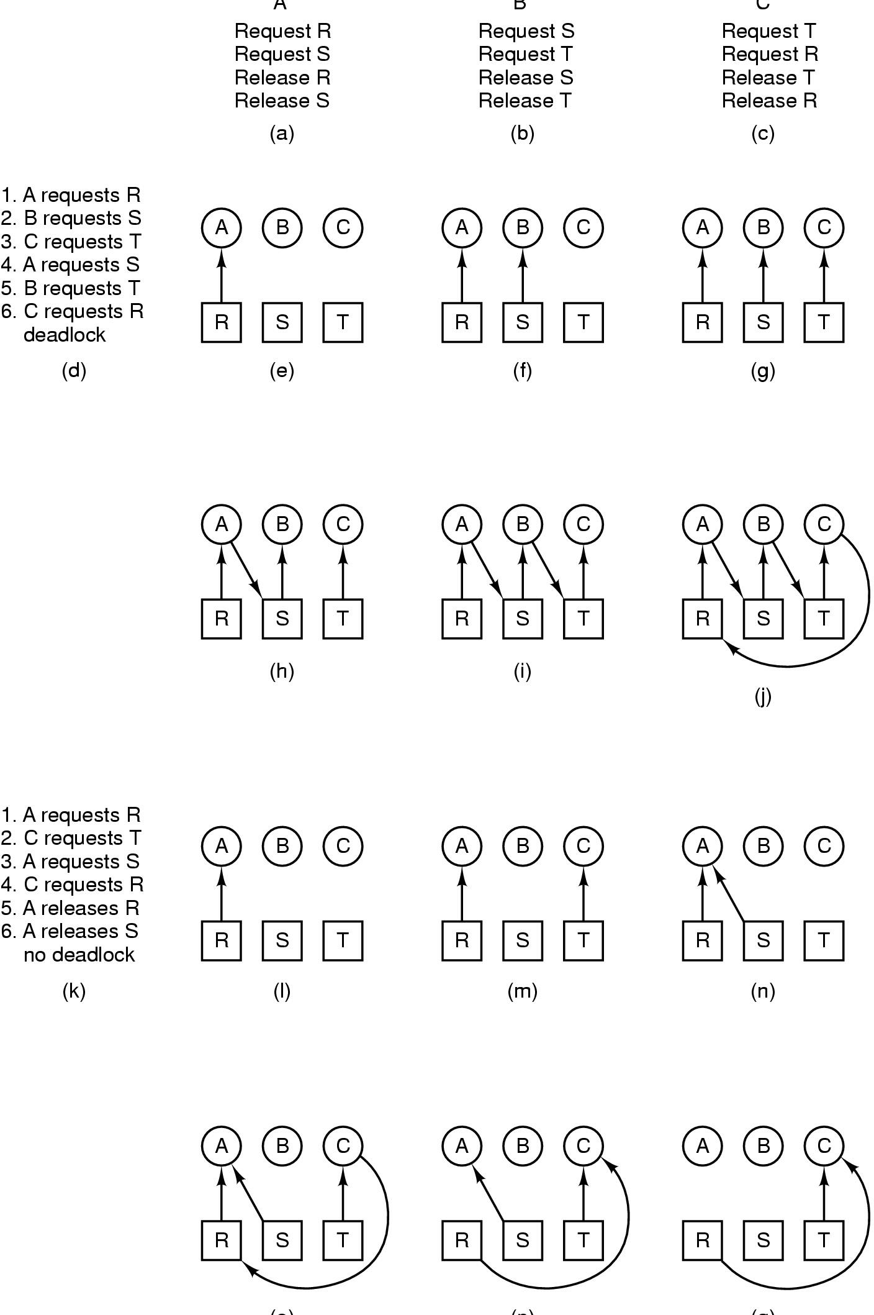
Deadlock Modeling (2)
A B C
How deadlock occurs

Slide 19
Deadlock Modeling (3)
(o) (p) (q)
How deadlock can be avoided

Slide 20
Resource-Allocation Graph (1)
A set of vertices V and a set of edges E.
  V is partitioned into two types:
    P = {P₁, P₂, …, P_{n}}, the set consisting of all the processes in the system.
    R = {R₁, R₂, …, R_{m}}, the set consisting of all resource types in the system.
  Request edge – directed edge P_{i} → R_{j}
  Assignment edge – directed edge R_{j} → P_{i}

Slide 21
Resource-Allocation Graph (2)
Process
Resource Type with 4 instances
P_{i} requests instance of R_{j}
P_{i} is holding an instance of R_{j}
P_{i}
R_{j}
P_{i}
R_{j}

Slide 22

Example of a Resource Allocation Graph

Slide 23

Resource Allocation Graph With A Deadlock

Slide 24

Resource Allocation Graph With A Cycle But No Deadlock

Slide 25
Basic Facts about Resource Allocation Graph
If graph contains no cycles ⇒ no deadlock.
If graph contains a cycle ⇒
  If only one instance per resource type, then deadlock.
  If several instances per resource type, possibility of deadlock.

Slide 26
Methods for Handling Deadlocks
Ignore the problem and pretend that deadlocks never occur in the system
Allow the system to enter a deadlock state and then recover
  Deadlock detection & recovery
Ensure that the system will never enter a deadlock state
  Dynamic avoidance (careful resource allocation)
  Prevention (negating one of the four necessary conditions)

Slide 27

The Ostrich Algorithm (1)
Don’t do anything, simply restart the system (stick your head into the sand, pretend there is no problem at all).
Consider
  How often will a deadlock happen?
  How severe will it be if it does happen?
  How hard would it be to avoid/prevent/detect?

Slide 28
The Ostrich Algorithm (2)
Rational: make the common path faster and more reliable
  Deadlock detection/recovery, avoidance or prevention algorithms are expensive
  If deadlock occurs only rarely, it is not worth the overhead to implement any of these algorithms.
UNIX and Windows takes this approach for some of the more complex resource relationships to manage.
It’s a trade off between
  Convenience (engineering approach)
  Correctness (mathematical approach)

Slide 29
Deadlock Detection and Recovery
Allow system to enter deadlock state
Run the Deadlock Detection algorithm periodically
After detecting deadlock, run a Recovery algorithm
Despite drawbacks, database systems do this.

Slide 30
Deadlock Detection
How often should the detection algorithm be run?
  Check every time a resource request is made.
    Possibly expensive in terms of CPU time
  Check every k minutes, or perhaps only when the CPU utilization has dropped below some threshold.

Slide 31
Single Resource per Type (1)
Check to see if a deadlock has occurred!
Recall: if there is only one instance of each resource, it is possible to detect deadlock by constructing a resource allocation/request graph and checking for cycles.
Graph theorists have developed a number of algorithms to detect cycles in a graph.

Slide 32
Single Resource per Type (2)
Deadlock Detection Algorithm
  1. For each node N in the graph, perform the following 5 steps with N as the starting node.
  2. Initialize L to the empty list, and designate all the arcs as unmarked. (L is the list of nodes)
  3. Add the current node to the end of the L and check to see if the node now appears in L two times. If it does, the graph contains a cycle (listed in L) and the algorithm terminates.
Notes:
Periodically invoke an algorithm that searches for a cycle in the graph.

Slide 33
Single Resource per Type (3)
Deadlock Detection Algorithm (ctd.)
  4. From the given node, see if there are any unmarked outgoing arcs. If so, go to step 5; if not, go to step 6.
  5. Pick an unmarked outgoing arc at random and mark it. Then follow it to the new current node and go to step 3.
  6. If this node is the initial node, the graph does not contain any cycles and the algorithm terminates. Otherwise, we have now reached a dead end. Remove it and go back to the previous node, make that one the current node, and go to step 3.

Slide 34
Single Resource per Type (4)
Example
  Process A holds R and wants S.
  Process B holds nothing but wants T.
  Process C holds nothing but wants S.
  Process D holds U and wants S and T.
  Process E holds T and wants V.
  Process F holds W and wants S.
  Process G holds V and wants U.
  Is this system deadlocked, and if so, which
  processes are involved?

Slide 35
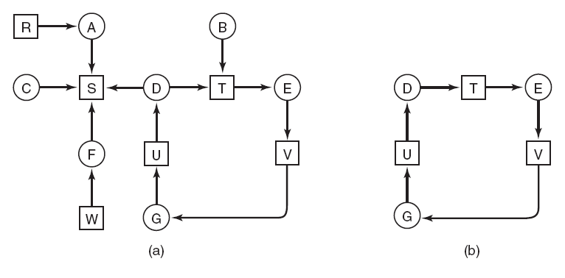
Single Resource per Type (5)
Example (ctd.)
Figure 6-5. (a) A resource graph. (b) A cycle extracted from (a).
Note the resource ownership and requests
A cycle can be found within the graph, denoting deadlock

Slide 36
Multiple Resources of Each Type (1)
Matrix-based Algorithm
  N processes, P1 to Pn
  The number of resource classes:m
    Ei: resources of class i (1 ≤ i ≤ m)
  E : the existing resource vector
  A : the available resource vector
  C : the current allocation matrix
  R : the request matrix

Slide 37
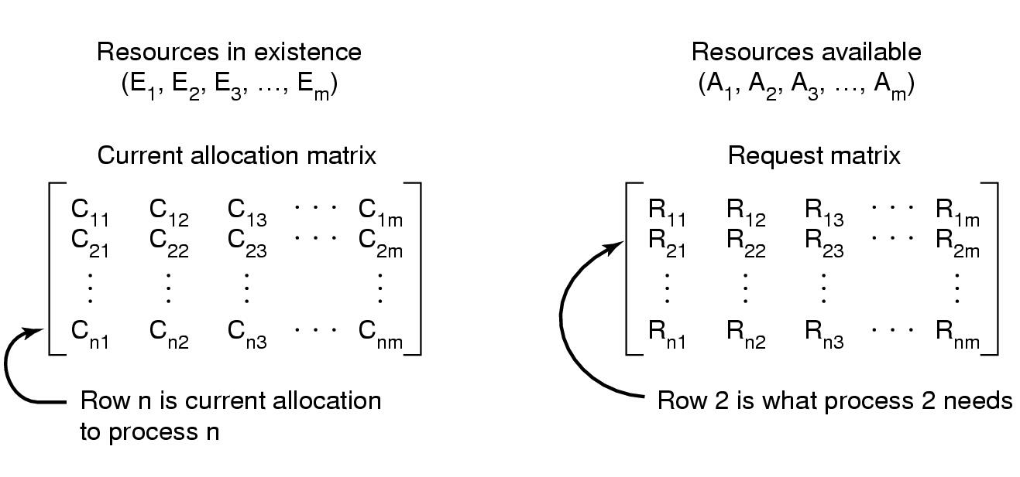
Multiple Resources of Each Type (2)
Figure 6-6 Data structures needed by deadlock detection algorithm
Σ Cij + Aj = Ej
n
i=1

Slide 38
Multiple Resources of Each Type (3)
Deadlock Detection Algorithm (ctd.)
  Based on comparing vectors.
    (A≤ B if and only if Ai ≤ Bi for 0≤ i≤ m)
  Each process is initially unmarked.
Look for an unmark process Pi, for which the i-th row of R is less than or equal to A. (Pi 's request can be satisfied )
If such a process is found, add the i-th row of C to A, mark the process and go back to step 1. ( When Pi completes, its resources will become available ).
If no such process exist, the algorithm terminates. The unmarked process, if any, are deadlock.

Slide 39
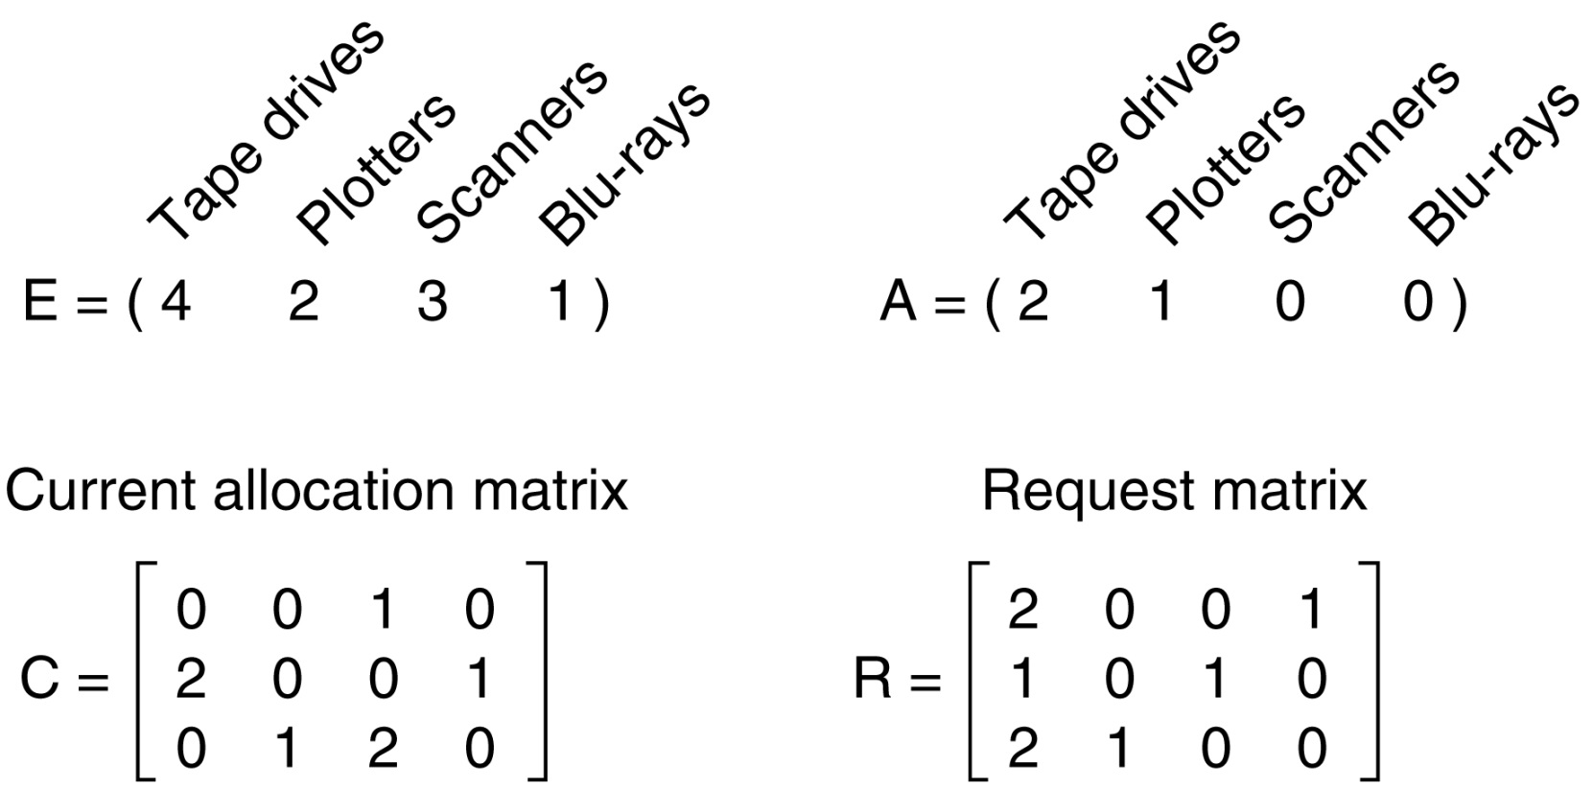
Multiple Resources of Each Type (4)
Example 1
Figure 6-7 An example for the deadlock detection algorithm

Slide 40
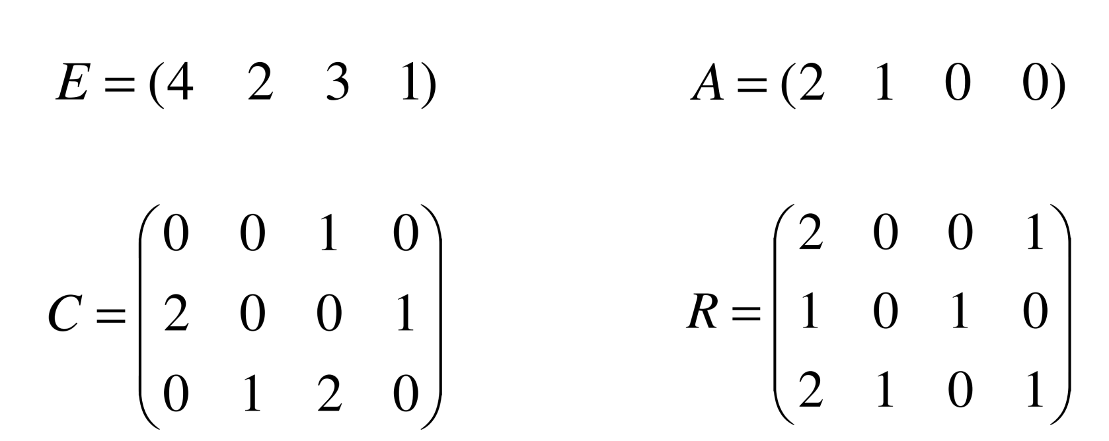
Multiple Resources of Each Type (5)
Example 2
  Suppose, P3 needs 1 Blu-ray as well as 2 Tapes and 1 Plotter.
Deadlock!

Slide 41
Recovery from Deadlock (1)
Recovery through preemption
  Take a resource from some other process.
  Depends on nature of the resource.
Recovery through rollback
  Checkpoint a process periodically.
    Write the process’s state (memory image &resource state) to a file.
  Use this saved state.
  Restart the process if it is found deadlocked.

Slide 42
Recovery from Deadlock (2)
Recovery through killing processes
  Crudest but simplest way to break a deadlock.
  How to choose which process to kill?
    Kill one of the processes in the deadlock cycle, then the other processes get its resources.
    Kill the process not in the deadlock cycle, but hold the resources that some process in the cycle needs.
    Kill process that can be rerun from the beginning with no ill effects

Slide 43
Deadlock Avoidance (1)
When a process requests an available resource, system must decide if immediate allocation leaves the system in a safe state.
This technique requires that the system would not allocate resources if deadlock could happen.
Very conservative since just because deadlock could happen doesn’t mean that deadlock will happen.
Requires that the system has some additional a priori information available.
Simplest and most useful model requires that each process declare the maximum number of resources of each type that it may need.
Notes:
银行家算法的保守性是指银行家算法只给出了进程需要资源的最大量，而所需资源的具体申请和释放顺序仍是未知的，因而银行家只能往最坏处设想

Slide 44
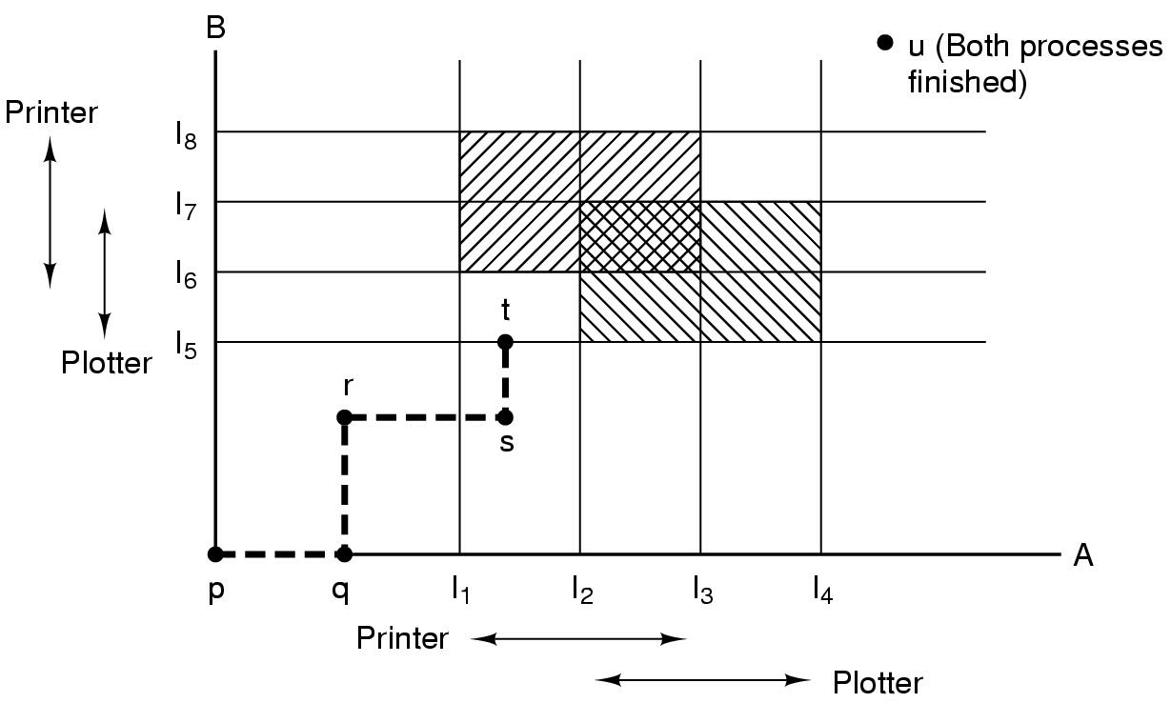
Deadlock Avoidance (2)
Resource Trajectories
  Implication: At t point, to avoid deadlock, B should be suspended until A has requested and released the plotter.
safe
Unreachable
safe
safe
Unsafe
safe
safe
Figure 6-8 Two process resource trajectories

Slide 45
Safe and Unsafe State (1)
The Current State
  “which processes hold which resources”
Safe State
  The system is not deadlocked.
  There exists a scheduling order that results in
  every process running to completion, even if
  they all request their maximum resources
  immediately.
When a process requests an available resource, system must decide if immediate allocation leaves the system in a safe state.

Slide 46
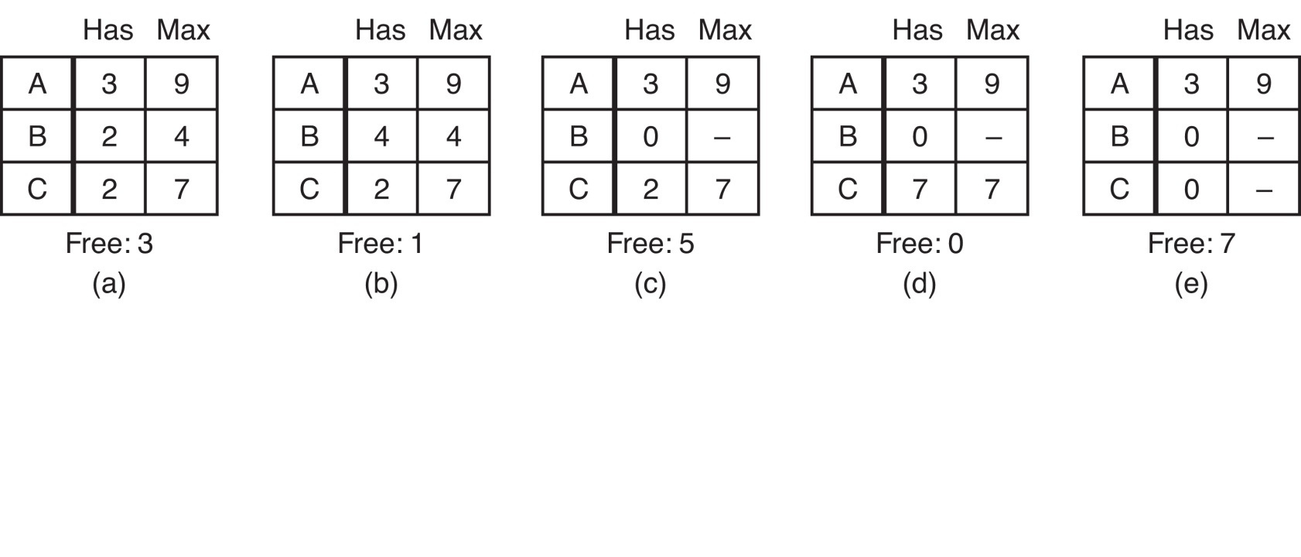
Safe and Unsafe State (2)
Example : Safe State
  Note: we have 10 units of the resource
Figure 6-9 Demonstration that the state in (a) is safe
(there exists a safe sequence BCA)

Slide 47
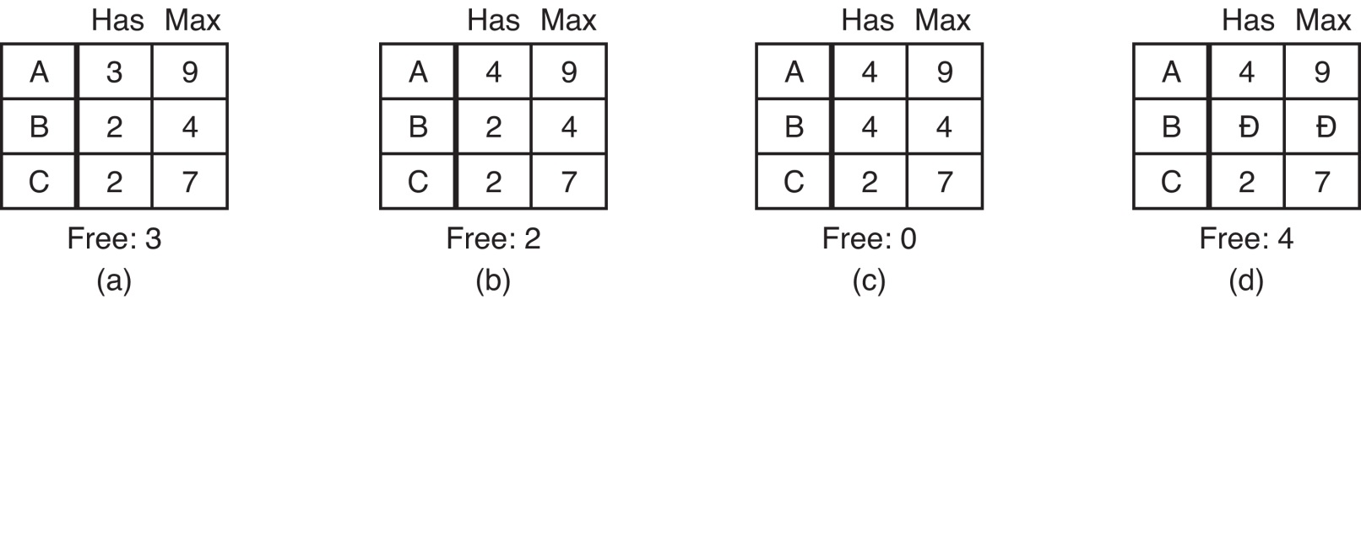

Safe and Unsafe State (3)
Example : Unsafe State
  A requests one extra unit resulting in (b)
Figure 6-10 Demonstration that the sate in b is not safe

Slide 48
Safe and Unsafe State (4)
Unsafe States
  Being in an unsafe state does not guarantee deadlock.
  An unsafe state merely means that the OS cannot guarantee deadlock will not happen.
    In other words, it is out of the hands of the OS.
From a safe state the system can guarantee that all processes will finish; from an unsafe state, no such guarantee can be given.

Slide 49

Basic Facts
If a system is in safe state ⇒ no deadlocks.
If a system is in unsafe state ⇒ possibility of deadlock.
Avoidance ⇒
  Dynamically examines the resource-allocation state
  Ensure that a system will never enter an unsafe state.

Slide 50
Banker's Algorithm for a Single Resource (1)
The Banker’s Algorithm
  Consider each request as it occurs, and see if granting it leads to a safe state.
  If it does, the request is granted; otherwise, it is postponed until later.
Safe state - there is a lending sequence such that all customers can take out a loan.
Unsafe state - there is a possibility of deadlock.

Slide 51
Banker's Algorithm for a Single Resource (2)
The Banker’s Algorithm (ctd.)
  Example: suppose we start with the following situation
    Our banker has 10 credits to lend, but a possible liability of 22. His job is to keep enough in reserve so that ultimately each customer can be satisfied over time: That is, that each customer will be able to access his full credit line, just not all at the same time.
Customer | Credit Used | Credit Line
Andy | 0 | 6
Bob | 0 | 5
Mary | 0 | 4
Sue | 0 | 7
Funds Available | 10
Max Commitment |  | 22

Slide 52
Banker's Algorithm for a Single Resource (3)
The Banker’s Algorithm (ctd.)
  Example (ctd.)
    Suppose, after a while, the bank's credit line book shows
    The question then is: Does a way exist such that each customer can be satisfied? Can each be allowed their maximum credit line in some sequence?
Customer | Credit Used | Credit Line
Andy | 1 | 6
Bob | 1 | 5
Mary | 2 | 4
Sue | 4 | 7
Funds Available | 2
Max Commitment |  | 22
Safe
Notes:
We presume that, once a customer has been allocated up to his limit, the banker can delay the others until that customer repays his loan, at which point the credits become available to the remaining customers.
Mary, Bob, Sue, Andy

Slide 53
Banker's Algorithm for a Single Resource (4)
The Banker’s Algorithm (ctd.)
  Example (ctd.)
    Suppose, however, that the banker proceeded to award Bob one more credit after the credit book arrived at the state immediately above:
Customer | Credit Used | Credit Line
Andy | 1 | 6
Bob | 2 | 5
Mary | 2 | 4
Sue | 4 | 7
Funds Available | 1
Max Commitment |  | 22
Unsafe

Slide 54
Banker's Algorithm for Multiple Resources (1)
The Banker’s Algorithm
Check to see if a state is safe:
Some Look for a new row in R which is smaller than A. If no such row exists the system will eventually deadlock ==> not safe. (If several processes are eligible to be chosen, it does not matter which one is selected.)
If such a row exists, the process may finish. Mark that process (row) as terminate and add all of its resources to A.
Repeat Steps 1 and 2 until all rows are marked == > safe state
or not marked == > not safe state.

Slide 55
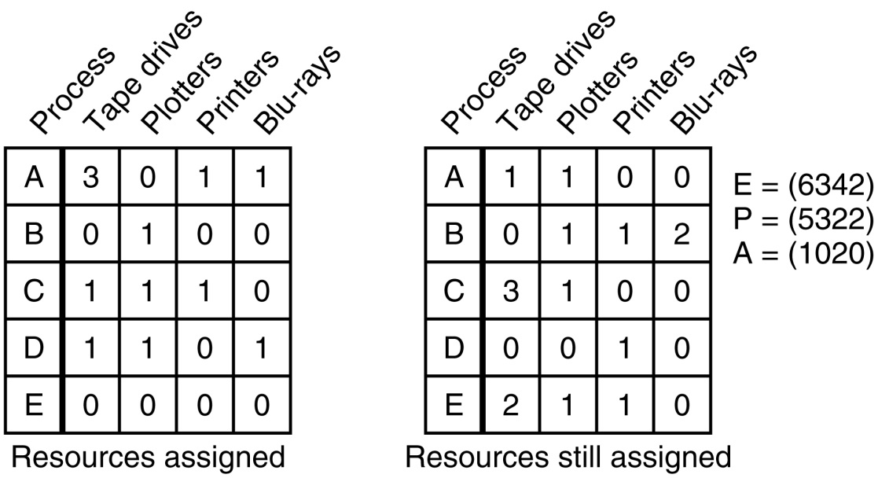
Banker's Algorithm for Multiple Resources (2)
Example
  Figure 6-12 is safe state
  Suppose that process B now makes a request for the printer. Can this request be granted?
  After giving B one printer, E wants the last printer. Can this request be granted?
C R
Figure 6-12 Example of banker's algorithm with multiple resources

Slide 56
Is Allocation (1 0 2) to P1 Safe?
Process
Alloc
Max
Need
Available
A
B
C
A
B
C
A
B
C
A
B
C
P0
0
1
0
7
5
3
7
4
3
10
5
5
P1
2
0
0
3
2
2
1
2
2
3
3
2
P2
3
0
0
9
0
2
6
0
2
P3
2
1
1
2
2
2
0
1
1
P4
0
0
2
4
3
3
4
3
1
If P1 requests max resources, can complete

Slide 57
And Run Safety Test: Group Discussion
Process
Alloc
Max
Need
Available
A
B
C
A
B
C
A
B
C
A
B
C
P0
0
1
0
7
5
3
7
4
3
10
5
5
P1
3
0
2
3
2
2
0
2
0
2
3
0
P2
3
0
0
9
0
2
6
0
2
P3
2
1
1
2
2
2
0
1
1
P4
0
0
2
4
3
3
4
3
1
If P1 requests max resources, can complete

Slide 58
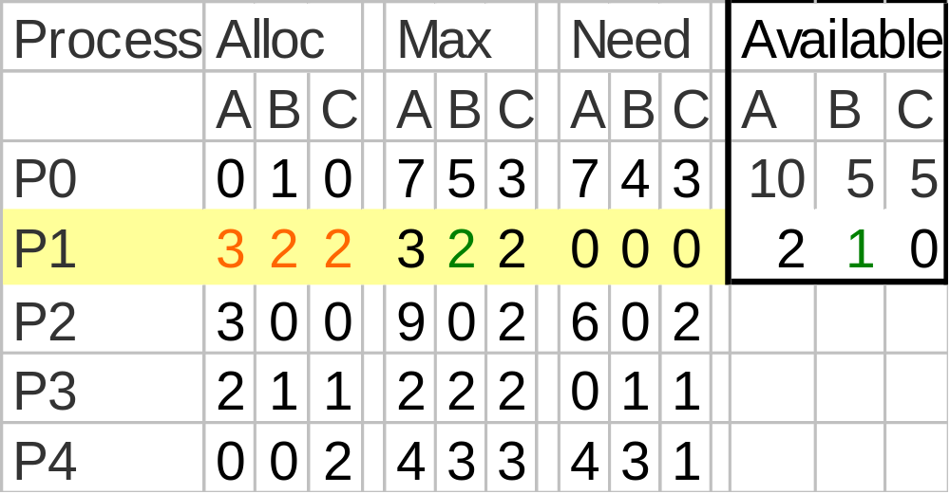
Allocate to P1, Then

Slide 59
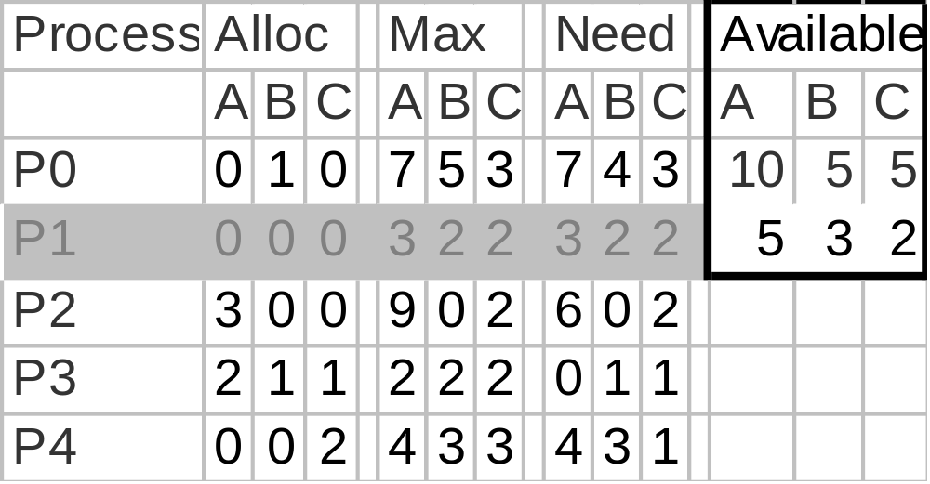
Release – P1 Finishes
Now P3 can acquire max resources and release

Slide 60
Release – P3 Finishes
Process
Alloc
Max
Need
Available
A
B
C
A
B
C
A
B
C
A
B
C
P0
0
1
0
7
5
3
7
4
3
10
5
5
P1
0
0
0
3
2
2
3
2
2
7
4
3
P2
3
0
0
9
0
2
6
0
2
P3
0
0
0
2
2
2
2
2
2
P4
0
0
2
4
3
3
4
3
1
Now P4 can acquire max resources and release

Slide 61
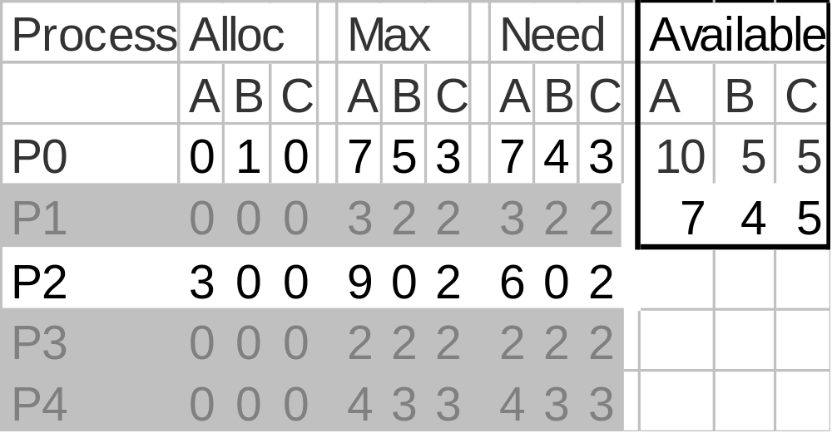
Release - P4 Finishes
Now P2 can acquire max resources and release

Slide 62
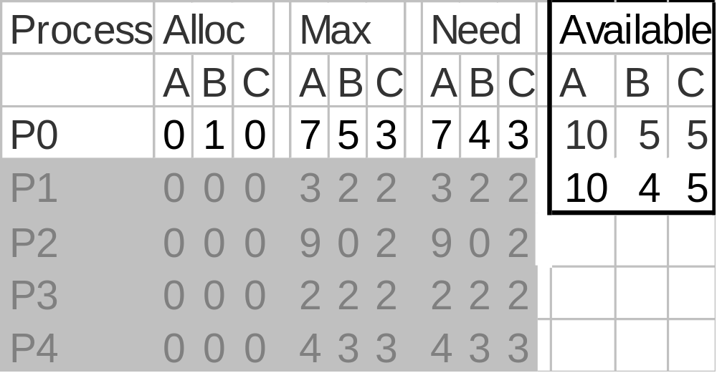
Release - P2 Finishes
Now P0 can acquire max resources and release

Slide 63
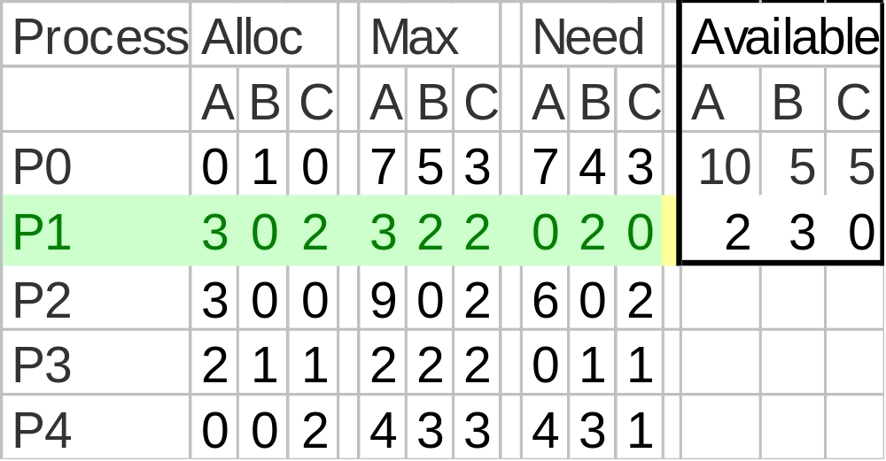
So P1 Allocation (1 0 2) Is Safe
There exists a safe sequence: P1, P3, P4, P2, P0

Slide 64
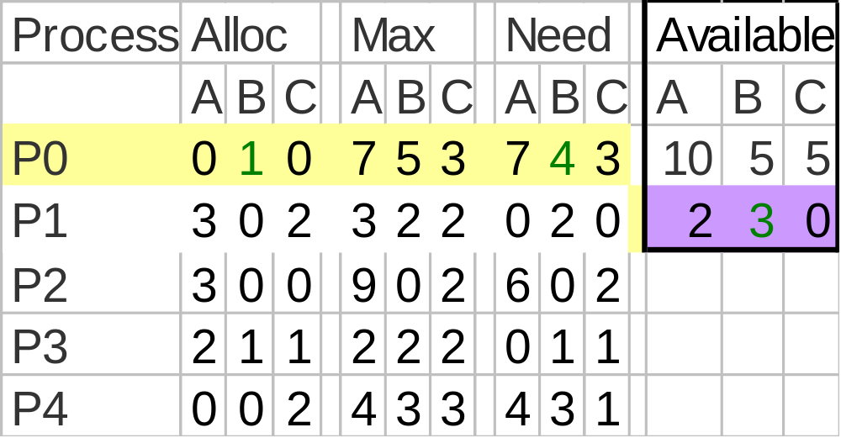
Is allocation (0 2 0) to P0 Safe?
Try to Allocate 2 B to P0

Slide 65
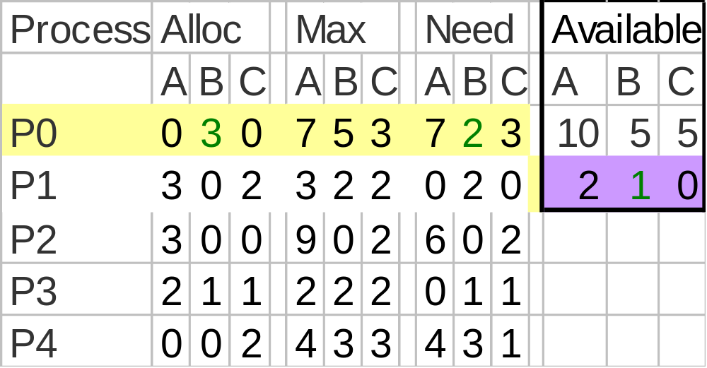
Run Safety Test
No Processes may get max resources and release

Slide 66
So Unsafe State - Do Not Enter
Return to Safe State and do not allocate resource

Slide 67
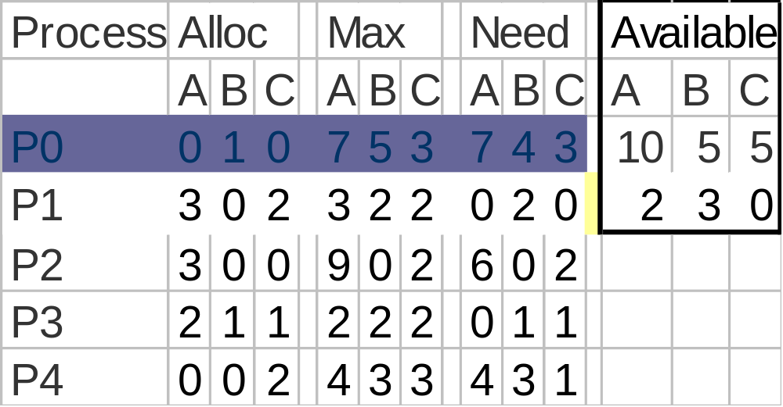
P0 Suspended Pending Request
When enough resources become available, P0 can awake

Slide 68
Results
P0’s request for 2 Bs cannot be granted because that would prevent any other process from completing if they need their maximum claim.

Slide 69
Just Because It’s Unsafe
P0 could have been allocated 2Bs and a deadlock might not have occurred if P1 say didn’t use its maximum resources but finished using the resources it had.

Slide 70
If P1 Doesn’t Need Max---
Process
Alloc
Max
Need
Available
A
B
C
A
B
C
A
B
C
A
B
C
P0
0
3
0
7
5
3
7
2
3
10
5
5
P1
0
0
0
3
2
2
3
2
2
5
1
2
P2
3
0
0
9
0
2
6
0
2
P3
2
1
1
2
2
2
0
1
1
P4
0
0
2
4
3
3
4
3
1
Then P1 would have finished…

Slide 71
Banker’s Problem Solution Issues
Trade-off
  The banker’s algorithm is conservative --- it reduces parallelism for safety sake.
Not very practicable
  Processes rarely know advance what their maximum resource needs will be.
  The number of processes is not fixed
  Resources that were thought to be available can suddenly vanish(tape drive can break).

Slide 72
Deadlock Prevention
Restrain the ways request can be made.
  Mutual Exclusion
  Hold and Wait
  No Preemption
  Circular Wait

Slide 73
Attacking the Mutual Exclusion Condition (1)
Some devices (such as printer) can be spooled.
Example: By spooling printer output and allocating the actual printer to only the printer daemon.
  Printer daemon doesn’t request other resources, so no deadlock for the printer possible.
  Question – Should the daemon start printing before all the output is spooled?
  Spooling space is limited, so deadlock is still possible with this decision.
    Two processes each fill up half the available space and can’t continue, so there is deadlock on the disk.

Slide 74
Attacking the Mutual Exclusion Condition (2)
Principle
  Avoid assigning resource when not absolutely necessary.
  As few processes as possible actually claim the resource.
Problem
  Not all devices can be spooled.
Not a general solution, but useful nevertheless.

Slide 75
Attacking the Hold and Wait Condition (1)
To ensure that the hold-and-wait condition never occurs in the system, we must guarantee that, whenever a process requests a resource, it does not hold any other resources.
Approach 1: Require all processes to request all their resources before starting execution.
  If everything is available, the process will be allocated whatever it needs and can run to completion.
  If one or more resources are busy, the process will just wait.
  Still done sometimes in the mainframe world

Slide 76
Attacking the Hold and Wait Condition (2)
Problems of Approach 1
  May not know required resources at start of run.
    Of course, if we could do that, we could use the Banker’s Algorithm
  Resources will not be used efficiently.
    Read data from tape, then analyze if for a week, then write back to the tape.
    The tape would be unusable by other processes that entire time.

Slide 77
Attacking the Hold and Wait Condition (3)
Approach 2: Process must give up all resources, then request all immediately needed.
  Might work for some programs, but many could not possibly (or efficiently) do this.
Problem of Approach 2
  Doesn’t work if some resources must be held.

Slide 78
Attacking the No Preemption Condition (1)
Difficult to achieve in practice
  Cannot take a printer away from a process in the middle of printing.
  Cannot take a semaphore away from a process arbitrarily.
    Might be in the middle of updating a shared area.
  Cannot take open streams, pipes and sockets away.
    Process would need to be written very carefully, probably using signals.
    Very undesirable if possible at all.

Slide 79
Attacking the No Preemption Condition (2)
Occasionally possible
  Processes resident in main memory
  Some deadlock occurs such as failure to allocate a page
  One or more processes can be swapped out to disc to release their pages and allow remaining processes to continue
    As long as they release any other resources they also hold on the way out
  Put back on the scheduling queues to be re-admitted to memory later

Slide 80
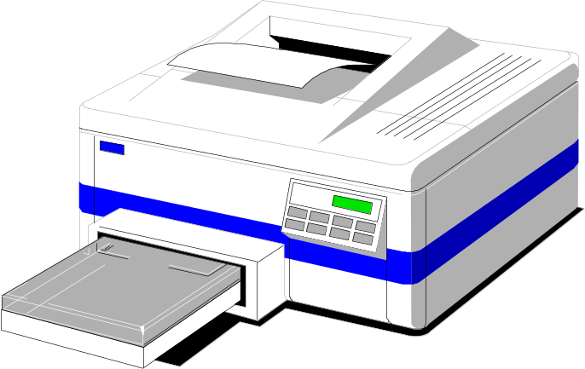
Attacking the No Preemption Condition (3)
Examples
  Consider a process given the printer
    Halfway through its job
    Now forcibly take away printer
    !!??
  Virtualization of Resources
    Spooling printer output to the disk
    Allow only the printer daemon access to the real printer

Slide 81
Attacking the No Preemption Condition (4)
Approaches
  Virtualization of Resources
  Some resources can’t be virtualized
    If a process is holding some resources and requests another resource that cannot be immediately allocated to it (that is, the process must wait), then all resources currently being held are preempted.
    The preempted resources are added to the list of resources for which the process is waiting. The process will be restarted only when it can regain its old resources, as well as the new ones that it is requesting.
Notes:
OS tables, etc.

Slide 82
Attacking the Circular Wait Condition (1)
Approach 1: Request one resource at a time. Release the current resource when request the next one
Approach 2: Global ordering of resources
  Requests have to made in increasing order
  Req(resource1), req(resource2)..
  Why no circular wait?
    Figure (next page)
Approach 3: Variation of Approach 2
  No process request a resource lower than what it is already holding.

Slide 83
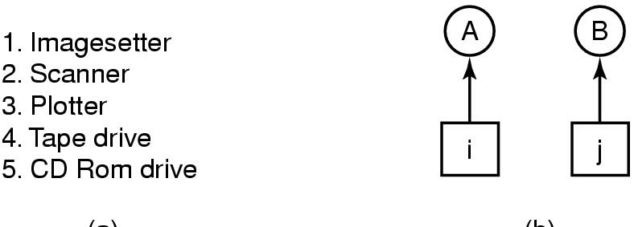
Attacking the Circular Wait Condition (2)
(a) (b)
Normally ordered resources
A resource graph
Number all resources and require all requests to be made in numerical order.

Slide 84
Attacking the Circular Wait Condition (3)
Problems
  Finding a suitable numbering to satisfy everybody could be difficult/impossible.
  Increases burden on programmers to know the numbering.

Slide 85
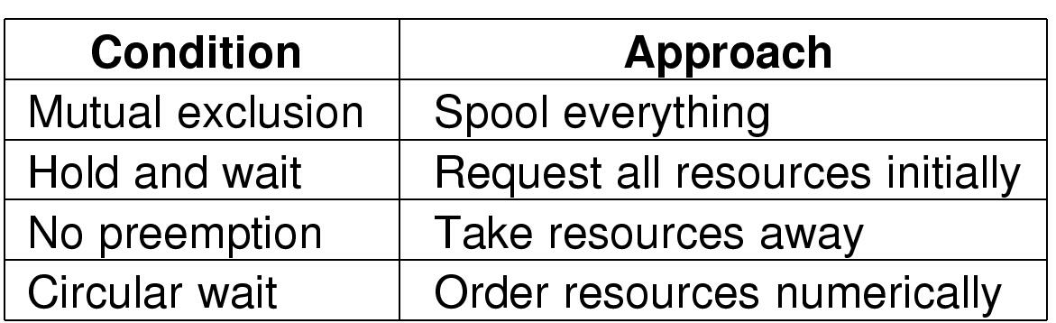
Summary of Approaches to Deadlock Prevention

Slide 86
Group Discussion
How to Prevent Deadlock in Dining Philosopher Problem?
  Attacking the mutual exclusion condition?
  Attacking the hold and wait condition?
  Attacking the no preemption condition?
  Attacking the circular wait condition?

Slide 87
Integrated Deadlock Strategy
We can combine the previous approaches into the following way:
  Group resources into a number of different classes and order them. Eg.
    Swappable space (secondary memory)
    Process resources (I/O devices, files...)
    Main memory...
  Use prevention of circular wait to prevent deadlock between resource classes.
  Use the most appropriate approach for each class for deadlocks within each class.
Notes:
还可以进一步对同一资源类中的资源进行细化，采用不同的适当方法。例如，使用死锁避免的方法处理外设资源分配，而对存储资源采用死锁预防方法。

Slide 88
Other Issues
Two-phase locking
Communication deadlocks
Livelock
Starvation

Slide 89
Two-Phase Locking
Phase One
  Process tries to lock all records it needs, one at a time
  If needed record found locked, start over
  No real work done in phase one
If phase one succeeds, it starts second phase,
  Performing updates
  Releasing locks
Note similarity to requesting all resources at once
Algorithm works where programmer can arrange
  Program can be stopped, restarted

Slide 90
Communication Deadlocks (1)
Resource Deadlocks
  A process needs multiple resources for an activity.
  Deadlock occurs if each process in a set request resources held by another process in the same set, and it must receive all the requested resources to move further.
Communication Deadlocks
  Processes wait to communicate with other processes in a set.
  Each process in the set is waiting on another process’s message, and no process in the set initiates a message until it receives a message for which it is waiting.
One technique to break communication deadlock is timeout.

Slide 91
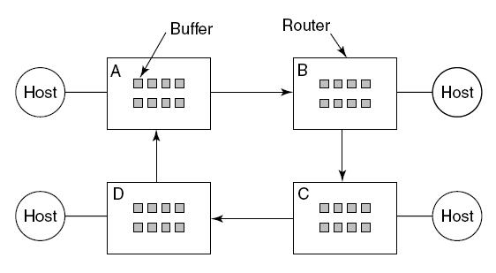
Communication Deadlocks (2)
Not all deadlocks occurring in communication systems or networks are communication deadlocks.
Figure 6-15. A resource deadlock in a network.

Slide 92
Livelock (1)
Deadlock
  Processes are blocked.
Livelock
  Processes run but make no progress.
Both deadlock and livelock lead to starvation.
But starvation may have other causes:
  MLQ scheduling where one queue is never empty
  Memory requests: unbounded stream of 100MB requests may starve a 200MB request

Slide 93
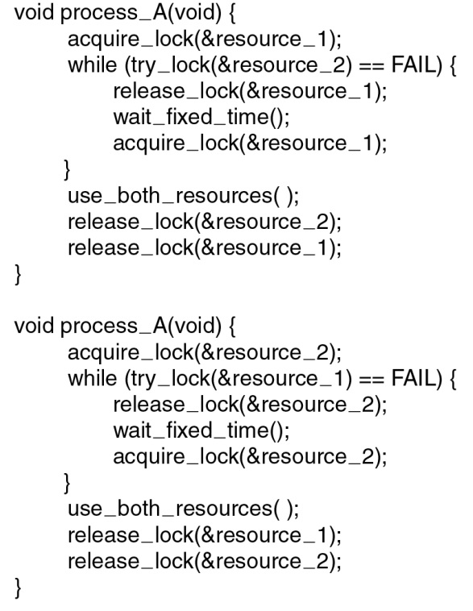
Livelock (2)
Livelock Example: Figure 6-16

Slide 94
Starvation (1)
饥饿(starvation)：当等待时间给进程推进和响应带来明显影响时,称发生了进程饥饿。饥饿到一定程度的进程所赋予的使命即使完成也不再具有实际意义时称该进程被饿死(starved to death)。
没有时间上界的等待
  排队等待
  忙式等待
忙式等待条件下发生的饥饿,称为活锁(live lock).

Slide 95
Starvation (2)
饥饿 vs 死锁
  死锁进程处于等待状态，忙式等待的进程并非处于等待状态, 但却可能被饿死
  死锁进程等待永远不会释放的资源, 饿死进程等待可能被释放,但却不会分给自己的资源,其等待时间没有上界
  死锁一定发生了循环等待,饿死不然;
  死锁至少涉及两个进程, 饿死进程可能只有一个
死锁、活锁、饥饿是包含与被包含的关系。死锁是活锁的特例，而活锁又是饥饿的特例。

Slide 96
Starvation (2)
饥饿 vs 死锁（续）
饥饿
活锁
死锁

Slide 97
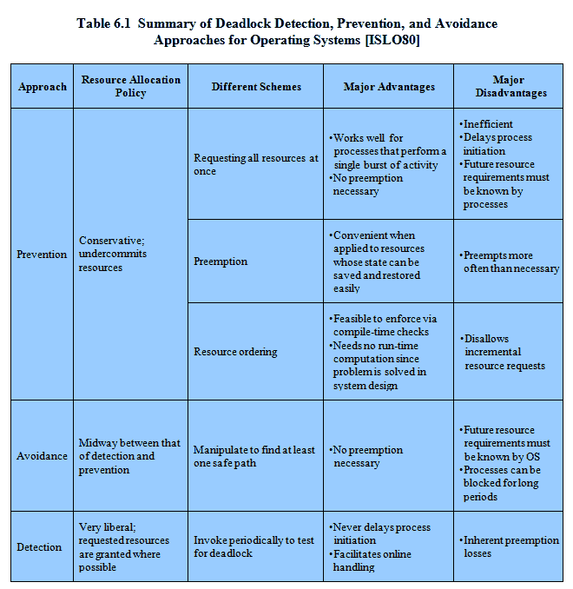
Deadlock Summary (1)

Slide 98
Deadlock Summary (2)
方法 | 资源分配策略 | 各种可能模式 | 主要优点 | 主要缺点
检测 Detection | 宽松的；只要允许，就分配资源 | 定期检查死锁是否已经发生 | 不延长进程初始化时间；允许对死锁进行现场处理 | 通过剥夺解除死锁，造成损失
避免 Avoidance | 是“预防”和“检测”的折衷（在运行时判断是否可能死锁 | 寻找可能的安全的运行顺序 | 不必进行剥夺 | 必须知道将来的资源需求；进程可能会长时间阻塞
预防 Prevention | 保守的；宁可资源闲置 | Spooling 一次请求所有资源 资源剥夺 资源按序申请 | 适用于作突发式处理的进程；不必剥夺 适用于状态可以保存和恢复的资源 可以在编译时（而不必在运行时）就进行检查 | 效率低；进程初始化时间延长 剥夺次数过多；多次对资源重新起动 不便灵活申请新资源

Slide 99
Process Management (1)
Process components:
  A program to define the behavior of the process
  The data operated on by the process and the results it produces
  A set of resources to provide an environment for the execution
  A status record to keep track of the progress and control of the process during execution
Process manager functions:
  Implements CPU sharing (called scheduling)
  Must allocate resources to processes in conformance with certain policies
  Implements process synchronization and inter-process communication
  Implements deadlock strategies and protection mechanisms

Slide 100
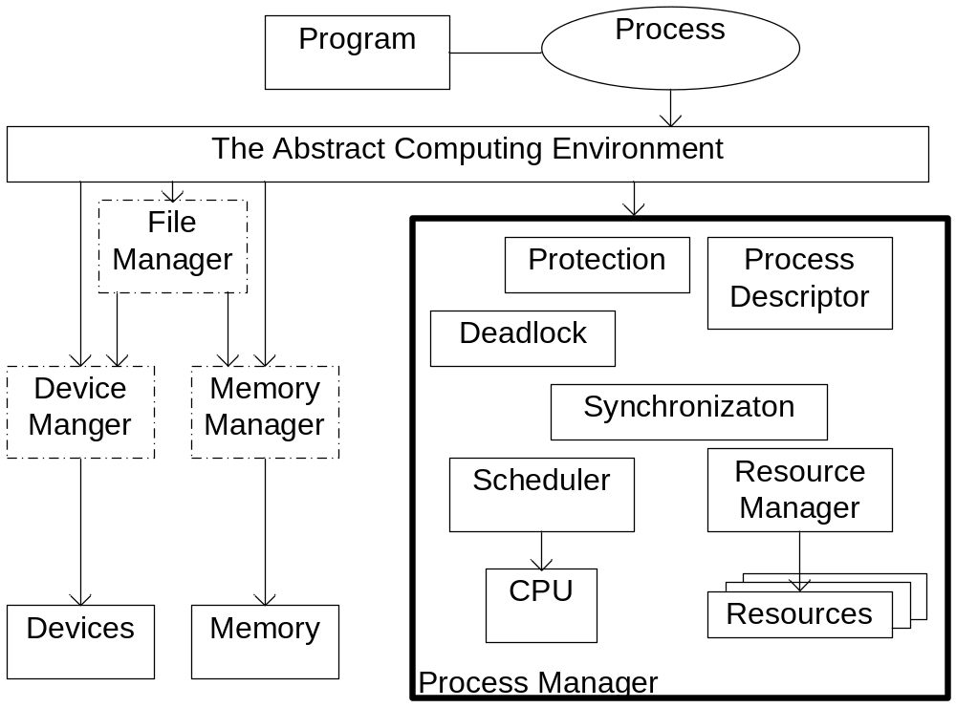
Process Management (2)

Slide 101
Homework
P465: 2, 9,14,31,34
补充题
  A system has five processes and four allocatable resources. The current allocation and additional needs are as follows:
  Please answer the following questions:
    （1）Is this state safe? Why?
    （2）The request (1,2,2,2) of P3 can be granted or not? Why?
Process | Allocation |  |  |  | Need |  |  |  | Available
 | A | B | C | D | A | B | C | D | A | B | C | D
P1 P2 P3 P4 P5 | 0 1 1 0 0 | 0 0 3 3 0 | 3 0 5 3 1 | 2 0 4 2 4 | 0 1 2 0 0 | 0 7 3 6 6 | 1 5 5 5 5 | 2 0 6 2 6 | 1 | 6 | 2 | 2

